Slide 1
Introduction to Soonr by ….
NAME, TITLE
Company Name

Slide 2
Soonr Workplace Key Use Cases
Company File Server
Company file repository in the cloud with mobile access
Save hours every week, work from anywhere
Eliminate errors working with wrong documents
Improve customer and partner relationships
Get going easily and rapidly, grow as you go
Deal-Room
Secure sharing with clients, partners and suppliers
Dropbox for Business
Secure email alternative when dealing with large files
Mobile Workers
Mobile office productivity, integrated editing, annotation, fax, etc. in one app

Slide 3
Soonr Pro Soonr Enterprise A Better Way to Work Empowering Enterprise IT with Mgmt and Control
3+ Team Members
1 TB of Online Storage
10+ Team Members
5 TB of Online Storage
Desktop Sync
Windows and Mac
Seamless Collaboration
File/folder commenting
Sharing files as links
No file size limitation
Integrated Mobile Doc Editing
File Versioning
180 days - Projects, Folders, Files
Groups & Subgroups
Efficient management of Members & Connections
Company Branding
Windows System Service for Soonr on a Server
Soonr Pro +
AD Integration
Easy & efficient team deployment
Super Admin Role
Access & control of all Projects
Team Auditing
Enterprise Policies
Managing password, session, IP address whitelisting, Public Links, remote access and mobile devices for team

Slide 4
The Dropbox Problem
Notes:
The Problem is only getting worse
Risk for breaches, data leakage and damage to your business

Slide 5
Competitive Lanscape
Server Support
Technical Support & Sales Support?
Branding
Where is the data?
Size Limitations
Password Protection
Link expiration
Granular Share Permissions
File editing & Annotation
File Retention
Enterprise Features & Policies
Dropbox
OneDrive
Google Drive
Other: Citrix Share File, Box, Anchor, Egnyte, SugarSync, SharePoint

Slide 6
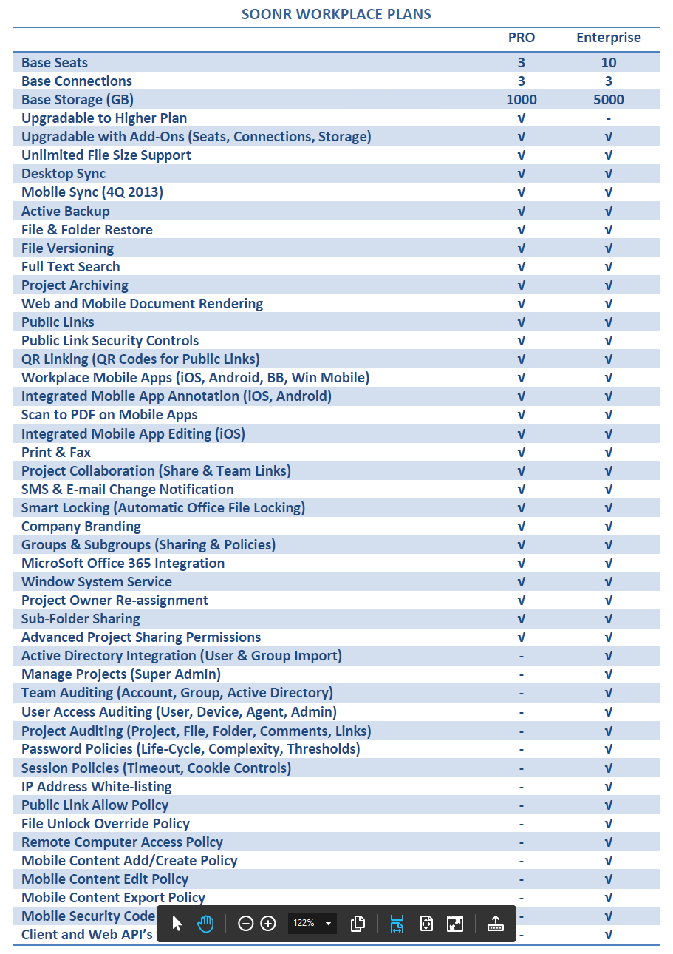
Soonr Workplace Plan Comparison

Slide 7
Soonr Workplace Plan Comparison cont.

Slide 8
How to Qualify an Enterprise Plan (internal slide)
Number of people in the organization
That are likely users of the service
If more than a few, consider Enterprise
Are you talking to IT or to a business owner?
If IT, likely an Enterprise opportunity
Or if the company has an IT department that will be involved in the service
What kind of business is this?
Small mom-and-pop or similar, likely Pro
Mid-sized organization, consider Enterprise
Plan-specific questions if needed
Does the customer need Active Directory support?
Does the customer have mobile device policies?
Does the customer need to control access to documents shared externally?
Or, does the customer want centralized control of the service to ensure data and document security?
Answer YES to any of these means Enterprise Plan
Notes:
The Soonr Enterprise Plan is becoming increasingly popular as companies are interested in the additional security and management features offered.
Number of people – small business usually will not have the interest, need, or resources for the Enterprise plan, whereas larger organizations will want the management, reporting and security offered
IT – small businesses frequently do not have an IT dept; mid sized and larger will and may be involved in the decision for an OFS service. If IT is involved, almost always it will be an Enterprise Plan.
Kind of business – similar vetting to 1 and 2
Specific questions are helpful as well for more detailed inquiry about the customer’s business, and if they’ll need AD support or the kinds of control (like over mobile devices and public links) that the Enterprise plan offers. Generally, the Enterprise plan provides IT a centralized method for policies, devices, and document control of what users of the service can do.

Slide 9
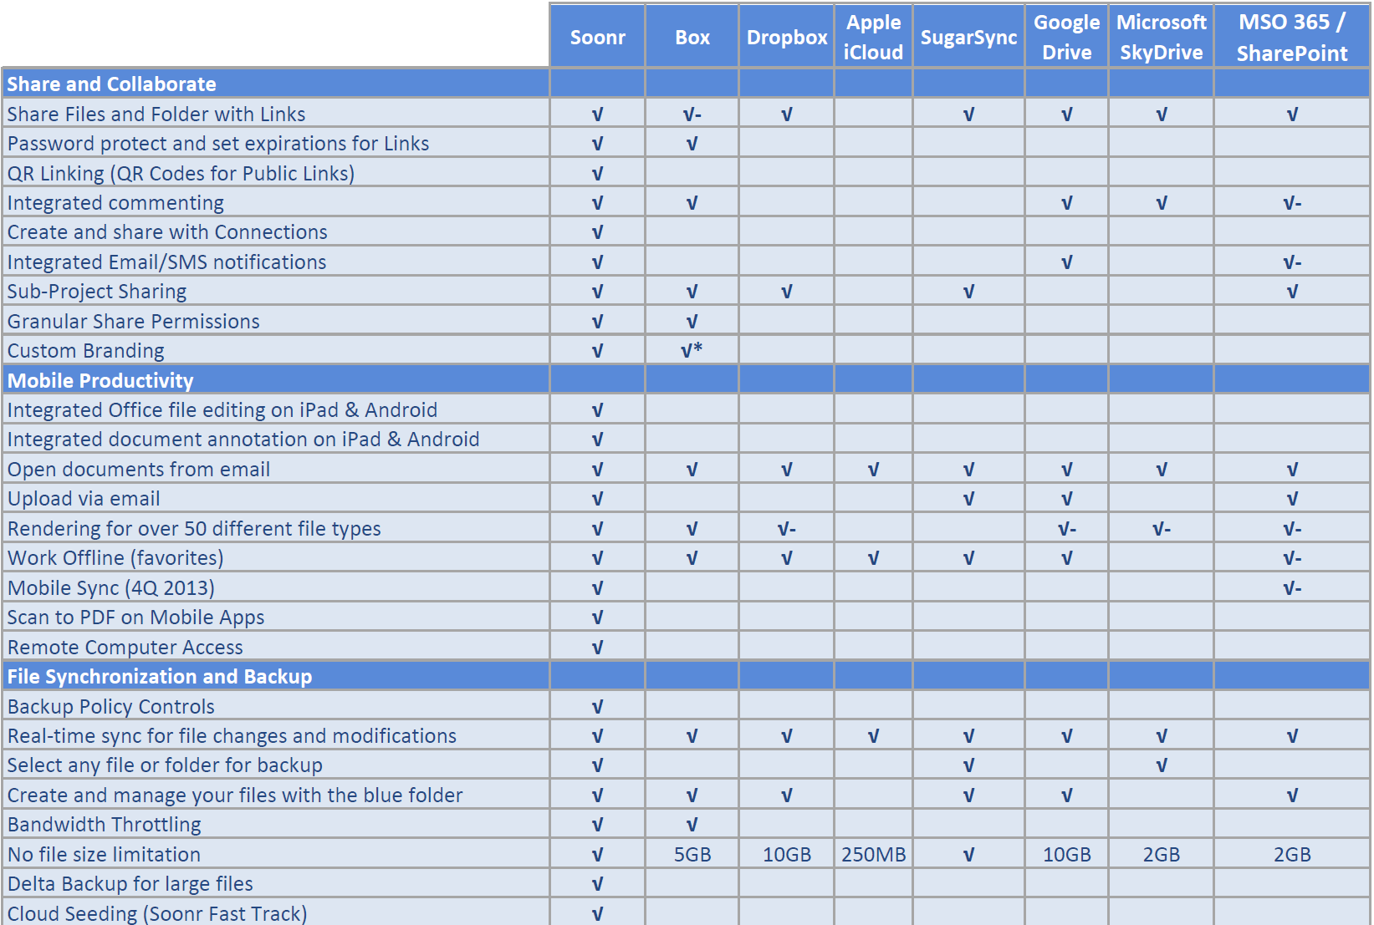
Competitive Lanscape

Slide 10
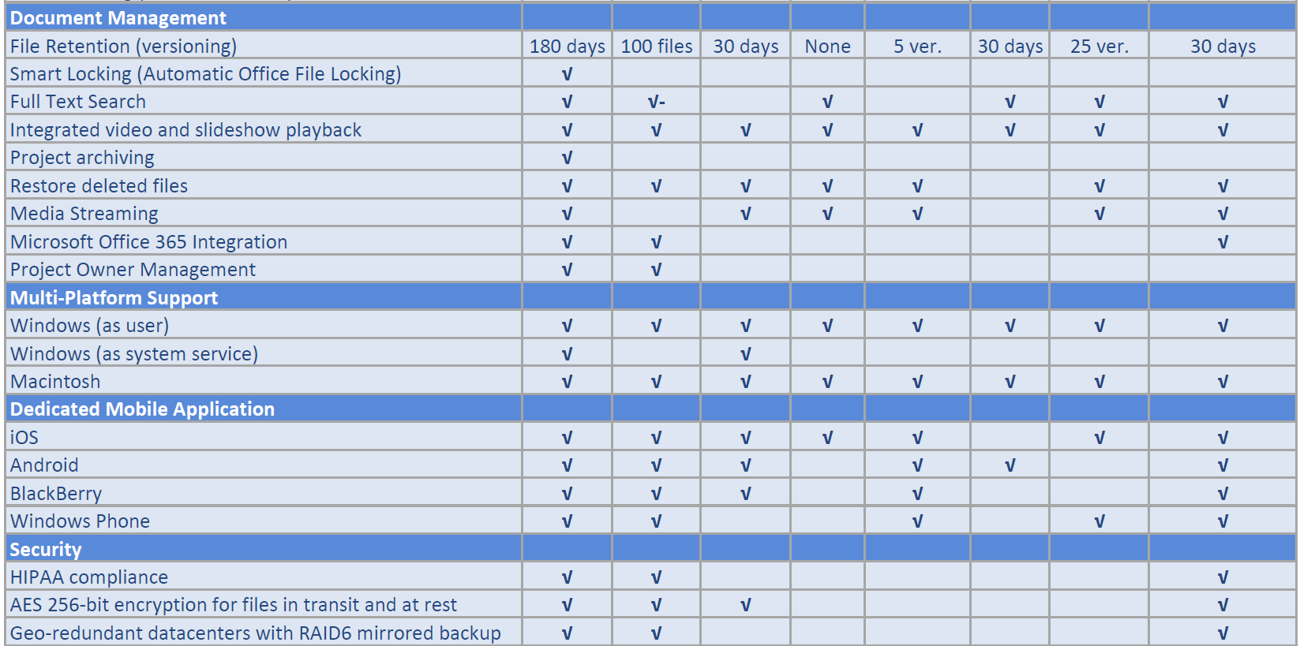
Competitive Lanscape

Slide 11
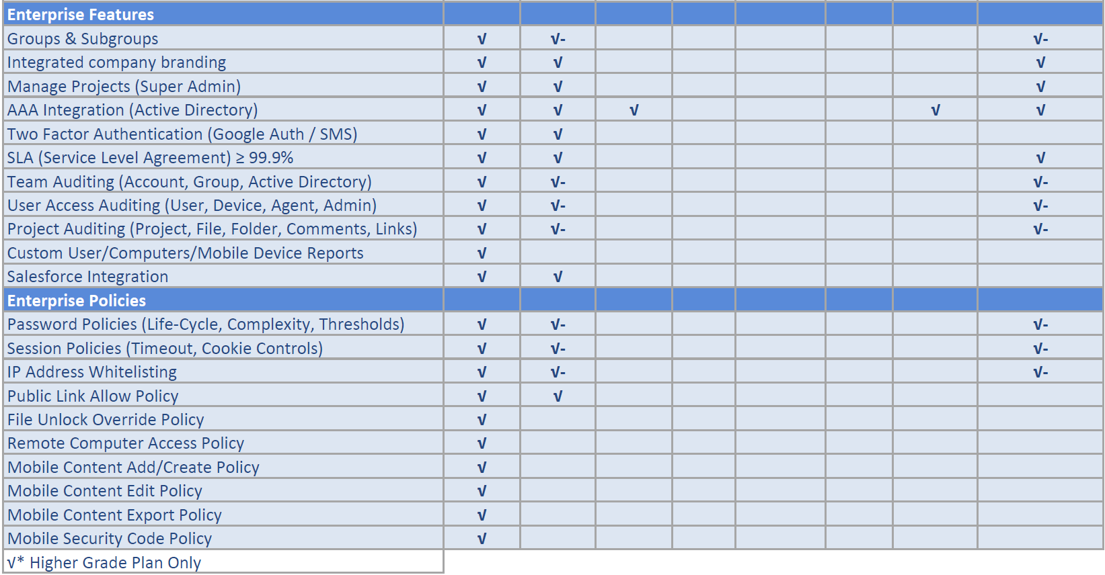
Competitive Lanscape

Slide 12
Why Dropbox isn’t for Business
Where is your data? How is it transferred? Amazon S3
Servers in the US? Concerns about US privacy lawes
Data integrity? Deduplication to store less data
Data encryption not unique to a file; same key reused
No secure public links (pw protection, expiration…)
No HIPAA compliance (medical, pers. identifyable info)
No PCI compliance (payment card industry)
Security
Limited
Mobility
No mark up and annotation of any file types
No editing of Office files on mobile via secure integ app
No MDM policies for assessing, creating, editing content
Limited Colalboration
No integrated commenting (projetcs, folders, files)
No alternate modes of notifications such as SMS
No mechanism to lock files while working on them
No Braqnding &
Limited Support
No customization of branding
No proper support -fill out an online form

Slide 13
Why OneDrive isn’t for Business
File Size
Limitation
No file size larger then 2GB
Can’t share file if open in an applciatiyon; close first
Sharing file with external party creates ghost account in MS
Sharing with “everyone” includes all external users
Can’t Share entire folders
Collaboration
Limitation
Mobility
Limitation
Can’t share file if open in an application; close first
Sharing file with external party creates ghost account in MS

Slide 14
Why Google Drive isn’t for Business
Security
Google has ownership rights to uploaded documents
Can’t restrict file storage to DC of choice
No password protection app on tablets and smartphones
Sync
Downloading file to mobile device stops sync
No file locking
Expirations
No time expiration for files or users

