Slide 1
Introduction to Soonr by ….
NAME Sales Person, TITLE
COMPANY NAME

Slide 2

… Overview
Founded in …
….
….
…
….
Key Strategic / Technology Partners
Industry Awards
Notes:
Soonr has been around since 2005 and has over 150,000 paying businesses of our service.
We have key partnerships with telcos, including AT&T, Comcast, and Rogers. Several of these partnerships are for “white-label” offerings whereby the partner offers our services under their own brands.
These relationships show how Soonr is “telco-grade” – able to pass the most stringent requirements for service capabilities, and security.
We are Hqed in Silicon Valley and are privately-held and venture-backed.

Slide 3











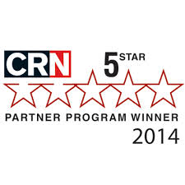


Soonr Overview
Service launched in 2007
Offices in US, UK, Denmark
A/NZ : Manage Protect
150,000+ companies
130+ countries
500% growth over the past 3 years
Key Strategic / Technology Partners
Industry Awards
Notes:
Soonr has been around since 2005 and has over 150,000 paying businesses of our service.
We have key partnerships with telcos, including AT&T, Comcast, and Rogers. Several of these partnerships are for “white-label” offerings whereby the partner offers our services under their own brands.
These relationships show how Soonr is “telco-grade” – able to pass the most stringent requirements for service capabilities, and security.
We are Hqed in Silicon Valley and are privately-held and venture-backed.

Slide 4
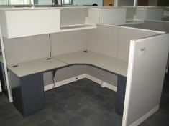
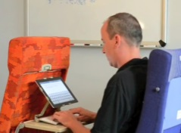
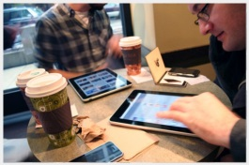
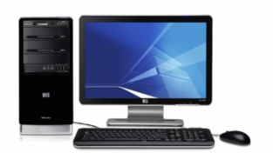

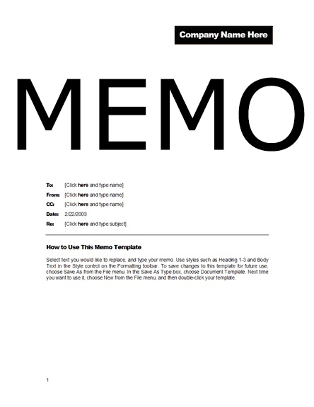
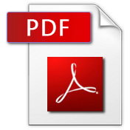
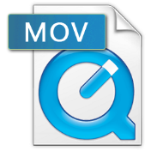
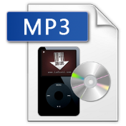




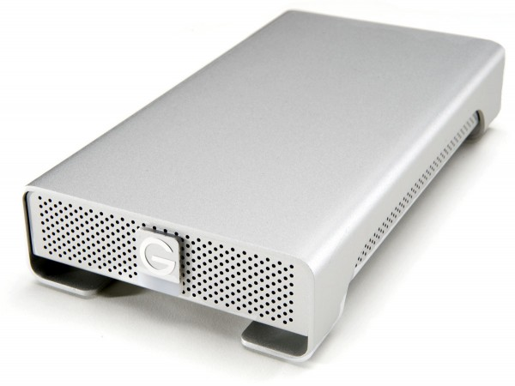

Mobility is Shifting the Workplace Paradigm
Yesterday
Today
Office
Device
Documents
Sharing
Storage

Slide 5
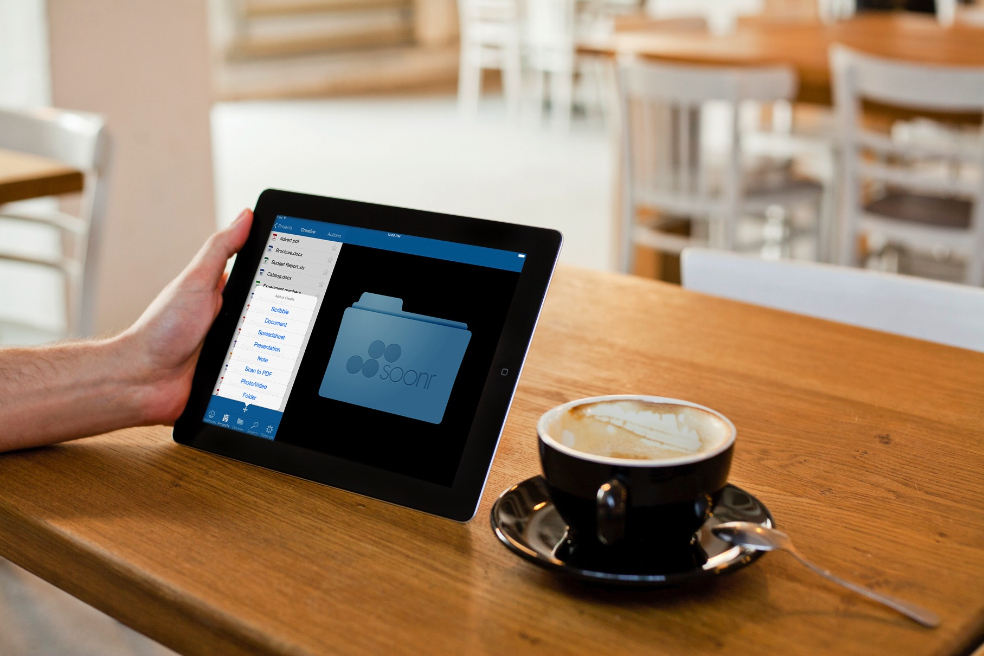
Introducing Soonr Workplace

Slide 6
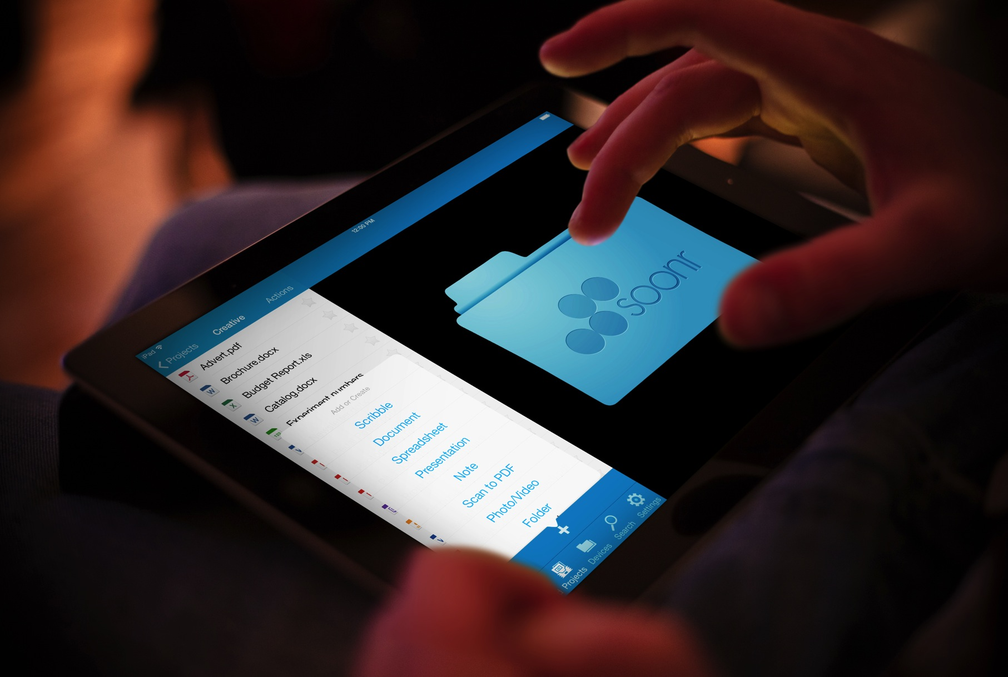
Mobile Productivity
Integrated document management on devices (edit, annotate, lock);
on/offline access
Secure private and public sharing without forcing app adoption
Scan-to-PDF for instant field image and document capture
Automated QR coding for optimised document access
Notes:
Soonr Workplace One-App™ – Access, edit, share and store, from our all-in-one application, ensuring ease of use and no data leakage
Optimized content delivery and rendering – Over fifty file types are rendered to perfection on all mobile devices
Device support – iPad and iPhone, Android smartphones and tablets, Windows Phone and Blackberry phones
Team-based sharing – Manage, organize and share files with ease, controlling access and permission on all Projects, folders and files

Slide 7

Privacy & Security
Jurisdictional data centers: US, CAN, EU, AUS/NZ
Encryption on-device, in-transit, in-session; two-factor authentication
Download/copy prevent; auto PDF; data wipe
Policy-based control of content, user & devices
Notes:
Industry-leading uptime and no-breach history – Soonr Workplace is “up” more than 99.9% of the time and has never experienced a security breach
Compliance support – meets all the key industry and government security certification requirements such as HIPAA, SSAE16, PCI to ensure sensitive data
Geo-redundant data centers in North America, Europe, Canada – 100% owned, operated and managed by Soonr exclusively for our service means no disruption or breach by another application

Slide 8

Business Ready
Industry-leading uptime;
no-breach history
Geo-redundant; local data centers
HIPAA compliant, SSAE-16 audited data centers
Granular administrator control and reporting

Slide 9
User Benefits
Mobile users get anywhere, anytime access, including network-based files
Internal users now collaborate more closely with remote team members – without changing how they work
Non-shared files easily backed up
Notes:
Policy-based control of content, seats, and devices – visibility and control of all Projects, files and folders and their permissions, as well as device password policies and data wipe
Flexible and open – Integration with Active Directory and public APIs for application integration
Setup and go – easy for users to start working immediately storing, managing and sharing files
USE HERE: Embraced by users and endorsed by IT

Slide 10
IT Benefits
Enable business without changing logical directory structure
Retain source of authority
Full visibility on LAN and cloud
Inexpensive backup resource
Reconsider need for VPN
Notes:
Policy-based control of content, seats, and devices – visibility and control of all Projects, files and folders and their permissions, as well as device password policies and data wipe
Flexible and open – Integration with Active Directory and public APIs for application integration
Setup and go – easy for users to start working immediately storing, managing and sharing files
USE HERE: Embraced by users and endorsed by IT

Slide 11
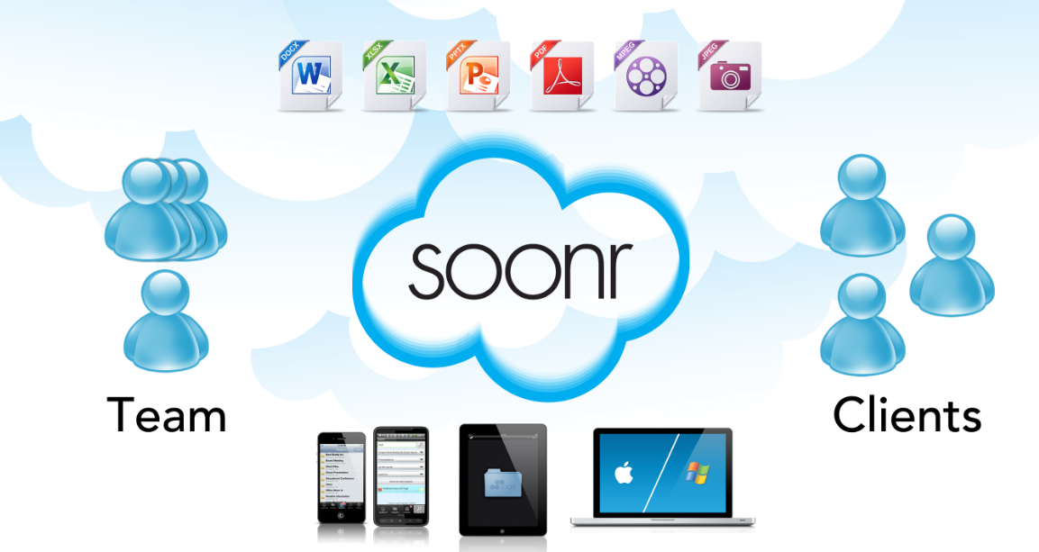
Enterprise File Sharing & Collaboration
Doing business faster without losing control

Slide 12

The Dropbox Problem
Notes:
The Problem is only getting worse
Risk for breaches, data leakage and damage to your business

Slide 13
Soonr Workplace Key Use Cases
Company File Server
Company file repository in the cloud with mobile access
Save hours every week, work from anywhere
Eliminate errors working with wrong documents
Improve customer and partner relationships
Get going easily and rapidly, grow as you go
Deal-Room
Secure sharing with clients, partners and suppliers
Dropbox for Business
Secure email alternative when dealing with large files
Mobile Workers
Mobile office productivity, integrated editing, annotation, fax, etc. in one app

Slide 14
Competitive Lanscape
No File Server Support
Technical Support
Branding
Where is the data?
Size Limitations
Password Protection
Link expiration
Granular Share Permissions
File editing & Annotation
File Retention
Enterprise Features & Policies
Dropbox
OneDrive
Google Drive
Other: Citrix Share File, Box, Anchor, Egnyte, SugarSync, SharePoint

Slide 15
Live Demonstration
The Soonr Product!
How we see Soonr being used today
How to setup & manage Soonr
Three views of your data
Questions
Notes:
Soonr Product..
Members vs Connections
Pro vs Enterprise
How we see Soonr being used today
Small: Dropbox alternative (cloud only), but with backup & branding, control and business grade.
Medium: SBS /server … has moved Exchange to the cloud, now is time for their files..
Enterprise: Have a server… VPN is dead, want remote access and local! / Sync of multi-servers (DFS killer)
How to setup & manage Soonr
Setting up users & groups
Setting up Projects and document management
Versioning
Policy Management & Branding
Three views of your data
Soonr Workplace (Files)
Soonr Online (web)
Mobility
Open
Share (public link)
Scribble
Create image
Open Powerpoint
Save back and view across all three views.
Reseller Panel
Questions

Slide 16
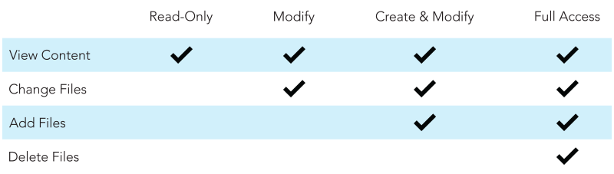
Works the Way Users Do…
Granular Share Permissions
Control the who, what, where and when of file sharing
Role-based permissions for multiple sets of content - controlled by owner or admin
Marketing Project
Marketing
Full-access
All
Read-Only
Engineering
Create &
Modify
Sales
Modify
Granular
Share Permissions

Slide 17
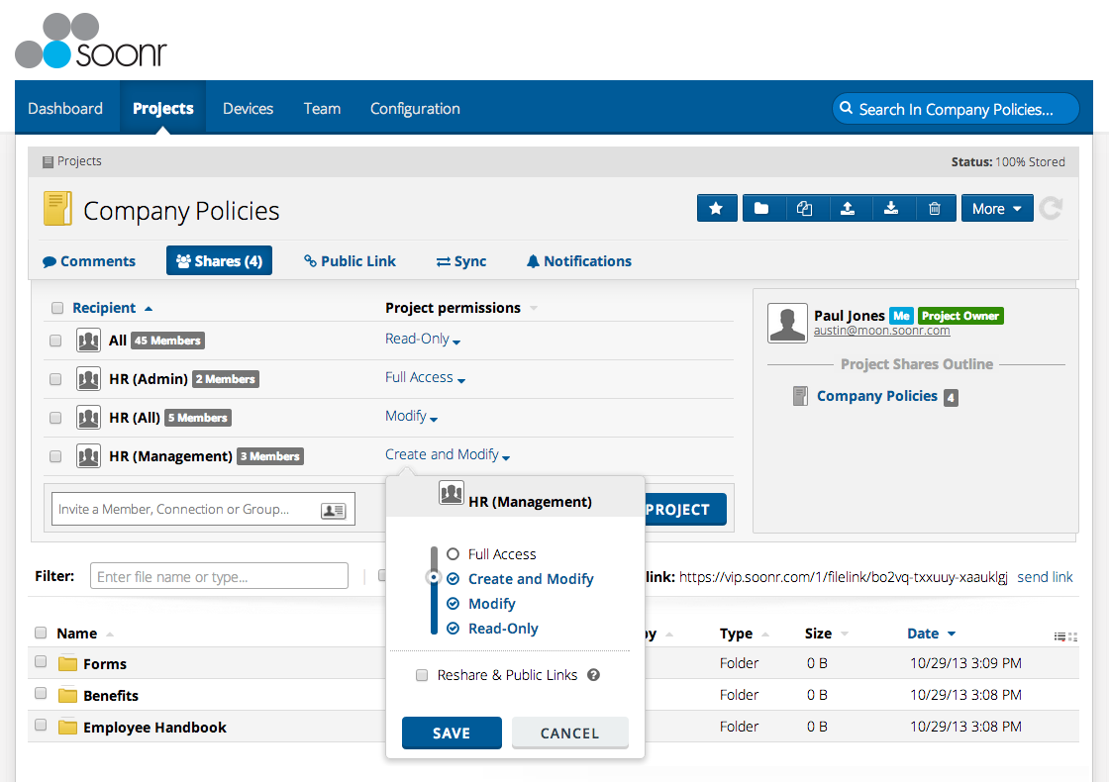
Use Case
Granular Share Permissions
HR Department use case for “Company Policies” Project

Slide 18
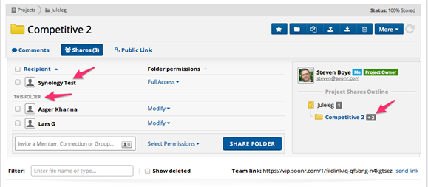
Works the Way Users Do…
Sub-Project Level Sharing
Share at the Folder Level
  Folders within Projects can be shared individually
  Group folders by natural work flow and share as needed
Use Case – Marketing Department
  Project with all manner of marketing folders
  Folder named “Competitive 2” shared with external contractor that manages tradeshows

Slide 19






Powerful Combination
Role-based granular Permissions and Sub-Folder Share
Role | Task | Shares | Permissions
Marcom | Edit and format press releases | Press Folder; Entire Marketing Project | Modify Rights; Read Only Rights
Sales Department | Share collateral with prospects | Case Studies Folder within Marketing Project | Read Only Rights
Marketing Manager | Document management | Entire Marketing Project | Full Access Rights
Contractor | Create case studies | Case Studies Folder within Marketing Project | Create and Modify Rights

Slide 20
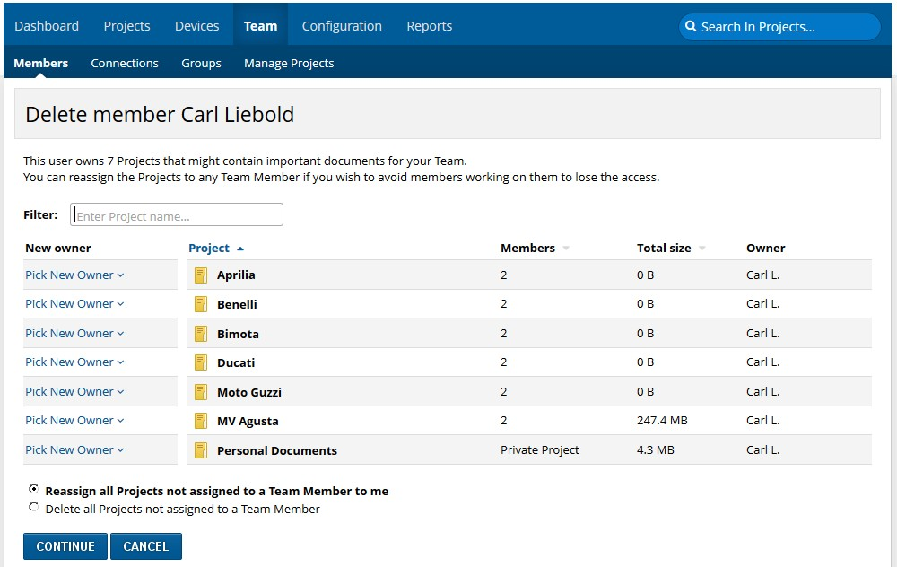
Flexible Project Management
Project Owner Reassignment
Reassign Projects to New Owners
  Change from one member to another
    Assumes all permissions
    Select if old owner still has permissions
  Delete a member
    “Pick New Owner” of each deleted member’s Projects
    Assumes all permissions

Slide 21
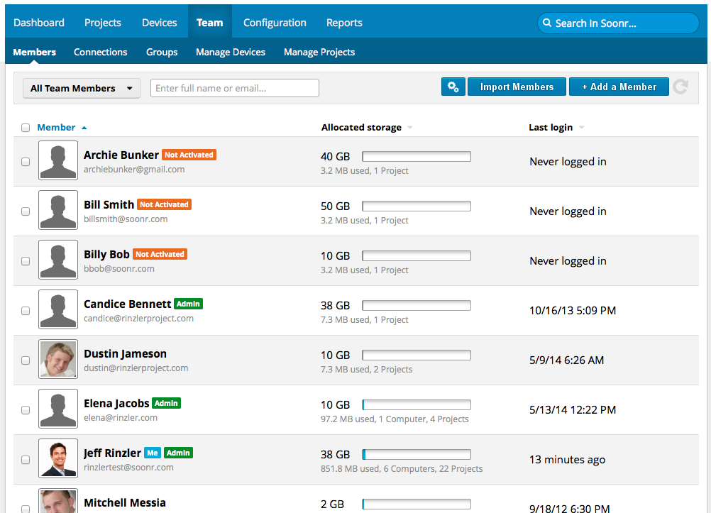
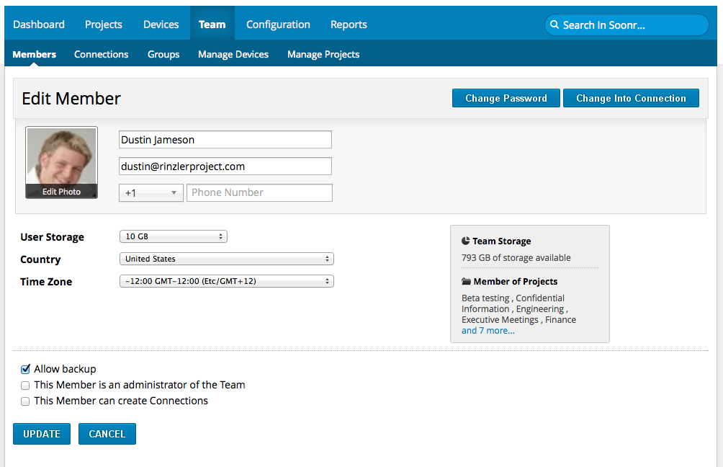
User Management

Slide 22
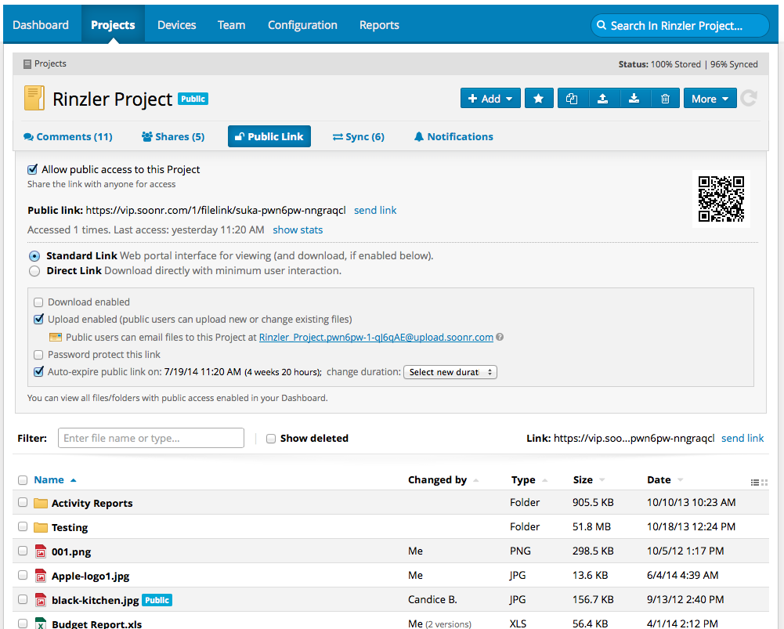
Project & Document Management

Slide 23
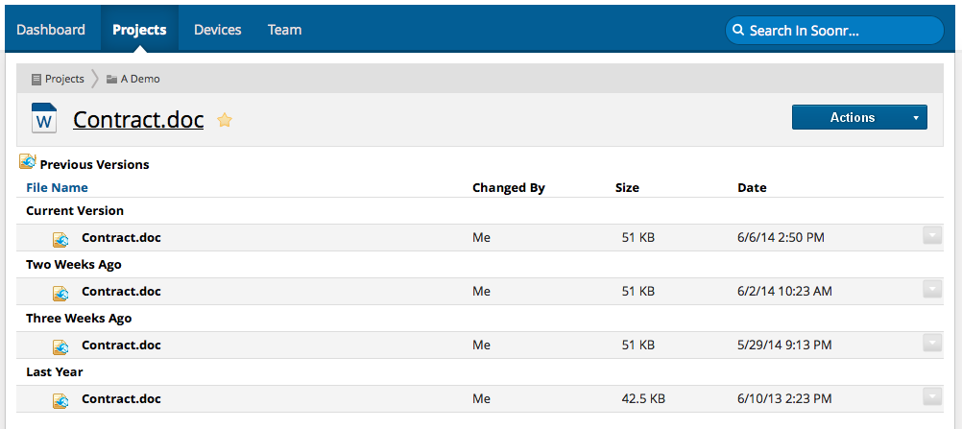
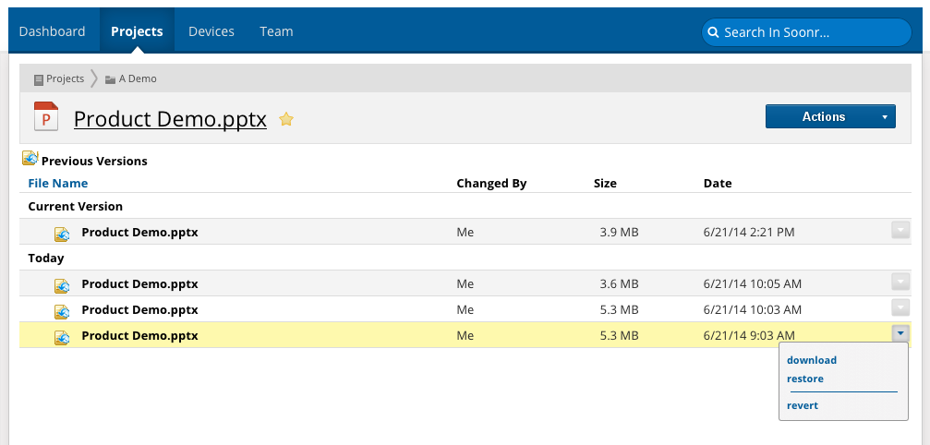
Versioning
Notes:
How far back for versioning?

Slide 24
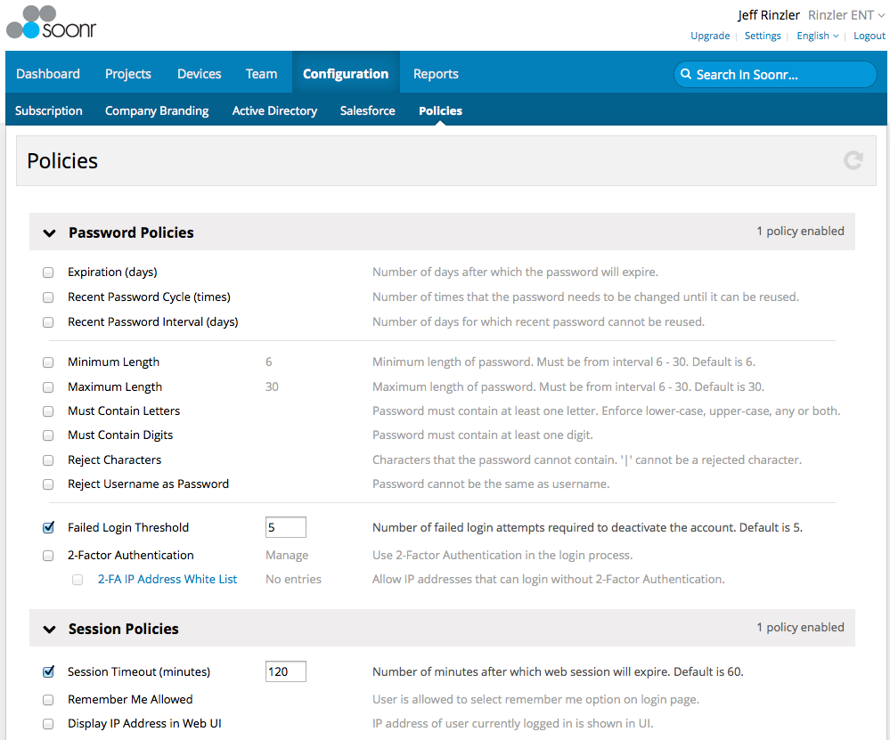
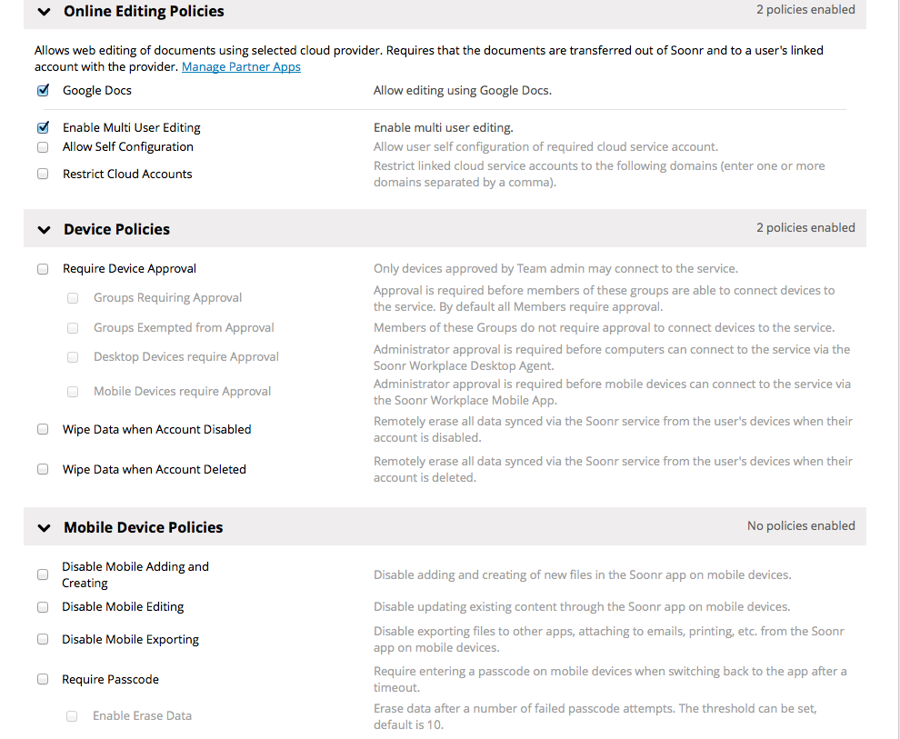
Policy Management

Slide 25
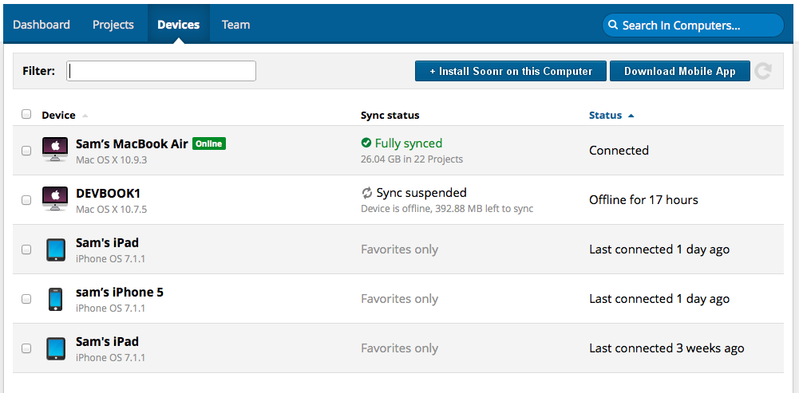
Device Management

Slide 26
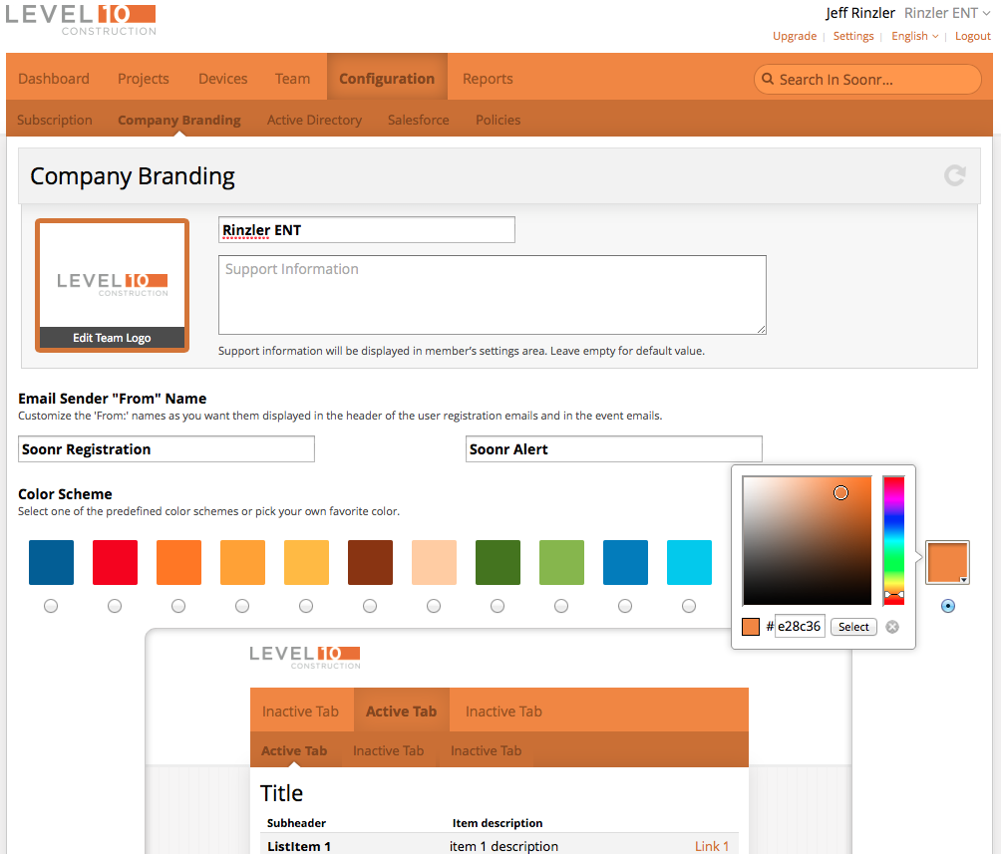
Company Branding

Slide 27
Mobile Productivity

Slide 28
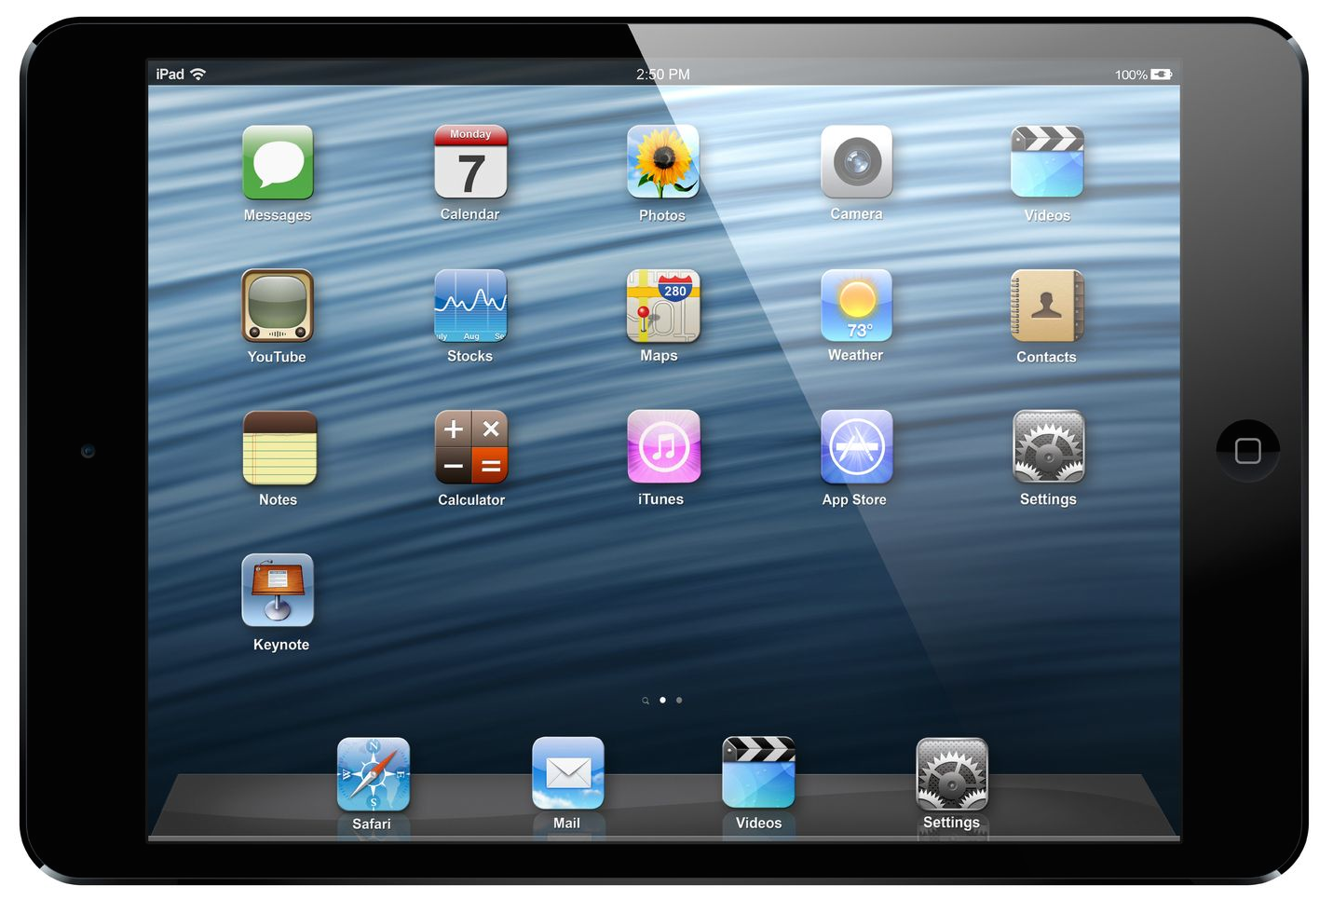
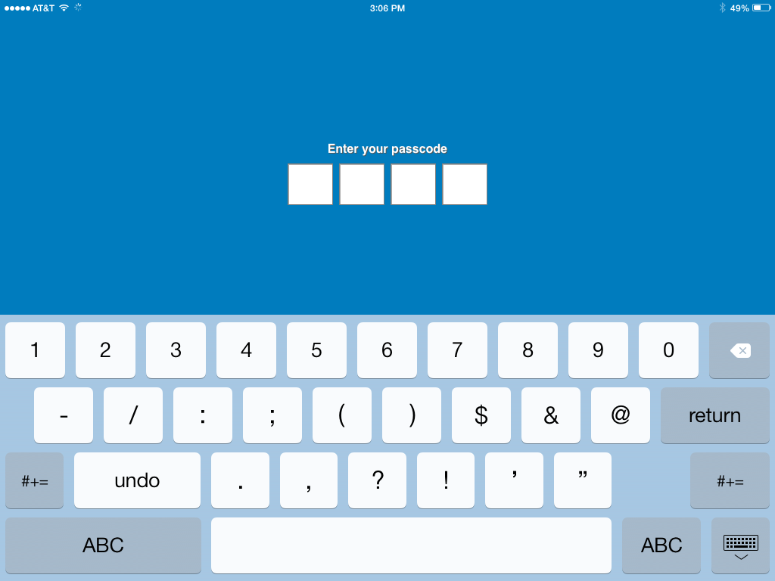
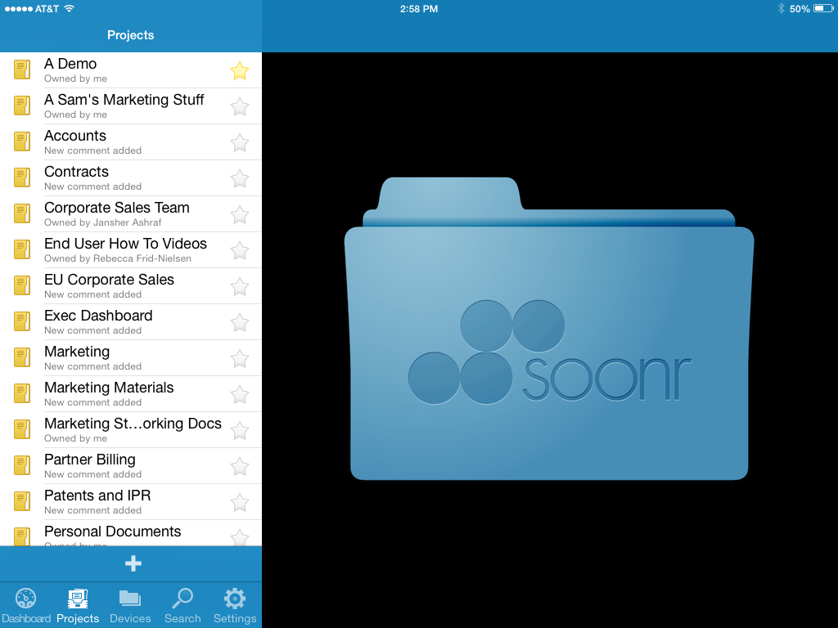
Integrated Mobile App
Two factor authentication
Encryption on-device, in-session, in-transit
Copy, download prevent; data wipe
Document editing & annotation
Scan-to-PDF; QR coding
On/Off-line access

Slide 29
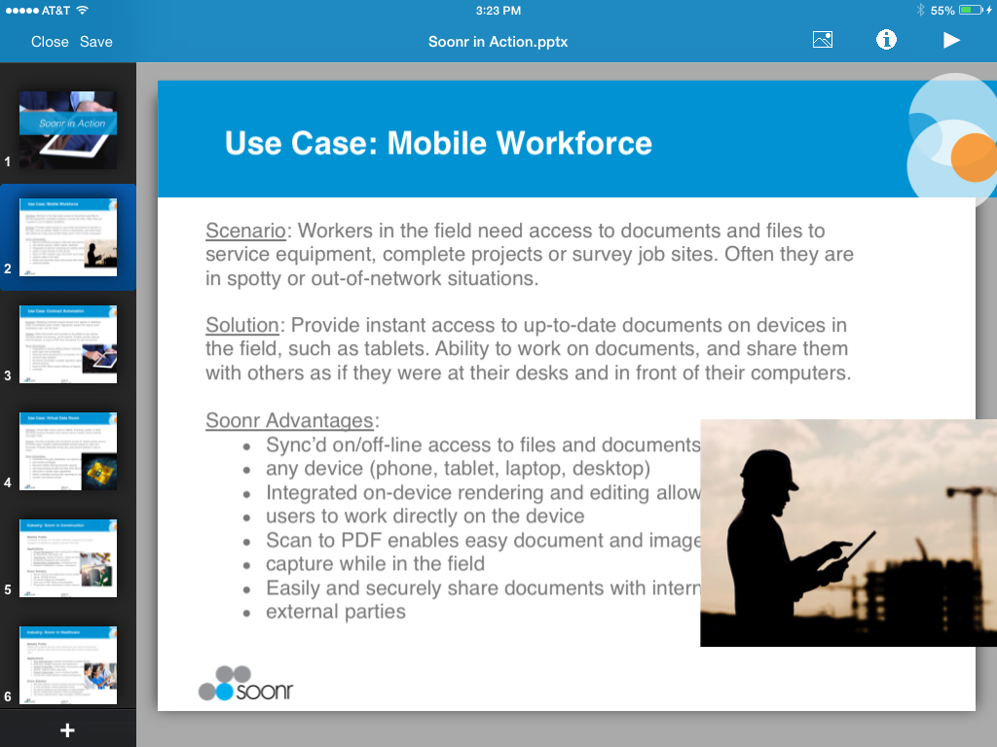
Document Editing

Slide 30
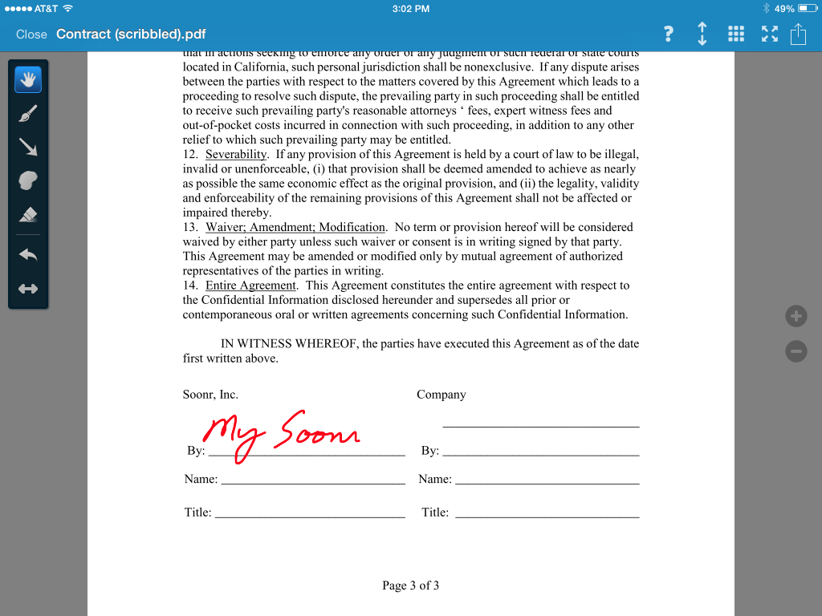
Document Signing

Slide 31
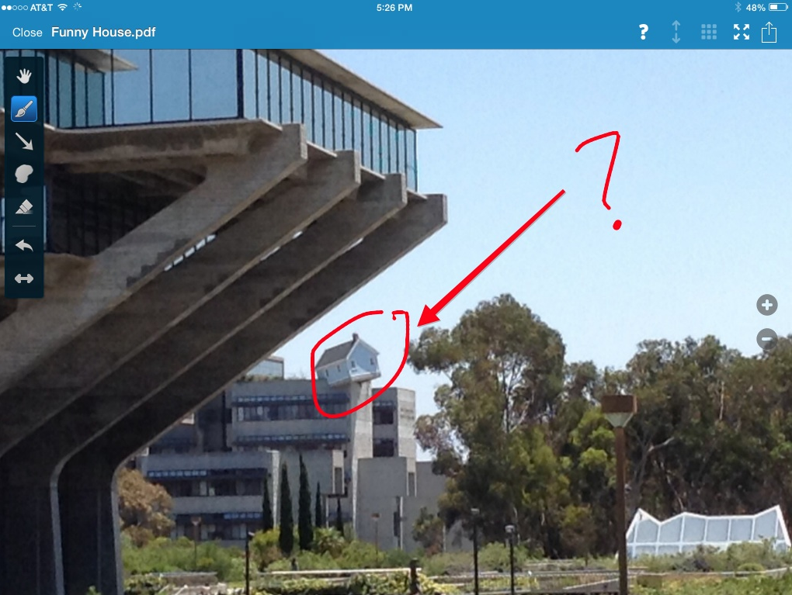
Image Capture w/ Annotations

Slide 32
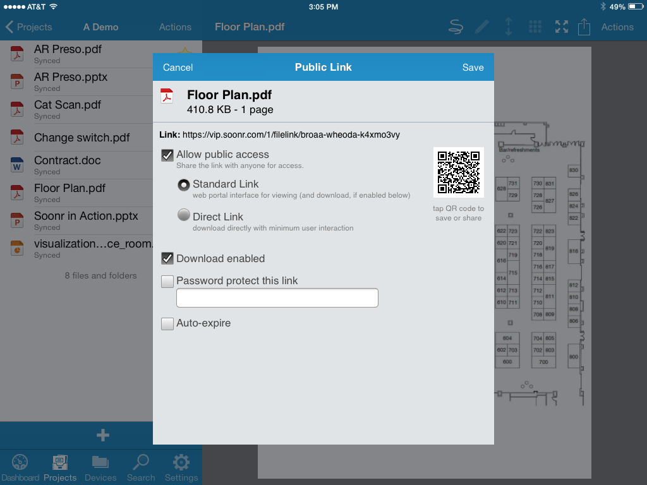
Secure Mobile Sharing

Slide 33
Plans and Pricing

Slide 34
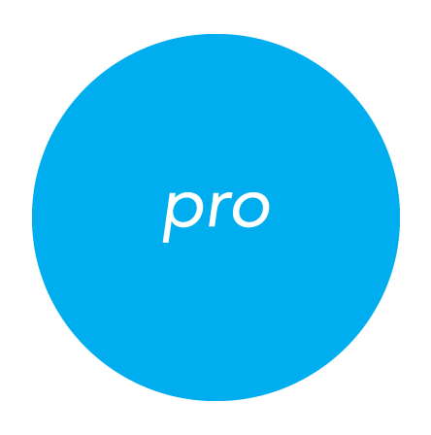

Soonr Workplace Plans & Pricing
Soonr Workplace Pro
3 Users and up
1 TB of storage
$... / User / Month
Soonr Workplace Enterprise
10 Users and up
5 TB of storage
$... / User / Month
Notes:
Soonr offers two plans, Pro and Enterprise. Both are for businesses; Enterprise offers additional features around security, management, policies, tracking, and reporting. Both plans can have users and storage added as the teams grow. Generally, if a customer has an IT department that will be managing the Soonr implementation, then they’ll want the Enterprise plan.

Slide 35
Soonr Workplace Plans
Notes:
Backup 6 months retention
These are all the features that both plans share – you can see how feature rich the plans are

Slide 36

Soonr Workplace Enterprise
Security
Management
Reporting
Storage

Slide 37
Soonr Workplace Plans
Notes:
Soonr Enterprise offers advanced capabilities and integrations, like with Active Directory. Enterprise introduces the role of super admin, that has the ability to audit, manage permissions, policies, devices, etc. This is designed for an organization to have the ultimate control over the service, ensuring data security while enabling productivity.

Slide 38
ENTERPRISE PLAN HIGHLIGHTS

Slide 39
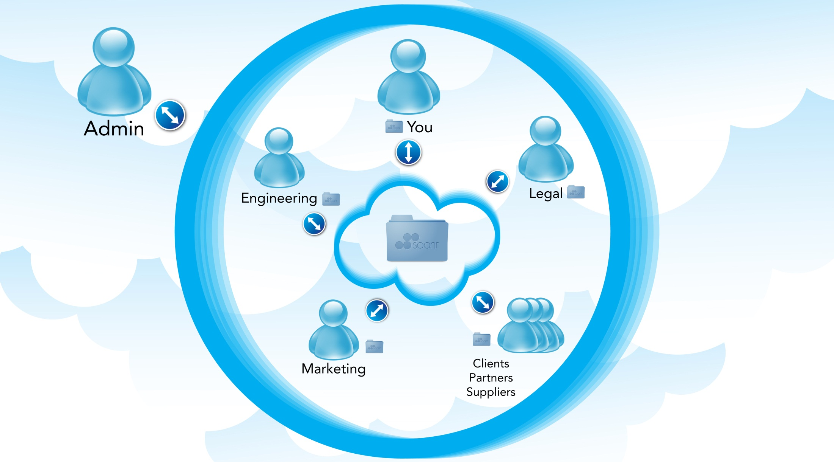


Central User & Device Management

Slide 40
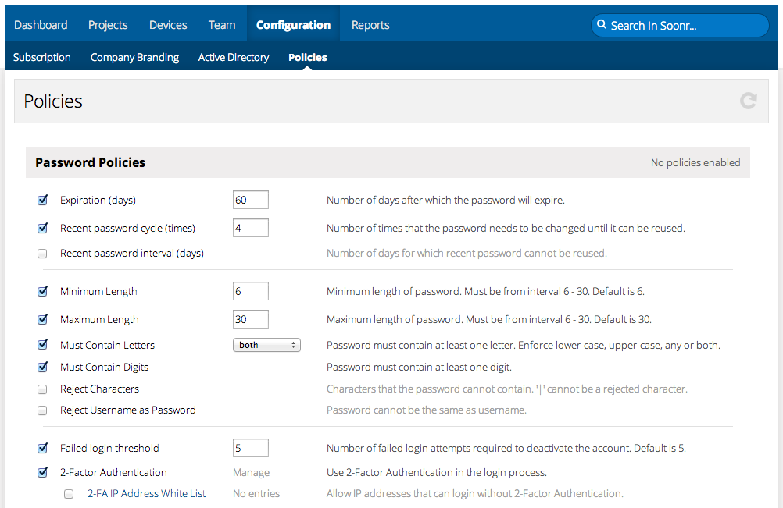
Enterprise Authentication Policies
Authentication against company Active Directory or Soonr Db, hybrid AAA model – authenticate employees and outsiders
  Import users and groups from AD
  Single Sign-on, eliminate mistakes, always in sync
  Additional layer of security through two-factor authentication

Slide 41
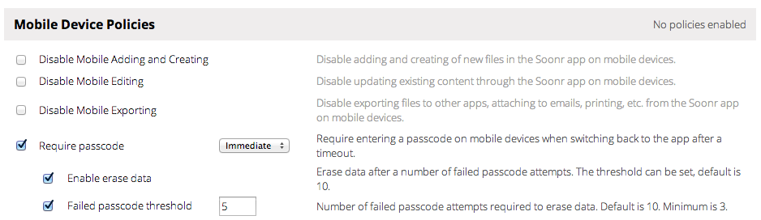
Enterprise Mobile Device Policies
Mobile pass-code and data-wipe policies
  Block access to Soonr app without pass-code
  Poison-pill, wipe device clean upon failed login threshold
  Prevent Soon data from being hijacked by 3rd party apps
Never worry about BYOD or data leakage again!

Slide 42
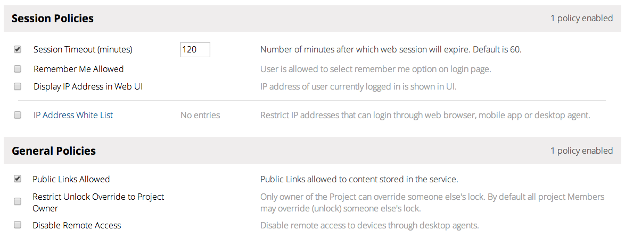
Enterprise Session and Team Policies
Control use of public links and remote access to computers – eliminate firewall gaps
Enforce VPN usage through IP Address White Lists for web, mobile, and desktop access

Slide 43
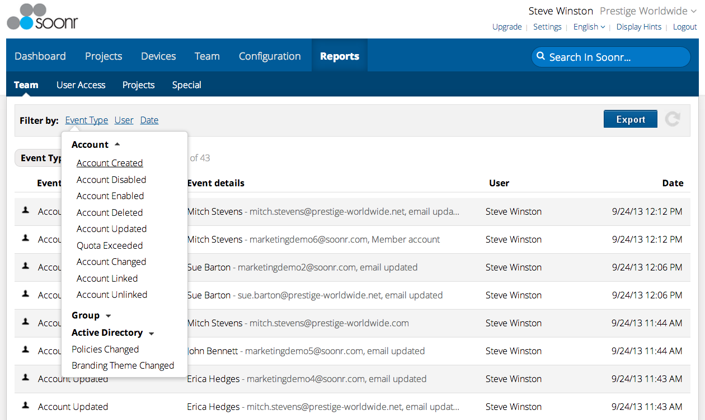
Enterprise Reports - Team Events
Create detailed reports on account activity, perform forensics on changes/add/deletes

Slide 44
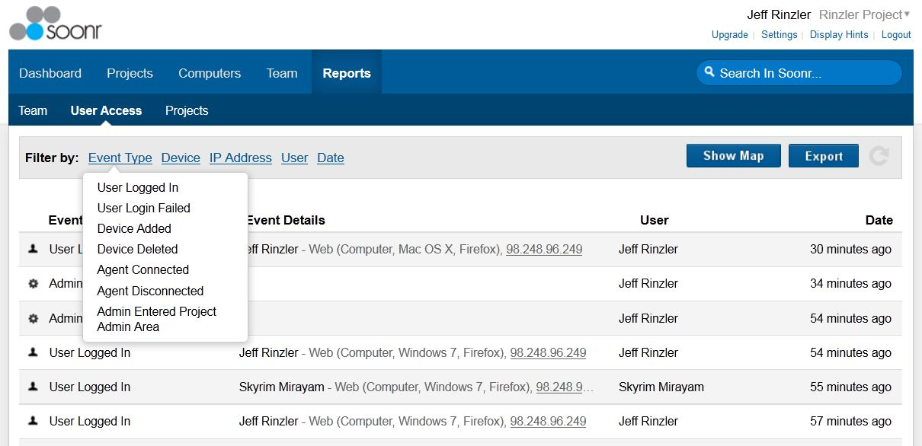
Enterprise Reports - User Access Events
Track user, device, and agent activity, rapidly determine access geo-location

Slide 45
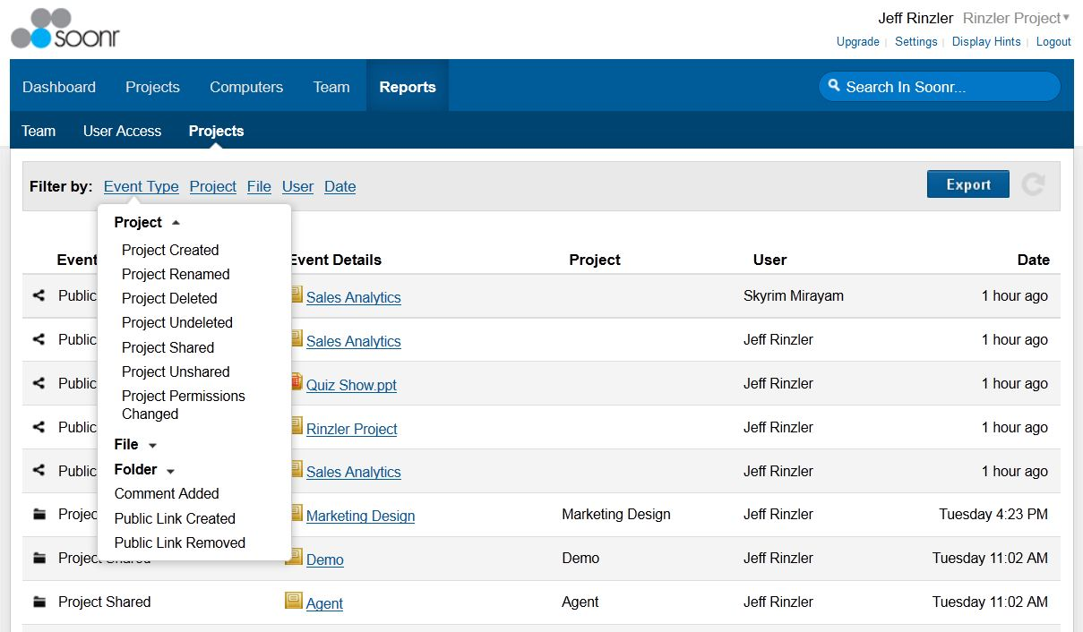
Enterprise Reports - Projects
Create reports on Project and document life-cycle, sharing, comments, and public links

Slide 46
Thank You!
LINK TO YOUR WEBSITE
Start your 14 Day FREE TRIAL Today!

