Slide 1
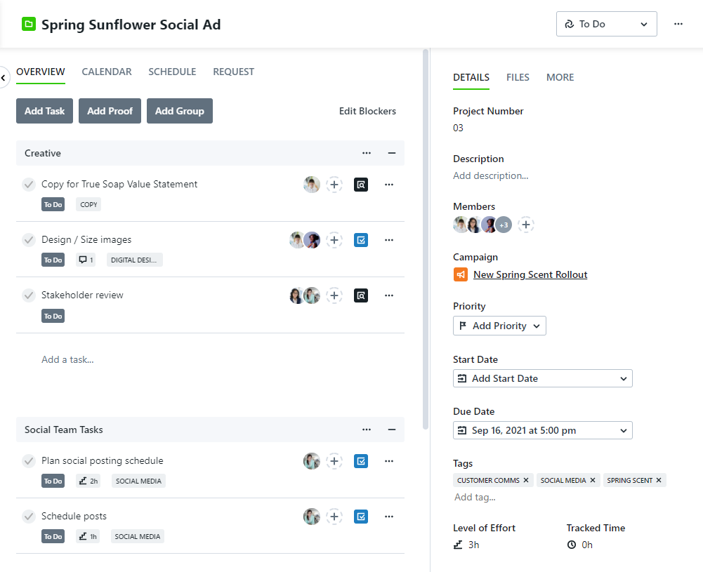
Tags
What are they?
Simply, tags are are words that describe work items.
Lightweight
Can be created on the fly by any team member.
Flexible
Can be used just about anywhere!
Strong Metadata Filtering
Filter by multiple tags with any/all logic.

Slide 2
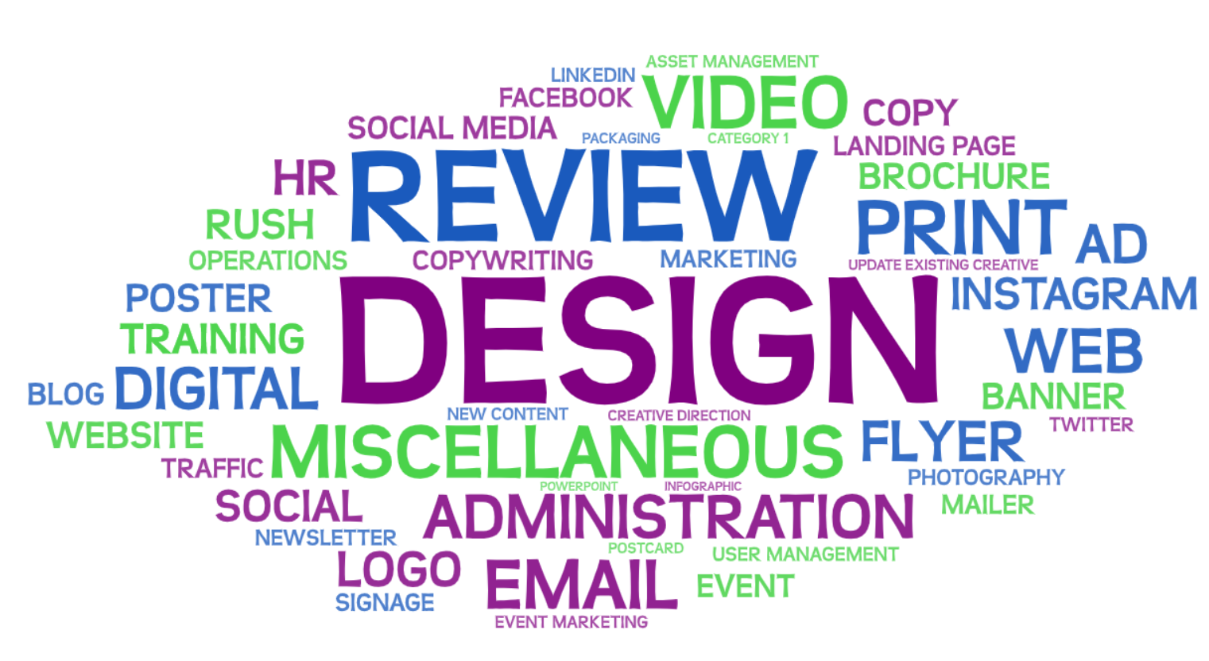
Tags in the Wild
The 50 most common Tags

Slide 3
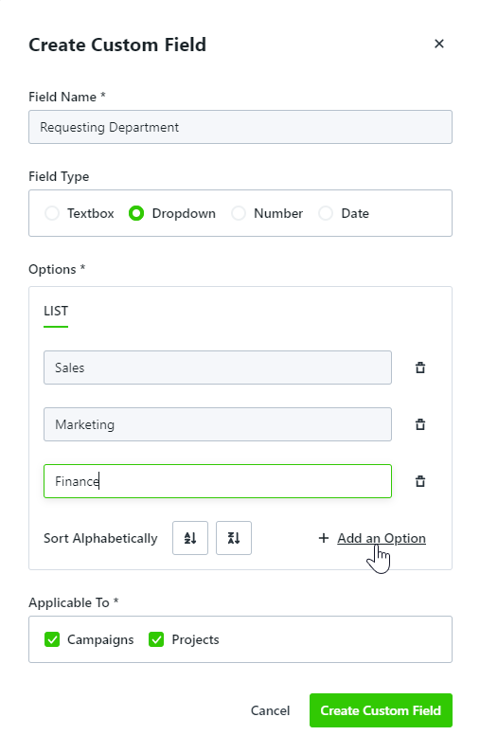
Custom Fields
What are they?
Typically, custom fields are used to store answers to project questions.
Customizable
Option of several different field types.
Searchable
Global search will return results if there is a match within Custom Fields.
Robust Reporting
Granular filtering and display options.

Slide 4
Custom Fields in the Wild
The 20 most common custom fields
1 | Department | 11 | Tactic
2 | Project Type | 12 | Print Order Number
3 | Brand | 13 | Deliverable
4 | Region | 14 | Email Send Date
5 | Project Owner | 15 | Channel
6 | Budget | 16 | Audience
7 | Priority | 17 | Banner Take Down Date
8 | Consultation Needed? | 18 | Banner Live Date
9 | Product Line | 19 | Designer
10 | Requesting Department | 20 | Division

Slide 5
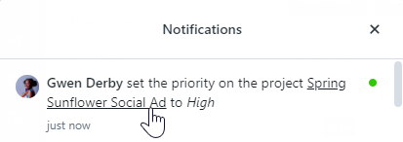
Priorities
What are they?
Priorities are indicators of the importance or urgency of work.
Customizable
Tailor the badge color and copy so your priorities match your team language.
Strong Visual Component
Badge displays in all views throughout ignite.
Triggers Notifications
Maintain alignment with in-app and email notifications when priorities change.

Slide 6
Priorities in the Wild
Real-world implementation of priorities
Usage on work types
Themes
URGENCY
Rush, Fire Drill, Quick Turn, Top
High, Medium, Low Hot, Hotter, Hottest, Lava
RELATIVITY
METADATA
Tier 1, 2, 3 Outsourced, Hard Due Date

Slide 7
Data Management
TAGS
CUSTOM FIELDS
PRIORITIES
Supported on requests, work, projects, and campaigns
Supported on projects and campaigns
Supported on work and projects
Can be mapped from requests
Can be mapped from requests
No mapping available
Can be used as a filter in reports and custom views
Can be used as filters and columns in reports and custom views
Can be used as filters and columns in reports and custom views
Single data type: Text
Multiple data options: Text, Dropdown, Number, Date
Single data type: Text (with custom color!)
Multiple tags can be added to a single item
Each custom field can be used only once per item
Limit one priority per item
Can be created ‘on the fly’ by any Team Member
Created and managed in Account Settings
Created and managed in Account Settings
Does not notify users when changed
Does not notify users when changed
Notifies users when changed
Cannot be made required
Can be made required
Cannot be made required
Not included in global search results
Included in global search results
Not included in global search results
Notes:
Data Management
What do you want to do with your data
Ex: Do you need to use it to manage ongoing work or report on historical work?
Who needs to see the data and how will they access it?
Your team, stakeholders, both?
How are teams currently using these (in clever and impactful ways in the real world)

