Slide 1
Wharton Attendance and Course Video Requests https://support.wharton.upenn.edu/help/wharton-attendance-absence-and-video-requests-module-for-students

Slide 2
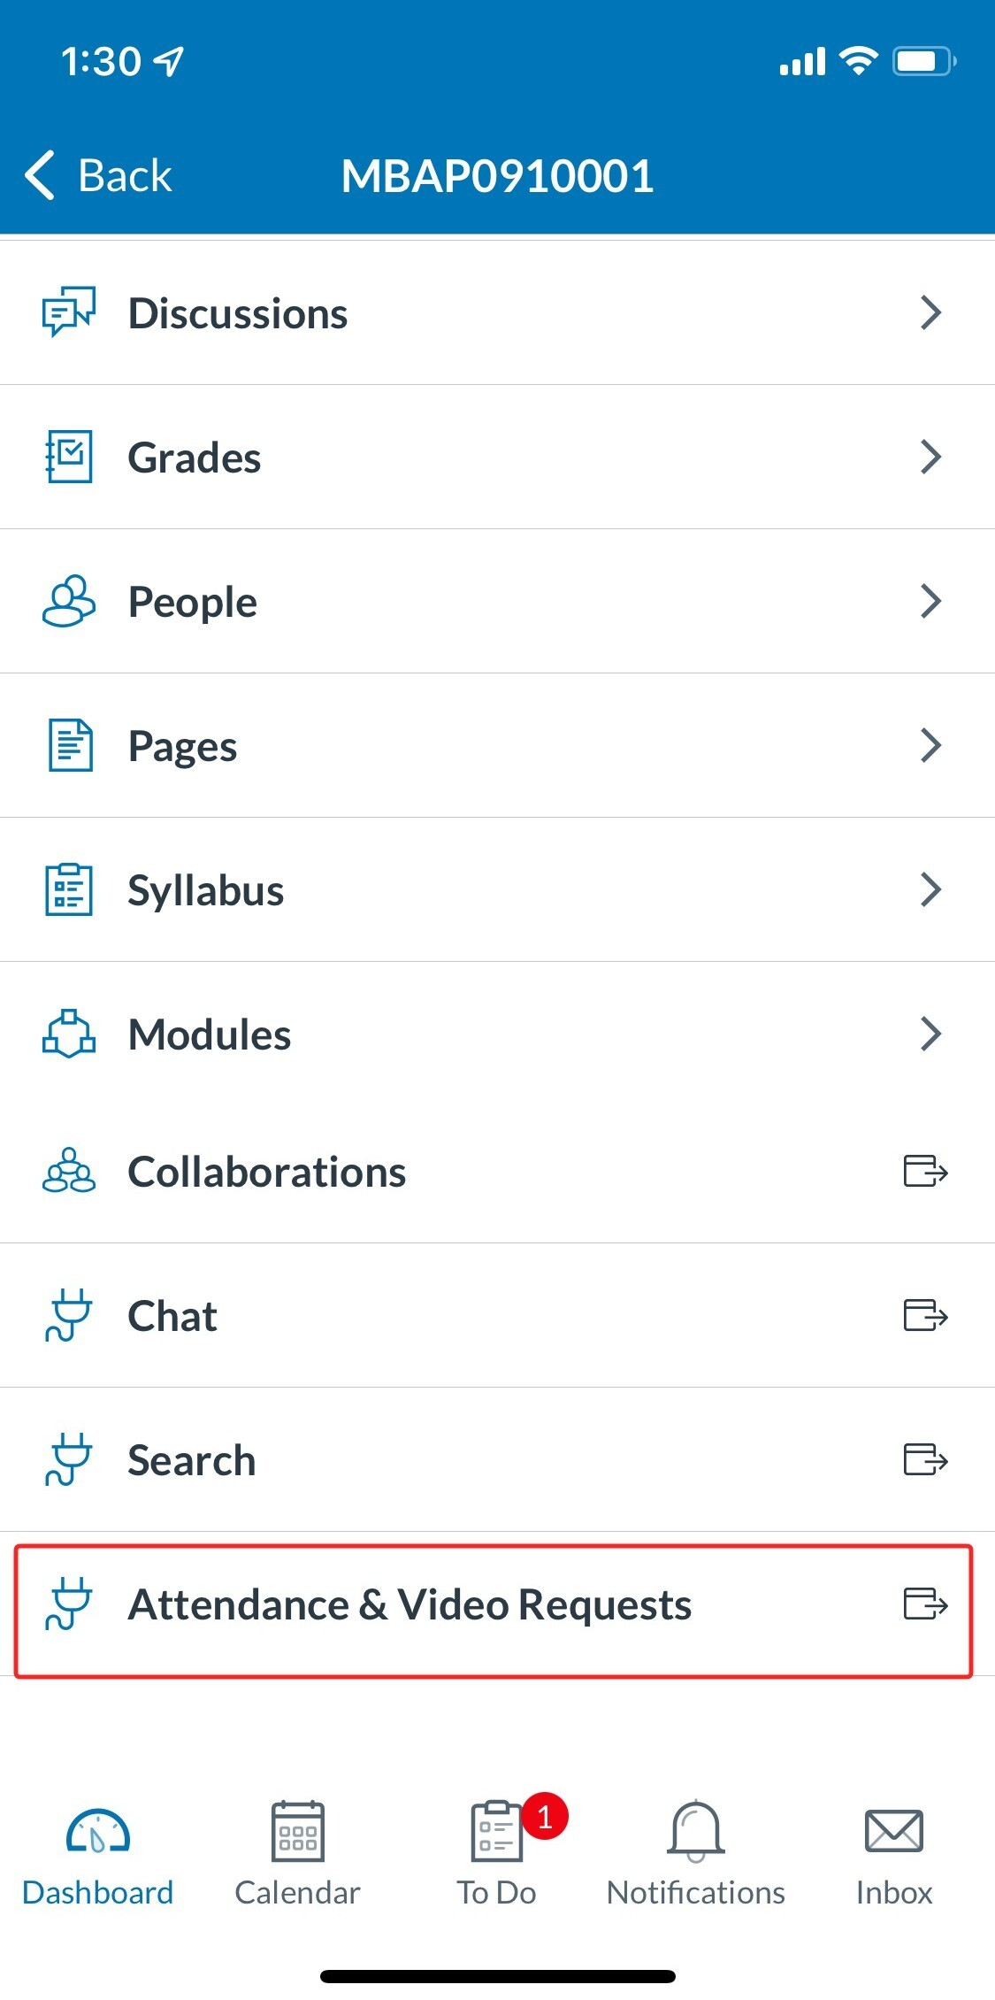
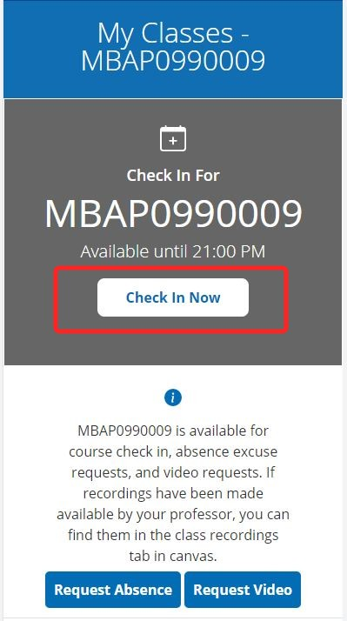
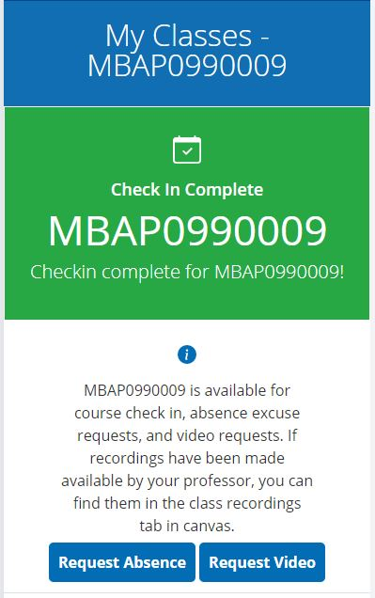
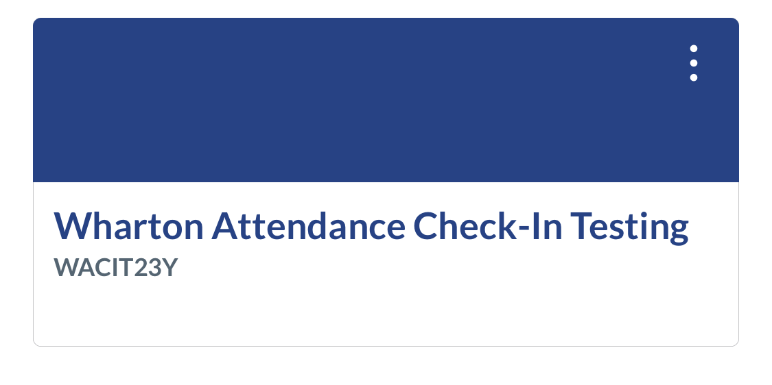
How to Check-In To Class
Check in opens ten minutes before class starts
1) Open the course Canvas site. We recommend connecting to AirPennNet and using the Canvas mobile app
2) Tap on the Attendance & Video Requests tab
3) Tap on the Check In Now button
4) Once you see green, you’re all checked in!

Slide 3
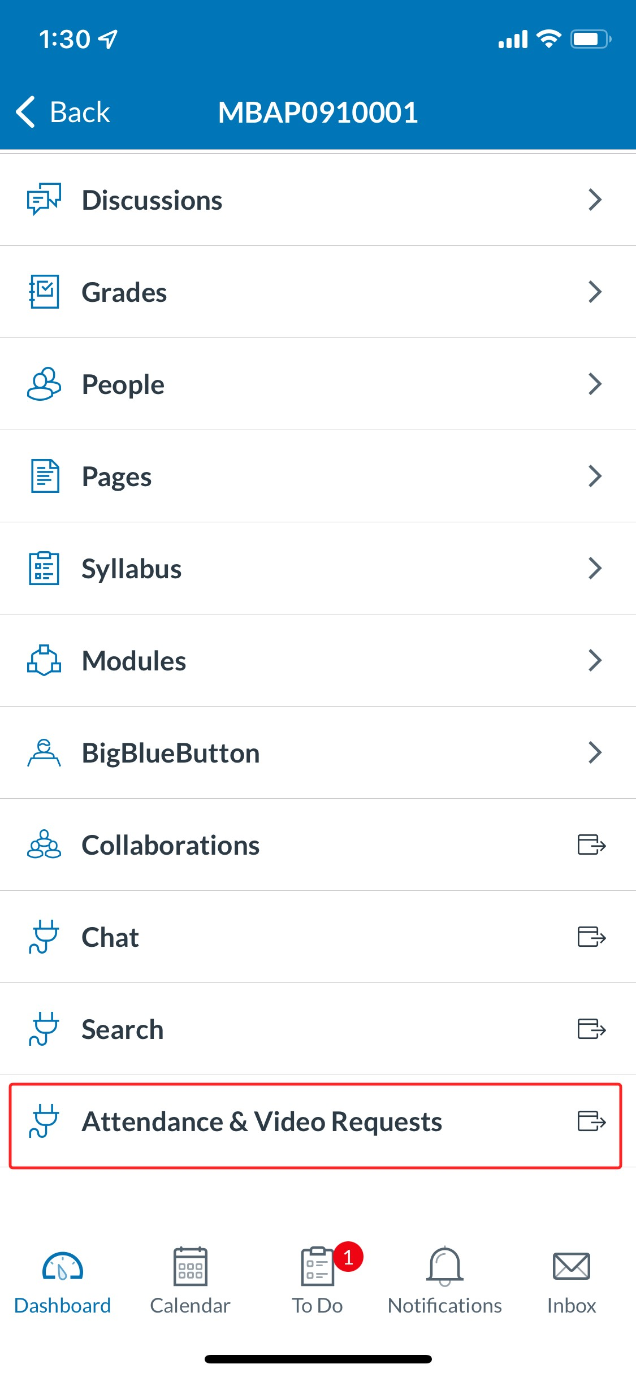
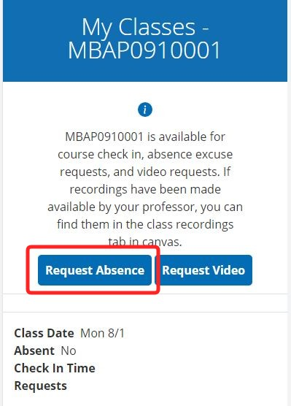
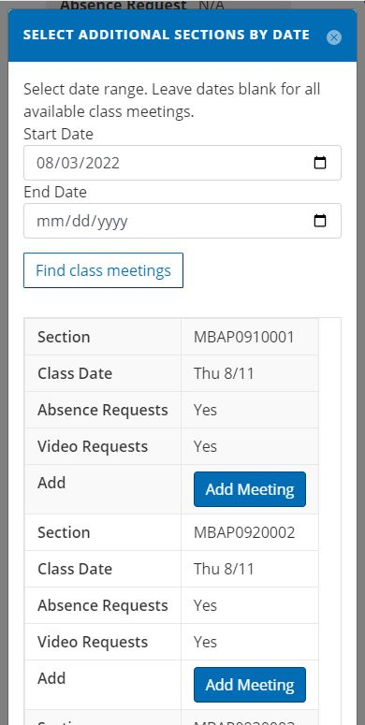
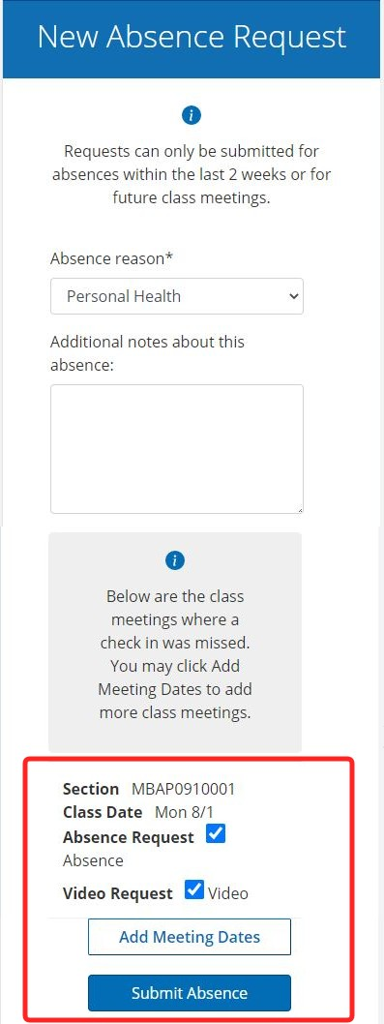
How to Enter Absence and Video requests
If you do not check-in to a class meeting, you will receive an email at the end of the day prompting you to submit an absence request. You can also do this proactively for future absences.

Slide 4
How to Enter Absence and Video requests
Open the Attendance & Video Requests module for your course in Canvas.
Click on either Request Absence or Request Video. This will show up below the check-in options if they are available.
Use the date search to find the class meeting for which you need to make a request. Then tap/click Add Meeting.
Select an absence reason and enter any notes in the text box. Then check off Absence Request (and Video Request, if desired) and Submit Absence
To view videos once you have been granted access, go to Class Recordings tab in the Canvas site for your course. Videos will be available through the semester.

Slide 5
NEED HELP? Get Connected with Wharton Computing
SH-DH 114
215.898.8600
support@wharton.upenn.edu

