Slide 1
Safety Planning

Slide 2
Developing optimal safety plans

Slide 3
Planning: Setting goals, developing strategies and outlining tasks and schedules to accomplish the goals derived from the engaging assessing and partnering process.
Plans are developed with families to help them use their current strengths and resources to resolve underlying causes of abuse and neglect. Plans include goals, strategies, task and schedules and are derived from the safety and family assessments.
Notes:
Natalie
Discuss why planning important.

Slide 4
PLANNING: IDEAL PRACTICE
Explains to the family the specific function of the safety plan being developed. This can include:
Uses detailed information (obtained in the assessment stage) about individual, family and environmental strengths and protective capacities during plan discussions and development.
Notes:
Melissa

Slide 5
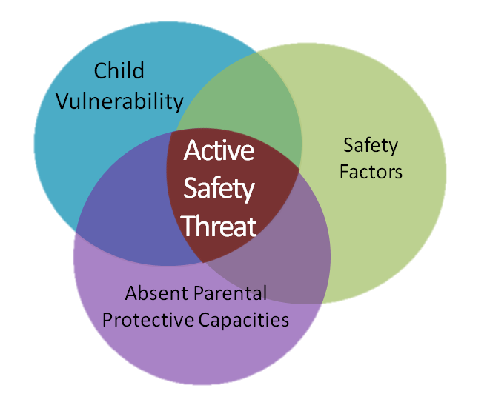
PLANNING: IDEAL PRACTICE
Gathers family members’ ideas about options for ensuring the immediate safety and/or placement of their children. Develops with the family written safety plans that are:
Time limited
Specific
Easily understood by the family
Address the immediate safety of the children
Notes:
Melissa

Slide 6
Communicating: Effectively sending and receiving information within the appropriate cultural context. Methods include verbal, nonverbal, electronic and written communication.
Notes:
Natalie
Discuss why planning important.

Slide 7
COMMUNICATING: IDEAL PRACTICE
Ensures recipients of communications have understood the communication.
Summarizes conversation and agreed upon actions or decisions
Asks if anything was unclear
Provides follow up clarification
Notes:
Melissa

Slide 8
COMMUNICATING: IDEAL PRACTICE
Uses respectful communication:
Engages in difficult conversations with those involved
Refrains from gossip or complaining
Avoids pejorative language
Is timely and objective
Notes:
Melissa

Slide 9
Safety Plan
A specific and concrete strategy for controlling threats of serious harm to a child(ren)

Slide 10
Protective Capacities
Child Vulnerability
Safety Factors
CHILD SAFETY

Slide 11
Features of an Effective Safety Plan

Slide 12
Safety Response
=
Type of Safety Plan

Slide 13
Safe
Sufficient Protective Capacities
No Active Safety Threat
Intervention is Not Necessary

Slide 14
In-Home Safety Plan
Least Restrictive
Parents Agree and Sign
Supplement Protective Capacities
Active Safety Threats
No Change in Custody
Child Remains in the Home
Intervention Is
Necessary

Slide 15
Out-of -Home Safety Plan
Responsible party to care for child
Parents agree and sign
Cannot supplement protective capacities
Active safety threat
No change in custody
Child is out of the home
Intervention is necessary

Slide 16
Legally Authorized Out-of-Home Safety Plan
Resources Are Not Sufficient
Custody Change Occurs
Cannot Supplement Protective Capacities
Child Is out of the Home
Active Safety Threats
Most Restrictive

Slide 17
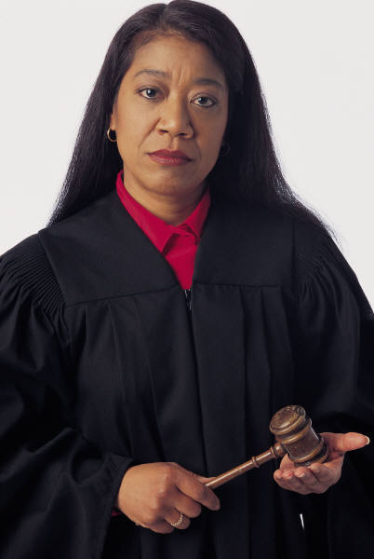
Legal
Intervention
Voluntary
vs

Slide 18
Adult Protective Capacities
Assesses the parent’s willingness and capability to protect

Slide 19
Cannot
Delayed
Impaired
Will Not
Denies
Vacillates
Has Not
Unwilling
Failure to Protect

Slide 20
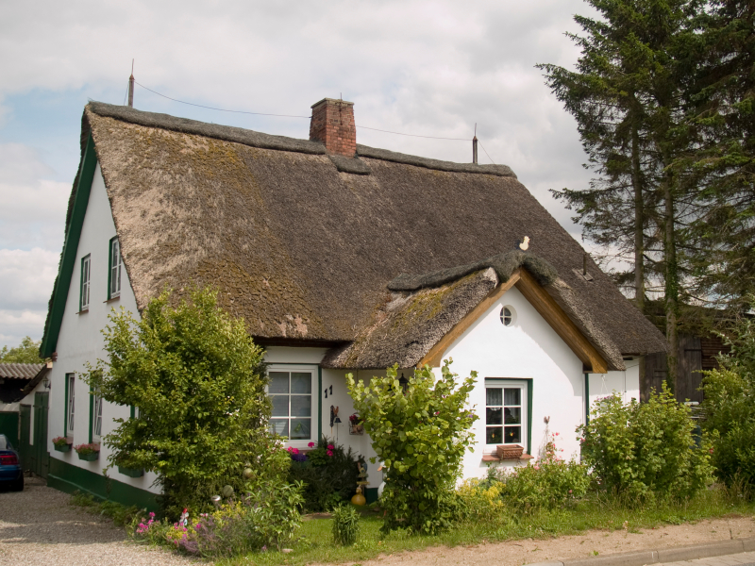
In-Home VS Out of Home

Slide 21
In-Home Safety Plan
Can I remove the threat?
No
Can I control the threat?
Yes
In home
Yes
No
Out Of Home
In Home

Slide 22
Can the active safety threat be removed or eliminated while the child stays home?

Slide 23
Controlling Safety Threats

Slide 24
Out-of-Home Safety Plan

Slide 25
Do I have responsible persons to assist in caring for the child ?
No
Legally Authorized
Yes
Out-of-home

Slide 26
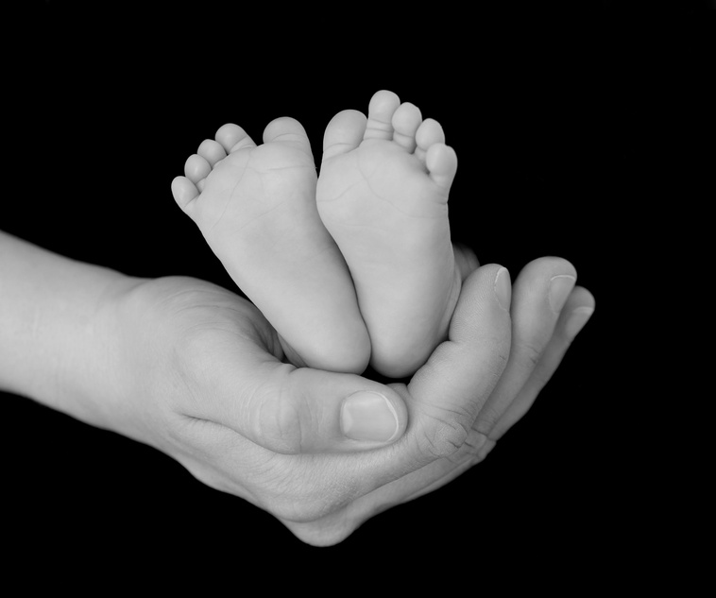
Responsible Persons
Relationship with parents
Do they have a criminal record?
Do they have a history of child abuse and neglect?
Are they able to meet the needs of the children?
Conditions of the home environment
Individual residing in the home

Slide 27
Child Vulnerability
Responsible Persons Ability or Willingness

Slide 28
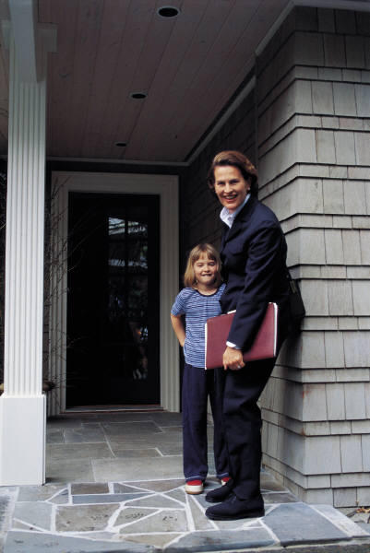
Community Services
Frequency
Duration
Quality

Slide 29
Legally Authorized Out of Home Placement

Slide 30
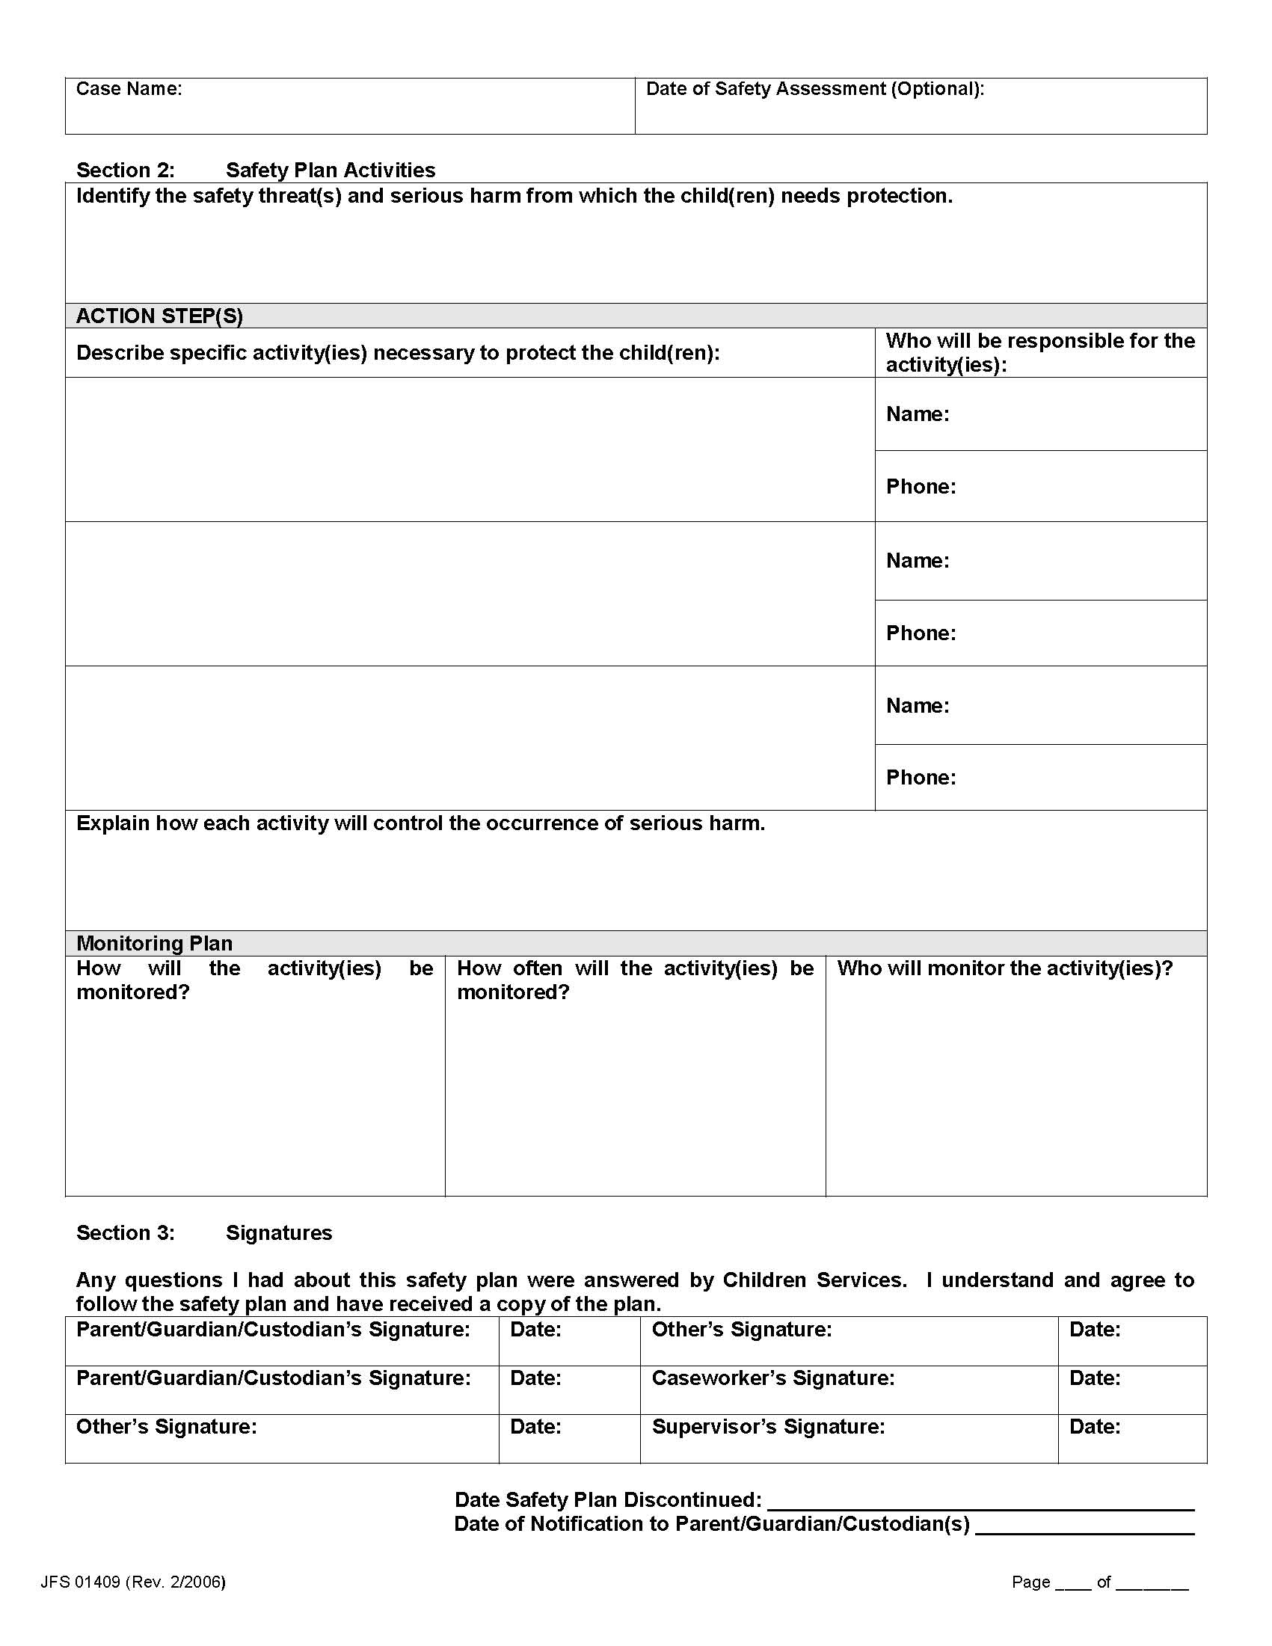
The “WHAT” is listed here

Slide 31
HOW you are controlling is listed here.

Slide 32
Does the description of the safety threat clearly identify what the child is being protected from?
Do the activities control the safety threat?
Are there promissory activities within the plan?
Does the monitoring plan seem sufficient?
What do you like about this plan?
Is there anything you would change in this plan?
Scenario 1
Scenario 2
Scenario 3
Scenario4

Slide 33
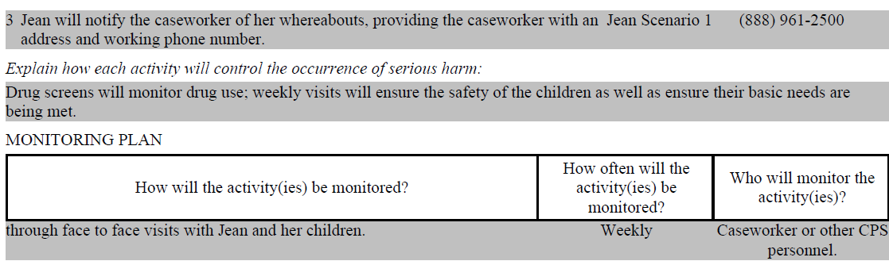
Scenario 1

Slide 34
Scenario 2

Slide 35
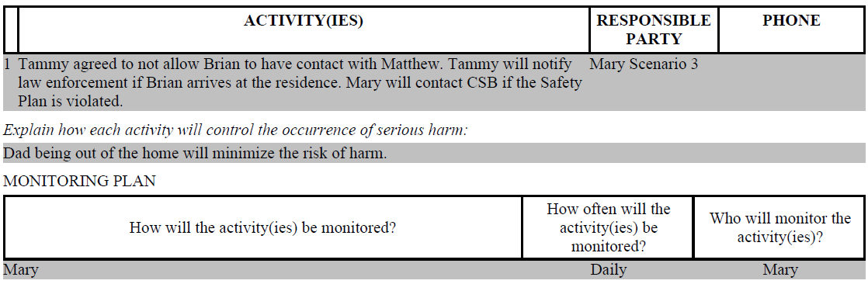
Scenario 3

Slide 36
Scenario 4

Slide 37
Monitoring

Slide 38
The Monitoring activities
are listed here

Slide 39
Active Safety Threat: The family is homeless, currently living in unsafe conditions. There is no food, no beds, as well as an unregister sex offender living in the home. Sally has a bruise on her forehead and a hand-shaped bruise on her back; there are no explanations to explain these injuries. Courtney requires immediate treatment for a severe diaper rash that has blistered.
1. Courtney and Sally will go to live with their grandmother, Esther. Esther will provide care and supervision for Courtney and Sally. – Esther (responsible party)
2. Jean and Esther will take Courtney to the pediatrician by tomorrow (Date).
3. Jean and Esther will contact the caseworker immediately if they cannot carry out the safety plan activities or are no longer in agreement with the plan.

Slide 40
Michelle and Scott state that their substance use prevent them from providing housing and supervision.

Slide 41
Monitoring assists the caseworker and supervisor in determining whether a more or less restrictive safety plan is necessary while ensuring the safety of the child.

Slide 42
Consider
Changes in safety threats
Changes in the parents’ protective capacities
Changes in child vulnerability
Responsible individual not implementing the plan as agreed
Conflict between parents and persons responsible for action step

Slide 43
Safety Factors
Protective Capacities
Child Vulnerability
Child Safety
Susceptible to harm
Extent of activities
Restrictiveness

Slide 44
Supervisors
Accountability
Guidance and Oversight
Ensure compliance

Slide 45
Promises, Promises

Slide 46
OCWTP Tool Kit

Slide 47
SACWIS Knowledge Base http://jfskb.com/sacwis/

Slide 48
