Slide 1

Child Protective Services Policy
Strengths and Needs Risk Asssessment

Slide 2
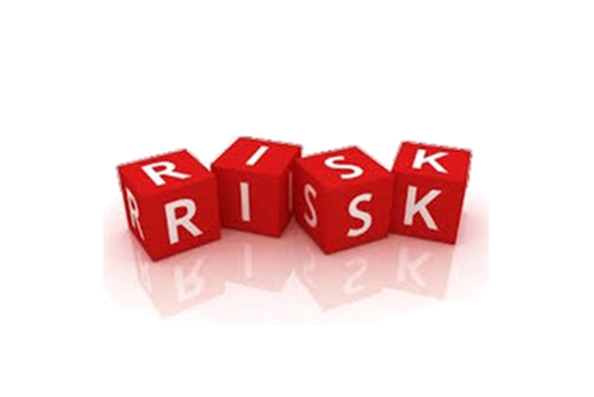
ASSESSING: IDEAL PRACTICE
Gathers detailed information regarding factors known to create substantial risk to children (such as domestic violence, mental health issues, substance abuse) and the underlying causes of behavior and history as relevant to possible child maltreatment.
Gathers detailed information about individual, family and environmental strengths and protective capacities that can mitigate risk.
Notes:
These two ideal practices really hone in on gathering information to help you assess safety and risk.
The first bullet talks about looking for safety factors that can create substantial risk for children. These are things such as Substance Abuse (Opioid Epidemic), Domestic Violence, & Mental Health Concerns which I like to think of the “big three” we see often co-existing in very high-risk cases. Pair that with insufficient protective capacities on the part of the parent and a high level of child vulnerability due to the child’s age or cognitive deficits and you have the makings of a very high-risk case.
Lindsay (1 minute)

Slide 3
FOCUS
The importance of the clinical assessment of risk in determining the family’s strengths and needs.
The elements of the assessment of risk within the CAPM tools.
The inter-relationship between the elements necessary to assess safety and risk.

Slide 4
FOCUS
The purpose of identifying risk contributors and strengths of a family.
Inter-relatedness of risk contributors, services, and the ongoing provision of services.
Effectuate behavioral change within the family.

Slide 5
RISK ASSESSMENT
AND
CAPM TOOLS
FAMILY ASSESSMENT
CASE REVIEW
REUNIFICATION ASSESSMENT

Slide 6
Risk
Child
Adult
Family
Historical
Categories

Slide 7
Strengths and Needs
Child Functioning
Self Protection
Physical Development
Adult Functioning
Cognitive Abilities
Physical Health
Historical
Caretaker’s Victimization of Other Children
Caretaker’s Abuse / Neglect as a Child
Family Functioning
Cognitive Development
Social Development
Emotional
Domestic Relations
Substance Abuse
Response to Stressors
Parenting Practices
Family Roles, Interactions, and Relationships
Resource Management and Household Maintenance
Extended Family, Social and Community Connectedness
Impact of Past Services
Mental Health Functioning

Slide 8
RC vs. NRC?
Risk Contributor:
“An assessment standard used to identify the conditions existing in the individual or family that create the likelihood of maltreatment to a child.”
Non Risk Contributor:
  “An assessment standard used to identify the conditions existing in the individual or family that do not increase the likelihood of maltreatment to a child.”

Slide 9

IS IT WORKING?
WHY?

Slide 10
Strengths and Needs
Child Functioning
Self Protection
Physical Development
Adult Functioning
Cognitive Abilities
Physical Health
Historical
Caretaker’s Victimization of Other Children
Caretaker’s Abuse / Neglect as a Child
Family Functioning
Cognitive Development
Social Development
Emotional
Domestic Relations
Substance Abuse
Response to Stressors
Parenting Practices
Family Roles, Interactions, and Relationships
Resource Management and Household Maintenance
Extended Family, Social and Community Connectedness
Impact of Past Services
Mental Health Functioning

Slide 11
Risk Contributor
An element is considered a risk contributor when it:
Creates the likelihood of maltreatment to a child.
OR
Increases the likelihood of maltreatment to a child.

Slide 12
Non Risk Contributors
An element is considered a non risk contributor when it:
Does not create the likelihood of maltreatment to a child.
AND
Does not increase the likelihood of maltreatment to a child.

Slide 13



Non Risk Contributors
Does not have a negative impact.
May have a positive impact.
  May decrease the likelihood of child maltreatment.

Slide 14
STRENGTH
A condition existing in the individual or family that reduces risk of maltreatment to a child and supports permanency and child well-being.
*ALL Strengths are
Non Risk Contributors

Slide 15
Strengths and Needs
Child Functioning
Self Protection
Physical Development
Adult Functioning
Cognitive Abilities
Physical Health
Historical
Caretaker’s Victimization of Other Children
Caretaker’s Abuse / Neglect as a Child
Family Functioning
Cognitive Development
Social Development
Emotional
Domestic Relations
Substance Abuse
Response to Stressors
Parenting Practices
Family Roles, Interactions, and Relationships
Resource Management and Household Maintenance
Extended Family, Social and Community Connectedness
Impact of Past Services
Mental Health Functioning

Slide 16
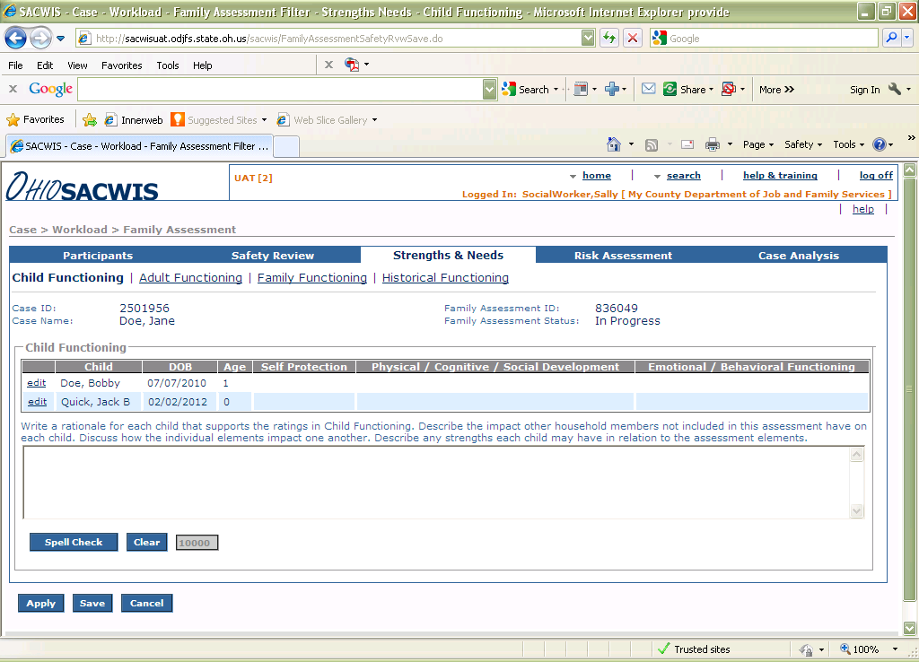
Family Assessment

Slide 17
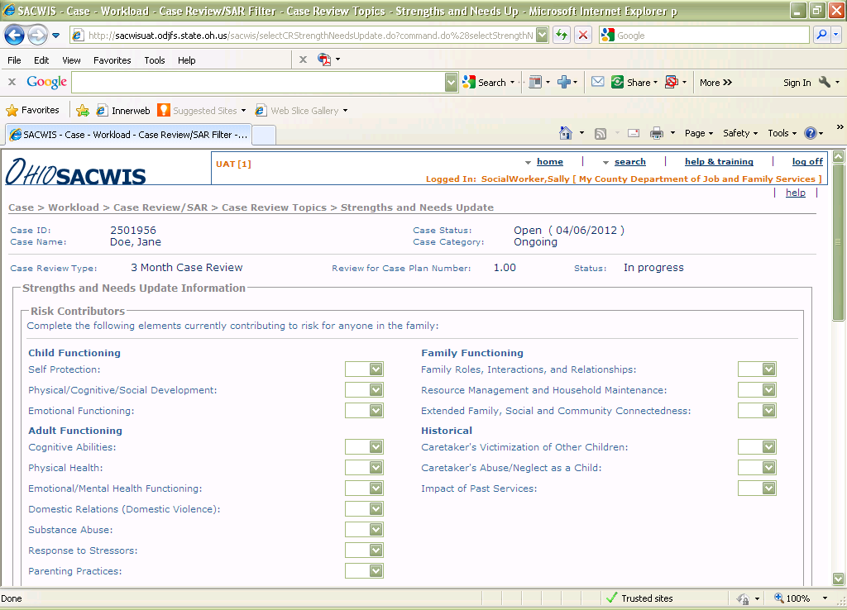
CASE REVIEW

Slide 18
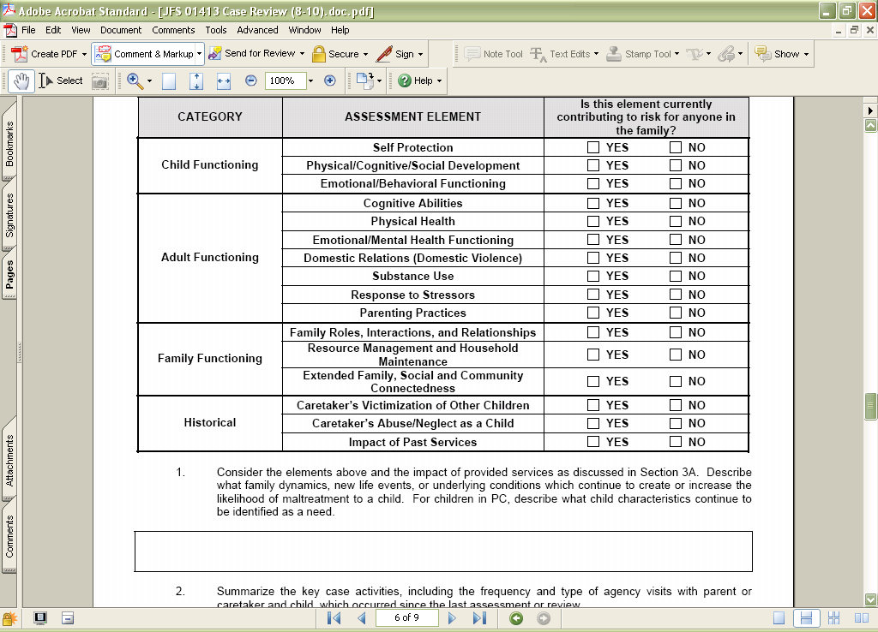

Slide 19

EVALUATING: IDEAL PRACTICE
Conducts comprehensive and holistic family service reviews. This is evidenced by documentation and discussion with the family, by the service provider’s perceptions of the family’s progress, by taking into account relevant and available information, and by observing changes in behavior.
Notes:
Vidalia – 2 minutes 29 minutes into webinar
This ideal practice talks about the formal, comprehensive reviews like 90 day case reviews or SARs, where you are evaluating the cumulative case plan progress over the last 90 to180 days. During these reviews it is important to get the perspective of the family, service providers, CASA/GAL if there is one, etc. This is a time to reflect on successes as well as opportunities. Many times trends or patterns begin to emerge when you look at progress over a longer period of time. Maybe mom always missed her supervised visits the last week of the month. You can ask her - What is it about the last week of the month that makes getting to the visits a challenge? Maybe you’ll find out that her food stamps have depleted by the last week of the month so she has to stand in line at the food pantry and if doesn’t have a ride and has to take the bus, then the line is really long when she gets there so by the time she is through she misses her visits or is very late. Then the team can help mom brainstorm solutions to this problem or maybe the visits can be scheduled an hour later on these days, etc.
25 minutes in

Slide 20

EVALUATING: IDEAL PRACTICE
In all formal reviews, assesses whether the current interventions are helping the family reach the desired immediate, intermediate and long-term outcome(s).
Notes:
Jeanie ( 2 minutes) 36 minutes into webinar
Private agency point of view on assessing current services and interventions. Scorecards? Looking for Trends? Foster Parent Advisory Group example?

Slide 21
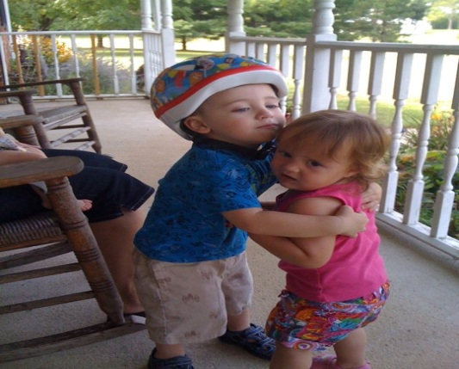
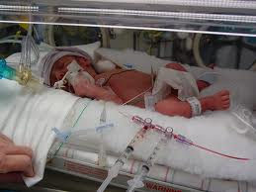
Child Functioning
Self Protection
Physical,
Cognitive,
Social Development
Emotional Behavioral Development

Slide 22
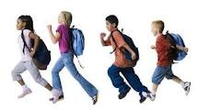
Self Protection
Children 5 years old and under are at increased risk of being abused/neglected. Birth to 1 year of age are at greatest risk of being abused/neglected.
A child is NOT responsible for his/her own protection.
The responsibility to protect a child from abuse and/or neglect lies with the parent, guardian, or custodian
A total of 1,740 children died from abuse and neglect in 2008; more than three quarters (79.8%) of these children were 3 years old or younger. (USDHHS, Child Maltreatment 2008).
This age group has the highest death toll resulting from abuse or neglect.
0-5 Years old
Does not verbalize
Is not visible to others
Denies abuse/neglect
Blames Self
Accepts CA/N

Slide 23
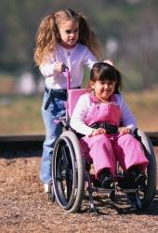

Physical/Cognitive/Social
Child’s behavior toward self or others has contributed to stressful interpersonal relationships.
This element refers to the degree to which a child’s physical, cognitive, or social development may increase the risk of the child being abused or neglected.
Poor peer relationships
Developmental delay
Learning disability
Physical appearance
Requires intensive care
Immobility

Slide 24


Emotional/Behavioral
Consideration should be given to behaviors that trigger negative interactions
This element refers to the child’s emotional attachment and behavioral reactions/actions that may increase the risk of the child being abused or neglected.
Argumentative
No Emotional Attachment
Defiant
Can’t tolerate frustration
High Energy level
Uses Drugs
Criminal activity
Antisocial
Cannot Deescalate
Emotional and behavioral challenges in children often increase the likelihood of future maltreatment.

Slide 25
Child Vulnerability
Assessment
Child Functioning
Elements
S
A
F
E
T
Y
R
I
S
K

Slide 26
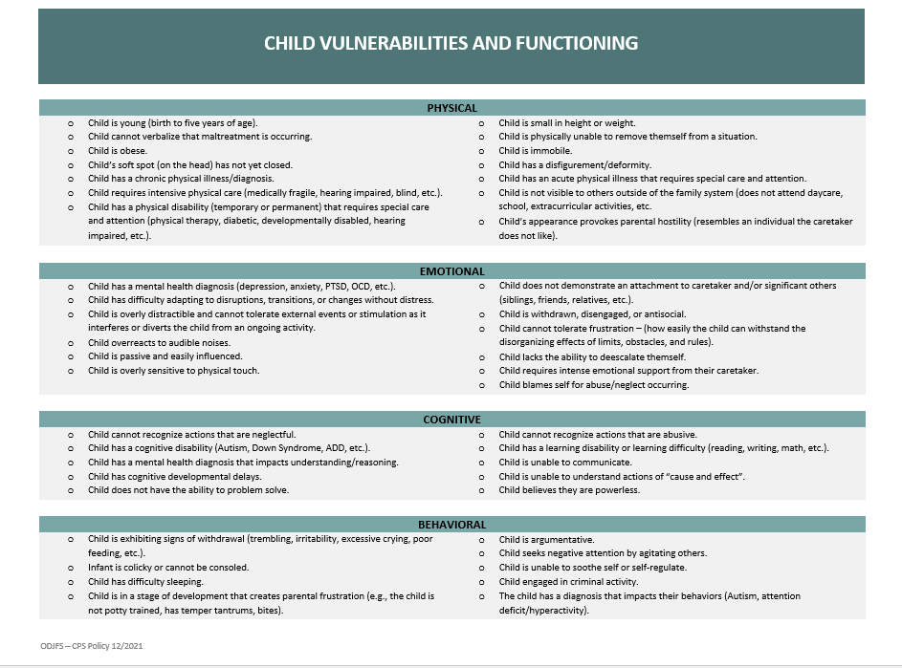
Child Vulnerabilities
Take a moment to review the handout.
Meanwhile, think about how child vulnerabilities relate to the child functioning elements
Notes:
Pass out Handout 3: Safety Factor Field Guide
Instruct participants to review this handout and refer to it in the following discussion.
Facilitate a discussion about the three-pronged approach to assessing safety by asking: What challenges do you see in the assessment of safety factors?
Clarify misinformation and assure the following content is addressed.

Slide 27
Sawyer Case Example
Watch the Sawyer Family Video
With your small group, complete the handout: Child Functioning: Lucy
Use the handouts: Strengths and Needs Field Guide - child functioning section, and Child Vulnerabilities as a resource
Make note of any observations you have about the adults on a separate sheet of paper.

Slide 28


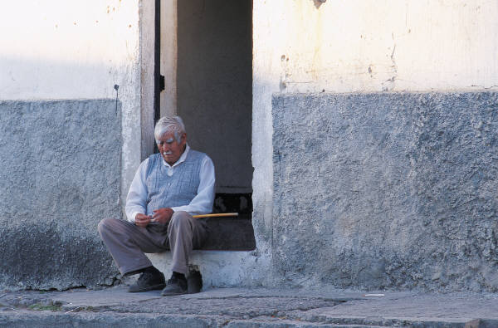

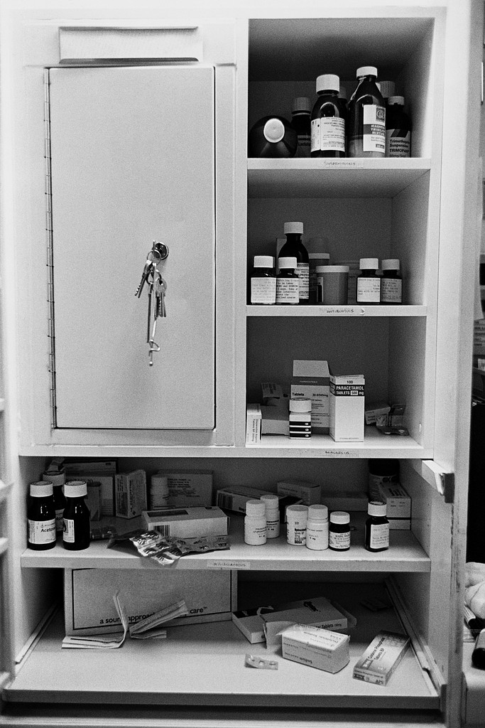


Adult Functioning
Cognitive Abilities
Physical Health
Emotional Mental Health
Domestic Relations
Substance Use
Response to Stressors
Parenting Practices

Slide 29
Cognitive Abilities
Understanding of the parental role in relation to caring for
and protecting their children.
Characteristics such as impulsivity, maturity, the ability to reason, knowledge of child development, are to be assessed in relation to risk of future child abuse/neglect.
  Is not reality oriented.
  Organic/inorganic impairment.
  Lacks understanding
  Impact recognize basic needs.
  Understand child abilities.
  Recognize need to protect .
  Subjects child to unsafe situations.

Slide 30
Physical Health
The degree to which a caretaker’s/adult’s physical health may
increase the risk of the child being abused or neglected.
Address the caretaker/adult’s ability to interact, protect,
and parent the child.
  Physical ability to intervene to protect a child.
  Physical ability to interact with the child.
  Ability to physically care for the child.

Slide 31
Emotional/Mental Health
The degree to which a caretaker’s/adult’s emotional and mental health functioning, may increase the risk of the child being abused or neglected.
  Is not reality oriented.
  Organic/inorganic impairment.
  Lacks understanding
  Impact recognize basic needs.
  Understand child abilities.
  Recognize need to protect .
  Subjects child to unsafe situations.
  Caretaker’s capacity to provide care to self?
  Caretaker’s capacity to provide care to child?
  Caretaker’s ability to control impulses of anger, hostility, and violence?

Slide 32
Domestic Relations
The degree to which a caretaker’s/adult’s current and historical relationships and interactions may increase the risk of the child being abused or neglected.
Considers the relationship dynamics between the caretakers/adults.
Examines whether a pattern of coercive control exists and results in conflictual or violent interactions thereby impacting the interaction, protection, and care of the child.
  Dynamics and quality of relationships.
  Historical or current conflictual or violent interactions.
  Caretaker’s behaviors to stressful interactions.

Slide 33
Domestic Relations
Children exposed to domestic violence often experience consequences similar to being directly abuse by a parent.
The co-occurrence of domestic violence and child abuse is thought to be present in 30 to 60 percent of cases.
DV may be the single major precursor to child abuse and neglect fatalities in the U. S.
(Carter, Janet. Domestic Violence, Child Abuse and Youth Violence: Strategies for Prevention and Early Intervention. Family Violence Prevention. 2001.).
The impact violence has on parenting and the caretakers’ ability to protect the child is paramount.

Slide 34
Domestic Relations
Uses weapons to threaten or harm.
Believes the other adult will kill him/her.
Uses strangulation to threaten or harm.
Exhibits unwarranted reactions.
Uses gestures or actions to intimidate.
Acts of family violence interfere with parenting practices.
Acts of family violence impacts the child regardless if the child witnessed the incident.
(disruption of daily routine, injuries on adult, damage to residence, arrest, interactions between adults)
Has visible inflicted injuries .
Authoritarian or controlling behaviors over other adult/caretaker.
Family violence in which a child attempts to intervene.
Little communication, support or attachment

Slide 35
Substance Use
The degree to which a caretaker’s/adult’s substance use may increase the risk of the child being abused or neglected.
Considers the substance use and its impact on:
    emotional responses/attachment,
    physical health,
    interactions with the child and adults,
    family finances,
    employment,
    criminal activity.
The severity, frequency and types of substances should be considered including the caretaker’s/adult’s history of substance use.

Slide 36
Substance Use
Substance use, both alcohol and drug abuse have been correlated with child maltreatment.
Substance abuse often interferes with a parent’s mental functioning, judgment, inhibitions, and protective capacities.
Substance abuse and child maltreatment often co-occur with other problems, including mental illness, HIV/AIDS or other health problems, domestic violence, poverty, and prior child maltreatment.
A holistic assessment of the family system is needed to identify and assess the affect on the likelihood of future maltreatment given the interconnectedness of these criteria.

Slide 37
Substance Use RC Examples
Has periods of incapacitating intoxication.
Inability to care for child.
Control of actions is significantly impaired.
Subjects child to unsafe situations.
Arrest(s) and/or incarceration(s) due to substance trafficking.
Traffic violations, arrest(s) and/or incarcerations(s) due to substance abuse/use.
Creates problems in social functioning.
Patterns and/or frequency of substance use is increasing.
The needs of the child become secondary to the use of substances.
Regularly uses illegal substances in presence of child.

Slide 38
Response to Stressors
The degree the caretaker’s/adult’s response to stressors may increase the risk of the child being abused or neglected.
  Considers the impact the stressors have on the caretaker’s/adult’s :
      emotional responses/attachment,
      physical health,
      and interactions.
The assessment should identify the stressor(s),the resulting behavior(s), and the impact on the care of the child.

Slide 39
Response to Stressors
Caseworkers need to be cognizant of the interaction of stress and the existence of certain personal adult characteristics may lead to abuse or neglect.
  changes in relationship status
  changes in the family composition
  marital conflict
  parental health problems
  financial need
  changes in employment, unemployment
  substandard housing
  food insecurity
  acute psychiatric episodes

Slide 40
Response to Stressors
This risk contributor is not about if stressors or present but rather the reaction to them
Reactions and behaviors may fluctuate due to the frequency and type of “current stressors”.
Ability to react and “control” stressors.
Pre existing conditions (Substance use/abuse and mental health) which are exacerbated by stressors should be identified along with their severity.
The reactions to stressors should be documented as well as addressing how the reactions impact parenting practices.

Slide 41
Parenting Practices

Slide 42


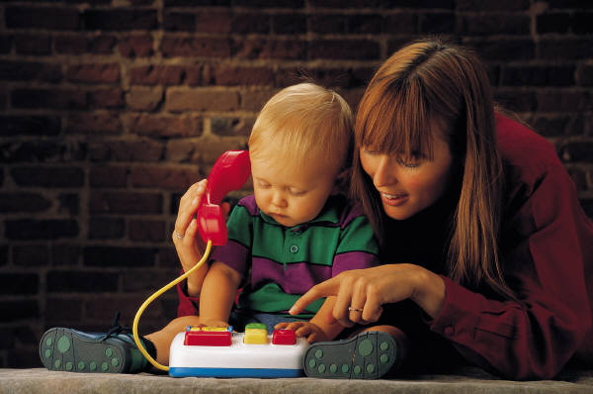


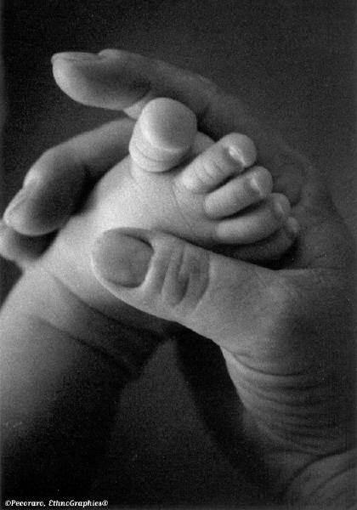


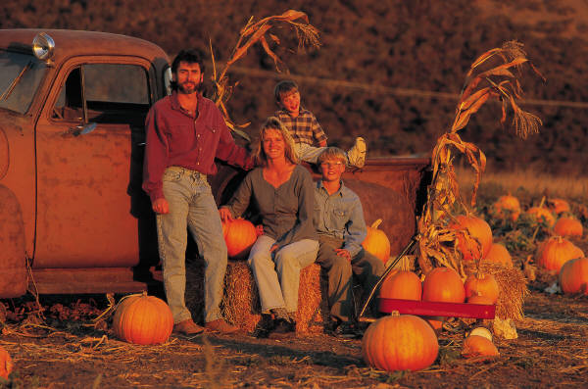
Nurture
food
Realistic expectations
Love
clothing
Protect
Medical care
discipline
Child development
shelter
religion
supervision
education

Slide 44
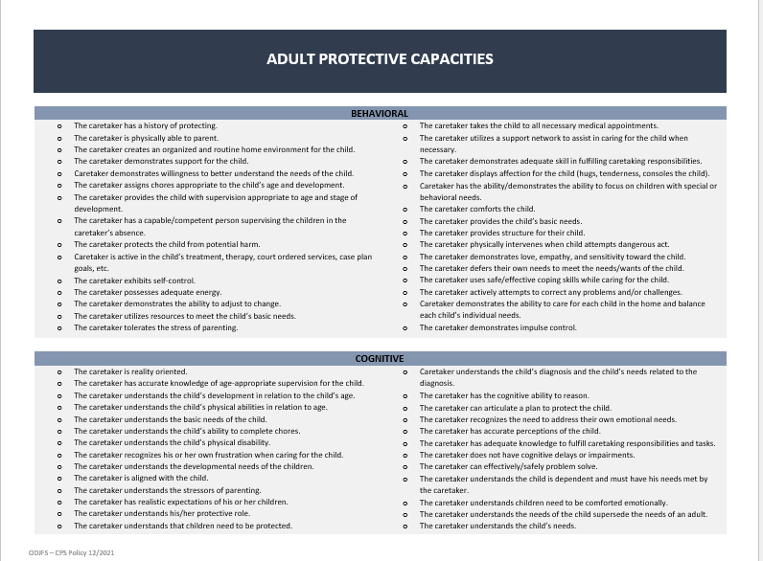
Adult Protective Capacities
Take a moment to review the handout.
Meanwhile, think about how adult protective capacities relate to the adult functioning elements
Notes:
Pass out Handout 3: Safety Factor Field Guide
Instruct participants to review this handout and refer to it in the following discussion.
Facilitate a discussion about the three-pronged approach to assessing safety by asking: What challenges do you see in the assessment of safety factors?
Clarify misinformation and assure the following content is addressed.

Slide 45
Parenting Practices
Does not provide basic needs of the child regularly.
Child is not fed food consistently.
Does not dress child in clothes suitable for the season regularly.
Does not respond to child’s physical, social, or emotional needs.
Does not administer required medication to child as directed.
Does not provide the child with supervision appropriate to age/development/behavior.
Child’s request for attention or affection is ignored or met with hostility.
Regularly excludes child from family activities.
Does not establish clear boundaries, limits, or consistent consequences.
Actions reflect desire to harm the child.
Predominately describes child in degrading or demeaning manner.
Only responds to child’s negative behavior.

Slide 46
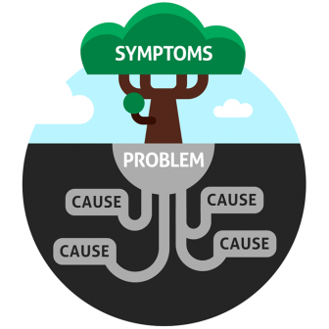
Are we addressing the “root cause” or just the symptoms?
Notes:
Lindsay (2 minutes) 38 minutes in
I really love this slide! When we talk about outcomes it is important to understand that many time the tangible outcomes we see (represented by the tree in this picture) are just the symptoms of something deeper. We may think the problem is dad’s drug abuse, but the problem really is that dad’s mother died when he was a teenager and he didn’t have the support system or the skills to cope with her death and as a result turned to drugs to numb the pain. In that example the symptom is the drug use and all that goes along with it (stealing, lying, neglecting the children, etc.) and the underlying problem is that dad is in emotional pain that he can’t manage. The root causes may be the loss of his mom; lack of a support system; inability to make sense of his feelings; and underdeveloped coping skills.
Do we have time for another poll question? Let’s see how good you guys are … this one is a little tougher ☺

Slide 47






Family Roles, Interactions, and Relationships

Slide 48

Family Roles, Interactions, and Relationships
Relationship with Domestic Relations element.
Adult projects blame of family problems onto the child.
Lack of interaction among family members.
Inability to form a relationship with other children/adults in the home.
Child’s physical/cognitive/social development negatively impacts the other
family member’s relationships/roles.
Child’s emotional/behavioral functioning negatively impacts the other
family members’ relationships/roles.
Adult’s cognitive abilities negatively impact the other family members’
relationships/roles.
Adult’s substance use negatively impacts the other family members’
relationships/roles.
Adult’s parenting practices negatively impacts the other family members’
relationships/roles.
Elements that have an identified risk contributor for the should be closely examined to determine if or how they impact the roles/relationships/interactions.

Slide 49



Resource Management &
Household Maintenance

Slide 50
Resource Management &
Household Maintenance
This element refers to the degree to which the family’s income, economic resources, and home conditions may increase the risk of the child being abused or neglected.
Family’s living conditions
Financial resources available
Service resources available
Utilization of the available resources
Resources to meet the basic needs of the family, including shelter, utilities, food, medical care, and/or clothing should be completed.

Slide 51
Resource Management &
Household Maintenance
Housing is unsanitary, filthy, infested, a health hazard.
Poor home conditions.
Piles of clothing, trash, boxes, or debris pose a fire hazard.
Family is homeless or moves frequently because they cannot afford to pay rent.
Excessive cockroaches, mice, rats, present in the home.
Family is frequently unable to provide for basic needs.
Room covered with animal feces or urine.
Services needed by the family are available but unknown to the family.
Services/resources needed by the family are not available.

Slide 52




Extended Family, Social and Community Connectedness
The degree to which the dynamics, quality and frequency of interactions the family has with extended family, friends, kin and the community may increase the risk of the child being abused or neglected. The assessment is to include an examination of the family’s extended social support network.

Slide 53
Familial, social and community connections :
exist,
are available,
are accessible
positively impact each family member.
The identification and assessment of familial activities, family and social connections, and cultural norms to determine how they influence identified risk contributors.
The dynamics and quality of the relationships between the family members and friends, kin, community, neighbors should be examined.

Slide 54
RISK CONTRIBUTOR:
Connections that negatively impact any previously identified risk contributors within the other elements. The assessment should describe the interactions/connections and identify how they are negatively influencing the risk contributor.
NON RISK CONTRIBUTOR:
Identify connections that are positive for the family. interactions/connections of the family and identify the positive impact. If the positive impact does not reduce the risk of the identified risk contributors in other elements then this would be a NRC for the family .
STRENGTH:
When the connections positively impact any risk contributors within the other elements = NRC and a strength for the family.

Slide 55

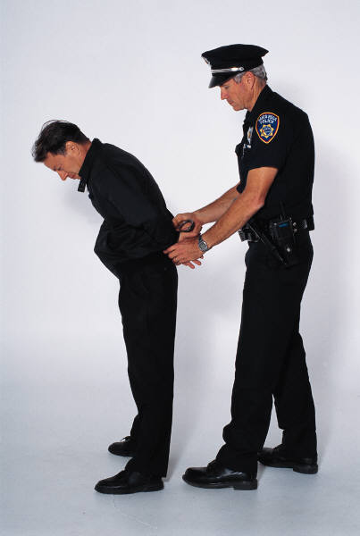
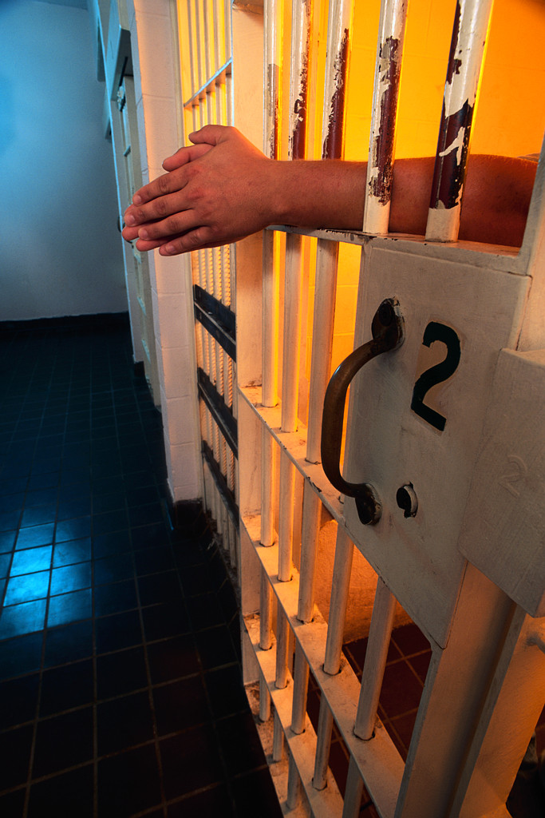

Caretaker’s Victimization
of Other Children

Slide 56
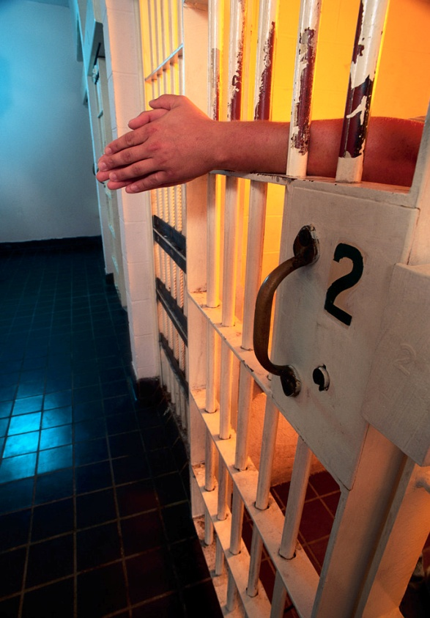
Caretaker’s Victimization
of Other Children
Consider all PCSA and law enforcement records and any court intervention.
Identify any patterns of abusing children
Age or gender of the child
Type of maltreatment
Relationship to the child’s parent

Slide 57


Caretaker’s Abuse and Neglect as a Child
This element addresses whether the caretaker’s victimization as a child influences the parental role
Identifies patterns of learned
behavior for service provision

Slide 58

Impact of Past Services
This element considers
all of the elements rated
as risk contributors and how
the services received in the past may have impacted that rating.

Slide 59
Impact of Past Services
Sufficiently engaged
Coerced or felt pressured to attend
Meet the identified need
Bad experience and won’t go back
Can no longer attend due to noncompliance

Slide 60
Outcomes Slide
Supervisor Guides
Caseworker in
Skill Development
Easy to work with
Not defensive; open
Honest upfront
Accept responsibility
Self-motivated
Take action to support goals
Self-aware
Believe in themselves
Resilient
Mixed
Outcomes
Superior
Outcomes
High
Family is Engaged
Caseworker Lacks Skills to Effect Change
Family is Engaged
Highly Skilled Caseworker
Family’s Willingness to Engage in the Process
Caseworker
Engages
Families
Poor
Outcomes
Slowly Achieves
Successful Outcomes
Family is Not Engaged
Caseworker Lacks Skills to Effect Change
Family is Not Engaged
Highly Skilled Caseworker
See themselves as victims
Can’t sustain motivation
Procrastinate
Self-sabotaging habits
Resist learning new skills
Strong emotions
Doubt personal value
PTSD
Low
Low
High
Engages Families
Assesses Needs
Partners with Family
Links family with services
Evaluates effectiveness of services
Advocates for the child(ren)
Demonstrates Cultural Diversity Competency
Communicates effectively
Collaborates with family and community partners
Timid and/or Fearful
Rigid and/or Set in Ways
Still Learning & Developing New Skills
Resistant to Learning New Skills
Strong Emotional Reactions
Secondary Trauma – PTSD
Requires Highly Skilled Supervisor/Intensive Level of Supervision
Caseworker’s Skill Level
Notes:
Melissa

Slide 61
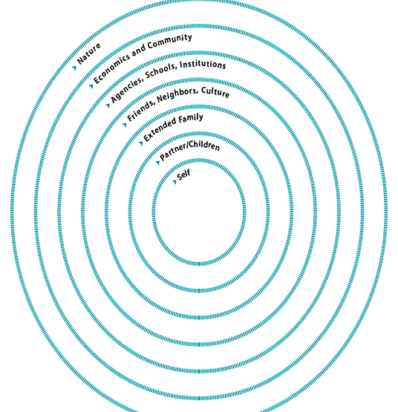
Family Circles Tool
Goal: As a family plot out the people and influences that make up your world.
Self: Personal strengths and challenges, your inner belief system, likes/dislikes, influences.
Partner/Children: This circle should include who you live with and consider your immediate family. Note their strengths and challenges.
Extended Family: Other family members in your life such as parents, siblings, aunts/uncles, and cousins. How do they support you? How do they hold you back?
Page 38 and 39 of the Caseworker Self-Assessment and Field Tools
Notes:
2 minutes (Sami)

Slide 62
Family Circles Tool
Friends, Neighbors, & Culture: This may also include informal care providers, cultural or religious groups, or acquaintances you have a relationship with by choice. List positive and negative impacts.
Agencies, Schools, & Institutions: People who are in your life because it’s their job. I.e. Teachers, case managers, service providers, supervisors/ coworkers. What is beneficial or a hindrance about each relationship?
Economics & Community: List economic influences such as employment status, pubic assistance services, etc. Describe your community and how it impacts your family’s well-being.
Natural Environment: List how the natural environment and it’s condition affects your family. I.e. If you child has asthma caused by air pollution, if you live near a park or lake, etc.
Page 38 and 39 of the Caseworker Self-Assessment and Field Tools
Notes:
2 minutes (Sami)
26 minutes into webinar

Slide 63
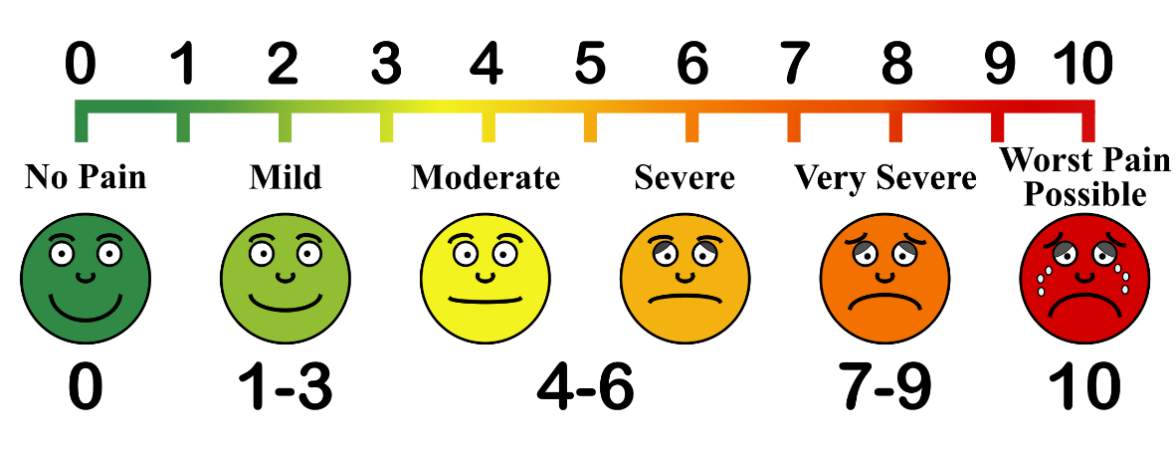
Scaling Questions
Ask the parent or child to identify a number between 1 and 10 to assess and evaluate perceptions of situations.
Works for children as young as 4 years old.
Helps to:
  Assess families’ perception about the seriousness of a problem
  Measure progress over time
  Determine level of motivation for change
  Move past resistance and engagement challenges with clients
Notes:
Sami and Sonia (1-2 minutes)
How:
Scaling questions ask the parents or children to identify a number between 1 and 10 to evaluate their situations. Because this is so simple, this technique can be used with children as young as 4. Counting and measuring are used in almost every language and culture. Scaling questions can be used to assess the family’s perception of the seriousness of a problem, measure progress, determine motivation, and can assist when encountering challenges to engagement. Scaling questions can also be followed with questions about what it would take to improve the number, and should be used to acknowledge a family’s progress and success.
Examples:
(Self-perception) On a scale of 1 to 10, with 10 being “completely” and 1 being “not at all”, how would you rate your ability to keep your children safe?
(Measuring progress) On a scale of 1 to 10, with 10 reflecting a feeling that your life is going well, and 1 reflecting your earlier expression of how terrible your life was when we first met, where would you say things are at now?
(Assessing children) With a smile meaning happy and a frown meaning sad, tell me how you feel things are going at home?
Follow-up questions:
Why did you choose (5) and what would you need to help move you to an (8)?
What do you think made the difference and changed the rating from then to now? (Credits the strength/success)
What rating scale goals would you like to achieve with my assistance? (Motivation/Identifies goals)

Slide 64
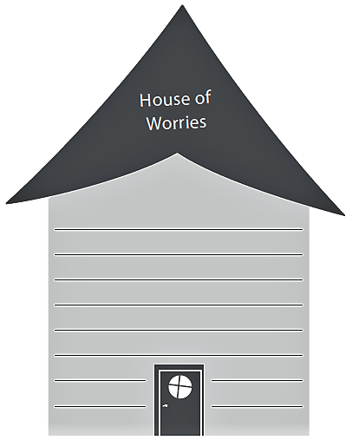
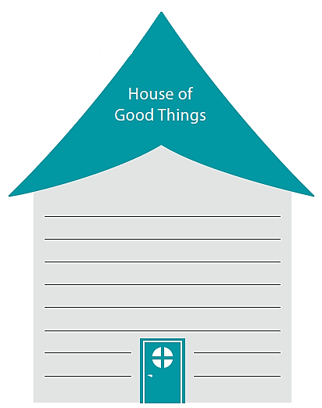
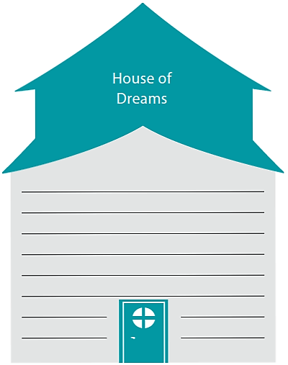
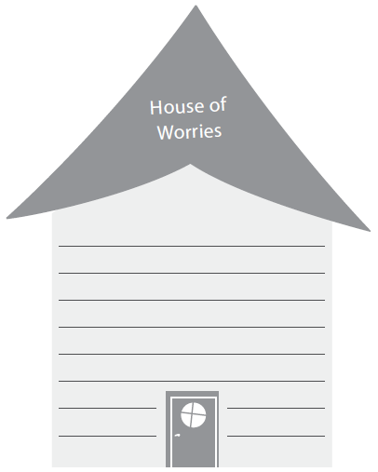
Three Houses Assessment Tool
Found on page 40 of the Caseworker Assessment and Field Tools, JFS 01055.
Adapted from Weld, N. (2008) The three houses tool: building safety and positive change. In M. Calder (Ed.) Contemporary risk assessment in safeguarding children, Lyme Regis,: Russell House Publishing

Slide 65
Thompson Family Video
Watch the video
In your small group complete the Strengths and Needs Assessment – Thompson handout
Use the handouts: Strengths and Needs Field Guide Chart, and Adult Protective Capacities as references
Be sure to include your rationale for your ratings.

Slide 66
Reunification Assessment
Section 3: Assessing Reunification Readiness
Does the child(ren) demonstrate an acceptance of the reunification plan?
Does the parent/guardian/custodian demonstrate an acceptance of the reunification plan?
Does the parent/guardian/custodian have the capacity to provide for the child(ren)’s basic needs (e.g., food, clothing, shelter, medical care)?

Slide 67
Reunification Assessment
Are the parent/guardian/custodian and/or other household members willing and able to use their protective capacities, resources and strengths to provide sufficient support to the child(ren)?
Are there any issues or concerns related to other children or adults in the family that may impact the child(ren)’s return?
Describe how the family dynamics will change when the child(ren) returns.

Slide 68
The narrative assessment information entered in this section should support the RC and NRC rating assigned within each element for each child. Additionally the text should contain assessment information of how each element within the Child Functioning category impacts one another.

Slide 69
The case review assignment of RC/NRC to each element is different from the Family Assessment as the assignment is not per child and per adult for each element.

Slide 70

Evaluating:
Monitoring outcomes of service plans and system programs to determine if the desired goals are being achieved and, if not, using this information to reconsider either goals and strategies developed in the planning phase, or services and resources identified in the implementation stage.
“This is the stage of the CPS case process where the CPS caseworker measures changes in family behaviors and conditions (risk factors), monitors risk elimination or reduction, assesses strengths, and determines case closure.” -DePanfilis, D. and Salus, M.K., 2003
Notes:
Lindsay (3-5 min)
13 minutes into webinar
Explain Evaluating
A lot of time when we talk about evaluating our thoughts go to the CQI cycle and we starting thinking in terms of larger scale evaluation such as program evaluations – and it’s easy to think – oh, evaluation – that’s something that happens in our QA unit or our CQI unit – it’s not really a part of my job…
We want to get an idea of where everyone is in terms of how often evaluation is something you do in your work with families.
Poll: Raise hand if you rarely or never use evaluating in your work with families. Sometimes. Often. Not Sure/Don’t Really Think About it.
Case Reviews/SAR – CP Progress – Service effectiveness – Willingness of family – parenting skills – goal progress, etc.
Question 2: How often do you use the skill of evaluating in your daily practice with children and families?
A) Never
B) Several Times a Year
C) Several Times a Month
D) Several Times a Week
E) Daily
Type in if you have comments – how does mastering the skill of evaluating aide us as child welfare professionals in our daily practice?
What type of activities do you do on a regular basis that involve a component of evaluating? Enter in chat bar…
Ok awesome, you guys are smart… some good responses… we would like to start out this morning by spending a few minutes talking about CQI and giving just a little refresher on what it’s all about. I’ll turn it over to Jeanie.

Slide 71
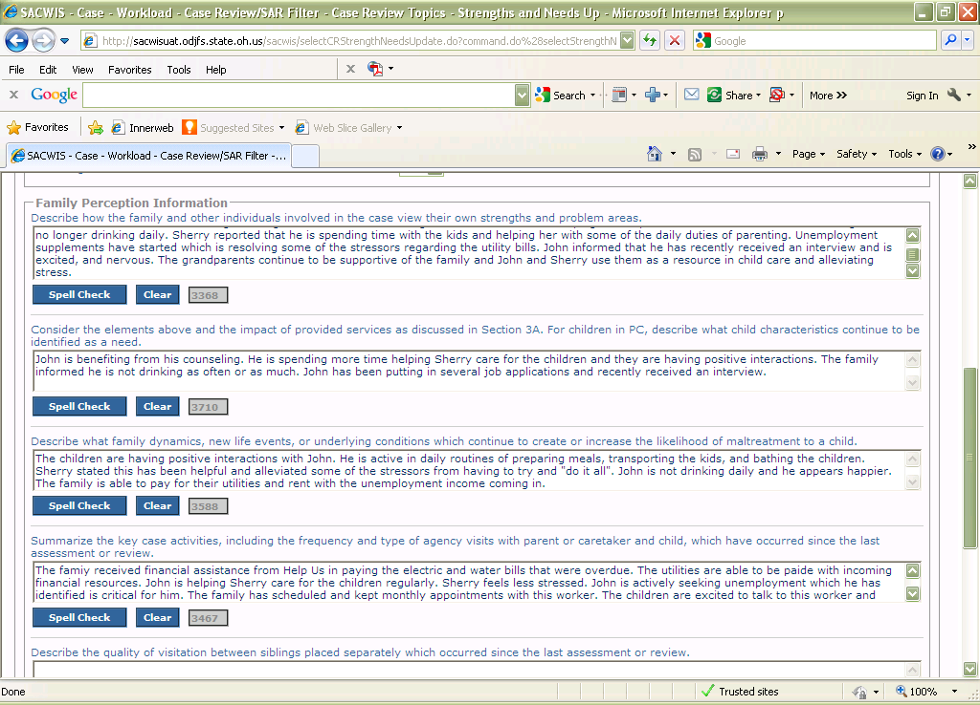
The information recorded here should be an assessment of the impact the services provided during the period under review has had on the elements previously identified as a risk contributor (RC).
RC’s and Services
All Elements
This section should include assessment information to support the reassessment of each element and the assigned rating (RC/NRC). The criteria listed above serve as prompts to be considered in the reassessment of each element.

Slide 72
CPS policy capmis mailbox
CAPMIS@jfs.ohio.gov

Slide 73


Reminder!
Your E-Track Certificate email will have a link to the correct survey answers so you can check your work!
This Photo by Unknown Author is licensed under CC BY

