Slide 2
Increase Equitable Access with Ally
Kimberlee Ball, History Professor & Interim Faculty Senate President
Christina Cross, Business Professor
Tamara Herod, Disability Services Manager

Slide 3
Overview
Why We Need Ally
The Student Experience
The Instructor Experience
A Go-Forward Strategy
Instructional Support
Tips to Turn the Dial Green!

Slide 4
If you can’t reach them,
you can’t teach them.
Creating accessibility is everyone's job
One size does not fit all
Accessibility supports a wide range of students
LSC mission to promote a culture of equity and access in education

Slide 5
How Ally Works
1. Provides learners alternative formats of course content to support flexibility in consuming instructional content.
2. Automatically runs course materials through an accessibility checklist.
3. Provides guidance for improving the accessibility of course content.

Slide 6
Ally supports the following file formats
PDF
Microsoft Word
Microsoft PowerPoint
Image files (JPG, JPEG, GIF, PNG, BMP, TIFF)
OpenOffice/LibreOffice
Uploaded HTML
Content created in the D2L course editor (WYSIWYG)

Slide 7
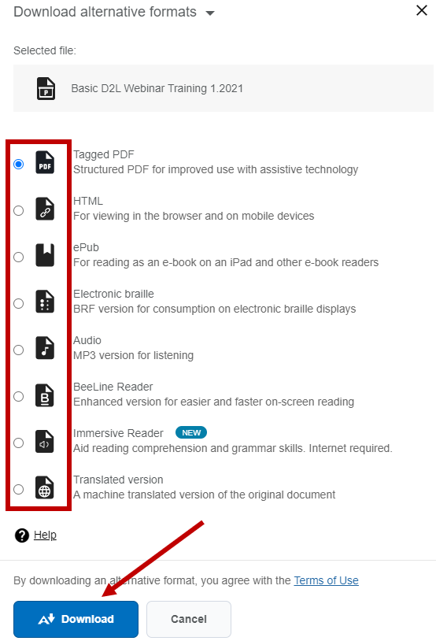
How to Access Alternative Formats
1. Find a file in your D2L course.
2. Select the alternative format icon.
3. Choose the alternative format that is best for your needs.

Slide 9
The Instructor Experience
Automatically runs course materials through an accessibility checklist that checks for common accessibility issues.
Assigns an accessibility score and indicator (colored gauge icon) which is displayed near each supported file.
Provides guidance for improving the accessibility of the content.

Slide 10
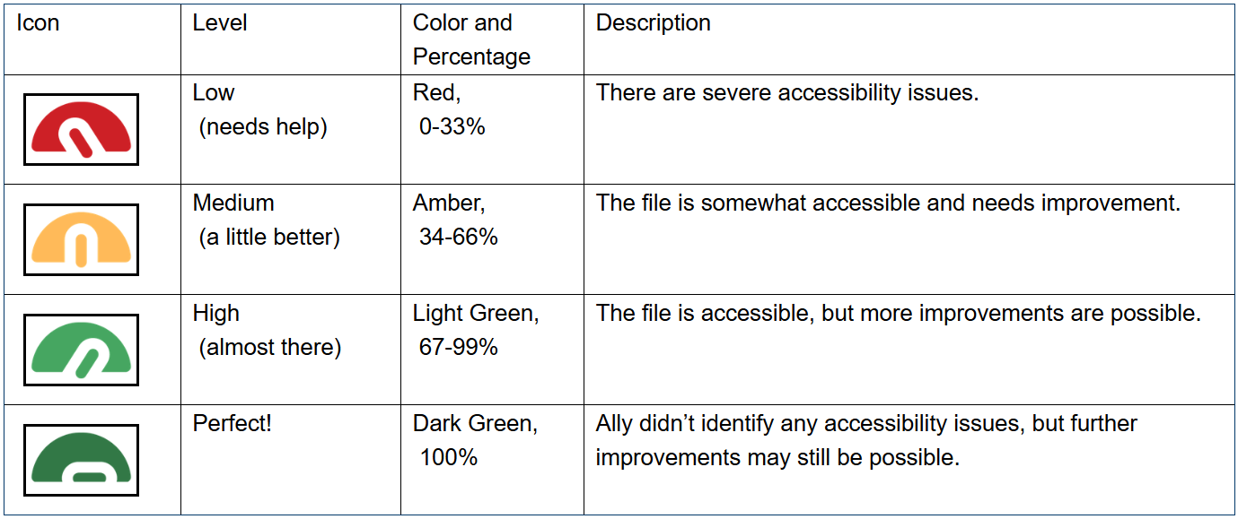
Accessibility Score Indicators

Slide 11
To View Accessibility Score

Slide 12
Ally Course Accessibility Report

Slide 13
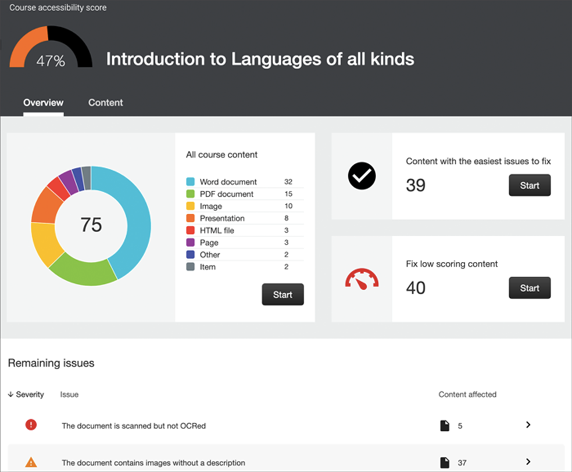

Slide 15
How to Add Ally to your Routine
Let Ally guide your learning about accessibility
Target one specific type of improvement first
Make a plan
Make sure new content is accessible
Improve older content when you have free time

Slide 16
Instructional Support
VTAC Ally Guides: https://vtac.lonestar.edu/help/ally
Ally Help Center: https://help.blackboard.com/Ally/Ally_for_LMS/Instructor
Contact your campus representative or instructional designer for questions and support or email VTAC@lonestar.edu.

Slide 17
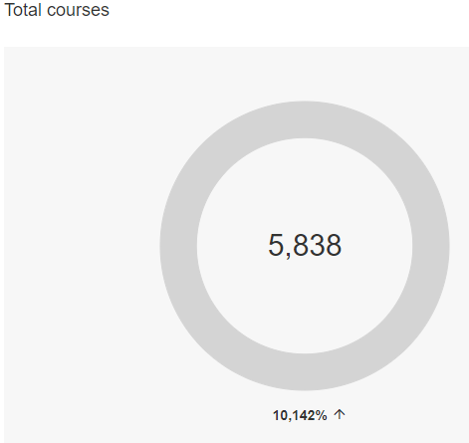
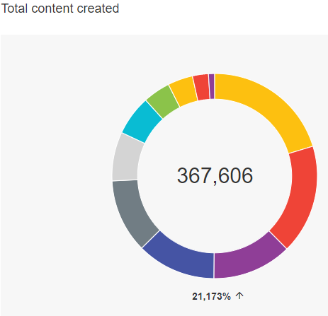
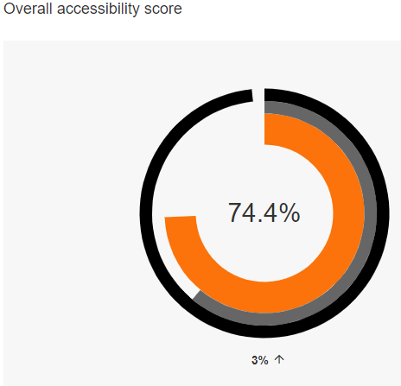
Institutional Report

Slide 18
Institutional Report

Slide 19
Institutional Report

Slide 20
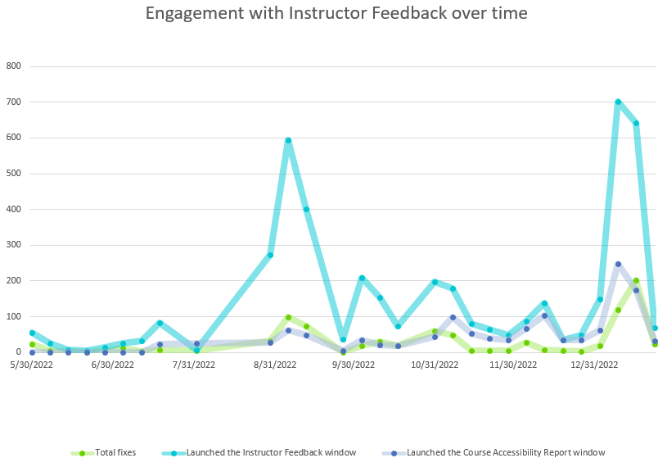
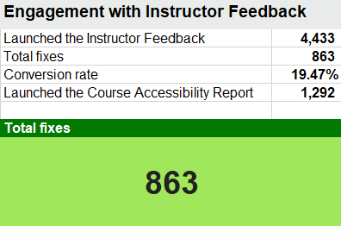
Institutional Report

Slide 21
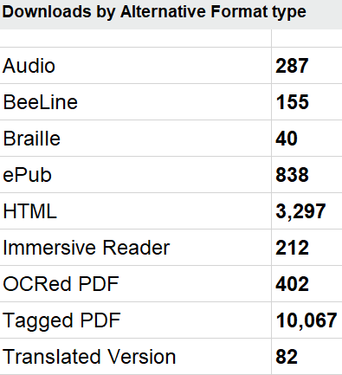
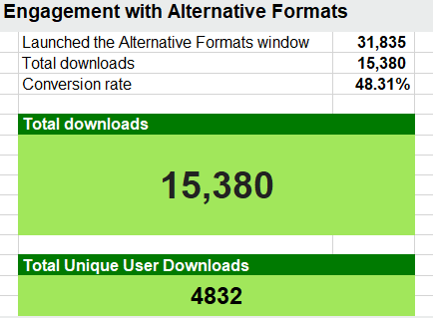
Institutional Report

Slide 22
What are Students Saying?
Student: “Ally allows me to download course material in more accessible formats to use with assistive technology- no converting files with software or waiting for materials to be given to me. These built in accessible formats are an invaluable resource for students with print disabilities and visual impairments. Tagged pdfs work for my screen reader and html allows me to zoom in to read or view images.”
Student: “As a single mom who commutes over an hour to work each way, Ally gave me part of my life back. Instead of rushing through dinner and play time with my child, I was able to enjoy it, because I completed my required reading using Ally’s audio mp3 version during my commute.”

Slide 23
Tips to Make Your Documents more Accessible: Working with Scanned Documents
Notes:
Create an Accessible PDF from a Microsoft Word Document
Make a Google Slides Presentation Accessible

Slide 24
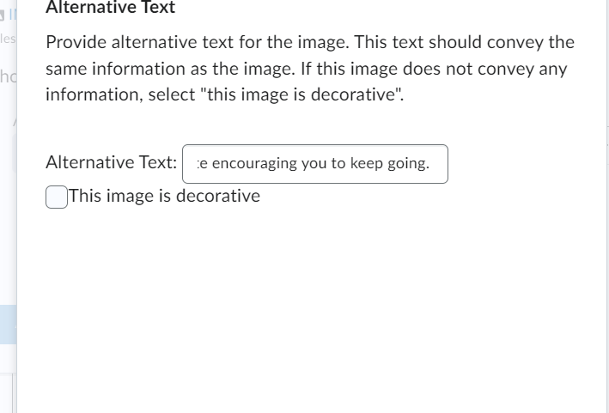
Working with Image Descriptions
Notes:
Make Complex Images Accessible

Slide 25
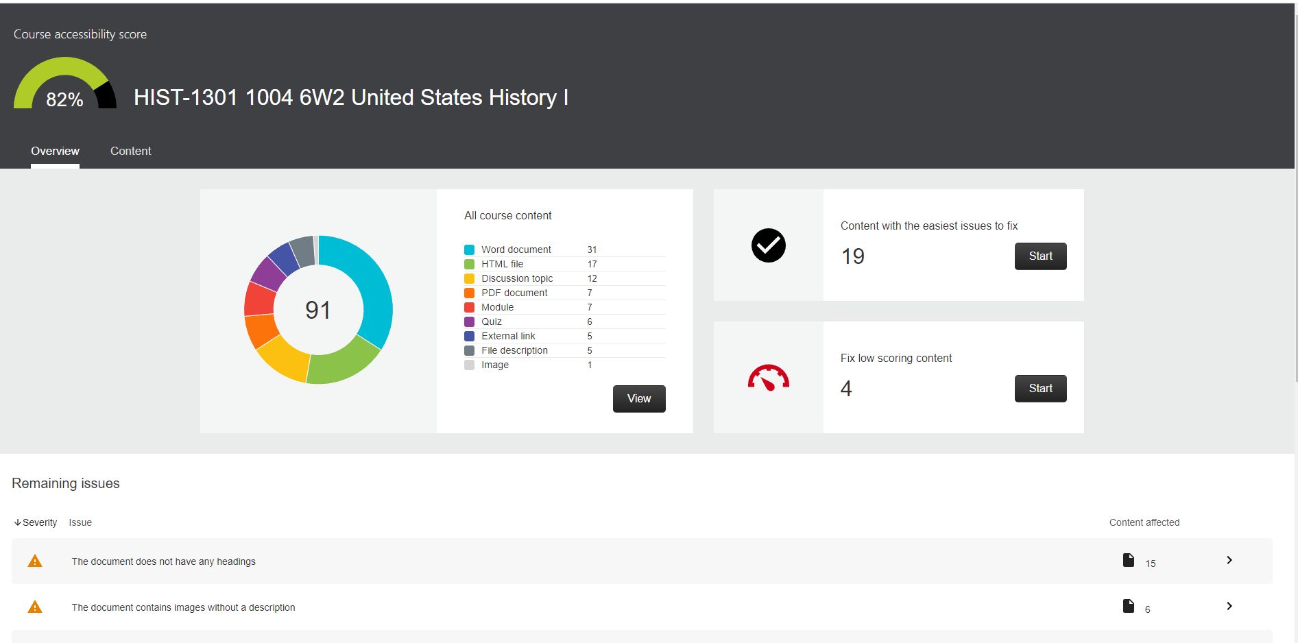
What Ally Looks like in Previously created Courses

Slide 26
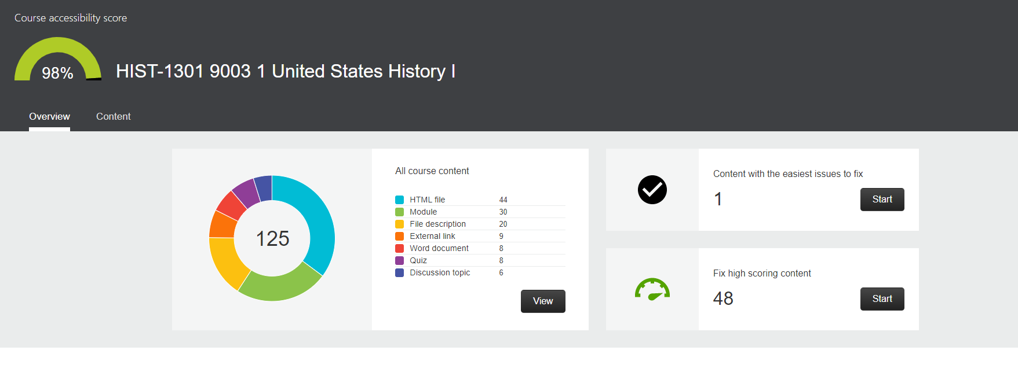
What Ally looks like in a course with corrections made

Slide 27
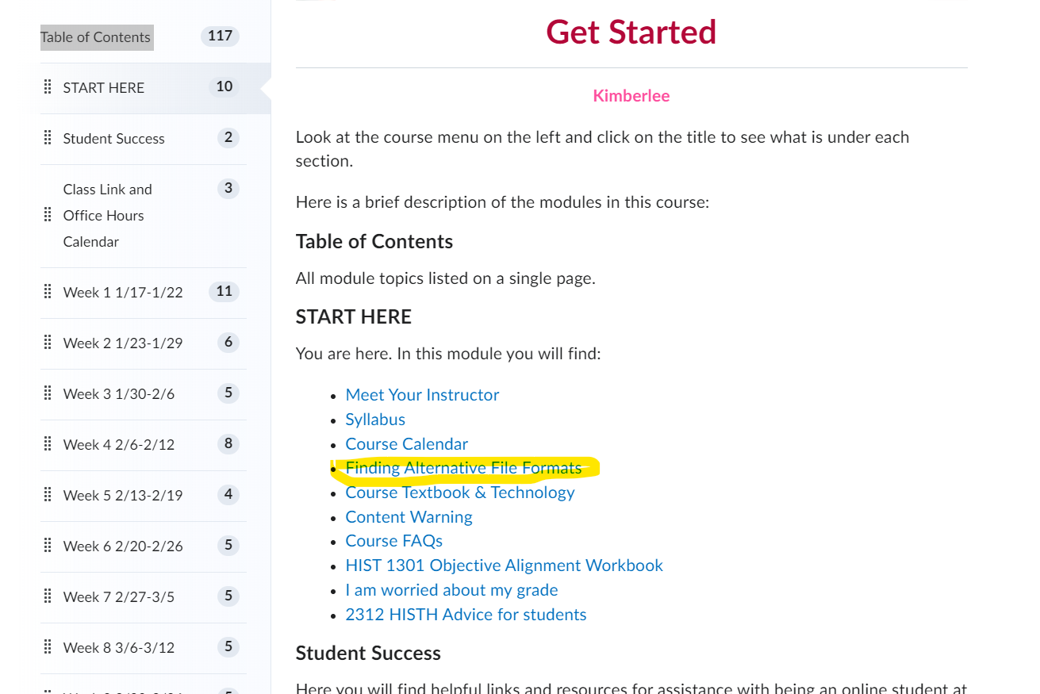
Sharing this Information with Students
Add to the Start Here Page
Create an announcement
Tell a student in an email
Talk about it in a video
Just let them know any way you can

Slide 28
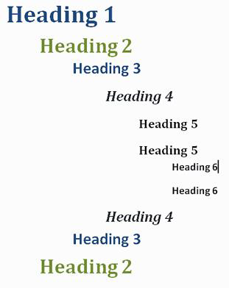
Working with Word Documents
Easy to read fonts
Headings
Alt Tags (Images, Graphs, Maps, Shapes)
Links with meaningful text
Table headings
Contrast
Equations (EquatIO)

Slide 29
Headings

Slide 30
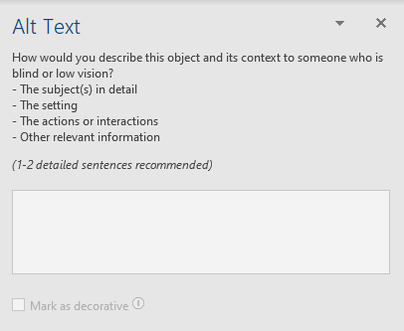
Alt Tags
Right click on the object and select Edit Alt Text.

Slide 31
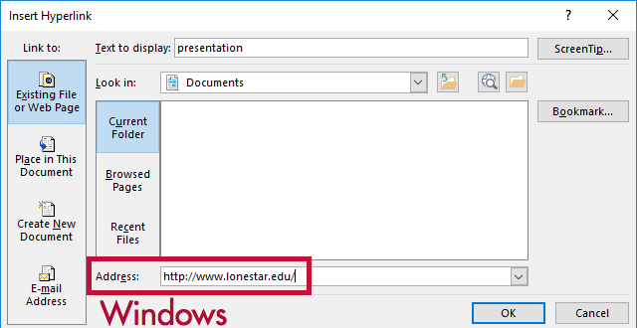
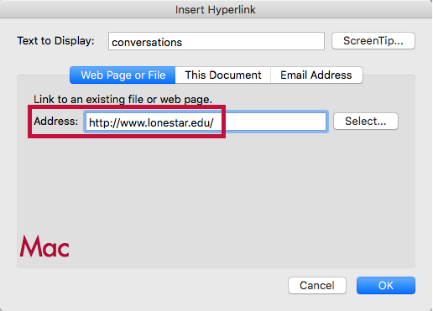
Links
Highlight and right click on the text and select Link
TIP: If you think students will be printing the document and you want them to have the URL, put it in parentheses after the link but don't hyperlink it.
Example: Lone Star College (www.lonestar.edu).

Slide 32
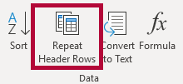
Table Headings
Click in the top row of your table then select Table Tools on the Ribbon.
Click Design Tab
Click Layout Tab
Windows
Mac

Slide 33
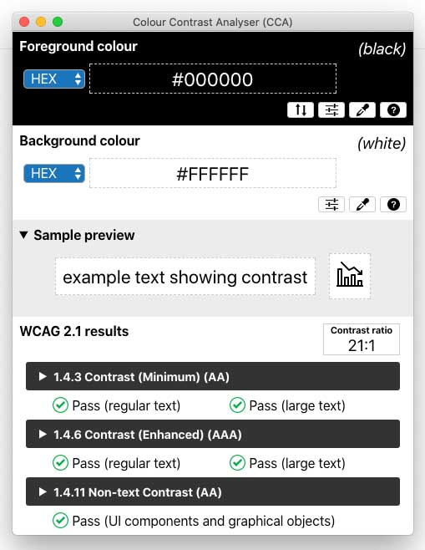
Contrast
Download the Colour Contrast Analyser

Slide 34
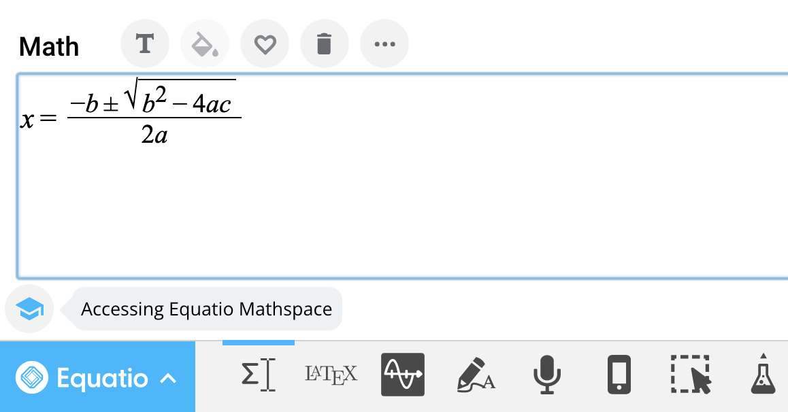
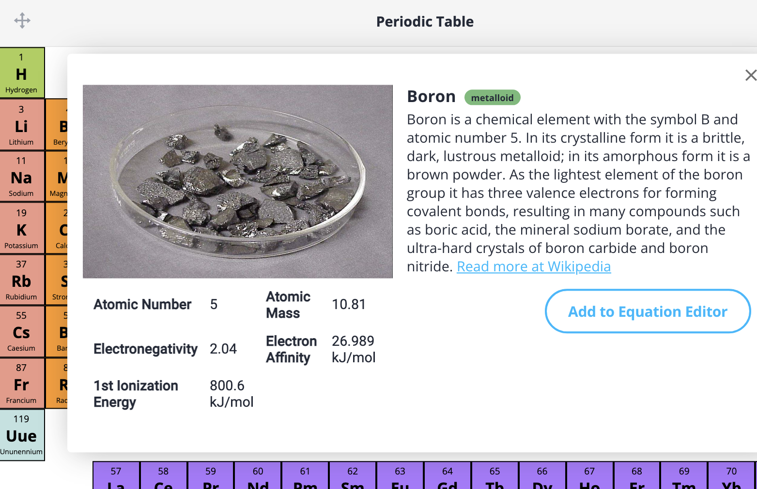
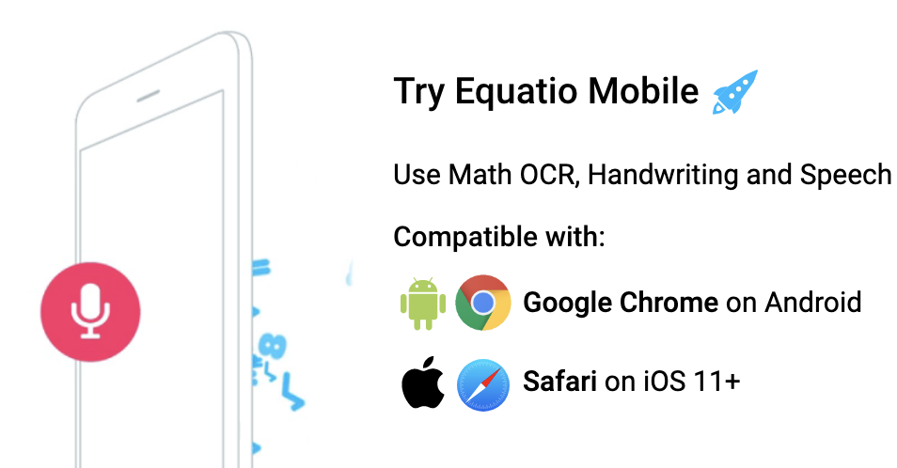
EquatIO

Slide 35
Helpful accessibility guides in VTAC
Create an Accessible PDF from a Microsoft Word Document
Make a Google Slides Presentation Accessible
Make a PDF Accessible
Make a PowerPoint Presentation Accessible
Make a Word Document Accessible
Make an Excel Spreadsheet Accessible
Make Complex Images Accessible
Make Google Docs Accessible
Make HTML Tables More Accessible
Make Math-Science Resources Accessible
Make Video Accessible
Make Web Content in D2L Accessible
EquatIO
Another great resource: The National Center on Disability and Access to Education Cheatsheets

Slide 36
Creating accessible digital environments is a journey
that starts with an awareness of the environment. Take
the first step on that journey, by exploring your course with Ally!

