Slide 1
February 23, 2023

Slide 2
Agenda
Introductions
Overview
Training
Communication Strategy
Questions and Answers

Slide 3
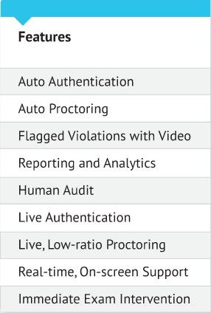
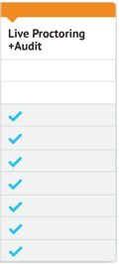
Live Proctoring
Automated

Slide 4
Our Process
Exam Setup
Test-taker
Post Exam
Create exam
Create profile & schedule
Audit
Select security level
Validate identity
Results
Tailor exam rules
Take proctored exam
Analytics

Slide 5
Demonstration

Slide 6
Guide to Prepare Exams
Prior to
Semester
At least 2 weeks
prior to exam
At least 1 week
prior to exam
• YOU select the Examity link within D2L to import your course
• WE import course and student info from D2L
• YOU announce Examity to students
• YOU tailor the exam in Examity
Securit level
Rules/special instructions
• YOU communicate exam to students
• YOU may work on your exam questions up until the day student's test
• WE proctor the test and provide you with proctor comments, videos
• YOU publish your test and create exam parameters
Exam name
Start/end dates and times
Duration
Password

Slide 7
Contact Information
Account Manager
Support
Brooke Poulin
Senior Client Success Manager
617.415.7214
bpoulin@examity.com
Day-to-day operations
Instructor training
Course and exam set up
Online Chat
855.EXAMITY
support@examity.com
Test-taker questions
Technical support

Slide 8
Question and Answer
Q
A
&

