Slide 1
LSC- Online: Campus Tours
Notes:
Seelpa

Slide 2
Objectives
D2L Resources and Supports
What's Needed?
Question / Answer
Notes:
Seelpa

Slide 3
Who We Are
The Foundations of LSC-Online
Founded in 2009
System Support Function
Online Technologies
-Support LMS
-Instructional Designers
-Instructional Technologists
Notes:
Seelpa

Slide 4
Support Services Available To All Faculty
VTAC & VLAC
Instructional Design Support
D2L Technical Support
Proctoring
Integrations & Instructional Software
D2L Updates and Enhancements
Quality Matters (APPQMR) Training
Online Conferences
Online Learning Alliance

Slide 5
VTAC – Virtual Teaching Assistant Center
VTAC (Virtual Teaching Assistance Center)
Resource created specifically for Lone Star College faculty
Supports all modalities of instruction
VTAC provides instructional guides and training to assist with the development and implementation of successful online courses
D2L
Instructional Software
Pedagogy & Best Practices
Access by visiting https://vtac.lonestar.edu/
Or from VTAC Support in D2L navbar

Slide 6
VLAC – Virtual Learning Assistant Center
VLAC (Virtual Learning Assistance Center)
Collection of resources for online students or students with online course components, including:
Guides for navigating & interacting in D2L
Links to college services such as Tutoring, Advising, Accessibility & Disabilities, Library, OTS, & more
Start & end of semester resources
Acts as “One Stop Shop” for LSC students
Access by visiting https://vlac.lonestar.edu/
Or from Support link in D2L navbar

Slide 7
D2L Technologist Support
D2L questions
Integrated and licensed instructional software
D2L forms
A variety of other specialized, third-party integrations
Learn more at: https://vtac.lonestar.edu/help/campus-reps
Notes:
Integrated and licensed instructional software
(Respondus, YuJa Media, SoftChalk, Publisher content)
D2L forms (Course Merge, Verify Roster, Extend Access)

Slide 8
Instructional Design Support
Online course development
Shareable/master courses
Pedagogical best practices
Student engagement
Assessments & rubrics
A variety of other specialized, instructional strategies
Learn more at https://vtac.lonestar.edu/help/meet-your-designers

Slide 9
Collaborative Support Model
VTAC
Designers
Technologists
YOU

Slide 10
Proctoring Services for the System
LockDown Browser
Respondus Monitor
Examity Live Proctoring

Slide 11
Proctoring
Respondus LockDown Browser + Monitor
LockDown Browser is custom browser that locks down the testing environment within a learning management system
Respondus Monitor is a fully-automated proctoring solution that utilizes LockDown Browser
Option for automated or “instructor live proctoring” using LDB and Monitor
Learn more at Respondus Monitor and LockDown Browser

Slide 12
Proctoring
Examity
Live proctoring for approved courses
Piloted in Spring of 2023
Assessment of tool will occur in Spring of 2024
Learn more at Examity Live Proctoring

Slide 13
D2L Integrations and Instructional Software

Slide 14
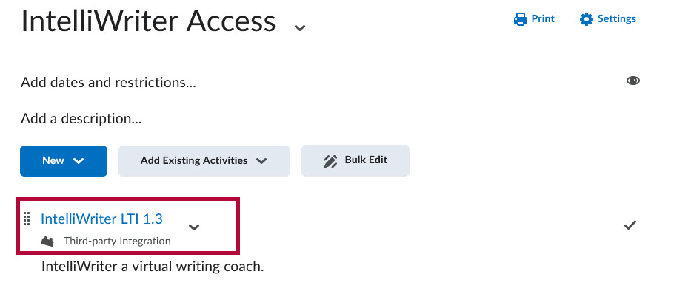
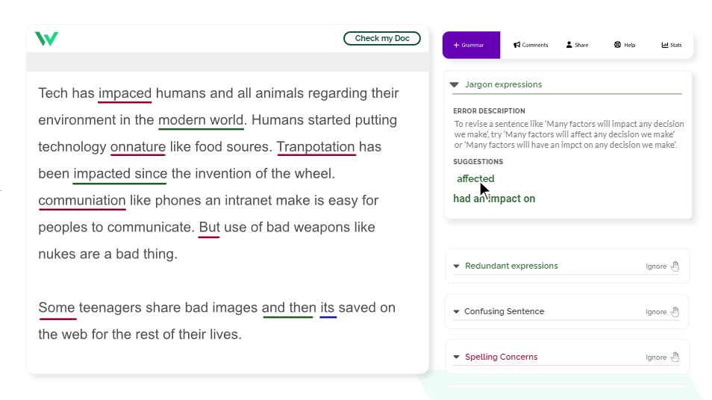
Intelliwriter
Replaces Grammarly
Serves as an on-demand virtual writing coach
Enhances writing efficiency by providing suggestions and contextual insights
Intelliwriter for Faculty

Slide 15
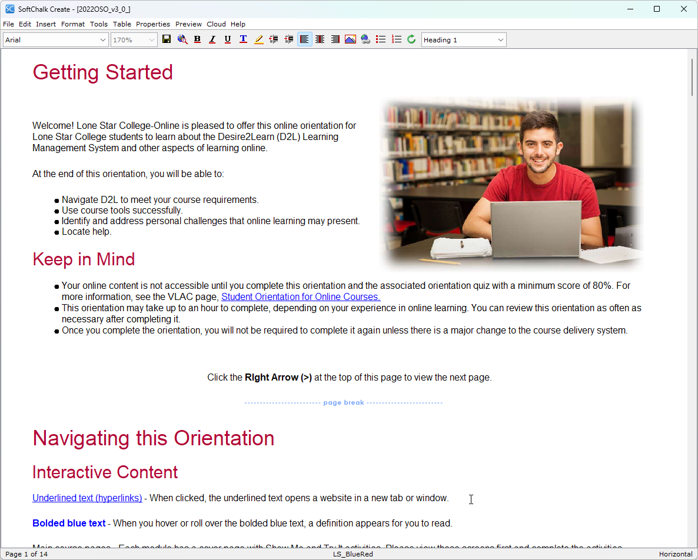
Softchalk
Upgraded to Enterprise license; available system-wide to all faculty
Content authoring program that allows faculty to create interactive lessons to embed in their courses
Softchalk Create

Slide 16
Coming Soon: Brightspace Creator+
Easily measure comprehension and keep learners engaged with a variety of practice exercises and question types
Insert interactive elements in courses
Create enhanced content within D2L
Launching after Spring Break

Slide 17
D2L Updates and Enhancements

Slide 18
Welcome Widget
What Does It Do?
Prompts a welcoming pop-up window to appear when anyone accesses your course.
How Does It Work?
Create a module with the word “Welcome” anywhere in its name. Any content topic(s) added to this module will be displayed in the welcome window.
Welcome Widget link

Slide 19
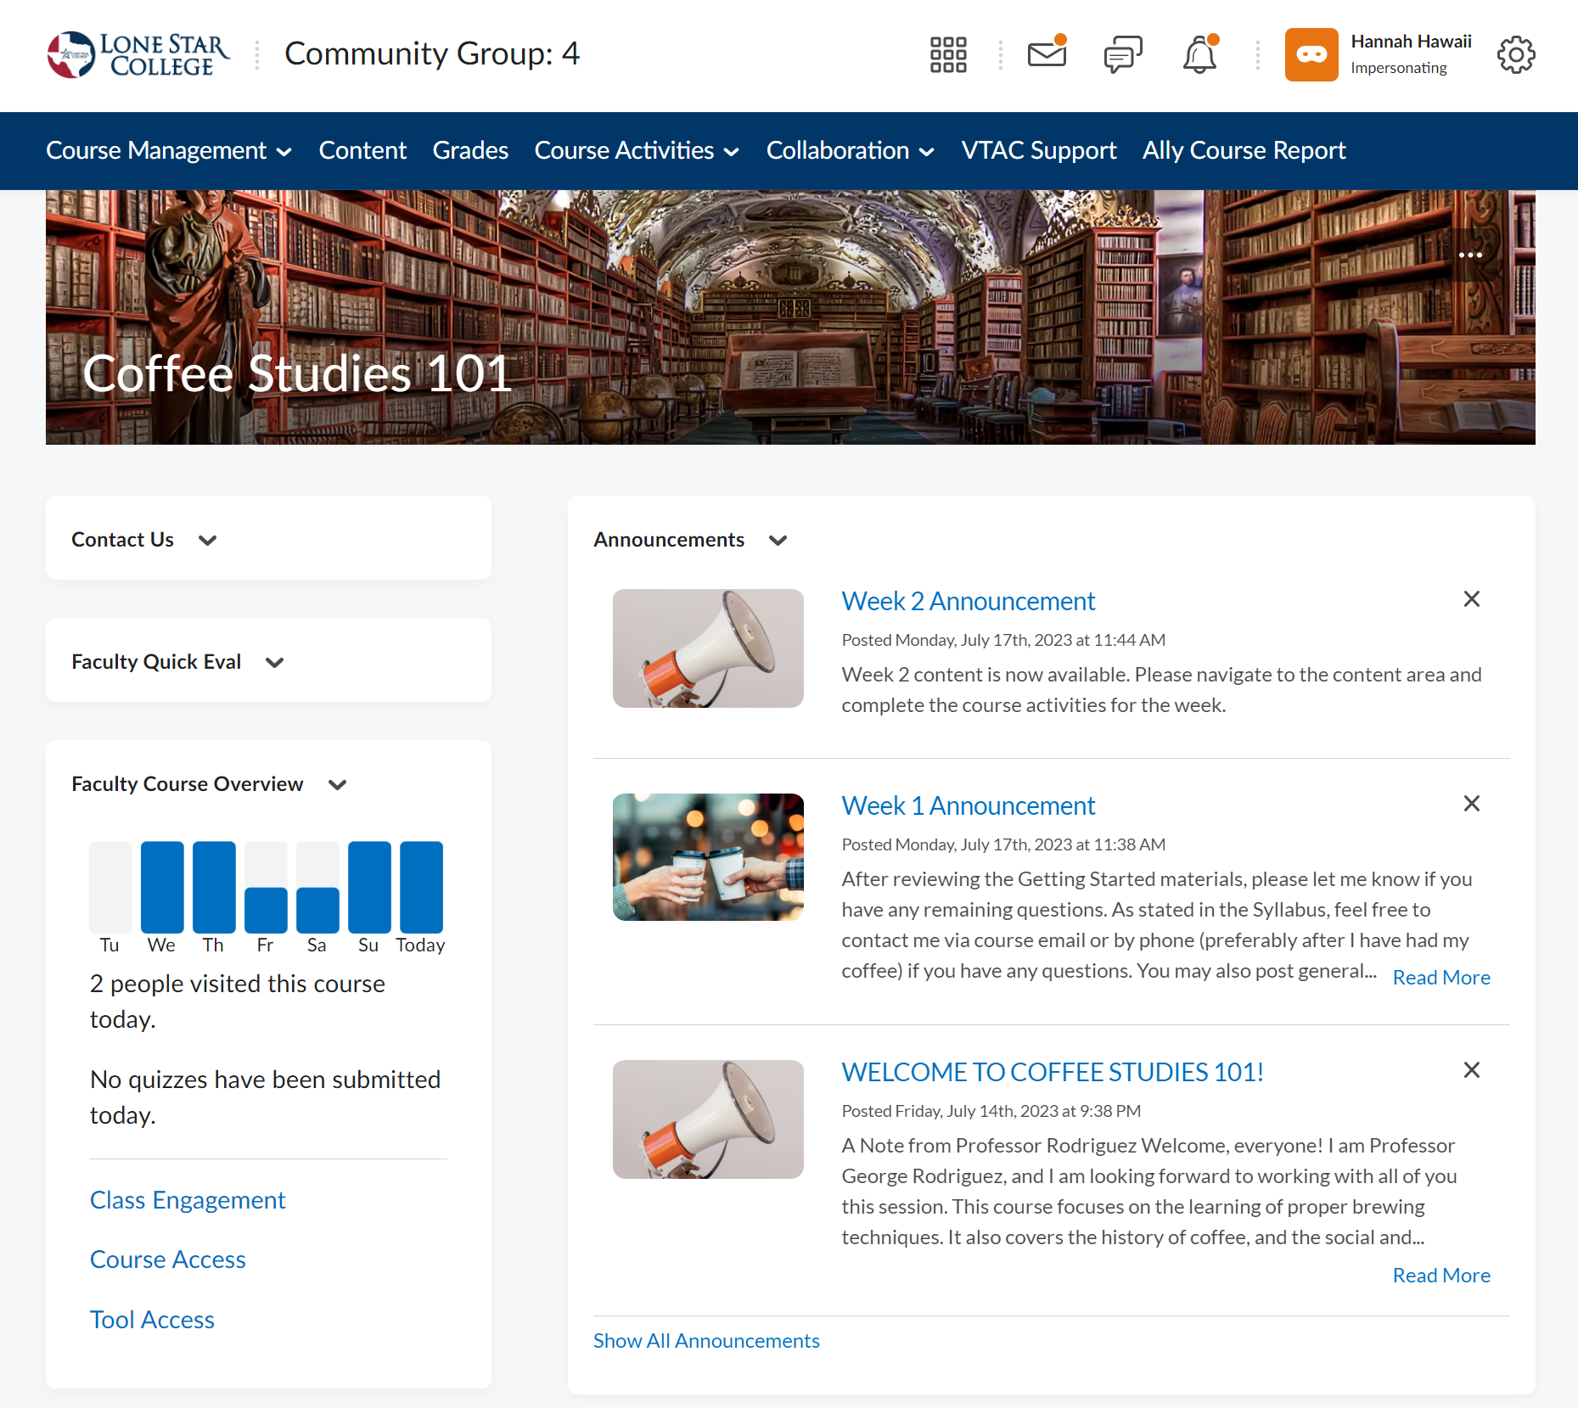
Faculty Course Overview
What Does It Do?
Reports analytic data about the course and students for the Instructor’s discretion.
How Does It Work?
Choose 1 of 3 areas to analyze from the widget.
Course Overview Widget Link

Slide 20
Visual Table of Contents
What Does It Do?
Creates a visual representation of your course’s content area.
How Does It Work?
Automatically creates a tile for each module in the Content area. Tiles will contain accompanying icon(s) & progress bars.
Visual Table Widget Link

Slide 21
Slim Announcements
What Does It Do?
Presents a simplified & unified view of all course announcements on the course homepage.
How Does It Work?
When announcements are created, they are truncated & previewed within the widget & must be clicked to open.
Slim Announcement Widget Link

Slide 22
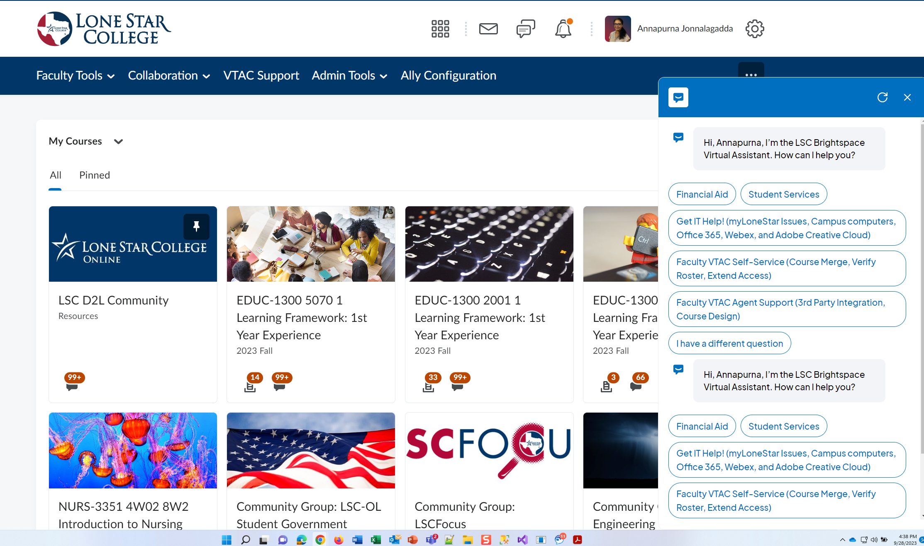
AI Chatbot in D2L

Slide 23
New Forms
Archive/Restore form empowers you to automatically archive or restore a course of your choice.
Add User form now allows you to search users by their email address. You do not have to know their email addresses.
Integration form – look and feel changes

Slide 24
Intelligent Agents
Tools that can communicate to students based on preselected behaviors, such as:
Not logging in for a certain amount of time
Scoring low on an assignment & providing tips to improve score next time
Congratulating a student for scoring well on an assignment
Sending periodic check-in emails to assess which students may need more support
IA are set up by the faculty and then deploy automatically. Each email is sent addressed personally to the student from the faculty.
IA can also be used in support of Early Alert communications.
Learn more at Intelligent Agents

Slide 25
Quality Matters

Slide 26
Quality Matters
Quality Matters is a global organization leading quality assurance in online and innovative digital teaching and learning environments
LSC-Online facilitates system wide APPQMR (Applying Quality Matters Rubric) workshops
QM Rubric –Course Designers use the Rubric to aid in the creation of courses designed to meet QM Standards from outset
QM Professional Development & Resources – QM offers FREE webinars, reduced cost for workshops, & other resources to aid in the development and teaching of online courses
Learn more, including how to sign up for training, at https://vtac.lonestar.edu/help/quality-matters

Slide 27
Online Conferences

Slide 28
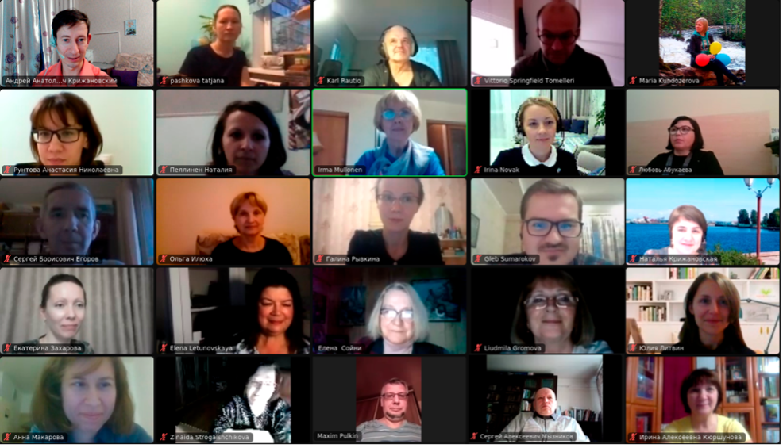
Online Conferences
PAST:
Artificial Intelligence Virtual Conference – May 5th, 2023 – System Wide Audience
Recording of all sessions can be found at https://vtac.lonestar.edu/help/ai-conference
This Photo by Unknown Author is licensed under CC BY-SA-NC

Slide 29
Online Conferences
UPCOMING: Online Teaching and Learning Summit - Nationwide Audience

Slide 30
Online Learning Alliance (OLA)

Slide 31
OLA- Online Learning Alliance
Purpose:
The Online Learning Alliance (OLA) is dedicated to driving the continuous improvement and technological boundaries of online education. Through a shared commitment to empowering educators and learners alike, OLA strives to create an accessible, engaging, and tailored online learning experience. Together, OLA aims to shape a bright future where every LSC student thrives and reaches their full potential in the digital age.
Goals:
Membership can be found here.
(A) Redevelopment of a Relevant & Meaningful Online Teaching Certification | (B) Identify & Implement Methods to Support Student Skill Building | (C) Explore & Facilitate Professional Development Opportunities Related to Online Pedagogy | (D) Examine DOE Expectations Regarding Reasonable & Substantive Interaction & Operationalize this for LSCS and Course Standards

Slide 32
How To Access LSC Online Support

Slide 33
LSC-Online Support
Faculty can access support from within D2L
Faculty can also access support at https://vtac.lonestar.edu/help/vtac-support
Support for faculty can also be accessed by visiting the LSC-Online webpage located at https://www.lonestar.edu/lsc-online/

Slide 34
Please Share Your Feedback
https://www.surveymonkey.com/r/PZJ2FFN

Slide 35
Thank You

