Slide 1
Recognition
August 2015

Slide 2
Research

Slide 3
There is EXHAUSTIVE Research on this Topic
Key Message: Don’t be fooled by short term impacts of tangible rewards, they’ll fail in the long run
“In the real world, even if not in the laboratory, rewards must be judged on whether they lead to lasting change – change that persists when there are no longer any goodies to be gained. This is the key question to pose to a manager who claims that performance in her division jumped after an incentive plan was introduced, or to a teacher who brags that his students read more books when they are given treats for doing so. We want to know what happens to productivity, or to the desire to read, once the goodies have run out.”

Slide 4
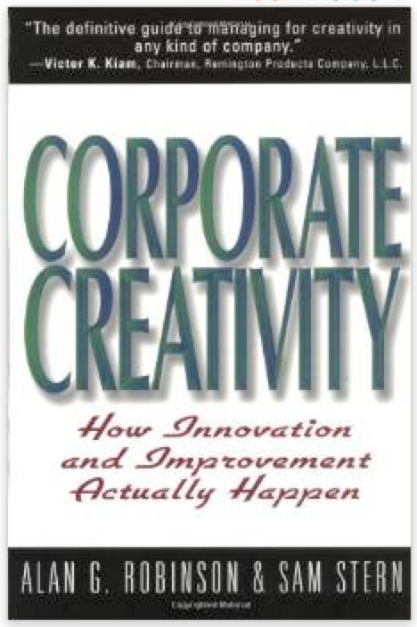
….More Research
Key Message: Intrinsic motivation beats extrinsic every time creativity is involved
“Ironically, the very success of IdeAAs in Action makes it harder for American to move to a higher level of creative performance. The question that American has to face, as will other companies that presently use rewards to try to motivate creativity, is how to wean employees off these rewards and strengthen their intrinsic motivation. The greater the company’s dependence on financial rewards, the deeper the hole that has been dug.”

Slide 5
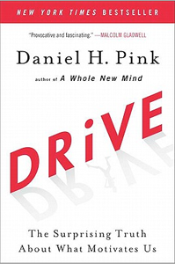
…More Research
“…instead of restraining negative behavior, rewards and punishments can often set it loose – and give rise to cheating, addiction and dangerously myopic thinking…. many practices whose effectiveness we take for granted produce counterintuitive results: They give us less of what we want and more of what we don’t want.”
Key Message: Design in Autonomy, Mastery & Purpose

Slide 6
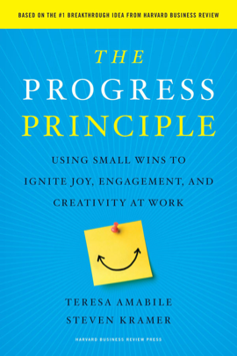
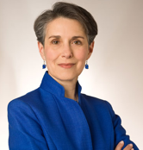
…Last One
“…making progress (being productive and creative) leads to positive inner work life. This creates the progress loop, the self-reinforcing process in which progress and inner work life fuel each other.”
“Across all study participants, there was a 50 percent increase in the odds of having a creative idea on day when people reported positive moods, compared with days when they reported negative moods.”
Key Message: Helping people make progress at work lifts their moods at work. A happier person has more creativity to offer.

Slide 7
Bottom Line to Great Design…
Do your homework
Throw out any preconceived notions
Carrot / Stick
Money Motivates Everyone
I design one static system that lasts “forever”
Educate people along the way
Design approach

Slide 8
Lessons Learned - Raffles
Raffles generally produce low quality results
People submit poor quality, or duplicate content to boost chances of winning.
The best people want to be rewarded for quality and thoughtfulness, not for just a chance of winning.
You have to announce the raffle winner, which may be for a poor quality idea or comment.

Slide 9
Lessons Learned – Leader Boards
Similar to raffles, this practice drives quantity
Your top few individuals often get a bad rap – they must be cheating
The only way for me to “win” is to game the system
As an alternative, post data for departments, business units, locations, etc. to encourage positive competition

Slide 10
Lessons Learned – What Works
Provide immediate feedback
Use the idea confirmation & contributor communication to provide quick positive reinforcement
Recognize Behaviors that Deliver Quality
Spotlight ideas that are thought provoking
Highlight desired behaviors - creative problem solving, collaboration & driving business value
Demonstrate Commitment
Show progress
Tell stories
Be visible
Create a program that is perceived as fair
Allows everyone an opportunity to “win”
Allows you to reward equally for desired behaviors rather than the value of the idea
Allows you to reward before the value of the idea is even contemplated

Slide 11
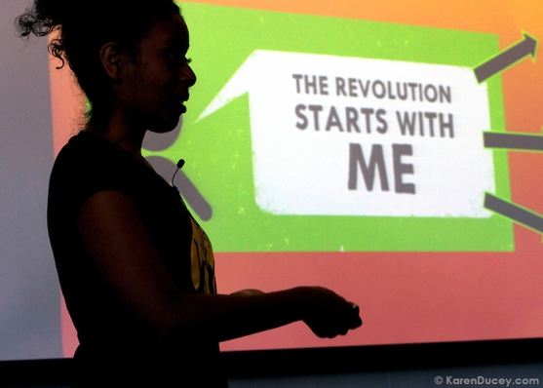
Define Key Behaviors
Notes:
Why did you run multi-line?

Slide 12
Program Journey
Where are you in the overall journey?
Brand new, need to increase awareness & demonstrate the desired behaviors
Have some experience, some strong implementations, so we have great stories to share and heroes to celebrate
Lots of experience and we are moving towards recognizing breakthroughs & big impacts

Slide 13
Put the Objectives on Paper
Action | Priority | Business Value (Objective) | Recognition
Collaboration Across “Silos” |  | Richer Ideas, Better Solutions
Visit Innovation Central Site |  | If I’m there, I may collaborate Good first step in marketing program Long Tail Research
Submit Ideas |  | Solves the problem or gives new perspective
Idea Chosen for Implementation |  | High quality idea
Read and Collaborate on Ideas |  | Richer ideas, better implementation plans, fewer “gotchas” from multiple perspectives
Star Rate, Bubble Up |  | Prioritize, offer opinion, support decision & action

Slide 14
Put Objectives on Paper
Action | Priority | Business Value (Objective) | Recognition
Send A Link |  | Inviting others to participate Greater diversity of perspectives SME knowledge
Review and/or Conclude Ideas |  | Make decisions Make progress
Implement Ideas |  | Achieve targeted value Do the “heavy lifting”

Slide 15
Thank you.

