Slide 1
WISDM – Shared Financial System (SFS)

Slide 2
How to log-in to WISDM:
Option 1:
Search “WISDM” (no “O”) on UWEC website – Knowledge Base article will appear in search results on the left side University Accounting: WISDM Information
Click on WISDM Log-in to log in
WISDM FAQs
Option 2:
Click Faculty + Staff (blue ribbon on left side of screen)
ASK Center (Link on right side of screen)
University Accounting (Link on right side of screen)
WISDM Information (Link on left side of sharepoint site)
This will link you to UW System website with:
WISDM Web Application Log in (helps to make a favorite if you haven’t already)
Training & Support
WISDM FAQ’s
Option 3:
A-Z Menu
University Accounting (old website – will eventually be removed)
WISDM Information (upper right menu)
WISDM Web Application link

Slide 3
WISDM Log-In Screen
Click on WISDM Production link

Slide 4
Helpful Searches/Reports
Budget Control Report (Main Menu/Tools/Budget Control Report)
Allows you to see a snapshot of each deptID within a Department by Fund
Assists with planning to use all resources within a department
Department Roll-up (Main Menu/Departments/Rollup)
Allows you to select multiple deptIDs (all Fund 136 accounts within your department and see the totals by revenue/expense category in aggregate or individual)
Note: deptID is a 6-digit code – first two are your division, second 2 are department (114401 = 11 – COEHS, 44 – Kinesiology)
Department Search (Main Menu/Departments/Search)
Allows you to search for an deptID if you cannot remember the number
Payroll (Main Menu/Payroll/Salary/Fringe Search)
Allows you to search all the funding strings that are used to pay an employee
AP/PO (Main Menu/AP/PO)
Allows you to search for expenses by searching by PO or vendor
WISER Departments – multi-year reviews (evolving) (Main Menu/WISER Departments)

Slide 5
GPR Fund characteristics
Fund 102 (402) -GPR & Fund 145–Federal Student Work-study
No revenue is loaded to these accounts
Budget plan is your allocation
Unused balances do not carry-over at end of year
Use budget balance to see how you are doing (budget vs actual)

Slide 6
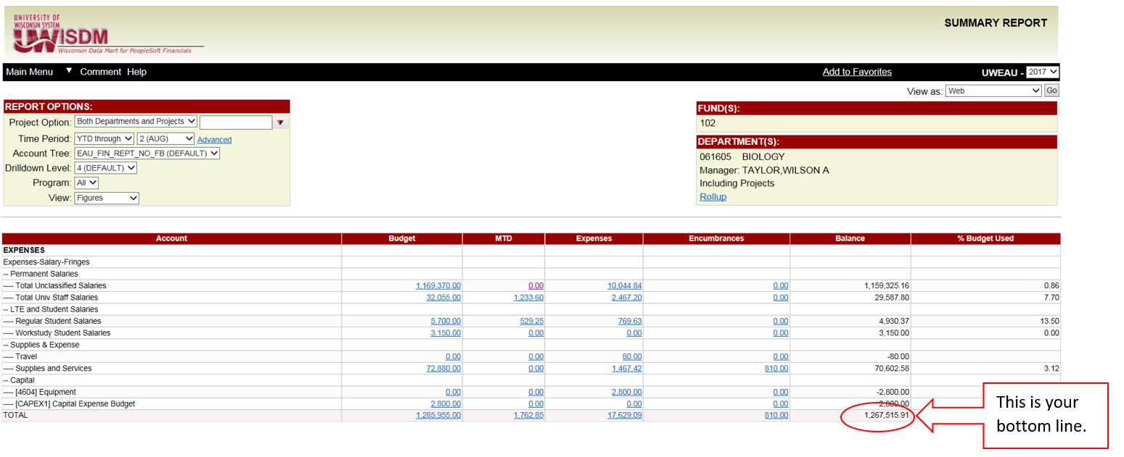
GPR DEPTIDS (Funds 102, 402)
No revenue, therefore the Budget is your allocation (cash).
The balance column identifies remaining resources.

Slide 7
Program Revenue Fund characteristics
Funds 128, 136, 150 (Program Revenue)
Revenue accounts
Budget plan is a spending plan, but must have incoming revenues or balance cover your spending plan – no budget transfers on these accounts
Unused balances carry-over at end of year
Use cash balance to see how you are doing (use of revenues and balances)
Fund 131 (Program Revenue)
Blugold Commitment Differential Tuition (BCDT) - Spend plan and revenue are equal and unused balances to not carry-over at end of year (budget transfers use BCDT eForm)
WIN/SUM Instruction – used for revenue and expenses for current WIN/SUM sessions – profit will transfer to WIN/SUM Revenue when session closes (no budget/spend plan in WISDM, therefore no budget transfers)
WIN/SUM Revenue – profit from previous WIN/SUM sessions to be used at departments discretion – unused balances carry-over at end of year (no budget transfers)
Funds 133, 233 Gift and Grant Accounts – rules vary by gift/grant - contact Paul Berkesch in University Accounting

Slide 8
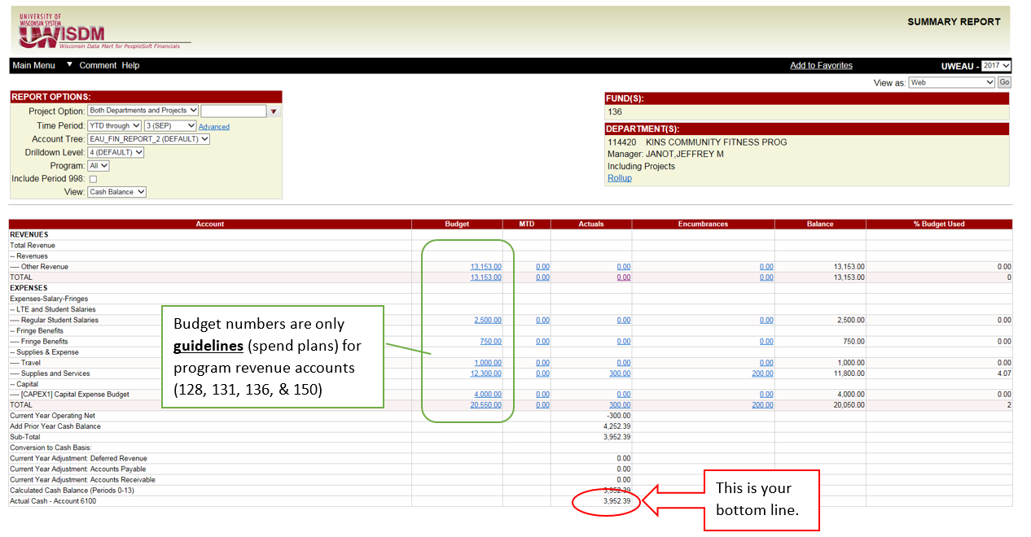
PROGRAM REVENUE DEPTIDS (Funds 128, 131, 136, 150)
Use Actual Revenue Total compared to Actual Expense Total to see your DeptIDs bottom line.
The balance column will only compare how close your projections came to the actuals (for both revenue and expense). The balance column will NOT identify remaining resources.

Slide 9
Data Details and Manipulation
Drill into the details to gather more information (deptID/revenue/expense)
Click on headers to sort the information by:
Acct Descr (type of revenue/expense)
Amount
Jrnl Date
Export to excel to further manipulate the data and save/share with others by changing the “View as: WEB” to “View as: EXCEL”
There are a few pop-ups that you will need to click to open, but should be quick
If you have excel open, you may notice the excel icon flashing because there is a pop-up within excel you need to accept before it will open
In the details, you can also “Pick Custom Columns...”
Click on the link and add the columns that are most useful for your analysis
This can be changed at any time to meet your research needs
To change the order they are displayed, click the arrows below the header

Slide 10
Favorites
Searches you do frequently can be saved to use again by simply clicking the Add to Favorites link
Caution: if you are selecting individual accounts and a new account is added after you set up your favorite, your search will not include the new account
Favorites can be individual deptIDs or a roll-up of several accounts
Favorites can be shared with others on campus
Example: If an ADA has set up favorites for a particular department, the ADA can share the favorites with the chair
My Favorites – select the favorites you want to share
Click on Share button
Enter user ID and select individual
Submit

Slide 11
Contact Information
Don’t hesitate to contact me with questions.
Alison Millis
millisaj@uwec.edu
715-836-3035

