Slide 1
About the HBA
Insert presenter name(s) here

Slide 2
Contents
Overview
Membership
Programming
Flagship Events
Corporate Partner Program
Gender Parity Collaborative
Contact Information

Slide 3
Overview

Slide 4
A United Force for Change
https://www.youtube.com/watch?v=cSoxR1MJVLU

Slide 5
A United Force for Change
When members of the HBA come together, it’s with a shared purpose: to be a united force for change. We connect diverse groups of both women and men, across all healthcare and life science disciplines.
By taking focused action to advance our mission, we are creating a powerful movement that directly drives professional opportunity and corporate growth.
We believe that by joining forces in the relentless pursuit of gender parity, we are doing more than uniting individuals—we are strengthening the business of healthcare.

Slide 6
Core Purpose and Mission
Core Purpose:
To further the advancement and impact of women in the business of healthcare
Mission:
The Healthcare Businesswomen’s Association is a global nonprofit organization comprised of individuals and organizations from across the healthcare industry committed to:
Achieving gender parity in leadership positions
Facilitating career and business connections
Providing effective practices that enable organizations to realize the full potential of their female talent
The HBA accomplishes its mission through strong business networks, education, research, advocacy and recognition for individuals and companies.

Slide 7
A United Force for Change
Key Audiences
Business Professionals:
We connect you with other passionate healthcare and life science professionals with a shared commitment to gender parity. By fostering a supportive and diverse environment, we give you the freedom to explore new skills, advance your career and be a catalyst for change.
Corporate Partners:
Uniting around the changing face of healthcare is the key to a competitive edge. And it’s the smart business leader who anticipates that new direction. Through the HBA, you will connect with the diverse industry voices who will be the architects of this shift – supporting your long-term growth and bolstering your success.

Slide 8
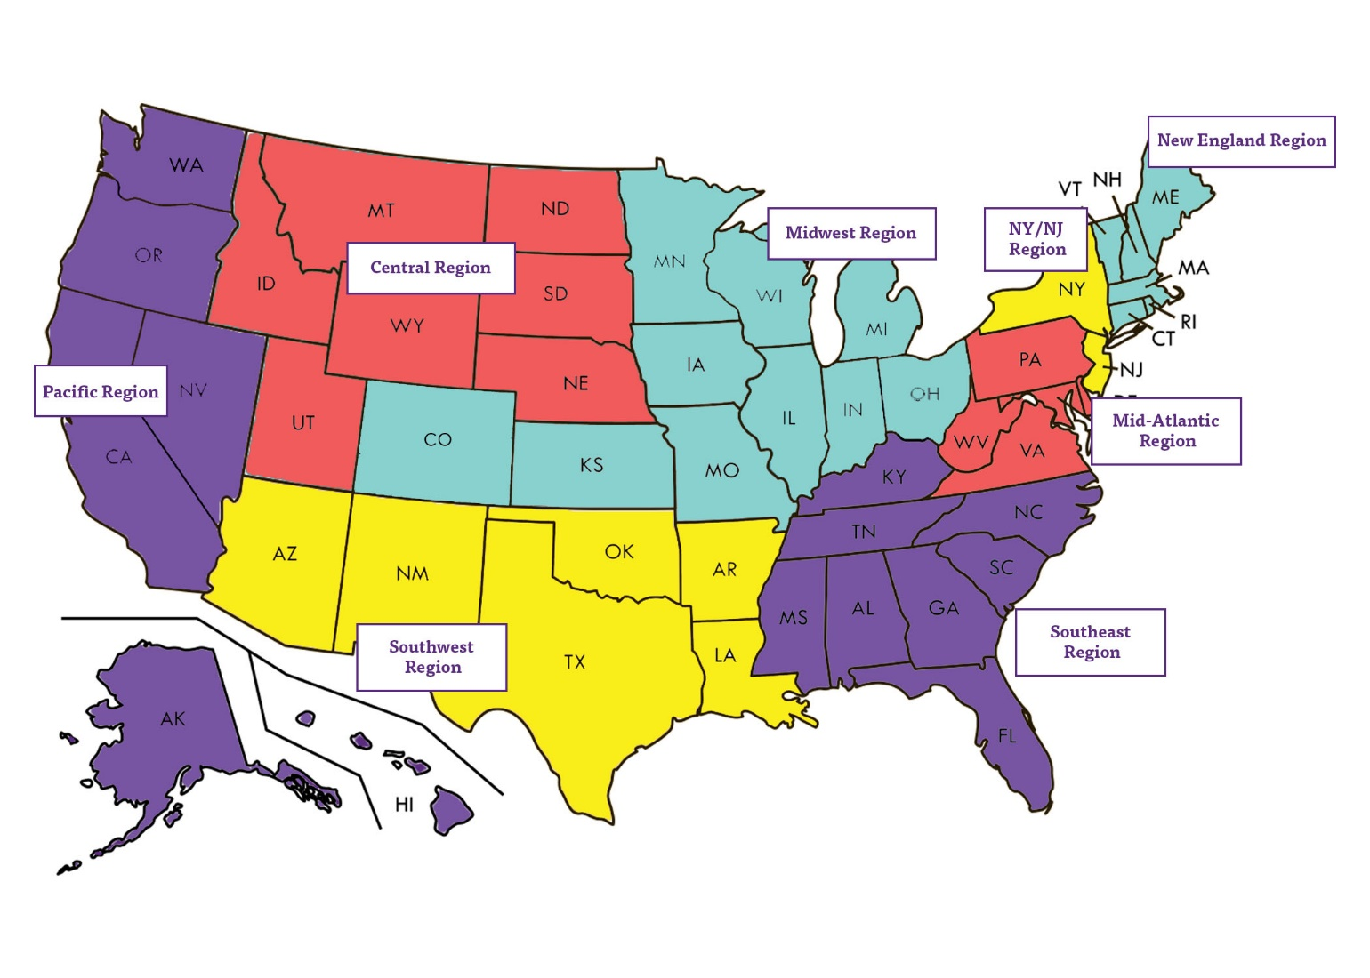
HBA Reach Growing Globally – United States
HBA Midwest region
Cincinnati Denver Columbus Kansas City
HBA New England region
Boston
Fairfield County (CT)
Marlborough
Waltham
St. Louis Indianapolis Minneapolis – St. Paul Northern Chicago
HBA Central region
Currently in development
HBA NY/NJ region
Central New Jersey
New York
Northern New Jersey
HBA Pacific region
Los Angeles Orange County San Diego San Francisco Bay Area Seattle
HBA Mid-Atlantic region
Baltimore
Greater Washington
Mainline Montco (PA)
Montgomery Corridor (MD)
Philadelphia
Pittsburgh
Richmond
West Chester
HBA Southeast region
Atlanta Miami
Palm Beach
Research Triangle Park Tampa
HBA Southwest region
Austin Dallas – Fort Worth
Houston
Phoenix
As of January 2019

Slide 9
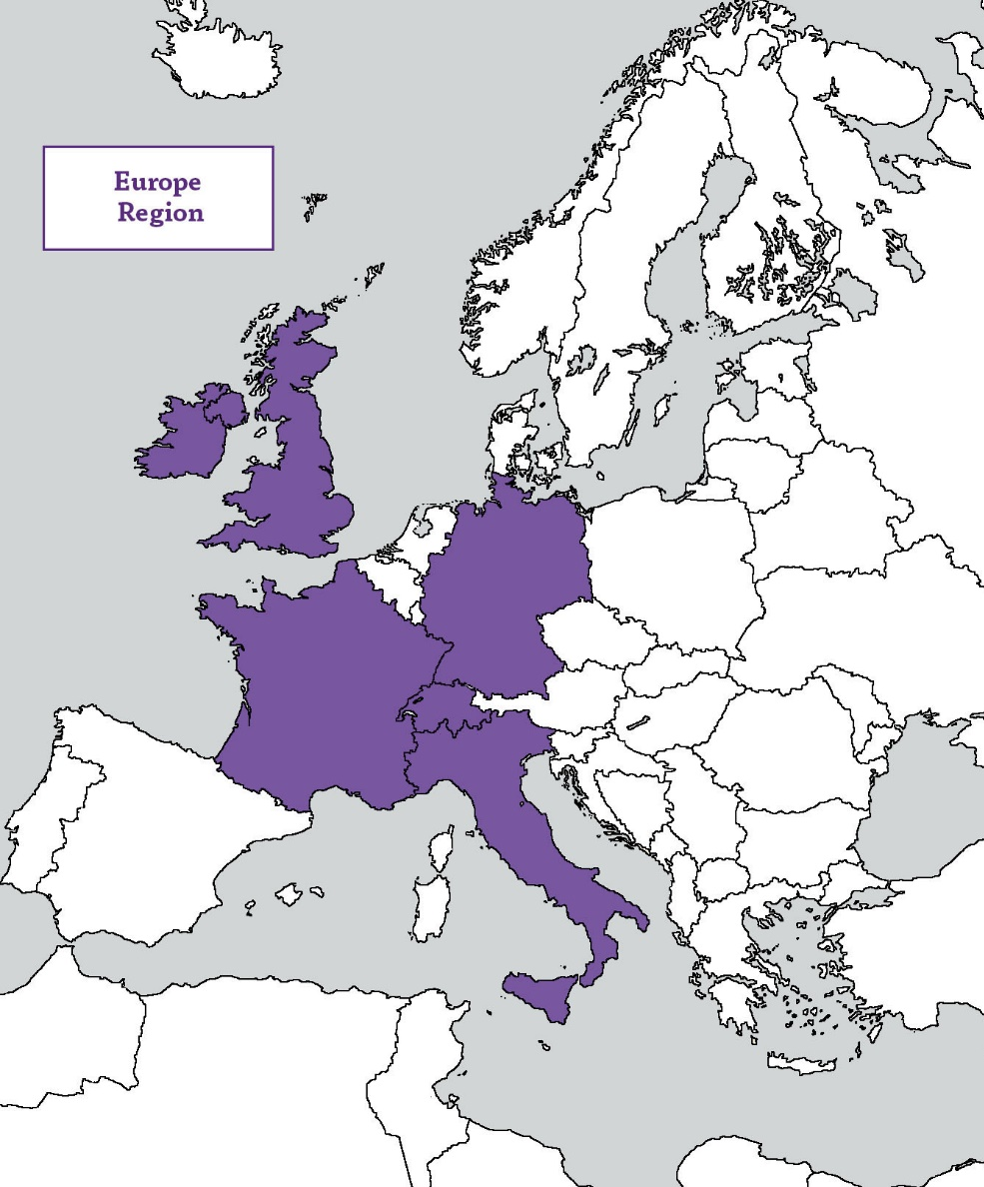
HBA Reach Growing Globally – Europe
HBA Europe region
Basel
Berlin
Brussels
Dublin
Frankfurt
London
Lyon
Milan
Paris
Suisse Romande
Zurich
As of January 2019

Slide 10
Membership

Slide 11
Value of HBA Membership
Make 2019 the year to impact your career
Up to 50 percent discount to more than 500 events across the globe
Invitation to exclusive member-only events such as the HBA Annual Conference and local networking opportunities
Access to exclusive online member directory, forums and resource libraries
Opportunity to join affinity groups based on your interests
Access to the online Career Center
Learn skills to grow your career through four on-demand webinars full of professional development insights
Join member-only formal mentoring programs to enhance your professional success
Leadership opportunities to broaden your professional experience and gain industry visibility
Receive recognition of leadership contributions through volunteer awards

Slide 12
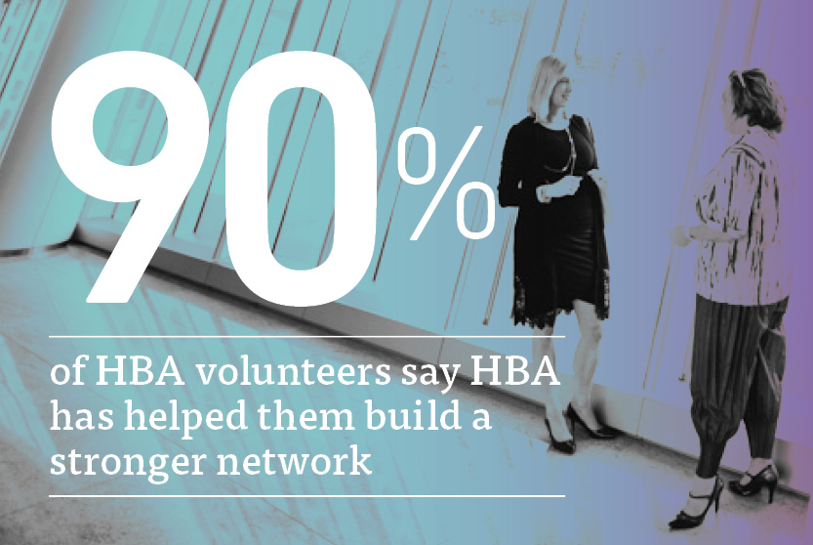
Membership
Connect with nearly 10,000 other passionate healthcare and life science professionals, representing more than 1,000 companies.

Slide 13
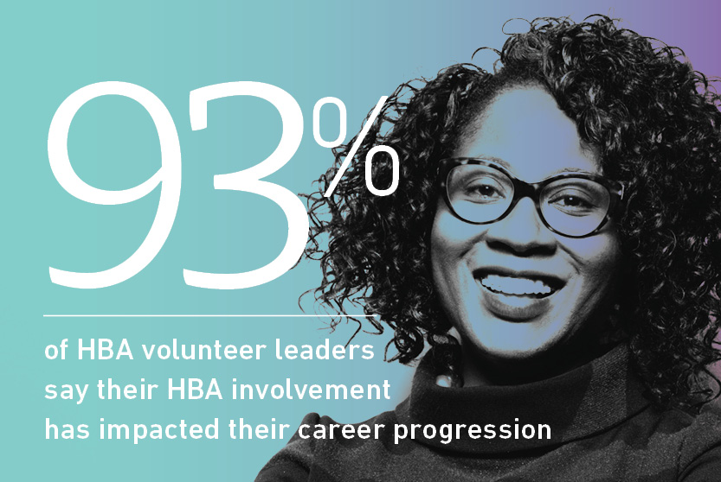
Membership
Explore new skills, share your expertise, advance your career and be a catalyst for change.

Slide 14
Advance Your Career Through Leadership Opportunities
The HBA offers hundreds of engagement opportunities to make a difference
Build your leadership experience
Increase your visibility and professional connections
Advance your career

Slide 15
Hear What HBA Members Say About Professional Enrichment
https://youtu.be/mvi8S16UfHk

Slide 16
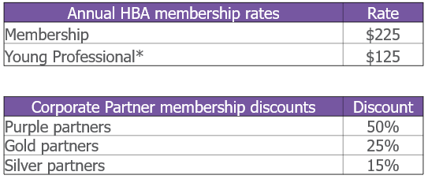
Individual Membership Fees
*This membership rate for those 30 and under includes all benefits of full membership except voting in the annual business meeting and the ability to serve on boards

Slide 17
Programming

Slide 18
Leadership Competency Framework
HBA programs are mapped to these competencies to assist with professional development planning.
Enlighten
1. Demonstrates integrity
2. Communicates effectively
3. Exhibits business and industry acumen
Empower
4. Displays professional presence
5. Determined to achieve
6. Makes decisions and takes risks
Engage
7. Influences and persuades
8. Builds relationships and teams
9. Networks and ethically self-promotes
Evolve
10. Facilitates change
11. Fosters innovation
12. Continues to learn, grow and transform

Slide 19
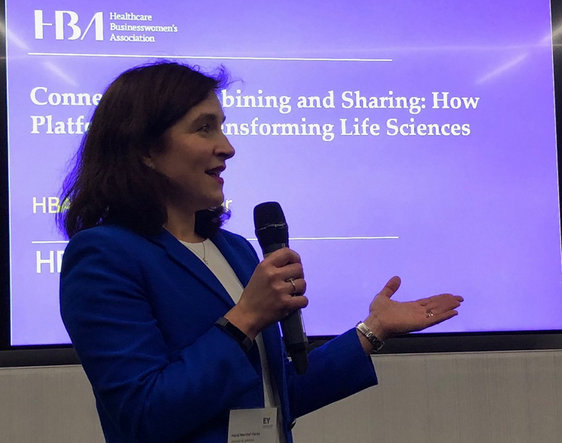
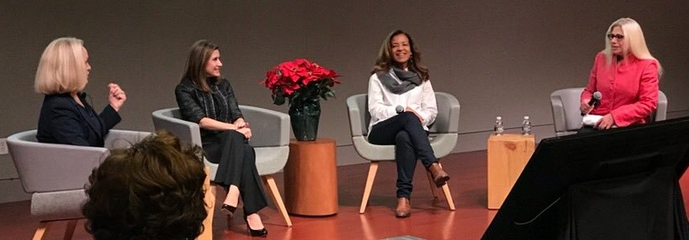
In-Person and Virtual Events
HBA members receive up to 50 percent discounts to:
500+ in-person chapter and regional events annually throughout the U.S. and Europe
Virtual programs, such as the quarterly Career Conversations webinar series, as well as free access to selected webinar offerings (e.g., International Women’s Day webinar) throughout the year
Flagship events (Woman of the Year and Annual Conference)

Slide 20
Career Conversations
Webinar Series Now In Its Seventh Year
HBA’s career advancement and professional development webinar series continues in 2019 with four more programs, which may be purchased individually or as a series.
Invest in yourself and your career and gain information and insights that you can put to immediate use for yourself and your organization.
2019 Career Conversations topics include:
Courage
Charisma
Conviction
Cultural Sensitivity

Slide 21
Mentoring Programs
An effective mentoring relationship provides growth opportunities for mentors as well as mentees, with the added bonus of developing/deepening skills for career success and company performance.
Opportunity to set and achieve measurable goals – and develop meaningful relationships – over six or more months
A members-only program with direct alignment to HBA’s core purpose: to further the advancement and impact of women in the business of healthcare.
2019 Regional Mentoring Programs:
Europe, Mid-Atlantic, Midwest, New England, NY/NJ, Pacific, Southeast, Virtual

Slide 22
Affinity Groups and Associated Programming
Boost your career by participating in one or more of HBA’s affinity groups
Get involved
Network with like-minded members and leaders
Build community
Build a targeted professional network
Stay connected
Gain access to key individuals and content for a select slice of the industry
2019 Active Affinity Groups
Entrepreneurs, Fit to Lead, HBA iLead, Tomorrow’s Executives, Women in Science, Women in Transition

Slide 23
Ambassador Program
HBA solution for our corporate partners to accelerate the development, advancement and visibility of their female talent pool
Currently available to HBA’s purple and gold corporate partners
HBA trained advisor assists companies to build “HBA Inside”
Customized to corporate goals, self-directed
Develop motivated and engaged HBA community inside company
Accelerates the development and visibility of talent within your company and fuels the career advancement of participants
Individual success metrics created and tracked
Connect company colleagues globally with multiple Ambassador programs

Slide 24
Flagship Events

Slide 25
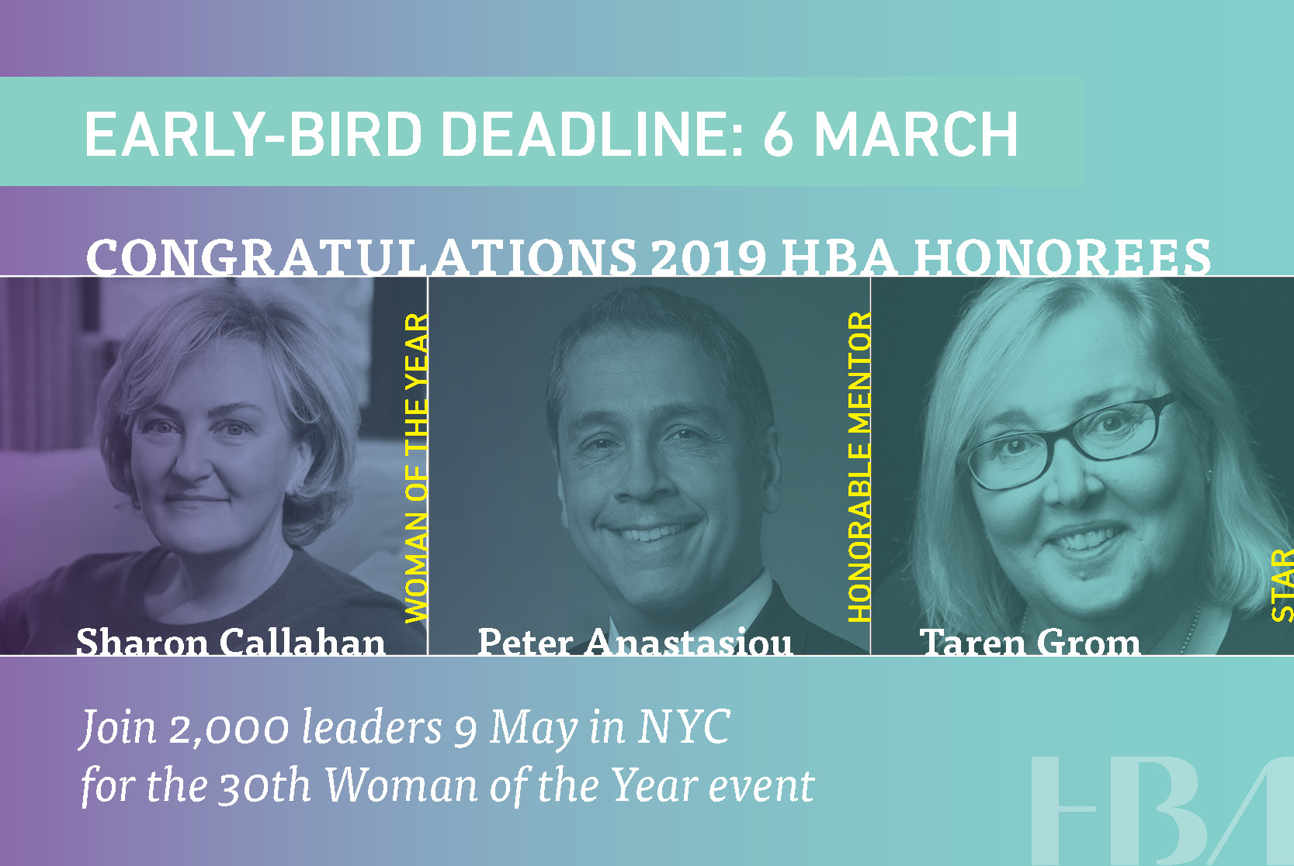
HBA’s 30th Annual Woman of the Year Event
9 May – New York City
“If it’s springtime in New York, it’s Woman of the Year time,”- Alex Gorsky, CEO, Johnson & Johnson.
Celebrate excellence in leadership with 2,000 healthcare and life science industry leaders at the HBA’s exciting and spirited Woman of the Year event where we will recognize our 2019 honorees:
HBA Woman of the Year (WOTY) Sharon Callahan, CEO, TBWA\WorldHealth, and chief client officer, Omnicom Health Group
Honorable Mentor Peter Anastasiou, executive vice president, head of Lundbeck North America
STAR Taren Grom, co-founder and editor-in-chief, PharmaVOICE, volunteer will be recognized.
Also lauded will be over 100 industry Rising Stars and Luminaries.
This intimate and engaging experience is not to be missed.

Slide 26
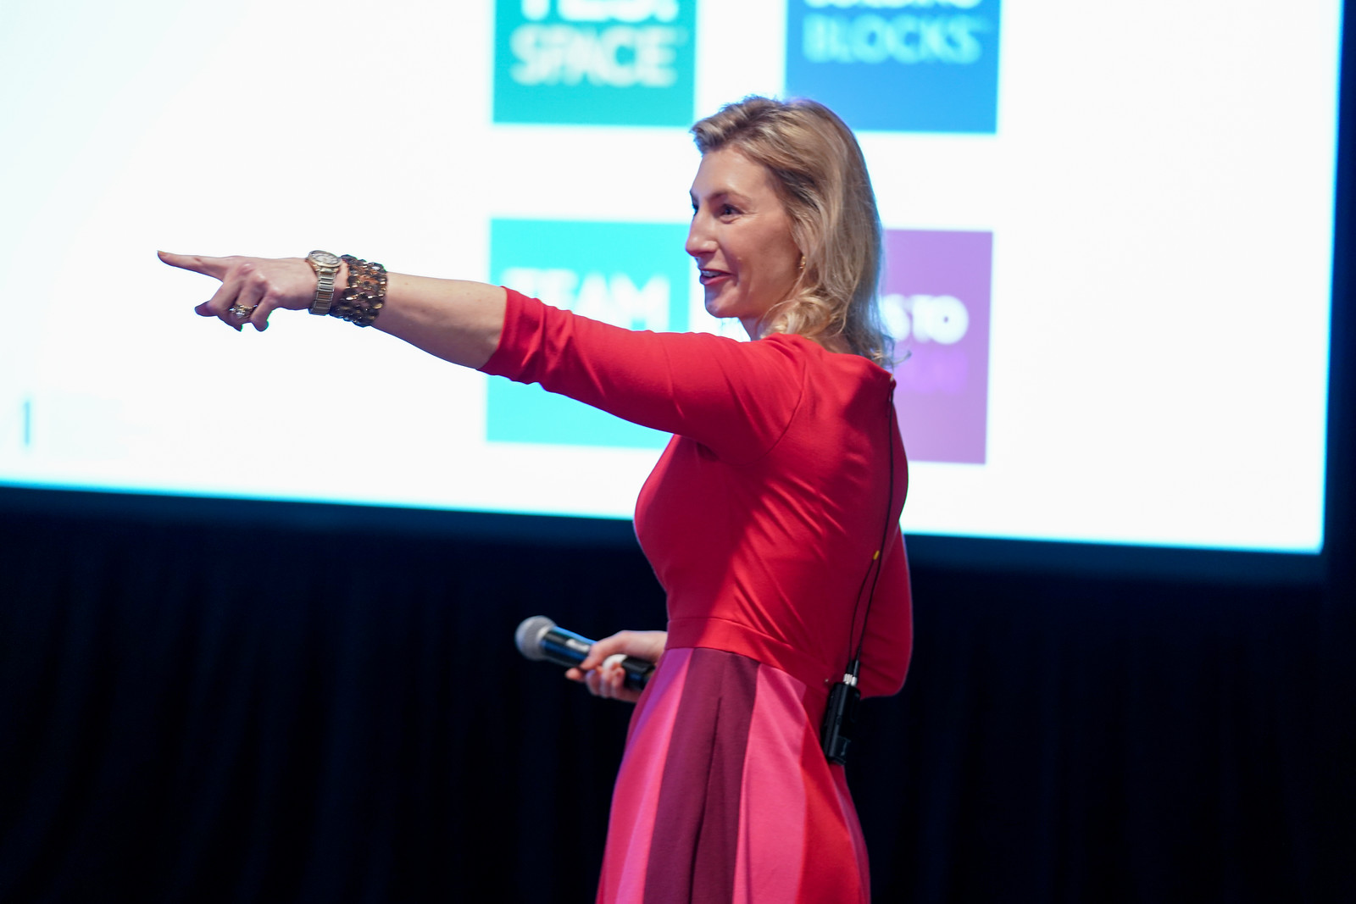
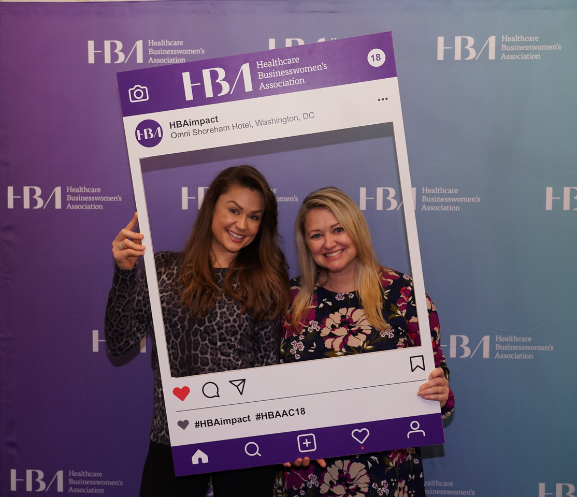
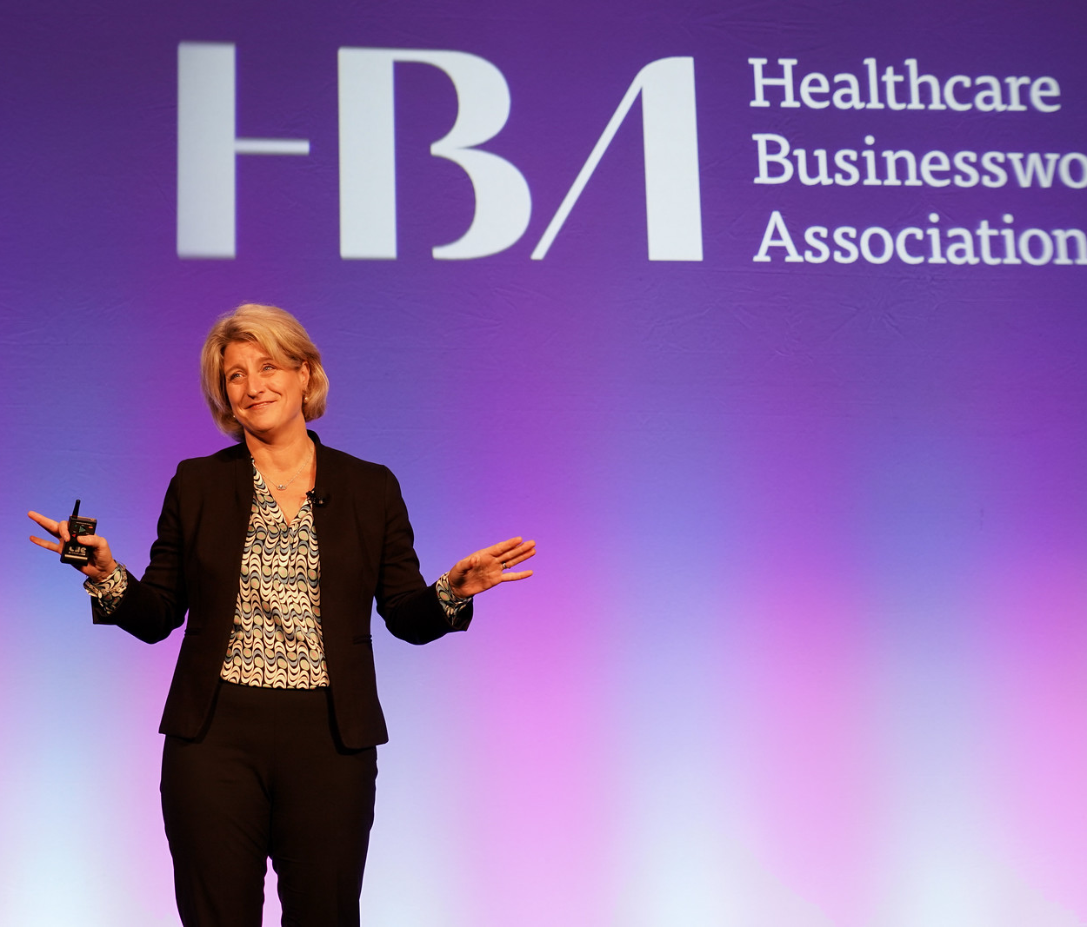
2019 HBA Annual Conference
11-12 November – San Diego
World-renowned speakers and leadership panels
Multiple workshop options focused on business and industry acumen, career and leadership skills

Slide 27
Corporate Partner Program

Slide 28
Corporate Partners
The business of healthcare is changing at a rapid pace, and following the trends won't be enough. Lead the way for your organization by partnering with the HBA – and gain the competitive advantage. Together, we can be a united force for change.
The Value of Partnership
Improved business results by developing talent within your organization
Increased recognition on a national platform for your brand and leadership and for celebrating accomplishments of your female talent and internal programs
Stronger relations with organizations across the healthcare industry
Empower women in your organization with proven opportunities for leadership development and growth

Slide 29
Corporate Partners*
* Partial Listing

Slide 30
Corporate Partners
Industry breakdown

Slide 31
Five Corporate Partner Packages in 2019
We offer five different corporate partner packages to meet the needs and desires of all healthcare and life science organizations.
Choose the path for your company by visiting www.HBAnet.org/corporate-partners or email us at CorporatePartners@HBAnet.org

Slide 32
Rising Stars and Luminaries
Honored at the Woman of the Year Event
Eligible corporate partner packages offer the option to name either a Rising Star or a Luminary (purple and gold corporate partner packages include recognition of two award winners)
These award winners exemplify leadership within their organizations and serve as role models and mentors
Rising Stars have up to 20 years professional industry experience
Luminaries have more than 20 years professional industry experience

Slide 33
Building Better Business Connections (3BC)
A group of senior leaders from HBA corporate partner organizations (purple, gold and silver) who work together to collectively overcome organizational challenges and achieve business goals.
Established in 2009 and chaired by an industry thought leader
Summit topics address challenges facing HBA corporate partners:
Building and Growing Internal Women’s Networks (IWNs)
Metrics that Matter: Strategies to Build the IWN Business Case
Blind Spot: Hidden Biases of Good People
Sponsorship: Breaking the Last Glass Ceiling
Innovation, Diversity and Market Growth
Power of the Purse
Technology and Gamification: Turning Disruption into Opportunity for Women and Business
Save the date for 10 May 2019

Slide 34
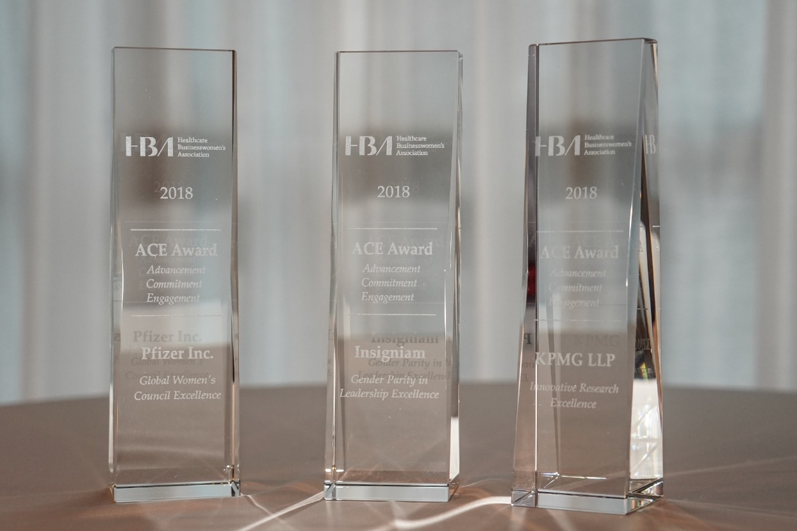
ACE Award
Three Awards to be Given in 2019
Honors best in class corporate leadership programs
Open to public and private companies of all sizes
Winners gain significant industry visibility
Receive feedback from independent judges on:
Business performance
Sustainability
Stewardship
Execution
Measurable results
2018 ACE award winners

Slide 36
New – Gender Parity Collaborative
Launched in 2018, the Gender Parity Collaborative is the first consortium of healthcare and life-sciences companies dedicated to accelerating gender parity in the industry. Together, Collaborative member organizations commit to taking an active role in defining strategies, measuring performance, creating change and inspiring others.
“We believe that together, relying on solid data, proactive strategies and firm accountability, we can close the gender gap, accelerate business results and transform our industry,” – Collaborative leader
And the results are clear. Companies with female representation in their senior management levels perform better than their peers financially. These organizations are more innovative and they retain their employees more effectively. By taking bold action to close the gender gap, the healthcare and life-sciences industry can achieve more.
Accelerating better business results
Gender Parity Collaborative

Slide 37
Gender Parity Collaborative
Founding Members
Founding member (and member) organizations commit to provide C-suite participation, provide company’s HR/gender-related data for benchmarking and tracking (through the most comprehensive study of its kind - the Women in the Workplace study - conducted by McKinsey & Company and LeanIn.org), be an active consortium participant and publicize their commitment. The Collaborative is likely to double its membership size a few months after its initial launch. Visit us GenderParity.HBAnet.org for more information
In collaboration with:
Lead the change, take action and join the Collaborative:
2019 Gender Parity Collaborative membership available for a limited time only.
For more information contact Marie-Caroline Strok at mcstrok@HBAnet.org

Slide 38
Contact info
Insert contact info here

