Slide 1
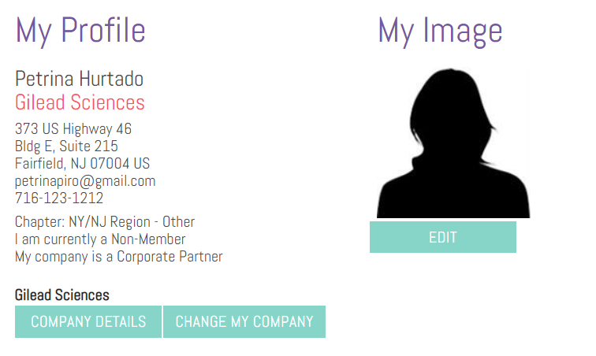
How to join and receive your Corporate Partner discount
Log in to your HBA Profile at www.hbanet.org/user
Ensure that your company is correctly listed in your profile

Slide 2
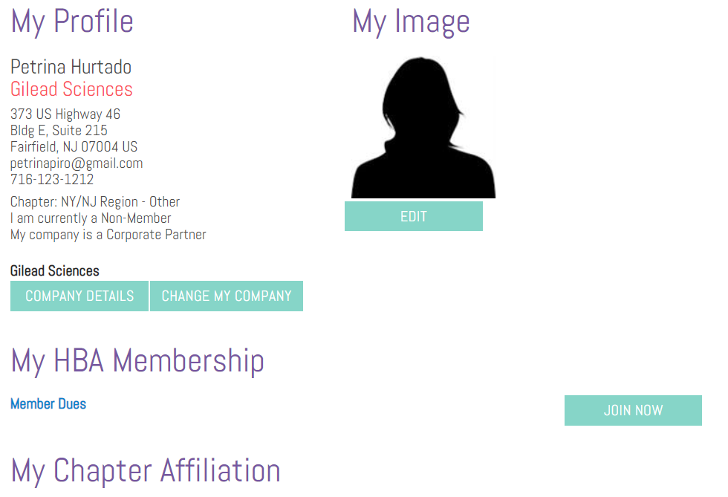
How to join and receive your Corporate Partner discount
Under “My HBA Membership,” click the “Join Now” “Rejoin” or “Renew” button

Slide 3
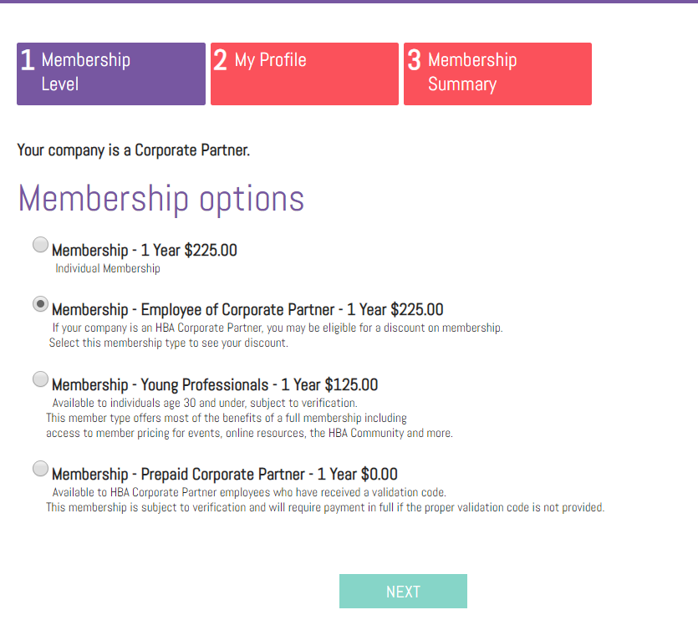
How to join and receive your Corporate Partner discount
Select “Employee of a Corporate Partner” as your membership type

Slide 4
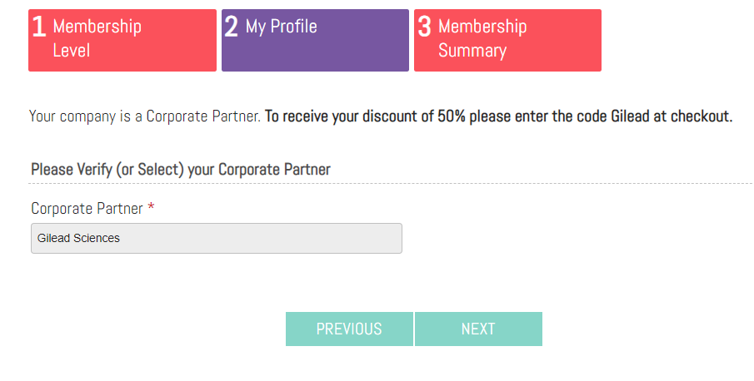
How to join and receive your Corporate Partner discount
On the next step, complete or confirm your profile information and click “next”
On the following page, you will see the message below. Note your discount code and click “next”

Slide 5
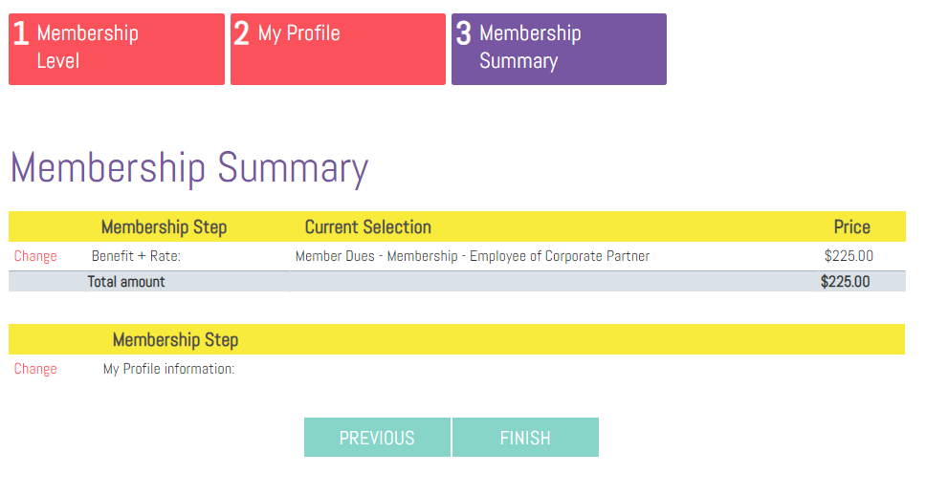
How to join and receive your Corporate Partner discount
On the next page you will see a summary showing the full price of membership. Click “Finish” to go to checkout

Slide 6
How to join and receive your Corporate Partner discount
On the checkout screen there is a section titled “promotions” – this is where you can enter your promo code Gilead to receive your discounted membership rate. Enter the code, click “Apply Promo,” and then click “Proceed to Checkout” to pay your dues.

