Slide 1
The Wellington Engagement Index
Robert Brisk, Chief Engagement Officer
Brendan Laughlin, Director of Client Success
Notes:
Both Introduce ourselves

Slide 2
?
Notes:
JOHN

Slide 3
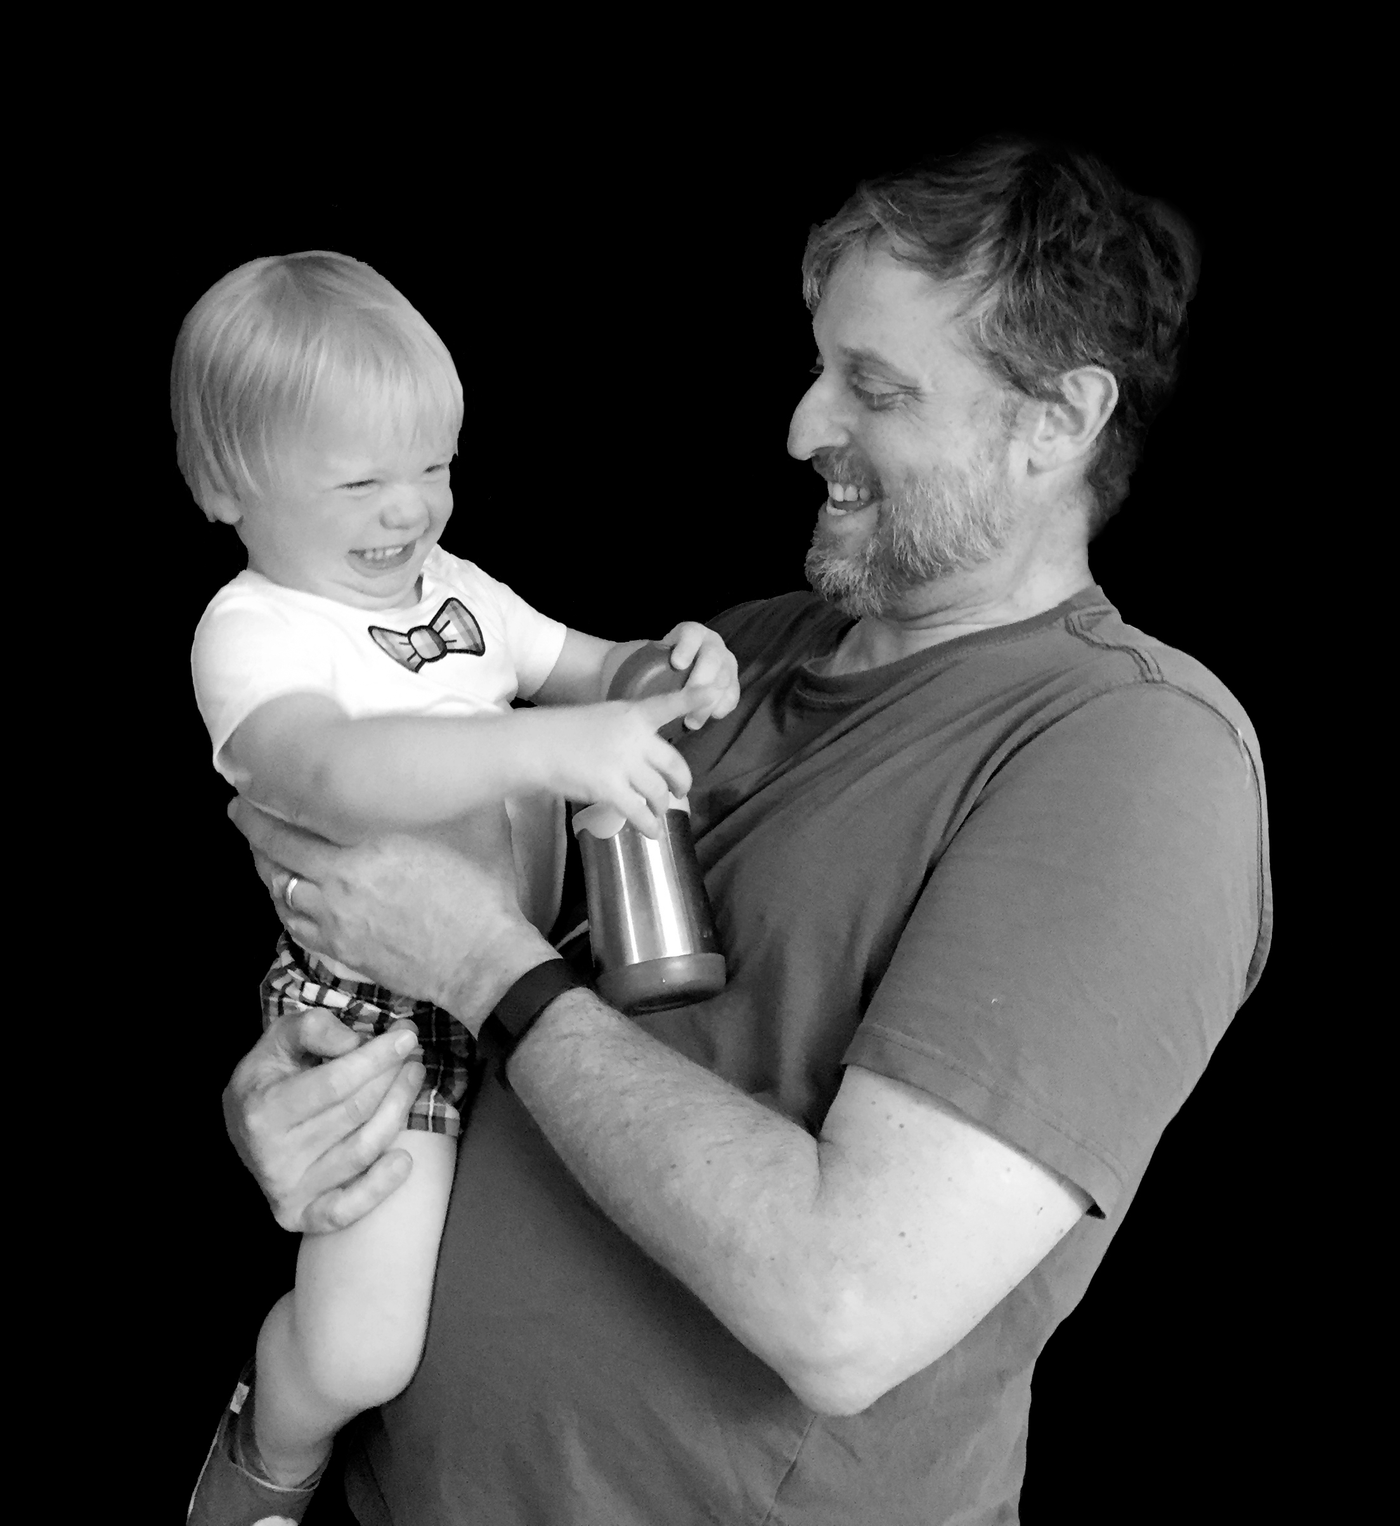

Slide 4
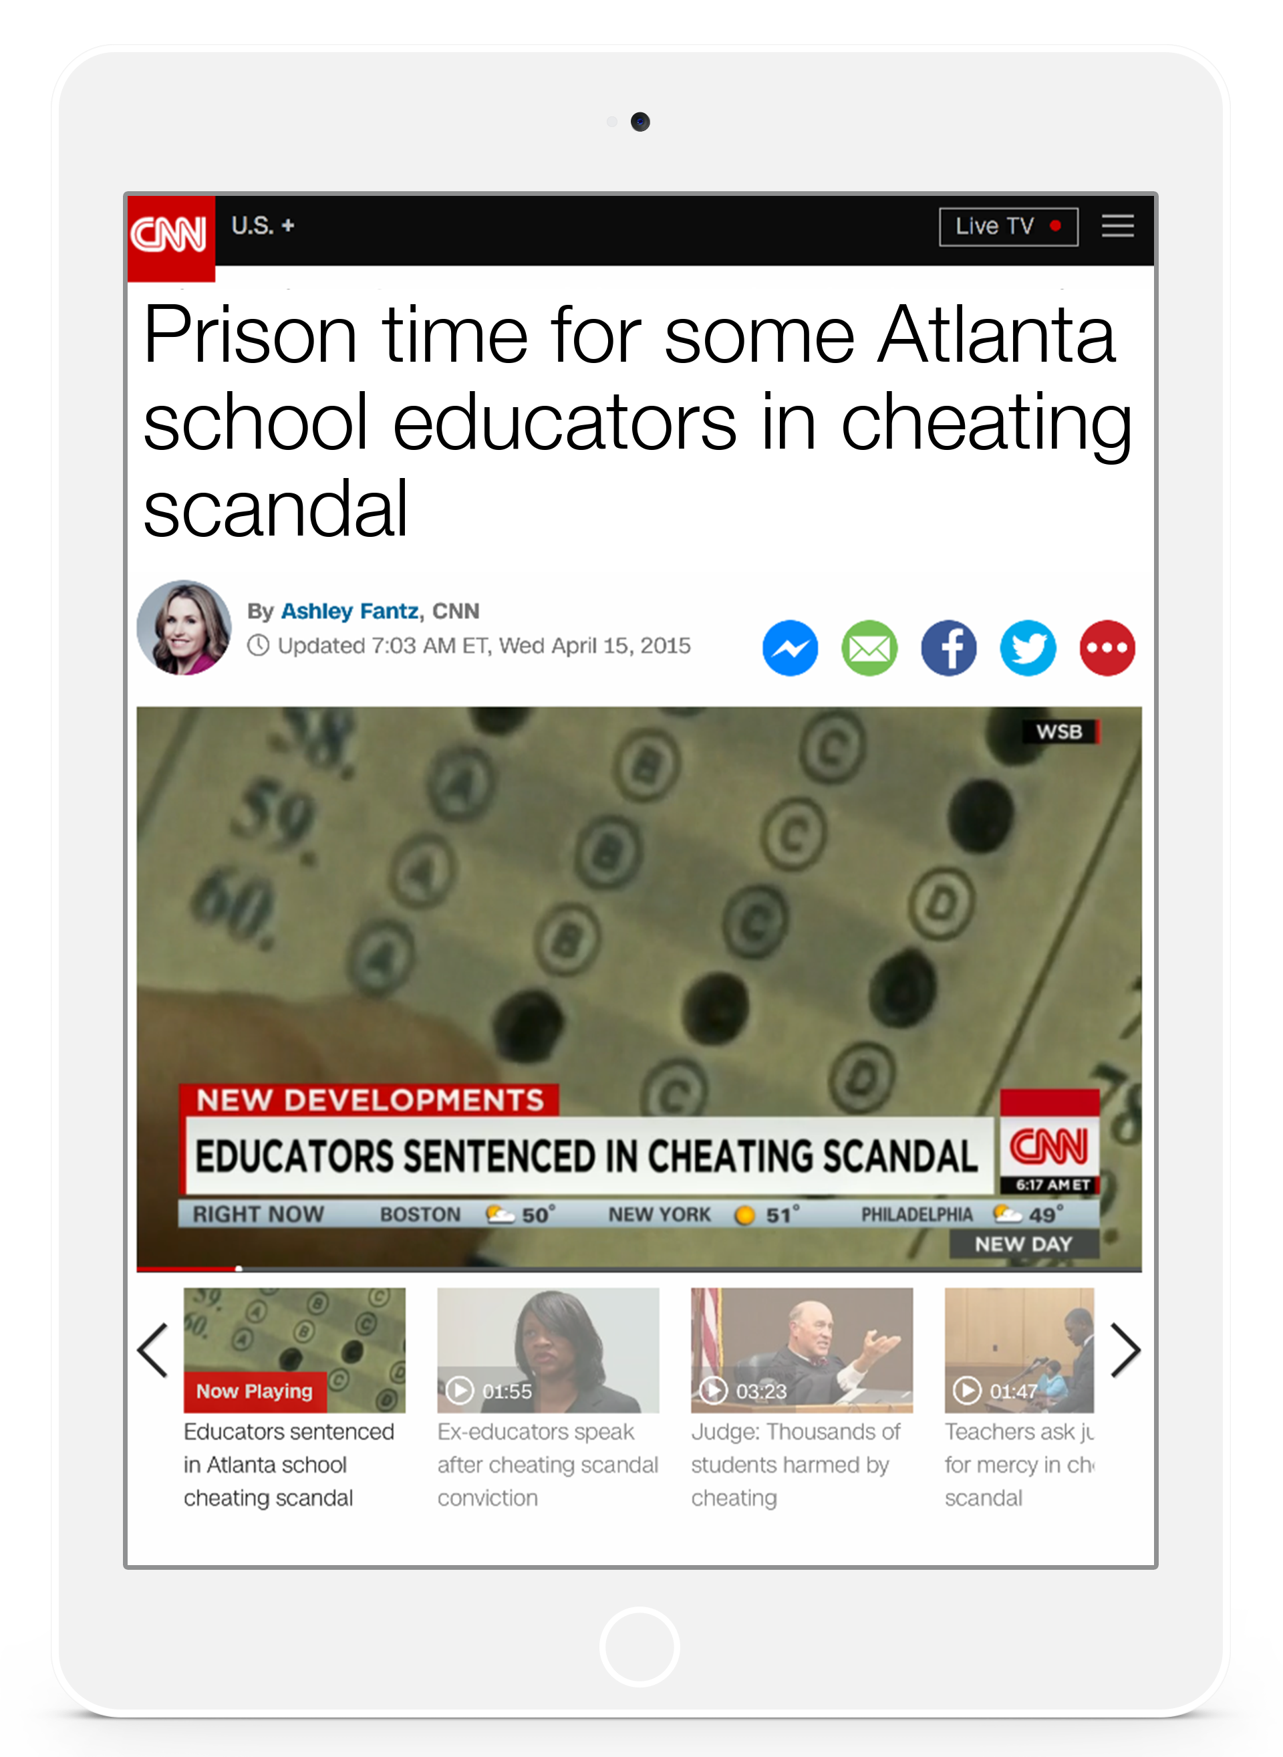
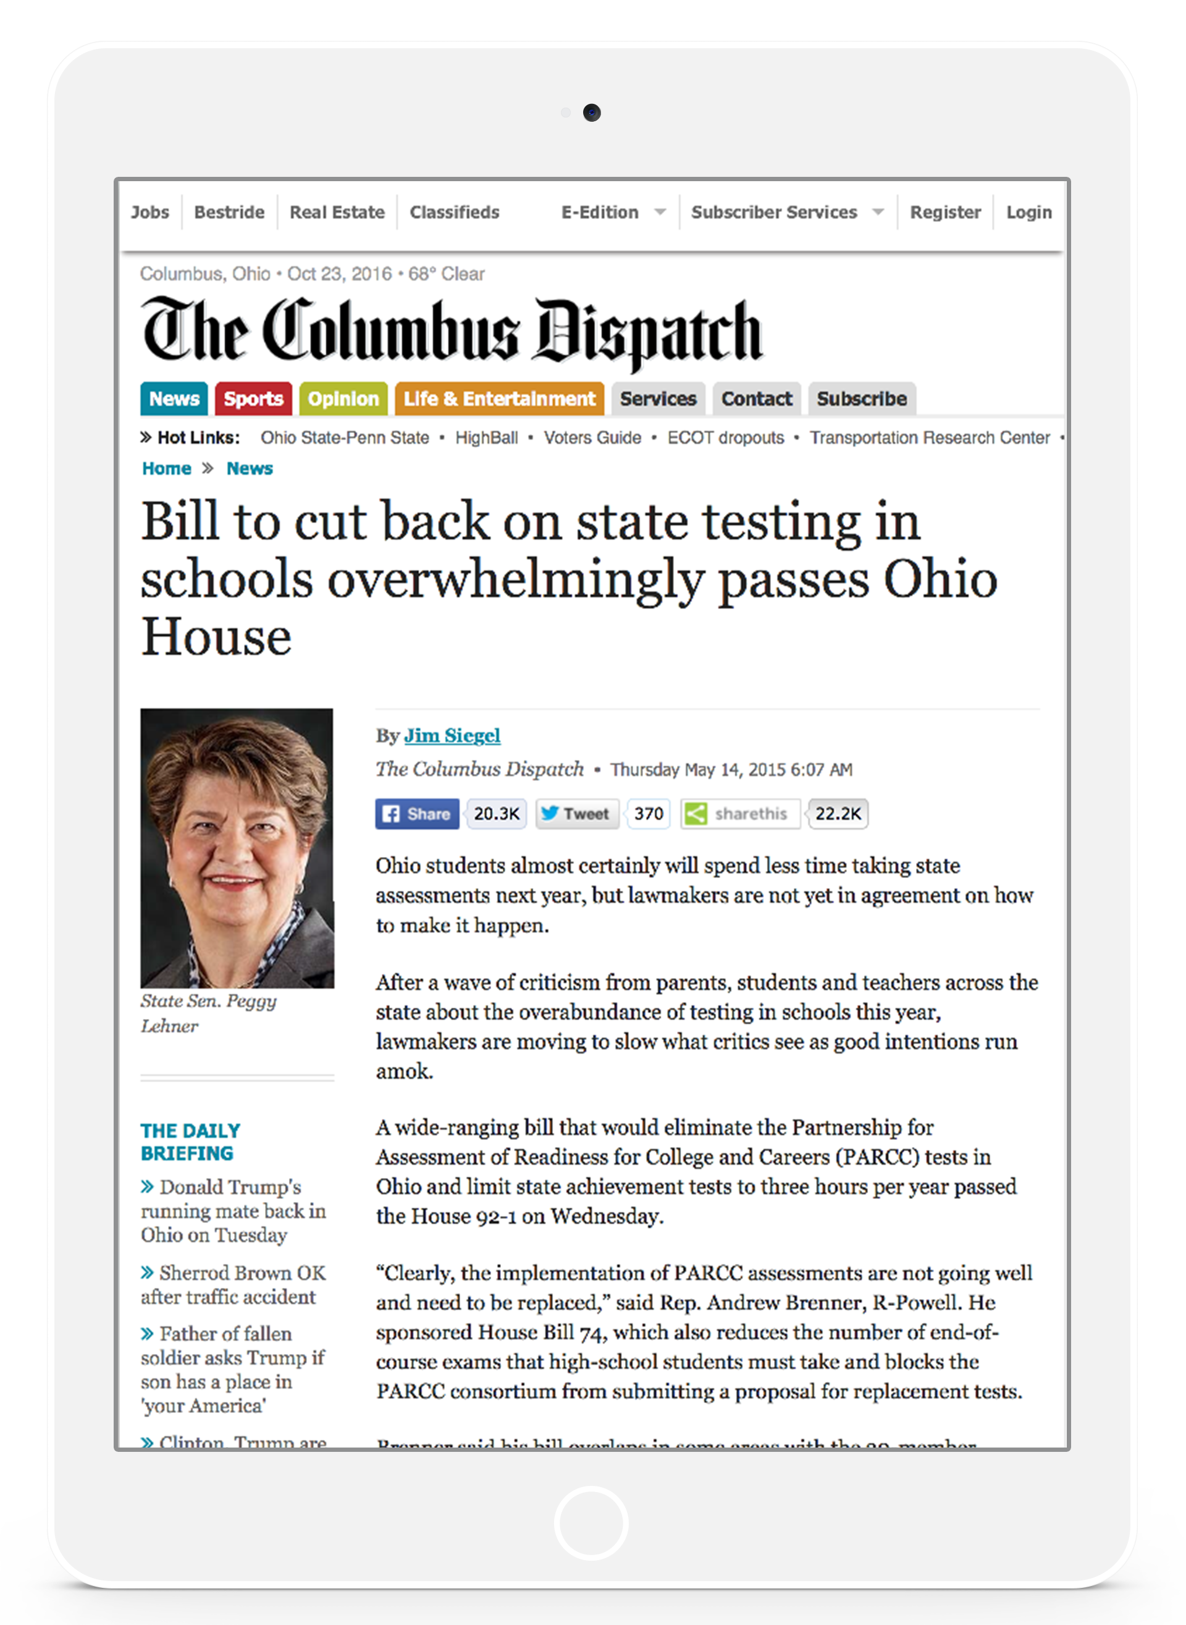
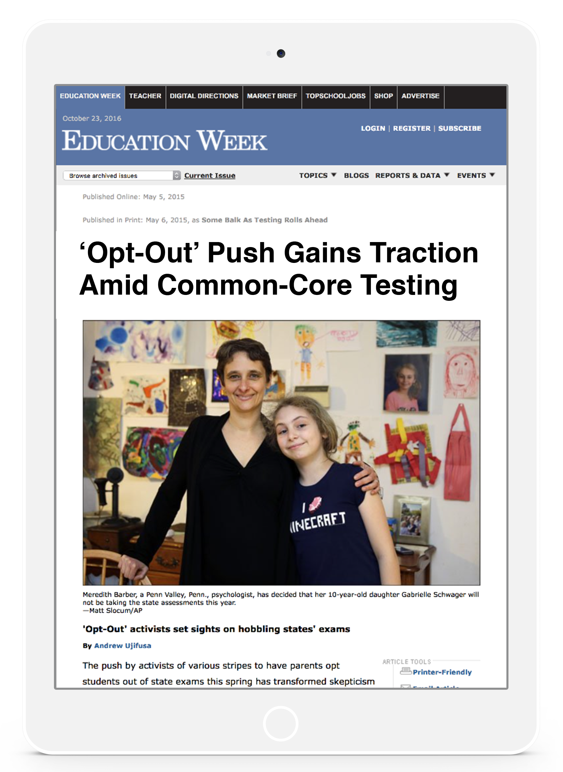

Slide 5
Love of Learning
Student
Engagement
=
Notes:
JOHN

Slide 6
Student Engagement: The degree to which students feel challenged by and love their classroom experiences
Notes:
JOHN

Slide 7
Challenging
“Grind”
“Engaged”
Hate It
Love It
“Bored”
“Entertained”
Unchallenging

Slide 8
Challenging
Senior Latin
“Grind”
“Grind”
“Engaged”
Hate It
Love It
“Bored”
“Entertained”
Senior Economics
Unchallenging
Notes:
ROB
Let me give you a personal example!
I loved Greek! It was really hard but it felt like I was unraveling mysteries, plus Mr. Beaver had tons of interesting stories about being an archaeologist in Israel!
World Geography was awful! I loved international relations and geopolitics, but the teacher neither challenged us nor gave us anything interested to cling to—it was extremely Boring!

Slide 10
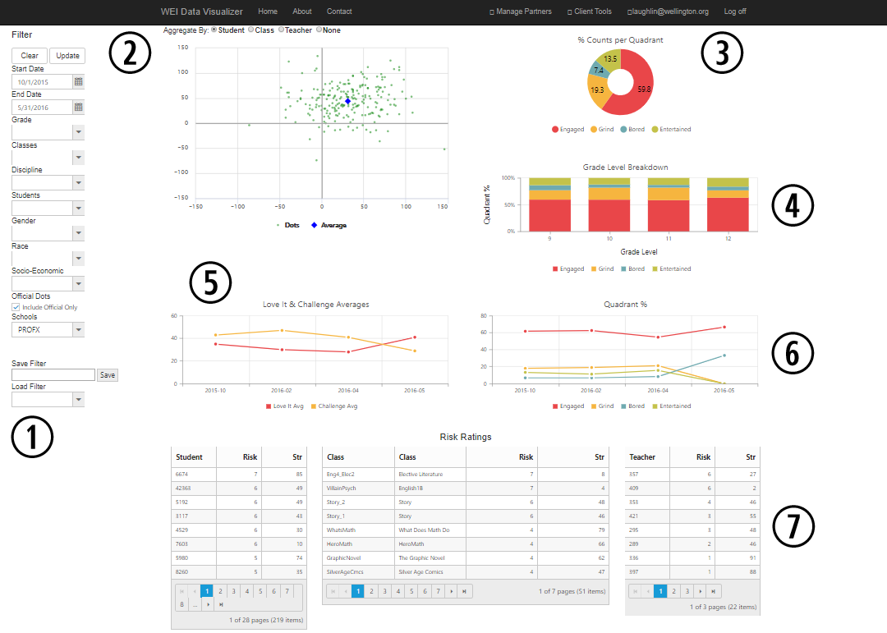

Slide 11
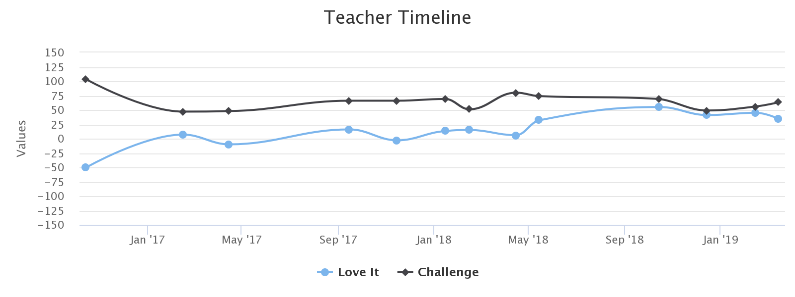

Slide 12
vs.

Slide 13
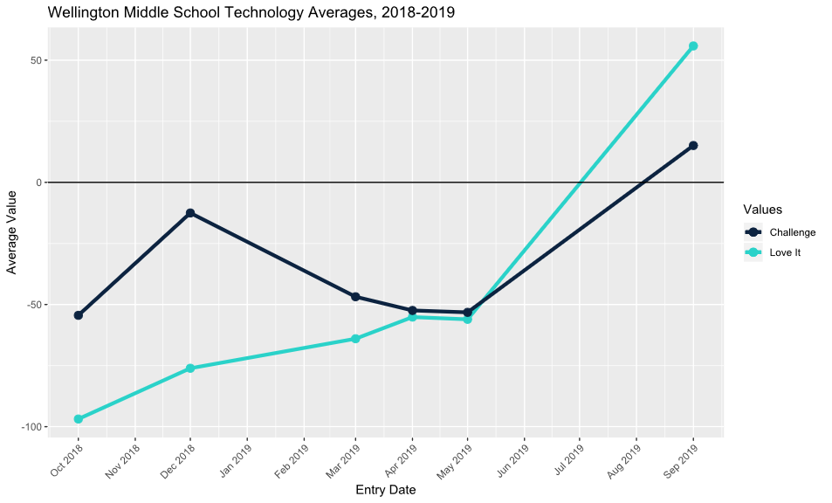

Slide 14
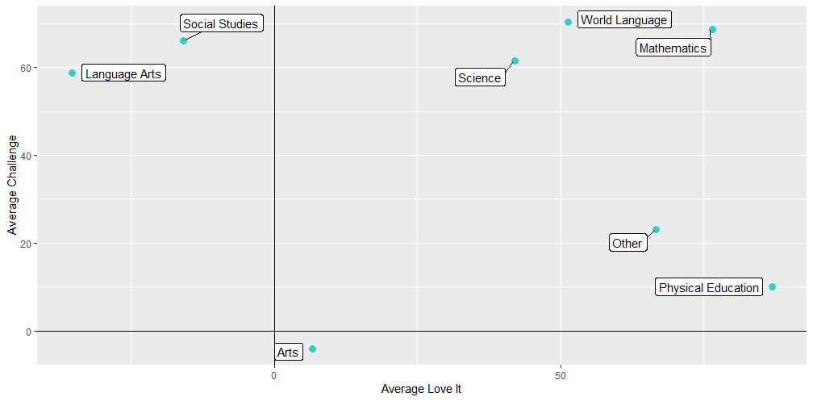

Slide 15
What factors lead to
student engagement?
Notes:
JOHN

Slide 16
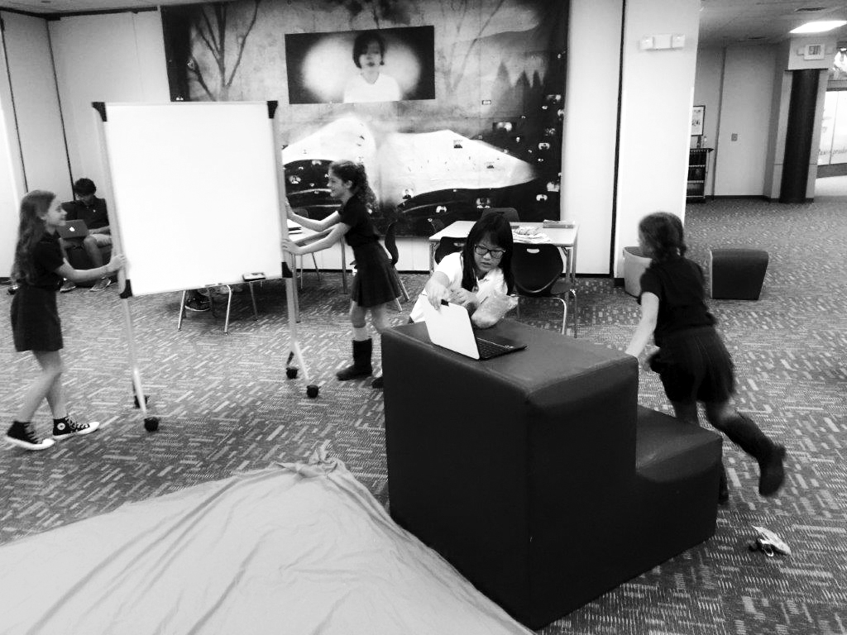
Mobility

Slide 17
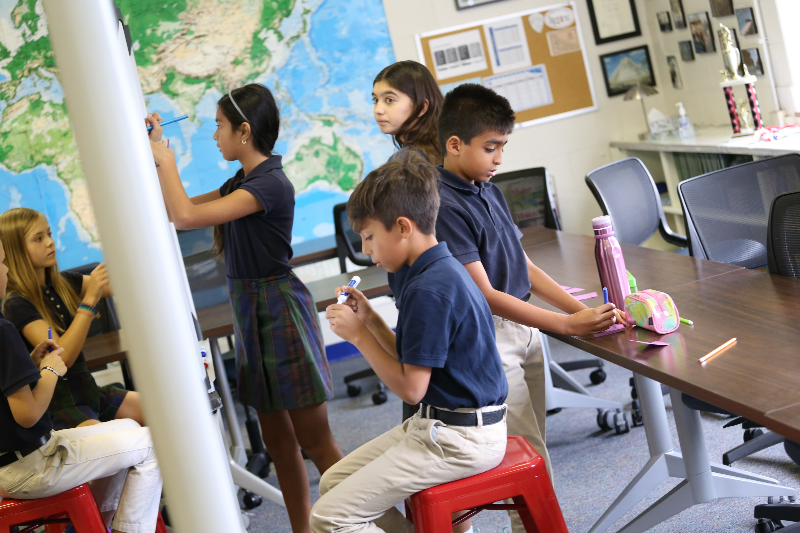
Autonomy

Slide 18
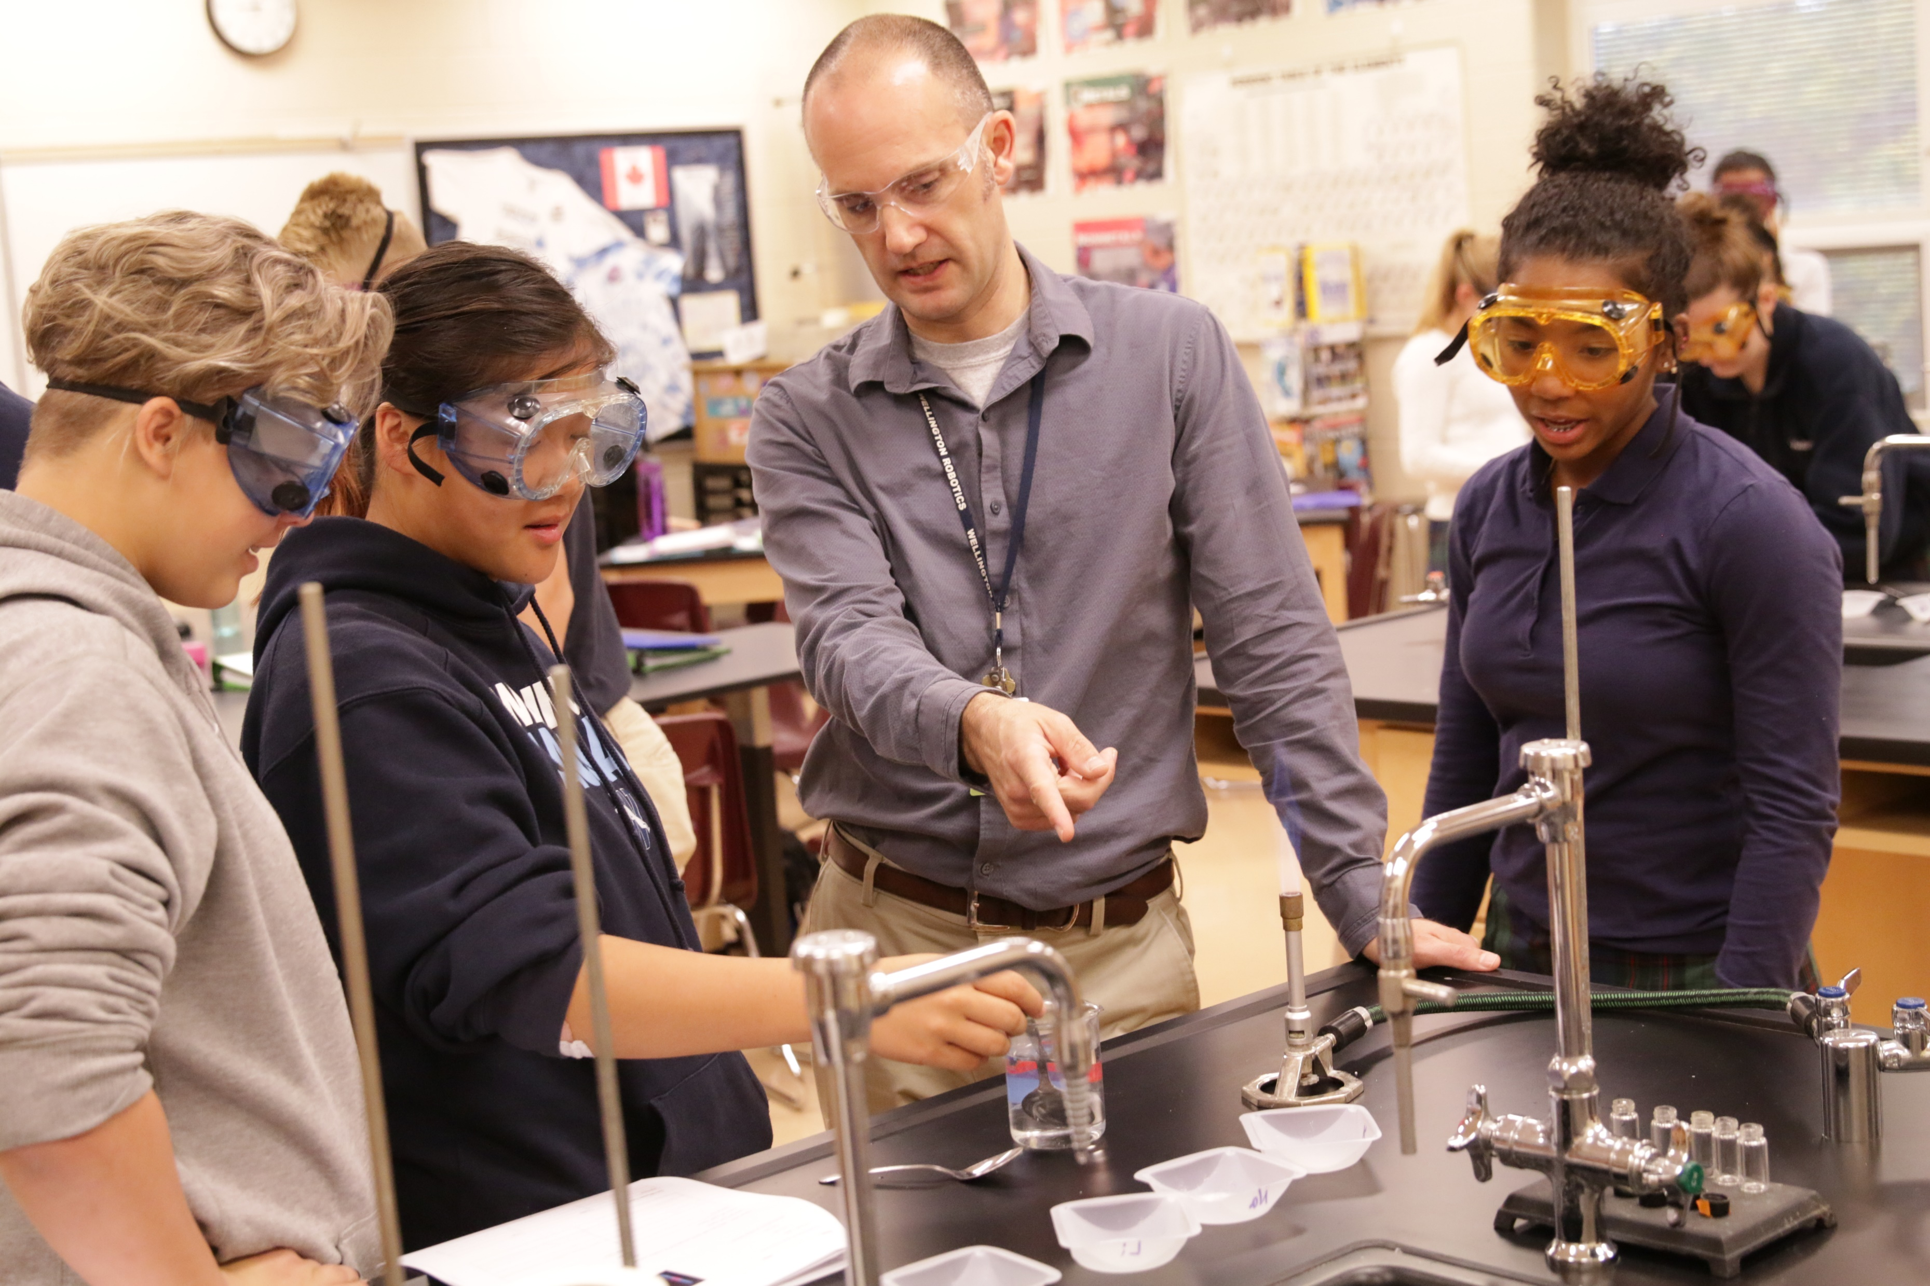
Connection

Slide 19
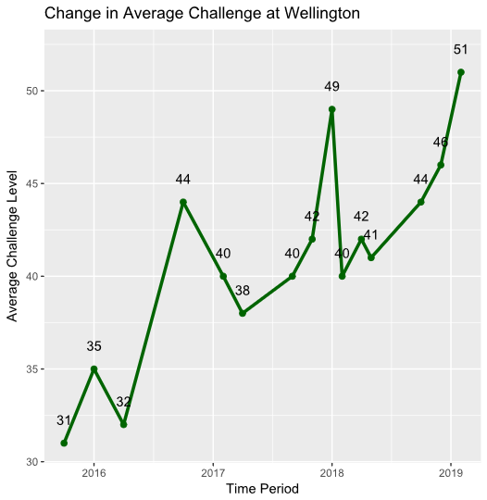

Slide 20
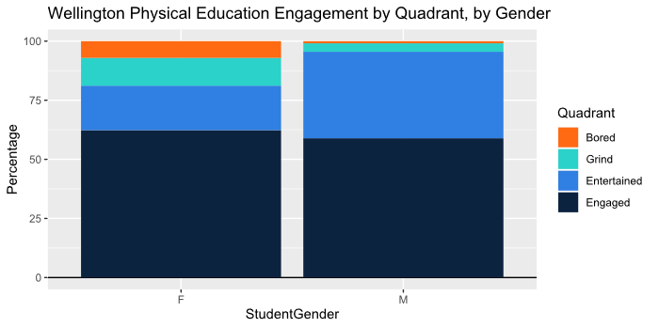

Slide 21
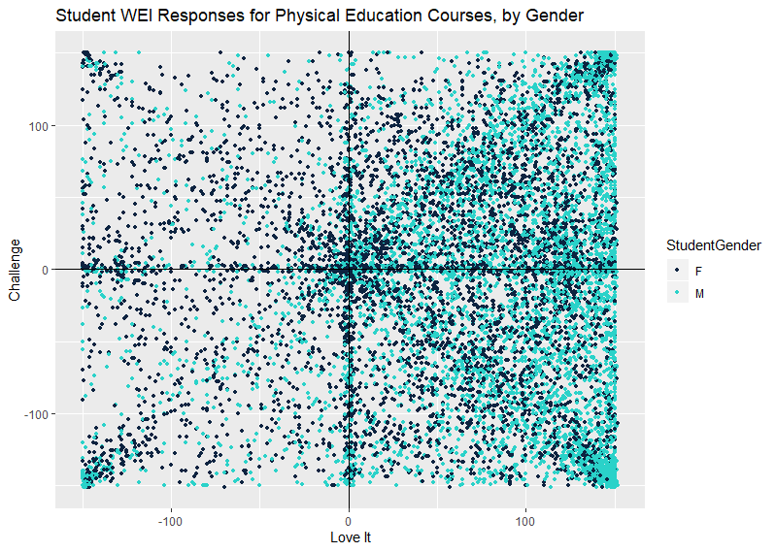

Slide 22
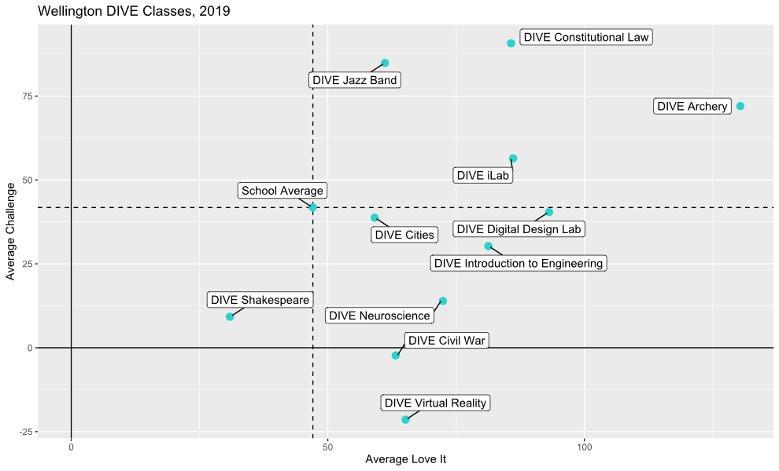

Slide 23
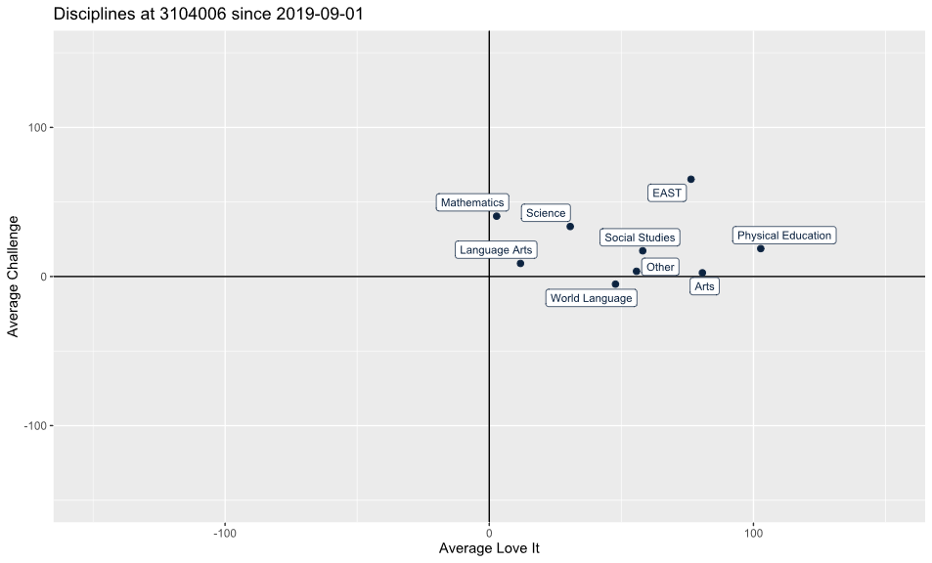

Slide 24
How do we contribute to improving education in America?
Notes:
JOHN

Slide 25
Brendan Laughlin Director of Client Success 614-754-4248 laughlin@wellington.org
Rob Brisk Chief Engagement Officer 614-324-1655 brisk@wellington.org

Slide 26
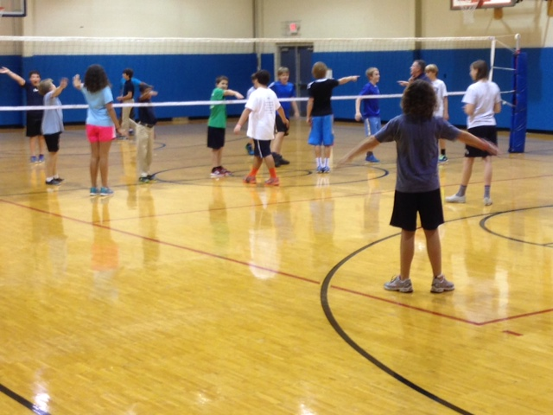
Quadrant:
Grind
Dimension:
Content, Subject
“Challenging because sports are hard.”

Slide 27
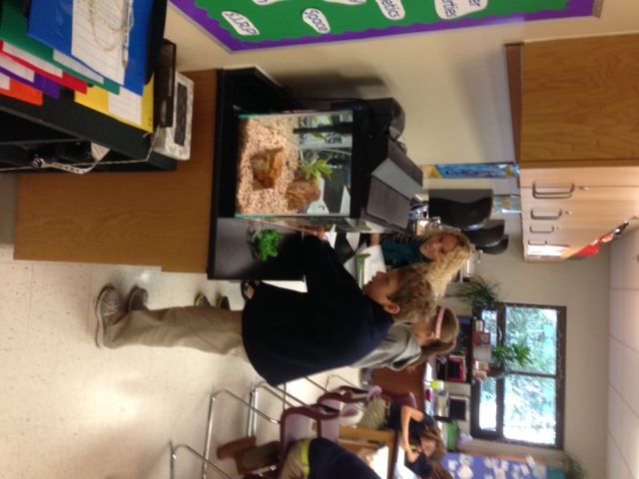
Quadrant:
Engaged
Dimension:
Teacher
“Participating but not intimidating.”

Slide 28
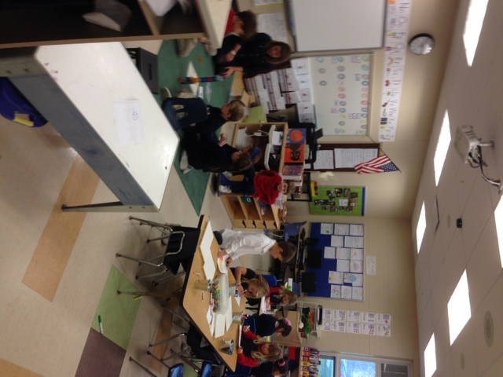
Quadrant:
Engaged
Dimension:
Classroom, Space, furniture
“Classroom used many colors and shapes, seems warm and loving.”

Slide 29
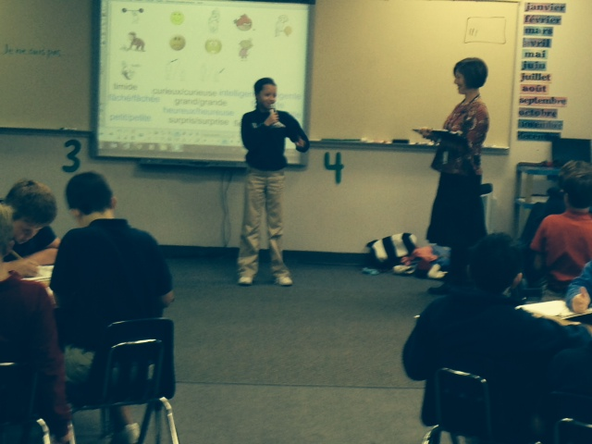
Quadrant:
Engaged
Dimension:
Teacher
“Teacher is standing and helping.”

Slide 30
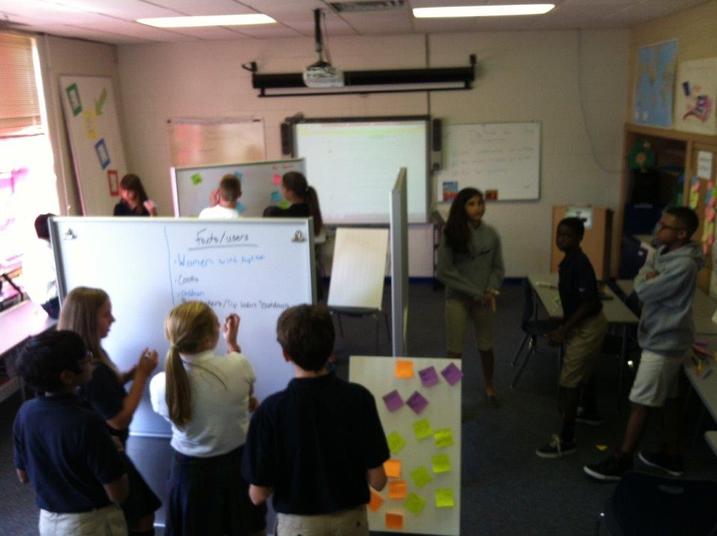
Quadrant:
Engaged
Dimension:
Room, Space, Furniture
“Use of large board for each group is interesting in a good way.”

