Slide 1
Dental Care = Preventive Care = Care Companion Plans

Slide 2
Imagine a world where pets…
Can avoid rotting teeth, bad breath and gingivitis.
Are free from the constant pain of periodontal disease.
Can avoid tooth or bone loss, oral infection and other related diseases.
Can receive professional dental care annually from juvenile through adult life.
Get regular routine dental care and proper home care.

Slide 3
Imagine a world where pets never develop periodontal disease in the first place
Today 78% of dogs have periodontal disease by age 3
This Photo by Unknown Author is licensed under CC BY-SA

Slide 4
Imagine a world where pets never develop periodontal disease in the first place
Today 68% of cats have periodontal disease by age 3
This Photo by Unknown Author is licensed under CC BY-SA

Slide 5
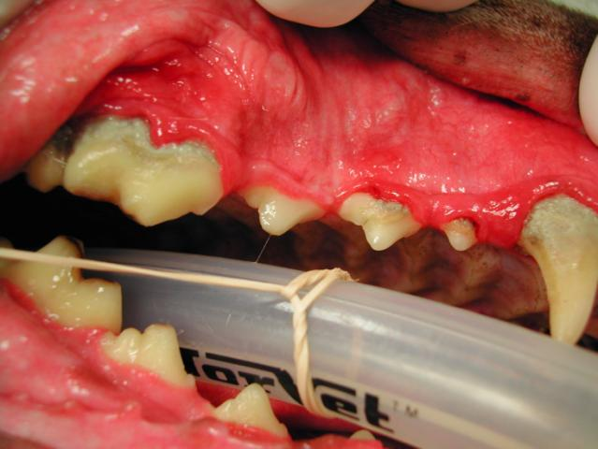
Periodontal disease is 100% preventable
What is the team doing now to promote prevention of periodontal disease?
What can be done for this pet now?
How can preventive dental care keep this pet’s mouth healthy going forward?

Slide 6
There is a gap between diagnosis of periodontal disease and offering dental cleanings When offered, client acceptance is high

Slide 7
Why is preventive dental care so important?
Easily preventable disease
Debilitating and painful pathology
Expensive to treat
Treating disease that has already occurred is always more expensive than the treatment
Can contribute to other diseases
Impacts pet’s behavior, and bond with family

Slide 8
How Can Care Companion Plans Help with Peridontal Disease Prevention?
By encouraging clients to come in at any time with free exams
This also helps improve the client/doctor relationship and builds trust when it comes to the best care for the pet
Regularly scheduled preventive care appointments help detect signs and symptoms early
By offering plans with annual dental cleanings as prevention of periodontal disease before it occurs
Prevention costs less than treatment

Slide 9
Resources
Veterinary Oral Health Council
http://www.vohc.org/veterinary_periodontal_disease.html
http://www.vohc.org/VOHCAcceptedProductsTable_Dogs.pdf
http://www.vohc.org/VOHCAcceptedProductsTable_Cats.pdf
AAAHA
https://www.aaha.org/aaha-guidelines/dental-care/dental-care-home/
https://www.aaha.org/aaha-guidelines/dental-care/educational-images/anatomy-of-a-tooth/
https://www.aaha.org/aaha-guidelines/dental-care/educational-images/dental-cleaning-sequence/

