Slide 1
Timed sections**
Basic Onboarding outline
Module 1: What is corporate relations? – serving companies (links to each type?)
  Customers we serve: prospects, CPs, GPCs – any healthcare/life science company that is or may in future become a part of HBA
  Definitions: sponsors are event specific, “corporate sponsors” do not exist, etc
Module 2: HBA CR infrastructure: we’ll talk about your role momentarily, but here’s what global staff do
  Global/Staff: sales and account management
  Regional structure/CR role (address: why there isn’t CR in the chapter leadership structure)
  How the two interact
Module 3: Regional CR roles and focus areas: President/VP, BD (non-CPs), CE (CPs), Ambassador Program, Operations/Insights and overall CR goals
Module 4: Local engagement: How does it all work at the local level? this is complicated so we don’t expect you to understand immediately, write down questions, how to get them answered.
  Transparency
  Full detail? Examples?
Module 5: What will be asked/expected of me
  How CR interacts with the various other functions
Module 6: your Resources
  Resource Center
  Community
  Tools, forms, etc and what they do
Our top customers
Global partnership – served by AM
Regions can help by engaging local sites
AFTER:
  office hours to answer questions
  Certificate of completion?
  At the end, quick quizzes?
ADD CP CUSTOMER JOURNEY?!

Slide 2
Corporate Relations Onboarding

Slide 3
Agenda
Module 1: CR basics
Module 2: CR infrastructure at HBA
Module 3: regional CR department and roles
Module 4: regional and local company engagement
Module 5: what’s expected of me
Module 6: your resources
Appendix

Slide 4
Module 1: corporate relations basics

Slide 5
What is Corporate Relations?
At it’s most basic, corporate relations creates the HBA experience for companies. This function engages healthcare / life sciences companies and their employees through HBA to best serve the company, individual and the relationship of our organizations.
Corporate Relations
Create HBA ‘experience’ for companies
Focus on companies as the customer
Build “HBA inside” to develop employees, create advocacy, drive HBA value
Provide platform for industry visibly and exposure
Goals
  Increase Corporate Partner engagement
  Increase number of Corporate Partners
  Increase sponsoring companies
How?
HBA Corporate partnership and benefits
Employee engagement and programs
Event sponsorship/content partnership
Mission-based initiatives
Visibility for senior execs
Cross-company connections
DEI and ERG enhancements
And more…
Notes:
Overall, corporate relations is much, much more than just selling sponsorships.

Slide 6
What companies do we serve?
Any healthcare or life science company is or could be a stakeholder with HBA, but our primary customers are:
HBA Corporate Partners
Companies become Corporate Partners with HBA by investing in one of HBA’s Corporate Partner Packages at a global level. This is an annual agreement and partnership between HBA and the company organization-wide.
HBA currently has over 150 Corporate Partner companies representing various sectors of the healthcare/life science industry (pharma, biotech, etc).

Slide 7





























Corporate Partners*
* Partial Listing

Slide 8
Corporate Partners

Slide 9
Corporate Partner Packages Overview
Pricing and benefits will change in 2022
Benefits (partial listing) | Purple | Gold | Silver | Teal | Red
Memberships | 115 | 40 | 20 | 10 | 5
Discount on additional memberships | 50% | 25% | 15%
Annual Conference registrations | 7 | 5 | 3 | 2 | 1
Ability to pre-purchase WOTY tables/seats | 8 tables | 5 tables | 1 table | 1 table
Rising Star and Luminary designations | 2 | 2 | 1 | 1
ACE Awards submission discount/inclusion | 50% | 50% | 50% | 100% | 100%
Career Conversations passes (per webinar) | 50 | 30 | 15 | 5 | 1
3BC event invitations | 4 | 2 | 1
Ambassador Programs | 3 | 2 | 1
Investment | $50,000 | $25,000 | $15,000 | $7,500 | $3,500
Notes:
HBA’s five Corporate Partner packages provide a variety of benefits to our partner companies and their employees. They have been designed to meet the needs of companies big and small, regional or global, and can be customized if needed. These packages are an agreement between the company and the HBA organization as a whole and are renewed on an annual basis. The tiered package include a wide variety of benefits for the company including things like individual memberships (“designees”), signature event passes, recognition opportunities and more.
Dedicated HBA staff manage all of these CP accounts at a global level to ensure satisfaction and benefits pull-through. They work with each company to get an understanding of:
Their strategic priorities relating to gender parity/DEI initiatives
How to make the most of their partnership through HBA
Internal workings of the company so HBA understands how to best engage them and provide the most value
This grid features some of the top benefits our Corporate Partners receive, but is just a partial listing. For full details on each program, please visit https://www.hbanet.org/corporate-partner-packages or see slides in the Appendix

Slide 10
Customer Definitions
Companies are categorized based on which corporate offering they purchase from HBA. There are 3 main corporate customer definitions:
  Corporate partner (CP): a company that purchases an HBA Corporate Partner package (annually)
  Sponsor: a company that pays or donates in-kind for specific HBA purposes (the most common are event-specific sponsors)
  Prospects or opportunities: potential future Corporate Partner or sponsor
  Note: Companies can be a Corporate Partner, a sponsor or both.
Other helpful terms:
  Gender Parity Collaborative (GPC) members: companies who have joined the HBA’s GPC are committed to advancing gender parity and diversity in the industry. This consortium of companies takes an active role in defining strategies, measuring performance, creating change and inspiring others through this HBA offering. Most are also HBA corporate partners.
  Ambassador program companies: the Ambassador Program is a one year leadership development offered as a benefit only to select purple, gold and silver-level Corporate Partners. Corporate Partners who leverage this benefit are sometimes referred to by this terminology.
Notes:
Before we go any further, it’s really important that we use the same terminology to avoid confusing each other and our customers. There are three basic corporate customers that HBA deals with:
Corporate Partners are companies purchasing HBA Corporate Partner packages
That are defined annually by HBA Central
Corporate partner benefits are fulfilled by HBA Central and the assigned account manager
B. Sponsors are companies who purchase sponsorship packages for HBA events
Sponsorship packages exist at the HBA Central, Regional and Chapter level
Any company may purchase sponsorship packages
Corporate Partners may also choose to sponsor
Flagship events
Regional events
And Chapter events
Sponsorships are separate from their CP package
Companies may be HBA Corporate Partners, HBA sponsors or both
A Prospect is any company who is a potential new Corporate Partner or sponsor
HBA Gender Parity Collaborative members:
The Collaborative is a community of Healthcare and Life Sciences Companies committed to advancing gender parity in the industry. Those involved with the Collaborative, both individually and collectively, take an active role in creating change and celebrating progress by way of participation in Collaborative initiatives and leadership programs
This is a new HBA offering for 2018, more details on pricing and activities forthcoming. We will share this information as soon as it is ready.

Slide 11
Module 2: CR global infrastructure at HBA
Notes:
We’ll talk about our volunteer organizational structure momentarily, but let’s start with how CR works at a global level

Slide 12
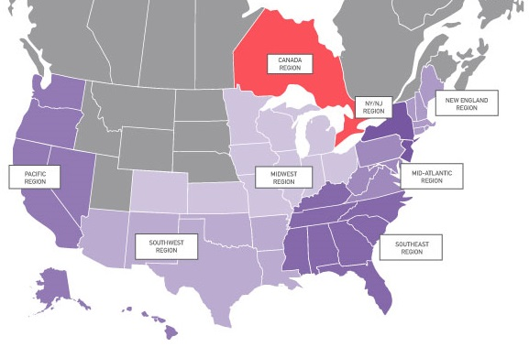
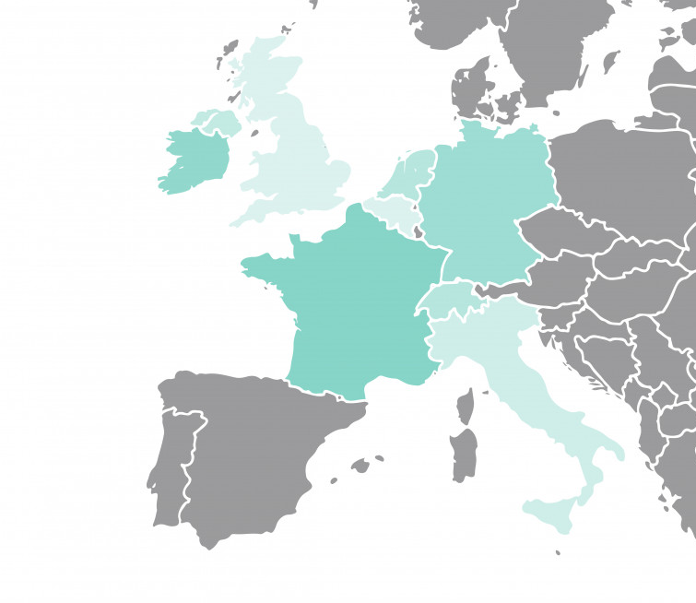
HBA Global, Region and Chapter illustration
HBA Board
HBA staff
Global Council
Canada
NYNJ
New England
Pacific
Midwest
Mid-Atlantic
Europe
Southwest
Southeast
Notes:
Lets look at the three components that make up HBA Global a little more closely. The HBA board at a global level determines the organization’s overall strategic priorities and direction. The HBA staff (aka HBA Central) and our Global Council takes board-determined priorities and translates them into an operating plan, initiatives and operational priorities that can then be executed on.
For CR specifically, HBA’s staff and global council take any company-related strategic direction/priorities and put them into practice at a global level, while working with the regions to do the same in their geographies.
Let’s take a second to talk more about the staff and global council before we dive further into our regional infrastructure

Slide 13
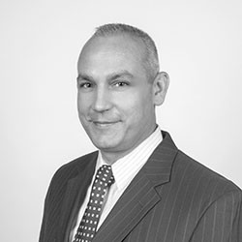
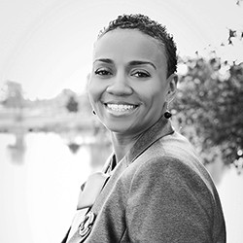
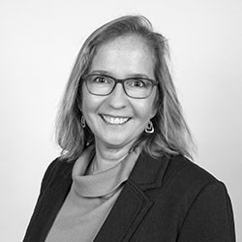
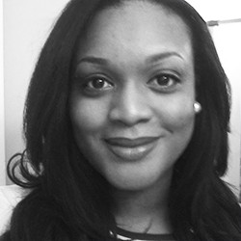


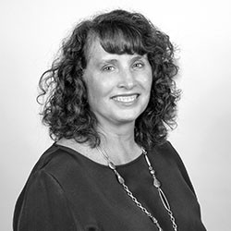
Welcome and meet the HBA CR staff
Account Management
Business Development and Sales
Ken Burris
Senior director, global business
development and sales
Serene Hollingsworth
Director, corporate accounts
A few strategic partners
Kathleen Rietzl
Senior manager, corporate partner engagement
Mostly purple/golds
Lanesha Whitefield
Account manager, corporate partner engagement
Mostly Silver/Teals
Gabrielle Todd
Associate manager, corporate partner engagement
Teals and Reds
Member experience/ volunteer support
Lauren Peck
Associate director, stakeholder engagement
Jeanne Piceno
Coordinator, corporate accounts
Notes:
Let’s start first by introducing you to the HBA staff dedicated to serving companies.
Ken oversees all BD and sales for new prospective Corporate Partners
Serene oversees our accounts and relationship management department while also account managing some of our key Corporate Partner account management
Kathleen, Lanesha and Gabrielle are our AMAZING account managers, building relationships, serving and driving value for all of our CP accounts at a global level. The account manager assignments in most cases are based on partnership level, as seen in italics here. An updated list of CPs with account managers is shared with the regions each month.
Jeanne is the one who keeps the staff team organized
And I’m the one you go to whenever you need anything else at all – I oversee all our CR volunteers and work to make their lives easier and their jobs more successful

Slide 14
HBA Global
HBA Board
The HBA Board determines the strategic direction and priorities for the organization globally
HBA staff
Global Council
Works on offerings, plans and initiatives to meet organizational priorities and overall, support the operations of the organization
Translates organizational priorities into functionally-specific strategies; organizes and executes global offerings/programs
Notes:
Now we’ve gone through what our staff do, let’s touch on the Global Council. The global council is comprised of volunteer leaders who lead all of HBA’s functional areas, affinity groups and programs at a global level. Each of these global leaders work to translate organizational priorities/strategies into functionally-specific ones that can be executed on

Slide 15
Global functions
Regional President
Regional President
Strategically focused; determines functional strategic priorities/direction with HBA staff and in line with organizational priorities
Regional President
Global Functional Chair
Deputy
Focus area 3
Focus area 1
Focus area 2
Regional President
HBA Central Expert Staff
Regional President
Regional President
#2, operationally focused; assists in strategic planning and overall functional ops
Regional President
Regional President
Global directors/committees:
Specific to the functions sub-focus areas and/or strategic initiative development/execution that falls under the function’s purview (i.e. projects/innovations that will directly impact that functional area)
Notes:
Our corporate relations global committee chair works closely with the staff to not only develop a CR-specific strategic plan, but to also lead in the execution of global-level CR initiatives to optimize the function, infrastructure and processes. The GCC is also the primary leader working with our regional CR leadership to guide, advise and align across the globe via regular communications and our monthly CR functional call

Slide 16
Module 3: regional corporate relations department and roles
Notes:
Now you’ve heard how CR works globally – let’s talk about YOU. HBA is a primarily volunteer-driven organization, so you are critical to HBA’s success.

Slide 17
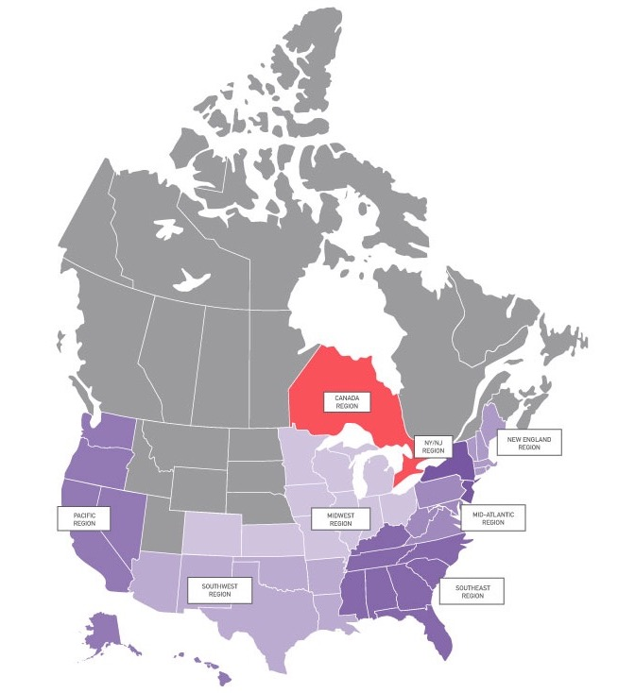
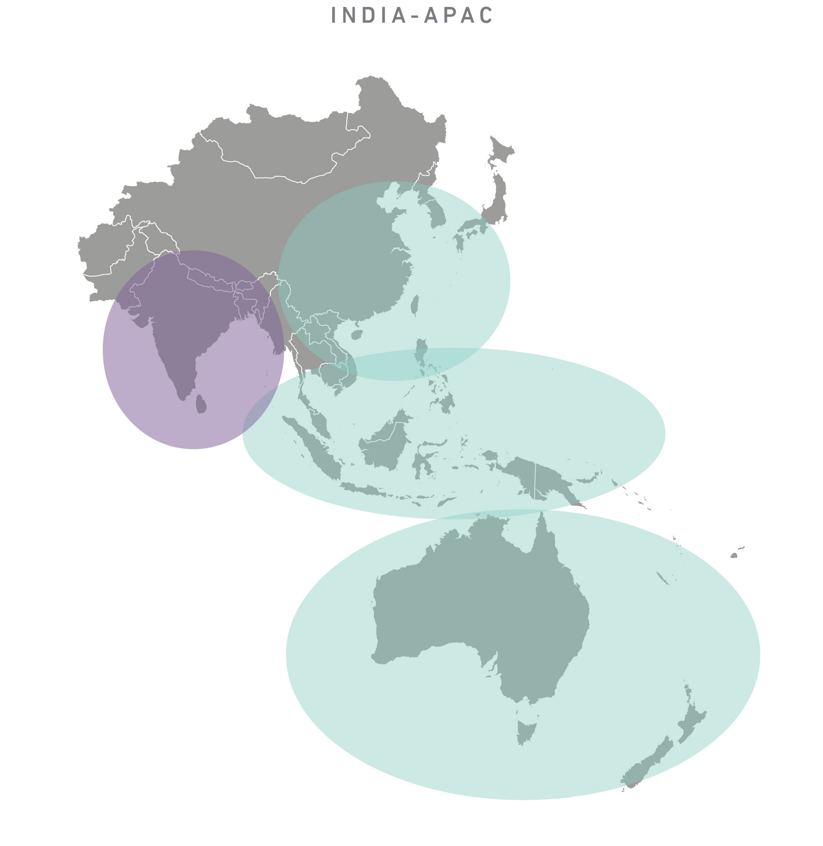
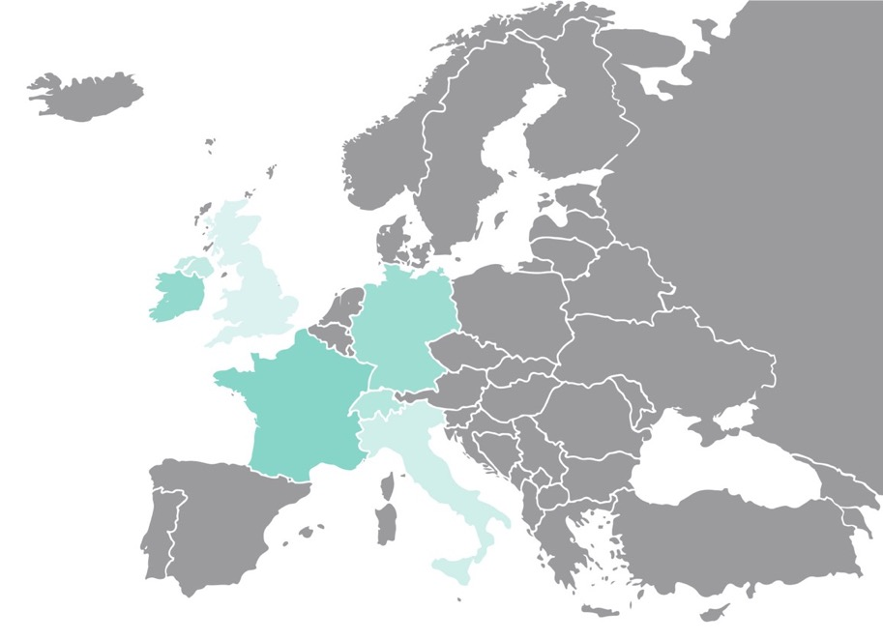
Note: India and APAC are budding areas without formal volunteer leadership structures as you may find in the US, Canada and Europe
Notes:
Given our vast geographic footprint (and growing!), numerous corporate and individual members and robust array of value offerings, HBA has a robust volunteer organizational structure to support everything we do.
As you’ve hopefully already been oriented to, HBA is divided into a number of geographic regions which are home to our numerous chapters. Our regions are led by a group of strategic functional area leaders to drive organizational strategy across the geography, provide support to the chapters and serve the stakeholders in the area.

Slide 18
Regional Organization
Purple titles =
Regional Council
Regional Council Chair
Regional Council
Deputy Chair
Treasurer
HBA
Experience
Market Research
Accounting and Analytics
Procurement and Processing
Chapter President
Chapter President
Chapter President
Chapter President
Corporate Relations
Member Experience
Volunteer Experience
President
President
President
Vice President
Vice President
Vice President
Vice President
Ops/ Insights
VP
Ops/ Insights
VP
Ops/ Insights
VP
Business Development
Member Recruitment
Leader Recruitment
Chapter Operations
Director
Chapter Operations
Director
Chapter Operations
Director
Chapter Operations
Director
Corporate Engagement
Member Engagement
Leader Recognition
Ambassador Program
Regional Experience Center
Local Chapters
Membership and Volunteer Engagement
Membership and Volunteer Engagement
Membership and Volunteer Engagement
Membership and Volunteer Engagement
Education And Events
Member Value Offerings
Marketing and Comms
Marketing and Communication
Marketing and Communication
Marketing and Communication
Marketing and Communication
President
President
President
Ops/ Insights
VP
Ops/ Insights
VP
Ops/ Insights
VP
Programming
Programming
Programming
Programming
Events
Mentoring
Marketing
Education / Content
Affinity Groups
Communications
Conferences
Social Media / PR
Notes:
Hopefully you already have an understanding of our regional organization, comprised of the Regional Council leadership (seen here in purple and focused on regional strategy, collaboration and shared success across the entire geography), the regional Experience Center and local Chapter leadership and volunteer teams.
Now let’s get to the part you really care about: the Corporate Relations department.

Slide 19
Corporate Relations department
Dedicated to: companies
Scope: strategic planning around company/Corporate Partner recruitment, engagement and sponsorship sales; regional and chapter business development, engagement and sponsorship activities/initiatives
Focus areas:
Business development: new company outreach and sales
Corporate engagement: HBA Corporate Partner site/employee engagement within the region and sponsorship sales
Ambassador program: Ambassador Program coordination/employee engagement (where applicable)
Corporate Relations
President
Ops/ Insights
VP
Business Development
Corporate Engagement
Ambassador Program
The department structure is flexible based on each region’s need to support regional and chapter activities.

Slide 20
CR focus areas
Business Development
Corporate Engagement
Ambassador Program
Operations and Insights
Customer focus:
Non-Corporate Partner companies
(i.e. leads, prospects, non-CP sponsors)
Customer focus:
Corporate Partner Companies
Customer focus:
Ambassador program sites
Focus:
Operations and CR insights/analytics
The goal:
To build HBA’s presence within CP locations through sponsorship, employee and company engagement strategies
The goal:
To engage and connect Ambassador companies and build growth initiatives
The goal:
To ensure the department is operating at full effectiveness and using insights to guide priorities
The goal:
To bring new companies into HBA through sponsorship and Corporate Partnership
Customer-facing focus areas
Internal department focus
Notes:
Each of the CR focus areas have a specific purpose in order to fulfil the purpose of CR and best serve the customers. We’ll get more into the details in a bit, but the leaders and volunteers work together to build and execute on strategies to engage and provide value to corporate customers while keeping regional/chapter sponsorship needs in mind.
There are three customer-facing areas focused on interacting with a particular HBA corporate customer, building strategies targeting their customer to increase engagement, and fulfilling regional sponsorship needs and one optional focus area that’s internally focused to help run the department.
The Business Development focus area develops regional BD strategy and oversees things like the development of a regional lead/prospect list. The corporate engagement area focuses on existing Corporate partners, their engagement strategy and regional CP lists. The Ambassador area manages any Ambassador Programs (where applicable) within the region, ensuring connections between other programs, chapters, advisors and the COE and developing new engagement strategies.
Alternatively, the Operations and Insights area is not customer-facing, but instead focuses their efforts internally on the department. They are responsible for the overall operations, organization, administration and reporting for the COE and using data, insights and trends gathered from the Market Research team to inform department strategic planning and committee focus.

Slide 21
Ambassador Program
HBA solution to meeting diversity goals for leadership in our corporate partner organizations: a 1 year HBA leadership development
Currently available to Purple, Gold and Silver level CPs
HBA trained advisor assists companies to build “HBA Inside”
  Customized to corporate goals, self-directed
  Develop motivated and engaged HBA community inside company
Accelerates the development and visibility of talent within your company and fuels the career advancement of participants
There is a separate full training on the Ambassador program available: https://hbavolunteer.knowledgeowl.com/help/ambassador-program-training
Notes:
One last definition before we go forward: the HBA Ambassador Program. Purple, gold and silver CPs have the ability to create an internal committee, comprised of employees from their company, who will work on a grass roots basis within their company to increase HBA awareness and engagement: this is an Ambassador Program within a company.
This is a value offering the whole CR team needs to know about, but it is run by a global HBA volunteer team who works with individual CP brick and mortar locations to get them set up, and our Ambassador RDs at the regional level,
The HBA will assign a trained advisor who will guide the employees through the process and assist to get the program up and running. The ambassadors will work to bring the HBA’s programming and values of networking, professional enrichment, leadership development and recognition “inside” the company.
The outcome is proven to accelerate the careers of these women as well as increase HBA membership and participation.
The GAC also holds two annual Ambassador Awards Events, one in Europe in conjunction with Summit, one in the US in conjunction with Annual Conference. You are encouraged to attend if able! At these events, Ambassador Visionaries who helped start programs within their companies are honored and special recognitions are given to companies for their amazing work and innovations.
As mentioned, this program is only available now to Purple, Gold and Silver CPs. You can use this program as a “sales” tool, and suggest potential Ambassador companies to the global team. It is a large, complex program, so we have a separate training recording available should you like to learn more.

Slide 22
CR focus areas
Business Development
Corporate Engagement
Ambassador Program
Operations and Insights
Customer focus:
Non-Corporate Partner companies
(i.e. leads, prospects, non-CP sponsors)
Customer focus:
Corporate Partner Companies
Customer focus:
Ambassador program sites
Focus:
Operations and CR insights/analytics
Tasks
Maintain regional list of CP locations
Coordinate request/communications/ opportunities across geography
Liaise with AM as needed
Tasks
To engage and connect Ambassador companies and build growth initiatives
Tasks
Tasks
Identify potential prospects
Conduct outreach to share about HBA, sell value prop of corporate partnership and/or sponsorship to engage
Customer-facing focus areas
Internal department focus
Notes:
Each of the CR focus areas have a specific purpose in order to fulfil the purpose of CR and best serve the customers. We’ll get more into the details in a bit, but the leaders and volunteers work together to build and execute on strategies to engage and provide value to corporate customers while keeping regional/chapter sponsorship needs in mind.
There are three customer-facing areas focused on interacting with a particular HBA corporate customer, building strategies targeting their customer to increase engagement, and fulfilling regional sponsorship needs and one optional focus area that’s internally focused to help run the department.
The Business Development focus area develops regional BD strategy and oversees things like the development of a regional lead/prospect list. The corporate engagement area focuses on existing Corporate partners, their engagement strategy and regional CP lists. The Ambassador area manages any Ambassador Programs (where applicable) within the region, ensuring connections between other programs, chapters, advisors and the COE and developing new engagement strategies.
Alternatively, the Operations and Insights area is not customer-facing, but instead focuses their efforts internally on the department. They are responsible for the overall operations, organization, administration and reporting for the COE and using data, insights and trends gathered from the Market Research team to inform department strategic planning and committee focus.

Slide 23
Department leaders vs committees
Department
President
Ops/ Insights
VP
Regional Director
Regional Director
Regional Director
There are a number of opportunities for volunteers within each department, specifically leadership and committee
positions:
Department leaders: responsible for high-level strategy, decision making and ensuring priority tasks are handled within the department. Leader titles include:
President: the strategic leader of the function and member of the regional council
Vice president: a strategic leader of the function, ensuring department strategy is implemented and the department is operating optimally
Regional director (optional, based on need): responsible for leading a specific focus area within the department
Department committees: execute on the tasks and activities of the department as defined by the department leadership and as dictated by their sub-focus area tasks. Standard committees within each department include:
Focus areas as dictated by the function
Operations and Insights: responsible for department administration and liaison to Market Research for data/insights relating to their function
Committees are led either by a regional director, who is a member of the department leadership, or a committee chair, who is not a member of the department leadership team but still focused on keeping the committee on task.
Regional Committee: Sub-focus Area 3
Regional Committee: Sub-focus Area 1
Regional Committee: Sub-focus Area 2
Notes:
As mentioned earlier, each region’s CR departments have a flexible structure so the leaders can build their volunteer leadership and committees to meet their region’s needs. All of our regional CR departments have a president, some have VPs and all have one or more regional directors and committees.
Explain the difference between leaders and committees

Slide 24
Chapter/local role in corporate relations
While the regional Corporate Relations department focuses on creating the HBA experience for the companies, HBA chapters:
Create HBA ‘experience’ in the local geography
Focus on individual members as the customer
Plan and execute events to satisfy members in the areas
Offer/provide leadership development opportunities… to operate local chapter and to interact with broader HBA organization
Goals:
  Increase member engagement
  Increase members
While there may be no corporate relations leader on the local chapter boards, building out regional corporate relations volunteer teams at the local level to interact, coordinate and collaborate with the local chapter leadership and companies is critical to your department’s success. More information to follow on how this works in practice in future modules.
Notes:
Now for those of you intimately involved with HBA in the past, you might remember a time when there was a corporate relations function at the chapter level. When we migrated into our new operating model in 2017-2018, we removed the function to just the regional level in order to ensure our corporate customers are best served.
To that end, now the chapter’s focus is on individual members as the customer, at the local level. Chapters focus on creating the HBA experience in the local geography and increasing member engagement.
The local chapters and CR department must work together to create the overarching company and member experience: the chapters turn to the CR dept for their sponsorship and venue needs, and CR turns to the local chapters to engage local company employees through things like Lunch and Learns.
Often this is most easily done by having regional corporate relations committee members dedicated to serving a particular chapter geography: keeping appraised of local chapter needs/opportunities and liaising with the local company sites to communicate them and better engage employees with HBA.

Slide 25
 | Global | Regional | Local
Who | HBA Central Staff | CR department leaders | CR volunteer teams
Reports to | HBA Board | HBA CR GCC | Regional CR department
Interacts with | CP key contacts and prospects | Regional CP contacts and prospects | Local CP contacts and members
Purpose | CP relationship management and benefits fulfilment Signature event sponsorship New business | Regional company engagement Regional/chapter sponsorship New business | Local CP member engagement Assistance with chapter sponsorship needs

Slide 26
Corporate Relations Leadership
Organizational Chart
Please see current Functional Call deck for current org chart and a leadership contact list!
Global Committee Chair
Berna Demiray
Pacific
Southwest
Midwest
Southeast
Mid-Atlantic
NY/NJ
New England
Europe
Stacie Coates
Andrea Wilkinson
Amy Hewitt
Juny Simpson
Eric Turbiville
Patricia Jassak
Stephanie Eitel
Emily Huebener
Wendy Heckelman
Diane Kostyshyn
Cris Toner
Louise Tramonte
Nishtha Jain
Monica Darling
Lisa Pilla
Kent Davis
Sarah Dykstra
Grace Yu
Zita Schneider
Marie-Caroline Chauvet
Isabelle Lonjon-Domanec
Ines Huebner
Daniela Richiusa
Dorthee Fuller
Carol Preisig
Mona Gupta
Kelsey Johnson
Helen McBride
Out of Date
Presidents
Vice Presidents
Business Development
Corporate Engagement
Ambassador Program
CR Operations and Insights
Last updated 1 January 2020
Notes:
But you are not alone in this! You have numerous counterparts across the organization to connect, share and learn with.
Here is the structure across all regions of the corporate relation COEs currently – these are your counterparts in other regions who are doing your same job, and are resources for you in your role. The Corporate Relations Global Committee Chair and HBA Central work together to oversee all these regional leaders, provide improvements, tools and resources to assist you in doing your job.

Slide 27
Module 4: regional and local company engagement

Slide 28
Corporate Relations
Create HBA ‘experience’ for companies
Focus on companies as the customer
Build “HBA inside” to develop employees, create advocacy, drive HBA value
Provide platform for industry visibly and exposure
Goals
  Increase Corporate Partner engagement
  Increase number of Corporate Partners
  Increase sponsoring companies
But what’s most important to get this done?

Slide 29
Step 1: understand the company landscape in your region
Regional Corporate Relations Department
Chapter
Company
Company
Chapter
Company
Company
Chapter
Company
Company
Company
Company
Company
Company
Company
Chapter
Chapter
Company
Company
Company
Company
Notes:
Each region is vastly different – some have just 3 or 4 chapters, others have 10 or more! Given this, your team’s size and what local engagement looks like in your region will vary, but we’d like to give you an idea of how local engagement typically works.
(click) Every region has a number of chapters within. In each of those chapter geographies there are a number of companies that the chapter will likely want to engage. Start with Corporate Partners and once you have a good understanding, you can begin to look at prospective companies that might derive value from HBA
Leverage chapter expertise and members: the chapters have the best understanding of their geography since they live there. They’re likely the ones who have contacts/connections to each of the companies in their area

Slide 30
Midwest Regional Corporate Relations Department
Regional CR Committee(s)
Regional CR Committee(s)
Chapter
Regional CR Committee(s)
Non-CP
Corporate Partner
Chapter
Corporate Partner
Corporate Partner
Chapter
Corporate Partner
Corporate Partner
Corporate Partner
Corporate Partner
Corporate Partner
Regional CR Committee(s)
Regional CR Committee(s)
Corporate Partner
Corporate Partner
Chapter
Chapter
Corporate Partner
Non-CP
Non-CP
Corporate Partner
Notes:
As we mentioned, some of these companies are HBA corporate partners, others are not, so they each need to be approached differently.
In most cases, non-CPs will be targeted and/or served by the regional business development teams to initially sell the value prop of HBA. They may work to even locate other prospective healthcare/life science companies in the area to try to engage. We’ll go more into this value selling process in future modules
Corporate partner locations are approached by the regional corporate engagement teams with the primary goal to engage local company employees with HBA, increase awareness about HBA and its benefits/how it can enhance company initiatives and priorities, share opportunities for increased involvement with HBA (i.e. programs, sponsorship opportunities, etc) and in some cases, assisting the CP account manager in the pull-through of CP benefits fulfillment
The easiest way to interact with all these companies in all these different areas is to have regional committees set up in each chapter geography. These committees report directly to the regional CR department, but are dotted line connected to the local chapter board. This ensures that the regional CR department is coordinated across all geographies and is able to stay on top of communications/asks across chapters to ensure the best company experience, while also ensuring connections to the local chapter boards to stay appraised of local engagement opportunities.

Slide 31
Step 2: build your teams
Regional Corporate Relations Department
Business development
committee
Corporate relations committee
(BD and CE)
Corporate engagement
committee
Corporate Partner
Non-CP
Chapter
Corporate Partner
Corporate Partner
Non-CP
Corporate Partner
Non-CP
Corporate Partner
Non-CP
Corporate Partner
Notes:
Lets look a little closer at how this local team works in action. Step two once you understand your landscape and the companies within is to build your teams – this is not a one person job and ideally you will have regional committees dedicated to a particular chapter geography. These are volunteers who work/live on the ground in that particular area, but report directly to you for corporate relations. Depending on the company landscape in that geography, your regional CR department may have 1 OR 2 committees in each area – lets run through some scenarios to help you better determine your committee needs:
If the geography has a lot of non-corporate partner companies, it likely makes sense to have a business development committee in the area
If the geography has a number of existing corporate partners, it will be critical to ensure you have a corporate engagement committee in the area
(click) In lieu of having two committees, you could also consider having just one committee to handle both focus areas, but this is likely best only in small chapters/with fre companies

Slide 32
Regional Corporate Relations Department
Committees report directly to their assigned regional director (BD or CE)
Regional Director
The regional liaison connects regularly with their regional director to maintain alignment and understand all regional opportunities/priorities
The committee itself is lead by one volunteer leader, tentatively titled “regional liaison”
(title to be finalized in early 2022)
Committee
Chapter
Regional Liaison
Corporate Partner
Corporate Partner
Liaison
The regional liaison is also the primary contact with the local chapter, keeping appraised of chapter opportunities/priorities so they can streamline any asks of local companies.
They oversee a number of volunteer “liaisons” to act as connectors with the companies themselves, working to get sites and employees more involved with HBA through engagement strategies
Liaison
Liaison
Liaison
Liaison
Liaison
Ideally, these individuals work for the company itself!
Notes:
Now what do each of these committees actually look like?
Ideally, each of your committees will have a regional liaison who is the leader of the committee. This person is the primary liaison to the regional department and is kept appraised of everything going on in the region, as well as connecting regularly with the local chapter leadership to ensure they’re aware of local needs/priorities. Some chapters invite this person to attend their chapter board meetings, though it is important to note this person is NOT a chapter board member, but a regional CR leader that is dedicated to serving that particular chapter.
They can keep appraised of both the regional and chapter priorities/opportunities and work to align/streamline asks across the board to ensure the companies in the area are being best served.
This regional liaison might have a number of volunteer liaisons under them, or HBA volunteers who interact with the local company sites to get them more engaged with HBA through Lunch and Learns, regular communications and event partnership opportunities. In an ideal world, these individuals actually work for the company itself and can wear two hats to support the HBA and its engagement within the company.

Slide 33
When it’s all put together…
Each region can have as few or as many committees as necessary in each focus area to serve their geography.
CR Global Committee Chair
and
HBA Central
Corporate Relations
President
Focus: COE ops/admin and MR insights
Regional Director
Operations and Insights
Committee Chair: operations
Operations committee
Committee Chair: insights
Insights committee
Regional Director
Business Development
Regional Director
Corporate Engagement
Regional Director
Ambassador Program
Committees are to be defined by the region based on needs/ geography and are not dedicated to a chapter, just the companies within the defined geographic area
Committee 1
Committee 2
Committee 3
Committee 1
Committee 2
Committee 3
Committee 1
Committee 2
Committee 3
Regional Liaison
Area 1
Regional Liaison
Area 2
Regional Liaison
Area 3
Regional Liaison
Area 1
Regional Liaison
Area 2
Regional Liaison
Area 3
Regional Liaison
Area 1
Regional Liaison
Area 2
Regional Liaison
Area 3
Liaison 1
Liaison 1
Liaison 1
Liaison 1
Liaison 1
Liaison 1
Ambassador 1
Ambassador 1
Ambassador 1
Liaison 2
Liaison 2
Liaison 2
Liaison 2
Liaison 2
Liaison 2
Ambassador 2
Ambassador 2
Ambassador 2
Liaison 3
Liaison 3
Liaison 3
Liaison 3
Liaison 3
Liaison 3
Ambassador 3
Ambassador 3
Ambassador 3
Customer focus: prospects and non-CP sponsors
Customer focus:
CP companies
Customer focus: Ambassador Program sites
Customer focus:
CP companies
Notes:
Every region will look very different, but here’s an example of what the full geography could look like once the teams are built out.
this is complicated so we don’t expect you to understand immediately, write down questions you have and we can review this again in more detail at any time.

Slide 34
Module 5: what’s expected of me

Slide 35
Corporate Relations department
Dedicated to: companies
Scope: strategic planning around company/Corporate Partner recruitment, engagement and sponsorship sales; regional and chapter business development, engagement and sponsorship activities/initiatives
Focus areas:
Business development: new company outreach and sales
Corporate engagement: HBA Corporate Partner site/employee engagement within the region and sponsorship sales
Ambassador program: Ambassador Program coordination/employee engagement (where applicable)
Corporate Relations
President
How might you cross-collaborate with other functions?
Find out here!
Ops/ Insights
VP
Business Development
Corporate Engagement
Ambassador Program
The department structure is flexible based on each region’s need to support regional and chapter activities.
Notes:
Your responsibilities as a CR leader are outlined online for you to review at your leisure, and please don’t hesitate to reach out if you have questions. You’ll interact often with your fellow CR leaders, and with the chapters, but we’d love to point out that you will find yourself interacting with the other functions at the regional level. CR is a very popular function, so you may often be reached out to in order to support various initiatives! Here is a helpful link where you can see some ways that you might be cross-collaborating
https://hbavolunteer.knowledgeowl.com/help/cross-collaboration-between-functionsdepartments

Slide 36
How does all this happen?
Step 1: understand your geography
Step 2: begin building your teams to meet the company needs
Step 3: understand the region and chapter needs
Step 4: plan, plan, plan!
Early planning and alignment across the functions and chapters is absolutely critical to best serve and engage all of our customers.
Proactive > Reactive!
Notes:
This may seem like a ton to do, but it can all be done if you plan properly! You now understand your geography and you’ve begun building your teams, next is understanding the needs of the region/chapters and strategically planning!
For example, a chapter may come to you and say they need sponsorship for an event they want to do next month. Rather than agreeing, think about the customer needs first – which company might this topic resonate with? What would be an ideal timeline for the company as opposed to the chapter? Set expectations with the chapter around what is realistic and get their programming plan for the remainder of the year so you can be proactive rather than reactive. Maybe it is wiser to meet with each of the companies first to understand their business priorities, then bring those to the chapter as opposed to the other way around! What can you do to make things mutually beneficial for both parties? Remember, CR is so much more than just finding sponsorships. It is about building the company relationships, proactive communications about things they might find valuable, engaging their employees, opportunities for visibility, etc

Slide 37
Chapter and Regional needs should be shared/ reviewed quarterly with CR to allow time for matching needs with opportunities and alternatives
Chapters within the region
CR
CR President
Exec Comm: President, VP, Dir Ch Ops
CR RD
Mem & Vol Engagement
DAL
Needs
Needs
Regional Education and Events
Regional Liaison
Regional Liaison
Marketing and Comms DAL
Regional Liaison
Programming DAL
Area Liaisons
Area Liaisons
Programming Plans
Area Liaisons
Notes:
As mentioned, ideally the chapters will have provided their programming ideas/plans to the Programming for consolidation at the start of the year, but on a more day-to-day basis, the flow of information might be a bit different so let’s dive a little deeper and see how the flow of information goes both ways.
First, if the chapters have new/updated needs in obtaining a sponsor or sponsored venue for their events, then this information is sent to their area’s regional liaison. The committee chair then informs their Liaisons of the requests/needs. Similarly, if a Liaison becomes aware of a company interested in sponsoring or hosting, they will share with the committee chair, who then informs the chapter and the connection is made.
On the regional side, the regional programming teams keep the CR leadership informed of sponsor and sponsor venue needs for their programs, and these needs are trickled down to the committee chairs then liaisons. If a Liaison becomes aware of company interest, they inform their committee chair who works to make the connection with the RD to the Programming team.
Any important interactions should be reported and logged in each region’s tracking document.
NOTE: Chapter and Regional needs should be reviewed shared and reviewed quarterly with the CR leadership to allow time for matching needs with opportunities. This early coordination and understanding is crucial to avoid the chaos of scrambling to find venues and sponsors for events at the last minute.

Slide 38

Sponsorship sales
Lead identified, lead becomes prospect
Outreach and pitch sponsorship to match need
Close the sale
Learn company needs
Business Development
VS
Corporate Engagement
Identify CP needs
Match sponsorship need to company with soft pitch
Close the sale
Know chapter/regional program sponsorship needs
Notes:
Let’s take a look at how your customer-focused committees will really work in practice. Knowing the needs of the company first is wholly important to maintain their satisfaction. Your knowledge of regional/chapter opportunities will then help you to match company needs with regional/chapter needs and close the sale of the sponsorship before passing it to the programming leader to execute the event.
Note: it is not your job to plan the events, but you should check in often with the company and programming team during the planning process to ensure all are satisfied

Slide 39
Process for new Corporate Partner Sales
  BD volunteer works with company to sell the benefits of Corporate Partnership – acts in a “sales” capacity and initial relationship builder
  Upon agreement, BD volunteer works with Ken Burris and staff to sign the company on officially as a CP
  Once a CP, BD volunteer introduces them to the CE volunteer who will be their “volunteer account manager” for the region. The CE team member will maintain the relationship and engagement with the local location, ensure company knows about sponsorship opportunities (soft sales/matching the company needs to chapter/regional needs), CP package upgrades, the Ambassador Program if eligible, etc
  If a Corporate Partner drops: local volunteer account manager passes the relationship back to the BD team as a new prospect
Lead identified/lead becomes prospect
Outreach and pitch
Close the sale and follow appropriate CP sales procedure
Introduction to regional CE volunteer/new account manager
Local company engagement
Ambassador program
Regional/chapter sponsorship
Package upgrades
All future sales:
Business Development Corporate Engagement
Notes:
On a higher level, let’s also look at the sale of a new Corporate Partnership. In this case, the BD regional team builds the foundation of the initial relationship, makes the hard pitch for the corporate partnership, closes, etc. THEN once the CP is officially on board with HBA Central, the local relationship passes to the corporate engagement team, who will maintain and engage it from then on, handle matching company needs to HBA opportunities (soft sales), etc. The process for CP sales is found here: https://hbavolunteer.knowledgeowl.com/help/how-to-process-a-corporate-partnership

Slide 40
Process for new Ambassador programs
  Corporate engagement in this example is the team doing the sales to an existing Corporate partner (in most cases)
  Upon agreement, the Corporate Engagement volunteer escalates to the Ambassador global committee for the pitch/close
    Ambassador RD is welcome to be involved in this process
  Upon launch, the relationship with that site is moved to the Ambassador RD’s team, assigning a committee chair to manage the relationship moving forward, integrate and connect the site with other programs/local chapter(s) and handle all future sales (i.e. event sponsorship, etc)
CP is identified as being appropriate or having interest in an Ambassador program
GAC outreach and pitch
Close the sale and follow appropriate Ambassador program launch process
Introduction to regional Ambassador leaders (RD and committee chair)
Local company engagement, integration into region/introduction to chapter, etc
Regional/chapter sponsorship
Package upgrades
All future sales:
Corporate Engagement Ambassador Program

Slide 41
Module 6: your resources
Notes:
HBA Resource Center, CR Libarary

Slide 42
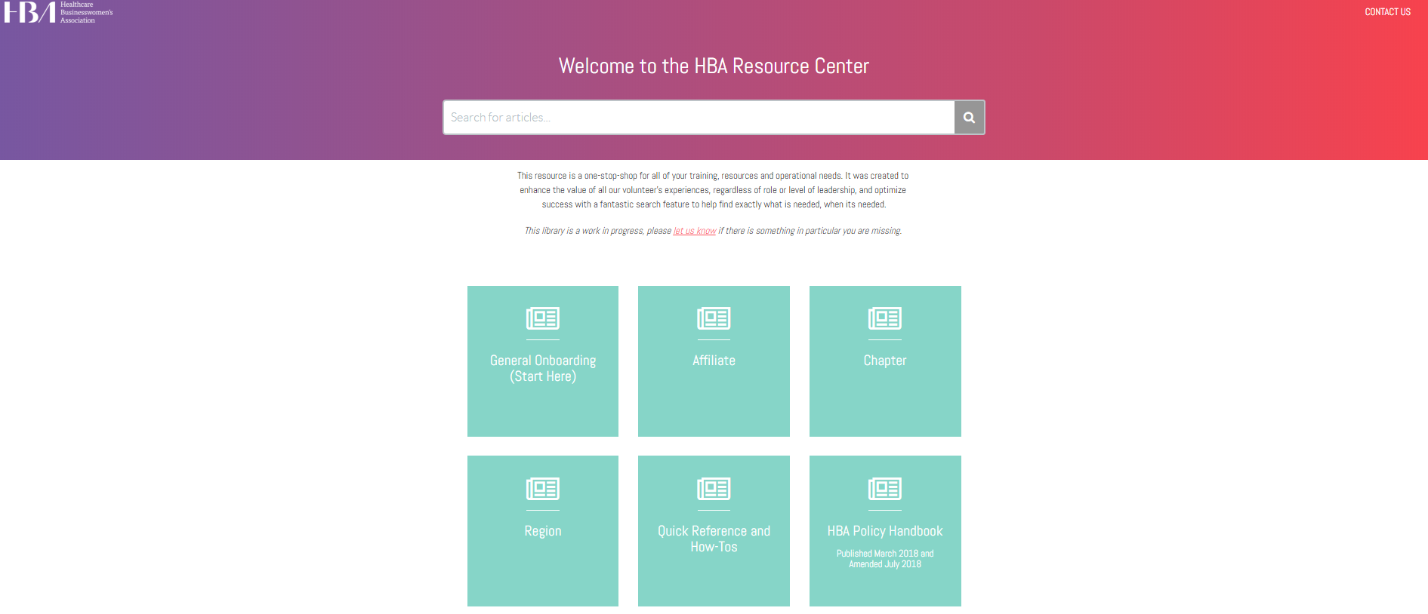
Notes:
The HBA Resource Center should be your first stop whenever you have questions or need something. This houses all of HBA’s non-proprietary resources for all functional areas and policies. It offers a search function as well to help you find what you need quickly and easily. If you’re completely new to HBA, I suggest first reviewing the General Onboarding before diving in further.
I highly recommend bookmarking this site for future reference: https://hbavolunteer.knowledgeowl.com/help or also available on the HBA Website under the Volunteer Tab
Quick Walk-through

Slide 43
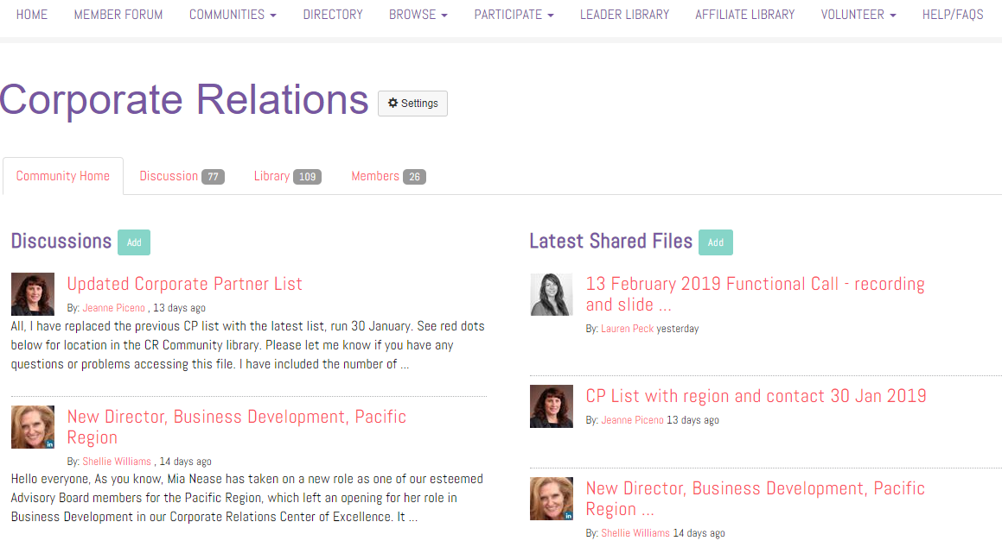
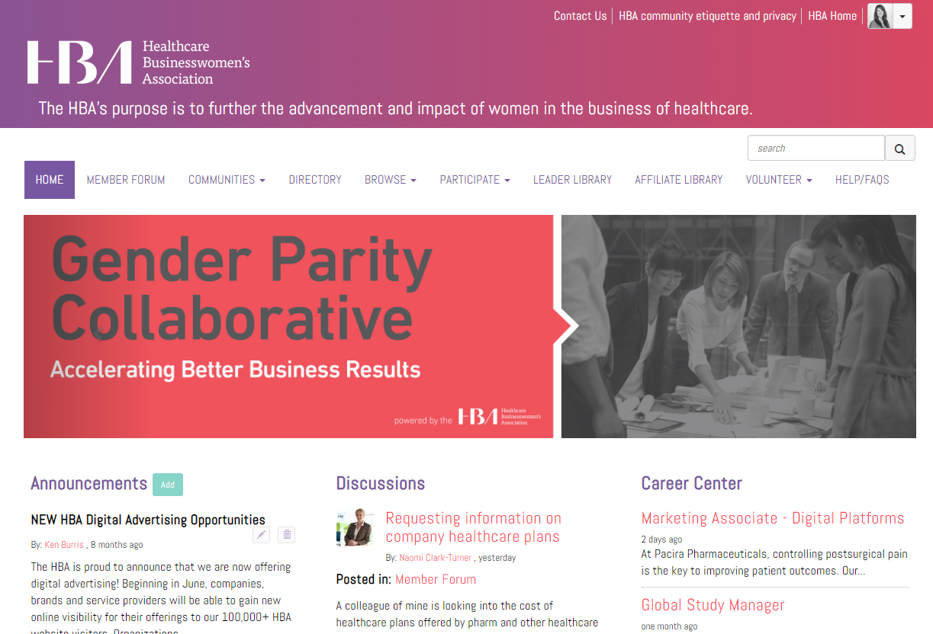
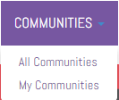
HBA Community
MORE DETAIL AND HOW TO SET NOTIFICATIONS
Notes:
The second is place to call out is the Corporate Relations Community, which you can get to via the HBA Website by logging in, selecting HBA Community then clicking Communities>My Communities, which will bring you to a list of all your specific Community forums. One of these forums will be the Corporate Relations community, which is available only to your fellow CR leaders (presidents and regional directors only) as it houses all of our proprietary resources.
Here we have a Discussion area where you can make announcements, ask for help from your fellow leaders and more! We’re constantly sharing new resources, tools, etc and keeping you in the know about important news. There is also a Library that houses our other important documents
Quick Walk through

Slide 44
CR tools and resources
Tool | What it is | Where it is
HBA Policy Handbook | A list of all CR policies that must be held to by all CR volunteers | Resource Center
CR role descriptions | Includes role descriptions for CR presidents, regional directors, committee chairs and liaisons | Resource Center
Event Sponsorship grid (in-person and virtual) and necessary forms | This outlines Regional/Chapter sponsorship benefits that should be provided depending on the sponsorship level of an event and includes the current HBA Invoice Request and Sponsorship Agreement to be completed. Process document also available with addtl resources | Resource Center
CP packages | PDFs which show all details of each CP package option this year. Can be used for CP sales or benefits awareness | Resource Center and HBA website
CP applications | To be used when companies are interested in signing on as a CP. Please follow proper procedure as outlined in the Resource Center Article: How to process a Corporate Partnership | Resource Center and HBA website
Training slides and recordings | This recording for any future leaders Ambassador Program training for all leaders And more coming soon… | Resource Center
HBA Central Advertising Sales Sheet and Sponsorship/Ad Prospectus | For use in selling HBA advertising or Flagship (WOTY and Annual Conference) sponsorships/program ads | Resource Center and HBA website
HBA Pitch deck (updated annually) | A large PPT deck which should be customized to your region. Edit as needed to include your proper regional info, then save new versions and edit down as needed when you’re pitching. Should never be used in it’s entirety due to it’s length. | Resource Center
HBA Invoice Request and Sponsorship Agreement Form | Must be completed by the sponsor for every agreed chapter/regional sponsorship, whether cash or in-kind. For cash sponsorships, this form is necessary to generate an invoice for the company. For In-Kinds, it helps us to understand what is being donated | Resource Center
In-Kind sponsor receipt and donor letter | A secondary required document for in-kind sponsors, to be completed post-event and assess the true value of the in-kind donations for HBA’s auditing purposes. | Resource Center
Regional lead lists | List of potential leads/prospects, broken down by region for BD | CR Library
Ambassador program overview/pitch | Can be shared with CPs to share the value and benefits of starting an Ambassador Program | Resource Center
Notes:
Resource slides need to be updated, non-proprietary resources are in the Resource Center. Proprietary are only in the CR Community

Slide 45
CR tools and resources
Tool | What it is/what it’s for | Where it is
Procedures for… | Processing a new Corporate Partnership, processing cash and in-kind sponsorships, joining and renewing prepaid members, Lunch and Learns | Resource Center
HBA Value Selling Guide | A resource to learn and teach yourself the real value of HBA engagement and how to position HBA’s value to companies when selling. | Resource Center
Template: initial outreach email to prospects | Just a helpful template for outreach | Resource Center
Monthly-updated CP lists with contact info | This list is updated once/month with new CPs, drops and includes their HQ region, account manager, primary contact for the Corporate Partner account globally and more. | CR Library
Historical CP lists | Historical lists may be good for building new prospect lists and just for historical knowledge | CR Library
Lists of all HBA Central award winners archived lists | Includes past ACE award winners, Women of the Year, Honorable Mentors, STARs, Rising Stars and Luminaries | CR Library
2018 non-CP member list | A list of all our members in 2018 who worked for companies that were not CPs. A good resource for potential company prospects | CR Library
BD Prospect code policies | We are currently piloting allowing our BD leaders to give promo codes to potential prospects, allowing them to attend an HBA event for free and see the value. This document outlines all guidance for the codes usage and rules to follow which must be followed. | CR Library and Resource Center
Functional call recordings and slides | Each month’s call recordings and full PPT slide presentation for reference and/or if you were unable to attend the call or need to refer back | CR Library
CR Contact List | Includes all current CR leaders and staff across all regions (names, titles and emails) to more easily connect with your CR colleagues | CR Library
2018-19 BD Leads Lists by region | Lists of potential prospect companies for BD committees to consider outreach | CR Library
CR blank org chart | For use in tracking and outlining your regional team and committees | CR Library
Past year archives | Includes past year trainings/resources as well as past years targets, member lists, top event lists, etc in case they assist in your planning | CR Library
Notes:
**CRM note: if you ever need any historical information about a particular company, demographics, etc please just ask their account manager if they’re a CP and they will be happy to oblige! If not a CP, ask Ken or Jeanne who can get you a little info from our ZoomInfo license.
NOTE: Covid-19 has spurred the creation of additional tools and resources which can also be found in the Resource Center

Slide 46
HBA Central functional calls and reporting
Functional calls
Are scheduled monthly – currently the second Wednesday of each month at 12:00pm EST – and are required for the CR leaders (president, VP and regional directors) and regional liaisons at RD’s discretion.
These functional calls are an opportunity to connect live with your counterparts across regions, keep up to date with important developments/information, discuss best practices and brainstorm resolutions to issues.
Functional call slide decks also include a regional CR org chart, leadership contact list and leadership profiles so you can understand who your counterparts are and connect with them.
CRM/tracker reporting
Currently we have no formal CRM system available to our regional leaders, but we do ask that each region maintain a tracker listing all brick and mortar companies you are aware of and interacting with in your geography, and provide our team access

Slide 47
Questions?
Notes:
Now we haven’t had much time to deep-dive into the Business Development or Corporate Engagement process, but I’m working on additional training now and would be happy to meet with you one-on-one in the meantime. For now, does anyone have any questions??

Slide 48
Corporate Relations Team
Ken Burris – Senior director, global business development and sales
kburris@hbanet.org
Serene Hollingsworth – Director, corporate accounts
shollingsworth@hbanet.org
Kathleen Rietzl – Senior manager, corporate partner engagement
krietzl@hbanet.org
Lanesha Whitefield – Account manager, corporate partner engagement
Lwhitefield@hbanet.org
Gabrielle Todd – Associate manager, corporate partner engagement
Gtodd@hbanet.org
Jeanne Piceno – Coordinator, corporate relations
jpiceno@hbanet.org
Lauren Peck – Associate director, stakeholder engagement
lpeck@hbanet.org
Phone: 973.575.0606 ext. 2

Slide 49
Thank you

Slide 50
Appendix

Slide 51
CR Role and Responsibilities

Slide 52
President
Corporate Relations
President Role and Responsibilities
Contribute as thought leader to global, integrates CR global strategies and priorities to the regional planning, manages committees to provide expertise and/or offerings to region, ensure alignment of plans across chapter presidents and other departments’s.
Position Overview
Highly visible, senior leadership role offering significant exposure and networking opportunities in the local geography and across the global HBA organization
Primary liaison with Regional Directors within their COE and works closely with the Regional Council
Responsible for the Annual department business and financial plans, monthly department board reports
Notes:
Key Responsibilities
As a member of the Regional Council regional leadership team:
Work in collaboration with the Regional Council Chair and Council members to advance the mission of the HBA in the geography including HBA brand awareness, member engagement and company/business participation.
Defines and aligns COE priorities and plans with regional goals and objectives
Champions key regional growth initiatives
Ensure good working relationships between her/his COE committees, the broader regional leadership and volunteer population
As regional COE leader
Oversees creation of strategic and annual plan for designated COE area
Chairs COE Board meetings; ensures efficient and effective COE operations
Creates and manage annual COE Budget; responsible for annual COE P&L
Manages regional committee Directors; attends to succession planning for self and Directors; recommends candidates for leadership positions in COE to Regional Council Nominating Committee
Works with regional teams and HBA staff to ensure effective on-boarding and training of COE volunteers
Mentors, coaches and supports Directors in their leadership roles and professional development
COE’s are not directly involved in Affiliate stage, but as affiliates are promoted to chapter, COE leaders are responsible to ensure effective transition of new chapters into regional operating model
As broader <COE functional> expert
Sits on global council of COE presidents
Participates in defining/setting global COE strategy and priorities
Facilitates the collection and sharing of new/innovative approaches and ideas; provides as input for global council consideration
Ultimately Responsible for
1) Driving the expansion and entrenchment of the HBA value proposition with companies and organizations in the region
2) Satisfying chapter and regional event teams with required venues and sponsors

Slide 53
Business Development Regional Director
Develops annual regional BD strategy in line with HBA Central priorities
Develops lead/prospect lists with help of committee in line with the year’s target markets/ geographies, etc.
Responsible for development and maintenance of BD committee(s), ensuring training and access to materials, organized by industry or geography to:
  seek and coordinate venues/space for local events and flagship/event sponsorship efforts for non-corporate partner companies, collaborating with regional and chapter committees
  soliciting new sponsors and corporate partners within the territory and transitioning newly engaged corporate partners into HBA’s Account Management system/regional account management
Coordination with programming department to understand annual sponsorship needs and align planning, goals and activities to secure venues/space and sponsorship for events at non-CP locations
Maintenance of committee budget where appropriate
Participates in regular department leadership meetings, monthly HBA Central functional calls and other chapter/regional calls as appropriate

Slide 54
Corporate Engagement Regional Director
Develops annual objectives and corporate engagement strategies in line with HBA Central priorities
Maintenance of regional CP list (CRM) and potential Ambassador program prospect companies
Responsible for development and maintenance of CE committee(s), ensuring training and access to materials, organized by geography to:
  Liaise with Connectors and/or Community of internal Ambassadors for CPs with sites within the region to drive engagement with HBA, awareness of member/volunteer benefits and local events, sponsorship needs and other opportunities
  Assists in building “HBA Inside” within these companies to further engagement and as a precursor to the Ambassador Program
  Suggest CP companies for Ambassador Program consideration (Global Ambassador Committee will develop all programs)
  Work with account managers as needed to coordinate communications and meet CP needs
Coordination with programming department to understand annual sponsorship needs and align planning, goals and activities to secure venues/space and sponsorship for events at CP locations
Participates in regular department leadership meetings, monthly HBA Central functional calls, bi-monthly global Ambassador calls, and other chapter/regional calls as appropriate
Notes:
Realistic to have this group included in bi-monthly calls?

Slide 55
Ambassador Regional Director
A member of the CR department leadership, reporting directly to the CR President. Helps to shape the overall corporate relations strategy within the region, working often with the Programming department to align on opportunities and corporate asks across the CR teams.
Responsible for managing the Ambassador Programs within their region, ensuring connections between the Ambassador Programs, local chapter(s), advisors and the regional department to build relationships, engage company participants and fulfill regional/chapter sponsorship/venue needs.
Manages and aligns a number of committee chairs, who oversee direct liaisons to each Program. Ensures team members are accountable for their roles/responsibilities. Attends to succession planning as needed.
Holds regular meetings with committee chairs to define expectations and share information
Develop strategic growth initiatives for the region/recommends potential companies to GAC for new programs through collaboration with Corporate Engagement teams (proactively and with prioritization in mind). Communicates recommendations on prospective programs to the appropriate GAC senior director(s) (and company global leads, where applicable) to ensure no overlap, to prioritize the programs being set up and to begin the set up process.
  Note: program set up requests can come through in various ways. The goal is to strategically grow the program across the region, but plans must be flexible to accommodate unplanned company interest/inquiries.
Ensure new committee members are trained, understand HBA policies and have access to required materials to be successful in their roles
This role and it’s committees are optional for each region depending on the number of Ambassador programs in the geography. Once a region has 3+ Ambassador programs, they should begin exploring adding this role to their organizational chart. See HBA Central staff for assistance.
Notes:
Term length: 2 years (multiple terms can be held consecutively)
Time commitment:
Monthly
Monthly CR COE calls – 1 hour
Monthly CR functional calls – 1 hour
Monthly Ambassador team calls – 1 hour
Strategic planning/growth planning and execution – 1 hour
Succession planning/team management – 1 hour
Email/team coordination – 2 hours
Quarterly:
Ambassador GAC meeting – 1 hour
Programming alignment meeting – ~2 hours
Overall commitment ~ 2-3 hours per week

Slide 56
CR Global Committee Chair
and
HBA Central
Similar to our existing “ideal” organizational structure, the Ambassador RD would build a team of regional committees, which are led by a committee chair who manages multiple liaisons.
CR COE committee structure
Corporate Relations
COE President
Each region can have as few or as many committees as necessary to serve their area. These committees can be dedicated to a specific smaller geography, industry, etc. as determined by the CR COE leadership.
Regional Director
Operations and Analytics
Regional Director
Business Development
Regional Director
Corporate Engagement
Regional Director
Ambassador Program
Regional Director manages all committee chairs and is the direct connection between them and the CR COE
Committee 1
Committee 2
Committee 3
Committee 1
Committee 2
Committee 3
Committee 1
Committee 2
Committee 3
Committee chairs ideally are past Ambassadors looking to get more involved after their program year (or a GAC member looking to get involved locally). They liaise with current Ambassadors and the local chapter(s) to understand all needs/ opportunities
Committee Chair
Committee Chair
Committee Chair
Committee Chair
Committee Chair
Committee Chair
Committee Chair
Committee Chair
Committee Chair
Liaison 1
Liaison 1
Liaison 1
Liaison 1
Liaison 1
Liaison 1
Ambassador 1
Ambassador 1
Ambassador 1
Liaison 2
Liaison 2
Liaison 2
Liaison 2
Liaison 2
Liaison 2
Ambassador 2
Ambassador 2
Ambassador 2
Liaison 3
Liaison 3
Liaison 3
Liaison 3
Liaison 3
Liaison 3
Ambassador 3
Ambassador 3
Ambassador 3
One Ambassador from each program would be the official “liaison” to the regional committee each year
Notes:
Committee structure is flexible enough to allow regions to set up as needed and to allow rapid program expansion. In the future, if necessary, an additional level of leadership can be added under the regional director to divide a large region into 2 smaller, more manageable regions.

Slide 57
The CR COE committee structure
Each region can have as few or as many committees as necessary to serve their area. These committees can be dedicated to a specific smaller geography, industry, etc. as determined by the CR COE leadership.
How does it all work at the local level? this is complicated so we don’t expect you to understand immediately, write down questions, how to get them answered.
CR Global Committee Chair
and
HBA Central
Corporate Relations
President
Focus: COE ops/admin and MR insights
Regional Director
Operations and Insights
Committee Chair: operations
Operations committee
Committee Chair: insights
Insights committee
Regional Director
Business Development
Regional Director
Corporate Engagement
Regional Director
Ambassador Program
“Area” committees are to be defined by the region based on needs/geography, but are not dedicated to a chapter, just the companies within the defined geographic area
Committee 1
Committee 2
Committee 3
Committee 1
Committee 2
Committee 3
Committee 1
Committee 2
Committee 3
Committee Chair
Area 1
Committee Chair
Area 2
Committee Chair
Area 3
Committee Chair
Area 1
Committee Chair
Area 2
Committee Chair
Area 3
Committee Chair
Area 1
Committee Chair
Area 2
Committee Chair
Area 3
Liaison 1
Liaison 1
Liaison 1
Liaison 1
Liaison 1
Liaison 1
Ambassador 1
Ambassador 1
Ambassador 1
Liaison 2
Liaison 2
Liaison 2
Liaison 2
Liaison 2
Liaison 2
Ambassador 2
Ambassador 2
Ambassador 2
Liaison 3
Liaison 3
Liaison 3
Liaison 3
Liaison 3
Liaison 3
Ambassador 3
Ambassador 3
Ambassador 3
Customer focus: prospects and non-CP sponsors
Customer focus:
CP companies
Customer focus: Ambassador Program sites
Customer focus:
CP companies
Notes:
The easiest way to explain how to best set up your committees is by going over the structure from top to bottom in. On a global level, we have a number of CR staff (mentioned earlier) and one Global Committee Chair, who is a fellow volunteer leader and will works closely with the staff, CR COE presidents on global strategy and implementation ideas.
The president oversees the regional directors, and each of the regional directors should aim to build out multiple regional CR committees under them, one dedicated to every AREA that has HBA presence within in your region – these are your “boots on the ground.” They live, work and volunteer within that specific geographic area and they report to the regional director. Their job is to engage with the companies in their area and match company needs with HBA chapter/region sponsorship needs, programs and other opportunities.
“Geographic area” is very vague here due to the fact that all of our HBA regions are very different. Committees in one region may oversee an entire state or country, in other areas they may only oversee a small chapter geography. This needs to be defined by each regional leadership team on what best meets the needs of the region. (click) Also, each region can define how many committees they need overall to best handle the tasks.
NOTE: it is incredibly important that these committees are dedicated not to a specific CHAPTER, but rather to the companies WITHIN that geography. This will ensure that we are meeting the needs of the companies first, while also making sure we fulfill chapter AND regional sponsorship needs. The companies must always be our first priority as the customer, and their increased local engagement will holistically lead to more sponsorship.
Each of these committees is led by a committee chair, whose job it is to directly liaise with the regional director to understand regional needs and CR priorities, communicate directly with the chapters to understand their needs/opportunities, and then push that information to their committee “liaisons’ who can work to match company needs with opportunities and for the company’s overall awareness and engagement. The volunteers on these committees are like “account managers” in a sense – working with local companies to better engage their local brick and mortar location and it’s employees with HBA, sharing opportunities and ways to get more involved like sponsorship, etc.
For any new regional director starting off without a team, one of your first major goals should be to build one to help you do the work and allow you to be more strategic. These teams work together on their focus area and drive success for the overall CR COE and the region

Slide 58
Operations and Insights RD
Leadership and strategic planning:
The Operations and Insights RD is a member of the regional CR COE leadership, reporting directly to the CR COE president. Helps to shape the overall corporate relations strategy within the region, working often with the Programming COE and Market Research teams to inform planning/decision making.
Functional responsibilities:
The individual is responsible for two areas*:
  Operations: the overall organization, administration and reporting for the CR COE
  Insights: using data, insights and trends to recommend and inform COE strategic planning and committee focus.
Committee management:
This regional director may engage one committee chair to lead each two functional areas (one for Operations, one for Insights). These committee chairs can engage and lead a committee under them to assist in the handling of responsibilities. The RD is responsible to oversee these chairs/committees and to ensure:
  committee members have appropriate training and access to materials, tools and resources
  prompt delivery on expectations
  proactive succession planning
  alignment of committee planning, goals/activities with other regional/chapter committees
*Detailed functional responsibilities can be found on the following slide.

Slide 59
Operations and Insights RD
Detailed functional responsibilities:
This RD is responsible for the following operations and insights responsibilities for the COE, and/or managing 1-2 committees (led by a committee chair) to handle each function:
  Operations: organization, administration and reporting
  Maintenance of regional CR committee lists/record keeping and repository of regional best practices/training/SOPs
  Ensure all CR team members have up to date CR tools/resources; check materials/agreements for accuracy and consistency
  Builds and maintains CRM of regional company data and ensures proper reporting
  Tracking of sponsorships and company participation, KPIs/goals and other metrics
  Manage COE calendar, meeting organization and agenda creation
  Coordination and meeting participation as needed with Programming COE to understand sponsorship needs and align planning
  Insights: using data, insights and trends to recommend and inform COE strategic planning and committee focus
  Liaison to Market Research (MR) RD and committees*, requesting research and data analysis to make better informed decisions/find trends to support the needs of the region. Examples include but are not limited to:
    Research company/market data for business development and to prioritize committee focus
    Analysis of existing customer and other data to find trends
    Provide HBA Central CP survey results for relevant insights into companies and segments
    Conduct additional targeted or ad hoc research as needed to support regional strategy
    Work cross-functionally within the region (with engagement, marketing/communications, programming and chapters as needed) to pull together relevant data, insights and trends in those areas to inform CR planning
  Use and share insights gleaned to provide suggestions, improvements or inform strategic planning and focus
*Note: this individual/team is not responsible for doing the data/trend analysis themselves (which is a function of MR), but instead liaises with MR in requesting needs for the COE

Slide 60
PILOT IDEA: Connectors as Committee members
Rather than developing volunteers to be the liaisons for multiple companies in CE, go direct to the company employees
Find HBA advocates at each company location (think: pre-Ambassadors) to act as the HBA liaisons/connectors
  1 to start but eventually/ideally 2-3 individuals per company to avoid territoriality, ease succession planning and ensure workload is manageable
  Connectors work internally within their company to drive awareness for HBA and also bring company engagement priorities back to the COE
Connectors report directly to Committee Chair for their area
Corporate Relations
COE President
Regional Director
Regional Committee
Area 1
Pros:
Lessens the number of CR volunteers to recruit as “account managers”
GOES DIRECT to the companies - working with actual company employees and eliminating the middle-man
Could consider offering potential benefits to the Connectors like monthly/quarterly meet up for cross-company networking and Ambassador program-type opportunities for exposure
Potential cons:
Consider doing at the higher levels first? Or all levels? Better service/engagement could encourage CPs to upgrade or alternatively, could encourage them to downgrade because levels of service have gone up
Might necessitate some sort of a regionally specific newsletter for CPs or other way to keep all Connectors in the know
Committee chair
Company 4 Connector(s)
Company 1 Connector(s)
Company 5 Connector(s)
Company 2 Connector(s)
Company 6 Connector(s)
Company 3 Connector(s)
Notes:
NEED to determine proper name: Ambassadors is too confusing – perhaps Connector or Liaison?

Slide 61

Mentoring Programs
A healthy mentoring relationship is opportune for mentors and mentees—with the added bonus of enhancing on-the-job performance. Become a changemaker in your organization by leveraging the HBA.
The HBA’s mentoring program empowers YOU to share professional goals, fears and challenges with seasoned professionals who have seen it all. Our mentors leverage their robust experiences to provide guidance, offer feedback and illuminate insights to help mentees advance their careers.
Since 2014, the HBA mentoring program has impacted over 3,000 professionals. Now is YOUR time.
2021 Regional Mentoring Programs:
Europe, Mid-Atlantic, Midwest, New England, NYNJCT, Pacific, Southeast, Southwest, Canada

Slide 62
Affinity Groups
Boost your career by participating in one or more of HBA’s affinity groups.
Get Involved
  Network with like-minded members and HBA chapter members and leaders
  Gain exposure with volunteer leadership opportunities
  Participate in virtual or in-person programs focused on group specific information and education
Build Community
  Join virtual communities for discussion and career-centric dialogue
  Build a targeted professional network
  Share personal and professional experiences and success stories
Stay Connected
  Gain access to key individuals and content for a select slice of the industry
  Stay abreast of current trends, innovations and emerging roles and jobs opportunities
  Establish direct connections to mentors and coaches
2020 Active Affinity Groups
Entrepreneurship, Fit to Lead, HBA iLead, Tomorrow’s Executives, Women in Healthcare Give Back, Women in Science, Women in Transition, Women of Color

