Slide 1
About the HBA
Insert presenter name(s) here

Slide 2
Table of Contents
Overview
Membership
Programming
Signature and Regional Events
Corporate Partnership
Gender Parity Collaborative
Contact Information

Slide 3
Overview

Slide 4
Core Purpose and Mission
Core Purpose:
To further the advancement and impact of women in the business of healthcare
Mission:
The Healthcare Businesswomen’s Association is a global nonprofit organization comprised of individuals and organizations from across the healthcare industry committed to:
Achieving gender parity in leadership positions
Facilitating career and business connections
Providing effective practices that enable organizations to realize the full potential of their female talent
The HBA accomplishes its mission through strong business networks, education and leadership development and global recognition of outstanding individuals and companies.

Slide 5
What Is the HBA About?
https://www.youtube.com/watch?v=conw0EtV6CY

Slide 6
Key Stakeholders
Business Professionals:
The HBA serves women in the business of healthcare who strive to advance their careers. We offer career resources, volunteer opportunities and an invaluable network that empower women of all backgrounds to grow professionally. When you are part of the HBA, you are empowered to advance your career, your company and gender parity as a catalyst for change across the business of healthcare.
Corporate Partners:
The HBA’s initiatives and community of industry leaders and peers help companies advance their women further, faster. When you partner with the HBA, you strengthen your company’s commitment to advancing women, enhance your competitive edge and become a catalyst for change.

Slide 7
A United Force for Change
When members of the HBA come together, it’s with a shared purpose: to be a united force for change. We connect diverse groups of both women and men, across all healthcare and life science disciplines.
By taking focused action to advance our mission, we are creating a powerful movement that directly drives professional opportunity and corporate growth.
We believe that by joining forces in the relentless pursuit of gender parity, we are doing more than uniting individuals—we are strengthening the business of healthcare.

Slide 8
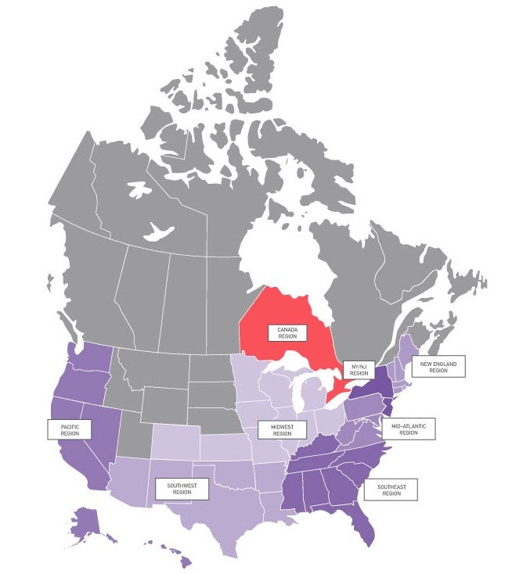
HBA Locations: North America
Canada Region
Toronto
Mid-Atlantic Region
Baltimore
Greater Washington
Mainline Montco (PA)
Montgomery Corridor (MD)
Philadelphia
Richmond
West Chester
Midwest Region
Chicago-Downtown
Chicago-Northern Suburbs
Cincinnati
Columbus
Denver
Indianapolis
Kansas City
Minneapolis – St. Paul
St. Louis
New England Region
Boston
Fairfield County, CT
Marlborough
Waltham
NY/NJ Region
Central New Jersey
New York
Northern New Jersey
Rochester
Pacific Region
Los Angeles
Orange County
San Diego
San Francisco
Seattle
Southeast Region
Atlanta
Charlotte
Miami
Palm Beach
Research Triangle Park
Tampa
Southwest Region
Albuquerque
Austin
Dallas– Fort Worth
Houston
Phoenix

Slide 9
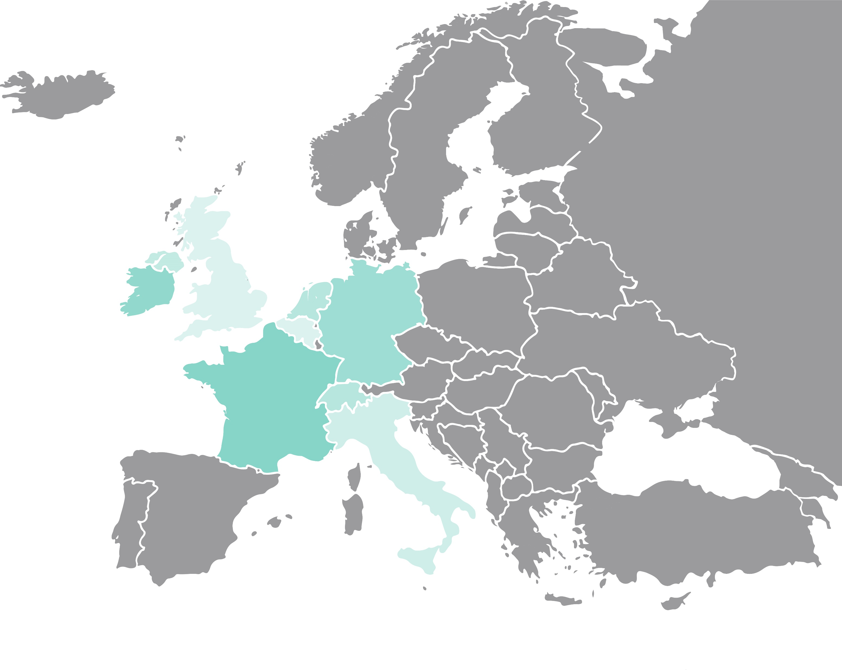
HBA Locations: Europe
Europe Region
Basel
Berlin
Brussels
Dublin
Frankfurt
London
Lyon
Milan
Paris
Suisse Romande
Zurich

Slide 10
Membership

Slide 11
Membership
Connect with nearly 10,000 other passionate healthcare and life science professionals, representing more than 1,000 companies.
Explore new skills, share your expertise, advance your career and be a catalyst for change.

Slide 12
The Value of HBA Membership
Up to 50 percent discount to more than 500 events across the globe
Invitation to exclusive, member-only events such as the HBA Annual Conference and local networking opportunities
Access to online member directory, forums, online Career Center and resource libraries
Opportunity to join affinity groups based on your interests
Join member-only formal mentoring programs to enhance your professional success
Leadership opportunities to broaden your professional experience and gain industry visibility
Receive recognition of leadership contributions through volunteer awards
Steer the future and governance of the association by nominating leaders and exercising voting privileges in the annual business meeting

Slide 13
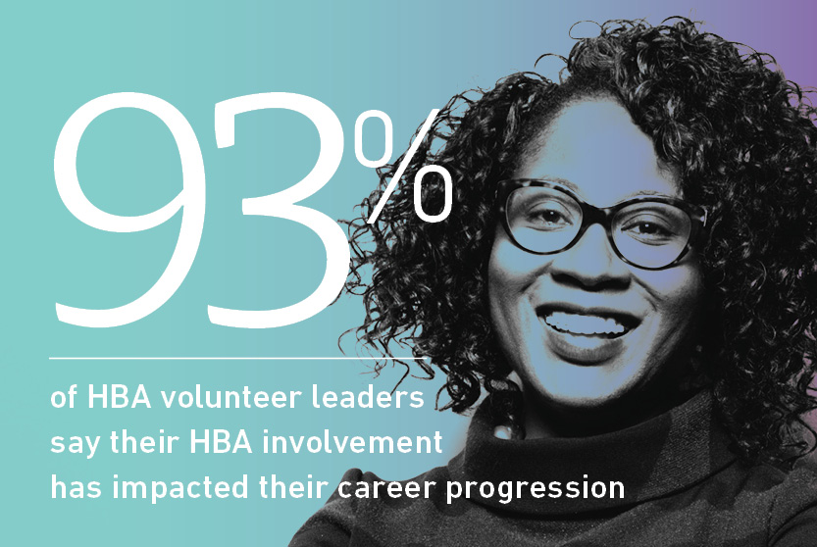
Career Advancement Through Leadership
The HBA offers hundreds of engagement opportunities to make a difference
Build your leadership experience
Increase your visibility and professional connections
Advance your career
Notes:
Let’s add numbers or data points here based on recent discussion—can be bulleted too

Slide 14
HBA Members Talk Professional Enrichment
https://youtu.be/mvi8S16UfHk

Slide 15
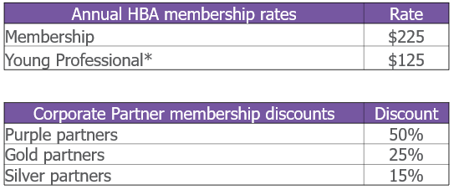
Individual Membership Fees
*This membership rate for those 30 and under includes all benefits of full membership except voting in the annual business meeting and the ability to serve on boards. Additional discounts do not apply to this membership type.

Slide 16
Programming

Slide 17
Leadership Competency Framework
HBA programs are mapped to these competencies to assist with professional development planning.
Enlighten
Demonstrates integrity
Communicates effectively
Exhibits business and industry acumen
Empower
Displays professional presence
Determined to achieve
Makes decisions and takes risks
Engage
Influences and persuades
Builds relationships and teams
Networks and ethically self-promotes
Evolve
Facilitates change
Fosters innovation
Continues to learn, grow and transform

Slide 18
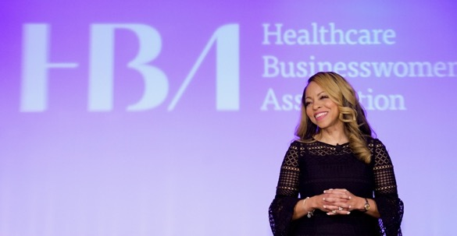
In-Person and Virtual Events
HBA members receive up to 50 percent discounts to:
500+ in-person chapter and regional events annually throughout North America and Europe
Virtual programs, such as the quarterly Career Conversations webinar series, as well as free access to select webinar offerings throughout the year
Signature events, namely Woman of the Year and Annual Conference

Slide 19
International Women’s Day
The HBA will join in celebrating International Women’s Day on 6 March.
New and renewing members will receive an opportunity to save money on their annual membership dues and participate in digital activities to make the most of this important international day.
Stay tuned to the HBA’s social media channels for the latest details on the celebration!

Slide 20
Webinar Series
The HBA’s virtual webinar offerings continue in 2020 with more webinars to be purchased individually or as a series.
A sampling of topics addressed in 2019 included:
Opportunities in a Changing Ecosystem
Visibility in Virtual Work
Becoming an Effective Leader
Growing from an Individual Contributor
Stay tuned!

Slide 21
Career Conversations
The HBA’s career advancement and professional development webinar series continues in 2020 with more webinars to be purchased individually or as a series. The theme will focus on ”vision.”
The series topics addressed in 2019 included:
Cultural Sensitivity
Collaboration
Courage
Connections
Stay tuned for details!

Slide 22
Smart Tips: Communication
Frequent presenter and HBA member Deborah Riegel has partnered with the HBA to offer an exclusive discount for her Udemy course.
Learn how to communicate with impact, master presentation skills, give and receive effective feedback and navigate tricky conversations.

Slide 23
Business Partnering in Digital Innovation
Business partnering – working more effectively and efficiently across functional areas – helps us drive and accelerate innovation in our own companies, increasing our impact and contribution to the business.
Take your career to the next level with the industry’s first and only Certificate Program for Business Partnering in Digital Innovation. Partnering with the Center for Communications Compliance (CCC), the Healthcare Businesswomen’s Association launched the program in 2018 to incredible success.
Registration is open; the program begins
March 2020.

Slide 24
Mentoring Programs
A healthy mentoring relationship is opportune for mentors and mentees—with the added bonus of enhancing on-the-job performance. Become a changemaker in your organization by leveraging the HBA.
The HBA’s mentoring program empowers YOU to share professional goals, fears and challenges with seasoned professionals who have seen it all. Our mentors leverage their robust experiences to provide guidance, offer feedback and illuminate insights to help mentees advance their careers.
Since 2014, the HBA mentoring program has impacted over 3,000 professionals. Now is YOUR time.
2020 Regional Mentoring Programs:
Europe, Mid-Atlantic, Midwest, New England, NYNJ, Pacific, Southeast, Southwest

Slide 25
Affinity Groups
Boost your career by participating in one or more of HBA’s affinity groups.
Get Involved
Network with like-minded members and HBA chapter members and leaders
Gain exposure with volunteer leadership opportunities
Participate in virtual or in-person programs focused on group specific information and education
Build Community
Join virtual communities for discussion and career-centric dialogue
Build a targeted professional network
Share personal and professional experiences and success stories
Stay Connected
Gain access to key individuals and content for a select slice of the industry
Stay abreast of current trends, innovations and emerging roles and jobs opportunities
Establish direct connections to mentors and coaches
2020 Active Affinity Groups
Entrepreneurship, Fit to Lead, HBA iLead, Tomorrow’s Executives, Women in Healthcare Give Back, Women in Science, Women in Transition, Women of Color

Slide 26
Signature and
Regional Events

Slide 27
2020 Woman of the Year
29 April – New York, NY
Celebrate excellence in leadership with 2,000 healthcare and life science industry leaders at the HBA’s exciting and spirited Woman of the Year event where we will recognize our 2020 honorees. Also lauded will be over 100 industry Rising Stars and Luminaries.
This intimate and engaging experience is not to be missed!
“If it’s springtime in New York, it’s Woman of the Year time.”
- Alex Gorsky, CEO, Johnson & Johnson
2019 Woman of the Year, Honorable Mentor, and STAR
Notes:
We’ll want to add in an image from Jen if possible that shows the treatment we’ll be using

Slide 28
2020 Virtual Woman of the Year
29 April – New York, NY
Celebrate your colleagues, mentors, mentees and friends being honored at the 2020 Woman of the Year. This year’s live stream offers the opportunity for companies, individuals and groups - large and small - to take part in the celebration.
Individual and site licenses will be made available. Stay tuned for the list of viewing parties hosted by local chapters across the HBA regions.

Slide 29
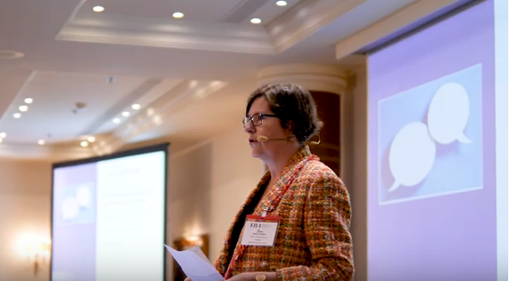
2020 European Leadership Summit
1-2 October – Brussels, Belgium
The European Leadership Summit convenes over 300 healthcare leaders to enjoy interactive workshops, TED-style talks, networking and expert speakers discussing the steps they are undertaking within their organizations in order to achieve gender parity.

Slide 30
2020 Regional Seminars
Stay tuned for locations!
Regional seminars provide the opportunities for attendees to build on critical skillsets, learn collaboratively with other healthcare businesswomen and a unique avenue for expanding networks and building relationships.
In 2019, the HBA welcomed Chiara Motley of GK Training and Communications as the host of the seminar series: Speak To Be Heard: Why Presence Matters and How to Master It. The seminar travelled across the country, stopping in three major cities.
Stay tuned for details about what’s to come for 2020!

Slide 31
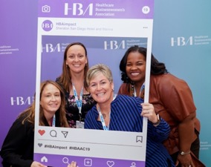
2020 HBA Annual Conference
17-19 November – Chicago, IL
The Annual Conference convenes women and men at every career stage to educate and empower them as change agents to drive innovation throughout the healthcare and life sciences industry.
Attendees learn best practices and practical solutions for solving industry-wide problems, hear from experts to radicalize their strategic thinking, develop impactful relationships with their colleagues and build their networks.
Representing cross-sector leadership within the greater industry, attendees continue the work to further the advancement and impact of women in the business of healthcare.

Slide 32
Corporate
Partnership

Slide 33
Corporate Partnership
The business of healthcare is changing rapidly and following the trends won't be enough. Lead the way by sponsoring HBA events - and gain the competitive advantage for high-profile visibility and exposure.
The Value of Partnership
Strengthened commitment to advancing women
Enhanced competitive edge through increased recognition through HBA’s international presence
Empower women in your company with proven opportunities for leadership development and growth
Stronger relations with organizations across the healthcare industry
Driving gender parity from the inside out, ultimately resulting in better business outcomes

Slide 34
Corporate Partners*
* Partial Listing

Slide 35
Corporate Partners

Slide 36
Five Corporate Partner Packages in 2020
Our corporate partner packages have been built to meet the needs and desires of all healthcare and life science organizations. Choose the path for your company by visiting HBAnet.org/corporate-partners or emailing us at CorporatePartners@HBAnet.org.

Slide 37
Rising Stars and Luminaries
Eligible corporate partner packages offer the option to name either a Rising Star or a Luminary. Standard purple and gold corporate partner packages include recognition of two award winners.
HBA Rising Stars are professionals in the early stages of their career. They represent various sectors of the healthcare industry and are designated by HBA's corporate partner organizations. The honor recognizes individuals’ outstanding performance, commitment to excellence and valuable contributions to their companies’ success. The Rising Stars are inspiring leaders, role models to others and are celebrated for their vision, dedication, and action.
HBA Luminaries are professionals with more than 20 years of professional industry experience, serve as a role model in their company, actively mentor and sponsor others and are a shining example of transformational leadership that the organization wants to formally recognize.

Slide 38
Building Better Business Connections (3BC)
Established in 2019, 3BC is an annual event chaired by an industry through leader wherein senior leaders from HBA corporate partner organizations (purple, gold and silver) work together to collectively overcome organizational challenges and achieve business goals.
Summit topics address challenges facing HBA corporate partners:
Building and Growing Internal Women’s Networks (IWNs)
Metrics that Matter: Strategies to Build the IWN Business Case
Blind Spot: Hidden Biases of Good People
Sponsorship: Breaking the Last Glass Ceiling
Innovation, Diversity and Market Growth
Power of the Purse
Technology and Gamification: Turning Disruption into Opportunity for Women and Business
Save the date for 2020: 30 April, sponsored by Microsoft

Slide 39
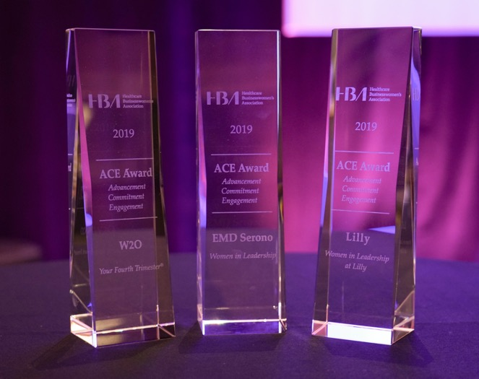
ACE Award
The prestigious ACE awards program recognizes exemplary leadership initiatives that advance and enhance the careers of women.
Open to public and private companies of all sizes
Winners gain significant industry visibility
Receive feedback from independent judges on:
Business performance
Sustainability
Stewardship
Execution
Measurable results
2019 ACE award winners

Slide 40
Ambassador Program
The ambassador program is the HBA solution for corporate partners to accelerate the development, advancement and visibility of their female talent pool.
Currently available to purple and gold corporate partners.
An HBA-trained advisor assists companies to build “HBA Inside.”
Self-directed and customized to corporate goals
Develops motivated and engaged HBA community inside company
Accelerates the development and visibility of talent within your company and fuels the career advancement of participants.
Individual success metrics created and tracked
Connects company colleagues globally with multiple ambassador programs.

Slide 42
Gender Parity Collaborative
The Gender Parity Collaborative (a.k.a the “Collaborative”) is a unique consortium of healthcare and life-sciences companies dedicated to accelerating gender parity. Together, our Collaborative members commit to taking an active role in defining strategies, measuring performance, creating change and inspiring others.
The Collaborative brings together senior executives from various industry organizations to discuss the necessary environmental and systemic changes needed to accelerate the pace of change — and transforming our industry in the process.
By taking bold action to close the gender gap, the healthcare and life-sciences industry can achieve more.
Collaborative Member Organizations as of January 2020
For more information, visit GenderParity.HBAnet.org or email us at GenderParity@HBAnet.org.

Slide 43
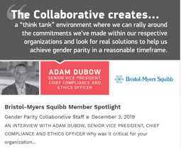
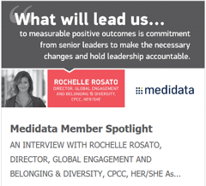
Gender Parity Collaborative
Commitment:
provide C-suite participation,
provide company’s HR and gender-related data for benchmarking and tracking through the most comprehensive study of its kind – the Women in the Workplace study, conducted by McKinsey & Company and LeanIn.org,
be an active consortium participant and publicize their commitment.
In collaboration with:
Read about what Collaborative leaders have to say by visiting the News and Reports section of our website.
Lead the change, take action and join the Collaborative.
GenderParity.HBAnet.org | GenderParity@HBAnet.org

Slide 44
Contact info
Insert contact info here

