Slide 1
Programming COE
Functional Call
29 October 2020

Slide 2
Agenda
Welcome
Quick updates:
Upcoming event no-go dates
Calendly/Airtable usage – regional/chapter alignment
Speaker admin/agreements
Zoom SWAT teams
Annual Conference coming up!
2021 Programming Guidance
COE division - discussion

Slide 3
Programming Leadership
Organizational Chart
HBA Central staff support
Lauren Peck, senior manager, stakeholder engagement
Barbara Bull, director, member experience
Global Committee Chair
TBD
Pacific
Region
Southwest
Region
Midwest
Region
Southeast
Region
Mid-Atlantic Region
NY/NJ
Region
New England Region
Europe
Region
Allison Marshall
Ana Barbosa
Emily Hobaugh*
[vacant]
Ruth Martin
[vacant]
[vacant]
[vacant]
Erin O’Brien
Regina Juliano
Mary Sylvester
Jessica Buday
Dawn Kumiega
Becky Kelly
Dagmar Albers
Diana Calderhead
Programming
Presidents
Op Ex
RDs
Last updated 28 Oct 2020

Slide 4
Quick updates
Event no-go dates due to global/US major holidays
25-27 Nov, 2020 – US Thanksgiving Holiday
21 Dec, 2020 – 5 Jan, 2021 – Holiday season/New Years
Speaker administration management:
Putting the responsibility on the speaker to ensure their information is accurate:
Protects not only the HBA, but our volunteers and speakers and better complies with GDPR guidelines
Speakers often request multiple changes and picture updates/title changes so it is best that they can go in a do it themselves.
We hear minimal complaints from speakers when they understand the reasoning behind it.
To better assist our volunteer leaders in getting used to this new process, we’ve created a few resources that illustrate how it works:
Event Speaker Management Guidance – includes links to the front-end HBA Help Center so you can copy/paste directly to a speaker
Speaker agreement-specific article
Best practice:
When engaging a speaker, SW found that it helps to let them know this is part of the process during the initial outreach.

Slide 5
Educational webinar scheduling considerations
Check Calendly to see what dates/times are available for booking
Webinars must be opened for registration at least four weeks in advance of the live broadcast
Step-by-step process for setting up educational webinars is available in the resource center: https://hbavolunteer.knowledgeowl.com/help/virtual-educational-event-setup
Notes:
Check Calendly, our dynamic scheduling tool, to see what dates/times are available for booking. Calendly is for booking educational, association-wide webinars; local engagement and networking events do not need to go through Calendly. This tool was created to avoid competing webinars.
Webinars must be opened for registration at least four weeks before the webinar takes place. This ensure optimal promotion time.
The Step-by-step process for setting up educational webinars is available in the resource center.

Slide 6
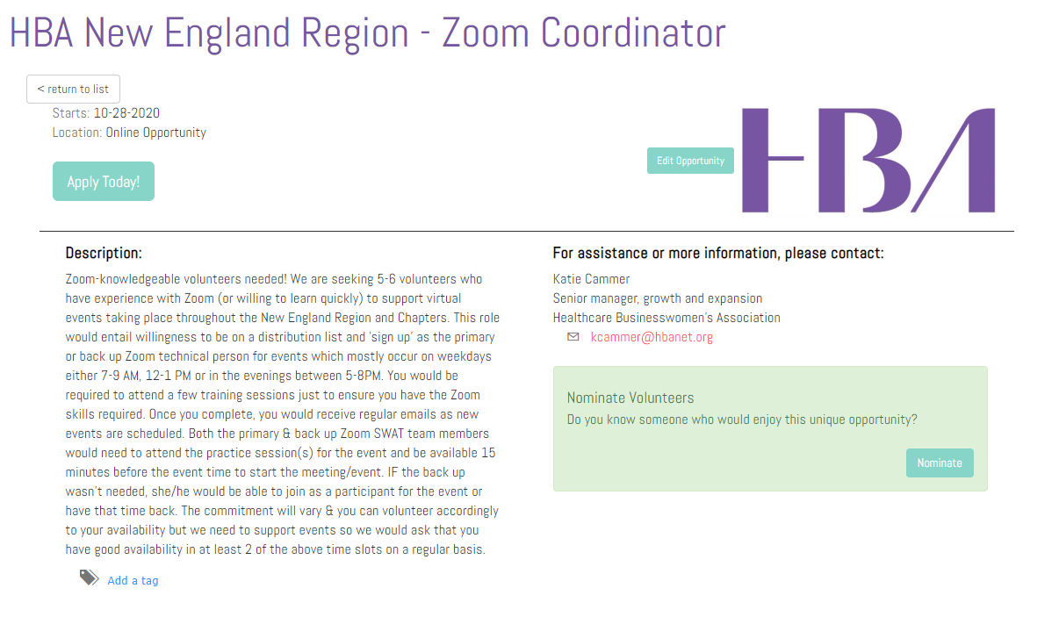
Zoom Coordinator opportunity
Katie will be opening this opportunity for all regions –
Thanks New England for developing!!!

Slide 7
Annual Conference FYI
Regular registration and the CP pass deadline upcoming: 30 October!

Slide 8
Programming guidance for 2021

Slide 9
Program planning guidance for 2021
Assumptions:
Q1 & Q2 fully virtual; second half a mix of in-person virtual
Chapters/regions entirely handle their own webinars/virtual events
Budgetary assumptions: will vary depending on the region
Chapter event recommendations each quarter:
~1 education (sponsored/partnership with local companies when able) event. We recommend no more than 1/quarter to focus on quality vs quantity, avoid burnout and to help the region better coordinate/avoid duplicative topics and replication of work. Smaller chapters can do less than 1 per quarter.
Quality over quantity: Revenue, Reach, Relevance
2-3 networking and engagement
Reasoning:
If each 50+ chapters do 1 educational webinar per quarter, that’s over 200 and doesn’t even include regional, affinity or HBA Global webinars.
Networking/engagement events are light lifts and while they don’t bring in revenue, they are a huge value-add to local members.

Slide 10
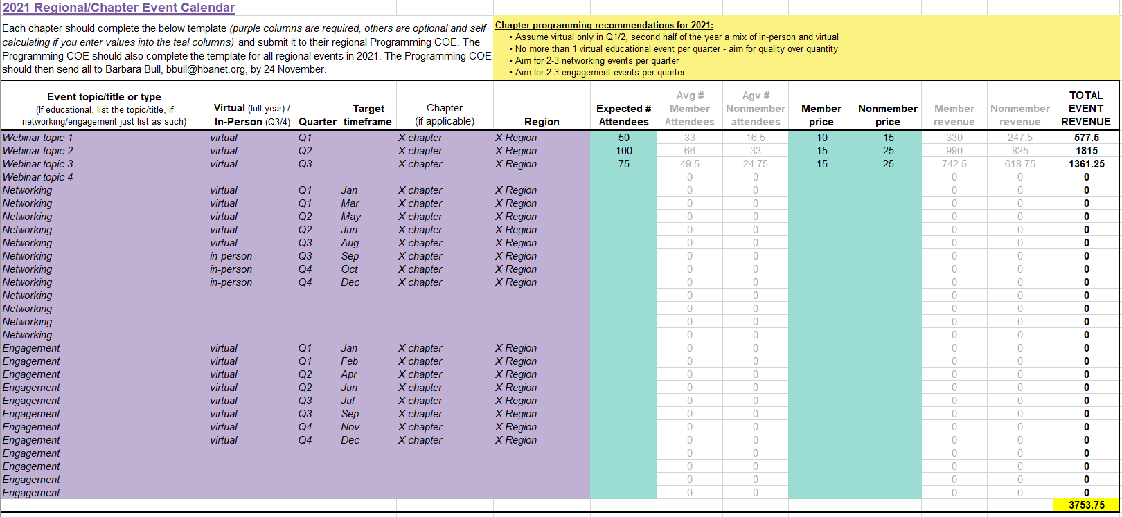
Program plans
Template available here!
Notes:
For those of you who haven’t yet begun formally program planning for 2020, use this template! If you have already begun working on them, just send to Barbara.

Slide 11
Programming COE division discussion / next steps

Slide 12
Appendix

Slide 13
HBA Strategic Plan
Strategic Success Measures (achievement of our top strategic priorities over 2021-2023)
Satisfaction - new and retained customers with launch of a new member model
Growth - within CPs and a geographic presence based on CP support
Impact - number of companies and amount of progress towards gender parity
Brand awareness - recognition as a key strategic driver of change and a trusted partner
Sustainability - top and bottom line growth and healthy reserves
Four Strategic Levers
1
Customers
2
Relevancy
3
Advocacy
4
Infrastructure
Members* Collaborative members Volunteer leaders Sponsors
Offerings target corporate needs Executives and allyship impact Virtual, FTF & hybrid modalities
Brand awareness & integrity Gen Par education and progress
Technology Volunteer leadership support Knowledge Center
13

Slide 14
Webinar sponsorship packages - draft
Feedback from last time:
Packages still too high in price, need to make it easier for companies to get involved and allow more flexibility for now
Consider a more blanket-approach? Low-level packages sold to multiple companies to raise awareness for the program
We need to be able to clearly articulate the value prop and maximize value/visibility

Slide 15
Regional
Chair
HBA
Experience
What’s next?
Regional
Deputy Chair
Regional
Treasurer
Phase 1: now – Jan 2021
Market Research
Accounting/Analytics
Procurement/Processing
Programming and Engagement division
Corporate Relations
Member Experience
Leader Experience
President
President
President
Add new VP and ops/insights roles as optional to all departments
Ops/ Insights
VP
Ops/ Insights
VP
Ops/ Insights
VP
Business Development
Member Recruitment
Leader Recruitment
Corporate Engagement
Member Engagement
Leader Recognition
Ambassador Program
Develop new role descriptions
Experience Center
Education And Events
Program Offerings
Marketing and Comms
Continued socialization of new concepts and mindset shifts, especially the flex structure
President
President
President
Ops/ Insights
VP
Ops/ Insights
VP
Ops/ Insights
VP
Events
Mentoring
Marketing
Education / Content
Affinity Groups
Communications
Cross-functional teams:
Conferences
Social Media / PR
Chapters
Change management
Concept refinement
Notes:
I’m sure you’re all asking yourselves “what comes next?
I am happy to share that we are planning to handle all of these and any future changes as they come. We will be taking our time, doing them right and handling them in phases. This will not be an overnight switch as it was when we moved into our operating model a few years ago. We hope also that this long-term, phased approach will help further emphasize our culture of feedback and adaptation
Luckily many of these concepts have actually already been socialized to the regional programming and engagement teams – so the most immediate changes you will see will be there over the next few months, and likely before 2021. We’ll be working closely with these COEs over the coming months to determine which of the new or revised roles are needed for their region and who on their teams might be appropriate to fill them. This way, in a few months when we have everything necessary in place, we’ll only be dealing with a few title shifts here and there
We’ll also add the option to add VPs and operations and insights roles to all the regional departments. Again: optional
We’ll be developing new role descriptions that are simplified, concise and clear to outline the new positions and the new departments as well.
We’ll continue over the coming months to socialize and more clearly define these new concepts, mindset shifts and connections. Especially the idea of the flex committee structure, which will also be introduced and refined at the chapter level along with some chapter committee refinements we’ve identified. Nothing major, just some committee structure changes
Lastly – and this is where everyone comes in – we’ll be pulling together a few cross-functional working teams to focus on change management AND refining the concepts we shared with you today to ensure the connections, reporting structure, titles and role responsibilities are the best they can be and so we don’t miss any gaps.

Slide 16
Regional
Chair
Market Research
President
HBA
Experience
VP
Regional
Deputy Chair
Regional
Treasurer
Accounting/
Analytics
Regional Executive Assistant
Procurement/
Processing
Chapters
Corporate Relations
Member Experience
Leader Experience
Chapter
President
President
President
President
Chapter Ops
VP
Chapter
President
Ops/ Insights
VP
Ops/ Insights
VP
Ops/ Insights
VP
DAL
DAL
DAL
Possible service departments
IT/tech support
Marketing services
Operations
Finance
Chapter Ops
VP
Business Development
Member Recruitment
Leader Recruitment
DAL
DAL
DAL
Chapter
Corporate Engagement
Member Engagement
Leader Recognition
President
Ambassador Program
Leadership Advisory
Chapter Ops
VP
Chapter
DAL
DAL
DAL
Education And Events
Program Offerings
Marketing and Comms
President
Chapter Ops
VP
President
President
DAL
DAL
DAL
President
Chapter
Ops/ Insights
VP
Ops/ Insights
VP
Ops/ Insights
VP
President
Chapter Ops
VP
Chapter
Events
Mentoring
Marketing
President
DAL
DAL
DAL
Education / Content
Affinity Groups
Communications
Chapter Ops
VP
Conferences
Executive Offerings
Social Media / PR
DAL
DAL
DAL
Experience
Center
Local Value
Center
Operational Excellence
Center
Communications & PR
Notes:
POTENTIAL, not final

