Slide 1

Team Training

Slide 2
Agenda
Introduction to inMotion ignite
Platform Overview & Navigation
Requests
Project Management
Reviews
Additional Features
Action Items

Slide 3
Welcome to inMotion ignite!🔥
inMotion ignite is the most versatile platform purposely designed to empower teams to achieve better content outcomes for their brand. From request intake to project management to proofing, inMotion ignite will help us align, manage, and assess our creative and marketing content.
List of all the reasons that your company chose this platform including:
Problems being solved
Outcomes you’re using ignite to help you achieve
Expectations for trainees following the training (examples: begin test projects, practice with real projects, etc.)
Provide the dates of your roll-out schedule – when you will train Stakeholders and go live!

Slide 4
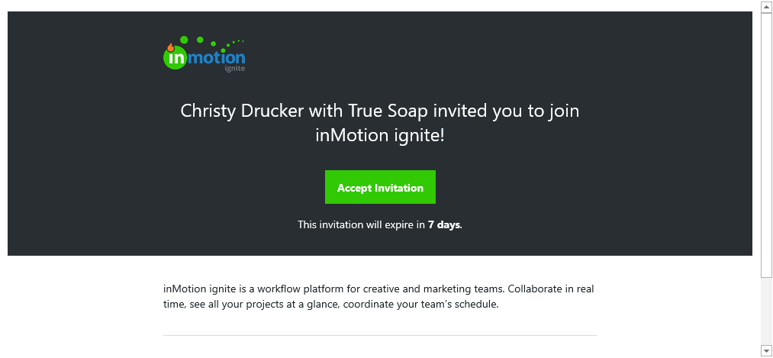
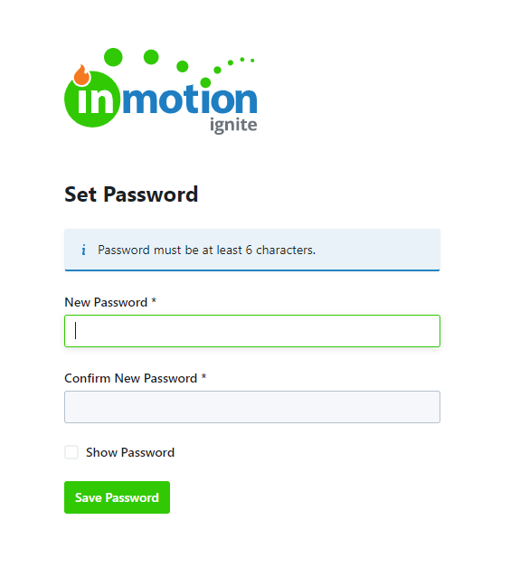
Create Your Account
1
You will receive an email from welcome@inmotionnow.com. Accept it!
Invites expire in seven days. If your invite expires, contact your name/main admin.
Accept invitation immediately
Create your account by setting a password
  Password requirements include:
Bookmark our unique inMotion ignite URL: teamname.ignite.inmotionnow.com
If you have trouble logging in, check out these Login FAQs
2

Slide 5
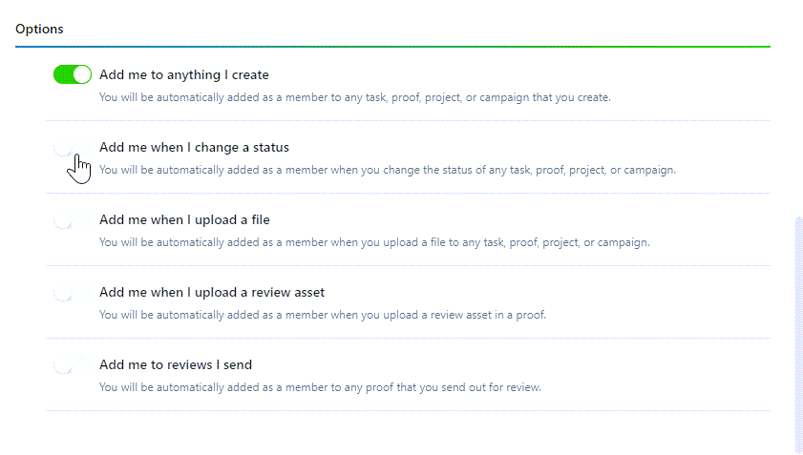
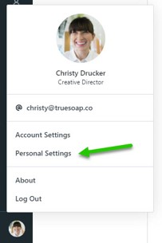
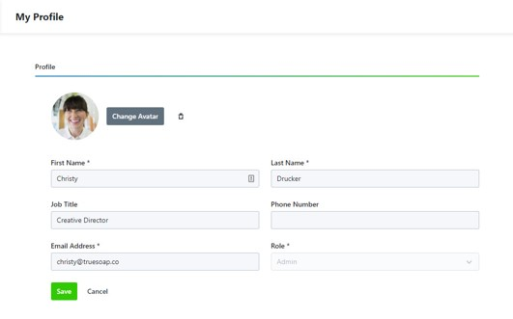
Updating Personal Settings
Access your Personal Settings
Update your profile
2
1
Read More: https://guide-ignite.inmotionnow.com/help/profile-management

Slide 6
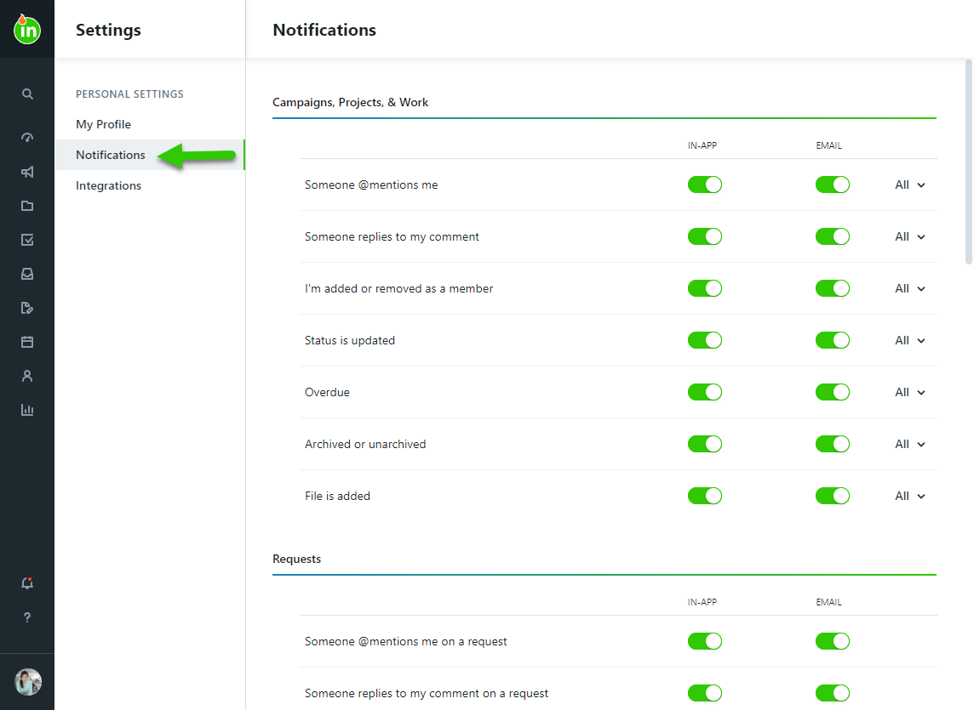
Updating Notifications
Manage your Notifications & Digest Settings
Read More: https://guide-ignite.inmotionnow.com/help/notifications

Slide 7
Platform Overview & Navigation

Slide 8

Core Roles in ignite
Stakeholder Roles*
Can request work
Review and approve work
Collaborate on requests & reviews
Receive deliverable files
*All based on permissions set within ignite.
Example Roles/Titles of Stakeholders:
List titles of stakeholders in your org
Team Member Roles* (YOU!)
Everything a Stakeholder can do, plus…
Manage incoming requests
Be assigned to and complete work
Collaborate on work and files
Send work for review
Create custom views and calendars
Create and reports on key metrics
*All based on permissions set within ignite.
Example Roles/Titles of Team Members:
List titles and roles of team members

Slide 9
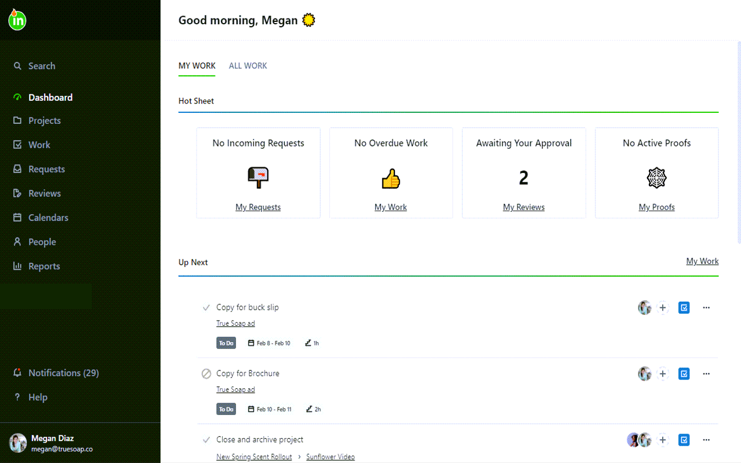
Getting Started
Full navigation opens when hovering over the ignite icon
Use Global Search to quickly find what you’re looking for in ignite
My Work vs All Work
Work is comprised of Tasks and Proofs
In-App Notifications
View the ignite Knowledgebase and contact Support
Access your Personal Settings

Slide 10
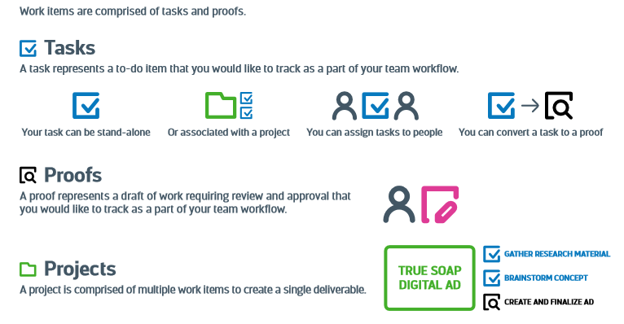
Working in ignite

Slide 11
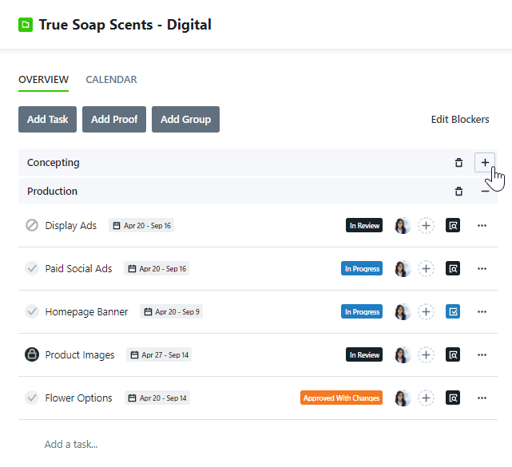
Workflow Example
Optional: Include screenshots of your team’s projects and work
Each project is a collection of multiple tasks and proofs

Slide 12
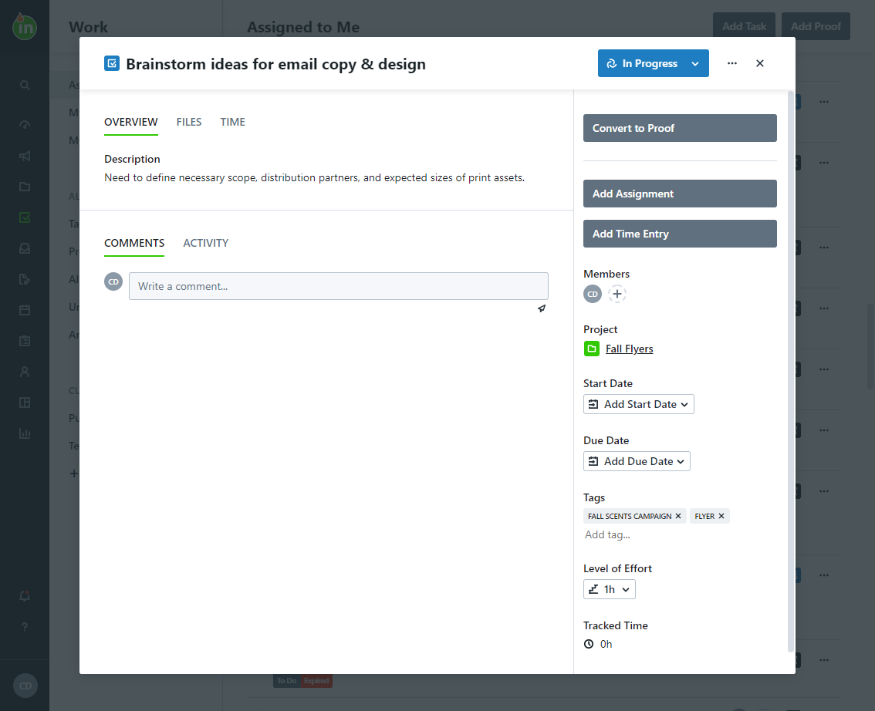
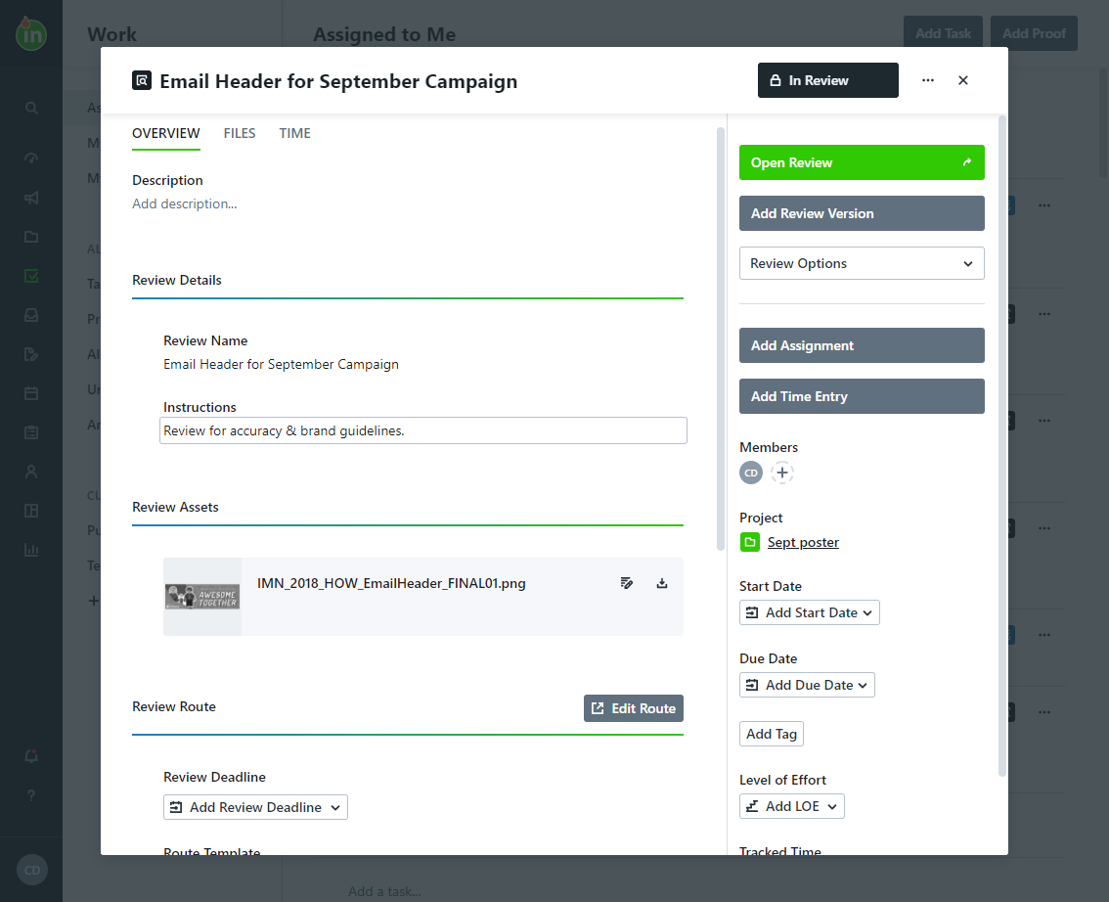
Workflow Example
Optional: Include screenshots of your team’s projects and work
Tasks are to-do items that do not need review
Proofs are to-do items for content that needs to be reviewed & approved by others

Slide 13
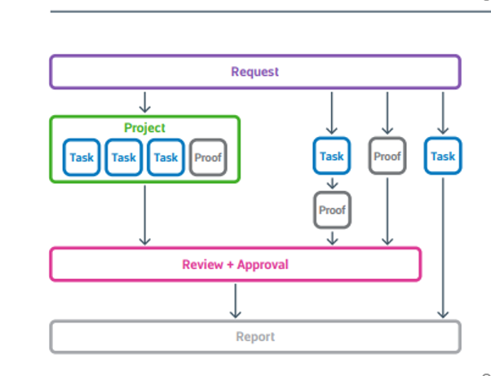
Workflow Example
Optional: Include an example process map(s) of your workflow.
At this point, we recommend completing your training within the app itself, so users can get hands-on. However, we’ve created the remaining slides for supplemental takeaways / reference material. As always, the most up-to-date articles can be found at https://guide-ignite.inmotionnow.com

Slide 14

Requests

Slide 15
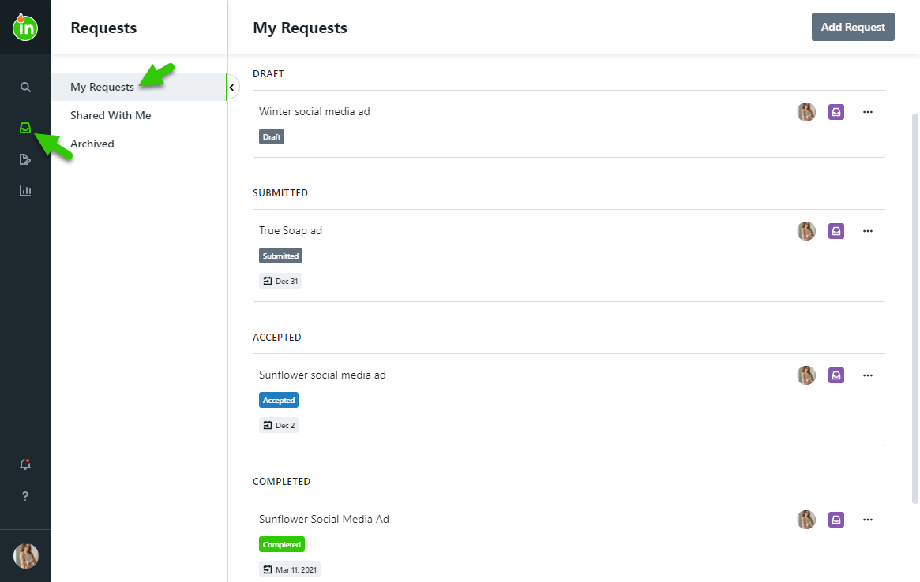
Requests
Create a New Request
Requests progress through the following statuses:
Draft: Still in progress; not yet submitted by the requester
Submitted: Acceptors are notified of the new request for review
Accepted: Acceptors have approved the request and created work to fulfill the request
Completed: Work is complete & the requester is notified
Archived: Work has been archived for future reference
Read More: https://guide-ignite.inmotionnow.com/help/requests

Slide 16
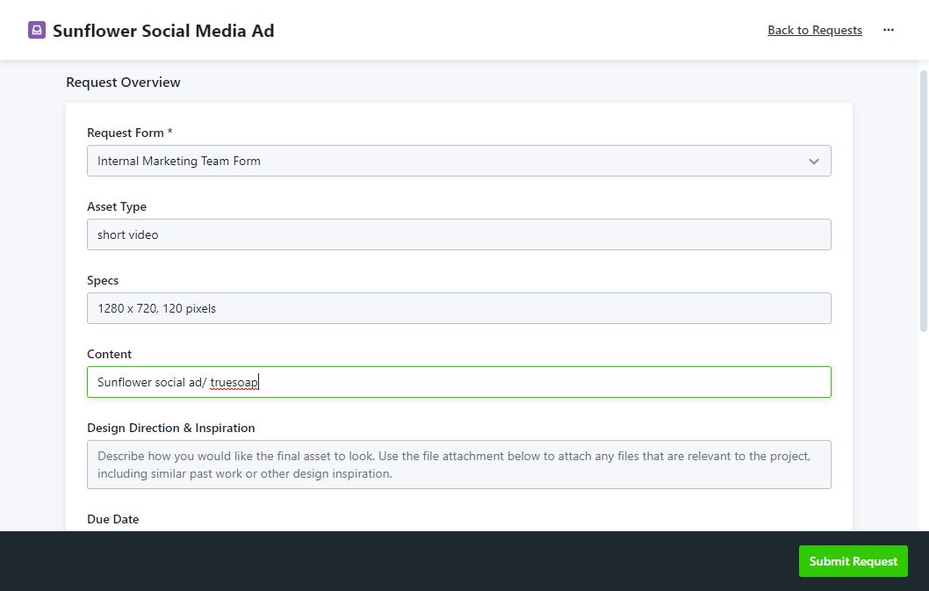
Creating a Request
Navigate to the Requests tab
Select Add Request
Name your request
Select the best form for your request needs
Fill out the form in detail – inputs are saved automatically!
Submit the request

Slide 17
Requests
Add Screenshots of your request forms & highlight fields that are important to your process.
Feel free to create multiple slides to show off your Request Forms and talk through your different expectations for each form ☺

Slide 18
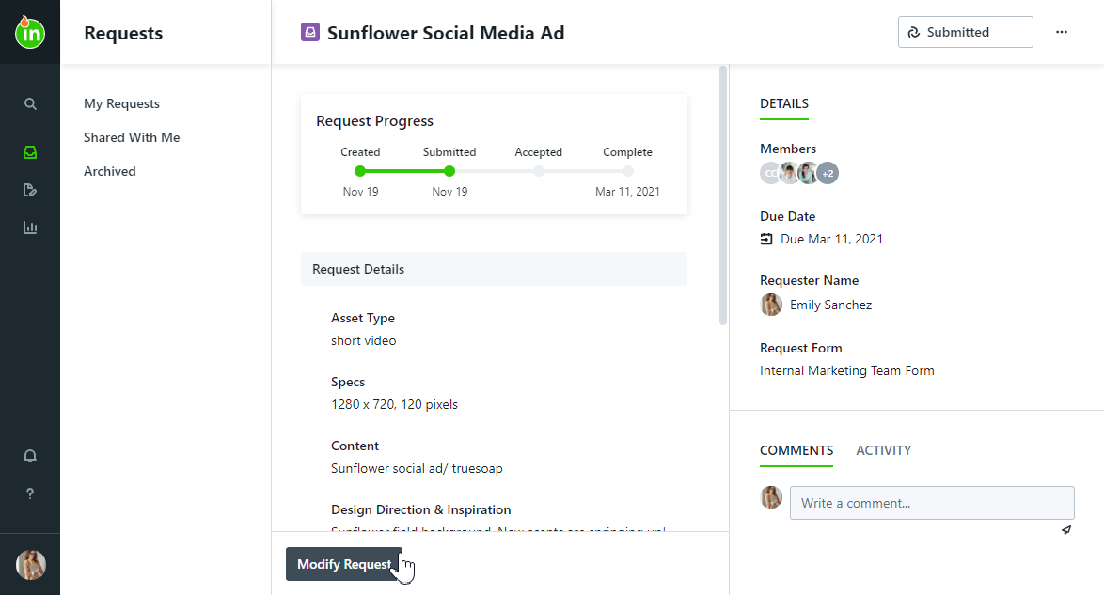
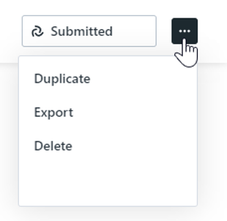
Updating & Sharing the Request
Before the request is accepted, you can modify it and/or communicate with the requester & other team members with permissions to accept
Duplicate requests to reduce repetitive work
Export the request as needed to review outside of ignite in a PDF format

Slide 19
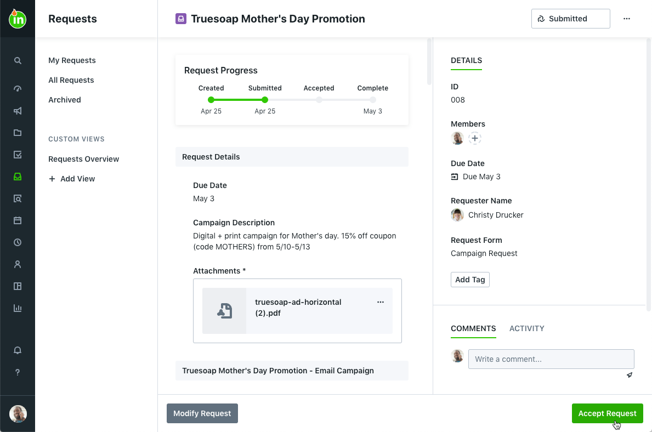
Accepting the Request
When a new request is submitted, associated acceptors will receive in-app and email notifications. The submitted request can also be accessed from the Dashboard and the Requests tab.
Requests can be updated before acceptance, but once accepted, requests cannot be modified!
@mention requesters with any questions or updates necessary for acceptance
You have the ability to decline the request (from the actions menu), which sends a notification back to the requester and returns the request into a draft state

Slide 20
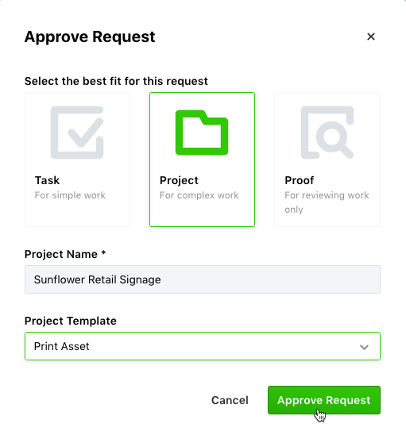
Creating Work from the Request
Once you accept the request, it can be associated with a new project, task, or proof (dependent on the type of work requested)
All updates made to the request are captured in the request activity for future reference

Slide 21
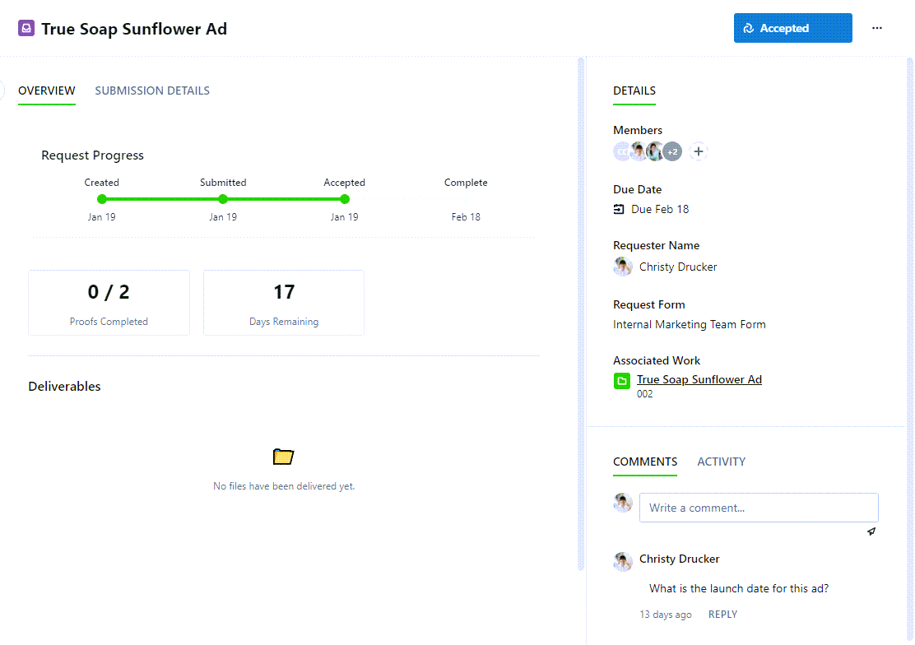
Monitoring Request Progress
The requester will be notified when the request is accepted and completed. They will also be notified of any updates to the due date
All other updates should be shared in the comments area – don’t forget to @mention the requester!
The original request can be viewed in the Submission Details tab
The requester will see:
  How many proofs they’ll expect to complete and the number of business days remaining
  Files shared as Deliverables

Slide 22

Project Management

Slide 23
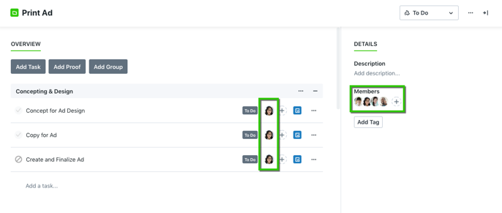
Membership
You will receive a notification when you become a work “member”
You will be able to see any work you’re a member of on your Dashboard and in “My Work” list views
You will also be able to see any work that is currently unassigned
When you are added to a task or proof, you will also be automatically added to their linked project
You will receive notifications when:
  The work status changes
  Files are added or updated
  The due date changes
  The work becomes overdue

Slide 24
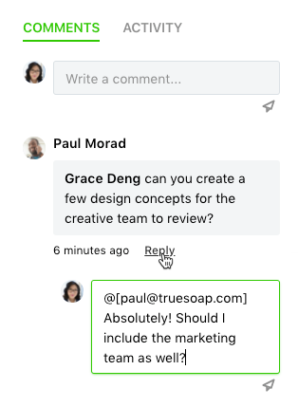
Collaboration
Throughout the system, you can collaborate with other users by commenting, replying and @mentioning on requests, projects, tasks, and proofs.
Locate the Comments tab on the related request, campaign, project, task or proof. Select the text area and begin typing to compose your message. Click on the send icon below the text area or type CTRL + Enter to post your comment.
Stakeholders can only see comments in requests and reviews. Any collaboration that takes place on a project, task, or proof will be available only to the Team Members on those work items
You will receive notifications when:
  You are @mentioned in a comment
  Someone replies to your comment
  Someone replies to a conversation you’ve participated in
Read More: https://guide-ignite.inmotionnow.com/help/collaboration

Slide 25
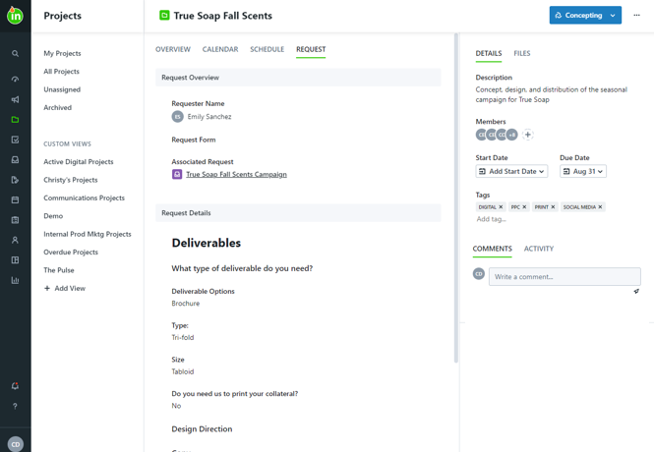
Accessing the Original Request
Quickly see request details, including the requester name and form submission, in the Request tab
Navigate to the Associated Request by clicking the request link to:
  View additional request details, including files provided by the requester
  Provide updates to and collaborate with the requester

Slide 26
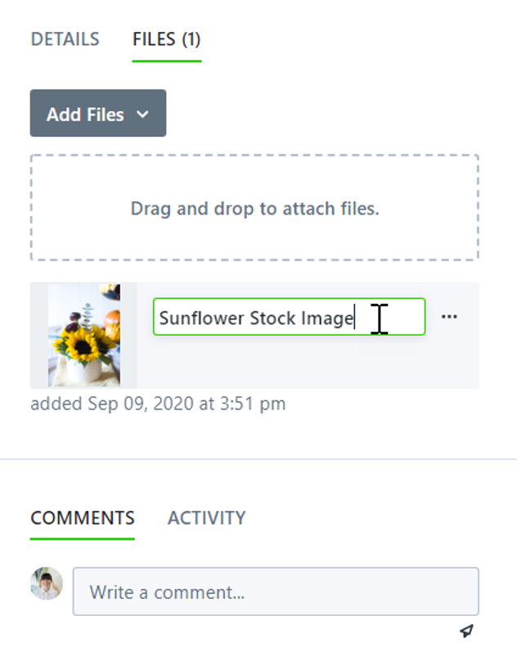
Uploading Files
Associate file(s) with each project for ease of use and team collaboration
Select the Files tab to upload or manage project files
You can also link to attachments from a website, storage, or integration
There is a 2gb limit to individual files uploaded
Files can be previewed, versioned, renamed, downloaded, and marked as deliverables to be made available to the requester
Read More: https://guide-ignite.inmotionnow.com/help/managing-project-files

Slide 27
Tags
Take screen shots of your tags in your Account Settings or place them in a bulleted list for your trainees. Take some time to talk about the importance of these items to your organization and when tags should or should not be used.
Read More: https://guide-ignite.inmotionnow.com/help/managing-tags

Slide 28
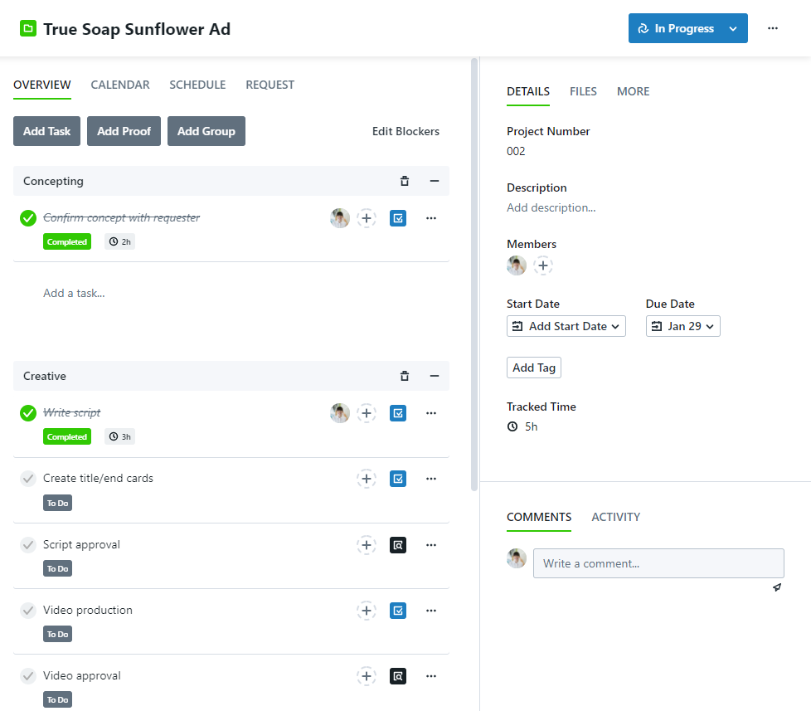
Project Overview
The Project Overview will show work groups that are comprised of tasks and/or proofs
Point out any areas of the project you want to bring to your team’s attention, like date fields, description, files, etc
Feel free to add in screenshots of your Project Statuses to show them off during training ☺
The Details side-bar will show information like Members, Due Date, and more

Slide 29
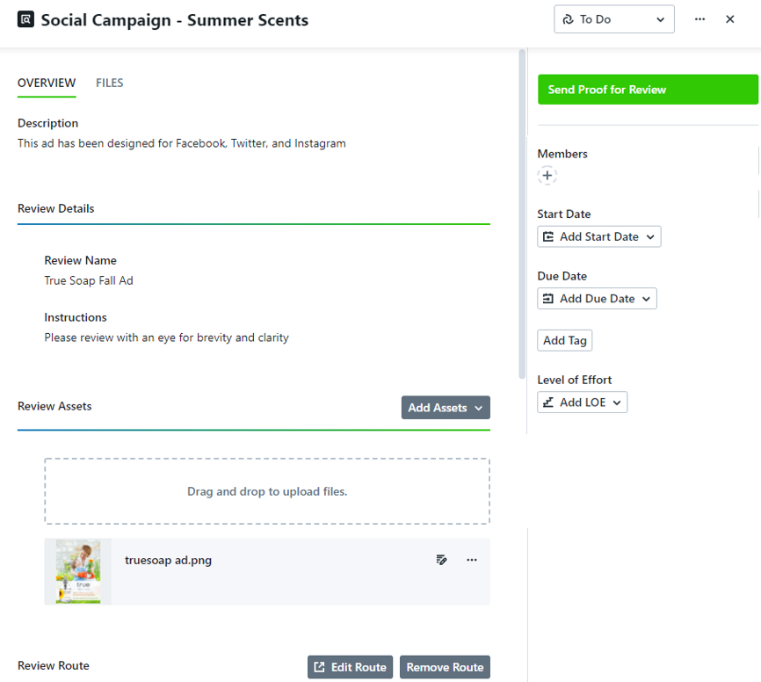
Sending a Proof for Review
A proof is similar to a task, with additional review related features that let you upload and customize the assets sent to reviewers.
A task can be converted to a proof as needed
Only Review Details, Review Assets, and Review Route sections are visible to reviewers
Update the Review Name & Instructions to provide additional details and context for your reviewers
In order to Send Proof for Review, you must have (1) Review Assets uploaded & (2) a Review Route selected
Once you send a proof for review, the proof’s status will automatically change to In Review.
Read More: https://guide-ignite.inmotionnow.com/help/creating-a-proof

Slide 30
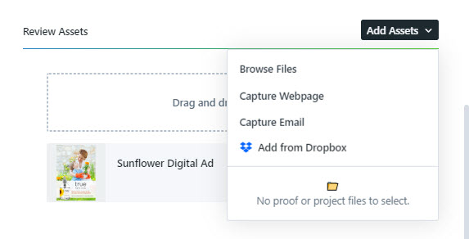
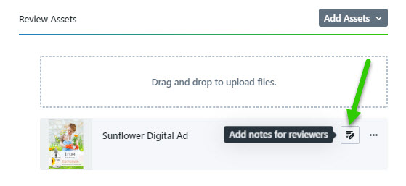
Uploading Review Assets
Any files in need of review can be uploaded as assets and sent out to the review environment.
Supported file types include PDF, Images, Microsoft Office, Multimedia, URL, and Emails can be sent for review
There is a 1 gb size limit for each asset file uploaded
Any files already added to the proof files tab, or linked project/campaign can be added for review (once per file)
To capture websites and emails, follow the provided instructions in-app. Once uploaded, you can remove, download, rename, and add notes to each asset
You can also view what the assets will look like within the review environment and add annotations before sending the proof for review
Read More: https://guide-ignite.inmotionnow.com/help/review-assets

Slide 31
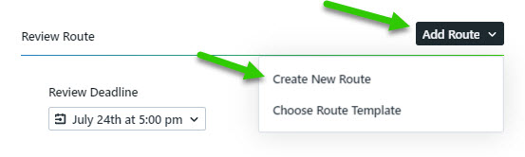
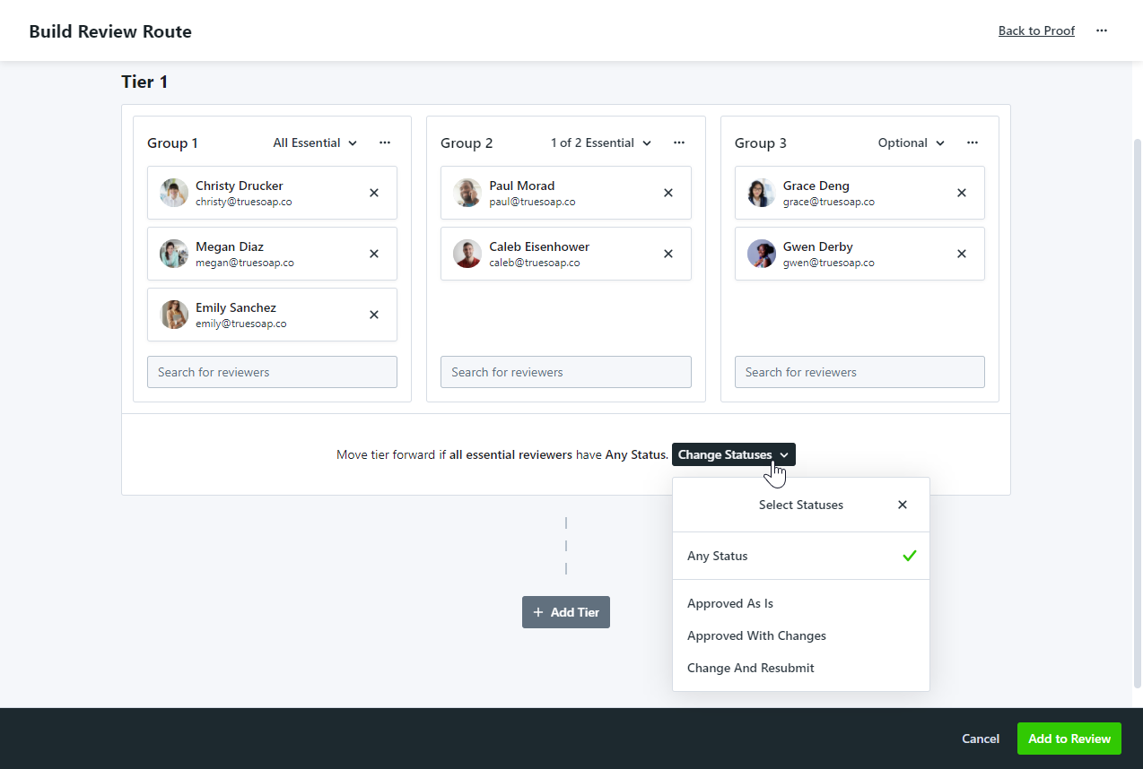
Selecting a Review Route
Review routes define the reviewers who will be responsible for approving your proof. You can create routes on the fly for an individual proof or select a route template! List route templates if you have built them for your team.
A review will only move forward in its route once all essential reviewers have submitted a review status. Any optional reviewers remaining will be skipped. Use review groups to designate each reviewer’s role in the review.
All Essential: Every user is required to submit a review status
Some Essential: Only the defined number reviewers are required to submit a review status
Optional: Reviewers are notified of the review, but are not required to leave a status
Reviewers do not need to be invited at one time. Create tiers and set rules that determine route progression.
Read More: https://guide-ignite.inmotionnow.com/help/review-routes

Slide 32
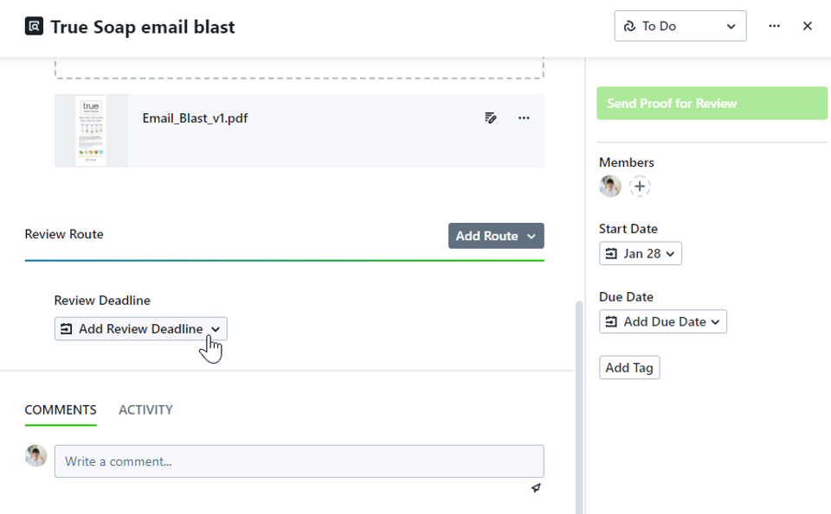
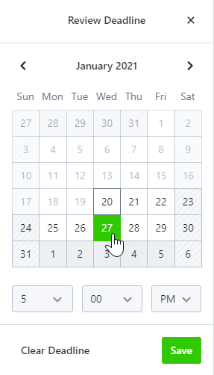
Selecting a Review Deadline
The review deadline defines the date and time that your reviewers need to complete their review.
The proof will be returned in an “Expired” status at the time and day selected, even if there are essential reviewers who have not completed their review.
Reviewers will receive notification of this deadline in their initial invitation and will be notified of any updates once they've been invited to the review
The review deadline can be updated to resend the proof as needed
This us an optional feature for more time-sensitive items

Slide 33
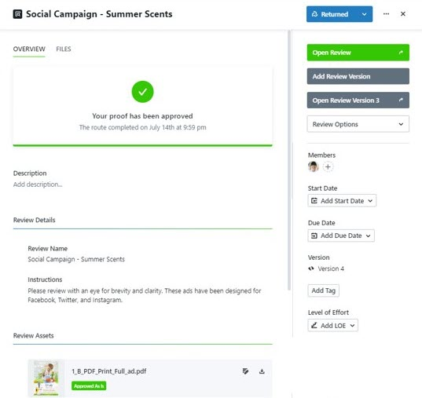
Returned Proofs
Based on the rules defined by the Review Route and Deadline, proof members will be notified that the proof has been returned. Approval statuses are aggregated at the review level, review asset level, and individual reviewer level.
Approved As Is: If all reviewers approve all assets
Approved With Changes: If at least one reviewer selects “Approved With Changes” on at least one asset in the proof
Change & Resubmit: If at least one reviewer selects “Change & Resubmit” on at least one asset in the proof
Expired: If the route deadline hits before all required reviewers have submitted their approval status
Cancelled: If you decide to manually cancel the review
Define what actions you’d like the team to take when each aggregate state occurs.

Slide 34
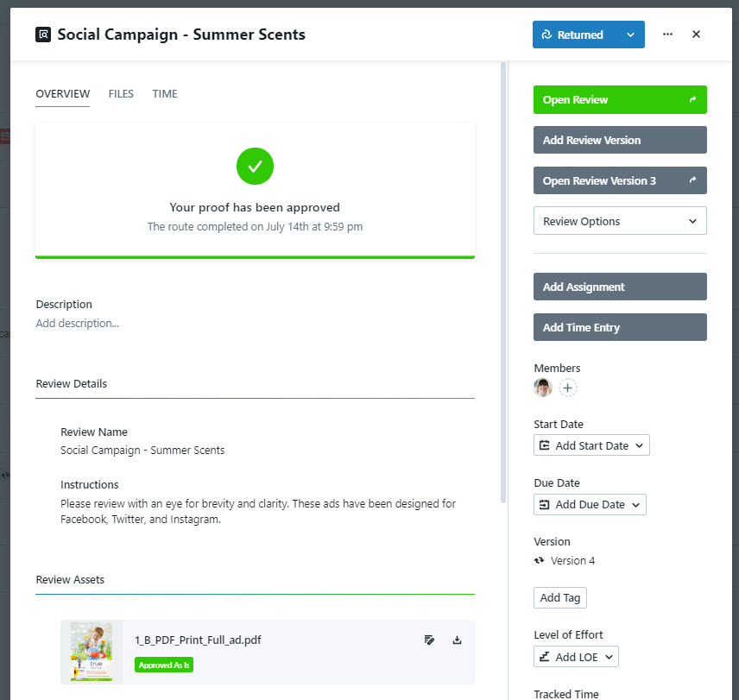
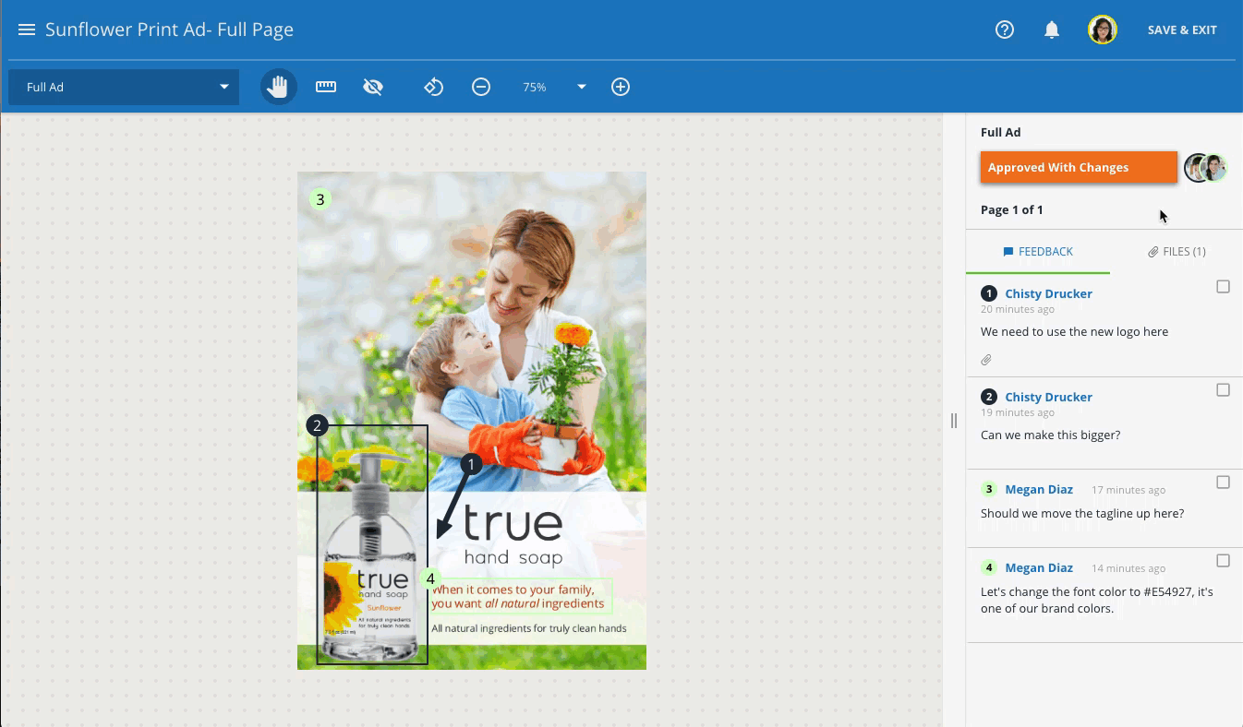
Viewing Feedback
At any point in time, you can choose to select Open Review to view feedback and collaborate with the reviewers you invited
Check off comments once feedback has been incorporated
Navigate to the files tab to easily see and download any added files from comments
Use the navigation menu (far left on the blue toolbar) to quickly see aggregate approval statuses per asset AND which pages have comments

Slide 35
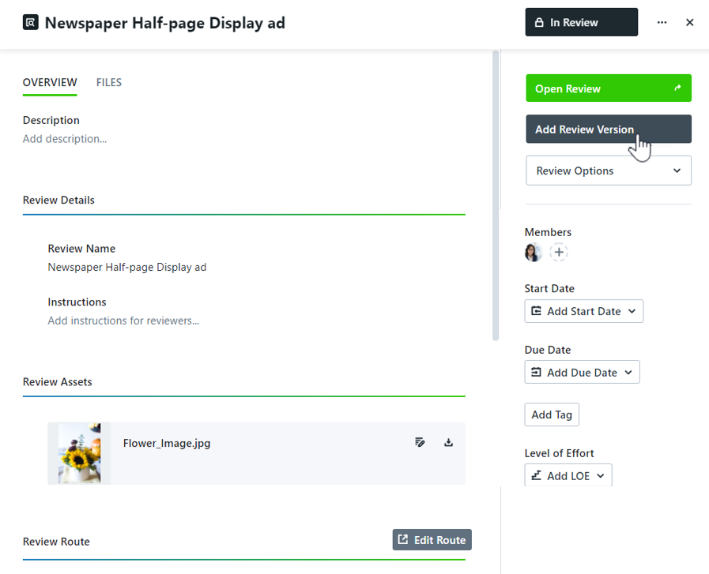
Versioning a Review
When you've implemented changes that you would like to route back out to your reviewers, select Add Review Version
You’ll be able to upload new assets
The review name, instructions, and route will be preserved from the previous version, but can be updated as needed
You can always view previous versions of your proof and all comments left through the Review + Approval interface
Read More: https://guide-ignite.inmotionnow.com/help/versioning-a-review

Slide 36
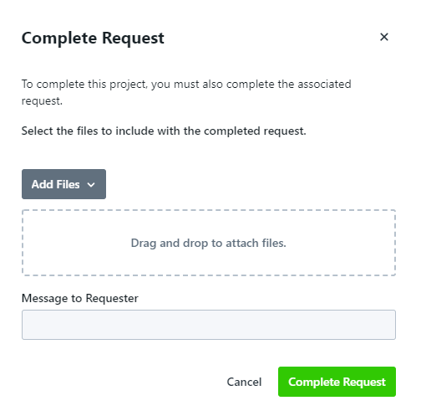
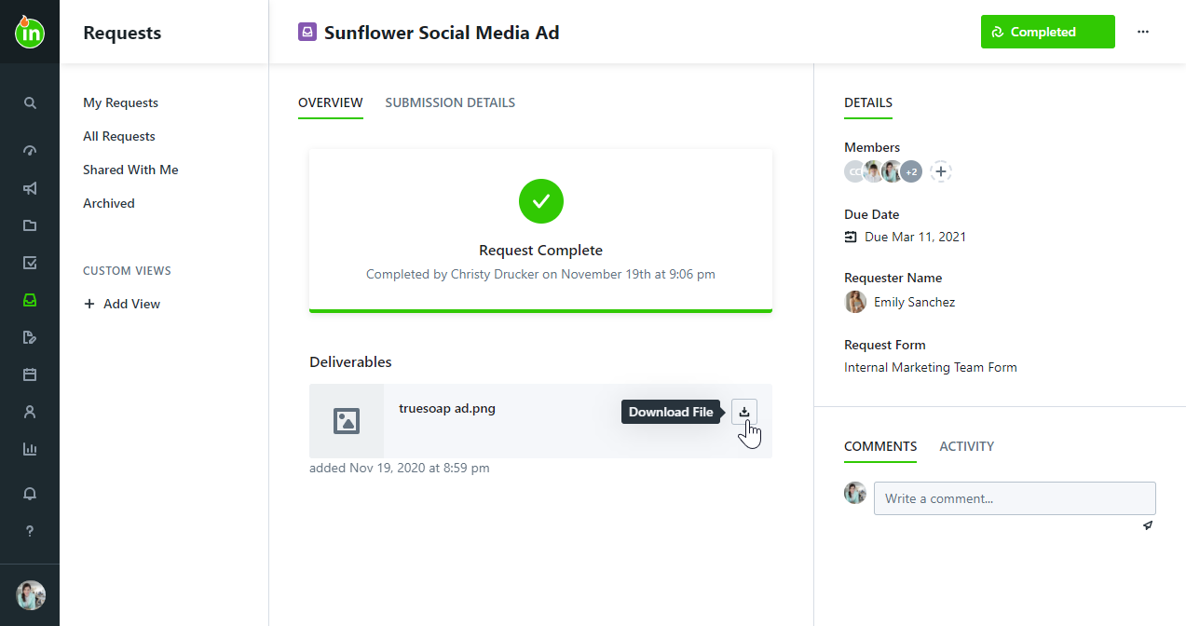
Completing Work & Providing Deliverables
When the work item tied to the request has had its status changed to a 'Completed' state, you will be prompted to:
Provide deliverable files and a message back to the requester
The requester will be notified of the request completion and can download files or ask additional questions as necessary
Read More: https://guide-ignite.inmotionnow.com/help/final-delivery

Slide 37
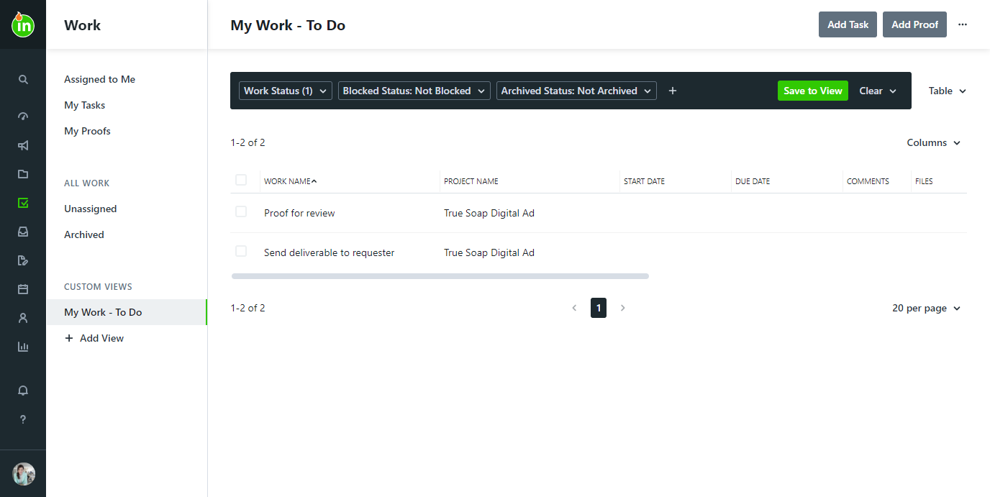
Custom Views
Create Custom Views in Work, Projects, Campaigns, Requests, and Calendar Views
Use Filters and Columns to view information important to you
Include your recommended Custom Views (Rush, Overdue, High Priority, etc)
Read More: https://guide-ignite.inmotionnow.com/help/custom-views

Slide 38
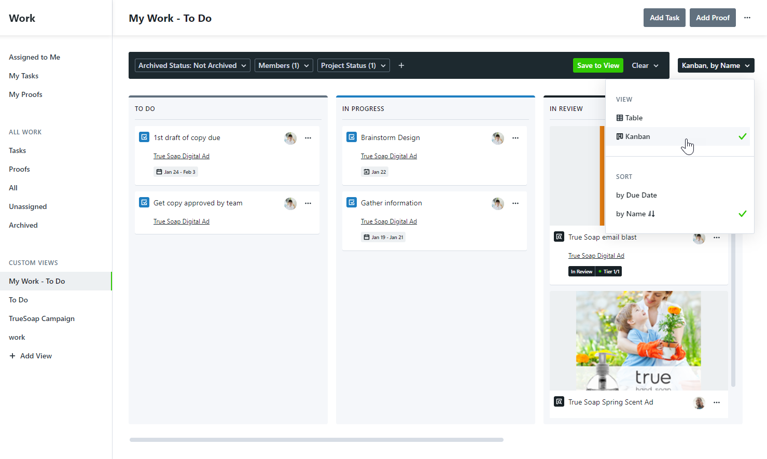
Kanban Custom Views
Turn your Custom View into Kanban format for a visual representation of work
Drag and drop functionality allows you to move work items into another status
Include your recommended Custom Views (Rush, Overdue, High Priority, etc)
This view is only available in Work
Read More: https://guide-ignite.inmotionnow.com/help/kanban-custom-views

Slide 39
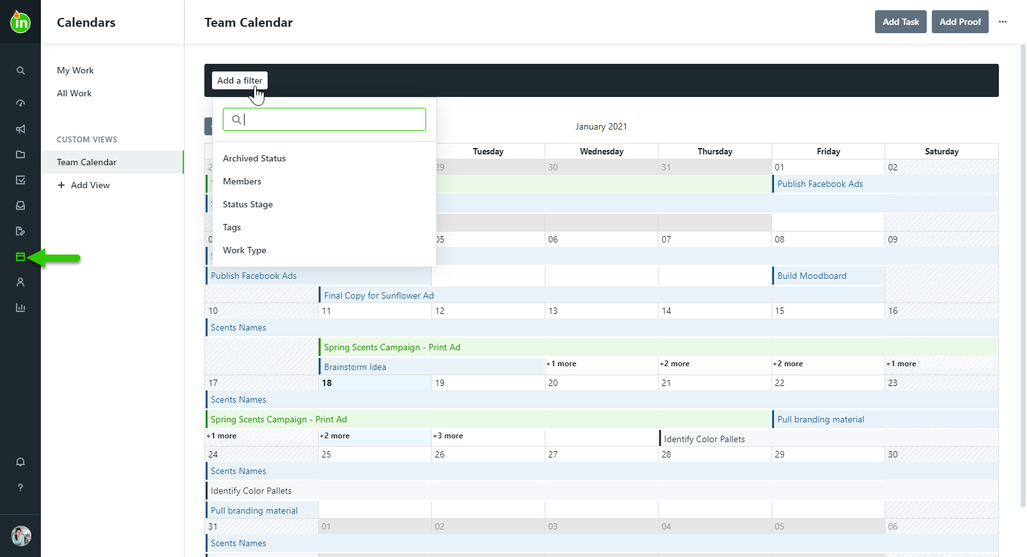
Custom Calendars
Navigate to calendar views to see how start and due dates fall across work
Include your Recommended Calendar Views (Team, Content Type, Brand, etc)
3
2
Archived Status allows you to filter work that is or is not archived
Members allows you to choose which Teammate’s work you see
Status Stage can be To-Do, In Progress, or Completed
Tags are keywords or phrases you would like to associate with work
Work Type is Task, Proof, or Project
Read More: https://guide-ignite.inmotionnow.com/help/calendars-views

Slide 40

Reviews

Slide 41
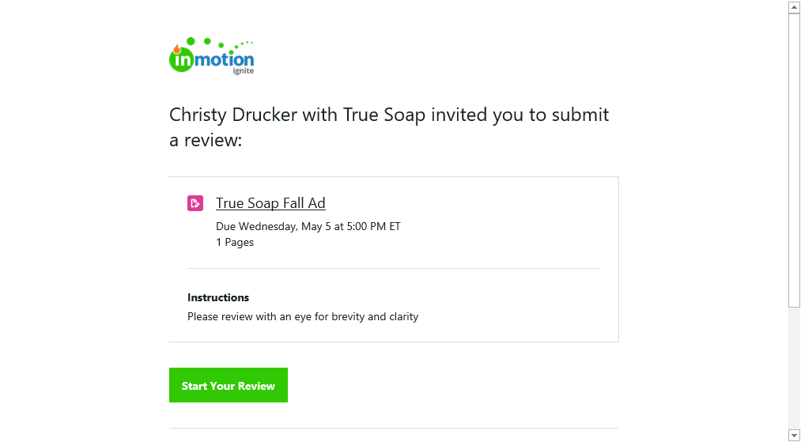
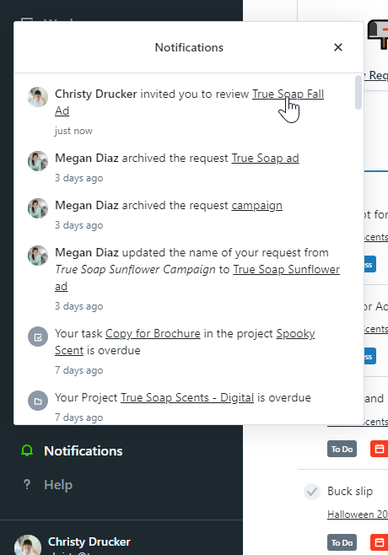
Receiving Your Invite to Review a Proof
You will receive an email from noreply@inmotionnow.com including the:
  Review Name
  Review Deadline
  Review Instructions
  Number of Pages
  Associated Project Name & Due Date
Click “Start Your Review” to access the review

Slide 42
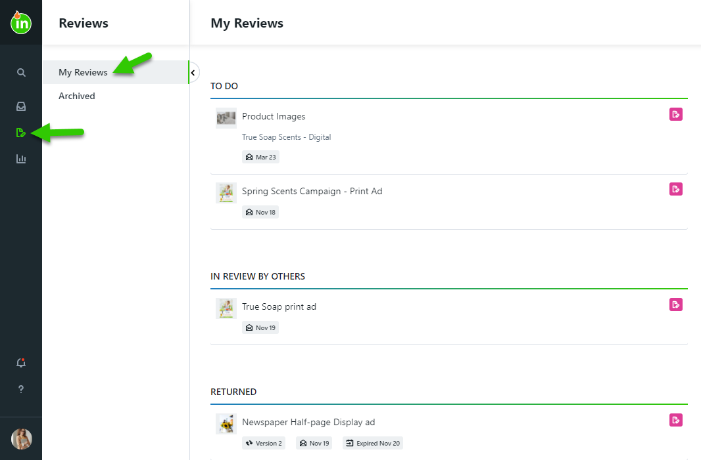
Reviewing a Proof
Find reviews awaiting your approval on your Dashboard or within the My Reviews tab. Reviews will progress through the following statuses:
To Do: Your approval needs to be provided
In Review By Others: You have completed your review, but the proof is still pending the review of others
Returned: Reviews that have ended
Archived: Reviews that have been archived for future reference

Slide 43
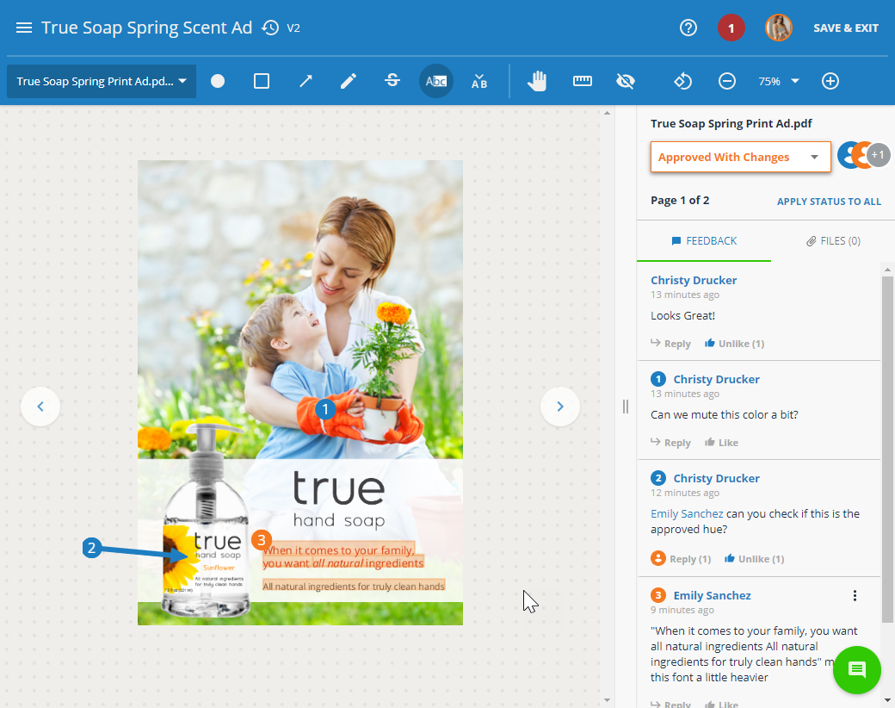
Provide Feedback & Submit Your Review
Provide feedback by marking up the assets using the intuitive annotation tools in the toolbar.
Each annotation will automatically be numbered and associated with a comment
Use the page navigation menu or the arrows next to the asset to navigate through review pages
@mention other reviewers and attach files to comments
You can also share the review with others not invited via @mentioning or the share menu
Select an approval status for each page, or apply one approval status to all pages for assets with multiple pages
Once approval statuses are selected for all pages, you can submit your review
Read More: https://guide-ignite.inmotionnow.com/help/quick-start-guide-submitting-a-review

Slide 44
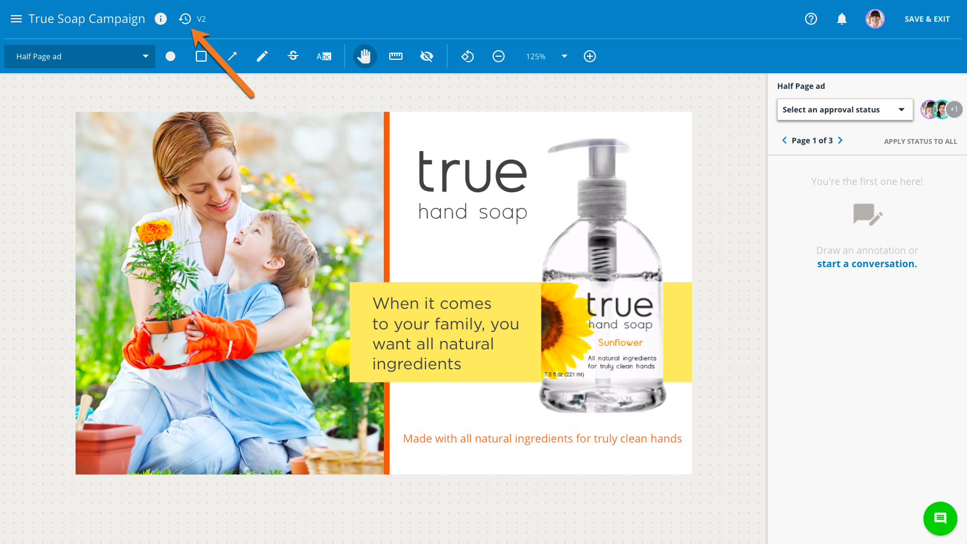
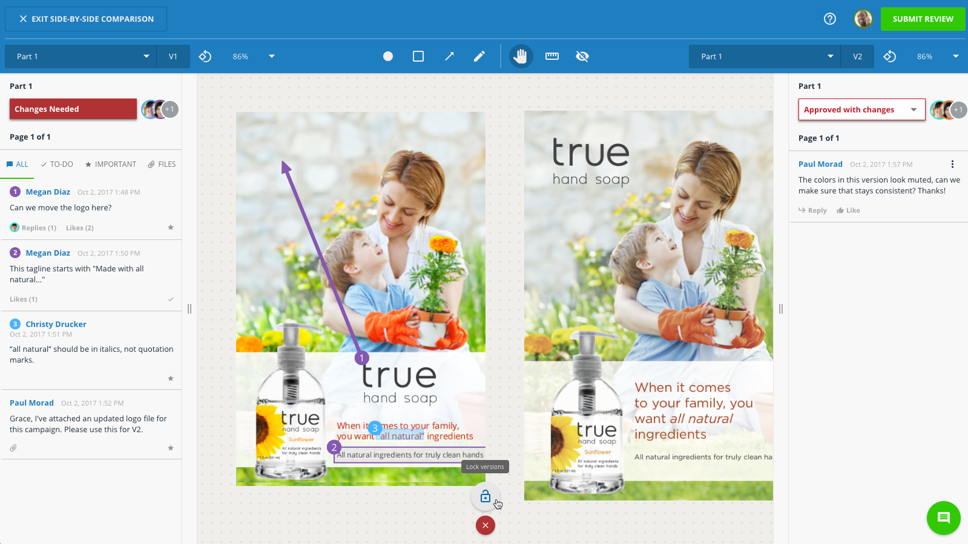
Review Past Versions Side-by-Side
If the proof is versioned, you can also access previous versions by selecting the versioning icon located to the right of the review name.
The proof’s version history will open to the left.
Hover over the version you’d like to reference to open it in either side-by-side comparison or a new tab of your browser
When in side-by-side mode, click the lock icon near the bottom center of the screen to pan, zoom, rotate, and navigate through both versions in tandem
You will not be able to comment on past versions – only the active version
Read More: https://guide-ignite.inmotionnow.com/help/proof-versioning

Slide 45

Reports

Slide 46
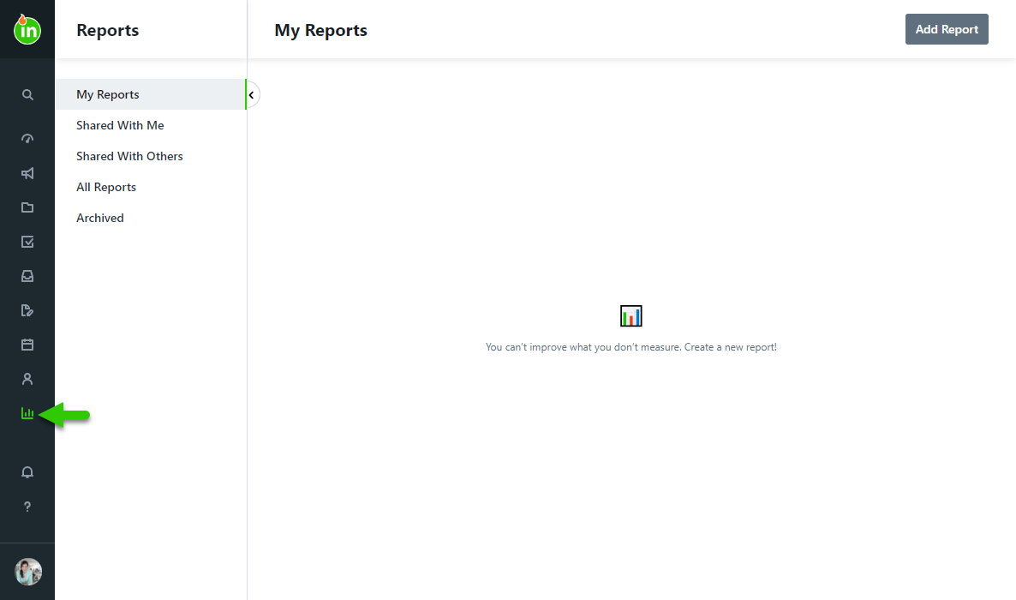
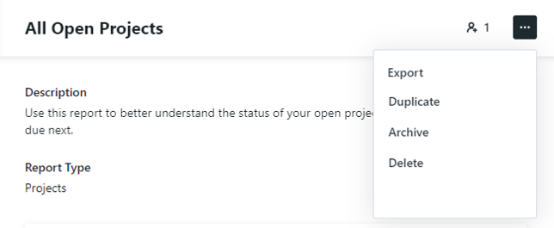
Reports
Add Report allows you to create a new report.
My Reports are reports you have created
Export will generate a .csv file with the report’s data
1
2
3
Read More: https://guide-ignite.inmotionnow.com/help/reports

Slide 47
Additional Features

Slide 48
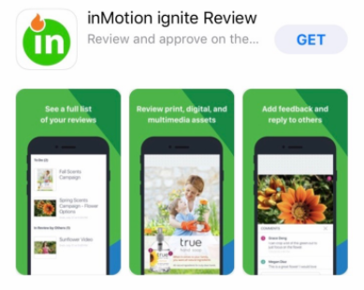
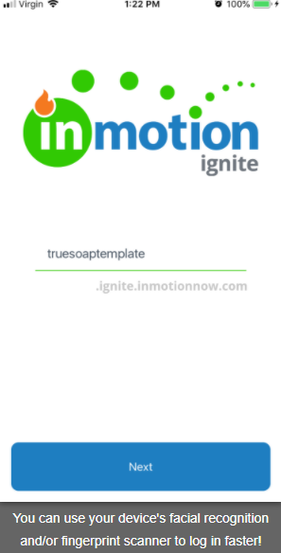




inMotion ignite Review App for iOS and Android
Enter Subdomain
List of Reviews
Provide Feedback
Submit Your Review!
Download the App for iOS & Android
Read More: https://guide-ignite.inmotionnow.com/help/inmotion-ignite-review-app-for-ios-and-android

Slide 49

inMotion Extension for Adobe Creative Cloud
Download the inMotion Extension for Adobe CC in Adobe Exchange to:
Create and version proofs
Send proof for review
View current proofs and their status
Receive notifications in real-time
Complete proofs
All from Adobe Photoshop, Illustrator, and InDesign!
Read More: https://guide-ignite.inmotionnow.com/help/install-adobe-extension

Slide 50
Action Items
Customize this list for the actions you want your team to complete after training!
Accept invitation
Build the following custom views:
  List your suggested custom views!
Create and send a practice proof
Download the Adobe CC app
Download the iOS/Android app
Contact [your name] with any questions!

