Slide 1
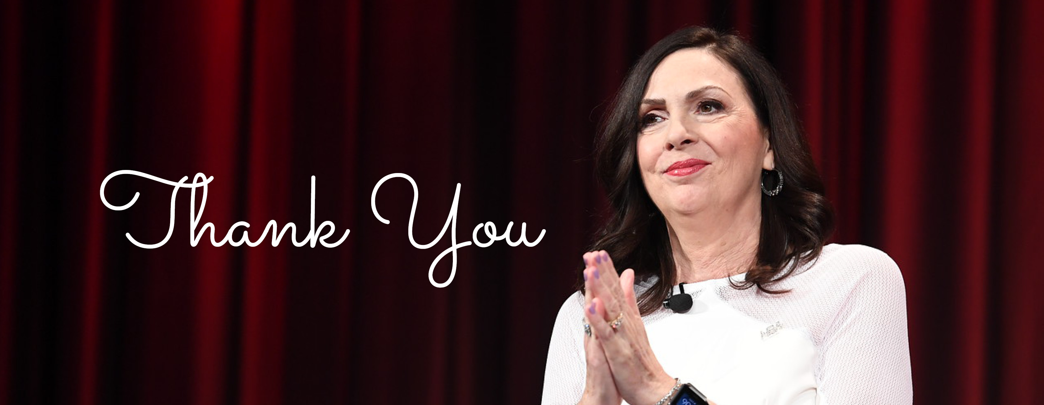
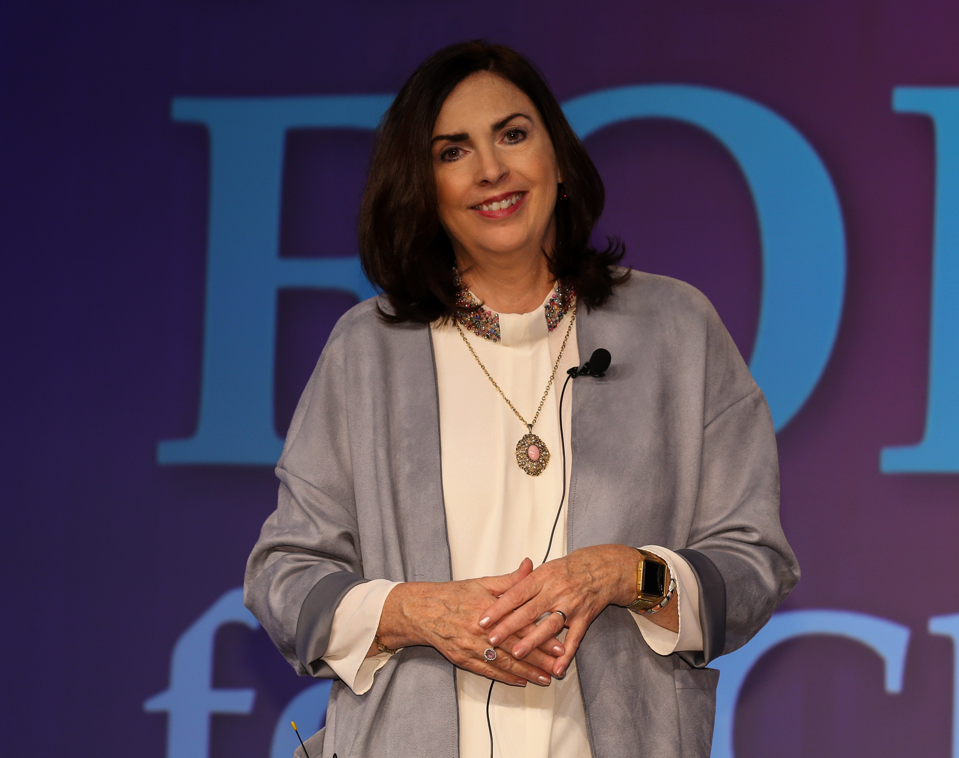
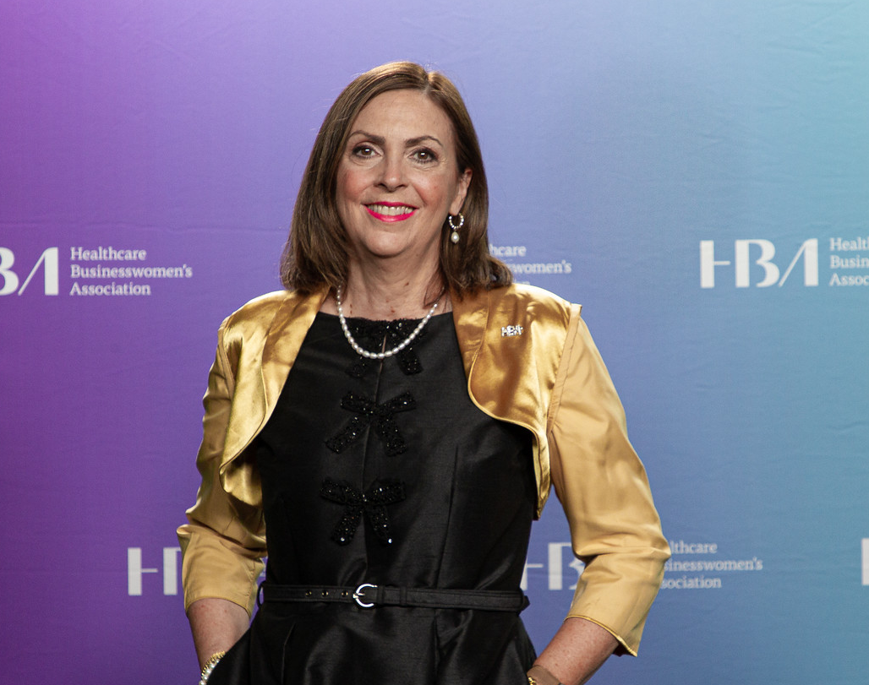
Update on HBA CEO Transition
15 years of #HBAimpact – Creation of strong legacy and great leadership team to carry our charge forward.
Egon Zehnder, a global executive search and leadership advisory firm, is leading the charge in placing our new CEO.
Transformative times – World events have helped spotlight our mission. It’s time to further advance the HBA and the healthcare industry.

