Slide 1
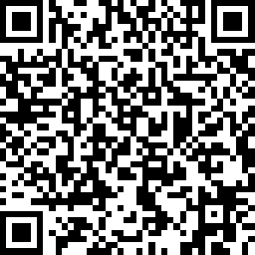
Thank you for attending
We value your support and feedback
Please respond to the post-event survey located at:
https://www.surveymonkey.com/r/2021HBAEvents

