Slide 1
Activate. Advocate. Achieve.
2021 HBA Overview
Insert presenter name(s) here

Slide 2
Table of Contents
Overview
Membership
Programming
Signature and Regional Events
Corporate Partnership
Gender Parity Collaborative
Contact Information

Slide 3
Overview

Slide 4
Core Purpose and Mission
Core Purpose:
To further the advancement and impact of women in the business of healthcare
Mission:
The Healthcare Businesswomen’s Association is a global nonprofit organization comprised of individuals and organizations from across the healthcare industry committed to:
Achieving gender parity in leadership positions
Facilitating career and business connections
Providing effective practices that enable organizations to realize the full potential of their female talent
The HBA accomplishes its mission through strong business networks, education and leadership development and global recognition of outstanding individuals and companies.

Slide 5
What is the HBA About?
https://www.youtube.com/watch?v=conw0EtV6CY

Slide 6
Key Stakeholders
Business Professionals:
The HBA serves women in the business of healthcare who strive to advance their careers. We offer career resources, volunteer opportunities and an invaluable network that empower women of all backgrounds to grow professionally. When you are part of the HBA, you are empowered to advance your career, your company and gender parity as a catalyst for change across the business of healthcare.
Corporate Partners:
The HBA’s initiatives and community of industry leaders and peers help companies advance their women further, faster. When you partner with the HBA, you strengthen your company’s commitment to advancing women, enhance your competitive edge and become a catalyst for change.

Slide 7
A United Force for Change
When members of the HBA come together, it’s with a shared purpose: to be a United Force for Change. We connect diverse groups of both women and men, across all healthcare and life science disciplines.
By taking focused action to advance our mission, we are creating a powerful movement that directly drives professional opportunity and corporate growth.
We believe that by joining forces in the relentless pursuit of gender parity, we are doing more than uniting individuals—we are strengthening the business of healthcare.

Slide 8
Our DE&I Journey
Diversity, equity and inclusion (DE&I) are the foundation of our existing organizational values, our culture, and respect for all people and their ideas and identities. Our greatest strength lies in our understanding of the diverse range of stakeholders we are honored to represent. As 2020 presented a seismic shift in our world to more widely expose racial, gender, economic and health inequities, our mission to advance the careers of women has accelerated the necessity to achieve more impactful change now.
Visit https://www.hbanet.org/the-hbas-dei-journey for the past, present, and future of our journey!

Slide 9
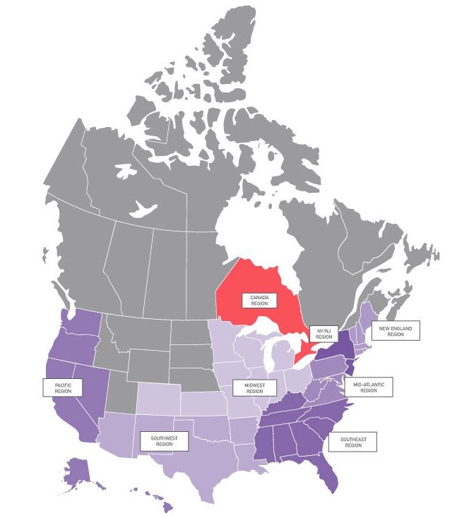
HBA Locations: North America
Canada Region
Toronto
Mid-Atlantic Region
Montgomery Corridor (MD)
Philadelphia
Suburban Delaware Valley
Midwest Region
Chicago-Downtown
Chicago-Northern Suburbs
Cincinnati
Columbus
Denver
Indianapolis
Kansas City
St. Louis
New England Region
Boston
Marlborough
Waltham
NY/NJ/CT Region
Central New Jersey
Fairfield County, CT
New York
Northern New Jersey
Rochester
Pacific Region
Los Angeles
Orange County
San Diego
San Francisco Bay Area
Seattle
Southeast Region
Atlanta
Charlotte
Miami
Palm Beach
Research Triangle Park
Tampa
Southwest Region
Albuquerque
Austin
Dallas– Fort Worth
Houston
Phoenix

Slide 10
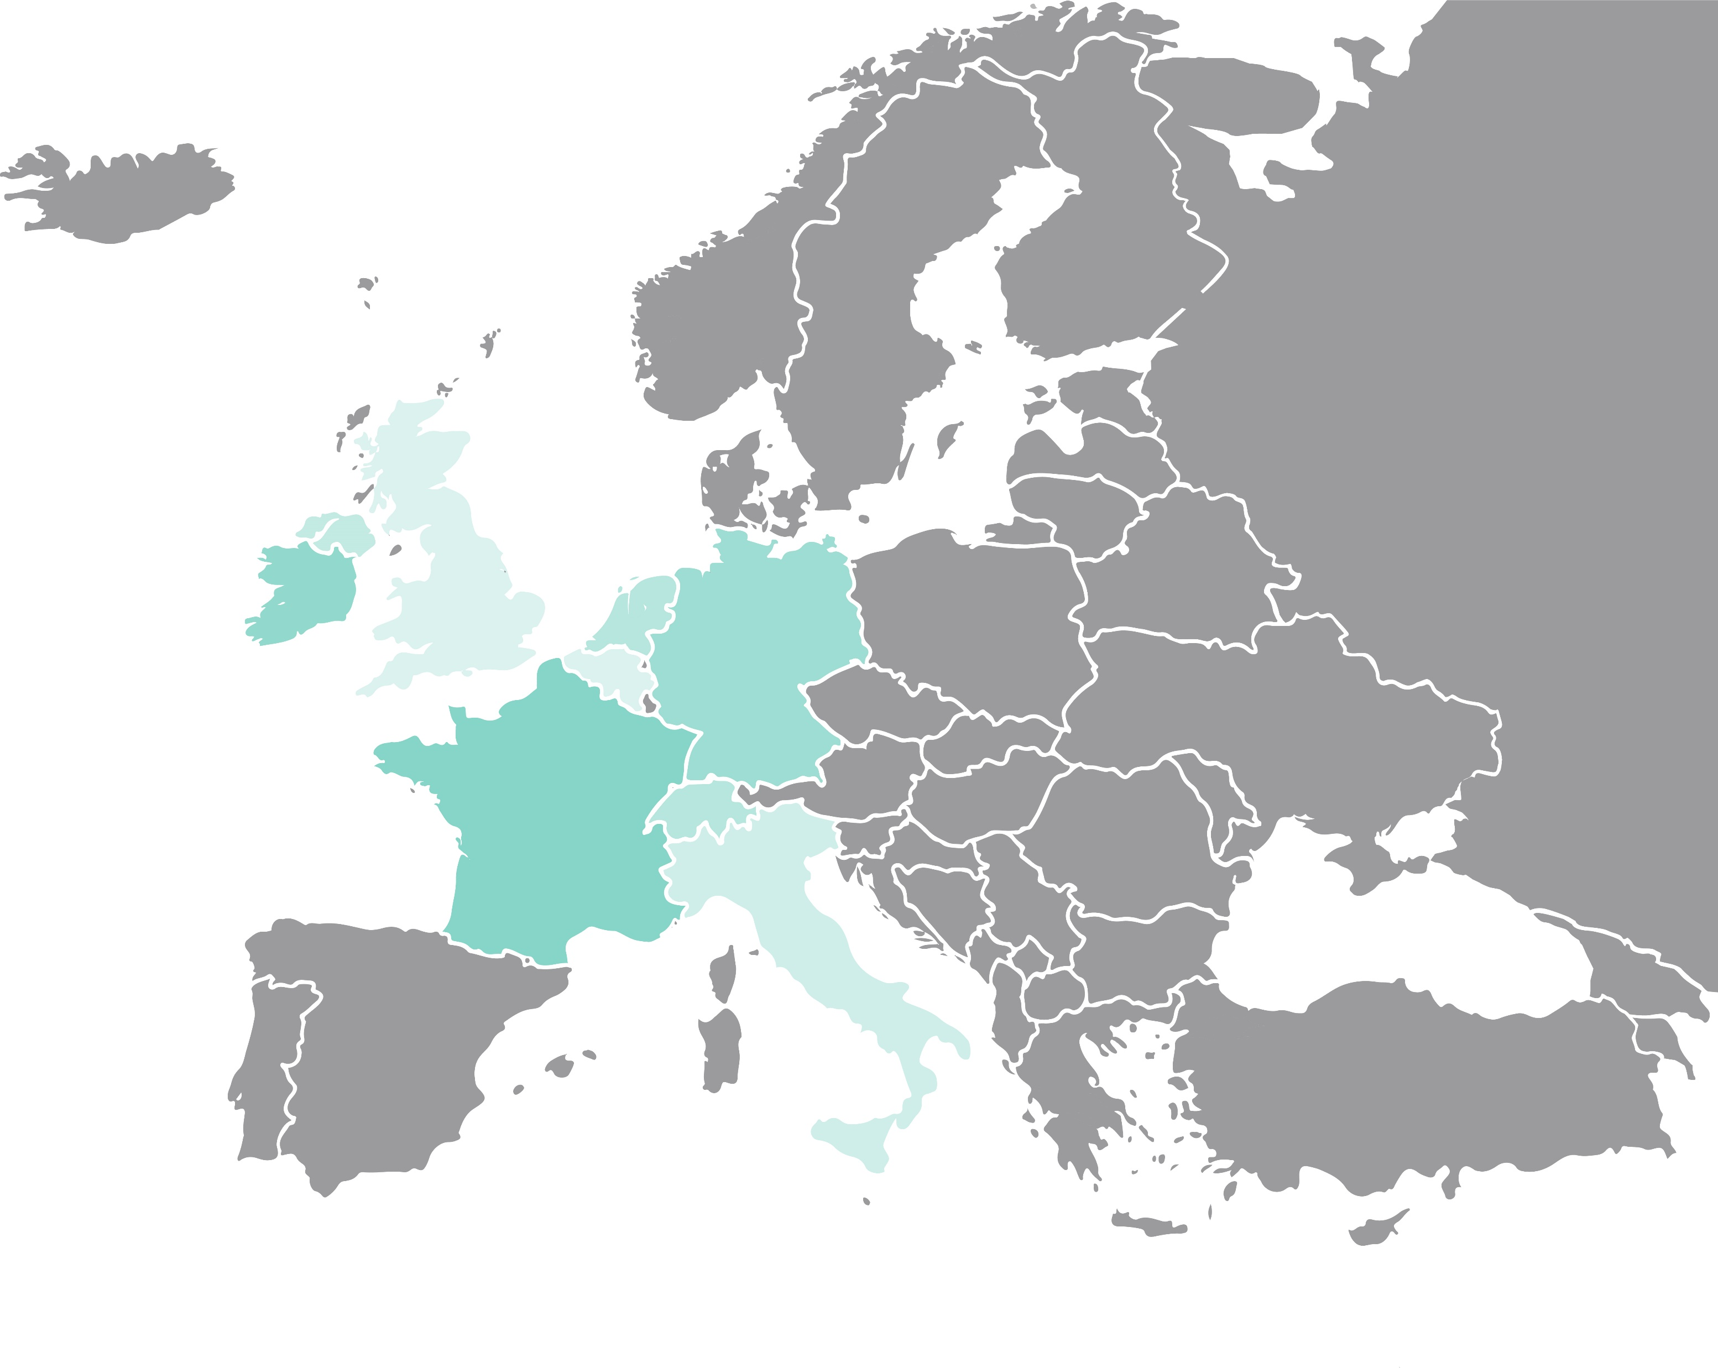
HBA Locations: Europe
Europe Region
Amsterdam
Basel
Bavaria
Berlin
Brussels
Dublin
Frankfurt
London
Milan
Paris
Suisse Romande
Zurich-Zug

Slide 11
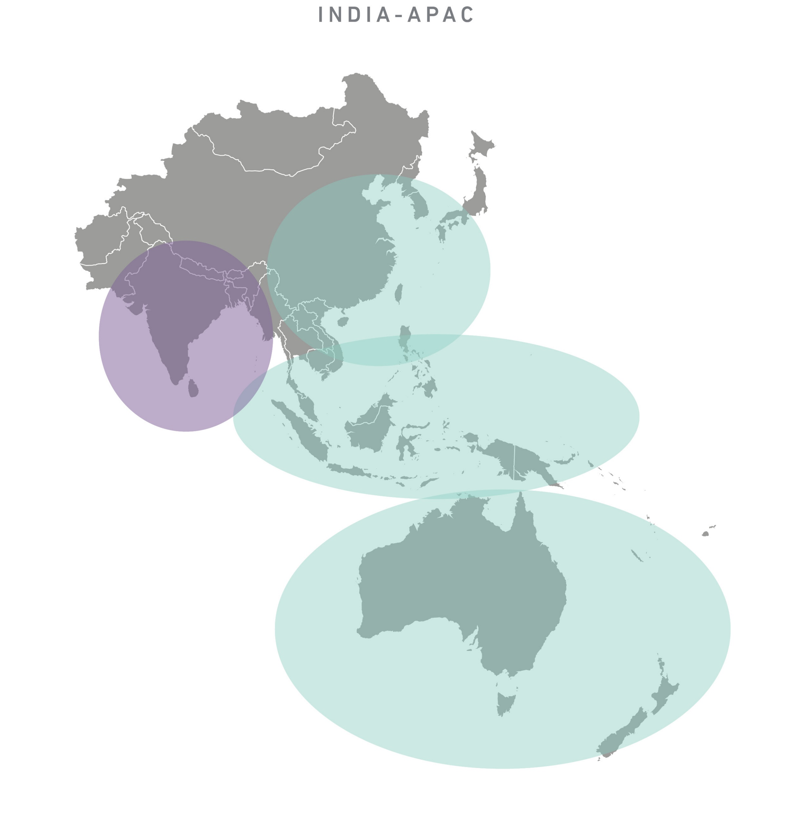
HBA Expansion: Around the World
New in 2021:
Asia-Pacific
India
…More to come!

Slide 12
Membership

Slide 13
Membership
Connect with over 11,000 other passionate healthcare and life science professionals, representing more than 1,000 companies.
Explore new skills, share your expertise, advance your career and be a catalyst for change.

Slide 14
The Value of HBA Membership
A multitude of exclusive free events to network with your fellow members
Up to 50 percent discount to hundreds of educational programs across the globe
Invitation to exclusive, member-only events such as the HBA Annual Conference
Access to online member directory, forums, online Career Center and resource libraries
Opportunity to join affinity groups based on your interests
Join member-only formal mentoring programs to enhance your professional success
Leadership opportunities to broaden your professional experience and gain industry visibility
Receive recognition of leadership contributions through volunteer awards
Enjoy unique opportunities through HBA partners like Bolstr who can boost your next bold move
Steer the future and governance of the association by nominating leaders and exercising voting privileges in the annual business meeting

Slide 15
Career Advancement Through Leadership
The HBA offers hundreds of engagement opportunities to make a difference
Build your leadership experience
Increase your visibility and professional connections
Advance your career

Slide 16
HBA Members Talk Professional Enrichment
https://youtu.be/mvi8S16UfHk

Slide 17
Individual Membership Fees
Employees of corporate partners receive an additional discount!
*The HBA is proud to offer a membership rate of $125 per year for those 30 and under, which includes all benefits of full membership except voting in the annual business meeting and the ability to serve on boards. Additional discounts do not apply to this membership type. Subject to verification at the time of purchase.

Slide 18
Programming

Slide 19
Leadership Competency Framework
HBA programs are mapped to these competencies to assist with professional development planning.
Enlighten
Demonstrates integrity
Communicates effectively
Exhibits business and industry acumen
Empower
Displays professional presence
Determined to achieve
Makes decisions and takes risks
Engage
Influences and persuades
Builds relationships and teams
Networks and ethically self-promotes
Evolve
Facilitates change
Fosters innovation
Continues to learn, grow and transform

Slide 20
In-Person and Virtual Events
HBA members receive free or significantly discounted access to:
Hundreds of virtual and in-person local events annually throughout North America and Europe
Virtual programs, such as the quarterly Career Conversations webinar series, as well as free access to select webinar offerings throughout the year
Signature events, namely Woman of the Year and Annual Conference
Due to COVID-19, our chapters have pivoted to a robust program of virtual events. In 2020, we held over 600 events and members get access (and discounts) to ALL of them.

Slide 21
International Women’s Day
The HBA celebrated International Women’s Day on 8 March, as well as Women’s History Month more broadly, with a robust social media campaign, membership sale, and many webinars and activities planned by HBA regions.
Stay tuned to the HBA’s social media channels for 2022 details.

Slide 22
Webinar Series
The HBA’s virtual webinar offerings continue in 2021 with more webinars to be purchased individually or as a series.
A sampling of topics addressed in 2020 included:
Opportunities in a Changing Ecosystem
Visibility in Virtual Work
Becoming an Effective Leader
Growing from an Individual Contributor
Due to COVID-19, we have pivoted to a robust program of virtual events. As such, our virtual portfolio has expanded in engaging and timely ways.

Slide 23
Career Conversations
The HBA’s career advancement and professional development webinar series continues in 2021 with more webinars to be purchased individually or as a series. The 2021 theme is ”Activate. Advocate. Achieve”
Good Guys: How Men Can Be Better Allies for Women in the Workplace – 25 March
Activate Your Voice – 24 June
Advocates in Action – 9 September
Achieve Success – 2 December
www.hbanet.org/career-conversations

Slide 24
Mentoring Programs
A healthy mentoring relationship is opportune for mentors and mentees—with the added bonus of enhancing on-the-job performance. Become a changemaker in your organization by leveraging the HBA.
The HBA’s mentoring program empowers YOU to share professional goals, fears and challenges with seasoned professionals who have seen it all. Our mentors leverage their robust experiences to provide guidance, offer feedback and illuminate insights to help mentees advance their careers.
Since 2014, the HBA mentoring program has impacted over 3,000 professionals. Now is YOUR time.

Slide 25
HOPE Program
Honoring Opportunities for Partnerships & Equity (HOPE) is an accelerated one-year leadership program designed to help support and advance the careers of mid- to senior-level, high-potential talent in underrepresented groups (i.e., LGBTQ+, women of color, women with ability diversity). The program aims to provide access and opportunity through career coaching, mentoring, networking, professional development, and volunteering.
At its core, HOPE focuses on the emotional intelligence leadership (EIL) theory, incorporating professional development programs designed to develop and enhance participant’s executive presence, mindset, and influence
Notes:
d

Slide 26
Affinity Groups
Boost your career by participating in one or more of HBA’s affinity groups.
Get Involved
Network with like-minded members and leaders
Gain exposure with volunteer leadership opportunities
Participate in virtual or in-person programs focused on group specific information and education
Build Community
Join virtual communities for discussion and career-centric dialogue
Build a targeted professional network
Share personal and professional experiences and success stories
Stay Connected
Gain access to key individuals and content for a select slice of the industry
Stay abreast of current trends, innovations and emerging roles and job opportunities
Establish direct connections to mentors and coaches
Active Affinity Groups
Career Transformations, Entrepreneurship, Fit to Lead, HBA iLead, Tomorrow’s Executives, Women in Healthcare Give Back, Women in Science, Women of Color

Slide 27
Signature and
Regional Events

Slide 28
2021 Woman of the Year
6 May – Virtual
The HBA celebrated excellence in leadership at an exciting and spirited Woman of the Year event where we recognized our 2021 honorees. We also spotlighted over 100 industry Rising Stars and Luminaries.
We look forward to celebrating again in 2022! Additional details to be released soon.
“If it’s springtime in New York, it’s Woman of the Year time.”
- Alex Gorsky, CEO, Johnson & Johnson

Slide 29
2021 European Leadership Summit
16-18 June – Virtual
The European Leadership Summit convenes healthcare leaders to enjoy interactive workshops, TED-style talks, networking and expert speakers discussing the steps they are undertaking within their organizations in order to achieve gender parity. The 2021 Summit theme was “The Future of Leadership.”
Stay tuned for details regarding the 2022 Summit.

Slide 30
2021 HBA Annual Conference
8-10 November – Virtual
As we draft blueprints for the future of work in our industry, the 2021 Healthcare Businesswomen's Association (HBA) annual conference (8-10 November) offers attendees data-driven and empowering opportunities to:
Reimagine pathways to a more equitable and inclusive workplace
Build on expanded concepts of advocacy and allyship to engage in mutually beneficial relationships
Apply insights from promising and proven practices to champion diversity, equity, and inclusion (DE&I) in their spheres of influence
Expand strategies that enhance one's presence, visibility, and performance for advancement in an evolving workplace
Strengthen an invaluable network of advocates and accomplices

Slide 31
Corporate
Partnership

Slide 32
Corporate Partnership
The business of healthcare is changing rapidly and following the trends won't be enough. Lead the way by sponsoring HBA events - and gain the competitive advantage for high-profile visibility and exposure.
The Value of Partnership
Improved business results by developing talent within your organization
Increased recognition on a national platform for your brand and leadership and for celebrating accomplishments of your female talent and internal programs
Stronger relations with organizations across the healthcare industry
Empower women in your organization with proven opportunities for leadership development and growth

Slide 33
Corporate Partners*
* Partial Listing

Slide 34
Corporate Partners

Slide 35
Corporate Partner Packages
Our corporate partner packages have been built to meet the needs and desires of all healthcare and life science organizations. Choose the path for your company by visiting HBAnet.org/corporate-partners or emailing us at CorporatePartners@HBAnet.org.

Slide 36
Rising Stars and Luminaries
Eligible corporate partner packages offer the option to name either a Rising Star or a Luminary. Standard purple and gold corporate partner packages include recognition of two award winners.
HBA Rising Stars are professionals in the early stages of their career. They represent various sectors of the healthcare industry and are designated by HBA's corporate partner organizations. The honor recognizes individuals’ outstanding performance, commitment to excellence and valuable contributions to their companies’ success. The Rising Stars are inspiring leaders, role models to others and are celebrated for their vision, dedication and action.
HBA Luminaries are professionals with more than 20 years of professional industry experience, serve as a role model in their company, actively mentor and sponsor others and are a shining example of transformational leadership that the organization wants to formally recognize.

Slide 37
Building Better Business Connections (3BC)
21-22 September – Virtual
Established in 2011, 3BC is an annual event for our corporate partner community:
Chaired by an industry leader
Connecting senior executives
Collaborating to overcome organizational challenges and achieve business goals
The 2021 event theme is “Leading with Empathy” - Leading with empathy is the entryway to pivotal transformation. The vulnerability empathy requires is essential for the bold actions necessary to drive meaningful change for the future.

Slide 38
ACE Awards
The prestigious ACE awards program recognizes exemplary leadership initiatives that advance and enhance the careers of women.
Open to public and private companies of all sizes
Winners gain significant industry visibility
Receive feedback from independent judges on:
Business performance
Sustainability
Stewardship
Execution
Measurable results
Information on the 2021 ACE Award winners to be released in November

Slide 39
Ambassador Program
The ambassador program is the HBA’s solution for corporate partners to accelerate the development, advancement and visibility of their female talent pool.
Currently available to purple, gold and silver corporate partners
An HBA-trained advisor assists companies to build “HBA Inside.”
Self-directed and customized to corporate goals
Develops motivated and engaged HBA community inside company
Accelerates the development and visibility of talent within your company and fuels the career advancement of participants.
Individual success metrics created and tracked
Connects company colleagues globally with multiple ambassador programs.

Slide 41
Gender Parity Collaborative
The Gender Parity Collaborative is an award-winning consortium of healthcare and life sciences companies accelerating gender parity quicker than the broader industry.
Together, our Collaborative members commit to taking an active role in defining strategies, measuring performance, creating change, and inspiring others.

Slide 42
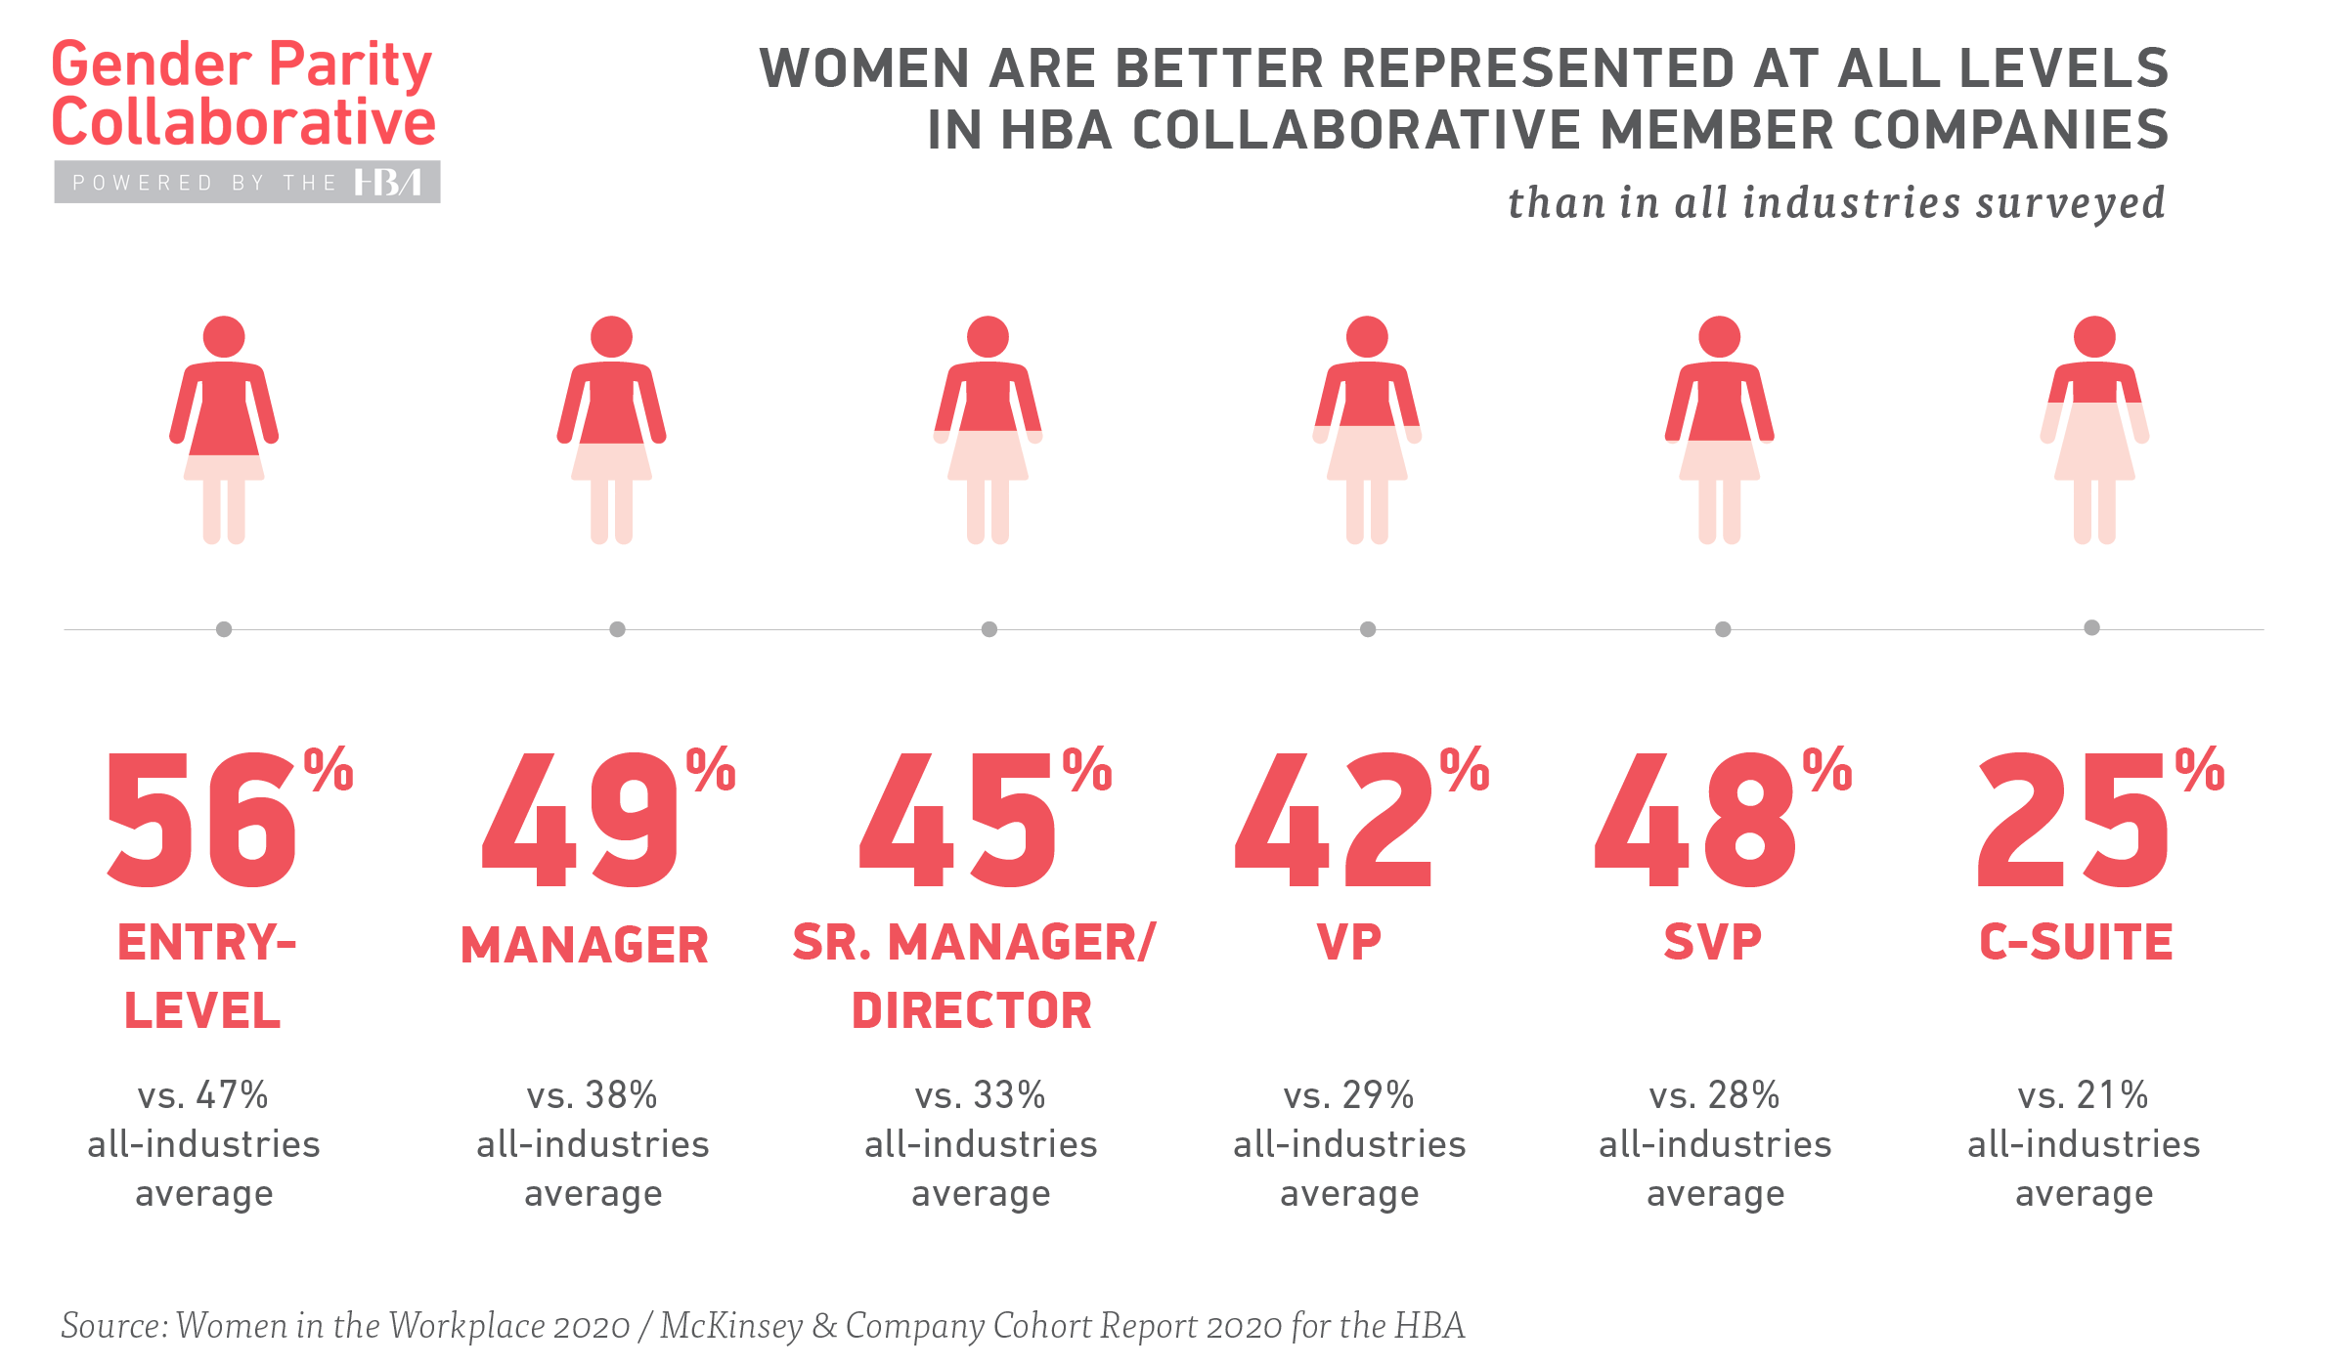
Gender Parity Collaborative
On average, Collaborative companies have more women at every level – from entry-level all the way to the C-suite – compared to the broader pharmaceutical and medical product industry.
The Collaborative brings together senior executives to discuss the environmental and systemic changes needed for companies to accelerate gender parity – and transform our industry in the process.
The Collaborative's work is data-driven, allowing for cohort-specific benchmarking, tracking, and measurement of progress and impact.

Slide 43
Gender Parity Collaborative
We invite your company to join this game-changing initiative as we treat the underlying cause of gender inequity in our industry.
Contact the Gender Parity Collaborative team to learn how your company can get involved:
Visit GenderParity.HBAnet.org or email us at GenderParity@HBAnet.org

Slide 44
Contact info
Insert contact info here

