Slide 1
HBA Community
Toolkit

Slide 2
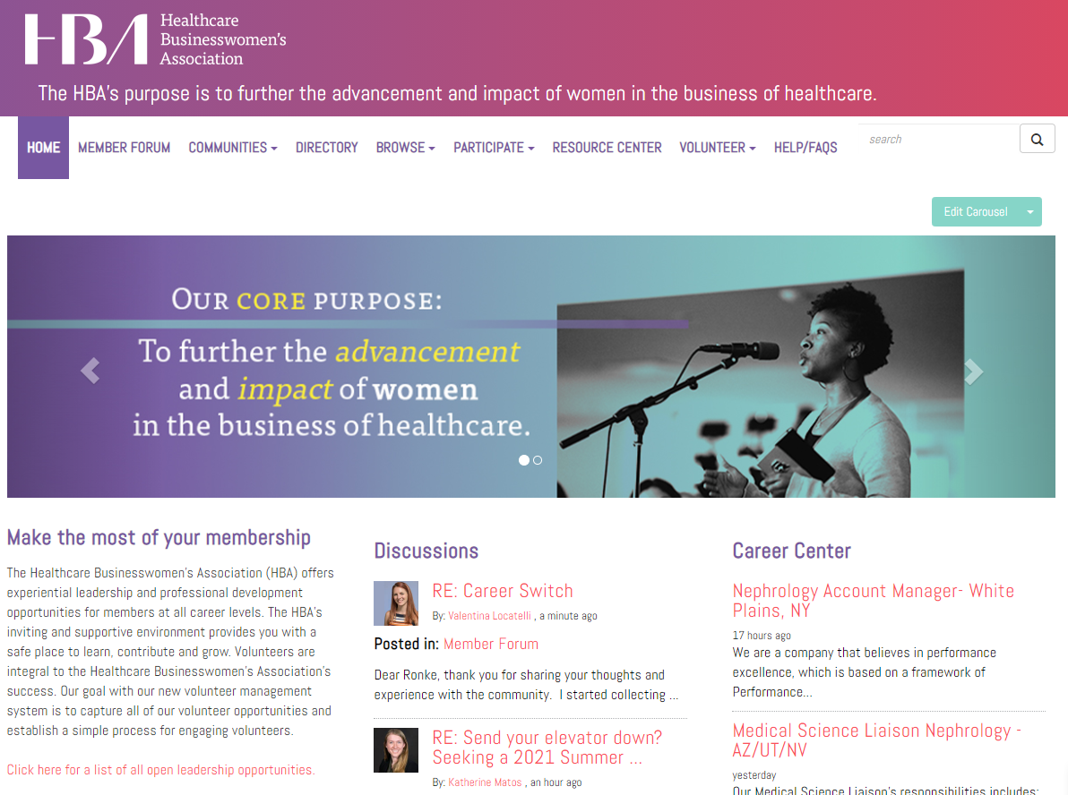
What is the HBA Community?
Think of the HBA Community a bit like social media: it’s a virtual platform for HBA members to connect, share and grow together.
Various Communities within provide forums for individuals to connect with others from particular geographies, with similar special interests and more!
Our Community platform overall saw a 110% increase in engagement in 2020!

Slide 3
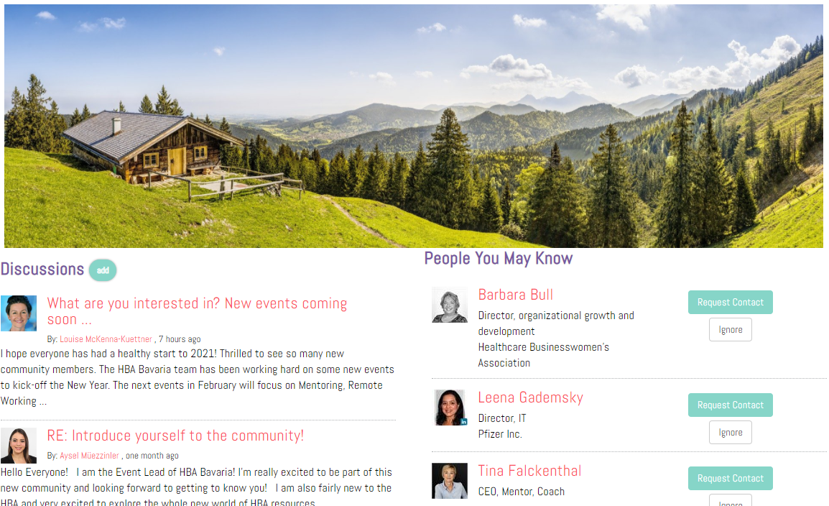
What is the HBA Community?
Our Communities feature:
A discussion forum
A library for resources
A member directory
Members within each Community receive email notifications (you can also set your notifications frequency to your liking) and can easily reply via email privately or to the full group, so essentially you can drive engagement within the Community without even physically going to it!

Slide 4
Get started by getting familiar
Jump into the HBA member forum to introduce yourself to your fellow members, search for other members, and so much more.
Not only can you find members within your region, but you can also seek out like-minded individuals:
Directory
Regional member communities
Affinity Groups
Explore open leadership opportunities to develop new skills and advance your career
Set up your profile, set your notification settings and find more help/how-tos by visiting the Community Help Center.

Slide 5
What does Community engagement look like?
The Community is your platform to drive value to members across the globe and should be a robust discussion forum and resource library. This takes time, but setting the example by sharing resources, creative solutions to member issues, advise and opportunities to chat and connect is key.
DO’s:
Make sure all posts have a “call to action”
Browse discussion threads to familiarize yourself with "hot topics" of the community
Use the member directory to search and connect with colleagues
The "advanced search" option allows you to search by company type, role title/contributor level, or region
When promoting an event, be sure to link to the event's registration page and why it’s relevant to the group
Tag your colleagues! Start with an "@" and begin typing - if they are an HBA member, their name should appear
Spread the love: take a look at our list of unanswered threads - can you help?
DON’Ts:
Post only event promotions
Post a reply to every discussion thread personally
Contact members personally in response to a post unless it is strategically decided upon as the best course of action
Contradict or correct "wrong" answers or information provided by other members
Inaccurate answers will be dealt with strategically and will come from one dedicated voice of the community (i.e. the community manager)
Post any material that could be construed as marketing or advertising
Examples of things that could be posted:
An issue you’re having with request for advice
An article/video/resource relevant to the group
HBA events members may find interesting
Opinions on relevant issues/current events/news
Get creative! What would you ask the group if you were face to face?

Slide 6
How do you make Community engagement happen?
The best way to create engagement is by being proactive and creating a content calendar!
Helps keep you/your team organized
Curate posts and types of content as a group, assign to different individuals to keep posts dynamic
How do we do this?
Start by creating a collaborative document (example here)
Aim for a mix of things that are engaging for new people and valuable for existing
Break out content by type (newbies, events, engagement, resources, etc)
Create 1 month first, then three months and check in every three months to recalibrate, see what kinds of posts are working/what’s not, what are the holes
Build your team so others can help post and be your eyes/ears in the Community as well
If your Community is just getting off the ground, buy yourself to work on this by leveraging the Introduce Yourself thread. Have your team While you’re creating your content calendar, at least create an introduce yourself thread and take turns with each of your team members getting started

Slide 7
Community best practices
How does it all work?
Anything that gets posted is sent via email out to your members depending on the frequency they have selected for their notifications (real-time, a daily or weekly digest)
Draft and schedule posts in advance! At the bottom, select your date/time that you want it to go out. You can view all your scheduled posts in your Community profile under My Contributions under List of Contributions
What kind of content should we post? Anything that your members would find interesting, valuable and engaging!
“Ask me Anything” thread with a volunteer or industry expert
Hot topic discussion
Crowd sourcing for job posts
Revive the introduce yourself thread with new questions
Present data relevant to members
Crowd sourcing for ideas, advice or opinions
Sharing resources, articles, videos, etc that are relevant to the group
Opportunities to get involved and/or build a skill
Creative event marketing. Yes, the Community is a marketing channel but posting just about events will lose your audience quickly. If you’re promoting an event, get creative with it – tie the promo to one of the above ideas so it’s valuable and promotional: “Want to learn more? This event is coming up…”

Slide 8
Community best practices (cont.)
How do you create an amazing Community post?
Tag people!!! This is a feature (like social media) that can really encourage people to answer and increase engagement. Simply type @ and the person’s name (must be a member in the Community)
Ask yourself: will someone find this valuable or interesting? If the answer is no, re-work your post until the answer is yes!
Make sure the subject line really grabs people – keep it interesting or they might not read on!
Make sure every post includes a call to action. As people respond, it keeps the thread at the top
Include more than just text! Add photos, embed videos, add attachments – make it interesting using different forms of media
Leverage the Library:
Each community comes with a Library - your archive of useful things like resources, etc for your members
Any attachments or things embedded in a post are auto-added to your library
You can create folders that you can organize as needed and previews of what’s in the folders show up on the right
Files at the top are the most viewed/downloaded. Anything important can be pinned if you click on the three dots!

Slide 9
HBA Community vs social media
What is the difference and how are both leveraged in a complimentary way?
HBA Community – to drive the value
Is meant for members only, where you have a group of individuals who are already bought into what you’re putting out there
Should be the place where all value is driven to those members (i.e. resources, connections, etc)
They’re already engaged, so make the most of it
Don’t forget to also leverage other communities (like the member forum and regional communities) to get the word out about your area
Social media – to increase visibility
Is a great place to get the word out about HBA and your area, but is more like shouting into the void. Many have no idea what HBA is, so all posts need context
A great place to increase visibility, especially through using you/your team’s personal social media to connect with those networks
Use your hashtag and link back to your Community page whenever possible!
*Note: at this time HBA does not allow social media groups for components

