Slide 1
Unified Coordination Platform
Briefing
AI in Action - Using New Technologies to Enhance Defense Support for Civil Authorities

Slide 2
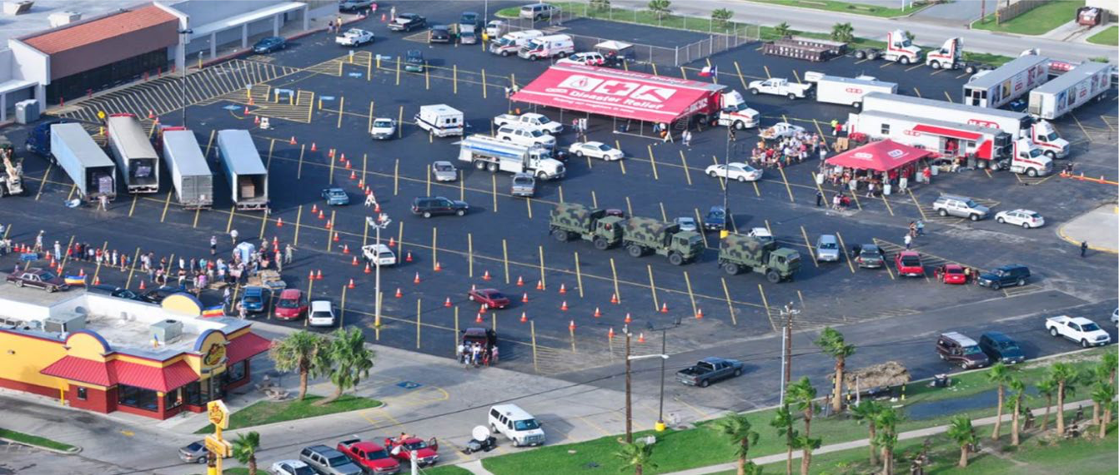

Presentation Narrative
Our community often leaves reimbursements on the table because of manual or cumbersome internal workflow processes. Attend this session to learn how Juvare’s WebEOC serves as the DSCA synchronizer to proactively plan and respond to requests for assistance from interagency partners
during incidents, track related costs for reimbursement, and coordinate mutual aid.

Slide 3

Presenter
Patrick J. Macfarlane
Vice President, Head of Federal & Defense
As Vice President, Head of Federal & Defense, Patrick spearheads the effort to enable a “whole of government unified coordination” in the defense of the American Homeland. Patrick has more than 25 years of experience in both unclassified and classified enterprise software. Patrick leads a team that enables 50+ federal agencies and departments to respond to any threat or hazard rapidly and effectively. Whether near-peer adversary or natural disaster, Patrick’s elite team is building and deploying open-source software powered by AI, that has become the core of our nation’s response.
Patrick J. Macfarlane
VP, Head of Federal & Defense
o: 470 279 6461
m: 202 415 4001
patrick.macfarlane@juvare.com

Slide 4


Panelists
Brian McKiernan, retired Major General
Deputy Commander XVIII Airborne Corps
Former Senior Mission Commander Ft Bragg
34 Years of Federal Service
Guy Beougher, retired SES
Former DLA J3
40 Years of Federal Service
The Mission Assignment Process during Hurricane Sandy through today with a focus on Irma, Marie and Joseph in 2017 where PR was hit hardest. Capturing all the costs associated with DoD executing a DSCA Mission.

Slide 5
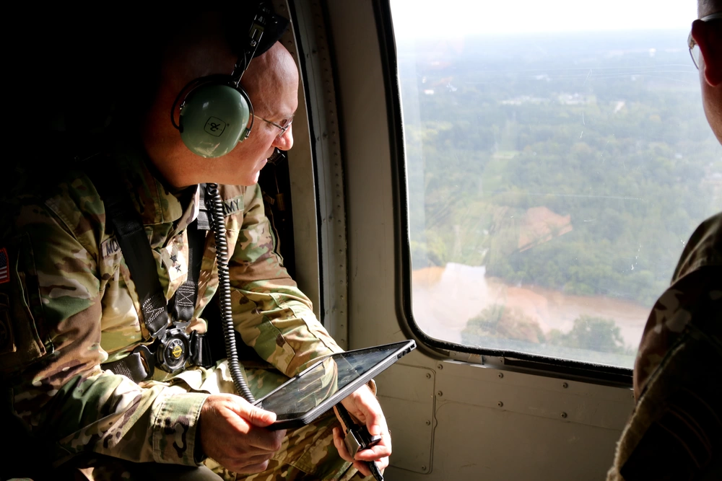
Panelists
U.S. Army Maj. Gen. Brian McKiernan, the deputy commanding general of the XVIII Airborne Corps., assesses the impact of Hurricane Florence on the Fayetteville, North Carolina, community from a UH-60 Black Hawk helicopter, Sep. 17, 2018. The United States Army is poised to provide Department of Defense support to Federal Emergency Management Agency, state and local response efforts due to the hurricane.

Slide 6
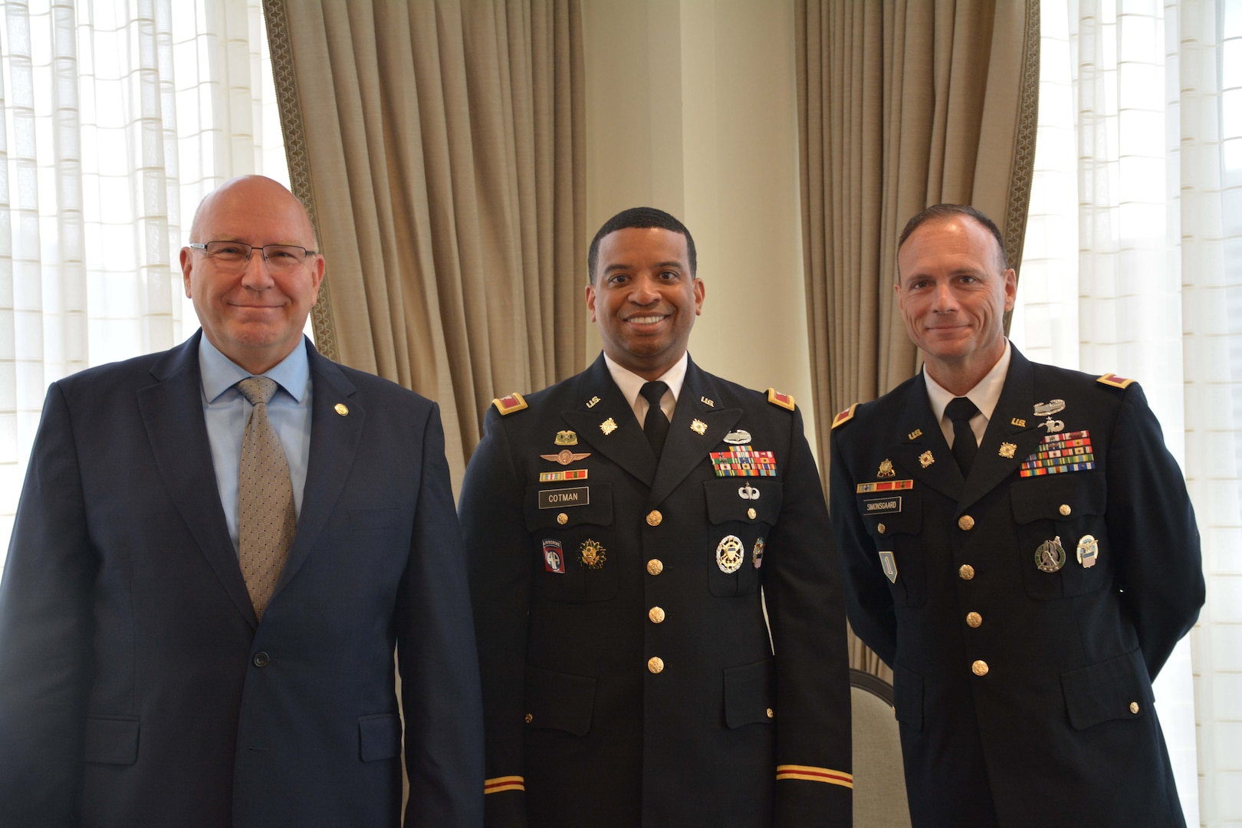
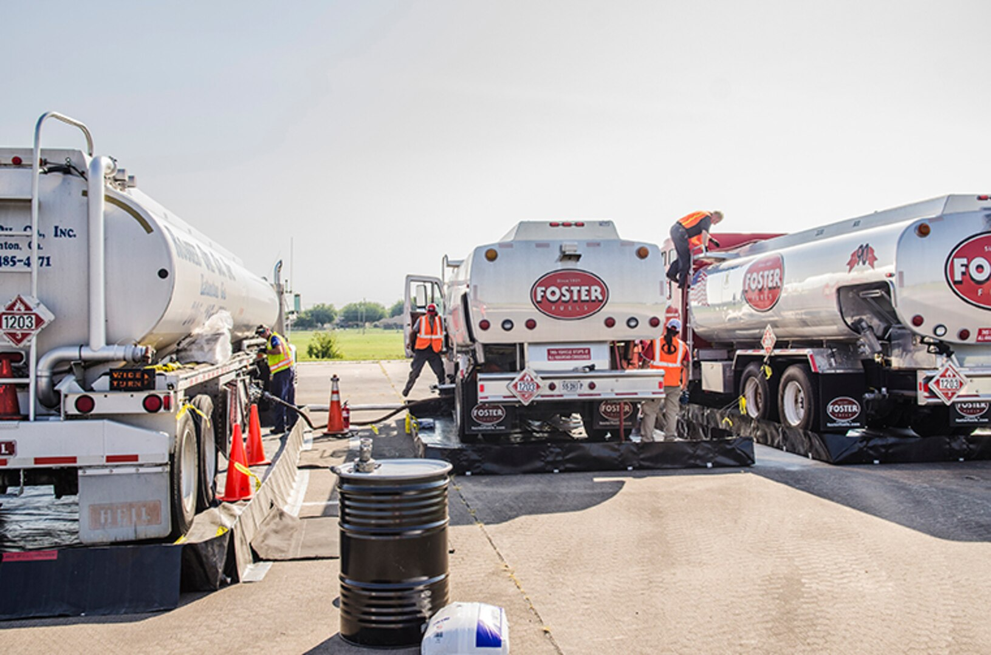
Panelists
“DLA Energy continues 24/7 bulk petroleum support to Hurricane Harvey relief efforts from DLA Energy Americas relocated at Fort Hood and here at DLA Energy headquarters,” said DLA Energy Deputy Commander Guy Beougher. “We are closely monitoring the storm’s effects on the supply chain.”

Slide 7
Key Facts
50+
Federal Departments & Agencies
10,000+
Local Jurisdictions
600
Emergency Management Operations
13
Strategic Allies &
50
States
42
State Public Health Agencies
4,600+
Hospitals
45,000+
Individual Healthcare Facilities
55
Corporations

Slide 8
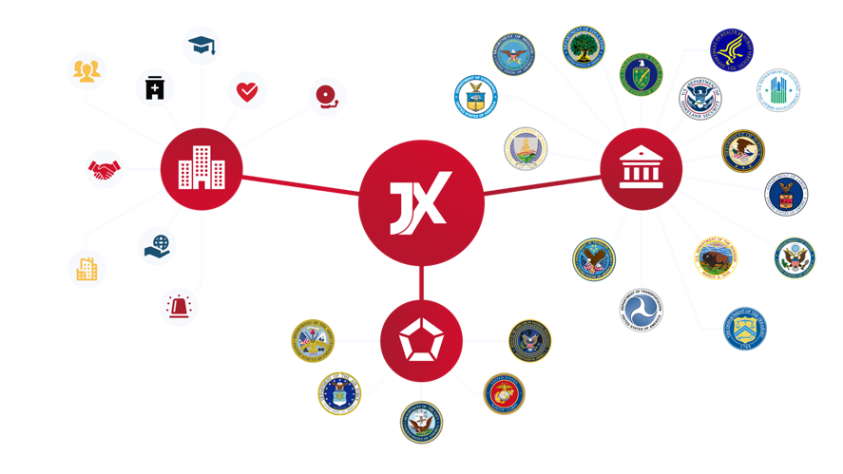
Whole of Government Unified Coordination Data Exchange
Green indicates 100% statewide coverage
Orange indicates partial presence, regional or non-complete coverage

Slide 9
Federal Examples

Slide 10
Federal Use Cases
FEMA’s Office of Response and Recovery (ORR) - Common Operating Picture, Resource Requests, Response Coordination, White House National Incident Brief, etc.
HHS Strategic National Stockpile - System of Record for Common Operating Picture for Crisis Response
US Army - System provides real-time Mission Assurance
US Dept. of State - System for Evacuations (Post Afghanistan)

Slide 11
Federal Use Cases
DHS Customs and Border Protection - System of Record for Emergency Management and Refugee Medical Intake
DHS Transportation Security Administration - System of Record for Incident Management, Sky Marshall scheduling, tasking, and intelligence sharing
DHS CISA - The CISA Central WebEOC supports the CISA Central watch analysts and the broader ISD community to manage information and incidents related to critical infrastructure
Strategic Petroleum Reserve - System of Record for Inventory, Operations, Transportation, and Crisis Response

Slide 12
Federal Use Cases
US House of Representatives, US Senate, Architect of the Capitol, Capitol Police - System of Record for Security Operations, Crisis Response, Protective Details, Motorcade Management
Pentagon Force Protection Agency - System utilized for Security Operations, Crisis Response, and Protective Details
DOE National Nuclear Security Administration - System of Record for Inventory, Operations, Transportation, and Crisis Response

Slide 13
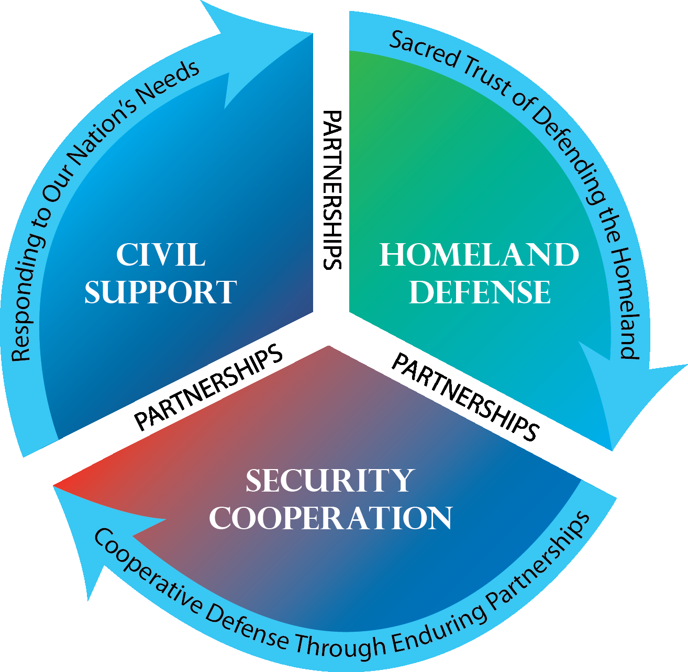
Defense of the Homeland

Slide 14

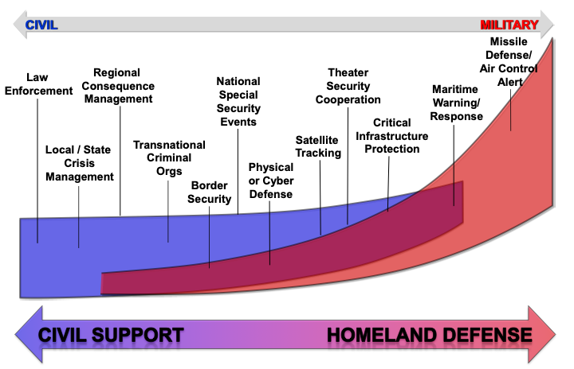
Defense of the Homeland

Slide 15
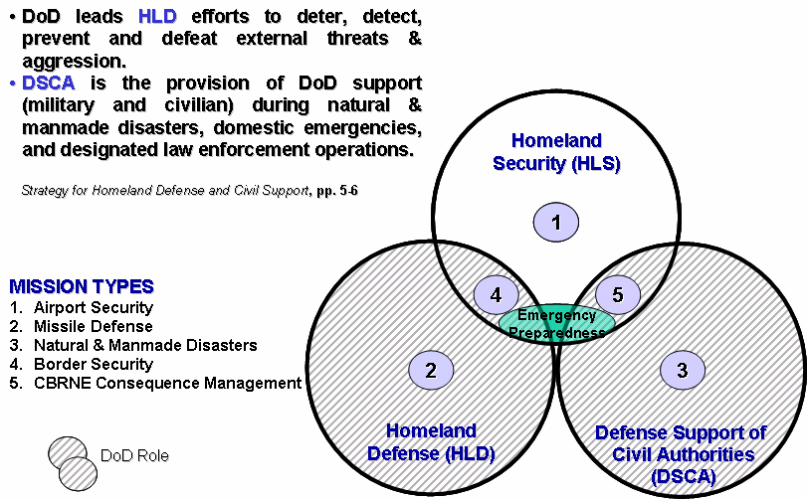
Emergency Preparedness- DOD INSTRUCTION 6055.17
6.2. INTERGOVERNMENTAL COORDINATION. All EM programs coordinate their plans in accordance with DoDIs O-2000.16, 6055.06, and 6200.03 and consistent with NFPA 1600.
a. Support Agreements. In accordance with DoDI 4000.19, installation commanders develop or provide input to support agreements with federal, regional, State, tribal, local, voluntary and NGO, private industry, or HN partners, including EM agencies, emergency services, and other response and recovery partners.
b. DSCA. DSCA operations and EM Program activities may occur simultaneously, requiring coordination and de-confliction of requirements to ensure that resources are applied
appropriately and to the most pressing need. DSCA response actions, including immediate response authority, must be conducted in accordance with DoDD 3025.18 and DoDI 3025.21.
c. Installations Outside the United States in accordance with DoDD 5530.3.
d. Interoperability. EM Programs should be consistent with EM efforts in their civilian mutual aid community or HN in order to provide effective and efficient emergency response. Interoperability improves interagency collaboration, coordination, and participation in all aspects of EM. Interoperability includes the technical exchange of information and the end-to-end operational effectiveness of that exchange of information as required for mission accomplishment. Information exchange must be balanced with information assurance.

Slide 16
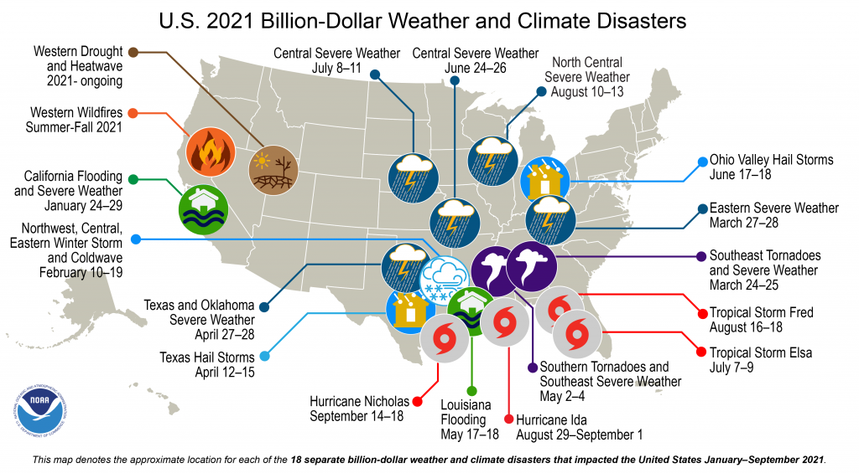
The Cost to the Homeland is Ever Increasing

Slide 17
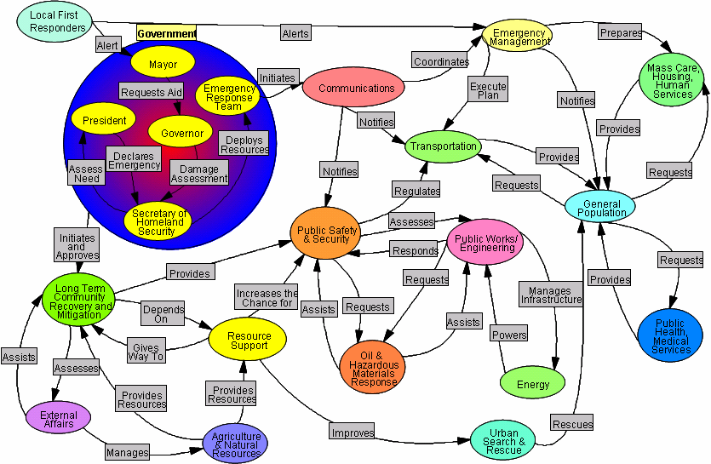
Why We Need to Add Advanced Technology Into the Effort
OV Level 1 architecture or high level operational concept.

Slide 18
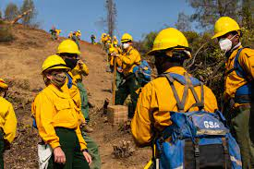
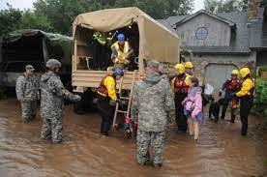
Predictive Analytics and Data Driven Decisions
Predictive analytics draws its power from a wide range of methods and technologies, including big data, data mining, statistical modeling, machine learning and assorted mathematical processes. Organizations use predictive analytics to sift through current and historical data to detect trends and forecast events and conditions that should occur at a specific time, based on supplied parameters.
With predictive analytics, organizations can discover and exploit patterns contained within data in order to detect risks and opportunities. Models can be designed, for instance, to discover relationships between various behavior factors. Such models enable the assessment of either the promise or risk presented by a particular set of conditions, guiding informed decision-making across various categories of supply chain and procurement events.

Slide 19
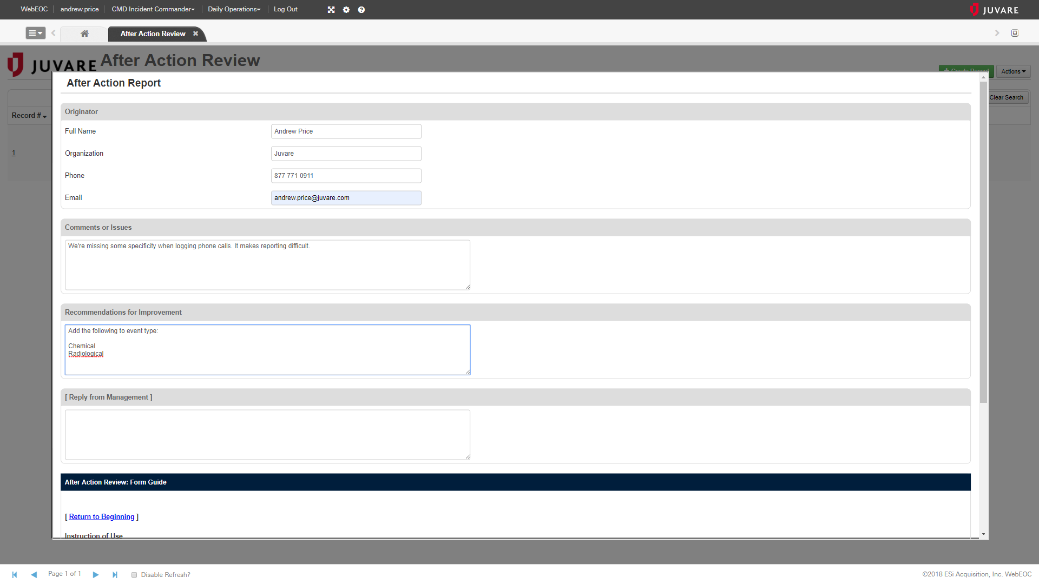
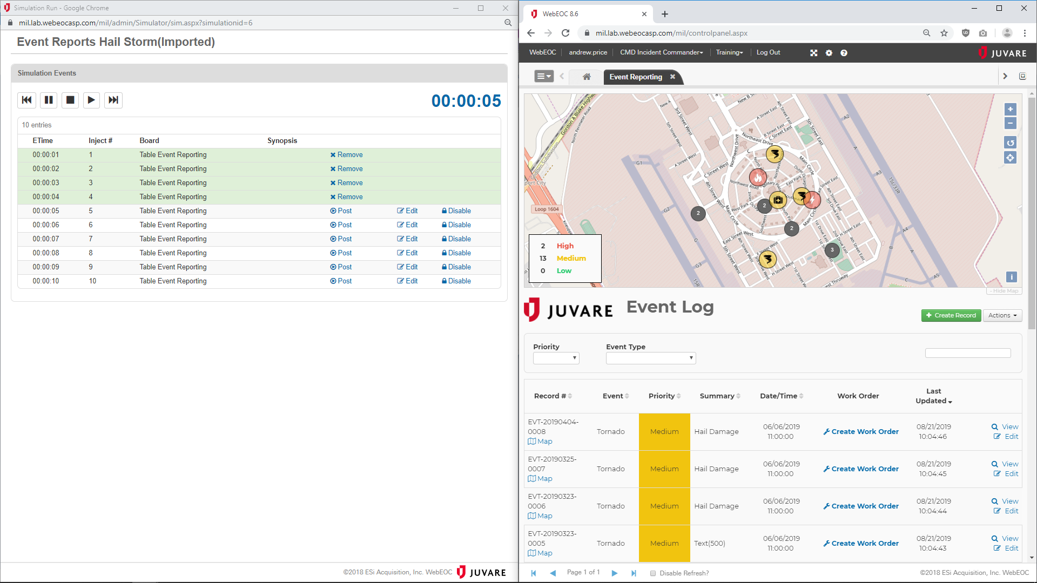
Lessons Learned
After-action reports for exercises as well as for real-world events
Module is formatted so all lessons learned are available for automatic upload to the Joint Lessons Learned Program IAW CJCSI 3150.25
Ensure all real-world and exercise AARs are tracked and available at all levels

Slide 20
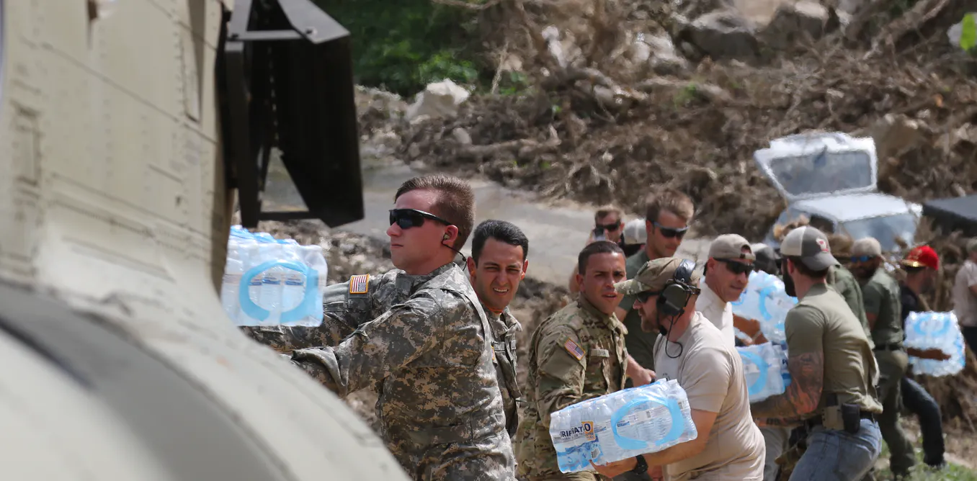
Capturing a Variety of Data in the Platform
Visual data
  Captured by cameras, visual data is made up of images that are tagged according to what they contain (people, vehicles, characters, defects, colors, quality, etc.). Computer vision is the corresponding AI technology for visual data.
Textual data
  Gathered via camera, scanners or digital documents, textual data is organized into linguistically relevant characters, words, sentences and concepts. Natural language processing is its corresponding AI technology.
Numerical data
  This type of data is neither visual nor organized into linguistic elements and is made up of figures and measurements gathered by machines, sensors or people.

Slide 21
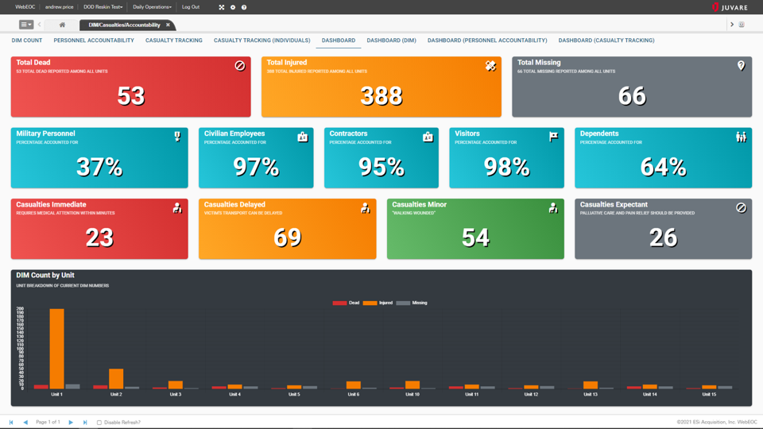
Accountability Dashboard

Slide 22
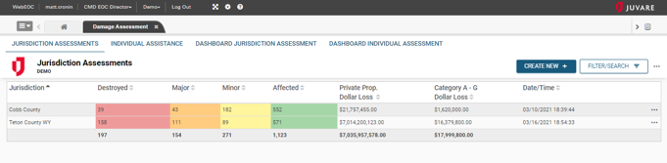
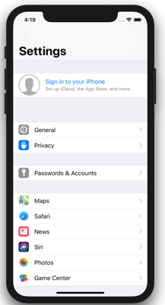
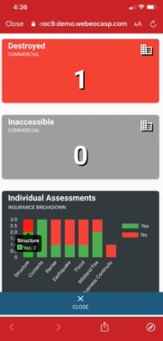
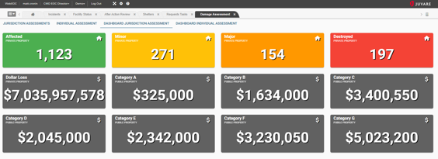
Damage Assessment
Notes:
-The updated Damage Assessment board now includes an individual assistance component in addition to the jurisdictional reporting.
-This new board includes 2 dashboards to summarize both individual and jurisdictional reporting.

Slide 23
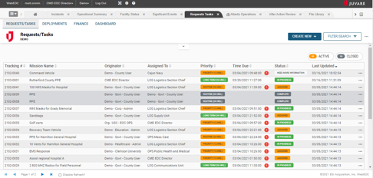
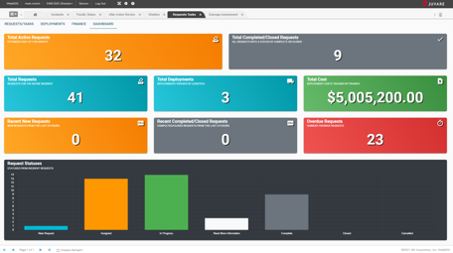
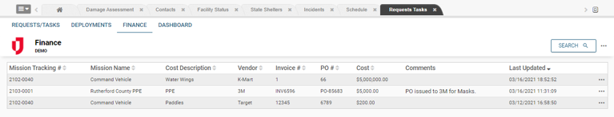
Requests, Inventory, Cost Tracking
Notes:
The Request Task board includes the core elements it had in v8 board but includes many new features including:
-New finance component & view
-New deployments view
-New history component to track the progression through the stages of the request
-New request dashboard

Slide 24
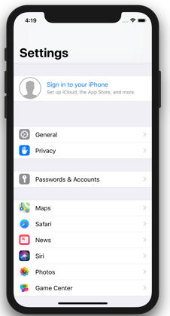
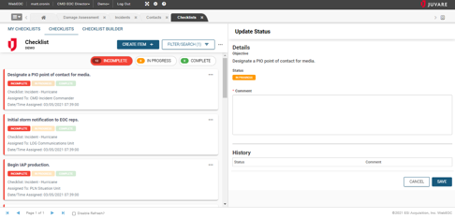
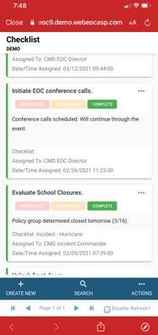
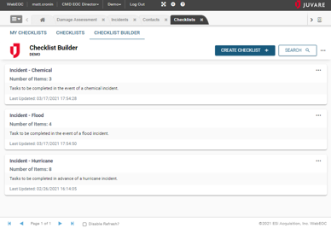
Checklists
Notes:
-Create library of daily, weekly, monthly, etc. checklists
-Activate with a single click
-Quickly update or track progress while on desktop or while on the go using the WebEOC mobile app.
-History of task updates is maintained in the board.

Slide 25
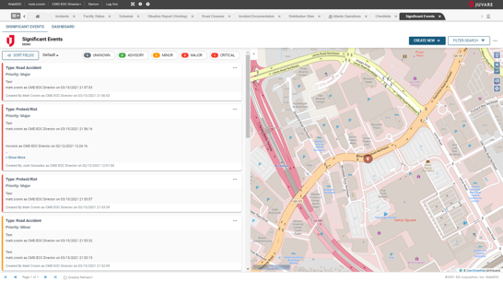
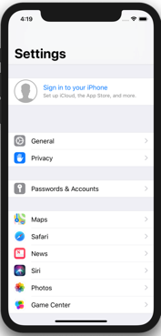
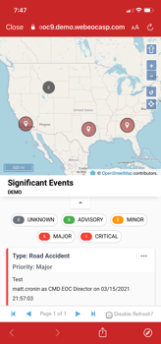
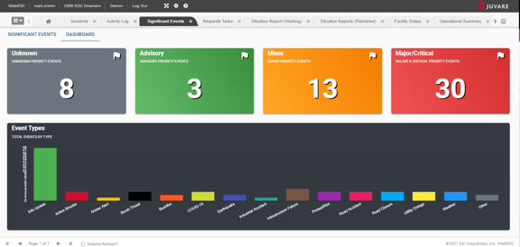
Event Reporting
Notes:
-There are two board styles (list and log) with the new UX design standard.
-The Event Reporting uses a log style view like the past.
-The board maintains the two levels of process (Activity Log and Significant Events).
-The board features a new Significant Events dashboard as well.
-New time-based filter to automatically remove records after an adjustable number of hours.

Slide 26
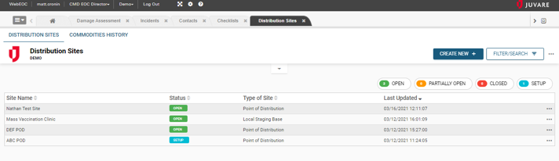
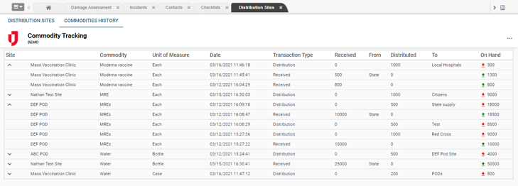
Distribution Sites
Notes:
-The new Distribution Sites board – Become standard for Emergency Managers need to track locations distributing commodities.
-Most often these are Points of Distribution (POD) but this board also encompasses other type of distribution sites such as Logistical Staging Areas, for example

Slide 27
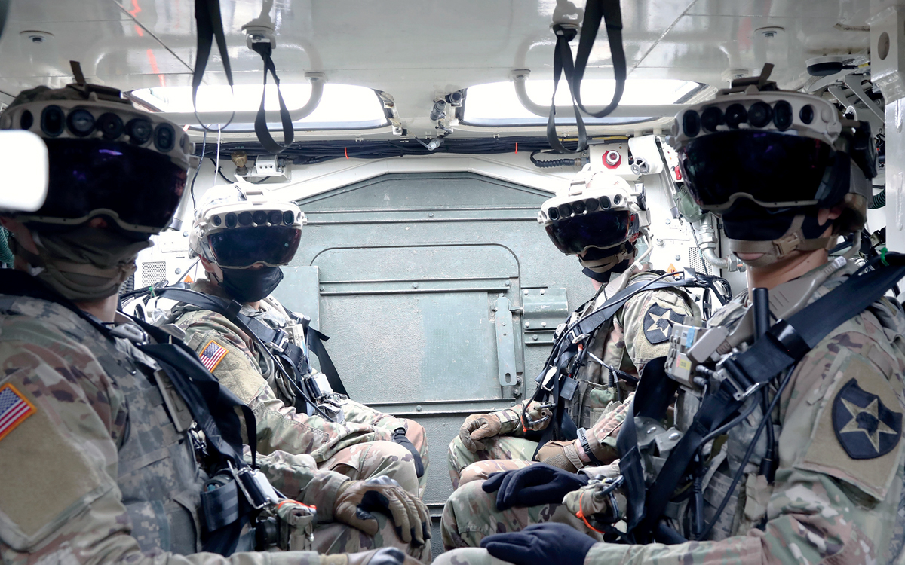
DSCA AI Use Cases – Mission Critical Decision Dominance
AI solution houses a slew of machine learning models that provide insights in real-time by digging into historical data troves to find similar crises. These are then fed to statistical models that make mission-critical suggestions for handling the crisis

Slide 28
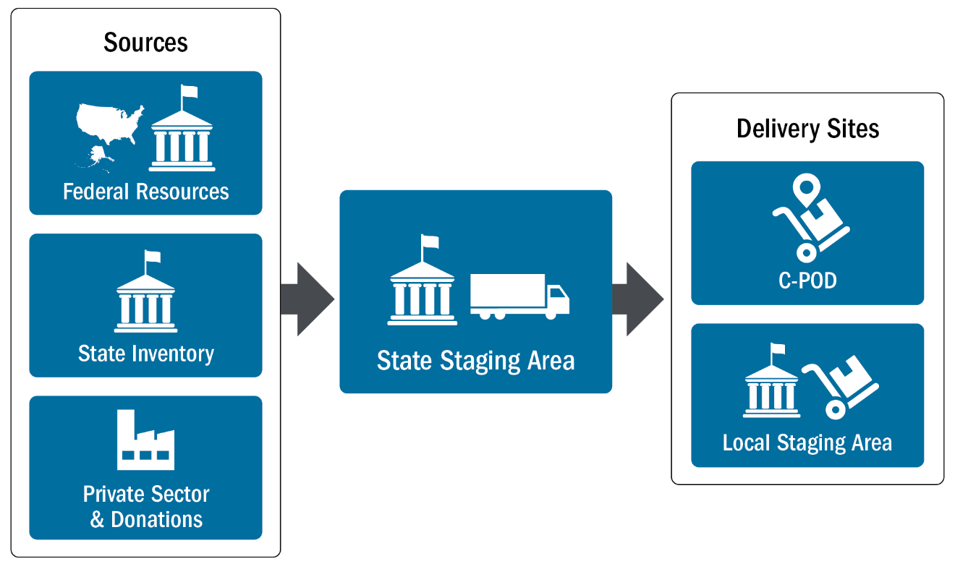
FEMA / DOD Forward Staging

Slide 29
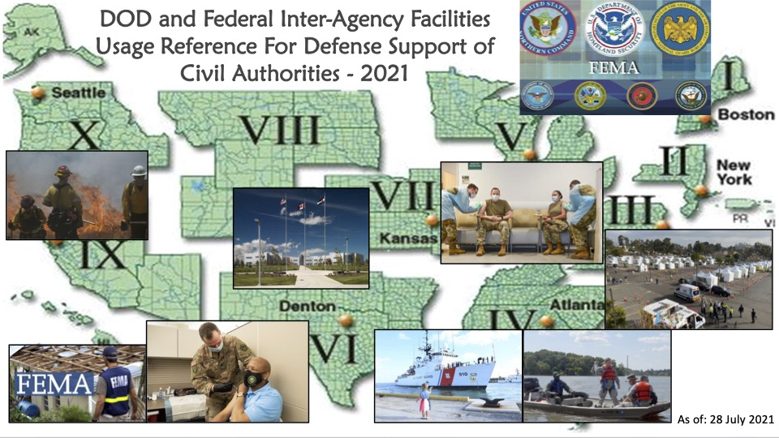
FEMA / DOD Forward Staging
1. Base Support Installation (BSI)
2. Incident Support Base (ISB)
3. Federal Staging Area (FSA)
4. National Guard Logistics
Staging Area (NGLSA)

Slide 30

FEMA AI Use Cases - Predictive Positioning of Critical Supplies
Large-scale behavior and movement data, run through predictive machine learning models, can help officials distribute supplies to where people are going rather than where they were.

Slide 31
National Disaster Medical System

Slide 32
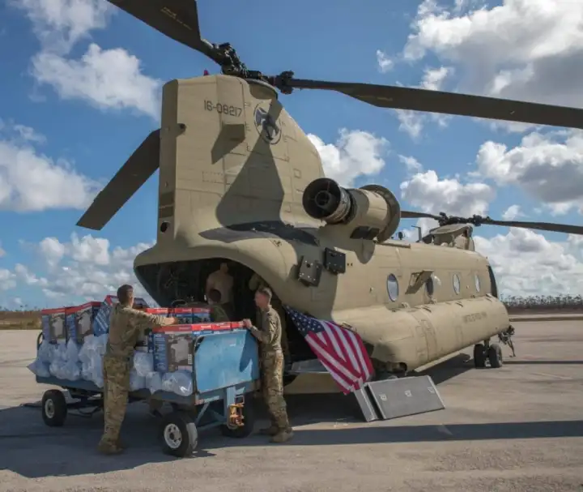
NDMS - DOD INSTRUCTION 6010.22
National Disaster Medical System (NDMS) is a federally coordinated healthcare system and partnership of the Departments of Health and Human Services (HHS), Homeland Security (DHS), Defense (DoD), and Veterans Affairs (VA).
Under Emergency Support Function-8 provides support of the Federal medical response to major emergencies and Federally declared disasters including:
Natural Disasters
Technological Disasters
Acts of Terrorism including Weapons of Mass Destruction Events
Support State, Local, Tribal and Territorial authorities following disasters and emergencies by supplementing health and medical systems and response capabilities.
Support the DoD and VA health care systems in caring for combat casualties, should requirements exceed their capacity.

Slide 33





NDMS Partners
Department of Health and Human Services
Department of Defense
Veterans Affairs
Department of Homeland Security
  FEMA

Slide 34




NDMS Partners
Medical Response
Disaster Area
Patient Movement
Definitive Care
Not in Disaster Area
HHS Response Teams
DMAT, IMSuRT, DMORT
DOD and Contract
Aero-Medical Evacuation
HHS Patient Return
VA / DOD Federal
Coordinating Centers
Public / Private
Participating Hospitals
Notes:
The National Disaster Medical System is a partnership between four Federal Partners:
The Department of Health an Human Services
The Department of Defense
The Department of Veterans Affairs
The Department of Homeland Security Federal Emergency Management Agency

Slide 35
NDMS Health Care Partner Facilities
NDMS
Hospital
Skilled Nursing
Dialysis Center
Rehabilitation
Hospice
Mental Health

Slide 36
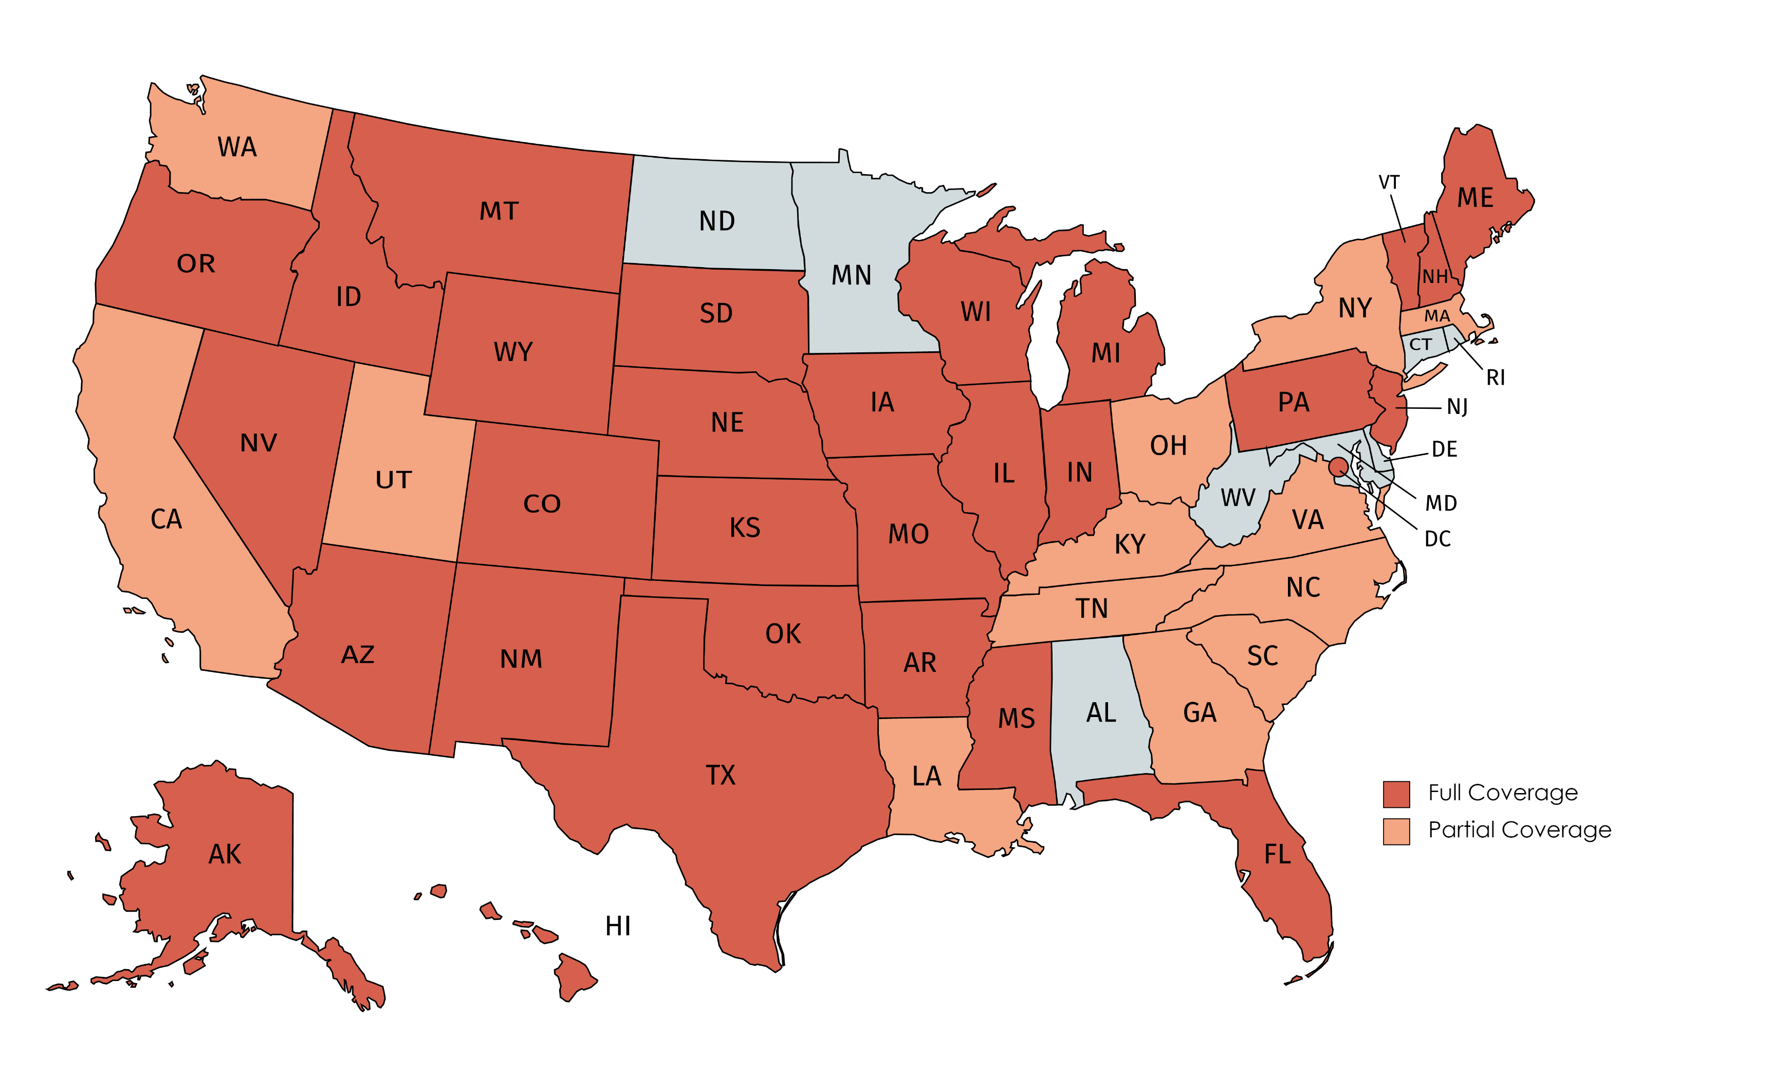
Healthcare Status Platform Footprint
Implemented at DOH or Hospital Association Level for 32+ Awardees, many other coalitions & IDNs
Changes to data schema, integration, validation logic, workflow parameters are instantaneous (no code)
Majority of data is automated (API, network agent, CSV upload), and >>1x daily updates

Slide 37
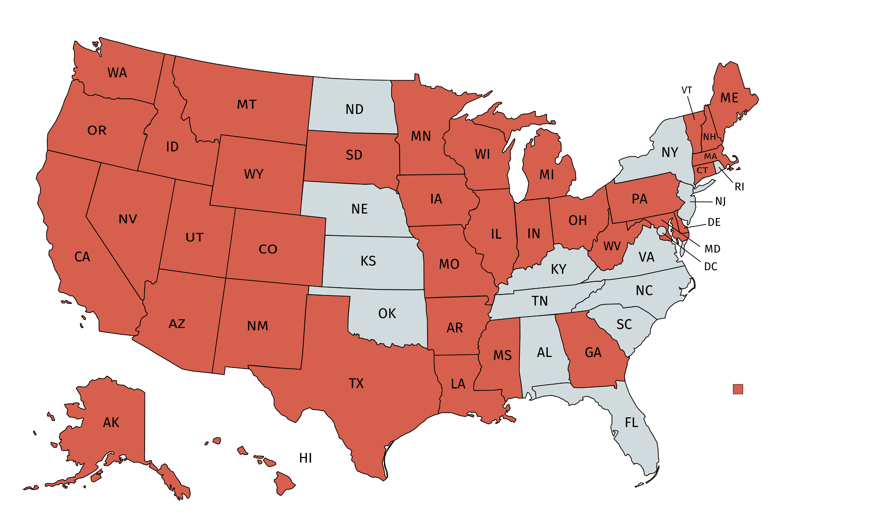
Healthcare Volunteer Platform Footprint
Implemented at State level for 37 Awardees
Primarily framed under ESAR-VHP and MRC
Supports Registration, Credentialing/Licensing, Accountability, Notification, and Reporting of Volunteers & Responders
Automated credential verification for roughly 700 occupations or professional licenses

Slide 38
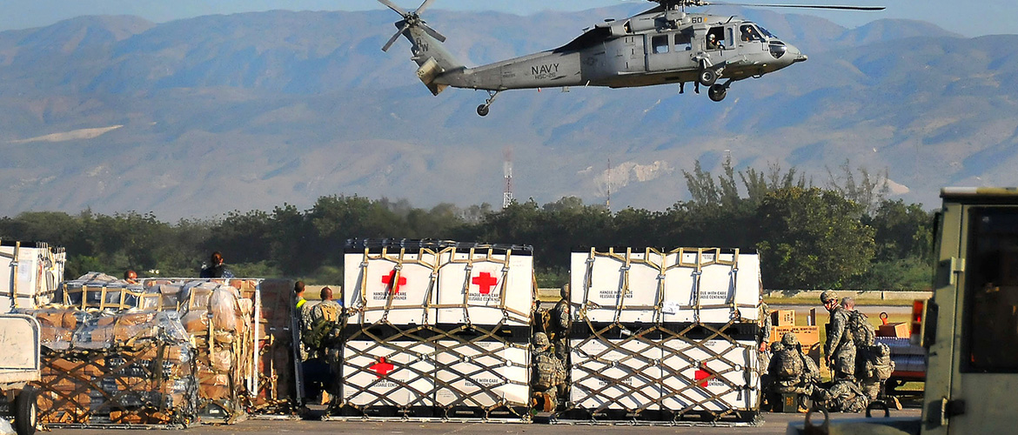
NDMS AI Use Cases – Efficient Distribution
AI to enable efficient and effective distribution of medical supplies and provide demand signaling.

Slide 39


NMDS AI Use Cases – Sharing of Vital Medical Staff / Resources
Practical collaboration with a mutual target, to enable both organizations to share staffing and material assists.
“As our support to FEMA and the whole-of-government response to the pandemic expands due to a surge in hospitalizations, we are committed to working alongside our civilian medical partners to assist hard-hit states and communities in need.”
Lt. Gen. John R. Evans, Jr., U.S. Army North commander. “Whether military or civilian, we are in this fight together.”

Slide 40
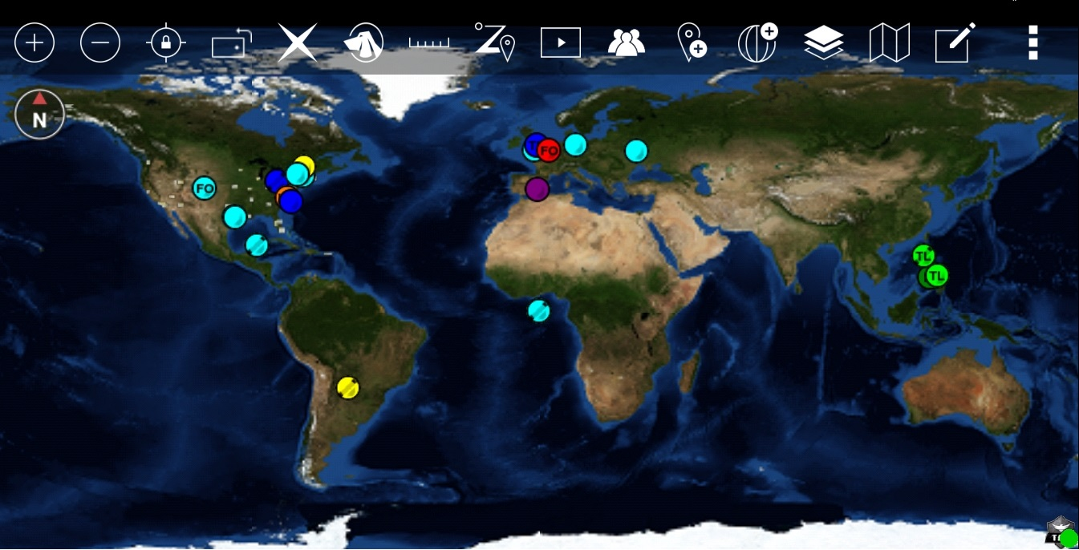

Federal Mobile App
FirstNet App
iTAK and ATAK Integrated
Touch / Face Biometric authentication, SSO, CAC/PKI, PIV
Transmits Encrypted / 3rd Party penetration tested
Available for Android & iOS
Available in the DISA approved app store
Photo / video uploads tied to an incident
Board data (records and attachments) available offline
Advanced file library to download files for offline use
Barcode / QR Scanning

Slide 41

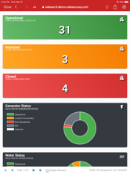
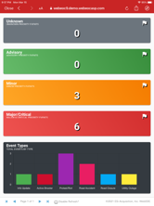




Federal Mobile App Responsive Dashboards

Slide 42
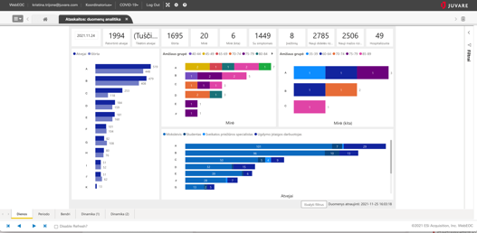
Analytics Dashboard by Power BI

Slide 43
Please contact:
  Patrick J. Macfarlane
  VP, Head of Federal & Defense
  m: 202 415 4001
  patrick.macfarlane@juvare.com
www.juvare.com

