Slide 1
FOLLOW THE MONEY . . . For Resiliency and Compatibility Funding Opportunities What’s New and Evolving in Federal Funding Programs and Notice of Federal Funding Opportunities for Defense Communities 2022 ADC National Summit

Slide 2
Joining You Today
Celeste Werner, FAICP Executive Vice President, Chief of Strategic Development Matrix Design Group Moderator
Scott J. Spencer Assistant Deputy Director, Community Adjustment, Office of Local Defense Community Cooperation
Andrew M. Porth Director of Resources for the Deputy Assistant Secretary of Defense (Real Property) Office of the Assistant Secretary of Defense (Energy, Installations and Environment)
Adam G. Wright Program Activity Lead, Defense Community Infrastructures Pilot Program, Office of Local Defense Community Cooperation
Dan Cecchini Director, Environmental Planning and Terrestrial Resources, Office of the Assistant Secretary of the Navy (Energy, Installations & Environment)

Slide 3
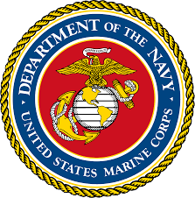
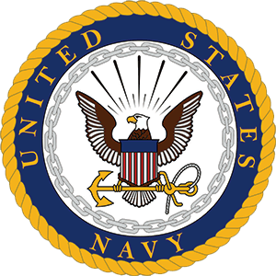
Air Installations Compatible Use Zones Encroachment, Compatibility and Resiliency
J. Dan Cecchini
March 2022

Slide 4
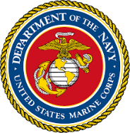
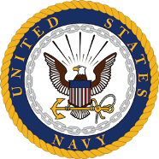
Overall Observation
Community partnering, fostered by open, transparent and proactive communication:
Allows communities to make informed land use planning decisions which,
Promotes compatible land uses around military installations which,
Fosters installation resiliency and happy communities

Slide 5
Air Installations Compatible Use Zones
The DoD Air Installations Compatible Use Zones (AICUZ) program was established in 1972
The purpose of the AICUZ program is to enhance compatibility between air installations and neighboring communities by:
Protecting the health, safety, and welfare of civilians and military personnel by encouraging land use which is compatible with aircraft operations;
Protecting Navy and Marine Corps installation investment by safeguarding the installation's operational capabilities;
Reducing noise impacts caused by aircraft operations while meeting operational, training, and flight safety requirements, both on and in the vicinity of air installations; and
Informing the public about the AICUZ program and seeking cooperative efforts to minimize noise and aircraft accident potential impact by promoting compatible development in the vicinity of military air installations.
Photo credit: Coralie Cobb
5

Slide 6
General Elements
DoD prepares AICUZ studies that include noise contours and clear zones/accident potential zones (APZs)
Noise contours around military airfields use the Day-Night Average sound level metric (DNL) (Community Noise Equivalent Level – CNEL - in California)
Normally shown in 10 dB intervals
DoD recommends types of development based on the noise contour
Less than 65dB – most land uses are compatible
65dB-75dB – transition area; incompatible development concerns
Greater than 75dB – most land uses are incompatible
Clear zones are established at the end of runways and all types of development in these zones is discouraged
APZs extend beyond Clear Zones and DoD recommends types of development compatible with these zones
Provides land use recommendations to ensure compatibility

Slide 7
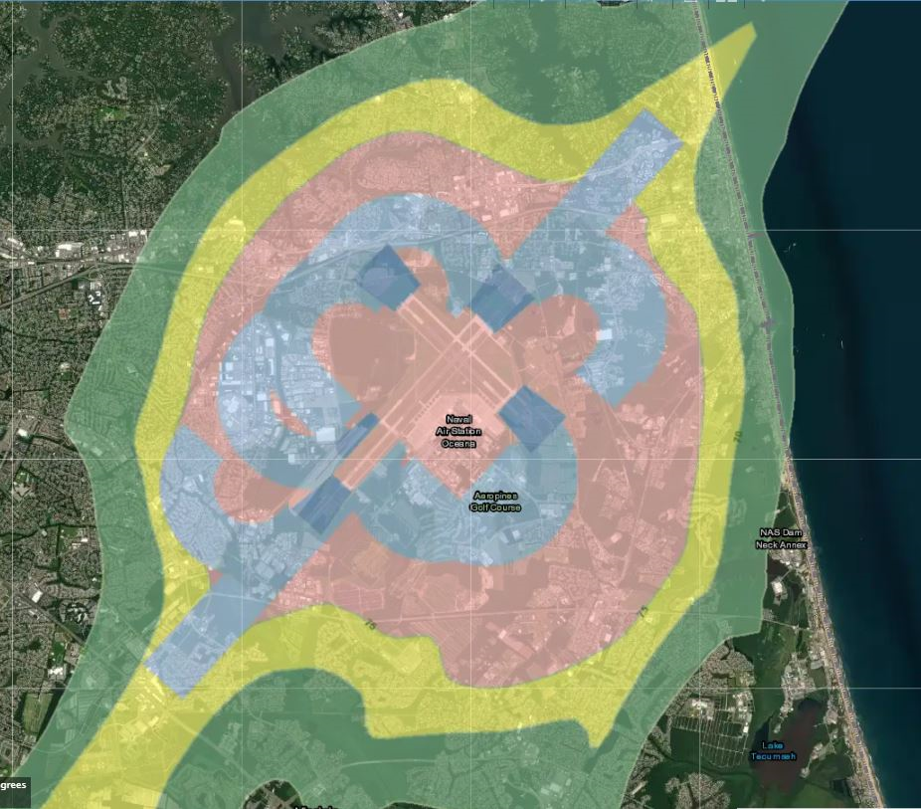
Naval Air Station Oceana
Virginia Beach, VA
Population: 450,349 (2022 estimate)
Approximately 150,000 people in 65dB DNL or higher noise zone and 20 schools
Where I
grew up

Slide 8
Notable Gaps
Level of engagement between DoD and communities and governing bodies is inconsistent
DoD may not be using all tools available to share information/interact with community
There is sometimes reluctance for communities to adopt AICUZ recommendations
Noise and accident potential zone concepts can be confusing

Slide 9
DoD Goals Moving Forward
The Defense Noise Working Group has initiated an effort to review the current AICUZ program with the following goals:
Ensure protection of the mission at every installation where DoD flies
Foster compatible development in communities surrounding our air stations
Encourage local communities to fully adopt our AICUZ findings and recommendations into land use planning requirements, guidelines and policy
Ensure internal and external stakeholders have a thorough understanding of AICUZ, noise contours, accident potential, and land use planning recommendations concepts
Encourage a better use of technology and visualization to support education and engagement
Ensure dedicated resources for AICUZ development and outreach

Slide 10
Questions?
J. Dan Cecchini
Chair, Defense Noise Working Group
Director, Enviromental Planning
Office of the Assistant Secretary of the Navy (Energy, Installations & Environment)
Joseph.d.Cecchini.civ@us.navy.mil; (757) 652-6300

Slide 11
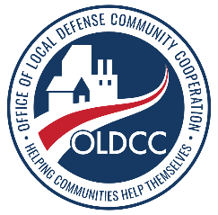
Defense Communities National Summit
U.S. Department of Defense
Office of Local Defense
Community Cooperation
Office of Local Defense Community Cooperation
Presented By:
Scott Spencer
Assistant Deputy Director for Community Adjustment
Adam Wright
Program Activity Lead, Defense Community Infrastructure Pilot Program

Slide 12
OLDCC Program Activities
U.S. Department of Defense
Office of Local Defense
Community Cooperation
Community Investment
Community Adjustment
Public Schools on Military Installations (PSMI)
Community Noise Mitigation (CNM)
Defense Community Infrastructure Pilot Program (DCIP)
Medical Facility Access Roads (Roads)
Pacific Readiness
Compatible Use (CU)
Installation Resilience (IR)
Diversification
Industry Transition
Defense Manufacturing Support Communities (DMSCP)
Growth
Realignment
Notes:
Enables states and communities to:
plan and carry out strategies to support lethality and enhance the military value of our installations, ranges, and test evaluation facilities;
partner with the Department, leveraging their comparative advantages to enhance economic, cyber and pandemic resiliency of the defense supply chain and advance competitiveness and innovation for our warfighters; and,
plan and carry out investments in public service and infrastructure to support mission growth at installations.
Unique Authority/Capabilities
10 USC 2391: make grants, conclude cooperative agreements, and supplement other Federal funds to work with states and communities
Executive Order 12788, as amended: establishes the Defense Economic Adjustment Program and Interagency Economic Adjustment Committee (EAC) to leverage the expertise of other Federal agencies – Commerce and Labor are co-vice chairs
Connect with state and local partners to advance mission and respond to needs, broker through impasses
Defense Field Activity Status
Separate appropriation (averaged nearly 300% more in appropriations than requested over last decade)
Strong Congressional support across parties and Committees
Capabilities and expertise are not replicated nor duplicated elsewhere in Department or Federal Government

Slide 13
Community Adjustment
U.S. Department of Defense
Office of Local Defense
Community Cooperation
Project Initiation
Projects may be initiated either through a Military Service nomination or by a community inquiry
The Office of the Secretary Defense or Congress may also direct a nomination.
The Compatible Use and Installation Resilience programs can be blended.
Project scope of work serves as a comprehensive strategy with specific implementation actions
OLDCC technical and financial assistance also available to carry out implementation recommendations
Project Intake (nomination, FFO response
Grant Application
Grant Performance
Report Recommendations
Project Assessment (OLDCC PM)
Project Initiation (approved authority)
Grant Carry-Out
Notes:
OLDCC Grant Application Processes:
OLDCC will assign a Project Manager once we receive a nomination or inquiry
OLDCC will validate proposal justification; will meet with local community leadership and military installation leadership
Once need is validated, OLDCC will invite community applicant to apply through our on-line grants management system
Applications must have installation coordination and endorsement referencing resilience issues
Program is enduring and not competitive; no application submission deadline
Installation
Recommend and support the nomination
Represent installation interests
Provide releasable data!!!
Community
Sponsor the effort
Fund its part of the effort (10% non-Federal match)
Administer the OLDCC grant
Implement recommendations
Office of Local Defense Community Cooperation
Confirm need for assistance
Provide guidance to initiate, conduct and complete a community-driven effort
Provide technical assistance to the local jurisdiction and installation
Provide funding assistance to the local jurisdiction to conduct the project
Facilitate communications between the local jurisdiction and the installation

Slide 14
Examples of Challenges
U.S. Department of Defense
Office of Local Defense
Community Cooperation
Compatible Use
Air Space and Land Restrictions
Airborne Noise
Urban Growth
Spectrum Encroachment
Endangered Species/Critical Habitat
Energy Compatibility
Air Quality
Cultural Resources
Marine Resources
Security
FY 2021: 21 Projects funded worth $7.9M
Resilience Risks:
Flooding & Tidal Surge
Wind
Drought
Wildfire
Earthquake
Resilience Impacts:
Water Availability
Stormwater
Wastewater
Installation Energy
Operational Energy (logistics infrastructure)
Transportation/Installation Access(Logistics)
Communications
FY 2021: 13 Projects funded worth $8.5M
Notes:
Compatible Use
Provide technical and financial assistance to communities to plan and implement and carry out civilian actions necessary to alleviate and/or prevent incompatible development and other civilian activities that are likely to impair the continued operational utility of a DoD installation, range, special use air space, military operations area, and/or military training route.
Reduces usage days
Prohibits certain operational, training and testing events
Reduces range access
Segments training and reduces realism
Limits new technologies
Restricts flight altitudes
Inhibits new tactics development
Reduces live fire proficiency
Increases personnel tempo
Complicates night and all weather operations and training
Increases costs or risks

Slide 15
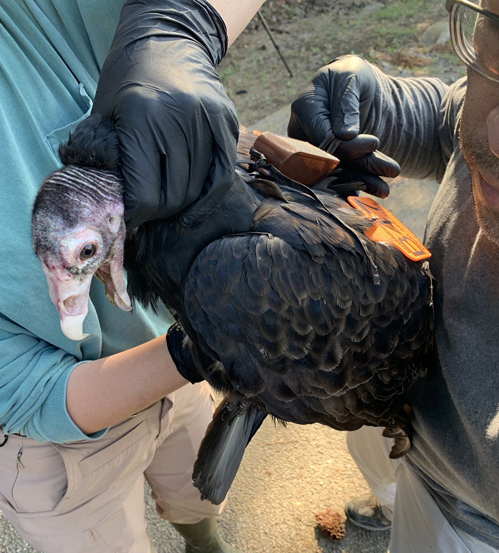
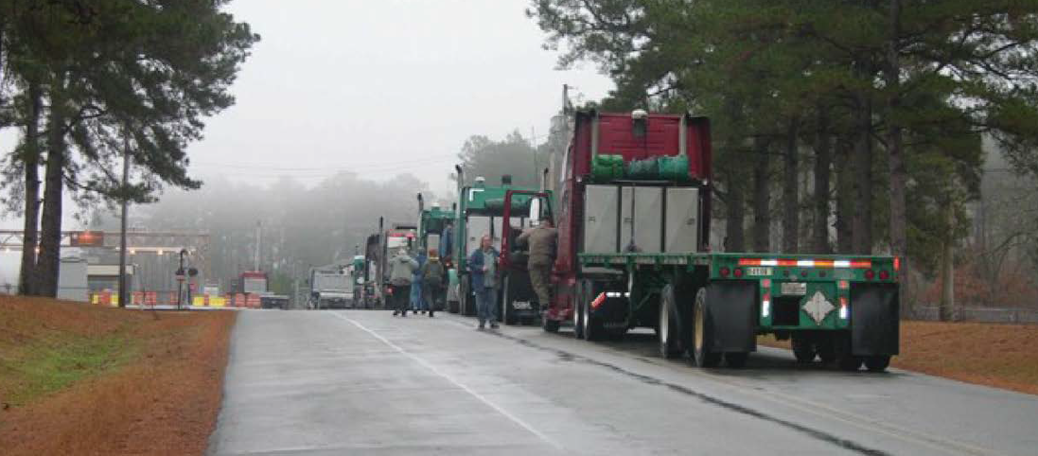
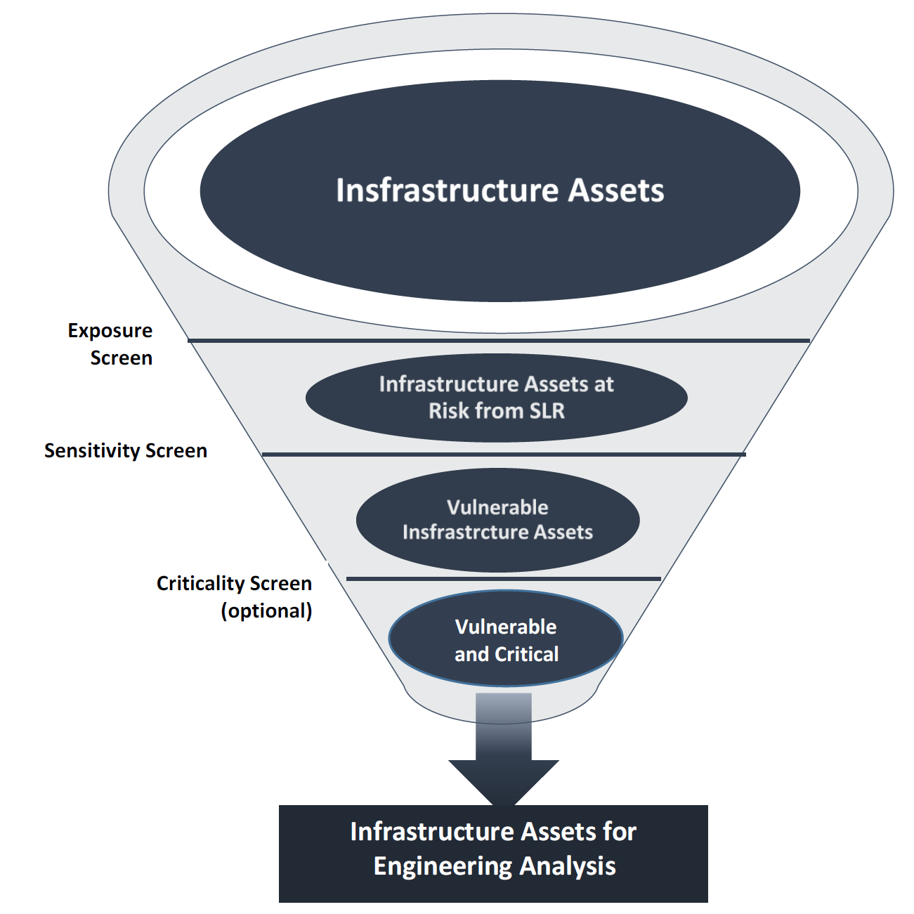
Think Outside of the Box!
U.S. Department of Defense
Office of Local Defense
Community Cooperation
Bird Air Strike Hazard (NAS Meridian Vulture Movement Study)
Infrastructure Sea Level Rise Analysis (MCRD Parris Island, MCAS Beaufort)
Sound Attenuation Brochures
Informational Videos (Avon Park AFR, JB San Antonio)
Legislation on Incompatible Energy (Oklahoma, Fort Riley)
Real Estate Disclosure Language
Transportation & Housing Studies (SUBASE New London, NSY Portsmouth)
Comprehensive Plan Updates (JBSA Kelly Field at Port San Antonio)
State Energy Studies (Washington, Oregon, Virginia, Texas)
Washington State Guidebook on Military and Community Compatibility
Web based Tools (NAS Fort Worth, Maxwell AFB)
Model Noise Ordinances (Avon Park AFR)
State Wide Compatible Use Studies (State of Maryland)
Gate Alternatives Analysis (JB Langley-Eustis)
Dark Skies Initiatives (Camp Bullis, Fort Gordon)
UAS Flight Corridors (Mississippi Gulf Coast)
Infrastructure Assessments/Design (Pine Bluff Arsenal, Fort Drum)
Storm water (US Air Force Academy)
Notes:
Compatible Use
Provide technical and financial assistance to communities to plan and implement and carry out civilian actions necessary to alleviate and/or prevent incompatible development and other civilian activities that are likely to impair the continued operational utility of a DoD installation, range, special use air space, military operations area, and/or military training route.
Reduces usage days
Prohibits certain operational, training and testing events
Reduces range access
Segments training and reduces realism
Limits new technologies
Restricts flight altitudes
Inhibits new tactics development
Reduces live fire proficiency
Increases personnel tempo
Complicates night and all weather operations and training
Increases costs or risks

Slide 16
Community Adjustment
U.S. Department of Defense
Office of Local Defense
Community Cooperation
Effort as a catalyst for sustained local, State, Federal agency and military engagement
Leverage local and State resources for implementation
Integrate recommendations and strategies into ongoing local and regional planning efforts, such as Comprehensive Plans, Emergency Plans, General Plan updates or Capital Improvement Plans
Maintain momentum by prioritizing strategies for implementation before Final Report completed
What worked well
Blending project types
Regional Resilience Coordination
What worked less well
Coordination and Communication with Services
Working with counsel to streamline the legal sufficiency reviews
Obtaining releasable data
FY2022 NDAA Amended 10 USC 2391 authorizing Construction related to installation resilience and encroachment mitigation
FY22 Planned Execution: Installation Resilience - $11.8M, Compatible Use - $4.6M
Installation Resilience Notice of Funding Opportunity pending publication
Expectations for FY 2022
Combined Military Service Call for Nominations (April)
Striving to address natural and human-driven events
Growing proportion of core program and funding towards resilience

Slide 17
Community Noise Mitigation
U.S. Department of Defense
Office of Local Defense
Community Cooperation
FY 2021 Appropriations and Report Language - $50M (2-year funding) to be competitively selected
Fixed wing aircraft - Approximately 205 installations with 65db or greater sound level around a military installation - FAA Part 150 Program coordination
Solicited Input on Needs Through Federal Register through Nov. 19, 2021
Received 1,724 Survey Responses from 37 Installation locations
FY 2022 Expectations
HAC-D Mark for FY 2022: Rescind $50M, Appropriates $75M, Rotary aircraft Congressional Report (avail until FY25)
SAC-D Mark for FY 2022: Rescinds $45M, leaving $5M, new aircraft (avail. until FY23)
Program development to proceed based on final appropriation

Slide 18
Defense Community Infrastructure Pilot Program
U.S. Department of Defense
Office of Local Defense
Community Cooperation
$60M in FY 2021 - Prioritized enhancements: military value, resilience, and military family quality of life
90 total proposals received (20 duplicate or ruled non-responsive)
70 complete proposals scored ($380M DCIP/$800M Match)
13 proposals selected/awarded ($60M DCIP/$68M Match)
What worked well
FY 2020 lessons learned and processing enhancements
Webinars, highlight at ADC events, and conducted debriefs to non-selects
Screening, proposal review, and application team approach
Generally higher quality proposals resulting in tighter scoring
Provided communities nearly 60 days to prepare proposal
The Commander’s letter continues to showcase the community cooperation and the need for the enhancement

Slide 19
Defense Community Infrastructure Pilot Program
U.S. Department of Defense
Office of Local Defense
Community Cooperation
What worked less well
Confusion on military value of the installation vs the value of the enhancement
Proposals with eligibility/quality/compliance concerns
Other Federal program participation – commitment of funds – shopping $$
Location of the enhancement (on/off the installation) – site control
Validity of 3rd party cost estimate
Ability to commence work within 12 months (shovel-ready)
Work which has already commenced (NEPA, Buy American Act issues)
Availability and source of match
Adequacy of back up documentation
Some high-value enhancements were found ineligible for being on installation leased property

Slide 20
DCIP Expectations for FY22
U.S. Department of Defense
Office of Local Defense
Community Cooperation
Competitively Selected Projects Delivering: military value, resilience, and military family quality of life
Notice of Funding Opportunity to be published this month
Expect effort to be materially the same as FY21
Availability of funding is uncertain – FY21: $60M or ?
90 days to prepare proposal
“Construction ready”- careful review of National Environmental Policy Act actions, availability of other Federal and non-Federal contributions (not for shopping), permitting
Ability to move past invited applicants where an application changes a proposal’s merits

Slide 21
U.S. Department of Defense
Office of Local Defense
Community Cooperation
Points of Contact
Scott Spencer Assistant Deputy Director Community Adjustment (571) 344-0104 scott.j.spencer.civ@mail.mil
Adam Wright Program Activity Lead Defense Community Infrastructure (571) 721-9861 adam.g.wright8.civ@mail.mil
Office of Local Defense Community Cooperation 2231 Crystal Drive, Suite 520 Arlington, VA 22202-3711

Slide 22
Compatible Use Programs Evolving
Association of Defense Communities National Summit
March 8, 2022
Andy Porth Director Resources Office of the Assistant Secretary of Defense (Energy, Installations, & Environment)
osd.repi@mail.mil

Slide 23
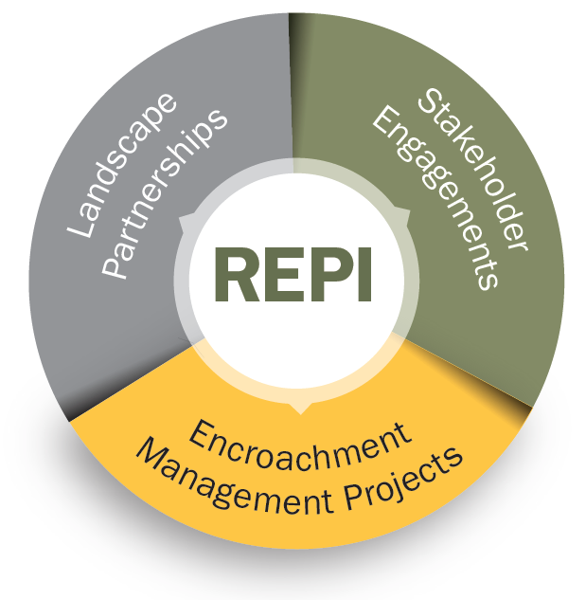
REPI Program Components
Landscape Partnerships ($$)
Sentinel Landscapes (sentinellandscapes.org)
Southeast Regional Partnership for Planning and Sustainability (serppas.org)
Western Regional Partnership (wrpinfo.org)
Americas Longleaf Restoration Initiative (americaslongleaf.org)
Stakeholder Engagements ($)
Internal DoD coordination and collaboration – DoD Natural Resource and Water Resources & Resilience Programs, Office of Local Defense Community Coordination, Military Departments, etc.
External coordination and collaboration with Federal agencies, State agencies, Local communities, NGOs, Academic Institutions, Foundations, etc.
Encroachment Management Projects ($$$)
Installation and range level implementation
Installation resilience justification (added in the FY19 National Defense Authorization Act)
Matching funds from ANY conservation or resilience program of ANY federal agency

Slide 24
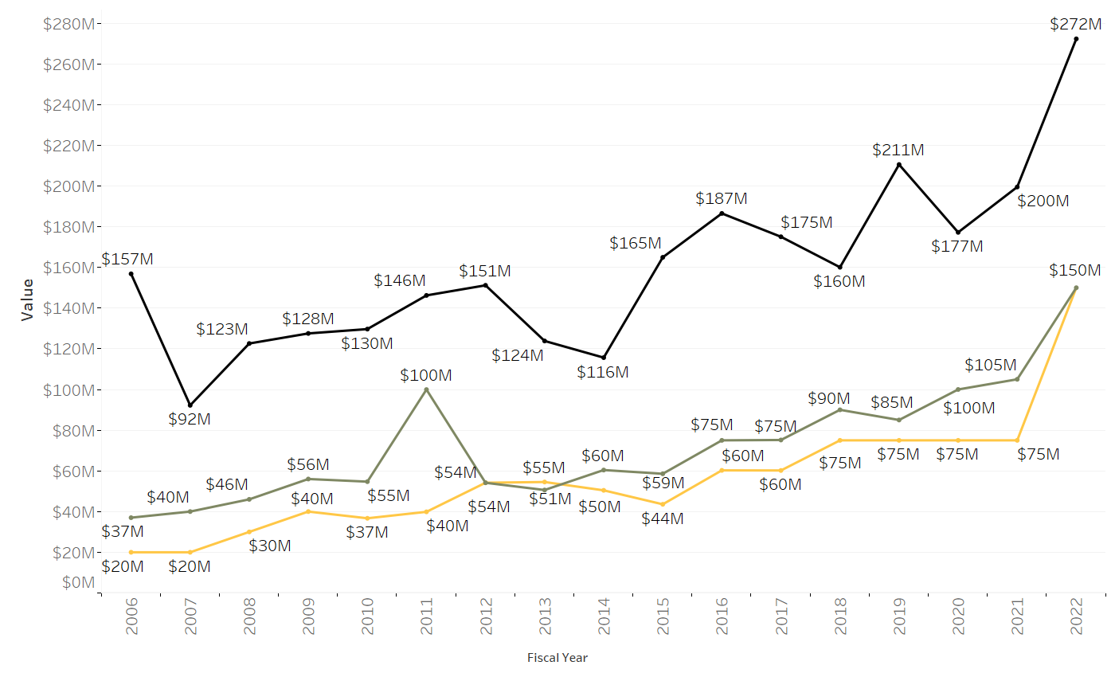
REPI Program Funding and Expenditures
REPI Program Funding through FY 2022
REPI
Partner
Combined
Military Service
$1 billion in DoD funds have been leveraged with over $975 million in partner funds.
PB FY22 $150M $75M OMB/DSD directed increase FY22 Appropriations are pending.
Notes:
The REPI program is supported by an annual line item appropriation from Congress. Several important things I’d like to emphasize about this funding chart:
The black line represents annual requirements for REPI funds – these requirements are generated by the Military Departments and submitted in the form of installation level projects to my office on an annual basis. The FY22 requested funding was $272M.
The green line represents annual appropriations from Congress – you’ll note that we have received fairly steady and increasing funding since FY05 – averaging $91M over the past 5 years, with higher funding levels in recent years - $90M in FY18, $85M in FY19, $100M in FY20, and $105M in FY21 – just over 50% of our average annual requirement, with big jump in FY22 looks like congress will support but not increase-not surprising given the big jump.
The yellow line represents the DoD Presidential Budget Request –
I want to emphasize about REPI funding, is that the work done within the REPI program is not only resourced by DoD funds appropriated by Congress, but also through non-DoD partner funds - $975M through the end of FY20 to be exact. These are other federal, state, local, and private dollars that are being leveraged with DoD funds to accomplish outcomes on the ground around our installations and ranges that preserve and enhance military readiness, promote installation and community resilience, and conserve important agricultural lands, habitat, and open space.

Slide 25
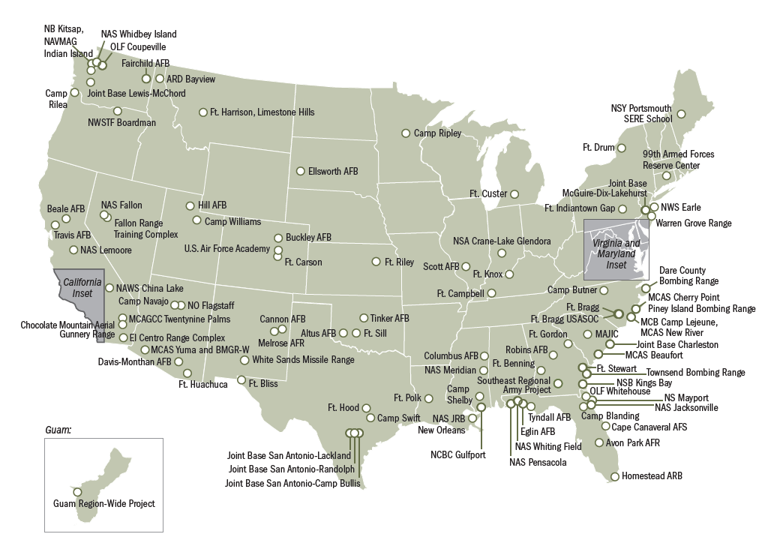
REPI Project Locations
Through fiscal year 2021, DoD has leveraged $1.18 billion with over $1.05 billion in non-Department partner contributions to protect nearly 830,000 acres of land, safeguarding vital test, training, and operational assets and capabilities in 118 locations in 35 states and territories.

Slide 26
Relevant REPI Authorities
10 U.S.C. § 2684a
Allows the recipient of REPI funds to acquire real property interests or water rights for property in the vicinity of, or ecologically related to, a military installation, range or airspace to:
Limit development or use of the property that is incompatible with the installation’s mission and/or
Preserve habitat to relieve current or anticipated environmental restrictions on military activities and/or
Maintain or improve military installation resilience
10 U.S.C. § 2684a(h): DoD Funds as Match Authority
Allows the recipient of REPI funds to use such funds as the match or cost-sharing requirement for ANY conservation or resilience program of ANY federal agency
10 U.S.C. § 2679: Intergovernmental Support Agreement (IGSA)
Authorizes the Military Departments to enter into agreements with eligible entities to provide, receive, or share installation support activities
16 U.S.C. § 670c-1: Sikes Act
Authorizes DoD to enter into cooperative agreements to maintain and improve natural resources on and off installations
Authorizes DoD to maintain or improve natural infrastructure in support of military installation resilience

Slide 27
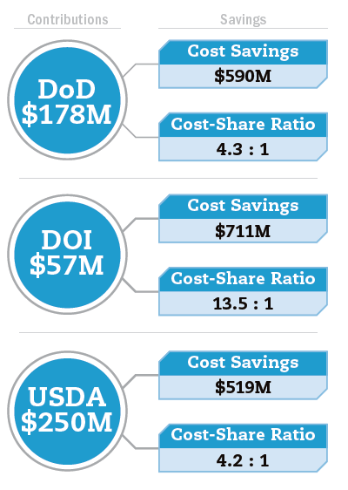
Sentinel Landscapes Partnership
The partnership was established in 2013 by USDA, DOI, and DoD with the strategic goals of strengthening military readiness, bolstering agricultural productivity, preserving natural resources, and increasing access to recreation.
Through fiscal year 2020, projects across sentinel landscapes have attracted roughly $178 million in DoD funds, $250 million in USDA funds, $57 million in DOI funds, $230 million in state funds, $16 million in local funds, and $104 million in private funds.
These contributions have permanently protected over 515,000 acres of land and enrolled 2.7 million acres of land in technical assistance programs.
On February 15, 2022, the partnership announced the designation of three new sentinel landscapes:
Camp Bullis Sentinel Landscape in Texas
Northwest Florida Sentinel Landscape
Southern Indiana Sentinel Landscape
Funding data through FY 2020

