Slide 1
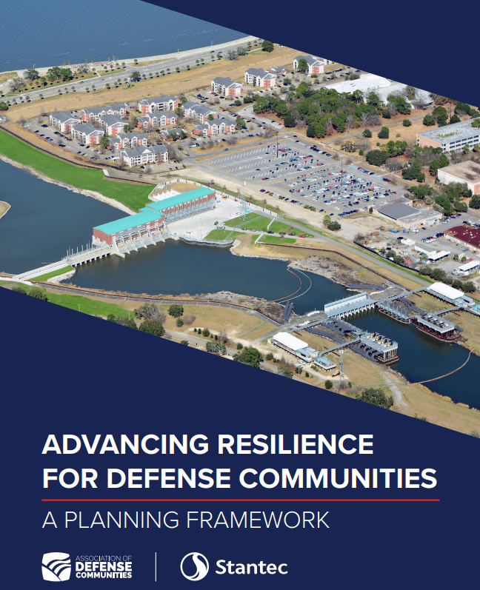
Advancing Resilience through Innovative Funding Strategies
Defense Communities
2022 National Summit
March 8, 2022

Slide 2
ADC Panelist
John Malueg, PE – Moderator Stantec
David Goldwater, VP – Public Policy Stantec
Josh Human – BRIC Partnership Coordinator FEMA
Jacqueline Guild, Esq. - Deputy City Manager City of Annapolis, MD

Slide 3
ADVANCING Resilience through innovative Funding Strategies
Federal Funding “Infrastructure Bill”
Infrastructure Investment and Jobs Act

Slide 4
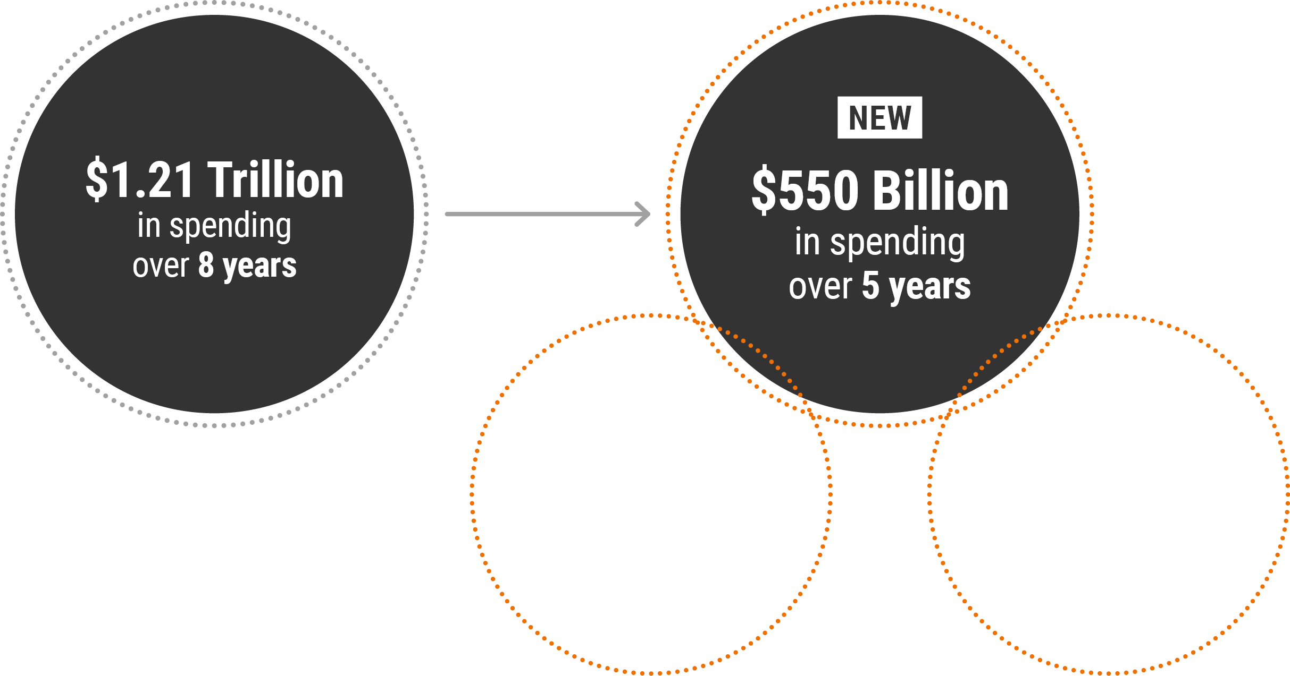
ADVANCING Resilience through innovative Funding Strategies
4
$1.2 Trillion Infrastructure Investment and Jobs Act (IIJA)

Slide 5
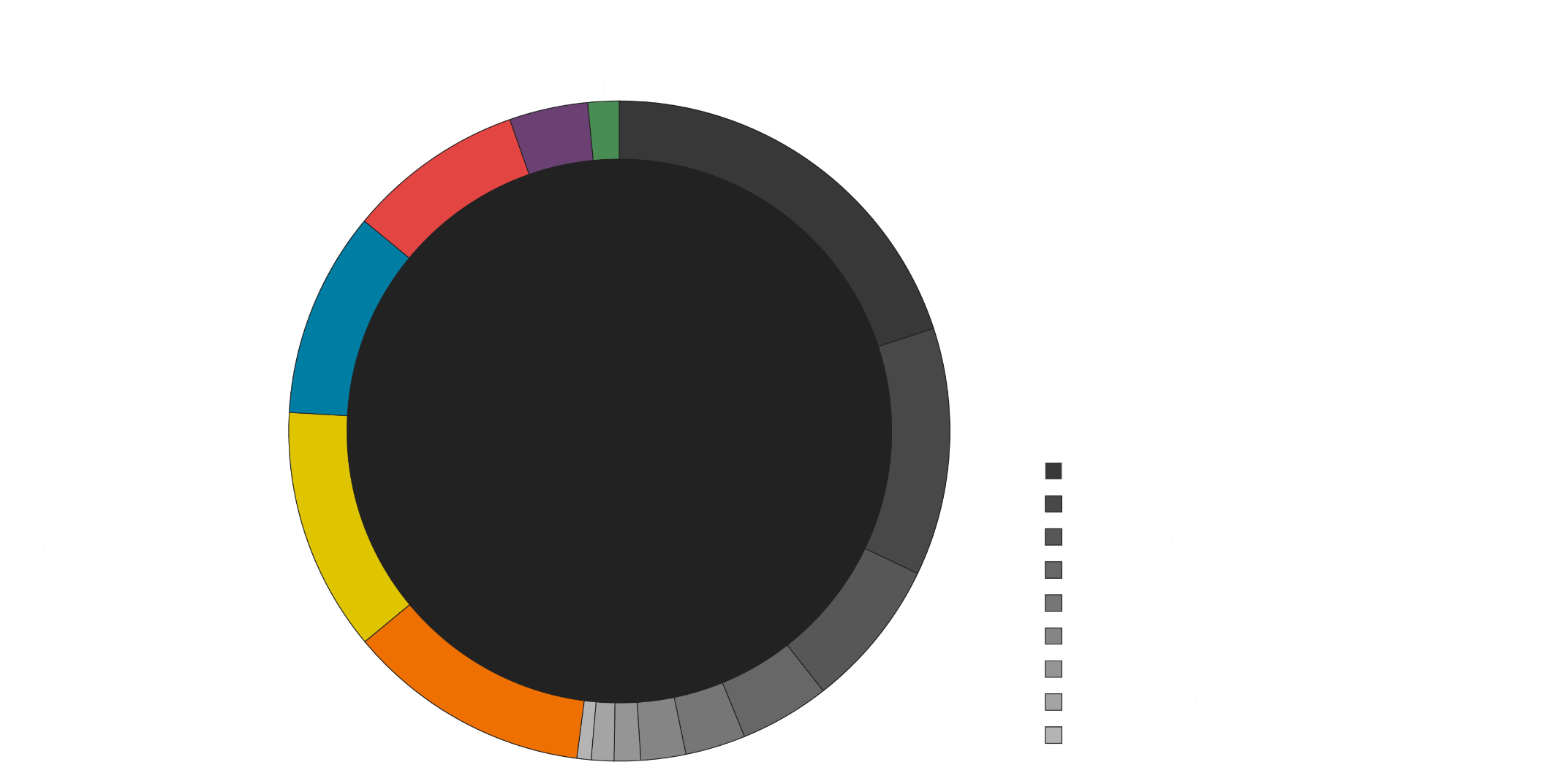
Divisions of Funding
ADVANCING Resilience through innovative Funding Strategies
Resilience $47.2
Water $55
Transportation $283.8
Power and Grid $65
Broadband $65
Source: Brookings “America has an infrastructure bill. What happens next?” November 9, 2021
In Billions

Slide 6
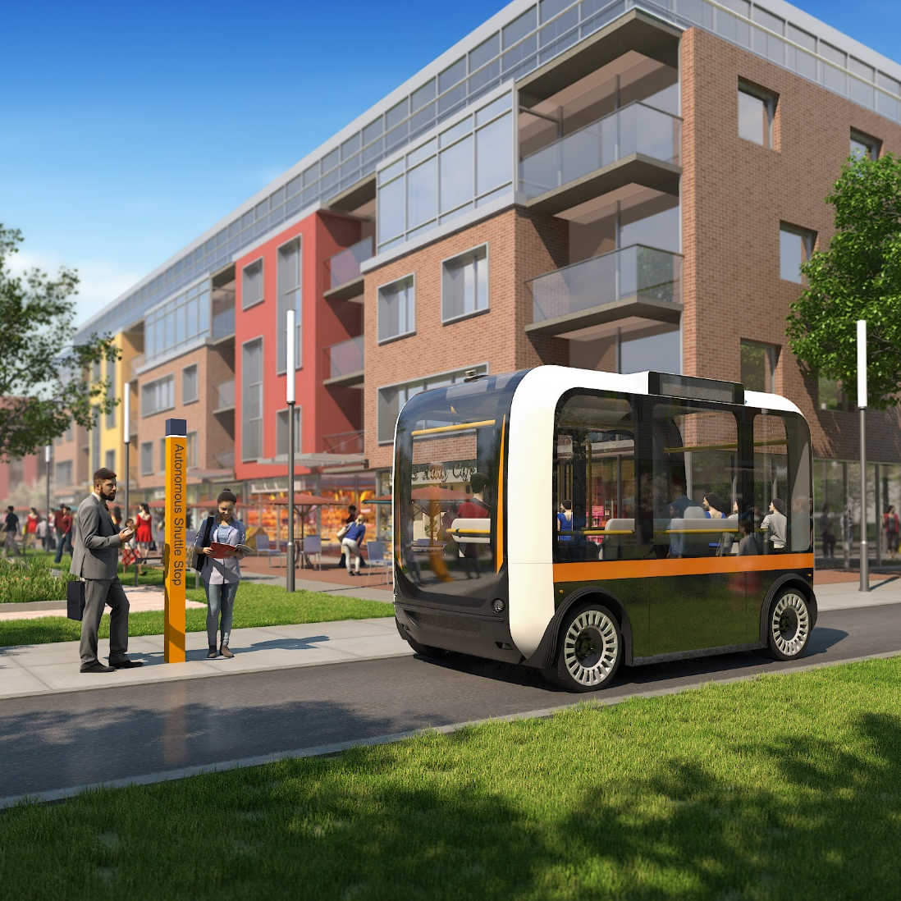
Highlights: Infrastructure, Environment and Equity
ADVANCING Resilience through innovative Funding Strategies
Resilience ~ $47.2 B Critical Infrastructure Lifelines
FEMA Flood Mitigation Assistance ~ $3.5B over 5-years
FEMA BRIC ~ Additional $1B over 5-years
NOAA ~ $2B includes funding for coastal resilience
USACE ~ $7B infrastructure flood mitigation priorities
EPA ~ $1.5 to clean up brownfield / superfund sites
Highway Trust Fund ~ $2.5B
National EV Infrastructure Formula / Grant Program ~ $7.5B
Low / No Emission - Clean Bus Program ~ $10.6B
Reconnecting Communities ~ $1B
“Equity” appears 42 times in the BIL Guidebook

