Slide 1
Understanding the Impact of Race, Diversity and Inequality Issues on Military Families
Victor Angry, Neabsco District Supervisor, Prince William County, VA
ADC National Community Summit
March 8, 2022

Slide 2
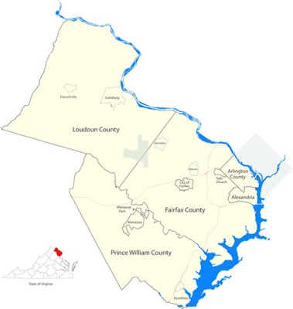
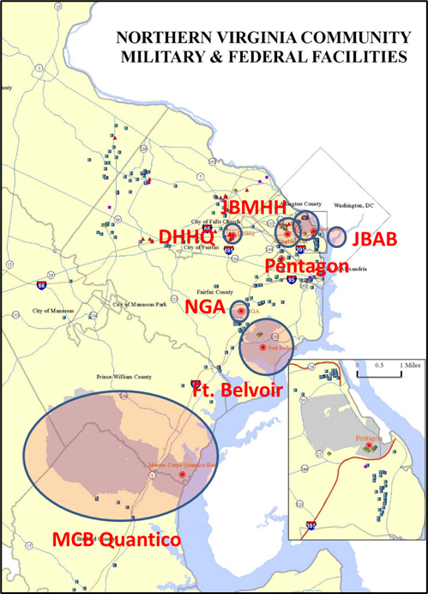
Northern Virginia Region & Defense
Population: 2,522,001 – has grown 13% since 2010 (290,000) (U.S. Census Bureau)
Gross Domestic Product: $211 Billion (2018), 40% of State GDP of $538 Billion. (US Bureau of Economic Analysis)
Defense Related Population
The Pentagon – 24,000
Joint Base Myer-Henderson Hall – 15,000 and 15 Agencies
Mark Center – 6400
Defense Health HQ – 2000
National Geospatial Intelligence Center – 10,000
Fort Belvoir – 56,000 and 156 Agencies
Marine Corps Base Quantico – 23,000 and 26 Agencies
2

Slide 3
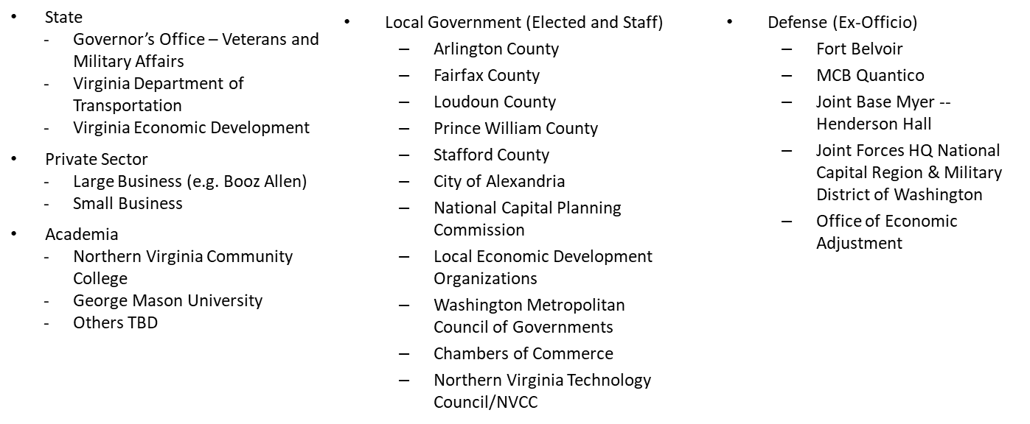
Community, Military & Federal Facility Partnership of Northern Virginia
Goals
  Grow and protect military activities in the region and remove impediments to operations
  Improve operational efficiencies with installations through full range of partnerships
  Improve resiliency of installations and surrounding communities
  Enhance the quality of life for all members of the military and community
  Achieve the Base of the Future with the military in the region
Members
NGOs
  EveryMind
  Blue Star Families
  Veterans Organizations
  Easter Seals

Slide 4
One Military, One Community (OMOC) Background
On October 1, 2020, the ADC launched the One Military, One Community (OMOC) initiative with the overarching goal of impacting change in defense communities* to help create a better place for all service members and their families to call home.
To advance this goal the initiative is focusing on four key actions:
  Listening to those who have experienced the impact of racism and inequality to ground our efforts in their experiences;
  Understanding the issues of racism and inequality in military communities, and developing a strong analytical foundation (e.g., National Survey and Report);
  Planning for collective action in every defense community by creating a roadmap; and
  Learning from each other through resources and engagements that enhance awareness, increase understanding, and keep this conversation alive.
The Community, Military, and Federal Facility Partnership of Northern Virginia added diversity, equity, and inclusion (DEI) to its list of partnership discussion topics in November 2020, and held large and small group listening sessions to learn, gather information, expand relationships, and developed a Roadmap to chart actions and future directions
* ADC defines defense communities as, “towns, cities, counties, regions and states that serve as home to our nation’s military missions, installations and industrial partners”

Slide 5
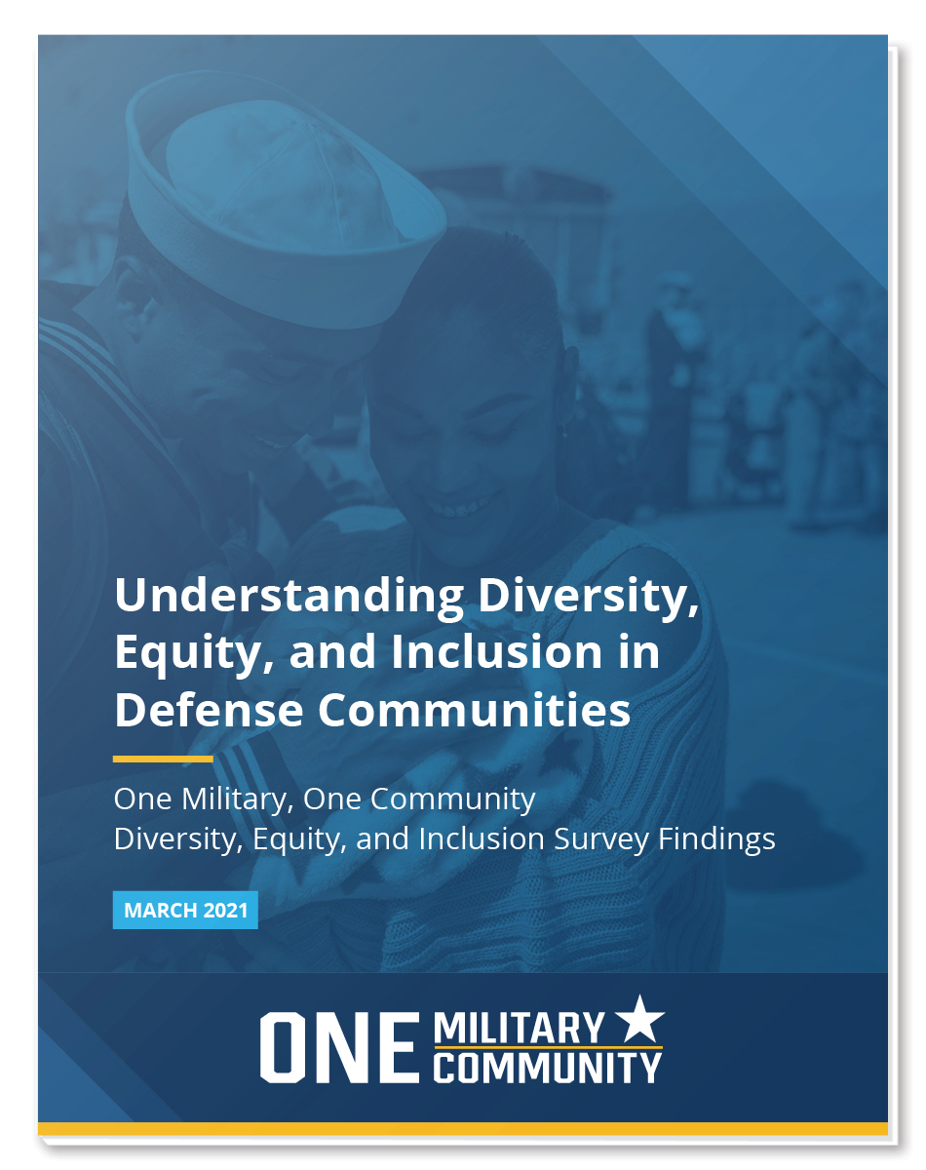
Example DEI Activities in Northern Virginia Region with Military Members and Their Families
1
3
Looked at Survey Results for Northern Virginia from ADC National Report
Initially Presented on January 14, 2021
Held Small Group Listening Sessions Organized by Non-Government Organization EveryMind
2
4
Held Large Group Meetings Every Other Month to Understand Installation and Community DEI Efforts
Developed a DEI Roadmap as a Framework to Coordinate DEI Actions in the Northern Virginia Region

Slide 6
Northern Virginia Survey Results
Sample from National Survey
Initially Presented on January 14, 2021

Slide 7
Respondent Overview
157 individuals responded from the following counties: Alexandria, Arlington, Fairfax, Falls Church, Loudoun, Manassas, Prince William
The majority of respondents were 41-60 years old and lived in their community for over 2 years
Duration in Housing (n=157)
Less than 1 month | 1%
1-6 months | 11%
7-12 months | 8%
1-2 years | 13%
More than 2 years | 67%
Age (n=157)
19-30 | 4%
31-40 | 17%
41-50 | 33%
51-60 | 29%
Over 60 | 14%
Unknown | 3%
Gender (n=157)
Male | 56%
Female | 38%
Unknown | 6%
Housing Location (n=157)
Off installation | 97%
On installation | 3%
Data are preliminary pending further analysis. Generalizations cannot be drawn from this sample.

Slide 8
Respondent Overview Continued
Over half of the respondents were Veterans, and the Army was the most represented branch of the military.
Respondent Affiliation
Service/DoD Component
1%
Active duty
Army
Military Family
Navy
15%
12%
Veteran
11%
Marine Corps
Other
Air Force
Unknown
Other
40%
20%
27%
52%
12%
10%
Notes:
Affiliation:
Other category composed of DoD Civilian Employee (9), National Guard (3), and/or Reservist (6)
Military Family category composed of spouse/domestic partner (31) and dependents (1)
Service/DoD Component:
Other category composed of DoD Components (9), Space Force (2), Multiple Services (3), Coast Guard (1), Army National Guard (3)
Data are preliminary pending further analysis. Generalizations cannot be drawn from this sample.

Slide 9
Race and Ethnicity of Respondents
Approximately half of the respondents were white, and the other half of respondents were Black, Hispanic, Asian, and Multiracial.
White
52%
Black/African American
24%
Hispanic
9%
Asian
6%
Multiracial
3%
Other
1%
Unknown
6%
n=157
0%
10%
20%
30%
40%
50%
60%
Note: Multiracial includes respondents who have selected 2 or more race categories
Data are preliminary pending further analysis. Generalizations cannot be drawn from this sample.

Slide 10
Top Areas to Address in Northern Virginia
Respondents most frequently listed K-12 education, criminal justice, housing, healthcare, and employment as the most critical areas to address to eliminate inequality in NoVA.
K-12 education
56%
Criminal justice
50%
Housing
47%
Healthcare
47%
Employment
45%
Food insecurity
42%
Public Safety
34%
There are no areas my
11%
community needs to address
Other
8%
0%
10%
20%
30%
40%
50%
60%
Percent
n=153
Note: This question was a multi-select, therefore percentages do not add up to 100%.
Data are preliminary pending further analysis. Generalizations cannot be drawn from this sample.

Slide 11
Structural Barriers
More Black, Indigenous, and People of Color (BIPOC) respondents agreed or strongly agreed that there are structural barriers in housing, education, and law enforcement than white respondents.*
Structural barriers cause inequity in housing
White
36%
9%
56%
Black/African American
3%
11%
86%
Other POC
19%
8%
73%
Structural barriers cause inequity in youth education
White
32%
16%
52%
Black/African American
8%
14%
78%
Other POC
26%
7%
67%
Structural barriers cause inequity related to law enforcement
White
26%
14%
60%
Black/African American
5%
14%
81%
Other POC
22%
7%
70%
100
50
0
50
100
Percentage
Strongly Disagree
Disagree
Neutral
Agree
Strongly Agree
Notes:
*Government Alliance on Race and Equity (GARE), Advancing Racial Equity and Transforming Government: A Resource Guide to Put Ideas into Action
Other POC represents respondents from minority racial groups including Asian, American Indian/Alaska Native, Native Hawaiian or other Pacific Islander, and/or Multiracial.
n=146
Data are preliminary pending further analysis. Generalizations cannot be drawn from this sample.

Slide 12
Structural Barriers Continued
More BIPOC respondents agreed or strongly agreed that there are structural barriers in employment and healthcare as well.*
Structural barriers cause inequity in employment
White
28%
10%
62%
Black/African American
3%
14%
84%
Other POC
19%
7%
74%
Structural barriers cause inequity in healthcare
White
33%
9%
58%
Black/African American
8%
11%
81%
Other POC
22%
4%
74%
100
50
0
50
100
Percentage
n=146
Strongly Disagree
Disagree
Neutral
Agree
Strongly Agree
Notes:
*GARE
Other POC represents respondents from minority racial groups including Asian, American Indian/Alaska Native, Native Hawaiian or other Pacific Islander, and/or Multiracial
Data are preliminary pending further analysis. Generalizations cannot be drawn from this sample.

Slide 13
Community Member Involvement in DEI Efforts
When asked whether individuals want to be more involved in DEI efforts in the community, approximately a third of respondents want more information and wished there were more opportunities.
If I had more time
32%
If I had more information
32%
about ways to get involved
If there were more opportunities
29%
to get involved
None of the above
24%
If I felt that my opinion
20%
was valued
If I felt that this is
16%
an issue in my community
If I had more training
14%
Other
9%
If I had the support
8%
of my community
0%
10%
20%
30%
40%
Percent
n=155
Note: This question was a multi-select, therefore percentages do not add up to 100%.
Data are preliminary pending further analysis. Generalizations cannot be drawn from this sample.

Slide 14
Northern Virginia DEI Roadmap
The purpose of the Northern Virginia Diversity, Equity, and Inclusion (DEI) Roadmap is to provide a framework for coordinating efforts in the Northern Virginia region to create more equitable and inclusive environments for all service members and their families to call home.
The Roadmap You can find the Roadmap document with preface here: https://www.novaregion.org/1539/Diversity-Equity-Inclusion-DEI-Roadmap
The Roadmap summarizes four initial focus areas and associated actions that have emerged from military & community conversations and data collection

Slide 15
Roadmap Focus Areas
Four DEI-related focus areas have emerged from community-military conversations and data collection for continued collaboration and action. These are summarized in the Roadmap & below:
FOCUS AREA | DESIRED OUTCOME
Listening Sessions. Planning and hosting Community Partnership Listening Sessions to understand what we don’t know and to ground our efforts in the experience of the military and their families who live in our communities | Increased community understanding of resident experience, identification of areas to be addressed & actions
Policy. Engaging in efforts to review, develop, and/or change policies that address findings from listening sessions & data collection specific to racial inequity and DEI | Structural changes that address challenges and barriers to DEI
Information Sharing. Sharing resources among all parties engaged in DEI efforts in the region to help build understanding and collaboration | Enhanced regional collaboration on DEI issues
Projects and Events. Maintaining an integrated list of projects, events, workshops, leadership meetings within the Northern Virginia region that provide opportunities to advance DEI and create more equitable and inclusive environments for all service members and their families to call home. | Community-military engagement and actions that build positive relationships and result in transformative change

