Slide 1
Regional Innovation Hubs: What are They and Why Should You Care?
Erik R. Pages
EntreWorks Consulting
ADC Defense Communities Summit/March 9, 2022

Slide 2
Some Brief History
Why Do Some Regions Do Better?
Theories of Regional Growth
Growth Pole: Growth centered around key industries
Cluster: Key role for agglomerations of industry and related sectors (e.g. Silicon Valley=Tech + Stanford + Venture Capital)
Innovation Hub: Growth driven by ecosystems that link talent, innovation, entrepreneurship, industry clusters, capital, etc.
Other terms to know: Innovation District, Innovation/Entrepreneur Ecosystem
Growth Poles (1960s)
Clusters (1980s)
Innovation Hubs (2010s)

Slide 3
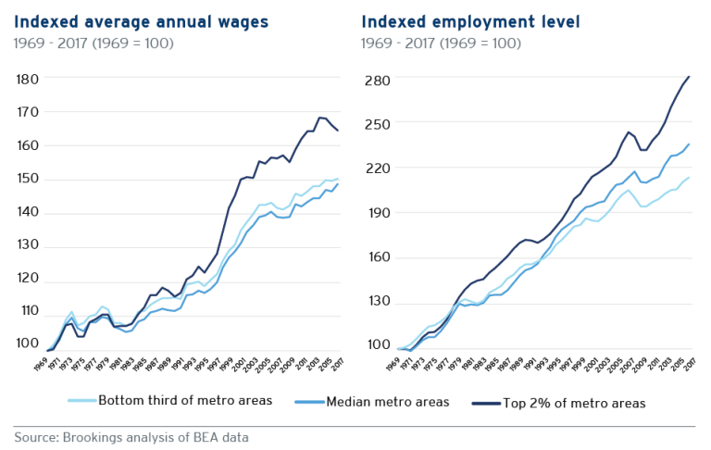
Why Care About Innovation Hubs?
Regional Innovation Hubs Perform Better:
More Prosperous (More Jobs, Better Jobs, More Growth)
More Innovative (More R&D, More Patents)
More Talented (Serve as Talent Magnets)
But Not Equally Distributed
5 Metros Account for 90% of all job growth in “advanced Industries”

Slide 4
One Definition:
Stevenson-Wydler Act (1980) defines regional innovation clusters as
“geographically bounded network[s] of similar, synergistic, or complementary entities that—
(A) are engaged in or with a particular industry sector and its related sectors;
(B) have active channels for business transactions and communication;
(C) share specialized infrastructure, labor markets, and services; and
(D) leverage the region’s unique competitive strengths to stimulate innovation and create jobs.”

Slide 5
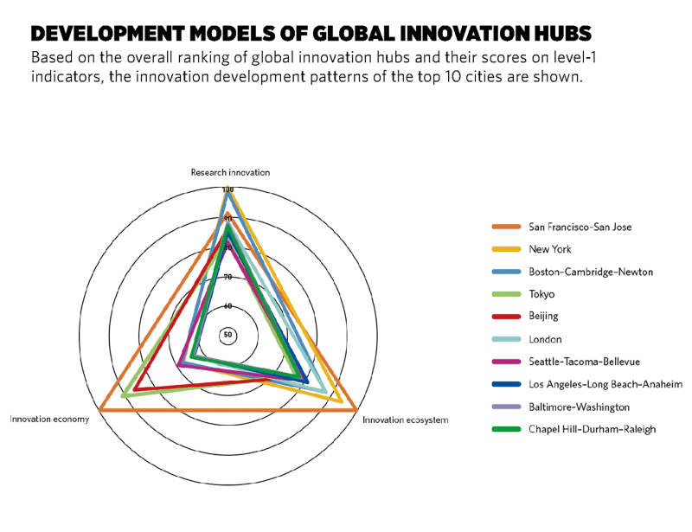
Innovation Hub Building Blocks
Typically emerge via a mix of:
Innovation Economy: Local expertise in leading sectors and industries (e.g. life sciences, manufacturing, AI)
Research Innovation: World class universities, R&D capacity, STEM Talent
Innovation Ecosystem: Entrepreneurial culture, start-up support programs.

Slide 6
Why Should You Care about Innovation Hubs?
Now serve as a primary organizing tool in economic development
Other terms to watch: innovation district, ecosystems, innovation networks, technology hubs
Concept is embraced globally
Concept embraced by other Federal and State agencies
NSF Big Data Hubs
DoD Manufacturing Institutes
Major federal dollars now focused on innovation hubs
EDA BBB Regional Challenge ($1B)
COMPETES ACT: Could contain up to $10B for regional technology hubs

Slide 7
Contact Information
Erik R. Pages
EntreWorks Consulting
epages@entreworks.net
703-237-2506
www.entreworks.net
BLOG: www.entreworks.net/blog
Newsletter Sign-Up: http://www.entreworks.net/Newsletter.php

