Slide 1
UNCLAS
Understanding How Communities Can Engage the DOD Manufacturing Technology Enterprise
DoD Assets to Support Regional Innovation
Michael Gilroy
Senior Workforce Analyst
OUSD (R&E)
OSD ManTech
Arlington, VA
9 March 2022
UNCLAS

Slide 2
National Manufacturing Challenges
American manufacturers contribute more than $2.35 trillion to the U.S. economy
Every dollar spent in manufacturing is an additional $2.79 added to the economy, making it the highest multiplier effect of any sector
Yet…. Since 2010, U.S. manufacturing productivity has decreased with a decline in manufacturing jobs and increased competition from other countries
Overall manufacturing productivity growth fell from 41% growth in the 2000s to a 4% decline in the 2010s
U.S. trade balance in advanced technology declined in recent decades, resulting in a $130 billion trade deficit
Technological innovation productivity has declined over the last 30 years.
U.S. manufacturing jobs reached a low point in 2010 with 11.5 million jobs, increased to 12.9 million jobs in 2019, but growth remains disrupted due to COVID-19
New manufacturing jobs—as many as 2 million—could go unfilled without training programs to prepare new graduates and current workers with the skills required
National Manufacturing Challenges are National Security Challenges
https://www.industryweek.com/the-economy/article/21169426/falling-us-manufacturing-productivity-is-cause-for-alarm
Congressional Research Service, Manufacturing USA: Advanced Manufacturing Institutes and Network (Washington , D.C.: March 3, 2021).
Department of Commerce, National Institute of Standards and Technology, Manufacturing USA Annual Report, FY2018 (September 2019) and FY2021 (September 2021)
Distribution Statement A: Approved for public release. DOPSR case #22-S-0307 applies. Distribution is unlimited.
Notes:
American manufacturers contribute: Department of Commerce, National Institute of Standards and Technology, Manufacturing USA Annual Report, FY2018
Every dollar spent in manufacturing: Department of Commerce, National Institute of Standards and Technology, Manufacturing USA Annual Report, FY2018
Productivity growth fell: Industry Week “US Manufacturing Productivity Is Falling, and It's Cause for Alarm”
U.S. trade balance in advanced technology declined: Congressional Research Service, Manufacturing USA: Advanced Manufacturing Institutes and Network
U.S. manufacturing jobs reached a low point: Congressional Research Service, Manufacturing USA: Advanced Manufacturing Institutes and Network
New manufacturing jobs could go unfilled: Department of Commerce, National Institute of Standards and Technology, Manufacturing USA Annual Report, FY2018

Slide 3
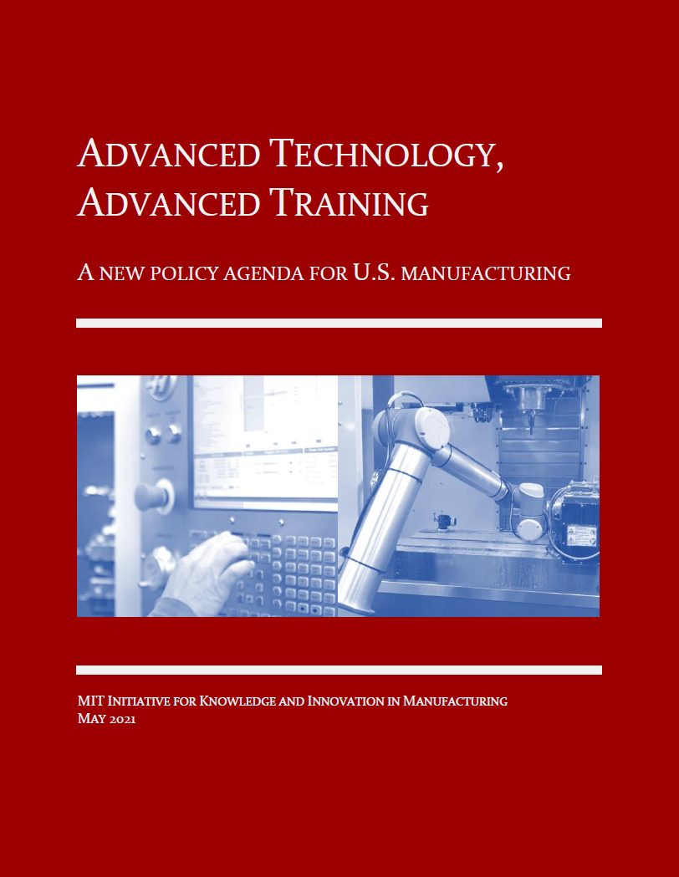
Small - Midsized Manufacturers Study
ManTech engaged MIT in 2020 to learn what actions
can be taken to accelerate the adaptation of advanced
manufacturing technologies by SMMs
First report delivered May 2021
https://www.ikim.mit.edu/national-manufacturing-workforce-plan
Findings include:
“Skill Gap” – large manufacturing firms are rapidly
acquiring new technologies, but cannot find workers to
operate them
Small and midsized firms “Home Alone” – lacking
support networks to aid adoption of new technologies
Fragmented Government Programs – support for firms
exists but lack coordination among supporting agencies
causing confusion
Distribution Statement A: Approved for public release. DOPSR case #21-S-1982 applies. Distribution is unlimited.

Slide 4
Manufacturing Workforce Focus In OSD
A&S
Workforce Focus
Address critical industrial
workforce gaps to meet
defense acquisition and
sustainment needs
Incentivize development
of training programs to
accelerate training time
and expand defense
pipeline capacity
Invest in skills
development efforts to
motivate and enable
communities, states and
regions to modernize
manufacturing equipment
and infrastructure
Shared Focus
Modernize manufacturing
education and industrial skills
Expand the talent acquisition pool
Promote diversity, equity,
inclusion, and economic mobility
Drive action regionally
Engage workforce and economic development interests
Develop data-driven workforce talent supply-demand assessments
Collaborate with USG and other stakeholders
Enable small and midsized manufacturers to modernize
Upskill and reskill incumbent workers
R&E
Workforce Focus
Develop talent and
technology concurrently
Develop a workforce
proficient in the use and
application of emerging
technologies
Expand non-traditional
learning models
Employ disruptive innovations
in learning tools, venues,
and pathways in
traditional education
Model Career and
Technical Education
modernization
Shorter Term (1-x years) Investment Return Time Horizon Longer Term (4-+ years)
Distribution Statement A: Approved for public release. Distribution is unlimited.

Slide 5
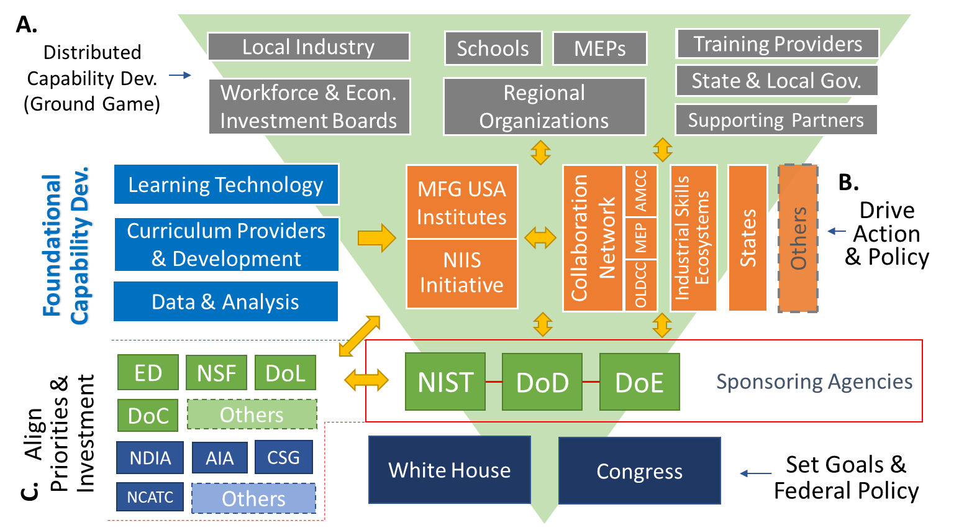
Three Theaters of Operation
MFG USA
Institutes
Relationships Built on Complementary Missions
Distribution Statement A: Approved for public release. DOPSR case #22-S-0307 applies. Distribution is unlimited.

Slide 6
DoD Manufacturing Innovation Institutes Current Network
Since Launching in 2012…
Committed Funding: $1.48B+ Federal and $2.15B+ Private/State Investments
1,550+ companies, universities, and non-profit members or partners
DoD MII members across 49 states, Washington DC, and Puerto Rico
Bioindustrial Manufacturing
St. Paul, MN
Digital Manufacturing & Design
Chicago, IL
Lightweight Metals
Detroit, MI
Integrated Photonics
Albany, NY
Rochester, NY
Regenerative Manufacturing
Manchester, NH
*Data as of December 31, 2020
Data as of 30 September 2021
Flexible Hybrid Electronics
San Jose, CA
Advanced Fibers
and Textiles
Cambridge, MA
Advanced Robotics
Pittsburgh, PA
New DoD MII launched in October 2020
Additive
Manufacturing
Youngstown, OH
Distribution Statement A: Approved for public release. DOPSR case #21-S-1982 applies. Distribution is unlimited.
6

Slide 7
DoD’s Manufacturing Innovation Institutes: Demonstrating Growing, Tangible Impact
Helping to bridge the gap between basic research and product development/fielding
Providing DoD with access to key, domestic enabling technologies
Advancing manufacturing innovation for specific, focused technology areas
Ensuring a strong ecosystem of companies and organizations
Maintaining close manufacturing partnering relationships
Providing shared assets among MII member organizations; key benefit for small and medium enterprises
Creating an environment to develop the skills and educate / train the workforce
DoD’s Manufacturing Innovation Institutes are creating new, collaborative environments spurring innovation, performance, and competitiveness across the U.S. industrial base.
Distribution Statement A: Approved for public release. Distribution is unlimited.

Slide 8
DoD MIIs by the Numbers
9 years since the launch of first DoD MII, America Makes
1,561+ members from 49 states, DC, and Puerto Rico
320 members on DoD MII Boards, Committees, Councils
650+ completed research and development projects, 230+ on-going
62,590+ students, teachers, workforce trained by DoD MIIs in FY21
$703+M initial DoD investment
Additional $246+M follow-on agreement investment from OSD ManTech
Additional $487+M for DoD-sponsored projects
$1.6+B initial committed industry, academia, non-profit cost share
Additional $129+M for academia/industry-sponsored projects
Additional $20+M for State/local government-sponsored projects
*Figures as of 30 September 2021
Distribution Statement A: Approved for public release. DOPSR case #22-S-0307 applies. Distribution is unlimited.

Slide 9
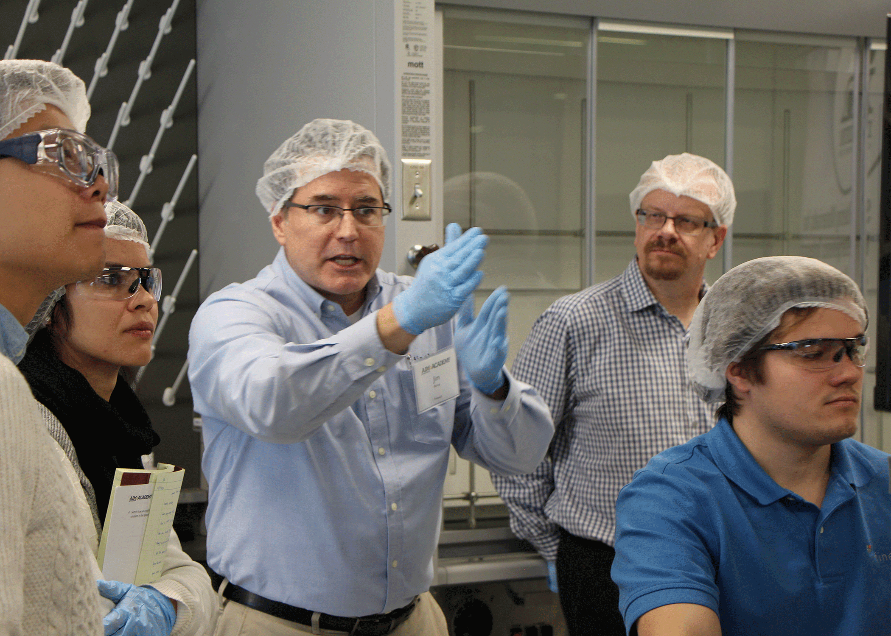
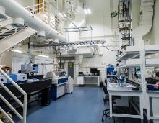
The DoD MIIs Advance Build Back Better
Education and Workforce Development
AFFOA embedded four research fellows from the Army's Combat Capabilities Development Command Soldier Center at the AFFOA-affiliated Defense Fabric Discovery Center (DFDC) at MIT Lincoln Laboratory. This collaboration considered DoD problems that all military Services wrestle with and additional ways to develop smart fibers and fabrics that complement the capabilities of their home institution. The DFDC is a secure facility where research and development in advanced fibers and fabrics is applied to problems of national security. | AIM Photonics offered a “Fabless Design of Photonic Integrated Circuits within the AIM Foundry Ecosystem” course for a second time this summer. Over 2,000 students enrolled in the six-week summer edX course in integrated photonic circuit design, with 159 students paying for the course and access to the software tools, using over 14,716 hours of computational time. 95 students submitted photonic integrated circuit designs as part of the course.
BioFabUSA developed the "TEMPtation" game to introduce students in grades 7-12 to the world of TEMPs and biomanufacturing. This online game ran for several weeks, challenging students to learn about the TEMP industry while winning prizes. The goal was to expose students to careers in this industry while they are still choosing high school and college course work. Forty BioFabUSA members were featured. This activity helps BioFabUSA meet their goal of closing the skills gap in tissue and organ manufacturing by providing training opportunities to non-college bound youth. | ARM, through its leadership in JROBOT (Joint Robotics Organization for Building Organic Technologies), identified and developed three robotic workforce positions specific to the needs of the military’s sustainment communities, providing Office of Personnel and Management with updated, relevant position descriptions for mechanic, operator, engineering, and equipment support positions. The new position descriptions include the right competencies as well as are indexed against commercial sector salaries, making it possible for the Services to hire the right workers, train their current workers with the right competencies, and ensure workers are paid competitively compared to working in the private sector.
Distribution Statement A: Approved for public release. DOPSR case #21-S-1982 applies. Distribution is unlimited.
9

Slide 10
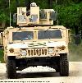
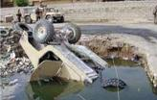
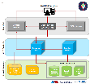
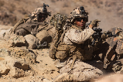
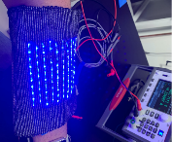
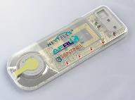
National Impact DoD Technology Transition
America Makes working in tandem with the Defense Logistics Agency (DLA), released the first-ever secure web-based system to collaboratively share 3D models across the Department of Defense in support of additive manufacturing. The Joint Additive Manufacturing Model Exchange (JAMMEX) links to various Service-Specific JAMMEX Repositories containing 3D models allowing users to search and view the 3D models, edit the models, and download the associated files. JAMMEX is accessible by Common Access Card authentication for all users, including the Warfighter in the field. | LIFT, in 2017, worked on a project with Ricardo Defense Systems to retrofit Humvees with Antilock Brake and Electronic Stability Control Systems – which could prevent rollovers by 74%. In March 2021, Ricardo Defense Systems announced that they had won a $89M contract with the Army to provide up to 9,480 critical safety improvement Antilock Brake System / Electronic Stability Control retrofit kits over the next three years for the U.S. Army’s High Mobility Multipurpose Wheeled Vehicle.
NextFlex, in conjunction with Air Force Research Laboratory, is developing a wearable atmospheric chemical sensor to monitor the safety of personnel operating in hazardous environments such as the inside of fuel tanks of aircraft wings. The device has Bluetooth connectivity to alert the user and coworkers if vapor levels are harmful, and it fits easily and unobtrusively in the uniform of the wearer. The prototype was fabricated at NextFlex integrating manufacturing capability from US supply chain through core-funded projects This new technology has the potential to be deployed in a wide range of use cases for safety monitoring as part of a networked set of on-body smart devices for soldiers, enabling a variety of nodes for environmental monitoring and/or vitals monitoring under a common platform that is easy to apply and comfortable to wear. | AFFOA, in conjunction with Massachusetts General Hospital and the Massachusetts Institute of Technology Lincoln Laboratory, developed a blue light therapy textile for advanced wound treatment. The prototype contains next generation light emitting fibers developed at AFFOA capable of delivering large doses of blue light into wounds in order to kill bacteria that are resistant to frontline antibiotic treatments. This work has generated interest from medical device companies and is expected to result in follow on proprietary opportunities.
Distribution Statement A: Approved for public release. DOPSR case #21-S-1982 applies. Distribution is unlimited.

Slide 11
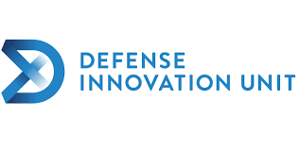
DoD Innovation Engines
AFWERX
The innovation arm of the Department of the Air Force and powered by the Air Force Research Laboratory. AFWERX seeks to transition agile, affordable and accelerated capabilities by teaming with technology developers.
https://afwerx.com/
Army Futures Command
Army Futures Command leads a continuous transformation of Army modernization in order to provide future warfighters with the concepts, capabilities and organizational structures they need to dominate a future battlefield.
https://www.army.mil/futures
NavalX
NavalX serves the Navy and Marine Corps as an innovation and agility cell, supporting and connecting initiatives across the Department of Defense.
https://www.secnav.navy.mil/agility/Pages/default.aspx
National Security Innovation Network
The National Security Innovation Network (NSIN) was built on the premise that the Department of Defense needs to incorporate new problem solvers into DoD processes and fundamentally change the way it solves problems.
https://www.nsin.mil/
Defense Innovation Unit
DIU is the only DoD organization focused exclusively on fielding and scaling commercial technology across the U.S. military at commercial speeds. It is focused on six technology areas where the commercial sector is operating at the leading edge: advanced energy & materials, artificial intelligence, autonomy, cyber, human systems, and space.
https://www.diu.mil/

Slide 12
Questions

