Slide 1
Welcome to Recover Care!
Updated 4.2022

Slide 2
Paperwork
TB Screening
1st Step Mantoux Administration
Employee Photo for Badge
Copy of COVID Vaccination Card (if applicable)

Slide 3
Introductions
Heart—What are you passionate about?
Head—What do you know a lot about?
Hands—What are you good at doing?

Slide 4
Our Mission
Our mission is about creating relationships that make a
meaningful difference in people’s lives.
Philosophy
Recover Care is a company of caring individuals with compatible values, whose drive and desire are to be part of something greater than themselves. It is our vision to recruit and retain only those individuals who are inspired by the same beliefs and values, and who intend to sustain relationships that make a difference in the lives of those we take care of, work with, and encounter in our business activities.

Slide 6
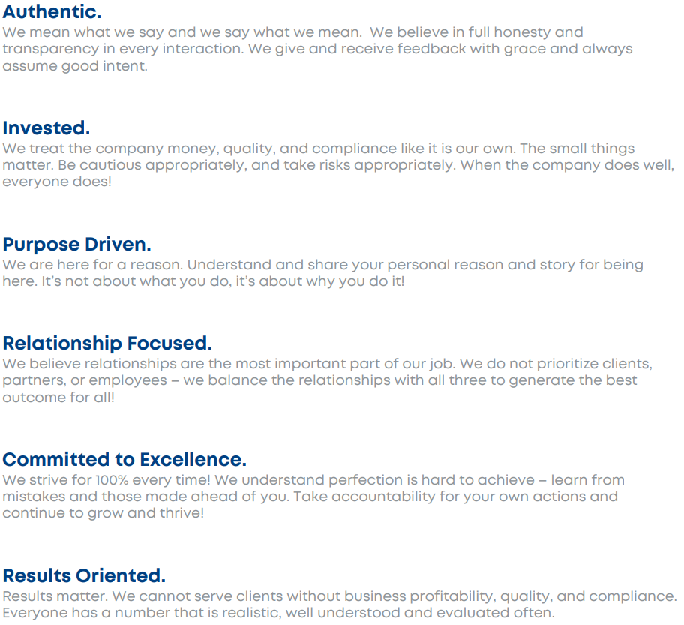
Core Values

Slide 7
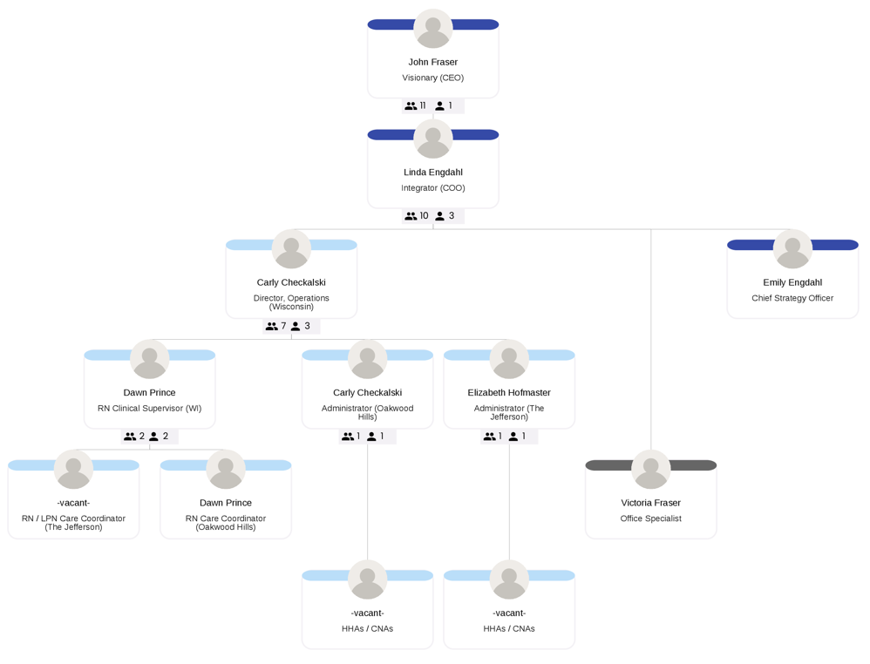
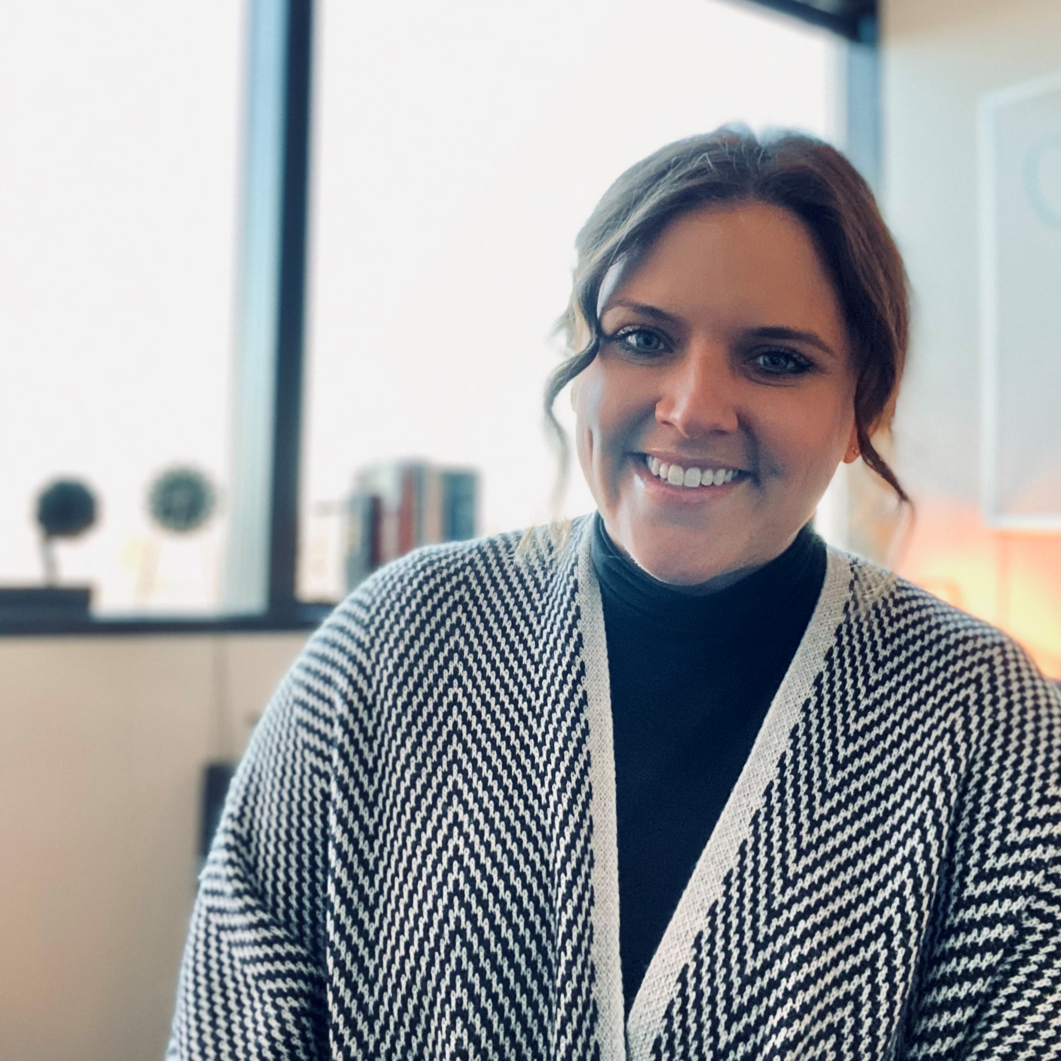
Accountability Chart

Slide 8
Recover Care History
Recover Care History
2003 – Recover Care business began as Healthcorps, Inc
2008 – Healthcorps, Inc was rebranded from Healthcorps, Inc to Recover Care when purchased by a company called Recover Health
2018 – Recover Care’s CEO was brought in to Recover Health to reinvigorate the Recover Care business line.
Revenue grew 22% / year on average
2020 – Recover Health (which included Recover Care) was purchased by Aveanna
2022 – Aveanna sold Recover Care to the current CEO (John Fraser) to continue and expand growth as its own small business.
Recover Care today serves 4 markets across Minnesota and Wisconsin
Recover Care has about 90 employees (HHA, CNA, RN, Administrative)

Slide 9
The Recover Care Difference
The Recover Care Difference is how we build relationships and operate our business in a way that makes us stand out to all of those we interact with including employees, clients, and partners. “Relationships First, not just employees or clients or partners but all of them”.
Our model and care plans focus on all aspects of a person’s wellbeing improving quality of life and building long term relationships
We bill less than our competitors through advancements in technology and operational efficiency
We don’t believe in weekly minimums because we are looking to build clients for life and provide people exactly what they need
In our buildings, we our shift minimums are as low as 15 minutes because more clients in a building mean continuous work for our employees without driving
If we are struggling to find an employee for a shift due to illness or emergencies, we are proactive with communication, allowing clients and families time to respond, even if it means lost hours
We focus on offering the very best in-home care and partner with other post-acute organizations rather than being all things to all people. We even collaborate with our own competitors to share client care when it is in the best interest of the client

Slide 10
@Home vs. Community Model
The Lodge – Metro, MN
Oakwood Hills – Eau Claire, WI
The Jefferson – Madison, WI
Metro, MN

Slide 11
@Home vs. Community Model
@ Home Model
Community Model
4-hour minimum
Provide care 4-24 hours / day
We will provide services wherever a client calls home (single-family home, ALF, Nursing Home, etc.)
Provide Recover Care Commitment
15-minute increment minimum
Provide care ~6am-10pm daily
Provide Recover Care Commitment

Slide 12
Confidentiality and Privacy
As an employee of Recover Care, regardless of position, you are required to abide by the HIPAA Privacy rule, which establishes national standards to protect individuals' medical records and other individually identifiable health information (collectively defined as “protected health information”) and applies to health plans, health care clearinghouses, and those health care providers that conduct certain health care transactions. The Rule requires appropriate safeguards to protect the privacy of protected health information and sets limits and conditions on the uses and disclosures that may be made of such information without an individual’s authorization. The Rule also gives individuals rights over their protected health information, including rights to examine and obtain a copy of their health records, to direct a covered entity to transmit to a third party an electronic copy of their protected health information in an electronic health record, and to request corrections.
**Any infringement of client privacy and confidentiality may result in immediate termination

Slide 13
Policies and Procedures
Office Hours and After Hours Protocol
Professionalism
Attendance Expectations
Dress Code
Holidays
Telephone Use
Payroll/ Accurate Reporting of Time, Expenses and Activities
Inclement Weather
Disaster Plan / Calling Tree
Injury in the Workplace
Client Grievance
Incident Reporting
Working with Behaviors
Boundaries in Professional Relationships
Performance Management
When to Call the Nurse
Stop and Watch
Fraud and Abuse

Slide 14
Office Hours and After Hours Protocol
Office hours are Monday – Friday 8a-5p
Recover Care has staff available 24/7
Reasons to Contact the After Hours Team may include:
The client is not answering the door or is not inside the home
The client refusing care
You will be late to the clients home.
You have an extreme emergency and will not be able to work your scheduled visit: You can NOT text us about a call off of a shift. You must talk with someone.
Any question about the client you are working with, including (but not limited to):
Medication questions
Observed bruising
Change in condition
A witnessed fall
Any other question/comment/concern pertaining to the client – your report is critical!
To contact the After Hours Team, call the on call Nurse

Slide 15
Professional Expectations
Work attendance expectations
Meeting attendance expectations
Following dress code
Respecting your colleagues
Respecting your clients
Carrying yourself with confidence, but not arrogance
Encouraging client independence
Using open and honest communication
Thoroughly completing documentation
Maintaining boundaries
Taking ownership and being proud of your work!

Slide 16
Attendance and Punctuality
Attendance and punctuality are essential functions of your position and is critical for your success with Recover Care. We work as a team, and this requires that employees must be at work when scheduled.
If you are going to be late for work notify your Scheduling Coordinator immediately. Do not notify the client directly all communication goes thru the Scheduling Coordinator or on call staff member (after hours)
If you are sick for two or more consecutive workdays, a statement from a physician may be required before you will be permitted to return to work.
Employees are paid for meetings and trainings
Attendance is critical to our clients’ success. Performance Management will be initiated for attendance.

Slide 17
Dress Code
The following dress is inappropriate in all situations:
Shorts or skirts which are more than two inches above the knee
Tank tops, “muscle” shirts, halter tops, midriff or tube tops
Any clothing with discriminatory pictures, language, slogans, or advertisements
Apparel with tears, rips, or holes (whether designed or not)
Open toes, open heels, flip-flops, platform, or smooth-soled shoes
Caps (of any sort) indoors
Sunglasses indoors, unless they are medically prescribed
Long, dangling necklaces
Perfume/cologne/scented lotions must not be worn due to sensitivities of our clients

Slide 18
Holidays
Recover Care provides holiday pay for designated holidays each calendar year. The six holidays recognized each year are: New Year's Day, Memorial Day, Independence Day, Labor Day, Thanksgiving, and Christmas Day. Hourly employees will be paid time and a half their regular rate for hours worked on these holidays.
It is expected that all employees will not work on a designated holiday unless previously authorized by their supervisor. Authorized work on the holiday will be paid at time and a half.

Slide 19
Telephone Use
Personal Calls
The use of telephones or cellular phones for personal calls while on duty is discouraged. Cell phones should be kept on silent or vibrate while at work. Texting is not allowed. Any personal calls made or received by employees should be limited to a 2-minute duration with client’s permission.
Telephone Etiquette: Do Not Give Out Personal Information
Employees may be asked to answer a client’s telephone. If so:
Employees are expected to answer in a courteous manner. They should first give the appropriate greeting, state their name, and then ask how they may help the caller.
When taking a message, it is important to get the caller’s name, telephone number and reason for calling and note the date and time of the call.

Slide 20
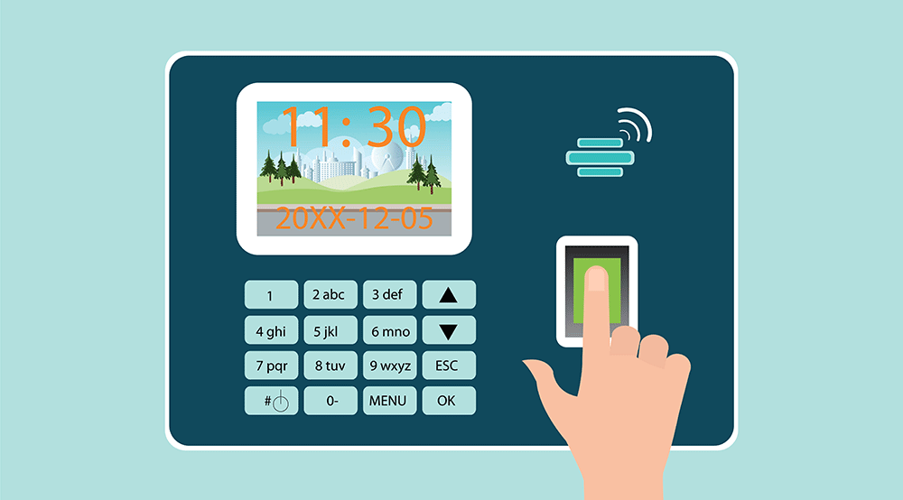
Payroll / Accurate Reporting of Time, Expenses, and Activities
The pay period is from Sunday 12am, Saturday 11:59PM (weekly)
All employees are paid every Thursday for the preceding pay period. Overtime accrues, at time and a half pay, when an employee exceeds 40 hours in one week
All documentation MUST be completed by the end of each visit to remain compliant. If this is not possible for technical reasons, call the on-call number ASAP
Falsifying any information on the timesheet is considered fraud and results in disciplinary action up to and including termination. Recover Care reports any incidents of fraud to the State for investigation.
Recover Care classifies falsification of timesheets as a federal offense and is classified as a felony.

Slide 21
Inclement (Severe) Weather
Recover Care makes every effort to deliver client services during severe weather conditions (without putting the health and safety of our staff and/or clients at risk)
Local weather reports should be utilized to make decisions on road conditions
It is your responsibility to contact your Scheduling Coordinator to discuss options for safe transportation and/or to determine if client services need to be rescheduled- at least 4 hours prior to the start of shift

Slide 22
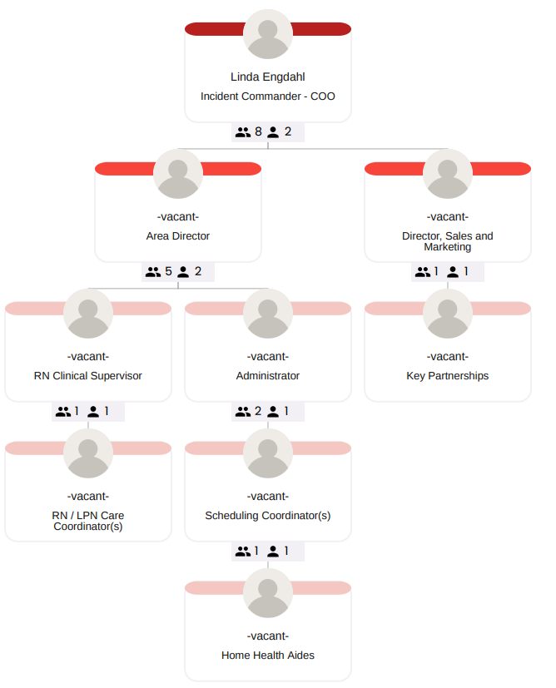
Emergency Preparedness: Disaster Plan
In the event of an emergency, the disaster plan calling tree (to the left) will be enacted.
Recover Care will follow its disaster plan in response to natural disasters, such as flood and storms, or any other emergencies that may disrupt our ability to provide care or services.

Slide 23
Injury in the Workplace
In the event you are injured at work, report the injury to your Supervisor Immediately and no later than 24 hours after the incident. No matter how slight, promptly report all injuries to the office. If the accident or injury is an emergency, follow your local emergency procedures immediately.
Our goal is to get you back to work as quickly as possible - To help you be able to heal and meet your personal financial responsibilities, Recover Care has an early return to work program to accommodate most restrictions following a workplace injury. Light duty status will be reviewed monthly, up to six months.
Worker’s Compensation
Recover Care maintains worker’s compensation coverage in compliance with applicable law. All employees are covered by worker's compensation insurance from the date of their employment. If you are injured or involved in an accident while on the job, it is your responsibility to notify a supervisor immediately so that medical attention can be administered, if necessary, and insurance reporting is done promptly. If you do not report an accident or injury in a timely manner (within 24 hours or less of occurrence) you may be subject to disciplinary action, up to and including termination.
It is also your responsibility to maintain communication with your supervisor and claims adjustor throughout the claims process.

Slide 24
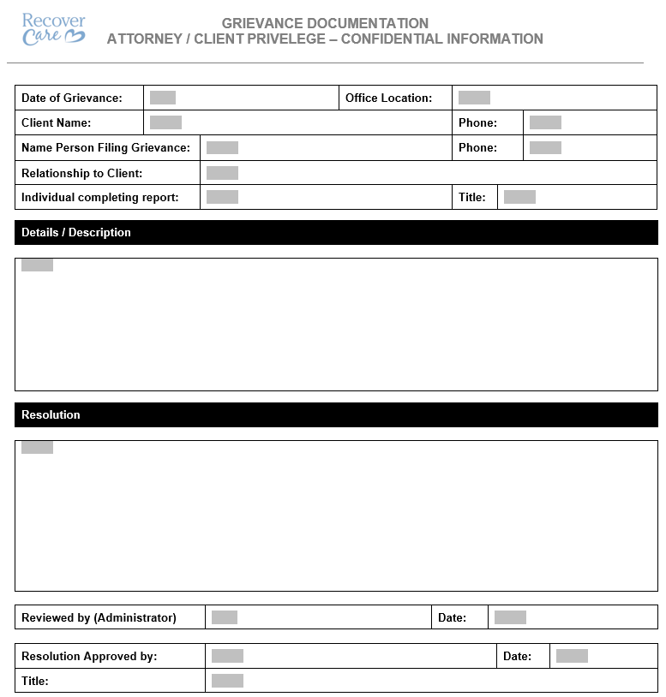
Grievance Reporting and Tracking
ANY time our client is not 100% satisfied, we should be evaluating what we can do better.
Recover Care desires to promptly and appropriately respond to all complaints from clients / client representatives. Clients/client representatives shall be encouraged to submit grievances, or to provide suggestions regarding any aspects of the agency's service. Any person voicing a grievance shall be free from reprisal. Clients and home care staff shall be made aware of grievance procedure.
Knowledge Base Reference – https://docs.recovercare.org/home/recover-care-at-home-rn-visit-nurse-article-client-grievance-and-investigation

Slide 25
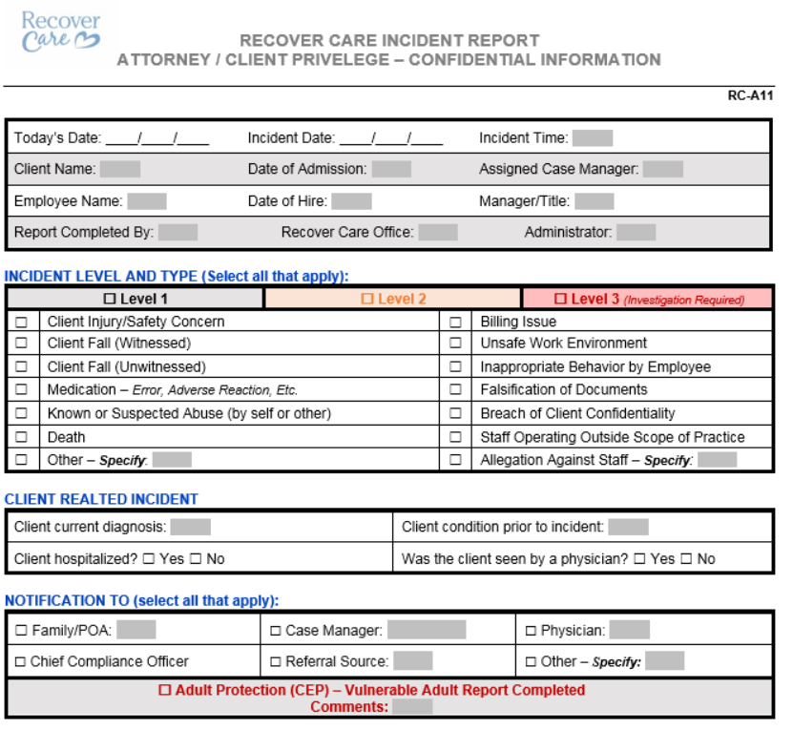
Incident Reporting and Tracking
An incident report is completed for events/incidents/accidents/complaints that are out of the ordinary course of events. Tracking is completed to determine potential liability and/or opportunities for improvement. Home care staff shall be made aware of incident management procedure.
All employee and client-related incidents or unusual occurrences, accidents and injuries must be documented on an Incident Report form. Incidents include, but are not limited to:
Endangerment of staff or client
Equipment or medical device malfunctions or failure
Financial Exploitation
Injuries – including those of unknown source
Safety hazards
Theft
Deaths
Verbal or physical abuse
Falls – witnessed or non-witnessed
Medication Error
Knowledge Base Reference – https://docs.recovercare.org/home/incident-reporting

Slide 26
Working with Behaviors
Depersonalize the behavior
Pay attention to what your client is attempting to communicate through behavior
Identify the cause of the aggression – the most important thing to remember about verbal or physical aggression, is that your client is not doing it on purpose
Avoid power struggle – be willing to compromise
Ask simple, answerable questions – do not use lengthy explanations
Avoid distractions when communicating with your client
Talk less and use more visual cues when communicating with your client
Create a calm, quiet environment
Give your client as much autonomy in daily tasks as possible
Turn a no into a yes by stating the task is on a trial basis
Avoid treating your client like a child
Softly talking to them about something they are interested in may also help to relax them/ distract them from the unpleasantness of the task being done
Pick your battles

Slide 27
Boundaries in Professional Relationships
You are to complete only the cares identified on the client’s plan of care. Notify the nurse of any discrepancy
Under no circumstances are you to give out a client’s telephone number or address to family members or friends.
Do not give out your home/cell phone number or address to any client.
Do not accept any keys (house, car) from a client.
Do not bring unauthorized individuals into your client’s home.
Do not take the client to your home.
The client’s medication is for their use only. Do not take any prescription or nonprescription medication belonging to the client.
You must provide your own food or beverages while you are working in the client’s home. The client’s food is not for your consumption.
You must never sleep while on duty. Sleeping while on duty will result in disciplinary action.
Do not discuss your personal problems with your client or their family.
Do not talk negative about your co-workers or the agency.
Do not have romantic or sexual relationships with clients or their family members.
Do not borrow money, cars, equipment or anything else from clients or their families.
Employees are prohibited from accepting gifts, money, loans, from clients or their families. Any such gifts or offers must be immediately reported to the employee’s supervisor.
No Sleeping at the client’s Home

Slide 28
Performance Management
When it is determined that an employee is not fulfilling the responsibilities of the position to which he or she is assigned, reasonable steps may be taken to improve performance.
Among other things, the following may result in disciplinary action, up to and including discharge:
Violation of our policies or safety or security rules
Insubordination
Unauthorized or illegal possession, use or sale of alcohol or controlled substances on work premises or during working hours, while engaged in Company activities or in Company vehicles
Unauthorized possession, use or sale of weapons, firearms or explosives on work premises
Theft, falsification of records, or dishonesty
Physical harassment, sexual harassment, or disrespect toward fellow employees, customers, visitors or other members of the public
Soliciting or accepting gifts or gratuities from clients
Performing conflicting outside work or use of Company property, equipment or facilities in connection with outside work while on Company time
Excessive, unnecessary, or unauthorized use of Company property and supplies, particularly for personal purposes
Poor attendance, poor performance, or non-performance of essential job duties, especially when it hinders or jeopardizes client safety or relationships
Damaging the Company’s reputation or presenting a conflict of interest
Failing to maintain the confidentiality of the business information of the Company including information protected by the Health Insurance Portability and Accountability Act of 1996 (HIPAA) Privacy and Security Rules

Slide 29
When to Call the Nurse
It is the employee’s responsibility to call a nurse for (but not limited to) the following reasons
Medication questions
Observed bruising
Change in condition (STOP AND WATCH)
A witnessed or unwitnessed fall
Behavior changes
Client is experiencing dizziness / confusion
If you call 911
Death of a hospice client
Any other question or concern related to the client

Slide 30
Stop and Watch
Seems different than usual
Talks or communicates less than usual
Overall appears much different
Participated less than usual in activities
Ate less than usual (not because of dislike of food)
N
Drank less than usual
Weight change
Agitated or nervous more than usual
Tired, weak, confused or drowsy
Change in skin color or condition
Help with dressing, toileting, transfers more than usual

Slide 31
Fraud and Abuse
Fraud: an intentional act of deception, misrepresentation or concealment in order to gain something of value (some benefit or payment for which no entitlement would otherwise exist. These acts may be committed either for the person’s own benefit or for the benefit of some other party). Examples include:
billing for services that were never provided
deliberately misrepresenting services
Falsified time cards
Abuse: excessive or improper use of services or actions that are inconsistent with acceptable business or medical practice. Refers to incidents that, although not fraudulent, may directly or indirectly cause financial loss. Examples include:
providing medically unnecessary services
billing for items or services that should not be paid for by client/Medicare

Slide 32
Fraud and Abuse – Risk Areas
Billing for services not rendered
Duplicative billing
Over-utilization and under-utilization
False dating of amendments to nursing notes or
Falsified plans of care or
Forged beneficiary signatures on visit slips/logs that verify service were performed
Improper patient solicitation activities and high-pressure marketing of unnecessary services (e.g., offer free gifts or services to patients)
Any marketing information offered by home health agencies should be clear, correct, non-deceptive and fully informative.
Incentives, inducements, or other illegal payments to actual or potential referral sources

Slide 33
Fraud and Abuse - Consequences
Significant fines
Civil monetary penalties
Triple damages for each false claim
Exclusion from Medicare / Medicaid Programs
Imprisonment

Slide 34
Fraud and Abuse – Mandated Reporting
Everyone has the right and responsibility to report possible fraud, or abuse. Report any concerns or questions immediately to:
Your supervisor or
Your Director or
The Compliance Officer or
The COO or
The CEO
OR: 1-844-880-1574

Slide 35
Questions?

Slide 36
Nurses (RNs/LPNs)
Home Health Aides
Administrative Staff

