Slide 1
Quality & Compliance Training
Updated 4.2022

Slide 2
Our Mission
Our mission is about creating relationships that make a
meaningful difference in people’s lives.
Philosophy
Recover Care is a company of caring individuals with compatible values, whose drive and desire are to be part of something greater than themselves. It is our vision to recruit and retain only those individuals who are inspired by the same beliefs and values, and who intend to sustain relationships that make a difference in the lives of those we take care of, work with, and encounter in our business activities.

Slide 4
Agenda
Comprehensive Licensure Overview
Recover Care Policies and Procedures (P&P)
Grievance Reporting
Incident Reporting
QAPI

Slide 5
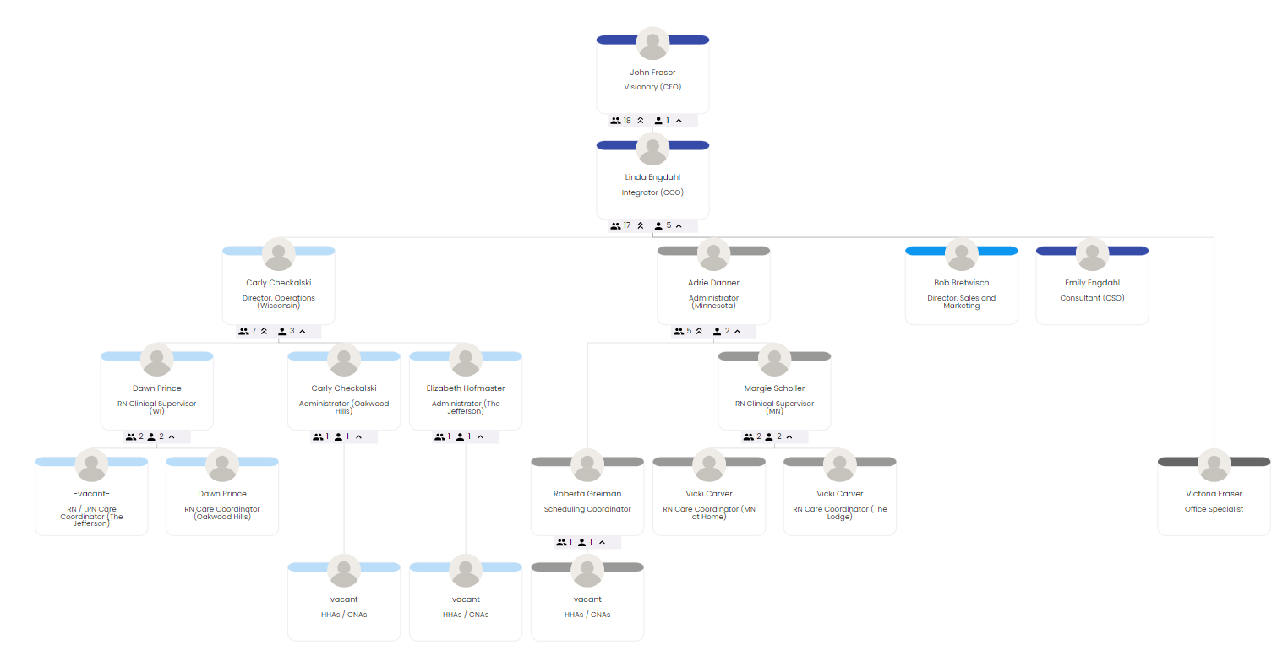
Accountability Chart

Slide 6
MN Comprehensive Home Care License
Recover Care operates under Minnesota’s Comprehensive Home Care License. Recover Care’s Policy & Procedure Manual is based on the MN Comprehensive License Requirements, so WI follows the same protocol (no WI licensure)
Client Requirements
The care of every client must be supervised by a Registered Nurse (RN)
Required monitoring visits: 14 days after SOC and at least every 90 days thereafter
Medication Management Regulations
Clients are all given the Home Care Bill of rights, outlining what their consumer rights are
Staff Requirements
All staff work under the delegation of Registered Nurse
Orientation Requirements (Classroom Orientation, Written Test, Competency Test)
30 Day Supervisory Visit
Annual Training – A minimum of 8 hours
Other Training as Needed or Requested
Knowledge Base Reference – https://docs.recovercare.org/home/mn-comprehensive-home-care-statutes

Slide 7
Statement of Home Care Services
Below are the services provided (and not) by Recover Care, under Minnesota’s Comprehensive License
Registered Nurse Services Licensed Practical Nurse Services Medication Management Services Delegated tasks to unlicensed personnel Hands-on assistance with transfers and mobility Providing eating assistance for clients with complicating eating problems (i.e. difficulty swallowing, recurrent lung aspirations, or requiring the use of a tube, parenteral or intravenous instruments) Assistance with dressing, self-feeding, oral hygiene, hair care, grooming, toileting, and bathing Providing standby assistance within arm’s reach for safety while performing daily activities Providing verbal or visual reminders to take regularly scheduled medication (includes bringing clients previously set-up medication, medication in original containers, or liquid or food to accompany the medication) Providing verbal or visual reminders to the client to perform regularly scheduled treatments and exercises Preparing modified diets ordered by licensed health professional Laundry Housekeeping/Other household chores Meal preparation Shopping | Advanced Practice Nurse Services Physical Therapy Services Occupational Therapy Services Speech Language Pathologist Services Respiratory Therapy Services Social Worker Services Services by a Dietitian or Nutritionist Complex or Specialty Healthcare Services

Slide 8
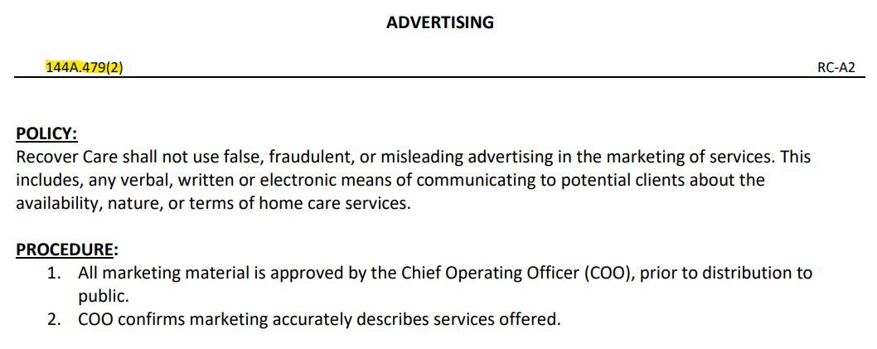
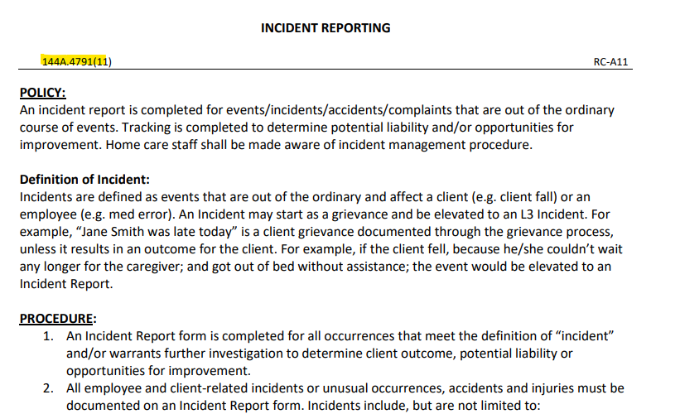
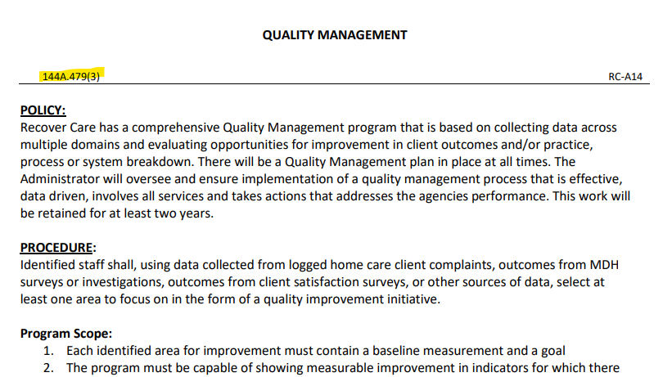
Policy and Procedure Manual
Where applicable, the policy will reference the MN Home Care Statute it is referencing:
Knowledge Base Reference – https://docs.recovercare.org/home/policy-procedure-manual

Slide 9
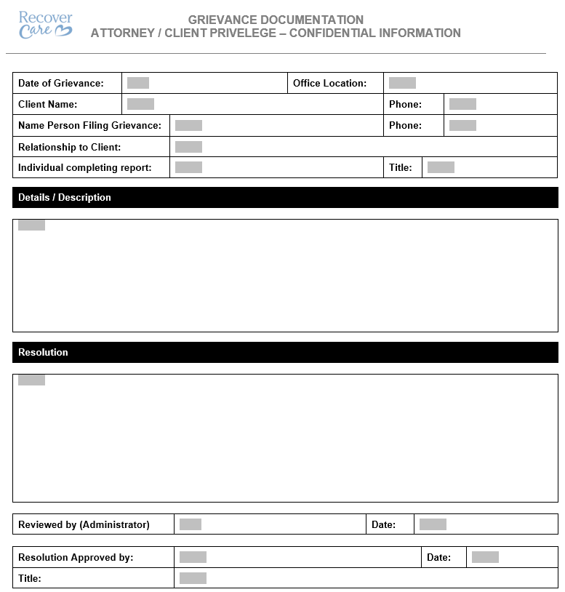
Grievance Reporting and Tracking
Recover Care desires to promptly and appropriately respond to all complaints from clients / client representatives. Clients/client representatives shall be encouraged to submit grievances, or to provide suggestions regarding any aspects of the agency's service. Any person voicing a grievance shall be free from reprisal. Clients and home care staff shall be made aware of grievance procedure.
A grievance stems from a client’s perception of care and is most often related to practice, process or communication skills.
Knowledge Base Reference – https://docs.recovercare.org/home/recover-care-at-home-rn-visit-nurse-article-client-grievance-and-investigation

Slide 10
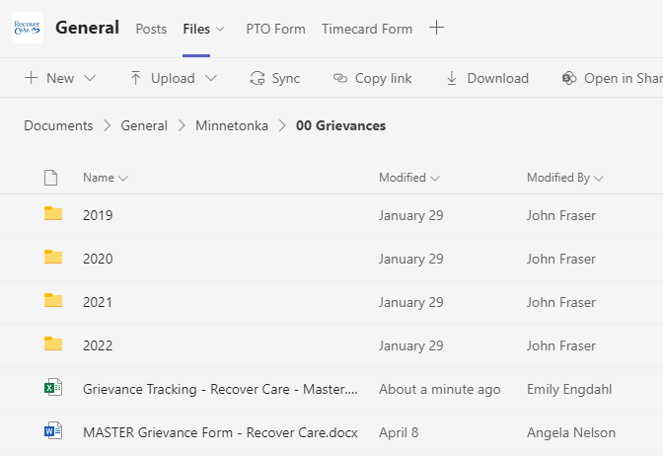
Grievance Reporting and Tracking
Knowledge Base Reference – https://docs.recovercare.org/home/recover-care-at-home-rn-visit-nurse-article-client-grievance-and-investigation

Slide 11
Incident Reporting and Tracking
An incident report is completed for events/incidents/accidents/complaints that are out of the ordinary course of events. Tracking is completed to determine potential liability and/or opportunities for improvement. Home care staff shall be made aware of incident management procedure.
All employee and client-related incidents or unusual occurrences, accidents and injuries must be documented on an Incident Report form. Incidents include, but are not limited to:
Endangerment of staff or client
Equipment or medical device malfunctions or failure
Financial Exploitation
Injuries – including those of unknown source
Safety hazards
Theft
Deaths
Verbal or physical abuse
Falls – witnessed or non-witnessed
Medication Error
Knowledge Base Reference – https://docs.recovercare.org/home/incident-reporting

Slide 12
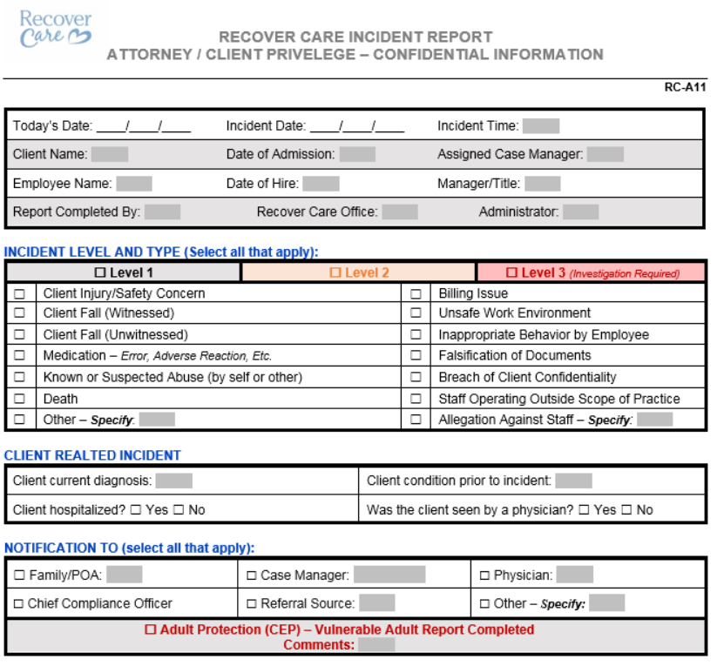
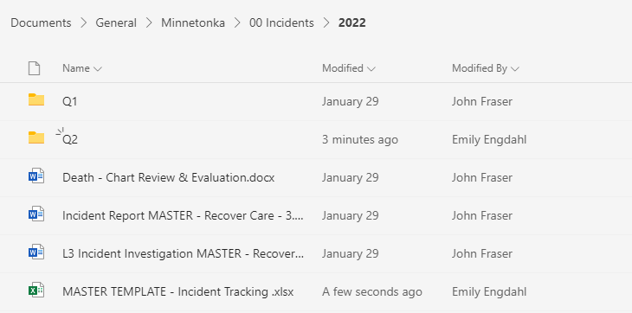
Incident Reporting and Tracking
Knowledge Base Reference – https://docs.recovercare.org/home/incident-reporting

Slide 13
Quality Management
Subd. 3. Quality management. The home care provider shall engage in quality management appropriate​ to the size of the home care provider and relevant to the type of services the home care provider provides. ​ The quality management activity means evaluating the quality of care by periodically reviewing client​ services, complaints made, and other issues that have occurred and determining whether changes in services, ​ staffing, or other procedures need to be made in order to ensure safe and competent services to clients. ​Documentation about quality management activity must be available for two years. Information about quality management must be available to the commissioner at the time of the survey, investigation, or renewal.
Knowledge Base Reference – https://docs.recovercare.org/home/quality-management-qapi

Slide 14
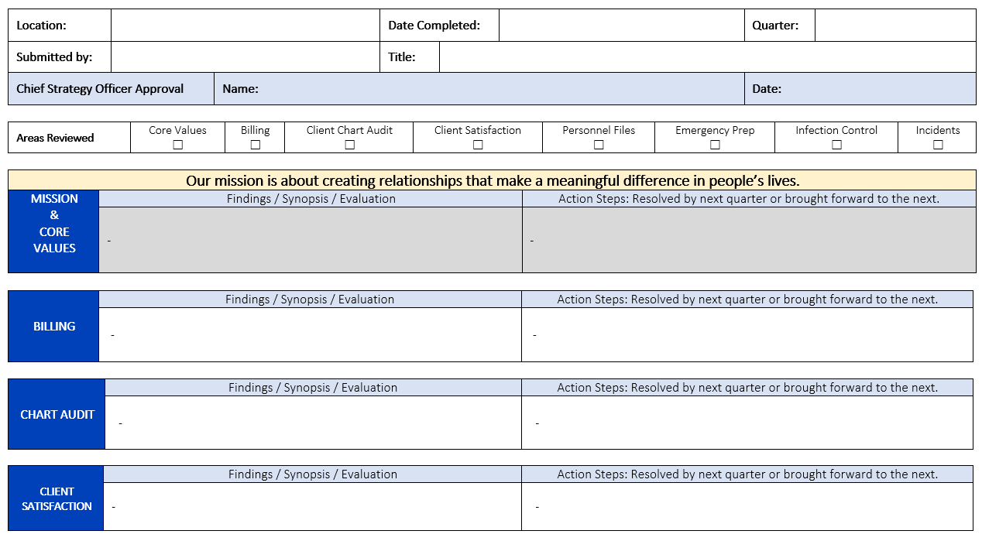
Quality Management
Knowledge Base Reference – https://docs.recovercare.org/home/quality-management-qapi

Slide 15
Survey Preparedness
According to Minnesota’s Department of Health, Recover Care will receive a survey at least every three years after that. The purpose of an audit is to ensure we are operating in accordance with our licensure, adhering to our policies and procedures and, most importantly, are protecting and supporting our clients to the best of our ability.
Steps of the Survey Process
Survey Entrance – An entrance conference is conducted where MDH staff introduce themselves, provide an overview of the survey process, and request a list of clients who are receiving home care services.
Observations + Home Visits – Observations of care and services provided to clients will be made throughout the survey and will vary depending on what services are offered by the home care provider. Observations may include medication administration and other tasks.
Staff and Client Interviews – Interviews with staff, clients and/or their representatives are conducted throughout the survey. Interviews provide an opportunity for MDH staff to verify the information obtained from other sources.
Home Visits – Home Visits are conducted during the survey to assist in evaluating the services provided by the home care provider. Consent for the home visit is obtained from the client or the client’s responsible person prior to the visit. Observations of the client and staff may occur during a home visit depending on what services are offered. At times it may be necessary to gather information by a telephone call to the client’s responsible person in lieu of a home visit.
Agency Documentation Review – A review of the home care provider’s documentation, including but not limited to: policies and procedures, marketing materials, client admission/information packet, client records, and personnel records may be conducted.
Survey Exit – When the survey tasks are completed, MDH staff will determine if the licensee is in substantial compliance with the survey.
Follow Up Survey – If there are deficiencies identified in the survey, a report will be given to the agency to correct. MDH will resurvey the deficiencies at a later, unannounced time

Slide 16
Questions & Follow Up

