Slide 1
Home Health Aide Orientation
Updated 4.2022

Slide 3
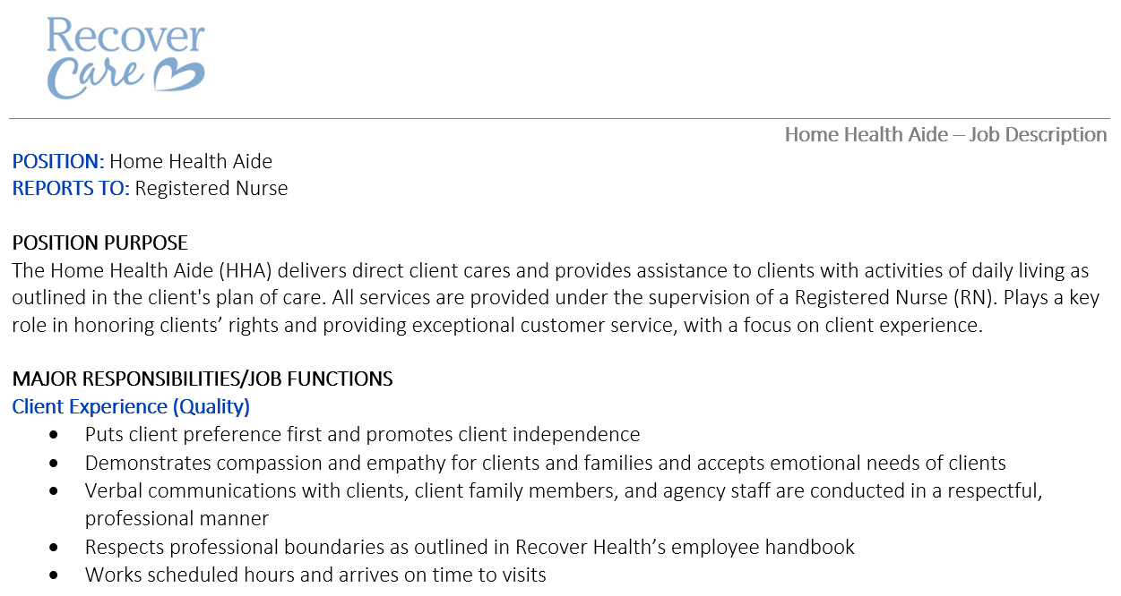
HHA Job Description Review
Review and Sign Job Description

Slide 4
Paychex
Recover Care uses Paychex a Human Resources Information System (HRIS) which
can be used for:
Viewing paystubs
Changing tax exemptions
Updating personal information
Viewing W-2’s annually
View PTO balance, if applicable
View company updates

Slide 5
Transportation
Requirements
If any employee is driving on behalf of the company (with or without client) there must be a valid driver’s license and current auto insurance on file
Prior to transporting clients, all employees must review the Vehicle Safety Manual and confirm understanding
Seat belts must be worn at all times
No use of your cell phone when transporting a client.
Reimbursement
Employee will be reimbursed for mileage if using personal car to transport a client
In the event a client requests staff member transport client in client’s car, no reimbursement will be given.
Mileage is reimbursed for miles traveled between shifts, when an employee works two (2) or more shifts in one day, with a reasonable amount of time between the consecutive shifts
To be reimbursed, employee must keep track of the miles driven and submit mileage when documenting at the end of your shift (prior to clocking out

Slide 6
Client Care

Slide 7
Delivering Quality Care with Respect and Dignity
Prepare for you shift before you arrive:
Read the Plan of Care’s ahead of time so you know what to prepare for
Understand your client’s abilities and each task you are to complete
Show up early to ensure you are on time
STOP + WATCH
Communicate with nurse whenever changes noted or questions arise
Be present with your client – ask questions, engage in client’s life, be proactive
Communicate in a way that preserves the dignity of the client
Respect for client preference, cultural background and history, religion, family, friends, visitors
Before leaving your client at the end of your shift, ensure the following:
Client’s assistive device is within easy reach (cane, walker)
Client has a fresh glass of water, and is within easy reach
Trash is emptied
Phone is within reach of the client
Client is wearing their LifeLine or call pendant, if applicable
Check to make sure the door is locked when you leave unless told to do otherwise.

Slide 8
Senior Specific Care and Concerns
Recognizing physical, emotional, cognitive, and developmental needs of our clients is critical in the success of maintaining their independence
In this section we’ll review:
Food and Nutrition
Fall Risk and Fall Prevention
Hospice and Palliative Care
Client Respect and Dignity

Slide 9
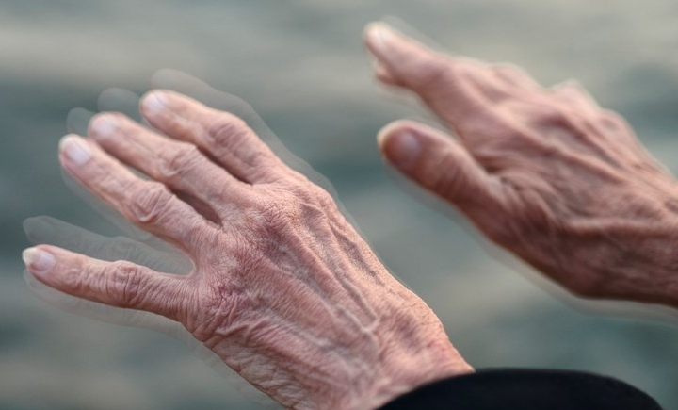
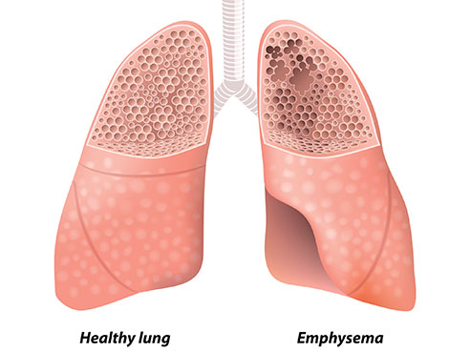
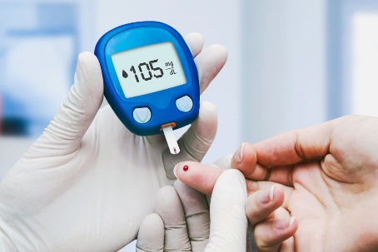
Common Conditions and Diseases in Seniors
Parkinson’s Disease
Dementia
Depression
Diabetes
Chronic Obstructive Pulmonary Disease (COPD)

Slide 10
Maintaining Clean and Safe Environment
Practical Skills Comp Testing:
Vitals
Eliminate Potential Hazards
Keep the environment free from recognized physical and chemical hazards
Use proper body mechanics and PPE (when necessary)
Remove any barriers to avoid slips, trips, and falls.
Always be on the lookout to for potential problems and safety risks
Use proper equipment
Regular Safety Training
New employees
Ongoing training
Safety Committee –
Workplace safety
Home environment safety
Client Safety
Employee safety

Slide 11
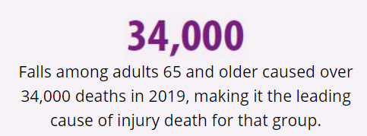
Fall Risk & Fall Prevention
Falls and injuries are especially detrimental to elderly individuals.
Fall-related death rates among adults 65 and older increased by 31 percent from 2007 to 2016
Even more alarming is that the fastest growing death rate, 3.9 percent per year, was found in the over-85 age group.
To better protect these individuals, it is imperative that healthcare teams are able to detect, assess, and respond effectively to elderly patients’ population-based fall risks.
Age-related risk factors include, but are not limited to the following. Most falls are caused by a combination of risk factors. The more risk factors a person has, the greater their chances of falling.
Delirium, confusion, and gait and balance deficits
Individuals with a current hip fracture and/or surgical repair may experience muscle weakness, well as incisional and referred limb pain with potential loss of sensation
Use of medicines, such as tranquilizers, sedatives, or antidepressants. Even some over-the-counter medicines can affect balance and how steady you are on your feet.
Challenges with toileting
Lower body weakness
Vitamin D deficiency
Vision problems
Foot pain or poor footwear
Source – Med Bridge: Building Clinical Capacity and Competency: Fall and Fall Injury Prevention

Slide 12
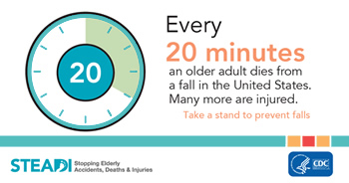
Fall Risk & Fall Prevention
Ways to prevent falls:
Fall Risk Assessment
Home and Safety Assessment & Modifications
Root Cause Analysis
Clear and Individualized Care Plan Interventions
Safe transfer and toileting practices
Regular Vision Checks
Regular Medication Review
Engage client in fall prevention
Encourage exercise, as able to keep clients strong
Proper Footwear
Proper Lighting
Introduce assistive devices, as necessary

Slide 13
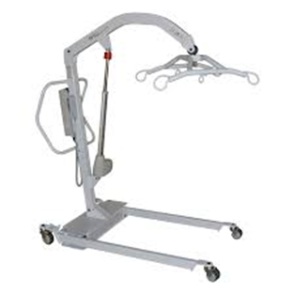
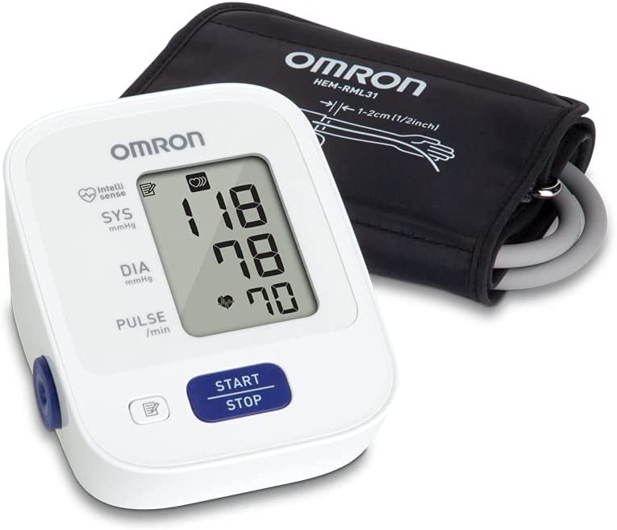
Commonly Used Equipment and Devices
Walkers
Wheelchairs
Hoyer
Transfer Belt
EZ Stand
Canes
Thermometers
Blood Pressure Monitors
Pulse Oximeter
Nebulizers
Weighting Scale

Slide 14
Stop and Watch
Seems different than usual
Talks or communicates less than usual
Overall appears much different
Participated less than usual in activities
Ate less than usual (not because of dislike of food)
N
Drank less than usual
Weight change
Agitated or nervous more than usual
Tired, weak, confused or drowsy
Change in skin color or condition
Help with dressing, toileting, transfers more than usual

Slide 15
When to Call the Nurse
It is the employee’s responsibility to call a nurse for (but not limited to) the following reasons
Medication questions
Observed bruising
Change in condition (STOP AND WATCH)
A witnessed or unwitnessed fall
Behavior changes
Client is experiencing dizziness / confusion
If you call 911
Death of a hospice client
Any other question or concern related to the client

Slide 16
Office Hours and After Hours Protocol
Office hours are Monday – Friday 8a-5p
Recover Care has on-call nurse available 24/7
Reasons to Contact the After Hours Team may include:
The client is not answering the door or is not inside the home
The client refusing care
You will be late to the clients home.
You have an extreme emergency and will not be able to work your scheduled visit: You can NOT text us about a call off of a shift. You must talk with someone.
Any question about the client you are working with, including (but not limited to):
Medication questions
Observed bruising
Change in condition
A witnessed fall
Any other question/comment/concern pertaining to the client – your report is critical!
To contact the After Hours Team, call: 952-297-0495

Slide 17
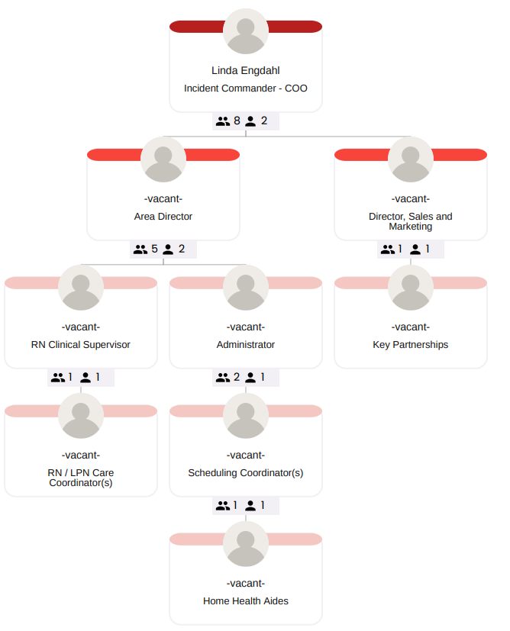
Emergency Preparedness: Disaster Plan
In the event of an emergency, the disaster plan calling tree (to the left) will be enacted.
Recover Care will follow its disaster plan in response to natural disasters, such as flood and storms, or any other emergencies that may disrupt our ability to provide care or services.

Slide 18
Emergency Preparedness: Tornado
If you are under a tornado warning at a client’s home:
Move the client and yourself to a safe room, basement or storm shelter.
If you are in a home with no basement, go to a small interior room on the lowest level of the home.
Stay away from windows, doors, and outside walls.
Take additional coverage by shielding your head and neck with your arms and putting blankets around you.
Continue to listen to weather reports for updated information.
If you are driving under a tornado warning:
If you can, safely seek a sturdy building or safe shelter.
Do not get under an overpass or bridge
Watch out for flying debris and can cause injury or death.
Use your arms to protect your head and neck. Cover yourself with a coat or blanket.
Do not try to our run a tornado in your car.
Stay clear of fallen power lines or broken utility lines

Slide 19
Emergency Preparedness: Flood
If are under a flood warning and the need to evacuate contact the main office for further direction
If flooding while at a client’s home move client and yourself to highest floor
If flooding while driving a car move to higher ground
Do not walk, swim or drive through floodwaters

Slide 20
Emergency Preparedness: Blizzard
If you are under a winter storm warning and are at a client’s home:
Stay indoors and dress warmly
Prepare for power outages. Collect flashlights and batteries.
Listen for emergency information and alerts
If there is no heat, close off unneeded rooms or areas. Dress the client in layers of loose-fitting, lightweight warm clothing.
Eat and drink. Food provides the body with energy and heat. Fluids hydrate.

Slide 21
When to Call 911
Most often, staff members will contact the nurse directly with any questions about
care, however the below situations require immediate call to 911 directly:
Has trouble breathing or has stopped breathing
Has no pulse
Is bleeding severely
Is having pain in the chest, neck, jaw, or arm
Is in a state of deteriorating consciousness or is unconscious
Has been badly burned
Is unable to move one or more limbs
Is having a seizure
Has been poisoned
Is having a diabetic emergency
Has suffered a stroke
Is choking

Slide 22
How to Call 911
Dial 911 and State:
This is a medical emergency.
Give the phone number you are calling from.
Give the address and any special directions for entering the building
Describe the problem and how it happened, if known, otherwise just tell the facts and what has been observed.
Give your name.
Stay calm.
Follow directions of the 911 dispatcher.
Hang up when the dispatcher says you can
After Calling 911
Wait for the 911 responder
Stay with the client and provide reassurance
Call the on-call RN. The RN will notify the client’s emergency contact person and/or responsible party.
Have documentation of DNR status, ready for the responder
Meet the emergency responder at the door
If the client is taken to the hospital, staff will secure and lock his/her apartment/home.

Slide 23
Bloodborne Pathogens
Bloodborne pathogens are infectious microorganisms in human blood that can cause disease in humans. These pathogens include, but are not limited to, hepatitis B (HBV), hepatitis C (HCV) and human immunodeficiency virus (HIV). Needlesticks and other sharps-related injuries may expose workers to bloodborne pathogens. Workers in many occupations, including first responders, housekeeping personnel in some industries, nurses and other healthcare personnel, all may be at risk for exposure to bloodborne pathogens.
What can be done to control exposure to bloodborne pathogens?
Personal Protective Equipment
Proper Handling and Disposal of Needles and Sharps
https://www.youtube.com/watch?v=auMdZ33E9e8
https://www.cdc.gov/infectioncontrol/basics/standard-precautions.html

Slide 24
Practical Skills Competency Testing: Bloodborne Pathogens
https://www.cdc.gov/infectioncontrol/basics/standard-precautions.html

Slide 25
End of Life Care
Hearing is believed to be the last sense to go in the dying process, so never assume the person is unable to hear you. Talk as if they can hear you, even if they appear to be unconscious or restless.
Lower lighting. Try to keep bright sunlight away from the dying person’s face and eyes.
You can create a peaceful, soothing atmosphere by playing a favorite piece of music or songs softly in the background.
You might wish to quietly read a favorite poem, a spiritual passage or a religious text that means something special to the person.
Strong physical contact can be painful or invasive. It is often best just to sit beside the bed and gently hold their hand. If appropriate, a gentle massage to the feet or hands can provide comfort and help communication on a deeper level. Even when a person is unconscious or semi-conscious, they might be able to respond with faint pressure from their thumb, or twitch a toe.
If appropriate arrange for end-of-life prayers to be said by a chaplain, vicar or priest, or by other faith ministers.
Remember: It is impossible to predict when death will actually happen. People can hover between life and death for hours and often days, and it is easy to miss the miss their final moments

Slide 26
Client Death – On Hospice Care
When a client passes away, while on Hospice care, do not call 911
Call Recover Care Nurse and:
Report time of death
Confirm who is present
Communicate any details regarding the death
Recover Care Nurse will call Hospice and report client’s passing
Hospice will notify family and Medical examiner

Slide 27
Client Death – Unexpected Death in the Home
Always know the client’s wishes for resuscitation, indicated in the care plan
If employee arrives and client has passed away (or client passes away on the shift, and client is not on hospice) call the 911 immediately
Notify Recover Care Nurse (after 911)
Do not move client’s body, regardless of presentation
Locate and present client’s resuscitation wishes to EMT’s (POLST)
Stay with client until nurse arrives or family or receive further directions.

Slide 28
Food and Nutrition

Slide 29
Food and Nutrition
In this section, we’ll review:
Basic nutrition
Meal preparation
Food safety
Assistance with eating
Preparation of modified diets as ordered by a licensed health professional

Slide 30
Basic Nutrition
Calcium and Vitamin D – Older adults need more calcium and vitamin D to help maintain bone health.
It is recommended to have three servings of calcium-rich foods and beverages each day.
This includes fortified cereals and fruit juices, dark green leafy vegetables, canned fish with soft bones, milk and fortified plant beverages.
Vitamin B12 – Many people older than 50 do not get enough vitamin B12.
Fortified cereal, lean meat and some fish and seafood are sources of vitamin B12. Ask your doctor or a registered dietitian nutritionist if you need a vitamin B12 supplement.
Fiber – Eat more fiber-rich foods to stay regular. Fiber also can help lower risk for heart disease and prevent Type 2 diabetes.
Foods to eat to gain fiber include: whole-grain breads and cereals, beans, peas, fruits, and vegetables.
Potassium – Increasing potassium along with reducing sodium (salt) may lower risk of high blood pressure.
Fruits, vegetables, beans
Prepare foods with little or no added salt – add flavor to food with herbs and spices.
Know Your Fats – Foods that are low in saturated fats and trans fat help reduce your risk of heart disease.
Most of the fats consumed should be polyunsaturated and monounsaturated fats
Nuts, Seeds, Avocados, Olive Oil and Fish
Notes:
Sources:
https://www.eatright.org/health/wellness/healthy-aging/special-nutrient-needs-of-older-adults

Slide 31
Hydration
Hydration – As we get older, our body water content decreases by approximately 15%and the risk for dehydration increases, resulting in risk for serious consequences including falls, confusion, impaired cognition, hospitalizations, and even death. Dehydration is one of the ten most frequent diagnoses responsible for hospitalization in the United States. Insufficient fluid intakes can also be the result of limitations such as reduced swallowing capacity, decreased mobility, or comprehension and communication disorders. Disease-related factors, such as incontinence can increase water losses.
Signs of Possible Dehydration
Little or no urination
Dark or amber-colored urine
Dry skin that stays folded when pinched
Irritability, dizziness, or confusion
Low blood pressure
Rapid breathing and heartbeat
Weak pulse
Cold hands and feet
Tips to Encourage Fluids:
Offer fluids regularly during the day
Make liquids readily available all day (at bedside or chairside)
Encourage consumption of fluids with medication
Provide preferred beverages
Notes:
Sources:
https://www.h4hinitiative.com/everyday-hydration/how-your-needs-change-over-time/hydration-and-elderly

Slide 32
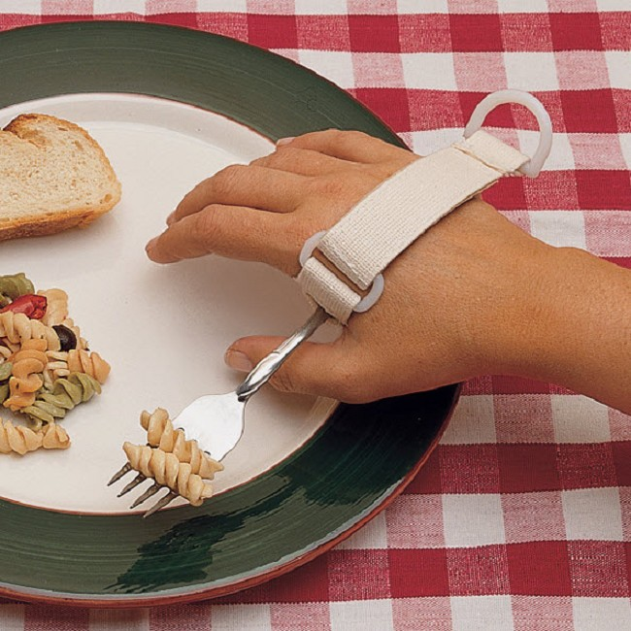
Assistance with Eating
Sometimes clients require additional assistance with eating. When this occurs, allow the client to maintain as much independence as possible, but assist as needed.
Use adaptive utensils and cups
Use light-weight glasses, dishes, and flatware when possible
Ensure proper lighting
Use cueing on the plate for food items
Offer finger foods if utensils are troublesome
Provide straws for liquids
Cover clothing if spilling is likely

Slide 33
Documentation

Slide 34
Documentation
ALL services provided must be documented in the client record (in the ClearCare app)
Medication Administration is documented on MAR.
Vital signs are documented on the tracking form. If you do not document it, it is considered not done. EVERY intervention must be documented.

Slide 35
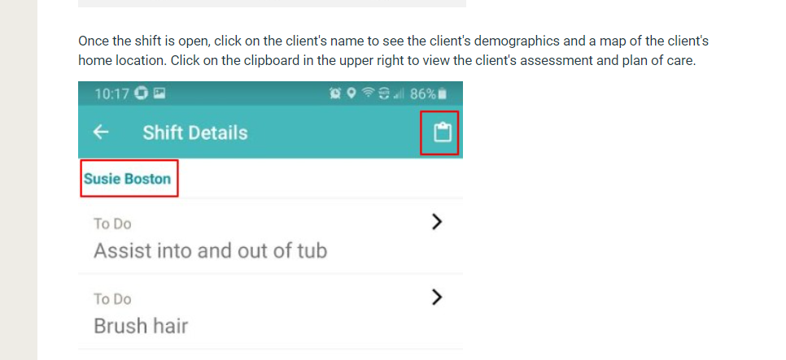
Documentation
All client scheduling and documentation is electronic and completed via your personal device
Go to your APP store and download Clear Care Go Caregiver
Once you login, you can review client care plan on your device by touching the clipboard in the upper right corner. Once reviewed sign the acknowledgement page for each client located in the client’s home chart

Slide 36
Practical Skills Competency Testing

Slide 37
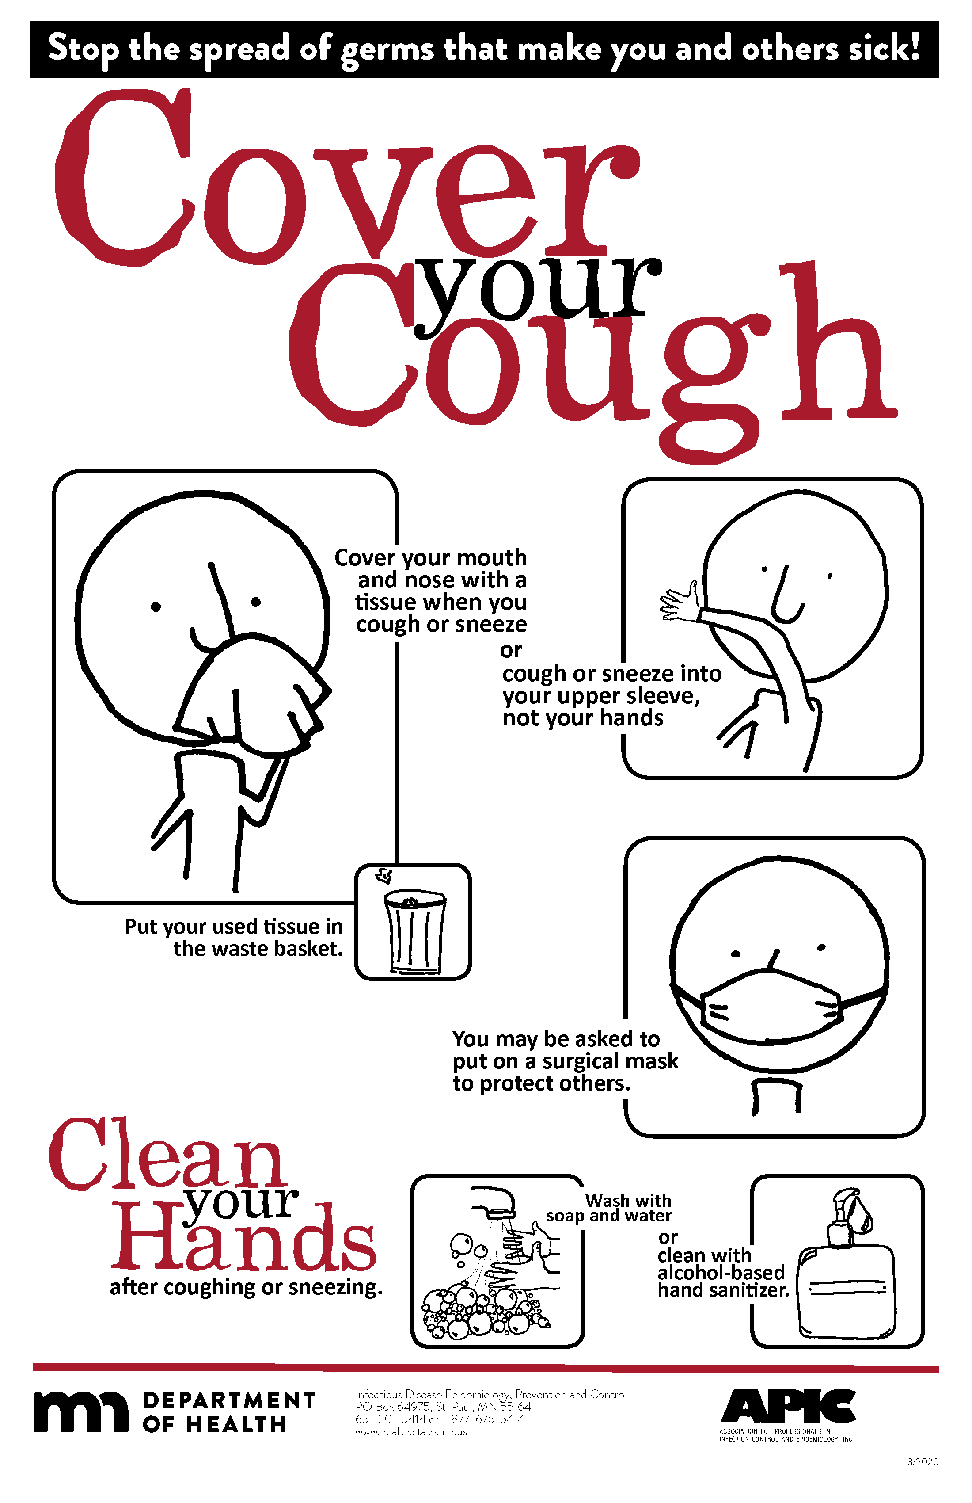
Practical Skills Competency Testing: Standard Infection Control Precautions
Perform Hand Hygiene
Handwashing Procedure
Hand Sanitizer
Gloving Application and Removal
Glo Germ Experiment
Personal Protective Equipment
Respiratory Hygiene / Cough Etiquette Principles
Isolation Precautions
Proper Handling and Disposal of Needles and Sharps
Client Equipment – Cleaning and Disinfecting
#1 Way to Prevent the Spread of Germs – https://www.youtube.com/watch?v=tmMGwO4N0Vc

Slide 38
Practical Skills Competency Testing: Vitals
Pulse Rate
Temperature
Respiration Rate
Blood Pressure (electronic cuff)
Weight
Vitals Documentation

Slide 39
Practical Skills Competency Testing: Personal Hygiene and Grooming
Hair care
Dressing
Grooming
Oral Care
Teeth
Gums
Oral Prosthetic Devices
Hearing Aids: Care and Use
Bathing
Shower
Tub
Bed
Dressing
Toileting
Toileting Assistance
Incontinence Care/Peri-Care
Catheter Care: https://www.youtube.com/watch?v=mT7QM6jPrHg
Nail and Foot Care: Soak and file only

Slide 40
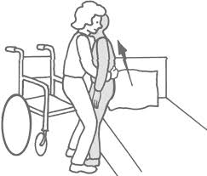
Practical Skills Competency Testing: Transfer Techniques
Safe Transfer Technique
Stand-by Assistance
Ambulation
Assistive Devices
Wheelchair
Walker
Cane Use
Slide Board: https://www.youtube.com/watch?v=E4TpbDcTkCY
Range of Motion
Positioning
Gait Belt
Exercise and Treatment

Slide 41
Practical Skills Competency Testing: Medication Reminders
Medication Reminders
Definition
Documentation
Preparing Medications for Clients with Planned or Unplanned Times Away

Slide 42
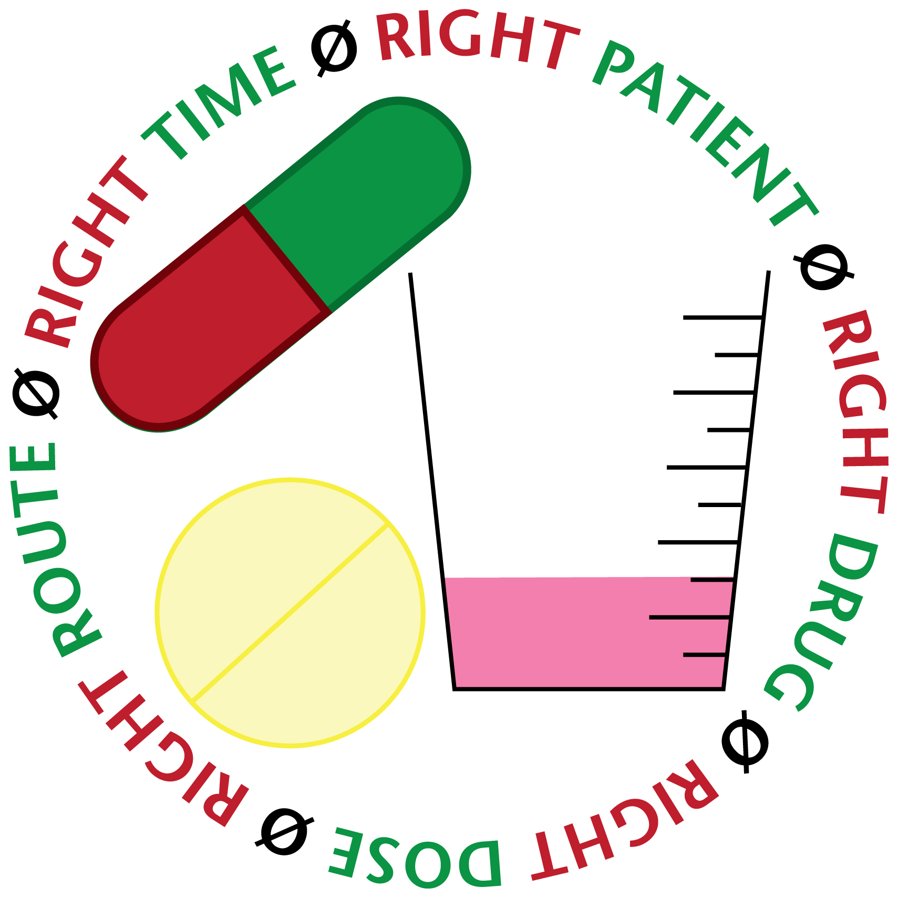
Practical Skills Competency Testing: Medication Administration
Medication Administration Definition
Medication Administration: Oral Tablets/Solutabs
Medication Administration: Oral Liquid
Medication Administration: Ear Drops
Medication Administration: Eye Drops
Medication Administration: Nose Drops & Nasal Spray
Medication Administration: Inhalers
Medication Administration: Suppository / Rectal Medication
Medication Administration: Topical Application of Ointment & Cream
Blood Glucose Testing: https://www.youtube.com/watch?v=MZCf621bRHs
Documentation – Medication Administration Record (MAR)
Refusal of Medications
PRN Medications
Preparing Medications for Clients with Planned or Unplanned Times Away

Slide 43
Practical Skills Competency Testing: Medication Administration

Slide 44
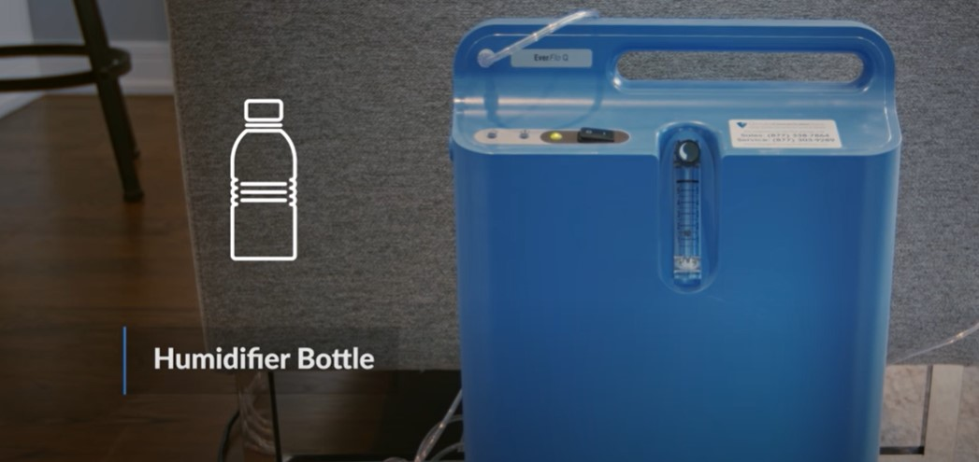
Practical Skills Competency Testing: Treatment Administration
Treatment Administration Definition
Treatment Administration: Nebulizer Treatment
Treatment Administration: Oxygen Administration
Oxygen Safety: https://www.youtube.com/watch?v=p4OZEdc5UKc
Treatment Administration: TED Socks
Treatment Administration: Farrow Wraps
Other treatments, as ordered by a physician, will be competency tested individually
Documentation
Refusal of Treatment

Slide 45
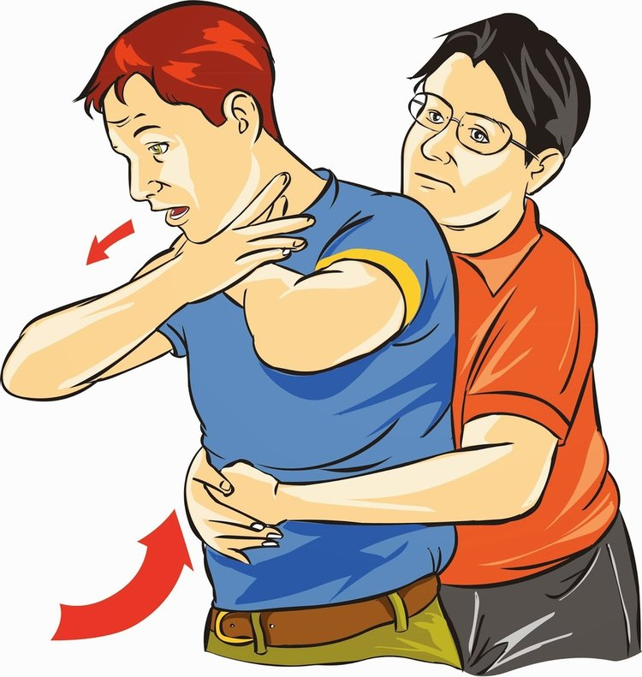
Practical Skills Competency Testing: Client Choking
Heimlich Maneuver: https://www.youtube.com/watch?v=7CgtIgSyAiU

Slide 46
Final Paperwork
Complete and Review Orientation Post Test
Employee must score 80% to pass
Review Orientation Checklist for Completion
Sign Orientation Checklist
Job Description
Availability Form

Slide 47
Questions?

