Slide 1
Google Dev Console Setup Guide
The following setup steps take place within console.developers.google.com and admin.google.com and must be performed by a Google Apps Super Administrator account.
Tool rights to System Administration > Campus Learning > Google Drive are also necessary.
All Google Dev Console values shown in this guide are for example purposes only. Use the values from your own Google Dev Console.
Disclaimer: Policies, practices and individual tool right may vary depending on district or position.

Slide 2
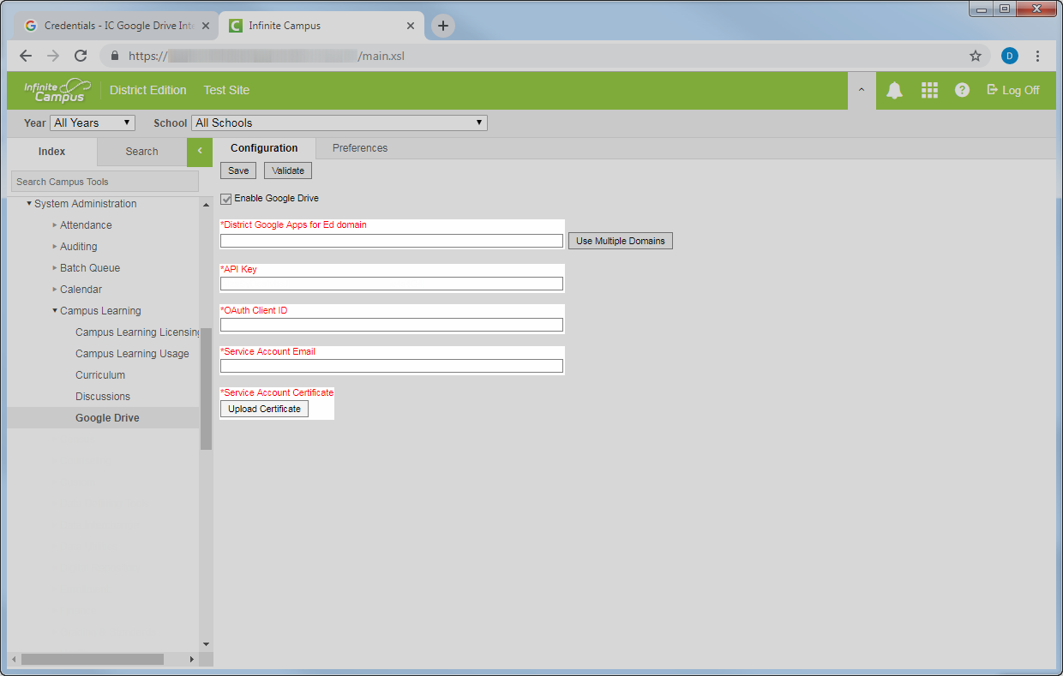
Overview: Infinite Campus requires four values and one file from the Google Dev Console in order to integrate Campus Instruction with Google Drive. You can see the five required fields below.
The rest of this guide will visually walk through the process of creating those four values and file within the Google Dev Console.

Slide 3
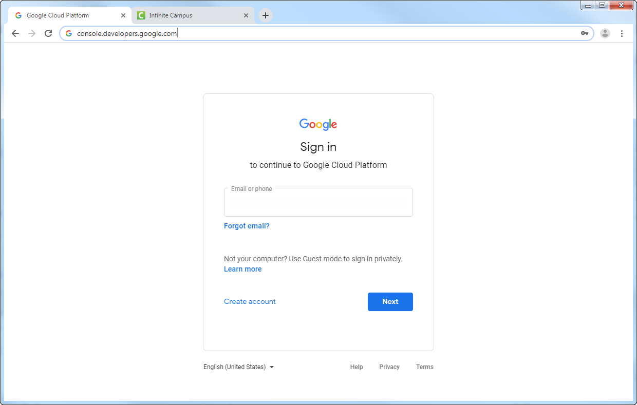
Navigate to console.developers.google.com
To begin creating the required values,
log in to console.developers.google.com

Slide 4
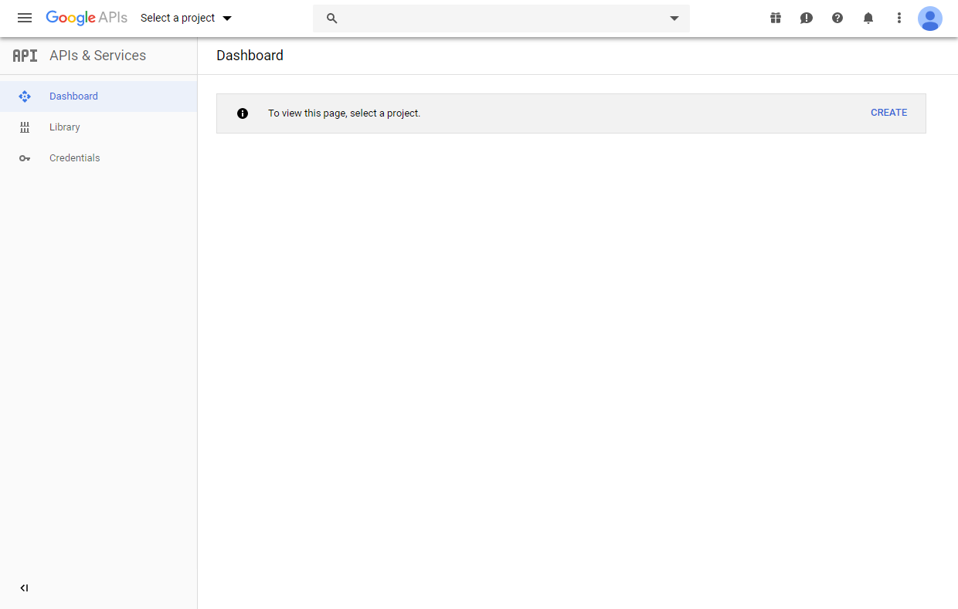

Slide 5
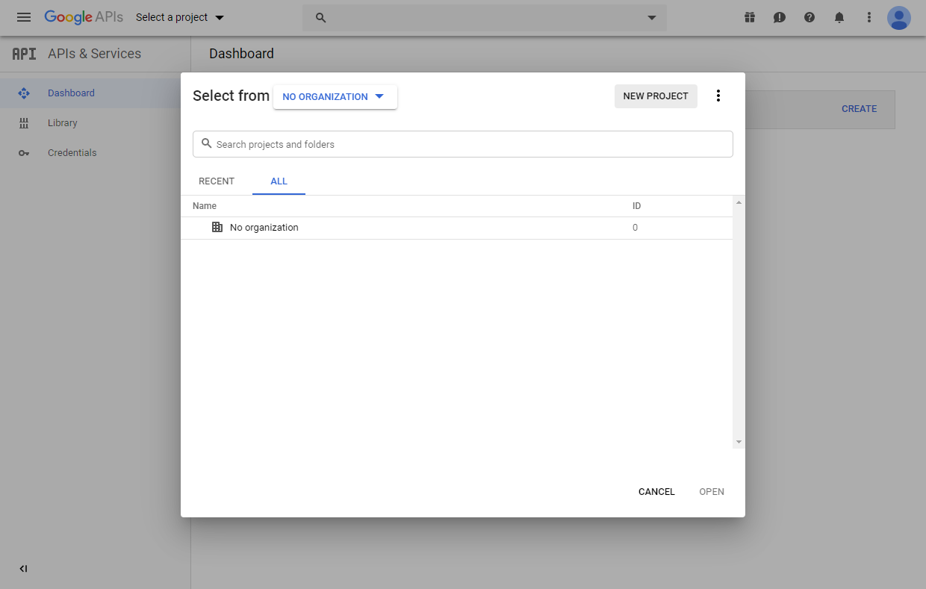

Slide 6
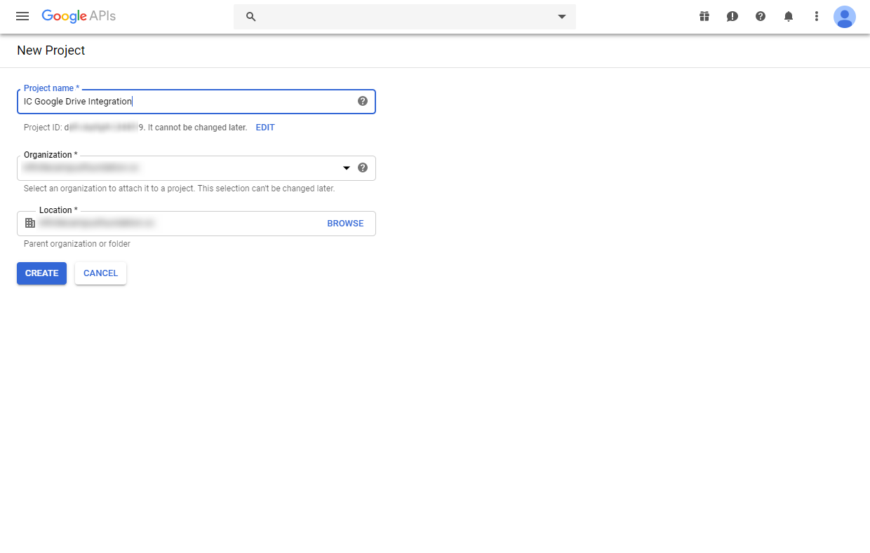
1
Name the project whatever you like.
2
Set this to your desired organization. This can not be set to “No Organization.”
3
Select location.
4

Slide 7
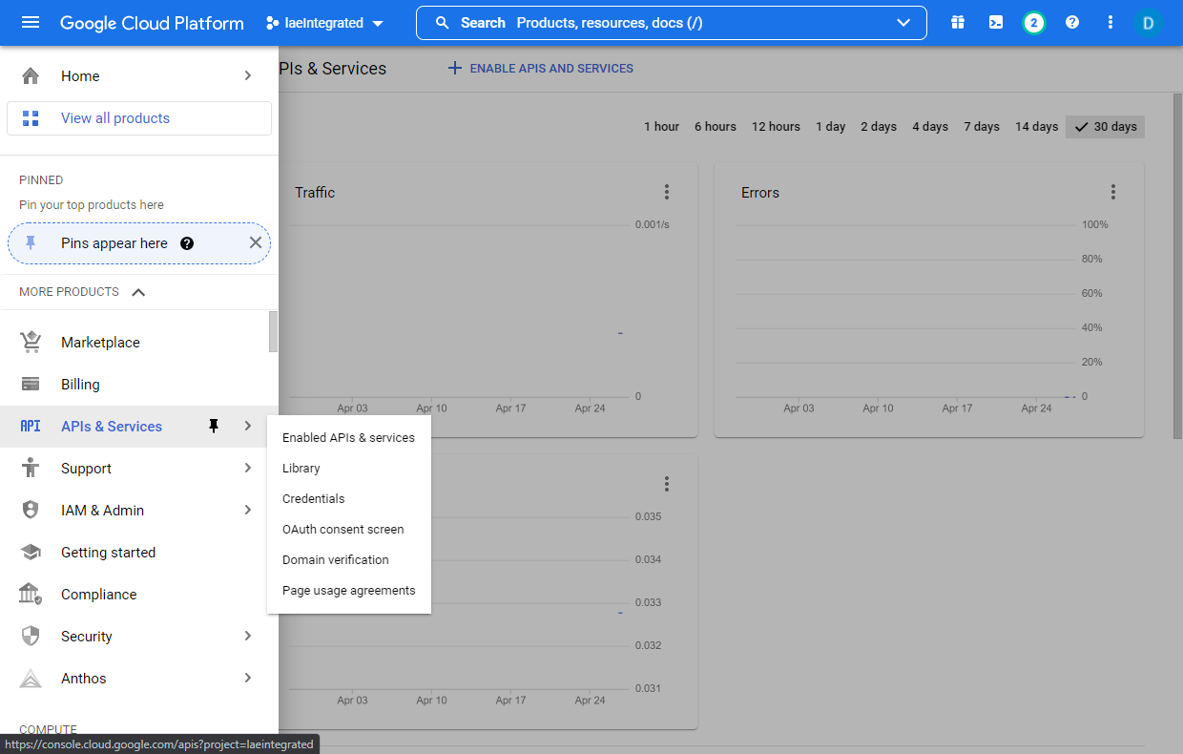
Ensure the project you just created is selected in the top menu.
Click the menu icon to reveal the sidebar menu.

Slide 8
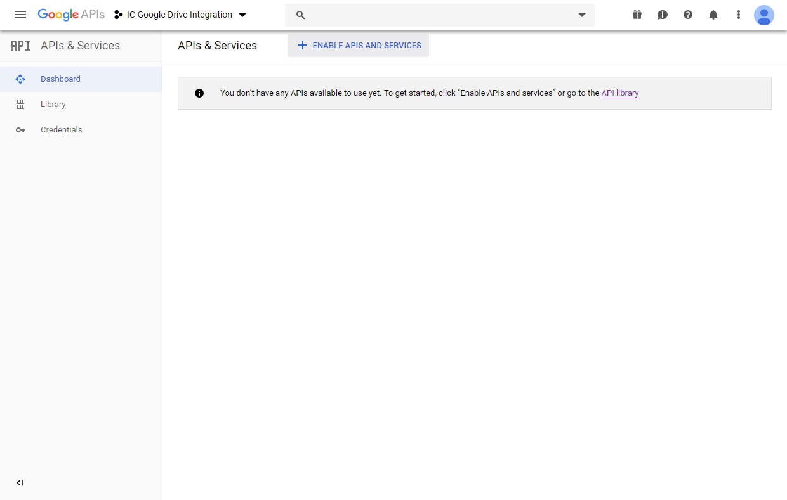

Slide 9
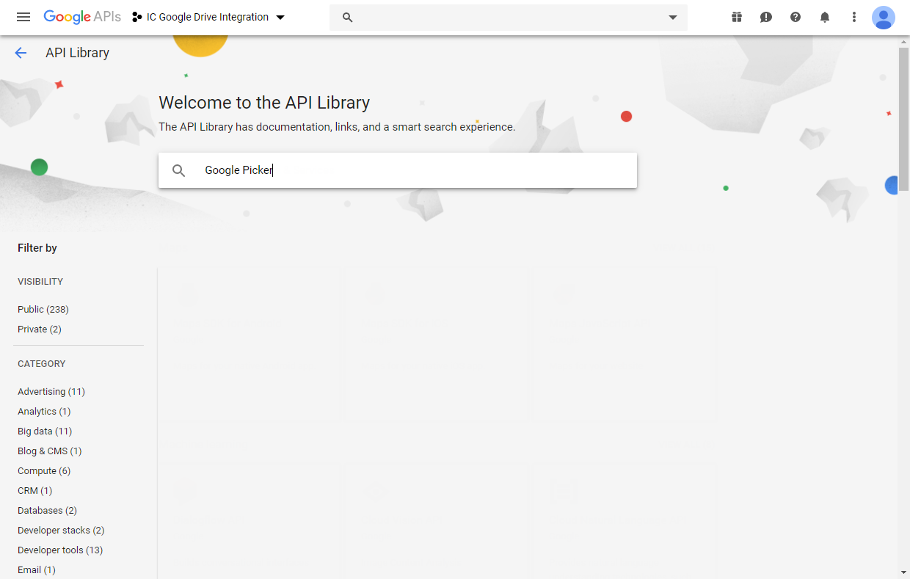
Start typing “Google Picker.”
Selectable APIs will display once you being typing.

Slide 10
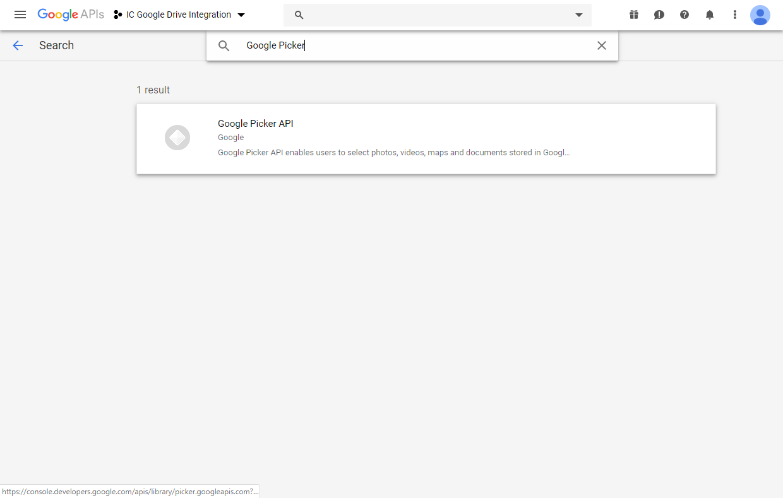

Slide 11
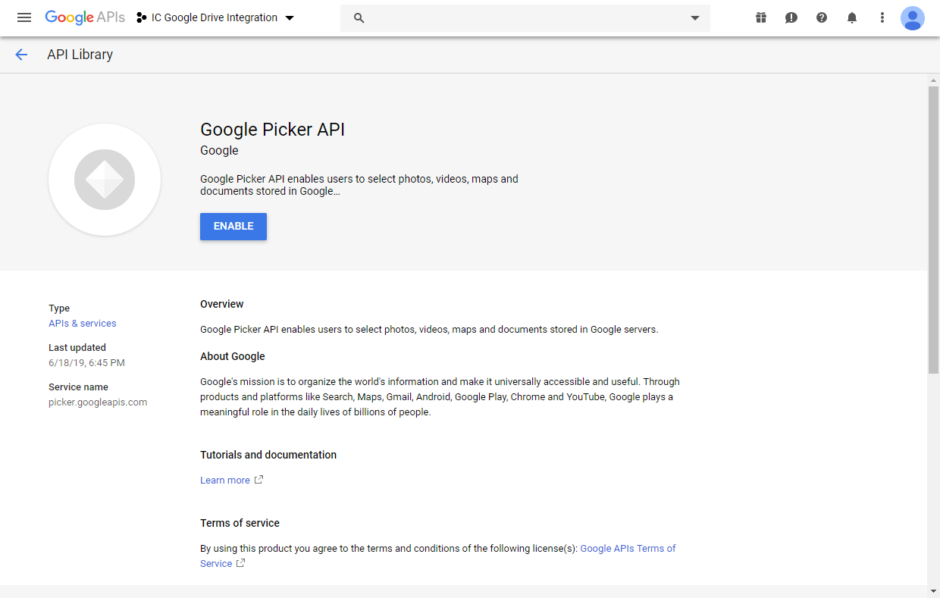

Slide 12
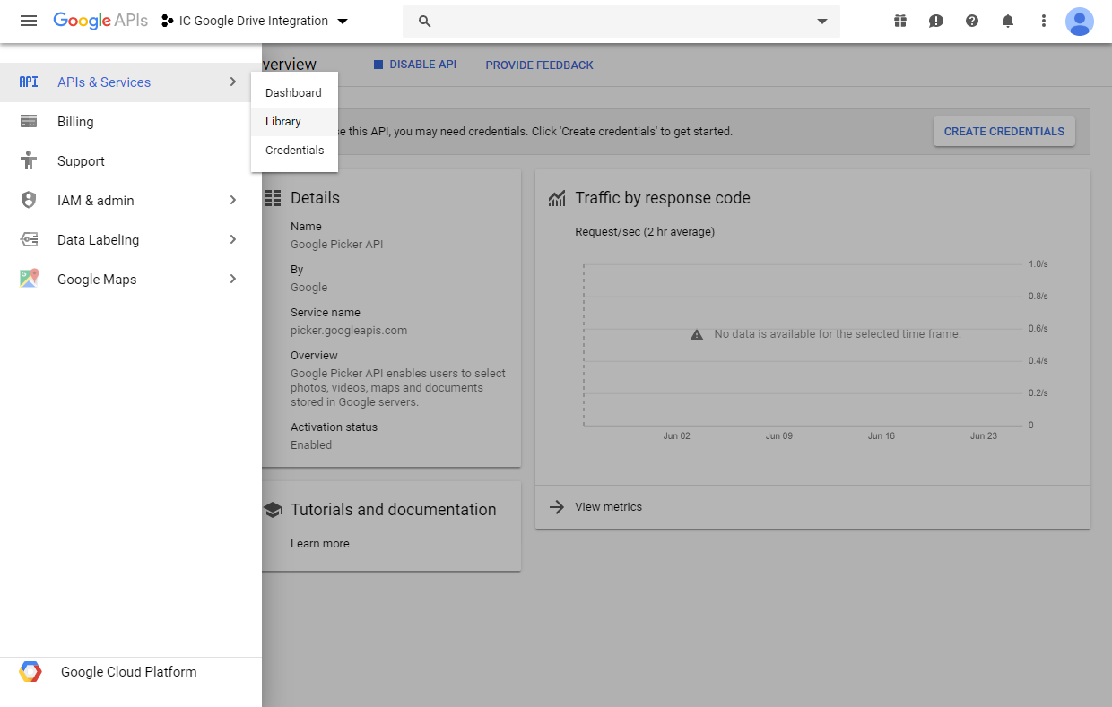

Slide 14
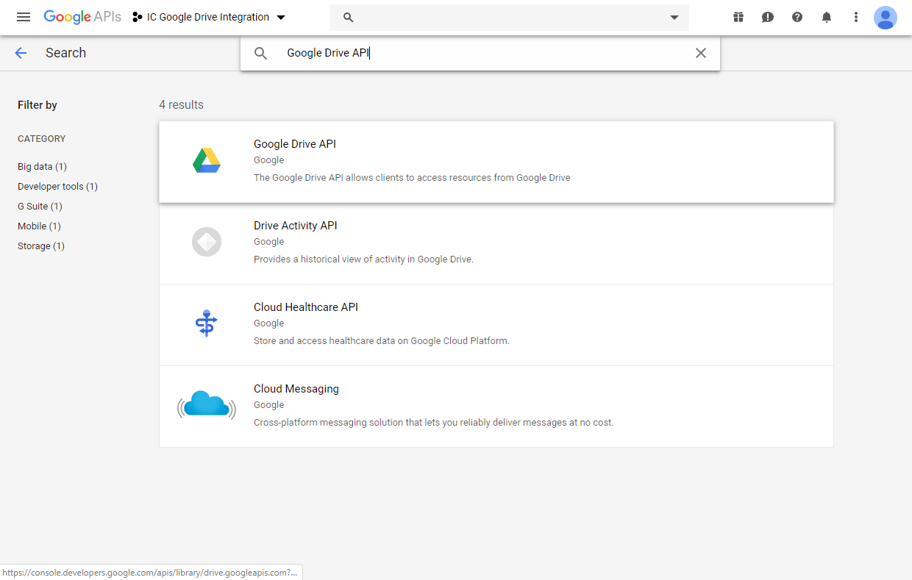

Slide 15
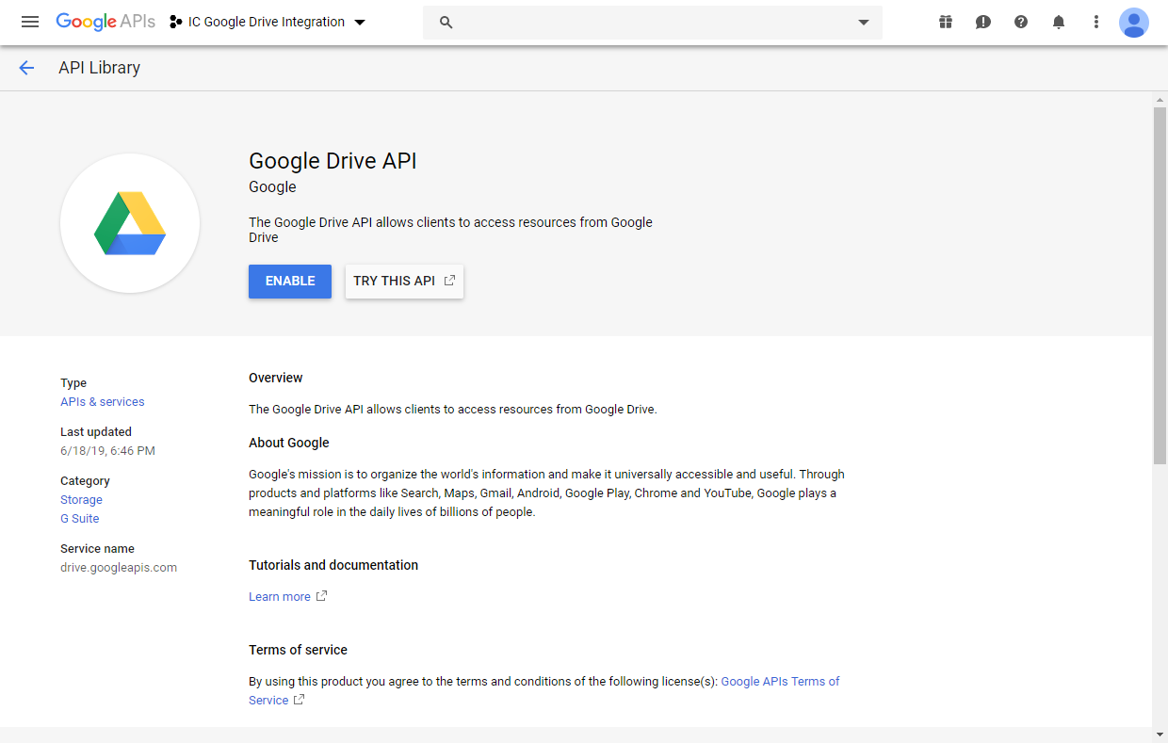

Slide 17
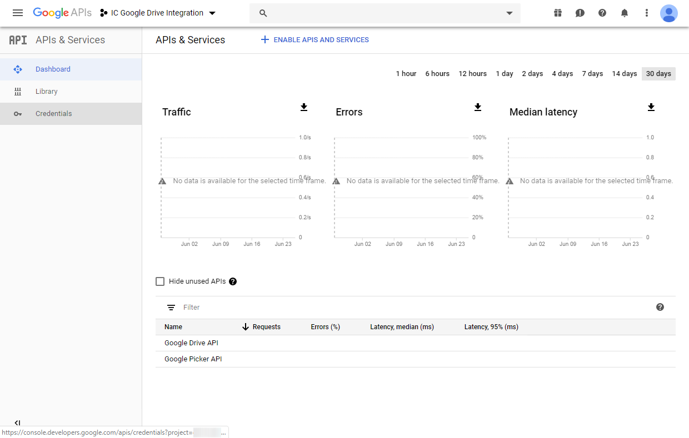
2
1
Ensure both Google Drive API and Google Picker API display here.
If any APIs other than Google Drive and Google Picker also display within this project, disabling those is recommended.

Slide 18
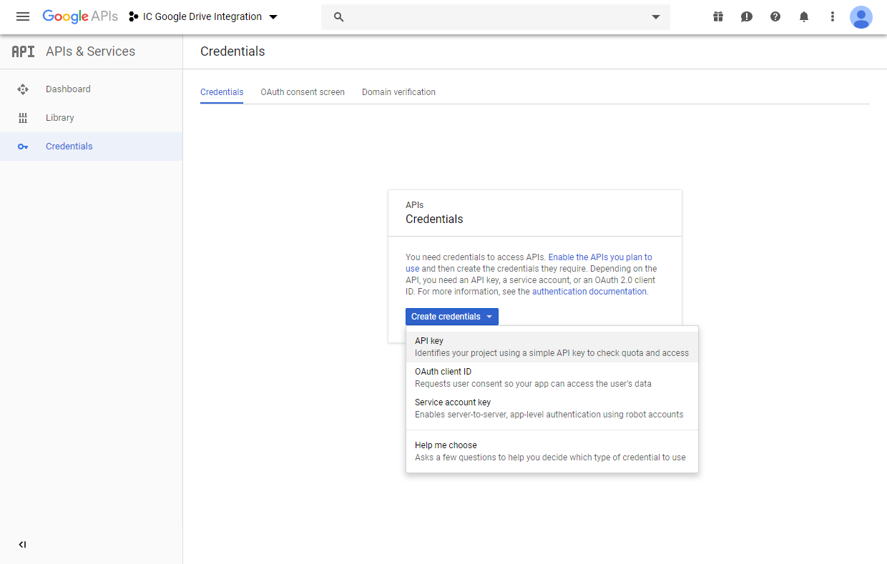

Slide 19
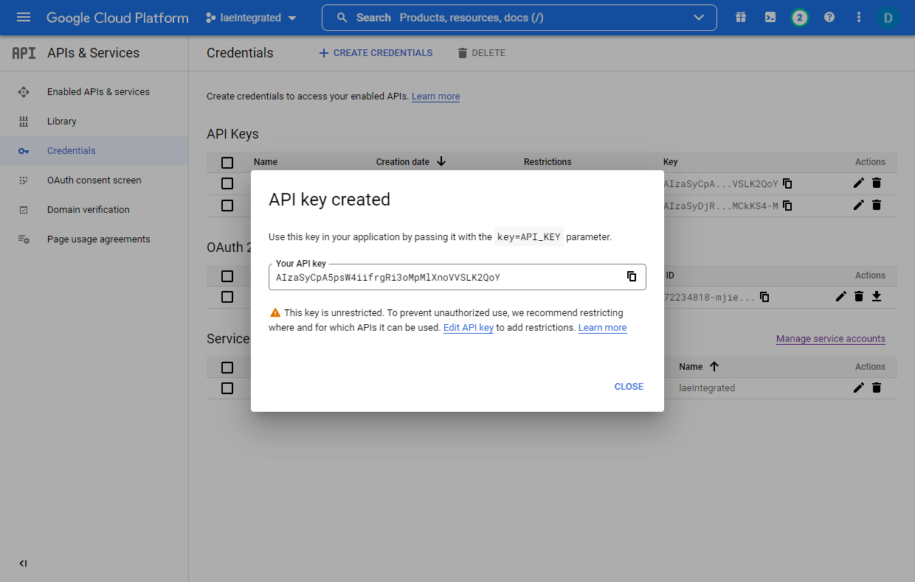

Slide 20
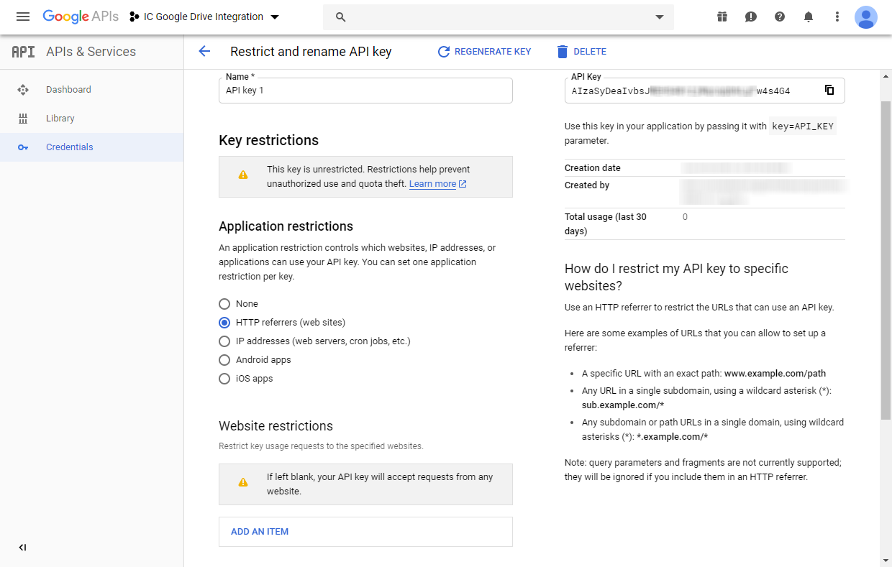
1
2
3
Scroll down.

Slide 21
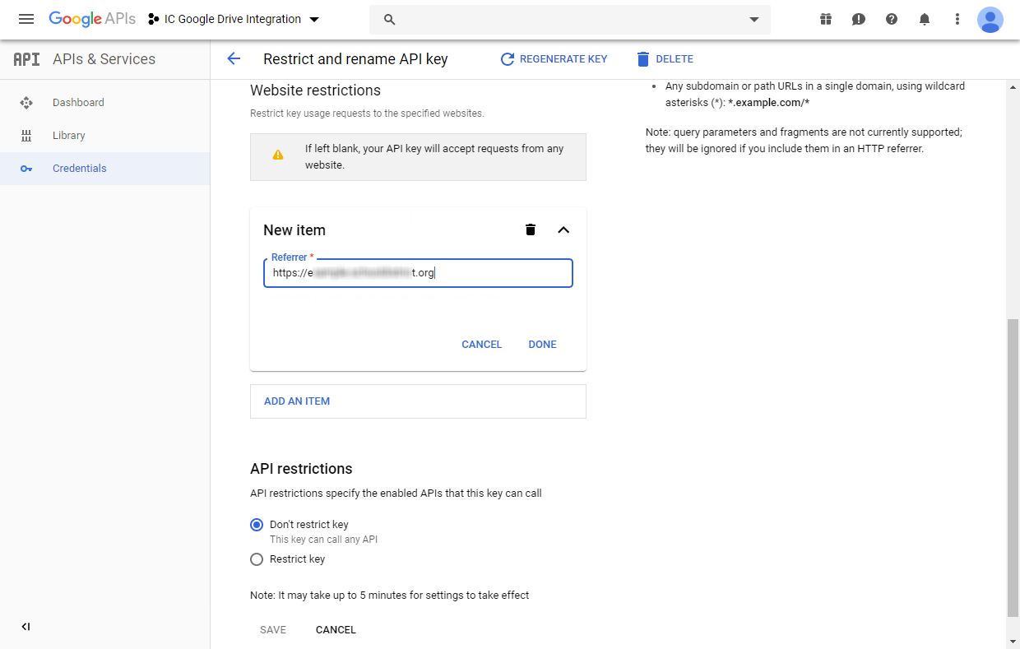
1
Enter your district’s Infinite Campus URL including https:// and up to the top-level domain (.com, .edu, etc.) only.
Ensure there are no slashes or other characters after the base URL. Do not include /campus/main.xsl in this text box, for example.
Then select Done.
2

Slide 22
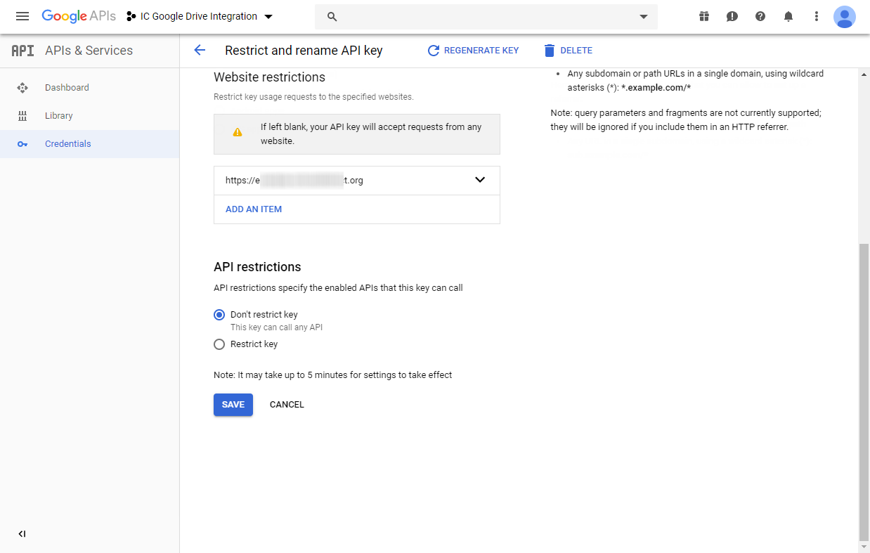
The Website Restriction you just added will display here.

Slide 23
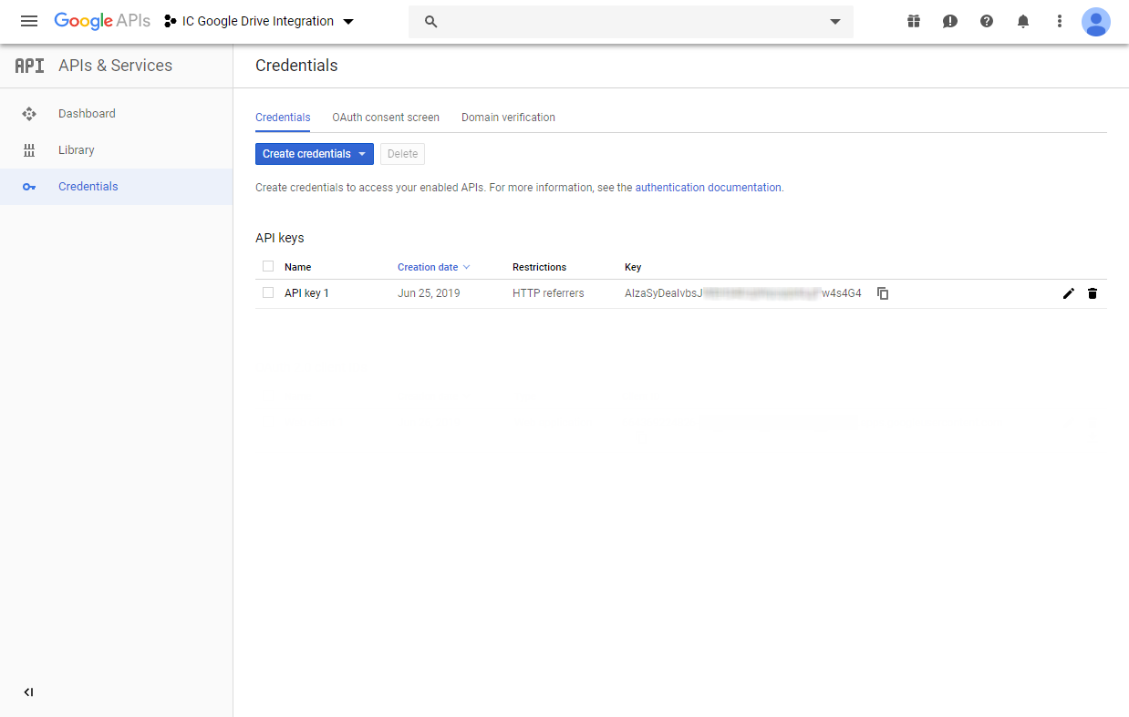
The API Key you just created will display here.
Select the copy button to copy the API Key to your clipboard.
Navigate to Infinite Campus.

Slide 24
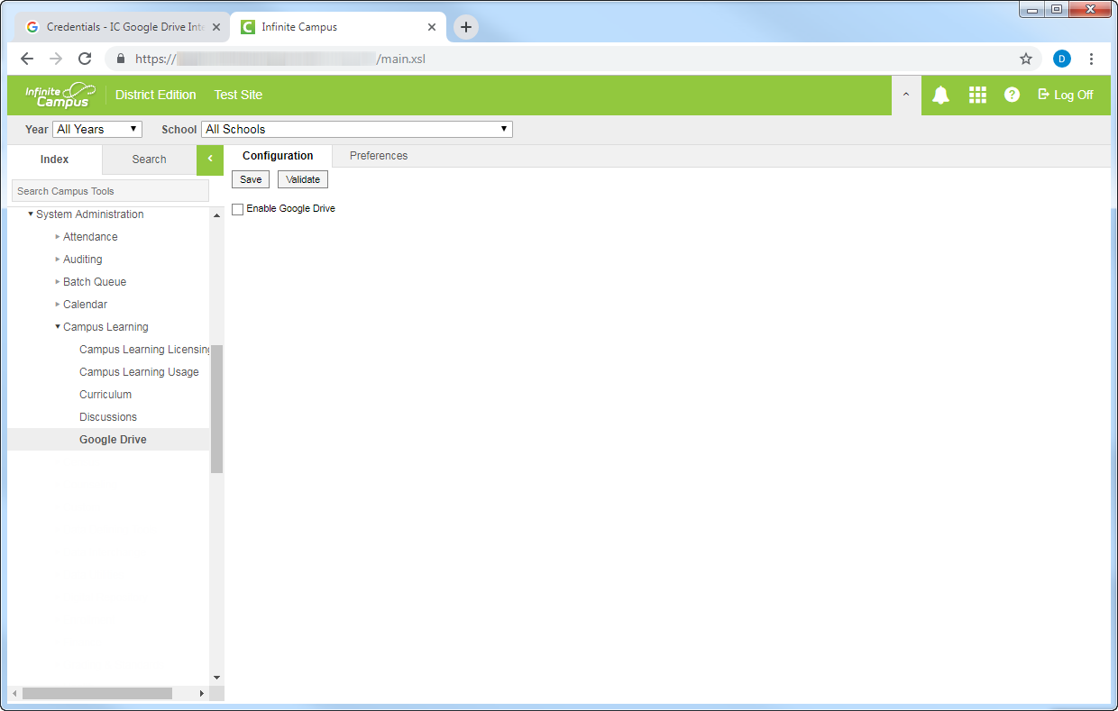
Note that your Infinite Campus account will need tool rights to System Administration > Campus Learning > Google Drive to link Infinite Campus to the Google Dev Console project you’re creating.
If you don’t see this tab, you may need to request to be granted the tool rights to access it by your district’s Infinite Campus administrator.
If you yourself do not have access to Infinite Campus at all and someone else will be completing the Infinite Campus-specific steps, please record the relevant values as you go (four values and one file) to provide to that person.

Slide 26
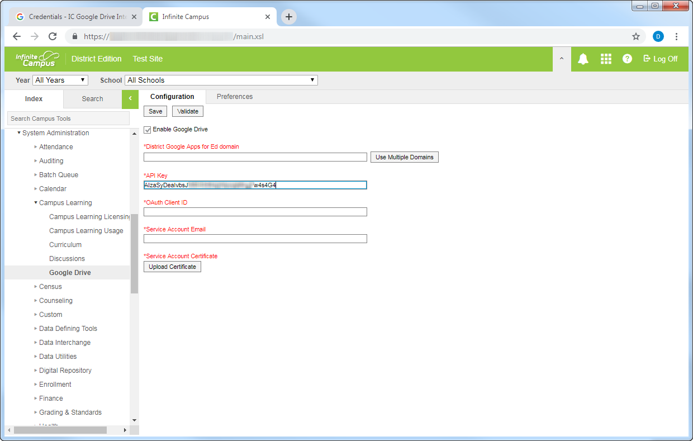
Paste the value you copied from the Google Dev Console into the API Key field. Ensure there are no typos or spaces before or after the value.

Slide 27
Navigate back to the Google Dev Console to continue the setup process.

Slide 29
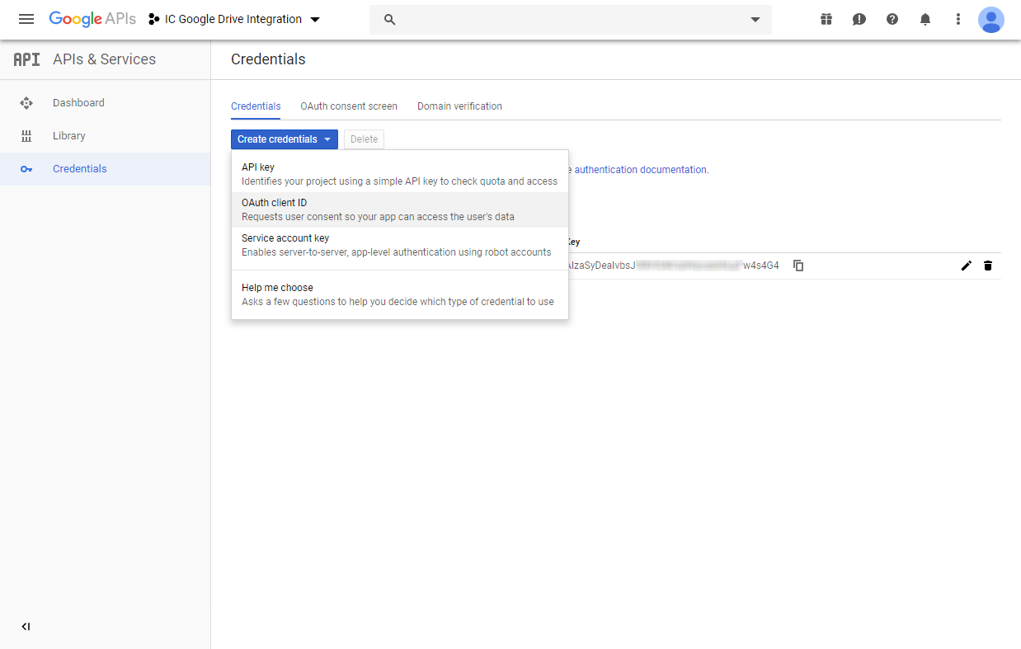

Slide 30
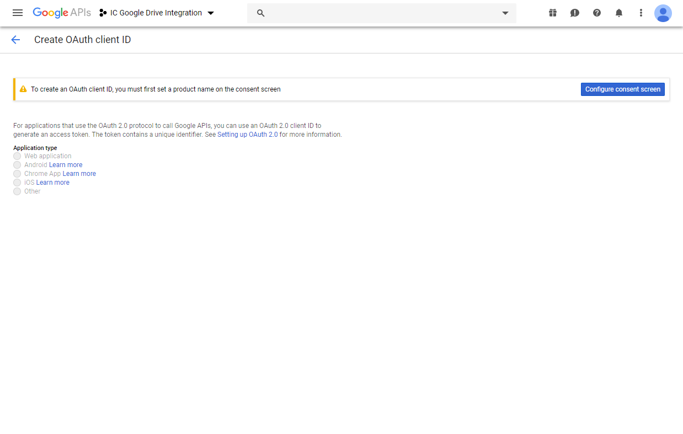

Slide 31
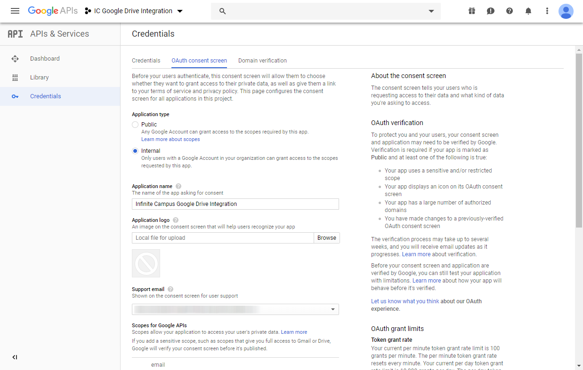
Context: The “Consent Screen” is the one-time screen your users will see upon logging into the Google credentials pop-up the first time. It will ask them to confirm they want to enable this integration.
1
2
This name can be whatever you like. “Infinite Campus Google Drive Integration” would be a clear description.
Displaying a logo on this consent screen is optional.
3
Scroll down.

Slide 32
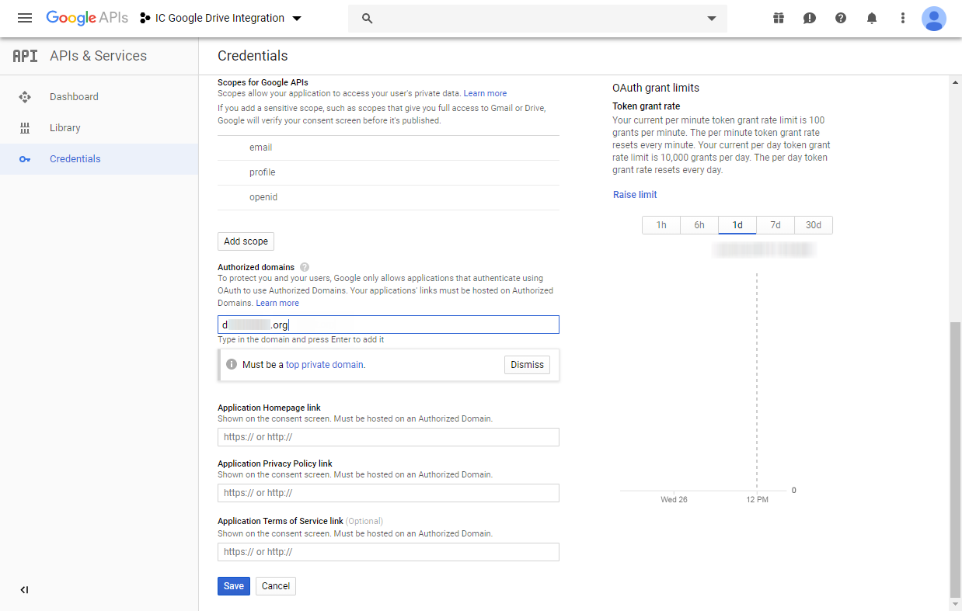
1
Enter your district’s Infinite Campus URL without the https:// and up to the top-level domain (.com, .edu, etc.) only.
If your URL includes a sub-domain, as the example here does, do not include it.
Ensure there are no slashes or other characters before or after the base URL. Do not include /campus/main.xsl in this text box.
2
Hit the Enter key on your keyboard to add the value.

Slide 33
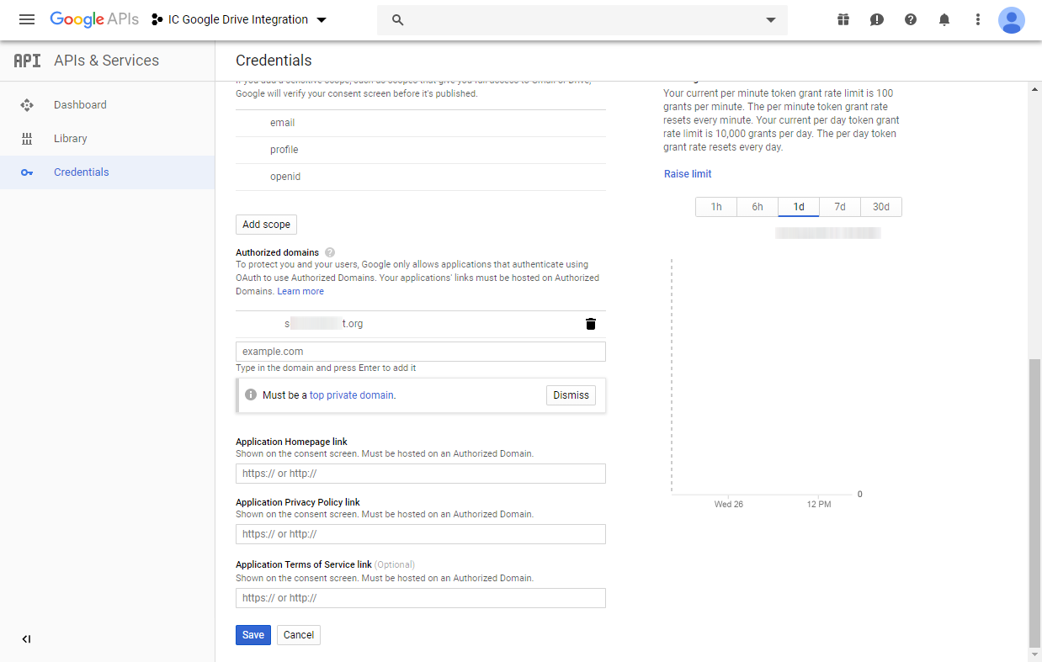
A garbage can icon indicates the value has added.
Note that the system will strip out any sub-domains and display the domain only. That’s all to be expected.

Slide 34
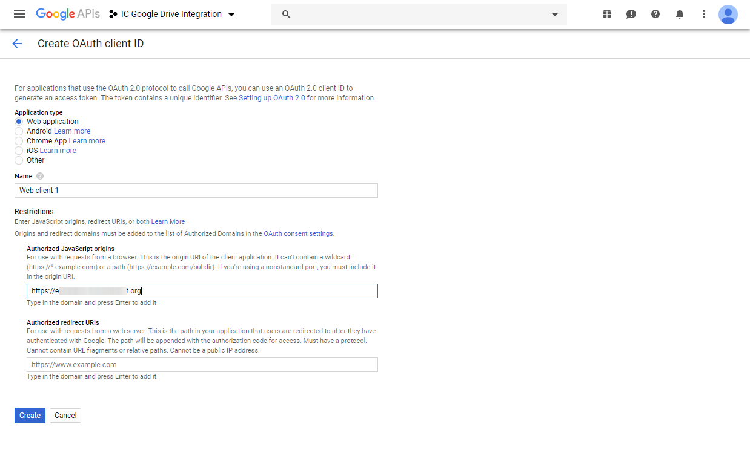
1
2
Enter your district’s Infinite Campus URL including https:// and up to the top-level domain (.com, .edu, etc.) only.
Ensure there are no slashes or other characters after the base URL. Do not include /campus/main.xsl in this text box, for example.
Hit the Enter key on your keyboard to add the value.
3

Slide 35
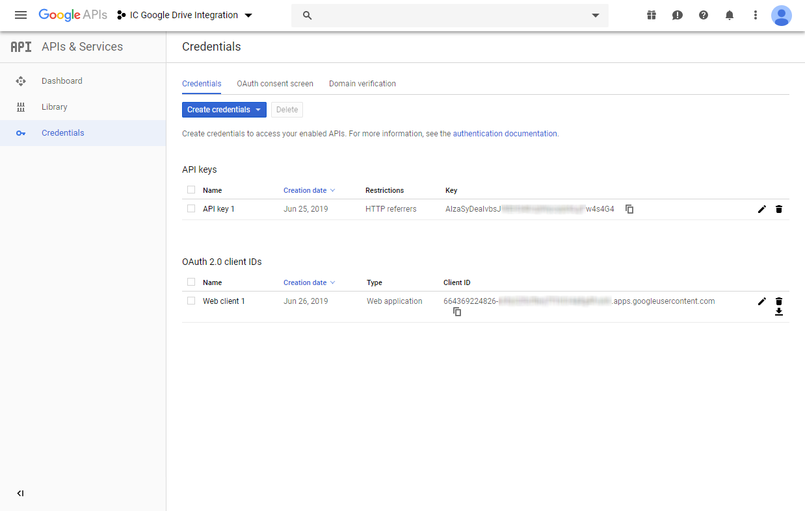
The OAuth Client ID you just created will display here.
Select the copy button to copy this value to your clipboard.
Navigate to Infinite Campus to paste the value.

Slide 36
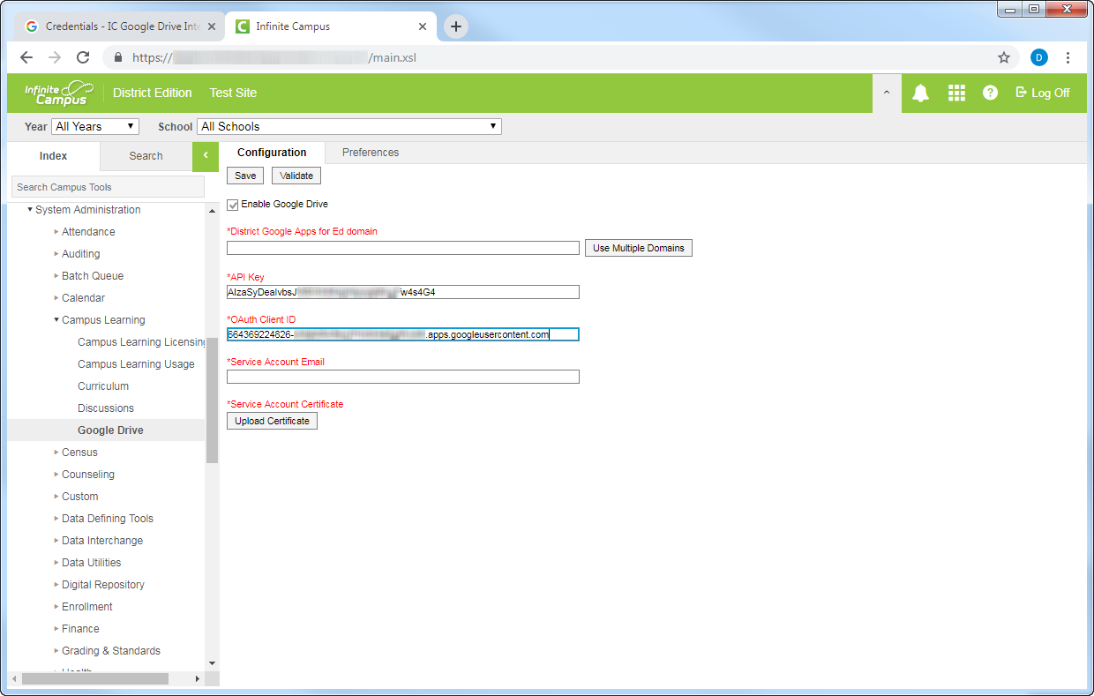
Paste the value into the OAuth Client ID field. Ensure there are no typos or spaces before or after the value.

Slide 37
Navigate back to the Google Dev Console to continue the setup process.

Slide 39
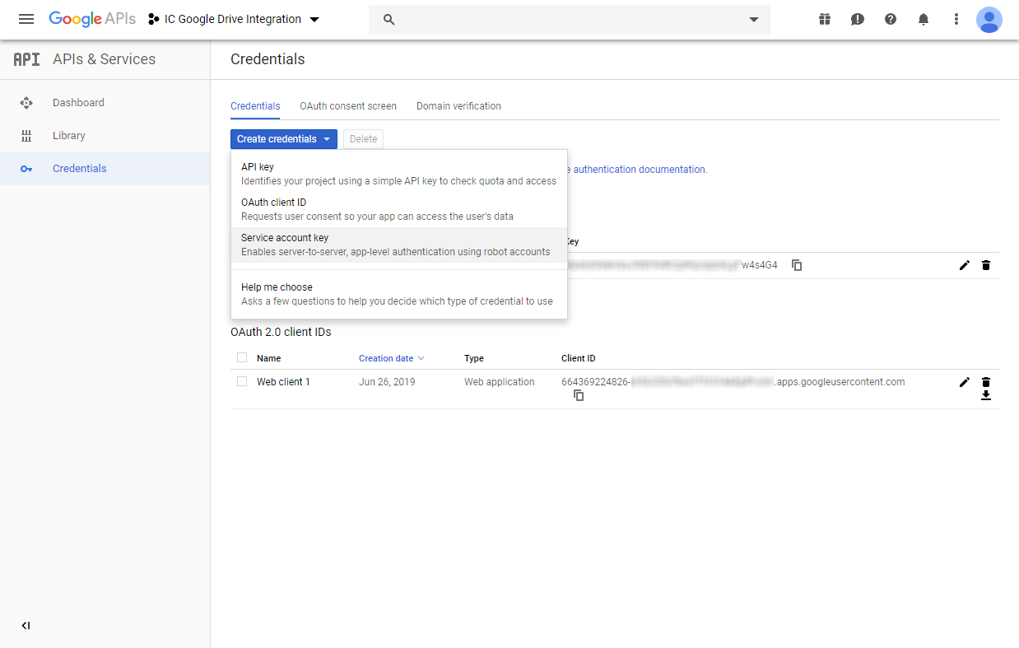

Slide 40
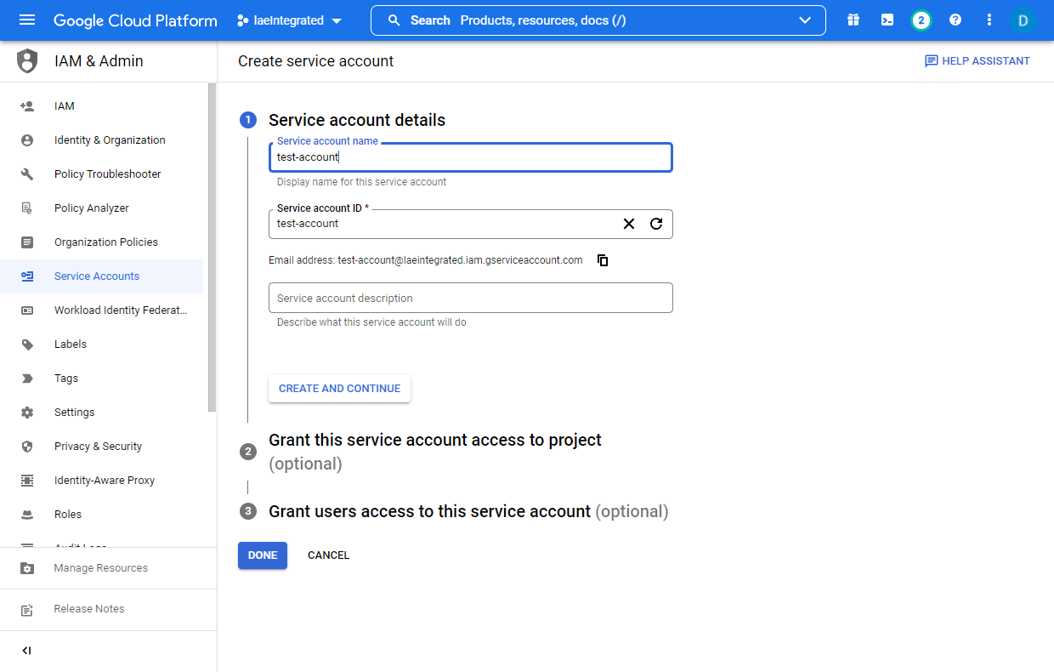
This Service Account Name can be whatever you like.
The Service Account ID will default to whatever the Name is.

Slide 41
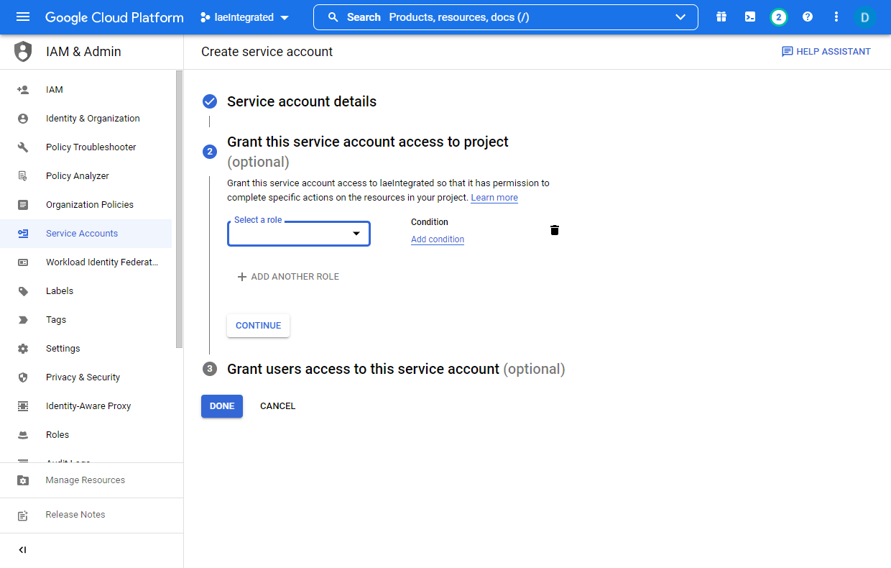
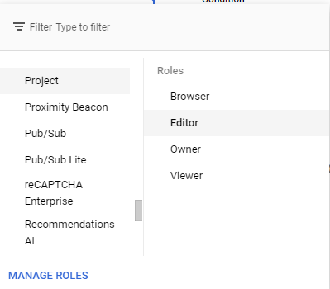

Slide 42
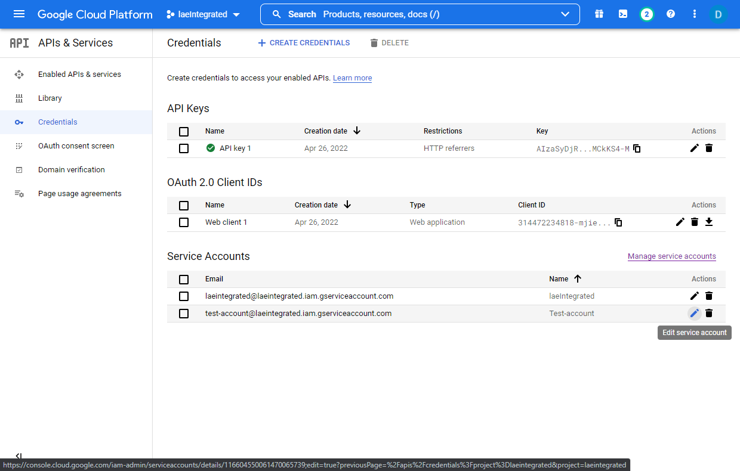

Slide 43
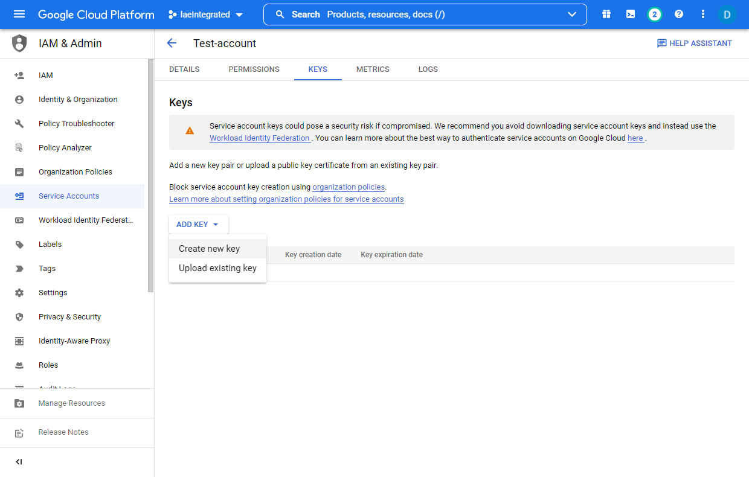

Slide 44
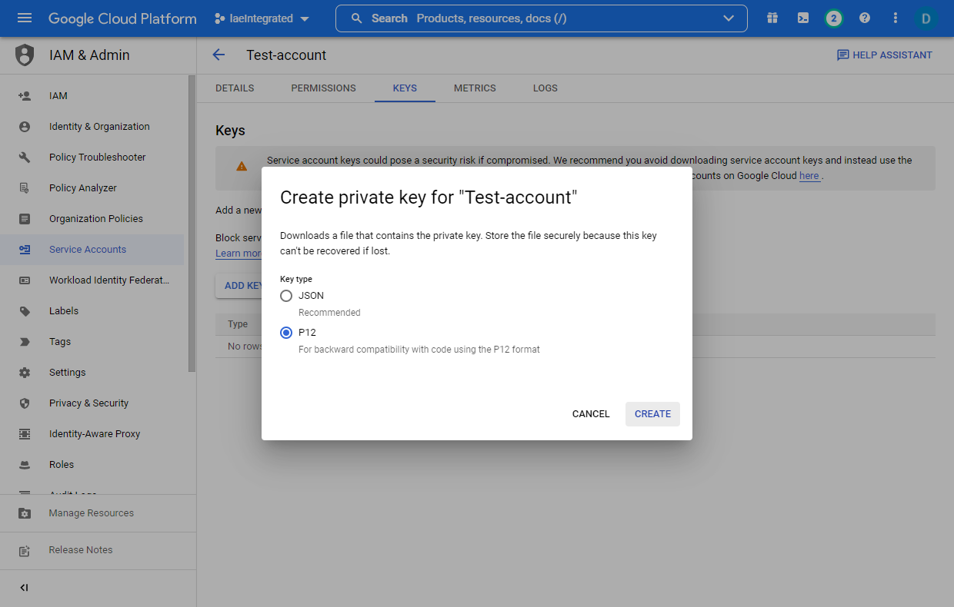
1
Ensure P12 is selected, not JSON.
2

Slide 45
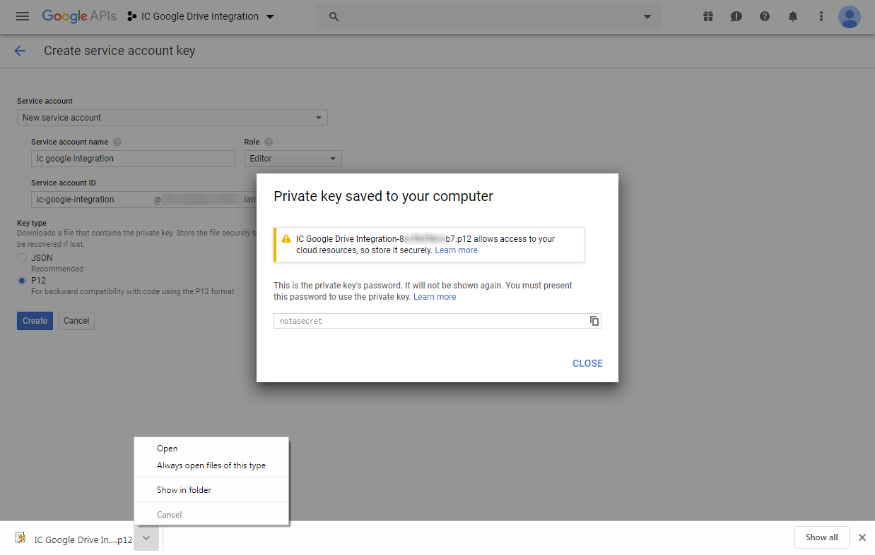
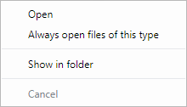
A .p12 file will download to your browser’s default downloads folder.
Relocate this file somewhere safe.
Navigate to Infinite Campus to upload this file.
(Uploading this file into Infinite Campus is a one-time process, but it is not a bad idea to keep a backup copy of this file somewhere safe as well.)

Slide 46
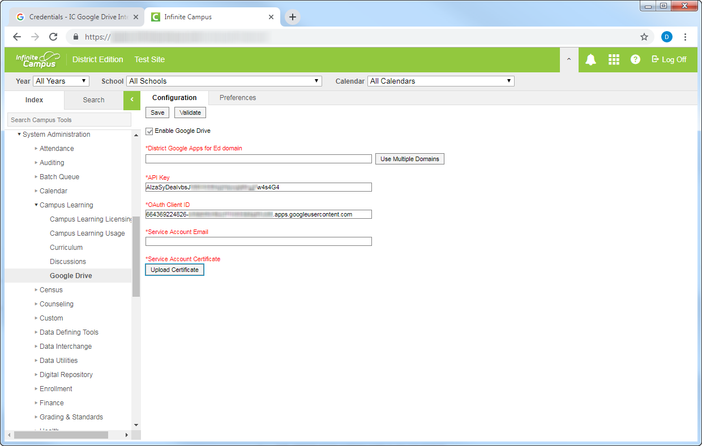

Slide 47
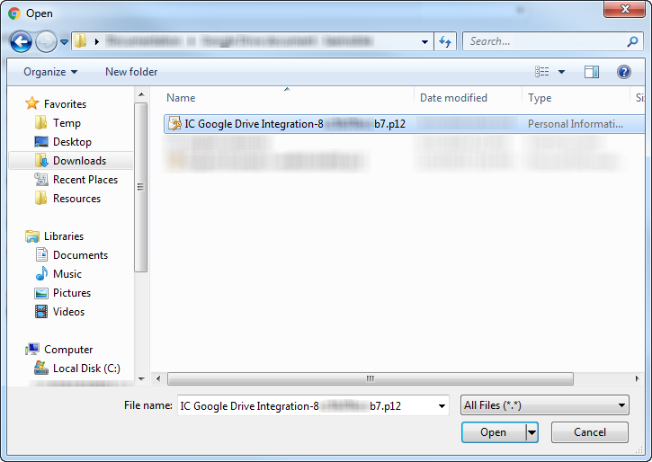
Navigate to wherever you saved this .p12 file in the previous step.

Slide 48
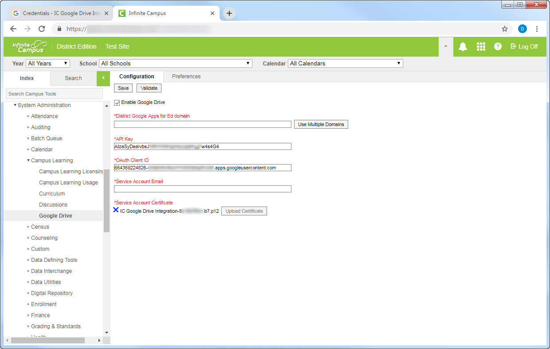
Navigate back to the Google Dev Console to continue the setup process.
The file you’ve selected will display here, but won’t actually upload until you supply all required values on this page and select Save.

Slide 49
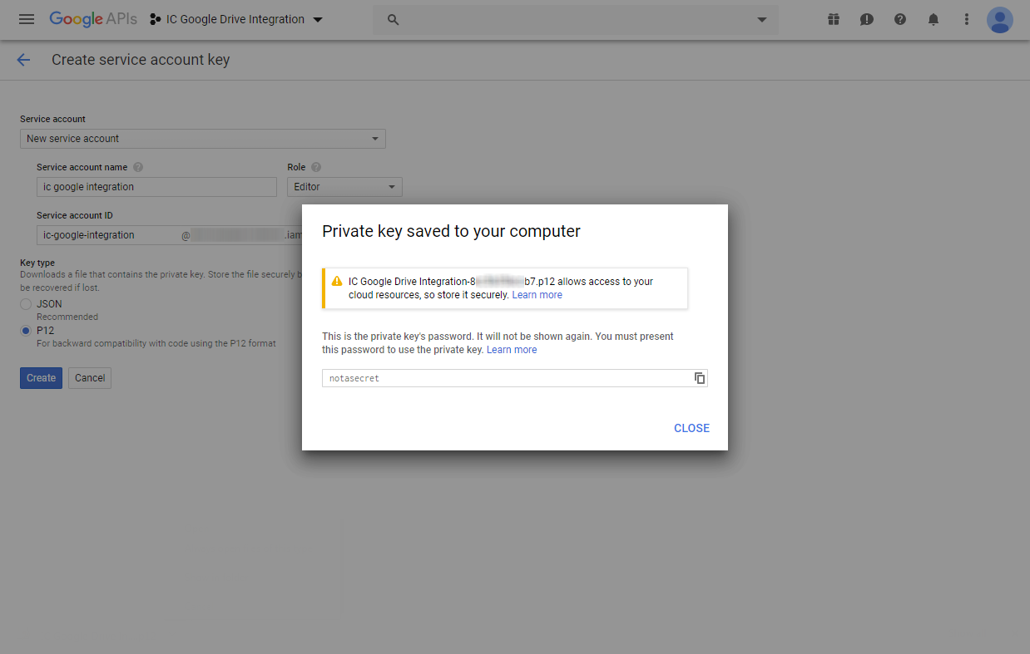

Slide 50
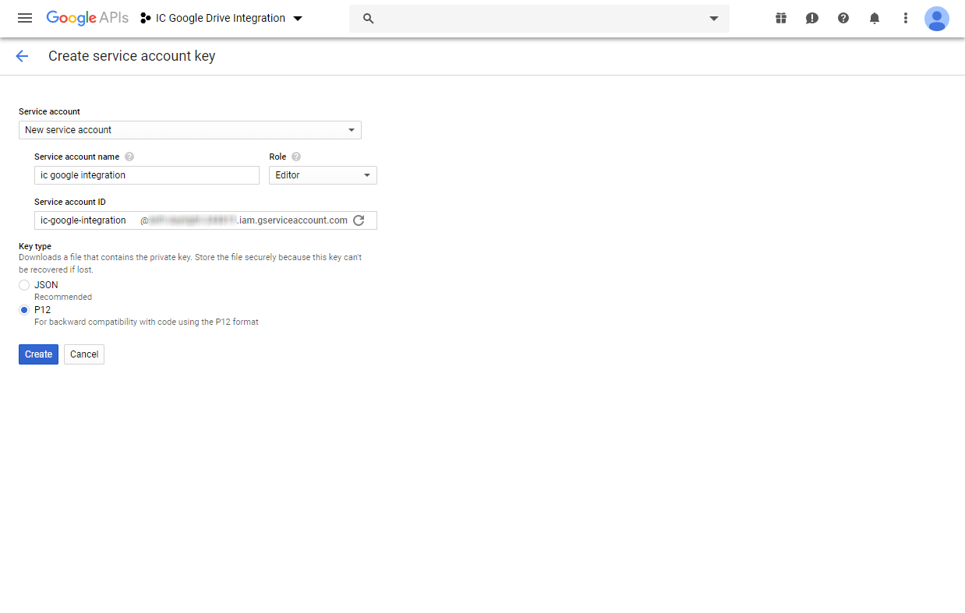

Slide 51
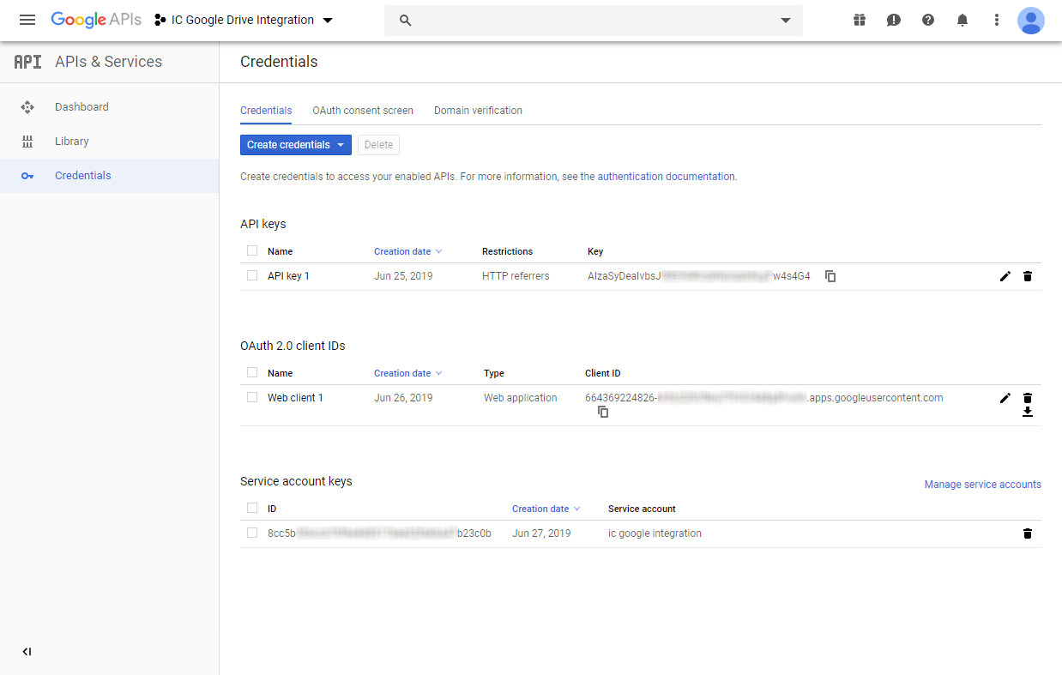

Slide 52
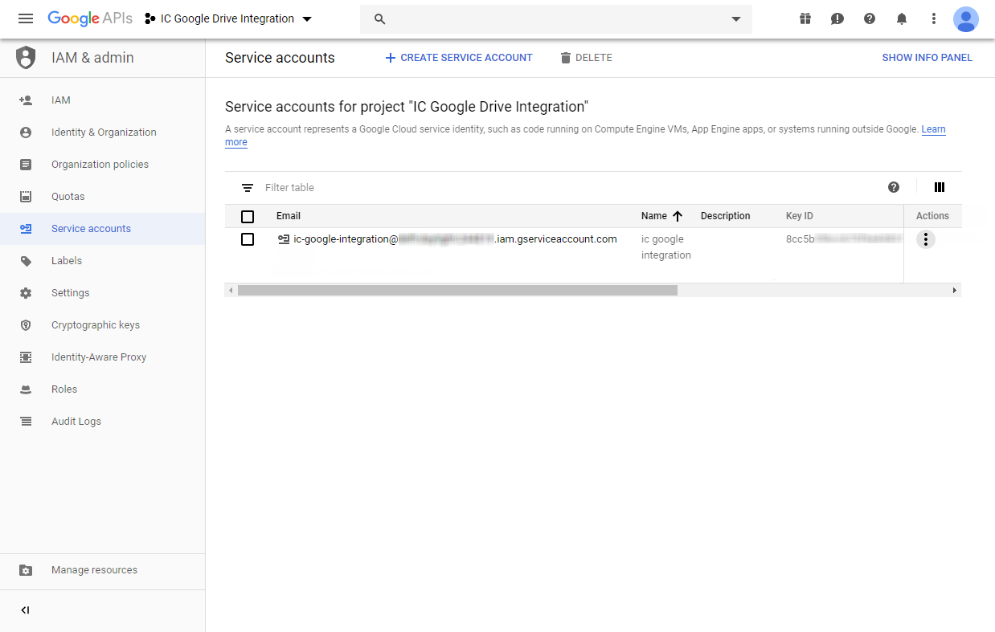
Copy the Service Account Email to your clipboard.
Navigate to Infinite Campus to paste in the value.

Slide 53
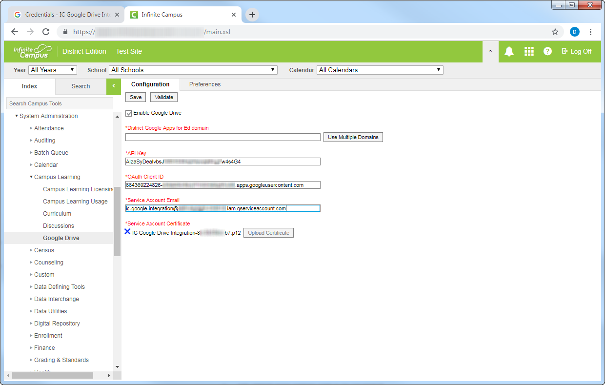
Paste the value into the Service Account Email field. Ensure there are no typos or spaces before or after the value.

Slide 54
Navigate back to the Google Dev Console to continue the setup process.

Slide 56
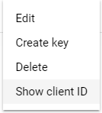
If the Show client ID button is an option available to you: select Show Client ID...

Slide 57
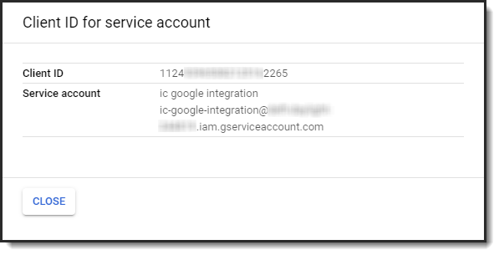
If the Show client ID button is an option available to you: select Show Client ID...
…A slide-out menu will appear. Copy the resulting Client ID.
Copy this value to the clipboard.
The final step is to authorize this value for use over at admin.google.com.
Since you see this Show client ID dropdown option, skip the next four slides and resume on the step in which you navigate to admin.google.com in a new tab.

Slide 58
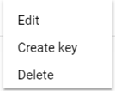
However, if Show client ID does not display in the dropdown: instead, select Edit.

Slide 60
Ensure this checkbox is checked.

Slide 61
1
Copy this value to your clipboard.
The final step is to authorize this value for use over at admin.google.com.
2
Select Save, then open a new browser tab.

Slide 62
Regardless of whether you copied the Client ID value to your clipboard via the “Show client ID” button or the “Edit” process, resume following the steps here:
In a new tab, navigate to admin.google.com.
You must remain logged into your Google Apps Super Administrator account.
Select Security.

Slide 63
Scroll down.

Slide 66
1
2
3
Ensure there are no typos or spaces before or after either of these values, then select Authorize.
Paste the service account Client ID copied previously from the Google Dev Console into the Client Name field.
In the event you need to review where that value was copied from, click here. (Slideshow must be in presenter mode to utilize this hyperlink: Shift+F5)
Input the following value into the One or More API Scopes field:
https://www.googleapis.com/auth/drive

Slide 67
2
Navigate to Infinite Campus.
1
Verify the values you just entered now display in the list of authorized API clients. Do not click Remove.

Slide 68
Enter the name of your Google Apps for Education domain here. This corresponds with the domain of your Google Apps users’ accounts, such as johnjohnson@schooldistrict.org
If you’re at all unsure of what to enter here, you can confirm your domains within the Google Admin Console.
For example…

Slide 69
If you’re at all unsure of what to enter here, you can confirm your domains within the Google Admin Console.
For example…

Slide 71
The values in this Domain area that you want to integrate with are what Infinite Campus needs.
The domains need to be input into Infinite Campus.

Slide 72
Your district may have multiple domains, as in this example. In that case, supply Infinite Campus will all the domains your district wishes to integrate with.

Slide 73
If you have multiple domains established within your Google Admin console, you can add additional domains by selecting Use Multiple Domains.
Note that all domains must be established within the same Google Admin account, as shown on the prior screen.
(If you only have one domain established, you may skip this step.)

Slide 74
You can select Add to add each manually, or select Automatic Fill from Google to auto-fill the values directly from your Google Admin Console.

Slide 76
Save to complete the setup.

Slide 77
You can verify you’ve configured the Google Dev Console and Google Admin console correctly with the Validate button.

Slide 82
Select any file from your Google Drive account. This validation process will not actually upload the file you select to Infinite Campus. It simply performs a dry run of the process to ensure your configuration was completed correctly.

Slide 84
Google Dev Console Setup Guide
If you’ve followed these steps exactly, your Google Dev Console project setup is complete!
Final steps:
Configure which schools can utilize the integration on the Preferences tab.
Ensure teachers have been granted the Campus Instruction > Google Drive tool right to access this integration.
Additional guidance can be found in Campus Community’s Google Drive article.
Training resources for your teachers:
An overview of the Google Drive integration functionality and workflow is available in Campus Community in article and video form.
Disclaimer: Policies, practices and individual tool right may vary depending on district or position.

