Slide 1
Update on HBA’s Vision and Strategic Plan
Overview Presentation
Q2 2022
Notes:
Good morning, good afternoon or good evening, everyone and thank you for joining us…
After the 2021 annual business meeting, we received feedback from tenured volunteer leaders about HBA’s vision and strategic plan. We recognized there was an opportunity to provide background and context, and engage with you – that’s the objective of today’s presentation.

Slide 2
Today’s Session
Agenda
HBA‘s Mission, Vision, & Lexicon
Strategic Plan 2022-2024
Your Feedback
Next Steps
Notes:
As you see in the agenda, this presentation walks through HBA's core purpose, mission, vision—making note of our updated lexicon—as well as review the 3-year strategic plan for the organization through 2024 .
We’re taking this opportunity to explain the evolution of the strategic plan, describe what’s coming and receive your feedback. Given you are HBA ambassadors, and partners of our Global Board of Directors, it's important to us that you feel informed and empowered to help spread the word.
It’s also important to note upfront that we’re not fundamentally changing our mission or strategy but improving the way that we work together with bigger and bolder objectives that enable us to expand globally, and help advance women, further, faster.
Let’s get started.

Slide 3
HBA’s Mission and Vision
Notes:
Before diving into the 3-year Strategic Plan, let’s set the foundation with two key elements that are the bedrock of our strategy for the future—HBA's mission and vision.
While our core purpose (the reason we exist) AND our mission (our business goals) are NOT changing, our lexicon, our wording, and our messaging are evolving.
You know the old adage…a picture is worth a thousand words…so let’s SEE how our lexicon is evolving…..
[PLAY VIDEO]

Slide 4
Mission and Vision
MISSION:
The Healthcare Businesswomen’s Association is a global nonprofit organization comprised of individuals and organizations in healthcare committed to:
Achieving gender parity in leadership positions
Providing equitable practices that enable organizations to realize the full potential of women
Facilitating career and business connections to accelerate advancement
VISION:
The Healthcare Businesswomen’s Association is the global leader in gender equity, advancing women into positions of influence and decision-making to improve health equity and outcomes.
Notes:
This evolution is the result of several factors:
Our 2019-2020 relevancy study revealed that some of the lexicon terms we’ve been using for decades are no longer in sync with more common and familiar words.
Our Advisory Board, Global Board and many in our global community – including our corporate partners - agree it’s time to evolve our lexicon to ensure greater relevancy and timeliness.
These changes will help HBA’s messaging more effectively align with the global marketplace around us.
It also became apparent that it was time to establish and adopt a Vision. For the Future. As a North Star. As an aspirational state for all women in our workplace. Across the globe.
And we believe…through research, data collection, and our collective experiences that:
By elevating women into positions of key decision-making in healthcare, we have a much better opportunity to influence health equity, which ultimately will lead to better health outcomes—a shared goal of our industry.
Our Vision is our bold aspiration of where we want to go. Our Mission and Strategy will help get us there.

Slide 5
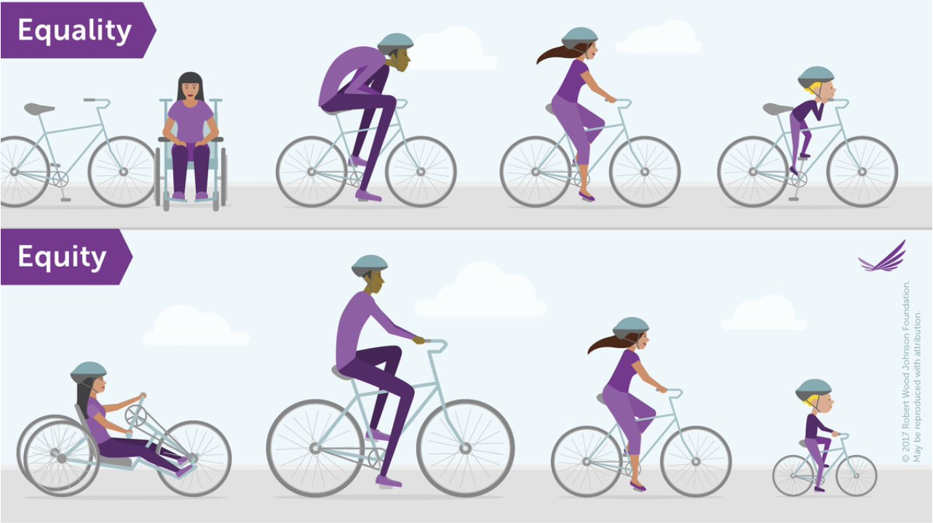
Notes:
OK, let’s take a minute to explore the differences within the concepts that you just saw in the video and within our Mission and Vision.
What is the difference between equality and equity and why did we choose these terms?
Here you can see a visual representation of the concepts behind each word. We were very intentional to look at equity, because we need to change the system. Equity is about providing the appropriate resources to each and everyone, according to their individual needs.

Slide 6
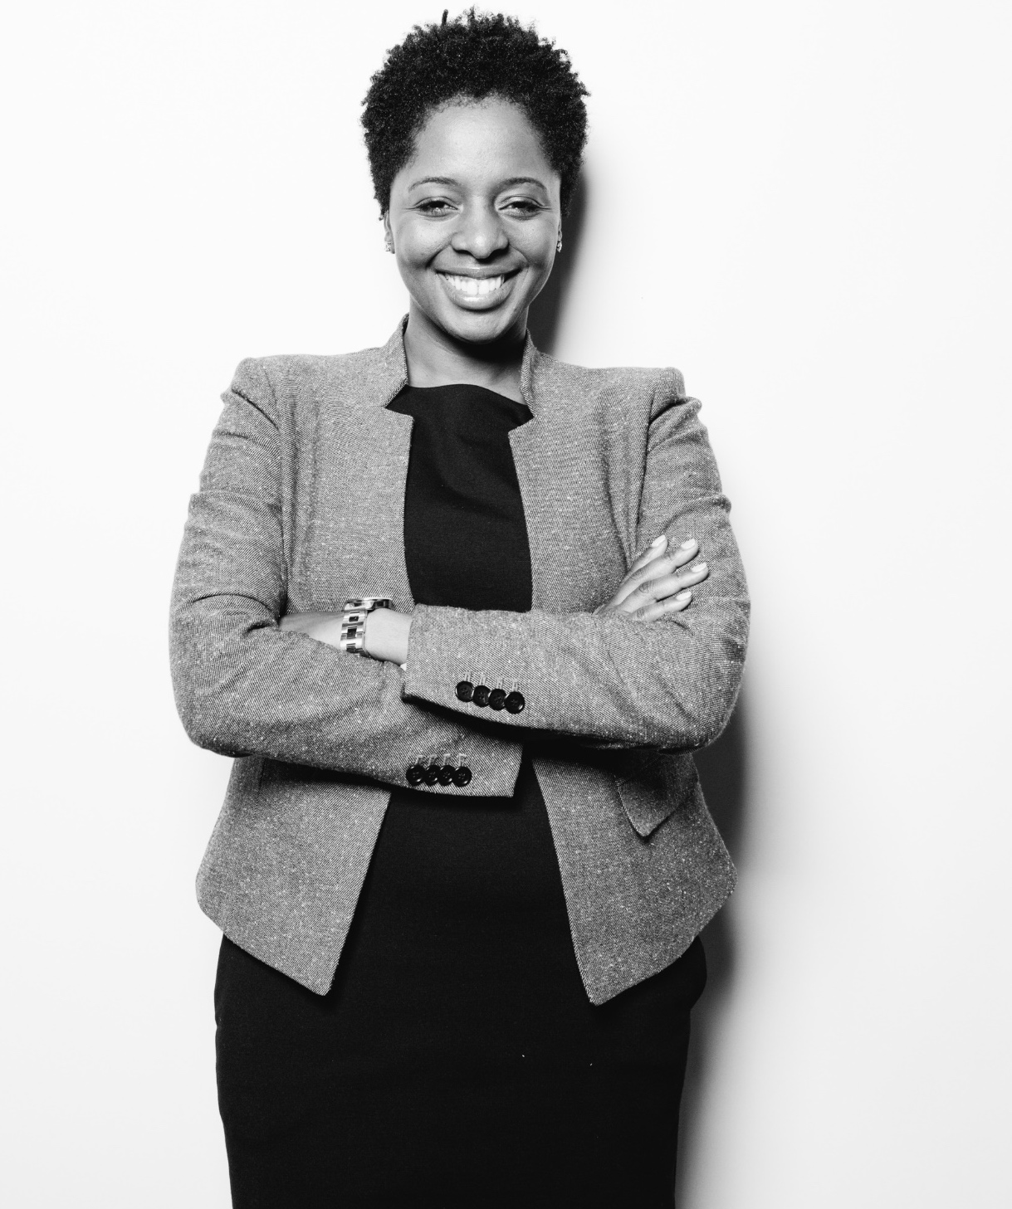
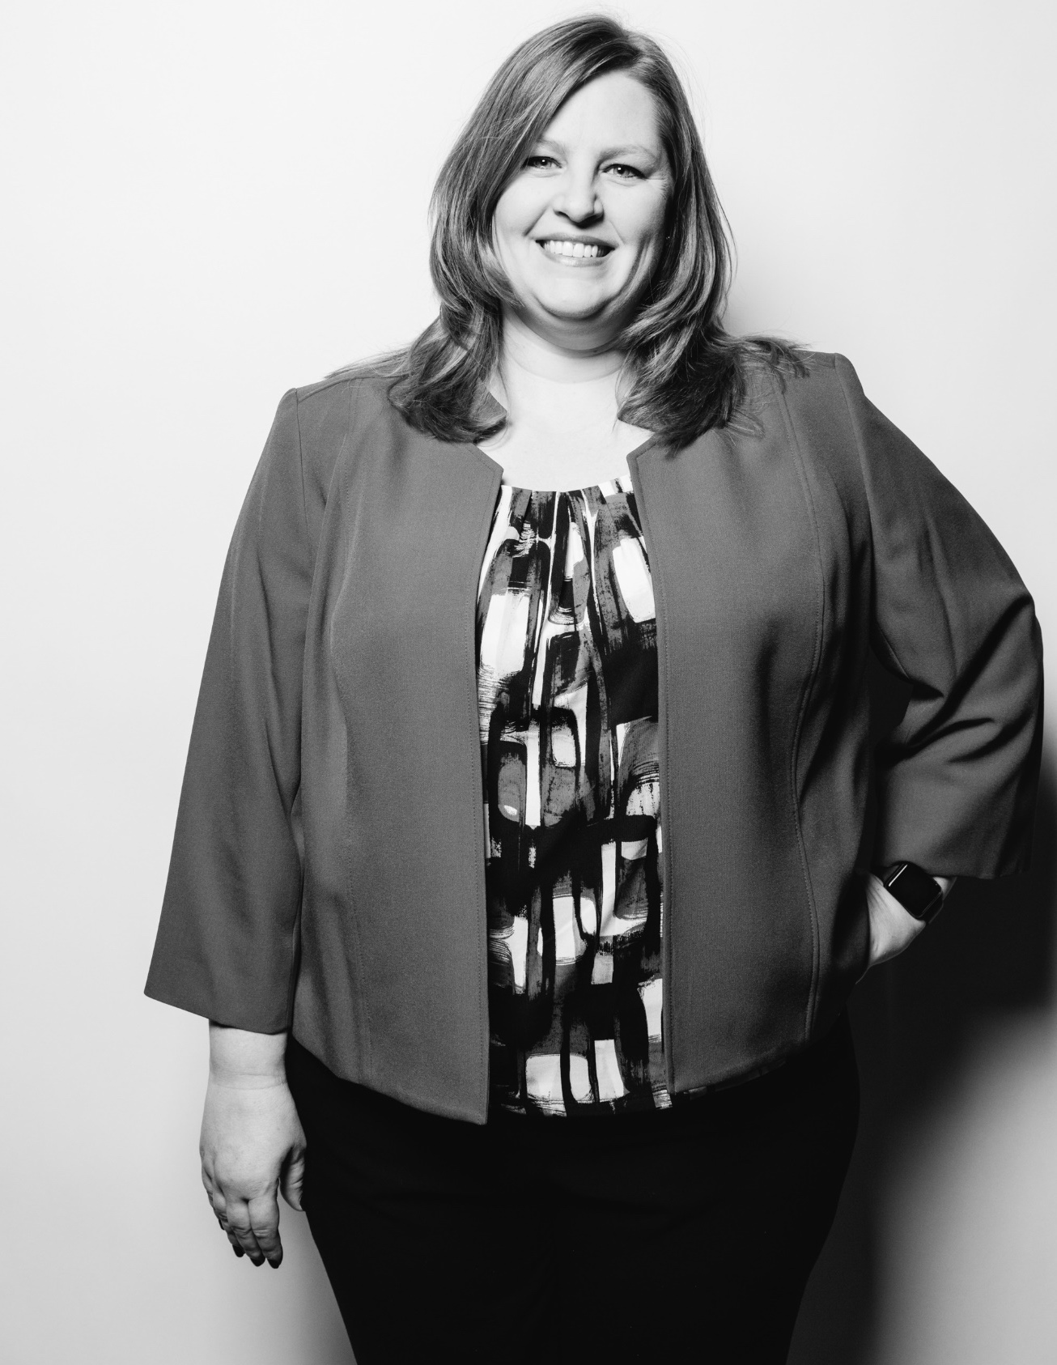
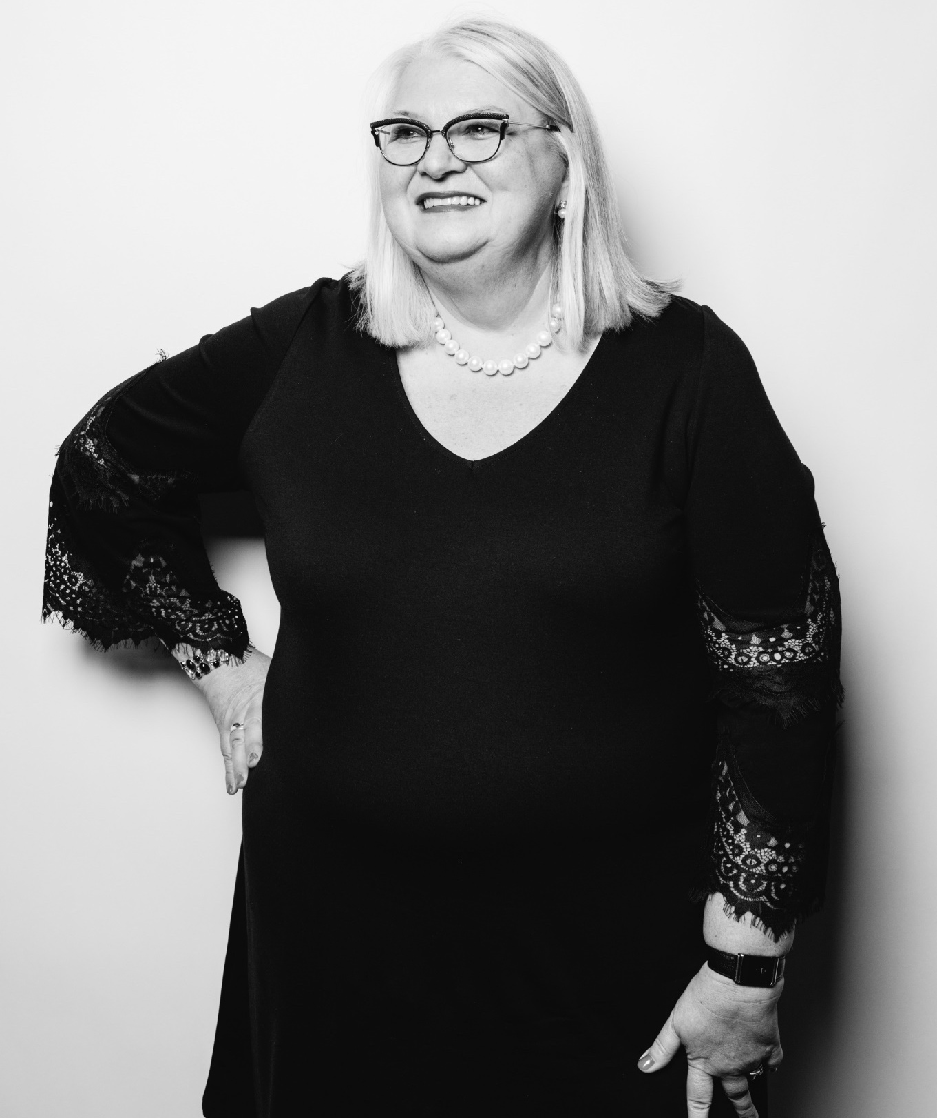
Strategic Priority
CUSTOMER/ CORPORATE PARTNER
MEMBER/ VOLUNTEER
ADVOCATE/ALLY
6
Notes:
Now, let’s talk about our strategic plan:
We’ve evolved it to focus on priorities within 3 key stakeholder groups, in which we mapped the 4 levers (customers, relevancy, advocacy, infrastructure) that some of you may have remembered from our previous strategy.
This puts the emphasis on meeting the needs of these stakeholders and it assumes that the infrastructure and relevancy levers support meeting those needs
We intend to focus on the three groups depicted on this slide equally as they are our key stakeholders

Slide 7
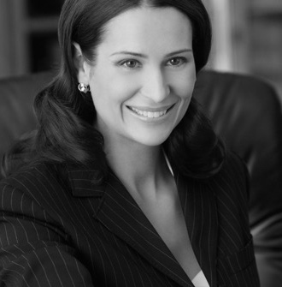
Strategy
Partner with leading corporations to advance Gender Equity by:
Providing expertise, thought-leadership and global resources for systemic change that elevates women to positions of influence & decision making
Expanding collaborative and publishing collective proprietary data and best practices of industry-leading healthcare companies
Providing leadership development experiences through capabilities development, volunteerism and networking
Customer/Corporate Partner
Expand membership and strengthen engagement by:
Recruiting and cultivating a global, connected, and diverse community founded on equity and inclusion
Developing new programming that advances SVPs/VPs to C-suite and Executive Teams
Creating a personalized, digital membership experience and leadership opportunities through volunteering
Member/ Volunteer
Advocate for systems changes to accelerate change globally by:
Activating Male Allies to increase sponsorship & overcome barriers
Establishing industry-leading best practices to advance underrepresented women (e.g., Women of Color)
Increasing global awareness of the business and societal impact of Gender Equity in partnership with organizations around the world who share similar missions
Advocate/Ally
7
Notes:
​Customer/Corporate Partner: includes organizations which sponsor HBA, as well as those that have signed up to be Corporate Partners. 80 percent of HBA’s current membership comes from Corporate Partners and we know that members are often the key to raising awareness and commitment from their organizations. We need to both “change the system” as well as have commitment from individuals to drive our mission, so our strategy here is:
To continue partnering with leading corporations to advance gender equity by collecting data, publishing best practices, and implementing solutions. As an example, we have an excellent basis from the Gender Parity Collaborative and we aim to leverage this initiative, moving forward, so we are the association that companies tap to better understand gender equity best practices.
We can expand both the impact of the HBA and our reach across our global corporate partners by providing expertise, thought leadership, and opportunities to develop women in these groups.
The life force of our organization are our members and, in particular, our passionate and dedicated volunteers. The HBA provides opportunities for advancement by networking, skill development, and developing leadership skills through influence:
Our strategy is to strengthen the engagement of the growing 12,000+ members across the globe.
We know that members engage with the HBA:
1. because they share a common passion around the HBA mission;
2. to grow their networks, and
3. career advancement/leadership development.
In addition to the offerings you’re familiar with, we also want to introduce new, senior-level programming and enhanced digital experiences.
One of our bold additions is under Advocacy/Allyship:
We recognize that there is an opportunity to align with and mobilize people and organizations who support the mission of the HBA – to raise awareness, expand advocacy and accelerate our impact.
In particular, we want to engage male allies as advocates, implement best practices to advance under-represented groups, and develop our thought leadership globally.
We have already started to be more active in this area with several events that have focused on allyship.
All of these three priority areas are of course interlinked. Let me share some examples:
We already have many allies within our corporate partners
Several corporate partners join the HBA because a member became a volunteer who convinced their employer to become a corporate partner
Corporate partners are an important platform for us to increase our individual membership

Slide 8
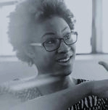
Member/Volunteer Value Proposition
Member | Unique Needs | HBA Differentiated Value
 | Business acumen Sponsorship External Board role | Male ally insights​; self-advocate for sponsorship​ Connection to external board roles​ Pods connecting women to women
 | Senior level capabilities Executive presence Sponsorship | Capabilities development Network for executive presence​ Community convening, peer-peer support
 | Finding their voice Leader exposure Mentor | Leadership development (coaching and education) Access to corporate leaders (HBA events)​ Mentor program
 | Work flexibility / culture Career path progression Global experience | Peer community​; ‘fun” environment Functional skills building Global projects and experience​
Executive
Level
Senior Level
Mid- level
Entry level
Notes:
Let’s now focus on the member/volunteer value:
As you see, we want to customize our HBA offerings to address Member needs at all levels.
In particular, volunteer leaders of the HBA have a wonderful opportunity to learn and practice leadership by influence, which is so important in today’s dynamic organizations so let’s talk about that next.

Slide 9
Member Development Through Volunteering
Member | HBA Volunteering | Leadership Development
 | Serve on HBA Board Serve on the HBA Advisory Board Co-lead HBA Strategic Initiative (e.g. Digital Strategy, Org. Redesign, etc.) | Demonstrate experience of Board role Cross company industry expertise Prepare to lead corporate initiative
 | Regional Council Executive Committee Global committee chair HBA company lead HBA Sponsor | Preparation for corporate regional leader role Gain global influential leadership Become leader in DEI strategy
 | Chapter executive committee Regional council member Mentor in Mentor – Mentee Program | Team leadership development Functional expertise and collaboration Management skills
 | Chapter director at large Chapter Committee member Event & Project contributor | Communication effectiveness Project management Critical thinking, problem solving
Executive Level
Senior Level
Mid- level
Entry
Level
Notes:
A key subset of our membership is you, our volunteers! We have more than 800 volunteer leaders plus countless micro-volunteers who are critical to achieving our mission – and we want to ensure that your passion and dedication also result in advancement and recognition for you.
We have been working to improve the volunteer experience and leadership development that our HBA volunteers get from their contributions with projects like our role assessment, as well as awards for enhanced visibility, which can be celebrated both within your organization and through online social media.
We are in the process of developing further support for volunteers including:
A Learning management system (LMS) to create consistent and robust volunteer training and development.
Mapping the volunteer journey so that volunteers can visualize their own development journey and enhance their overall experience.
THANK YOU for your time, commitment, and contributions to the HBA!

Slide 10
Thank you
Questions? Feedback?
Feel free to share comments via boardstratplanning@hbanet.org

Slide 11
So Let’s Be Bold!
Our time is NOW to be the catalyst that breaks down the systemic barriers to achieving gender equity.
If not now...
When?
If not us…
Then Who?
Notes:
In closing, we'll leave you with these thoughts for consideration.
What ideas do you have as a volunteer to bring our strategy to life?​
Be Bold – join the HBA on our transformational journey toward achieving our vision.​ Together, we are a united force for change!

