Slide 1

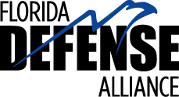
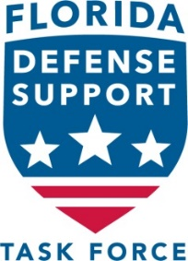
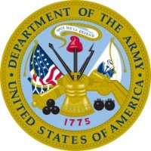

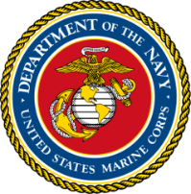



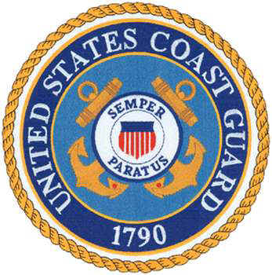
Florida’s Support of
Military and Defense
22 September 2022

Slide 2
Florida’s Military Presence
20+ major military installations
Defense contributions to state economy:
  $96.6 Billion annual impact from military and defense business presence
  860,2221 direct and indirect jobs
  State’s largest and most resilient economic driver
Optimum training environment; extensive ranges
Notes:
In our most recent update to our 2020 Florida Factbook – regarding the economic impact to Florida of our military and defense, the results are remarkable. The military and defense contribution at the end of 2018 was $95B, and we suspect even more now. It’s in the top three drivers of our economy and found relatively stable in the past year’s effect of COVID-19.

Slide 3
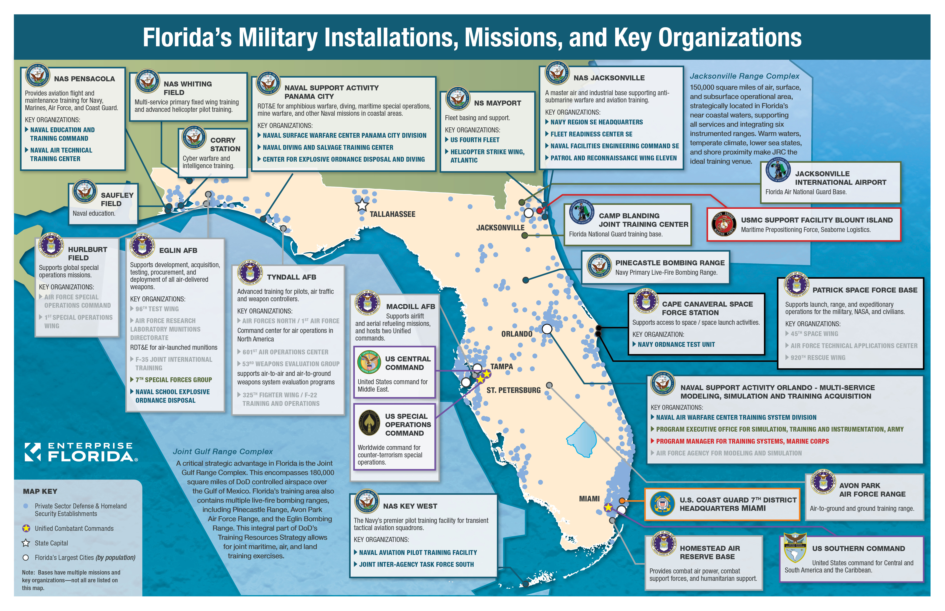
Major Military Bases In Florida
Notes:
We all know that in Florida, it’s hard to get too far from a military installation no matter where you stand in our state. Our network of installations covers all six military services and components. Specifically exciting was the renaming of Patrick Space Force Base and Cape Canaveral Space Force Station just last month.
We can’t forget to highlight the expansive training and range space Florida provides the military in our Joint Gulf Range Complex and the Jacksonville Range Complex. These national security assets are truly unequalled and critical to the development and training of future warfighting capabilities such as hypersonic missiles and the space force.

Slide 4










Who’s Who: Veterans, National Guard, and Military and Defense
Veterans National Guard Military/Defense
Total Veterans Army & Air 21 Major
*all components, retirees National Guard Military Bases
(1.5 million) (13,000+) (AD 65,000+)
(Reserve 24,500+)
Gov Base CDR Mtg
4
Notes:
With the 2nd largest military retiree population in the U.S., the 3rd largest veteran population, the 4th highest number of defense contracts, and the 5th largest population of DOD personnel – military support remains in our Florida DNA.
As you are very aware, Florida’s state organizations correspond to the federal agencies to work on behalf of our Florida military, families and veterans. Our team at EFI works shoulder to shoulder with the other agencies who support our military, veterans and national guard. The statutory focus of our team and the two organizations we administer is the military installations, missions, servicemembers and their families. We work to protect and enhance Florida’s military installations and missions assigned, the defense industry and the surrounding communities.

Slide 5
The Florida Model -
Support of Military and Defense
Florida Defense Alliance (FDA)
Florida Defense Support Task Force (FDSTF)
Defense Grant Programs
Governor’s Base Commanders Meetings
Notes:
The Florida Model for supporting our military installations, missions and people continues to be unique. We will talk more about the two statutory organizations in a moment. So, here I’ll highlight the two bottom facets of our model.
The statutory defense grants program in (F.S. 288.980) administers ~$2M annually to defense communities for infrastructure and reinvestment. These are currently managed by DEO. The Task Force provides an additional $1-2M in grants each year. Our team works with communities to match or optimize state funding with DOD funds such as DCIP and REPI, and FEMA grants such as BRIC.
The Florida Base Commanders Meeting is a forum for installations to raise state centric issues. The Governor focuses on areas he can affect by his staff, agency heads, relationships and supporting partners in the state.

Slide 6
Florida Defense Alliance
Authority & Purpose (from F.S. 288.980):
The FDA is the organization to ensure that Florida, its resident military bases and missions, and its military host communities are in competitive positions as the United States continues its defense realignment, and base structure adjustments, as well as efforts with the defense industrial base. The defense alliance shall serve as an overall advisory body for defense-related activities of Enterprise Florida, Inc.
Mission:
The FDA identifies and coordinates the plans, engagement and public awareness necessary to provide statewide leadership and support to defense related people, installations and missions throughout Florida.
Notes:
Created in 1998
This is the grass roots local and regional defense community network that serves as an advisory body for EFI and the Task Force.
the FDA is a grass roots, all volunteer consortium of organizations and people like Daniel who see regional issues and opportunities they raise. The Florida Defense Support Task force responds to items raised by developing state’ solutions through legislation, policies and programs.

Slide 7
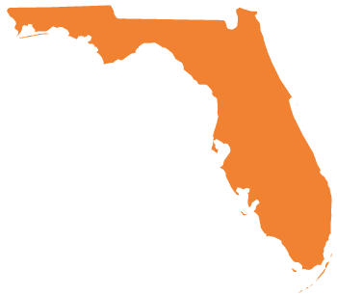
Members of the Florida Defense
Alliance Executive Board
Terry McCaffrey
Enterprise Florida – M&D
EX DIR - FDA
Paul Hirsch
Space Coast Economic
Development Council
Chris Middleton, West Florida Defense Alliance
Mission Sustainment
Working Group Lead
Kellie Jo Kilberg,
Kilberg & Assoc
Chair
Jennifer Codo-Salisbury
Central Florida Regional Planning Council
Kathleen Nestor
Tampa Bay Defense Alliance
Family Support Working
Group Lead
Rick Miller,
South Florida Defense Alliance
Vice Chair
Jonathan Borgert
South Dade Chamber of Commerce
Military Affairs Committee
Notes:
Here is the current location and position of our leaders and executive board members. You can see this example of the wide range of organizations that come together in support of our installations and servicemembers.

Slide 8
Defense Alliances / Partners
Santa Rosa County
Jacksonville Military Affairs
and Veterans Department
Clay County Economic
Development Corporation
West Florida Defense Alliance / Great Pensacola Chamber
Bay County
Defense Alliance
Economic Development
Commission of Florida’s
Space Coast
Defense Support Initiative /
Economic Development Council
of Okaloosa County
Orange County Research
and Development Authority
Tampa Bay Defense
Alliance / Pinellas County
Central Florida Regional Planning Council
Other Partners
Building Healthy Military Communities
National Center for Simulation
Florida High Tech Corridor
National Security Innovation Network (DoD)
Association of Defense Communities (ADC)
Highlands County Economic
Development Commission
and Polk County
South Florida Defense Alliance / Monroe County
Miami-Dade Defense Alliance / Beacon Council
Notes:
Here you can see the current location of our local defense alliances / EDCs and other partners

Slide 9
Florida Defense Support Task Force
Created in 2011 – F.S. 288.987, Replaced the Florida Council on Military Bases and Mission Support. Sunshine exemption – F.S. 288.985.
Make recommendations to preserve, protect and enhance Florida’s military missions and installations
Increase the defense industry in Florida
Strengthen state support for education, health care, employment, and family programs for service members, families, retirees and businesses that bring military-related jobs to the state
Notes:
Created in 2011, meets monthly in different installation locations
1st bullet – Main focus for TF in 2021
3rd Bullet – This now has a direct impact on 1st bullet because in 2020 Dept of Defense began scoring military family QOL in communities around bases as a decision-making criteria for basing decisions.

Slide 10
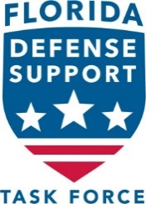
Florida Defense Support
Task Force Members
Brig Gen, USAF (ret.) Chip Diehl – Chair – House
Mr. Tom Neubauer – Vice Chair – Senate
Rep Thad Altman – House
Col, USAF (ret.) Gregg “Mr. Bill” Billman – Governor
The Honorable Thomas G. Bowman – Senate
RADM, USN (ret.) Stan Bozin – Governor
Rep Wyman Duggan – House
Maj Gen, USAF James O. Eifert, TAG – Governor’s Representative
Maj Gen, USAF (ret.) Richard “Beef” Haddad – Senate
CAPT, USN (ret.) Keith Hoskins – Governor
Ms. Kay Rasmussen – House
S. Reeves Valentine – Governor
Sen Tom Wright – Senate
Notes:
Chair rotates between Senate and House annually on July 1st
Notes:
This is our current membership. Legislators serve on the Task Force until the end of their term in office in the legislature, other members serve a four-year term.

Slide 11
Florida Defense Support
Task Force Members
CAPT Keith Hoskins, USN (R)
Col Terry McCaffrey, USAF (R)
EX DIR - FDSTF
Representative Wyman Duggan
RADM Stanley Bozin, USN (R)
Ms. Kay Rasmussen
Major General James Eifert,
The Adjutant General, FL
Governor’s Representative
Mr. Tom Neubauer
Senator Tom Wright
Maj Gen Richard Haddad, USAF (R)
Representative Thad Altman
Brig Gen Chip Diehl, USAF (R)
The Honorable Thomas G. Bowman
S. Reeve Valentine, Lockheed Martin
Col Gregg “Mr. Bill” Billman, USAF (R)
Notes:
Here is the current geographic distribution of our Task Force members. As you can see, it would be helpful to add a member(s) familiar with, and who can represent the issues of, the Central Florida and South Florida military communities.

Slide 12
2022 Florida Defense Industry
Economic Impact Analysis

Slide 13

FY21-22 Military Benefits Guide

Slide 14
Difference: FDA and Task Force
Florida Defense Alliance
Volunteer representatives from local defense communities
Support bases and solve base issues with the community
Bring the perspective of local communities together to advise state level representatives of the community view
Share and advise best practices and identify common problems where state-level action would be appropriate
Florida Defense Support Task Force
State-level appointees with military, legislative, and business experience; working on state level issues; provide grants
Promote FL bases at national level; address base issues; support state level military friendly legislation
Maintain statewide perspective on all military issues
Notes:
The big take away from this slide is that the FDA is our grass roots, volunteer organization. Since these are volunteers, we can have as many as we can find, but they can come and go as their time and other commitments permit. The FDA is really our eyes and ears on the ground and the FDA is invaluable for identifying issues and bringing them to the attention of FDSTF as well as for spreading the word about the value of the military in their local communities.
While the FDA has that local perspective, the FDSTF are state-level appointees who keep a state-level perspective. The FDA’s volunteers work closely with the FDSTF’s appointees to get everything done.

Slide 15
Defense Grant Programs
Military Base Protection Program
Secures non-conservation lands to buffer Military Installations from incompatible development
DEO collects, EFI prioritizes, Task Force approves tiered list
Unfunded since 2014
Defense Reinvestment Grant
Focuses on supporting defense-dependent communities’ programs that assist military installations / enhance robust capabilities
Currently funded at $800K – Administered by DEO
Defense Infrastructure Grants
Focuses on local (off base) infrastructure programs deemed to have positive impact on Military installation
Currently funded at $1.6M – Administered by DEO
Florida Defense Support Task Force Grant Program
Focuses on encroachment and defense support projects / studies
Currently funded at $2M – Administered by EFI
Notes:
There are four programs in the state of Florida that really show the commitment of the statue of Florida to our military installations and the communities that support them across the state.

Slide 16
Example FY21-22 Defense Grants
Defense Reinvestment Grant
$70,000 – promote, protect, and develop initiatives in the Tampa Bay area to grow defense simulation industry and employment
$90,000 – continue efforts to bring shipbuilding and maintenance programs to Naval Station Mayport and gain nuclear aircraft carrier
Defense Infrastructure Grants
$250,000 – provide needed repairs to the Tyndall Air Force Base and Mexico Beach water supply from Hurricane Michael
$300,000 – continue easement purchases around Naval Air Station Whiting Field to provide critical buffer zones
Defense Support Task Force (Grants & Contracts)
$500,000 – matches $1,500,000 in Federal REPI funding for restrictive easements to buffer Naval Station Mayport
$189,950 – FL Range Modeling / Defense Economic Impact Study
Notes:
Here are a few examples to illustrate the types of projects that are completed using these grant programs.

Slide 17
M&D Enduring Priorities
Prevent encroachment / incompatible development that may limit military operations
Gulf Range Protection and Enhancement
Influence Pentagon decisions on missions and basing
Enhancing military family quality of life
  Spousal employment
  Schools
Installation resiliency
Notes:
Preventing encroachment remains job one – engaging at the local community planning level and protecting bases from mission loss.
Last, since basing decisions are mostly formed by the services in the Pentagon then go to Capitol Hill and/or the White House for approval; our teams consistently need insight from and influence within DOD to lay the foundation for our state work to protect our installations and secure current and new missions.
The gulf range anchors multiple installations to Florida. Without it, the missions could be done in other states; it is not only a national asset, its Florida’s asset and we need to protect it and expand its capabilities to support future weapons test and training capabilities.
These two family QOL issues have become larger considerations for the military services now because they are driving service member decisions to stay in military or leave the military is formally evaluating this as part of the criteria in making basing decisions.
“installation resiliency” means energy, communications, cyber, transportation resiliency, anything that can potentially interfere with accomplishing the installation mission.

Slide 18
M&D Focus for 2022
Gain Space Force Missions / Space National Guard in Florida
Gulf of Mexico Energy Security Act (GOMESA) Extension
Increase Florida’s education rating on USAF scorecard
Support MacDill AFB KC-135 to KC-46 Transition
Ensure Tyndall rebuild / F-35 bed down remains on track
Determine / increase installation resiliency
Increase defense related industry / contracts in Florida
Notes:
Our 2022 focus reflect our enduring priorities.
We’ve talked about our support for securing Space Force elements….
We will push for congress to extend the GOMESA law that expires in June 2022 – the oil exploration and drilling moratorium is currently restricted by executive order by the Trump administration and upheld by the Biden administration, but that legal mandate needs to be extended to ensure we retain this national asset and to ensure USAF enhancements can ensure funding
We are working with the FDA work group, the FDSTF, and other states in the Association of Defense Communities to understand the rating system, potentially change it, and also increase the education opportunities and quality of education of our military children near our 20 major installations. This I critical as DOD scores quality of life issues highly for basing decisions as well as any future BRAQ criteria, if that was to be considered in the future.
Supporting MacDill and Tyndall as they gain modern aircraft enhances our installation military capabilities and the military necessity. At MacDill, the KC-46 transition will add an estimated $400 million dollars in Military Construction from 2023-2028 and increase of 39 additional jobs. The Tyndall rebuild is a $5 billion investment to create the Base of the Future right here in Bay County. The 3 squadrons of F-35 aircraft will begin arriving in 2023 will bring about 2,200 personnel and about 3,000 family members and increase jobs and economic impact of the base to Bay county for decades
Resiliency is synonyms with mission assurance and the DOD is focusing on it now. Everything from ensuring energy and infrastructure are enhanced and readily available to hardening against negative affects of environmental impacts like floods and hurricanes are important to the installations and the communities that our servicemembers and families live together.
Finally, we are focusing on major weapons acquisition programs all the way down to local support contracts and how Florida can win and support both creating more high-paying jobs for Floridians while at the same time increasing the capability of our military forces that ensure our national security here and across the nation and world.

Slide 19
Questions or Comments?
For future contact:
Terry McCaffrey, EFI VP of Military & Defense Programs, tmccaffrey@enterpriseflorida.com, C: 850-294-8854
Ray Collins, FDSTF Staff, rcollins@enterpriseflorida.com, c: 850-266-1865

