Slide 2
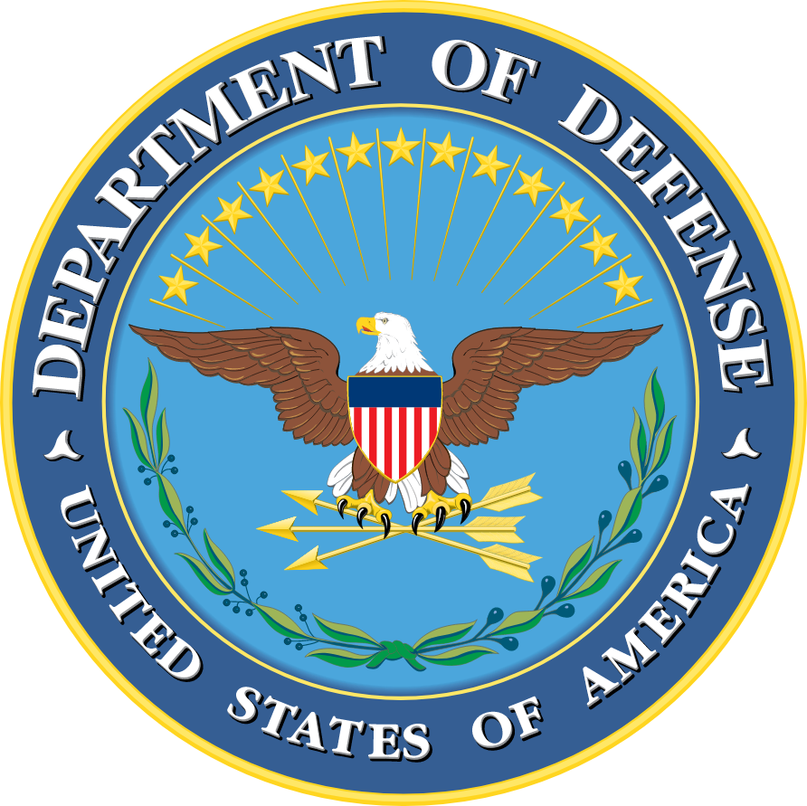
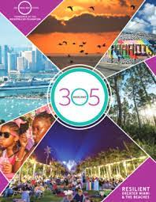
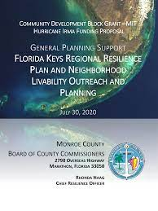
World-Leading Yet Disconnected…

Slide 3
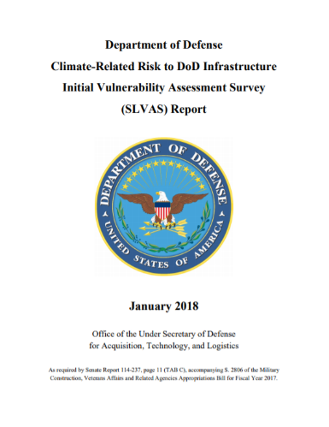
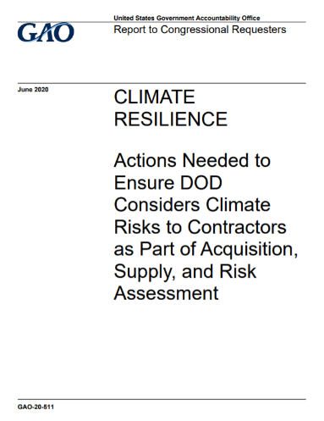
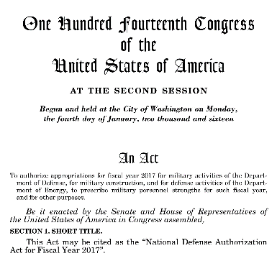
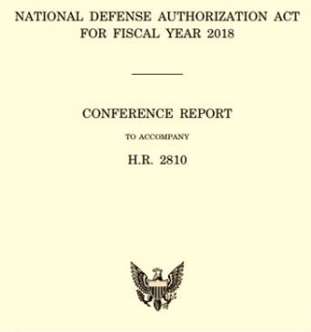
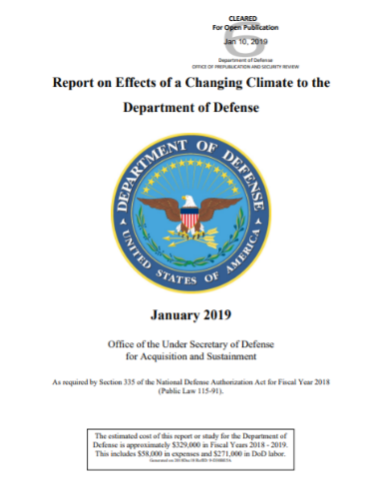
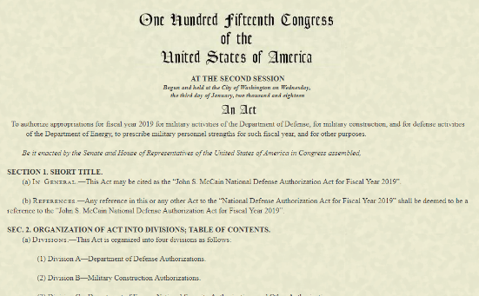
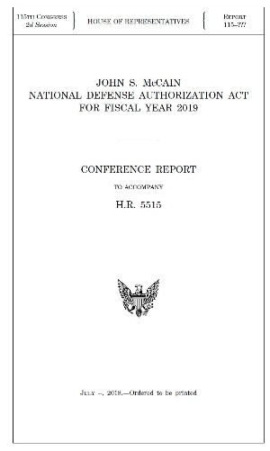
…Because “We” Said So….
Directed to identify Top-10 challenged sites
Resilience formally includes climate changes
Climate change in UFC
Floodplain requirements
Installation Master Plan changes
Directs installation resilience plans
Improved building codes (UFC)
Floodplain / sea-level rise linkage and restrictions
Update climate change adaptation roadmap
Improve installation water management
Perform USCG vulnerability assessment
COCOM installation climate risk assessment
Various new spending authorities to support
Increased funding authorities
National Defense Authorization Act (NDAA)
FY18
FY19
FY20
FY21
FY22
> 50% of DoD installations at-risk
Highlighted multiple environmental risk factors
Florida & South Florida installations perceived at risk
Highlighted benefits of regional collaboration
2018 & 2019 Defense Department Reports

Slide 4
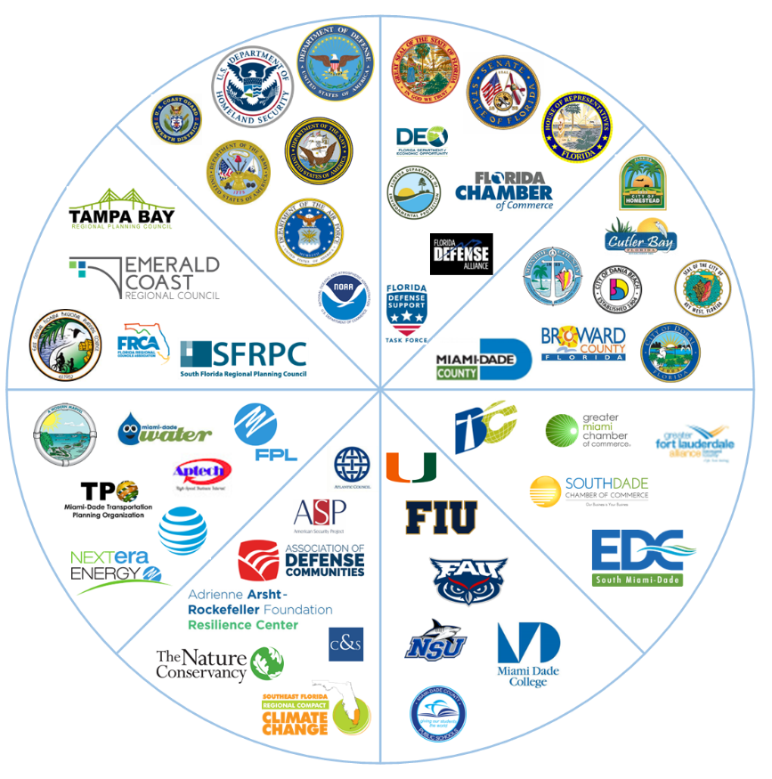
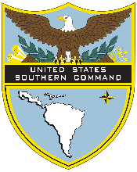
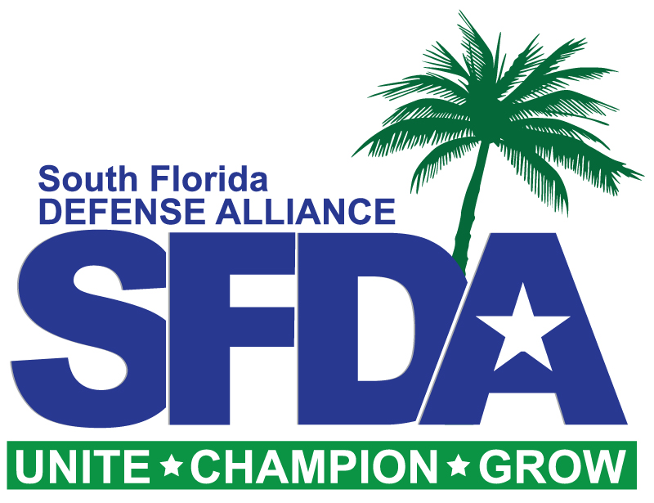
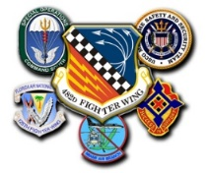
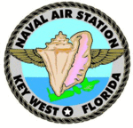
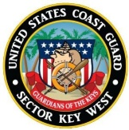
Linking Communities Through Resilience

Slide 5
St. Lucia
MIRR Coverage & Engagement
Installations / Facilities:
USAG-Miami
Homestead ARB
NAS Key West
USCG
Base Miami Beach
Air Station Miami
D7 Headquarters
STA Ft. Pierce
STA Lake Worth
STA Ft. Lauderdale
STA Miami Beach
STA Islamorada
STA Marathon
STA Key West
Richmond Heights
FLANG Armory
NUWC Det AUTEC
NSWC SFOMC
Key Tenant Commands:
SOUTHCOM
MARFORSOUTH
482nd Fighter Wing
SOCSOUTH
125th FW Det
CBP
USCG District 7
USCG Sector Miami
USCG Sector Key West
USCG MSST
JIATF-S
Army Dive School
Other Commands:
(17) USCG Cutters
(3) USCG ANTs
(1) USCG MSD
(1) USCG COE
MIRR Covered Locations

