Slide 1
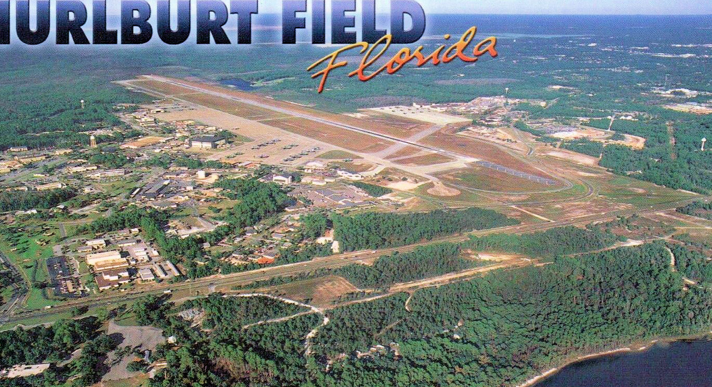
EMERALD COAST MILITARY INSTALLATION RESILIENCE REVIEW

Slide 2
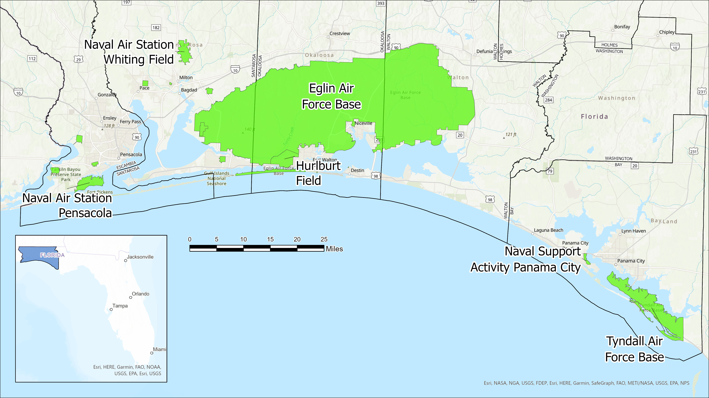

Slide 3
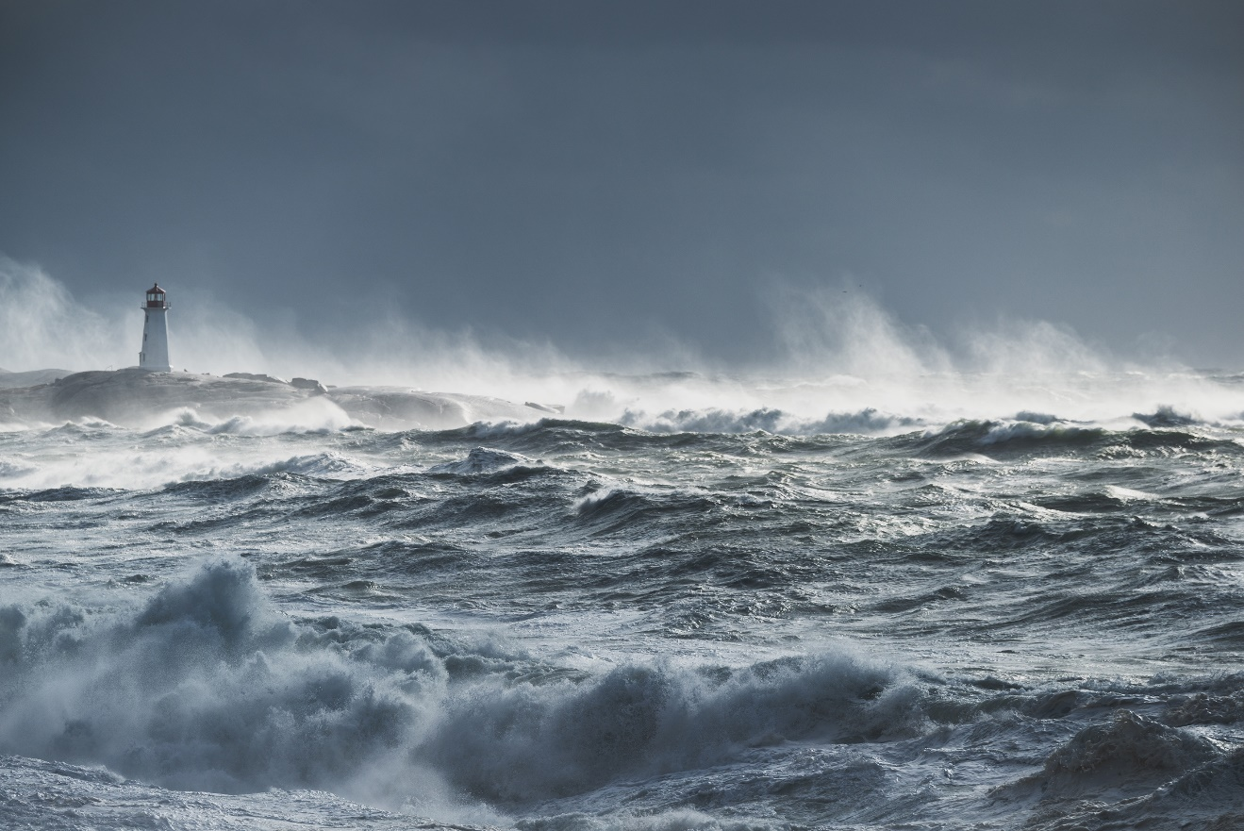
Emerald Coast Military Installation Resilience Review
Assess Threats
Identify, assess, and map natural and man-made hazards and the threat they pose to military installations.
Heavy Rain / Flooding, High Winds, Storm Surge, Wildfire, Flooding, Sea Level Rise, High Temperatures, Land Use Change,
Establish scenarios and time frames to assess.
Identify Vulnerabilities
Prioritize Mitigation
Implementation Plan
Notes:
The objective of the MIRR is to strengthen and preserve military readiness, capabilities and operability by This will be undertaken at the installation level without losing sight of regional threats/risks and solutions.

Slide 4
Emerald Coast Military Installation Resilience Review
Assess Threats
Identify Vulnerabilities
Identify areas where hazards may impact mission readiness with a particular focus on key infrastructure.
Recognize impacts and potential consequences to mission readiness of identified vulnerabilities.
Prioritize Mitigation
Implementation Plan
Notes:
The objective of the MIRR is to strengthen and preserve military readiness, capabilities and operability by This will be undertaken at the installation level without losing sight of regional threats/risks and solutions.

Slide 5
Emerald Coast Military Installation Resilience Review
Assess Threats
Provide a comprehensive strategy with specific implementation actions to address and mitigate risks that may impair the operational utility of military missions or impact available resources.
Identify Vulnerabilities
Prioritize Mitigation
Implementation Plan
Notes:
The objective of the MIRR is to strengthen and preserve military readiness, capabilities and operability by This will be undertaken at the installation level without losing sight of regional threats/risks and solutions.

Slide 6
Emerald Coast Military Installation Resilience Review
Assess Threats
Because the MIRR is particularly focused on projects “outside the fence” the cooperative relationships developed will be key to rapid and effective implementation.
Create a framework for ongoing collaboration among local governments, state and federal agencies, and the military community to support resilience among military installations and surrounding communities.
Identify Vulnerabilities
Prioritize Mitigation
Implementation Plan
Notes:
The objective of the MIRR is to strengthen and preserve military readiness, capabilities and operability by This will be undertaken at the installation level without losing sight of regional threats/risks and solutions.

