Slide 1
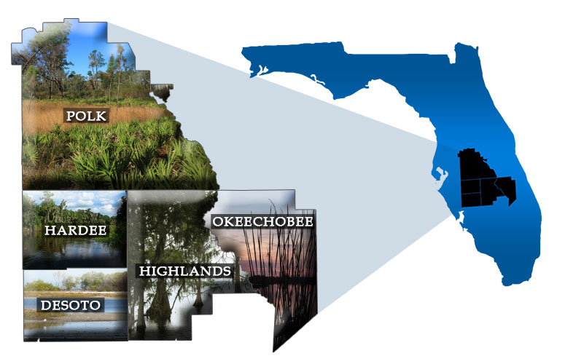
Avon Park Air Force Range
Sentinel Landscape Program
Central Florida Regional Planning Council
Jennifer Codo-Salisbury, AICP
Deputy Director
jcodosalisbury@cfrpc.org

Slide 2
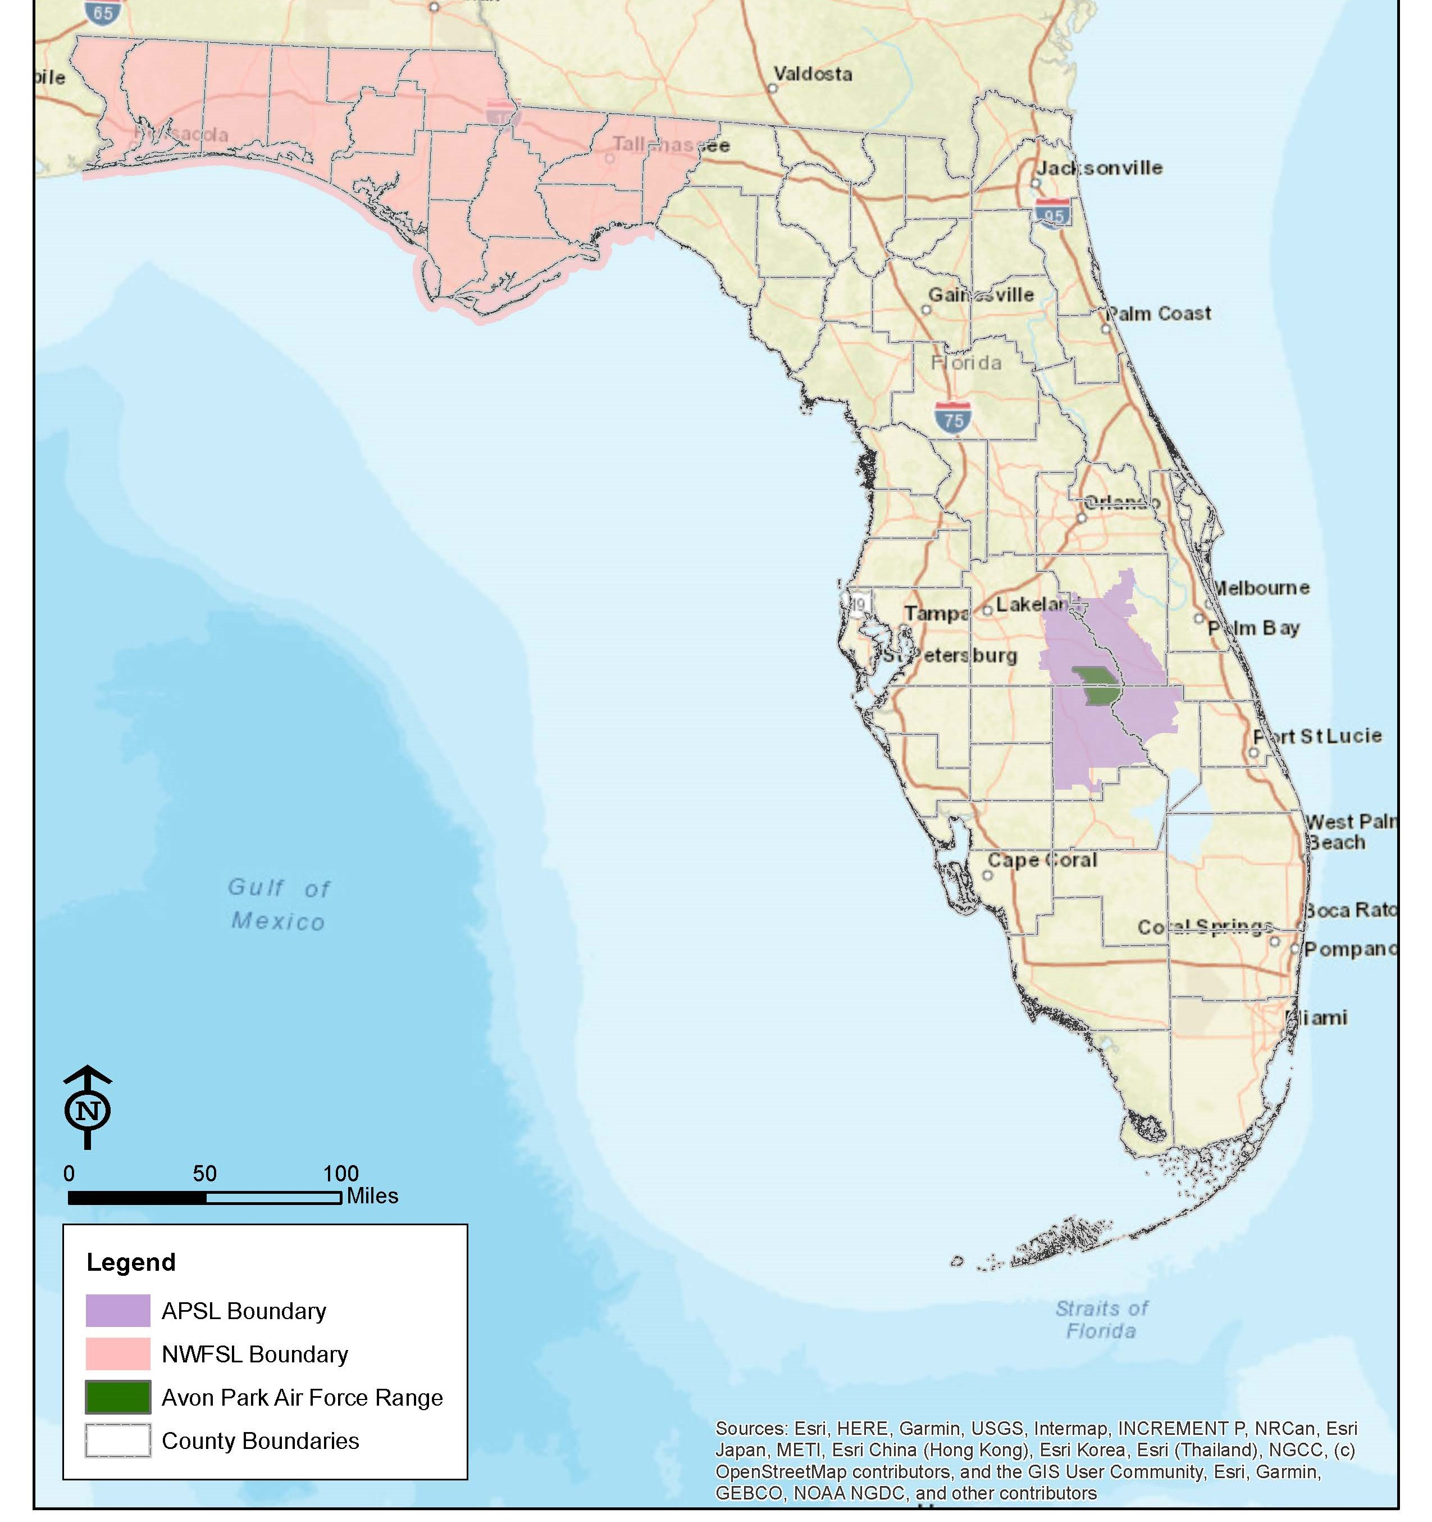
Avon Park Air Force Range Sentinel Landscape
Located in Central Florida
4 Counties
9 Municipalities
1.67 million acres
Avon Park Air Force Range
One of two Landscapes in Florida
Notes:
Chris has suggestions for links to mapping application/layers that SLs could use to show climate impact on the map.
If so, delete the next slide.

Slide 3
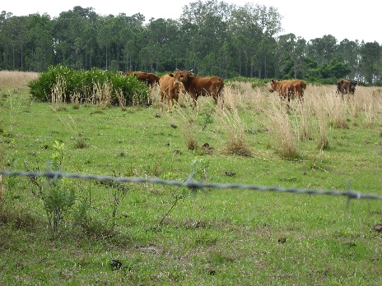
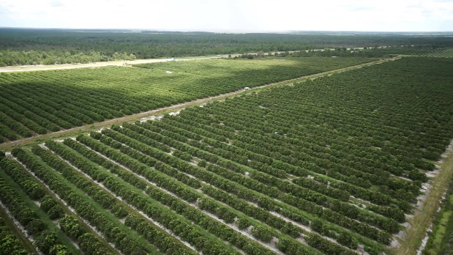
Partnership Efforts
Florida Forest Service’s Rural and Family Lands Protection Program
Natural Resource Conservation Service’s Agricultural Conservation Easement Program
The Nature Conservancy and Conservation Florida
Local Governments (BOCC and Soil and Water Conservation Districts)
US Fish and Wildlife Service
Florida Forever Land Acquisition Program

Slide 4
Environmental Avoidance and Mitigation
Notes:
Environmental Mitigation – How do we meet transportation demands but also protect and preserve the natural environment?
We heard from environmental partners. Their concerns were wildlife crossings and…

Slide 5
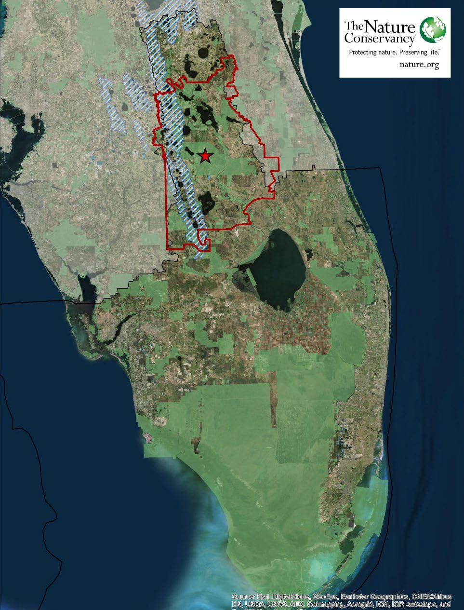
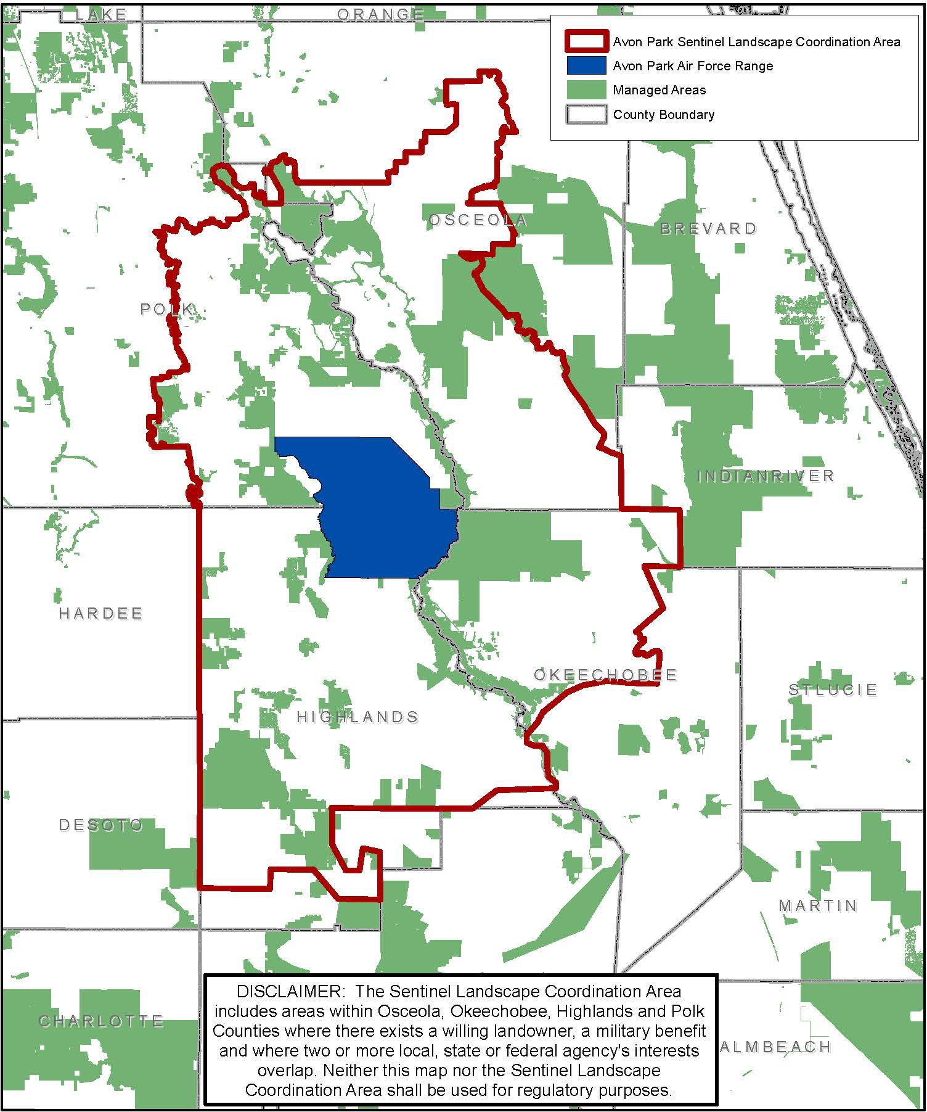
Natural Resources
2

Slide 6
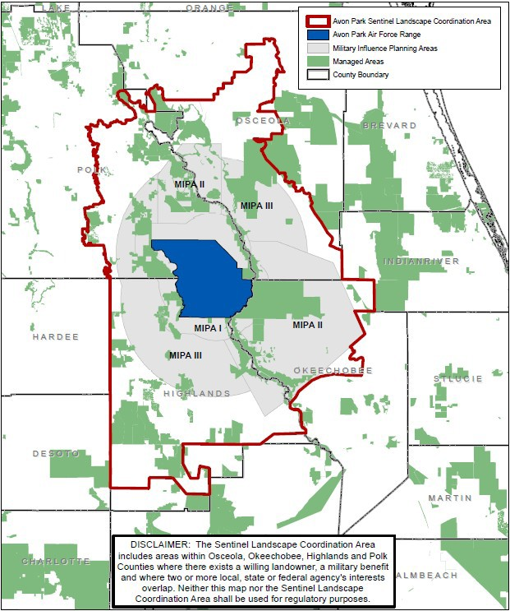
Avon Park Air Force Range
Sentinel Landscape
Coordination Area to help:
Protect Military Readiness
Benefit Working Lands
Provides Conservation Opportunities
Broad partnership – Agencies, NGOs, and Others
Not Regulatory

Slide 7
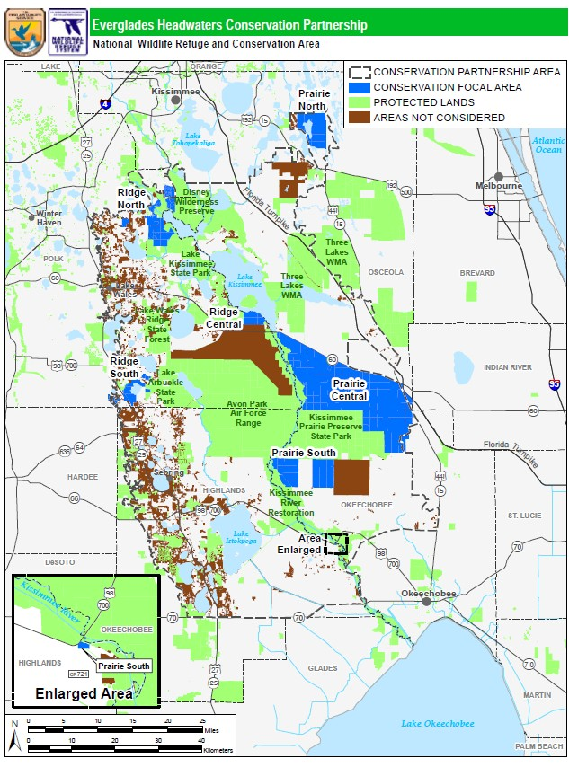
Everglades Headwaters NWR & CA
A partnership approach to conservation
~745,000 acre Conservation Partnership Area
150,000 acre project
Up to 100,000 acre less than fee (conservation easement focus)
Up to 50,000 acres fee
Willing sellers approach

Slide 8
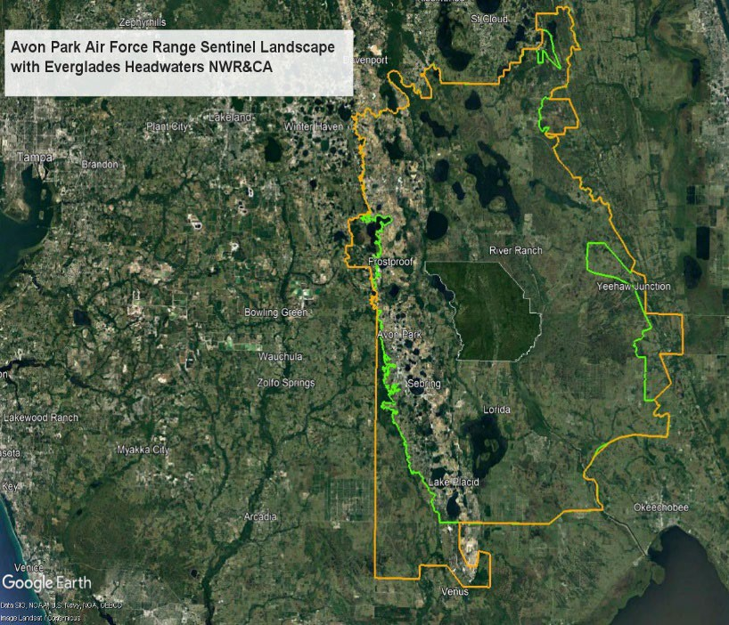
Corrigan Tract:
Extremely high value property: connectivity, T&E/species richness, close proximity to APAFR.
~6,248 acres protected.
Partnership driven approach within the APAFRSL including multiple agency and NGO partners.
FDEP State Park (~4,382 acres) and USFWS NWR System (~1,866 acres) owned/managed.
REPI funds utilized to assure military readiness/mission of APAFR protected in perpetuity.

Slide 9
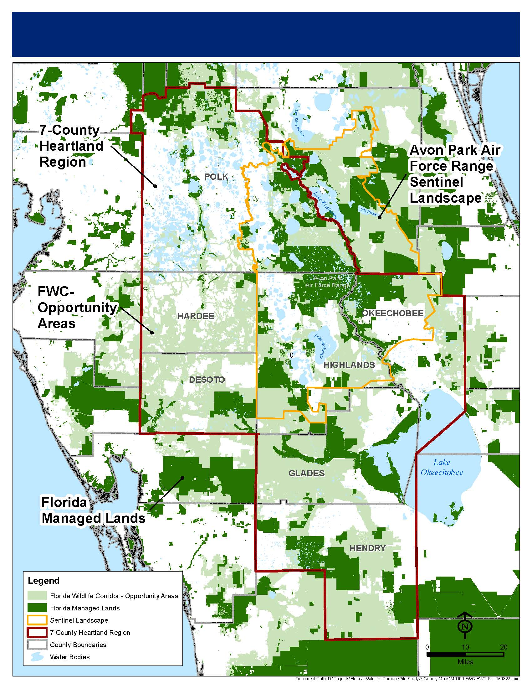
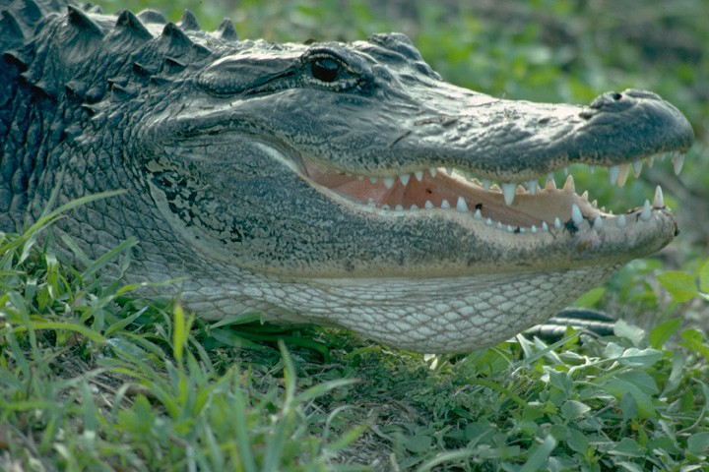
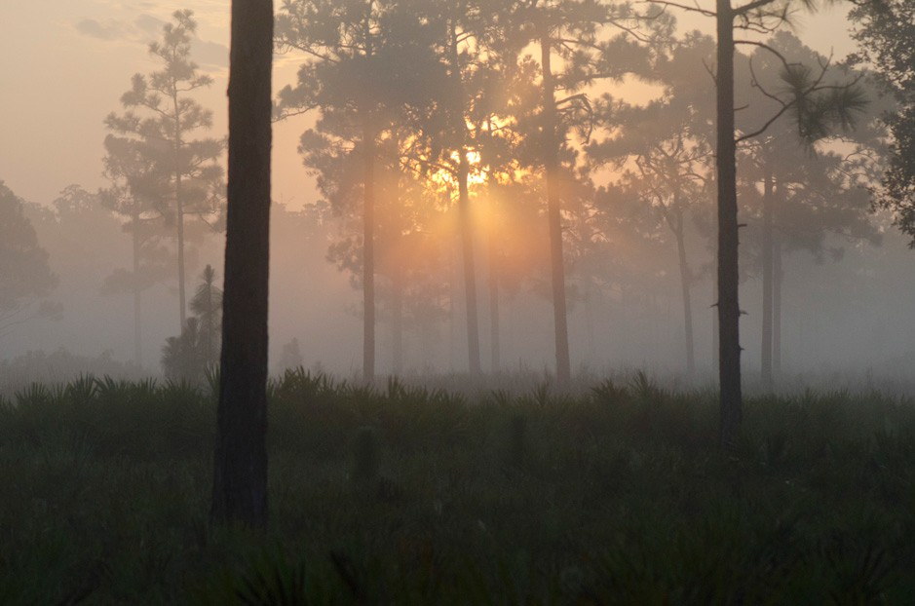
APAFR Sentinel Landscape & Florida Wildlife Corridor
Florida Wildlife Corridor Opportunity Areas within the APAFR Sentinel Landscape
Notes:
Chris has suggestions for links to mapping application/layers that SLs could use to show climate impact on the map.
If so, delete the next slide.

Slide 10
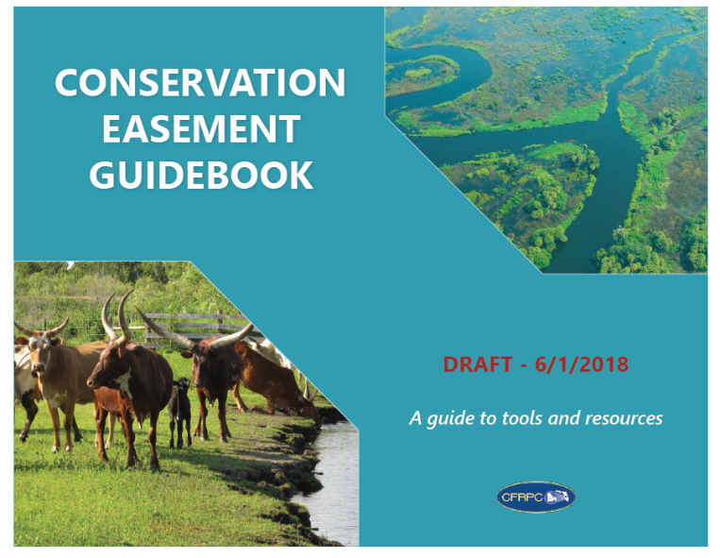
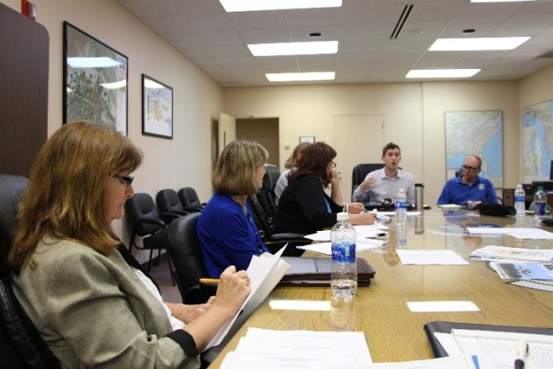
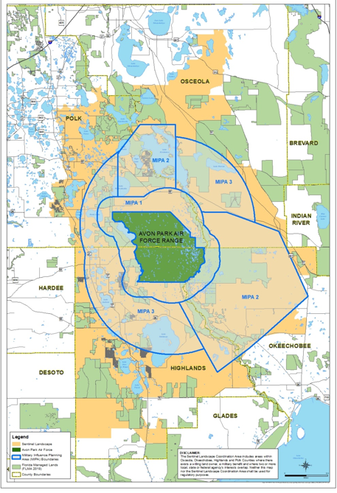
Ongoing
Priority Action Plan implementation
Continued coordination
Additional landowner workshops for conservation opportunities
PR efforts and advertisements (videos)
Easier & faster delivery of conservation programs
Identification of alternative/incentive-based conservation opportunities

Slide 11
Contact Information
Jennifer Codo-Salisbury, AICP
Deputy Director
jcodosalisbury@cfrpc.org
Charles “Buck” MacLaughlin
Avon Park Air Force Range
charles.maclaughlin.1@us.af.mil

