Slide 1
Association of Defense Communities – Florida Defense Forum
Leveraging REPI and Sentinel Landscapes to Obtain More Resources
September 23, 2022
Mike Shaw
Booz Allen Hamilton
REPI Program Support
Kent Wimmer
Northwest Florida Sentinel Landscape Coordinator
Notes:
Good morning. I’m Kent Wimmer, Coordinator of the Northwest Florida Sentinel Landscape and a Senior Representative with Defenders of Wildlife. Defenders of Wildlife is a national organization dedicated to protection of all native animals and plants in their natural communities.
In Mike Shaw’s absence, I will incorporate his presentation on the REPI program into mine.

Slide 2
Notes:
The REPI program mitigates encroachment threats near DoD installations and ranges by working with the Military Services and dedicated partners, like defense communities, to promote compatible land uses, address environmental restrictions that can hinder military operations, and increase military installation resilience to climate change.
As you will see on this slide, there are three primary components of the REPI program: landscape partnerships, stakeholder engagements, and encroachment management projects, also commonly referred to as REPI projects.
REPI projects account for around 90% of the program’s funding. This is where the on-the-ground implementation happens – facilitated and supported by the other two components.

Slide 3
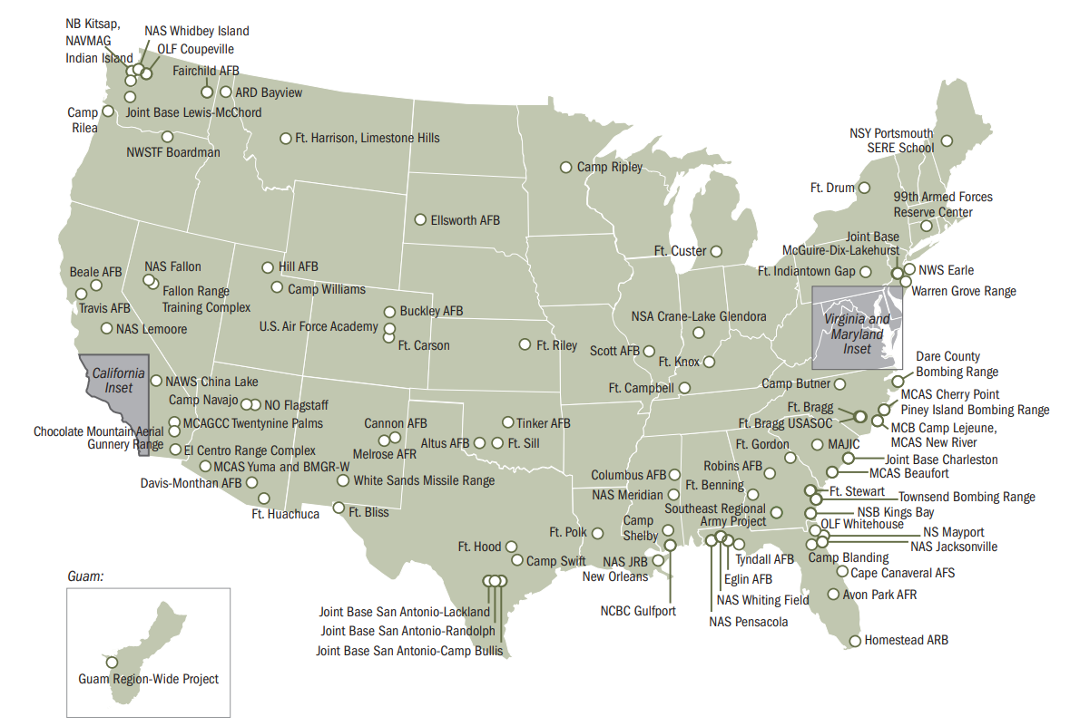
REPI Project Locations
Through Fiscal Year 2021, DoD has leveraged $1.18 billion with over $1.05 billion in non-Department partner contributions to protect nearly 830,000 acres of land, safeguarding vital test, training, and operational assets and capabilities at 118 locations in 35 states and territories.
Notes:
There is a good chance an installation in your community has an existing REPI project as there are 118 project locations across 35 states and territories.
With tremendous support from partners, REPI projects have protected nearly 830,000 acres of land, and in fiscal year 2021 alone, protected over 75,000 acres.
In Florida, DoD and its partners have contributed over $218 million to REPI projects across ten installations.
Out of the $218 million, the REPI program has funded over $61 million to projects that are helping support critical missions and operations for the 62,000 active duty soldiers and 34,000 civilian personnel in Florida.

Slide 4
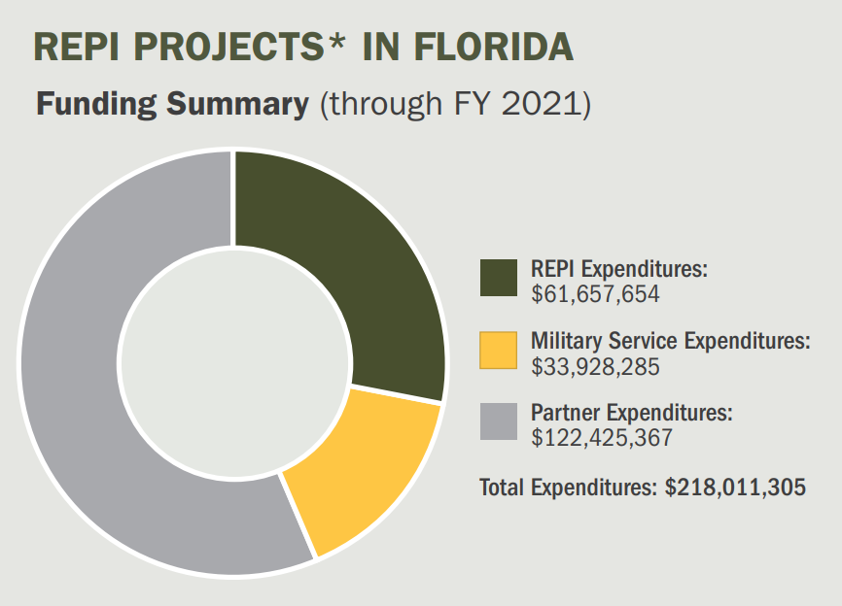
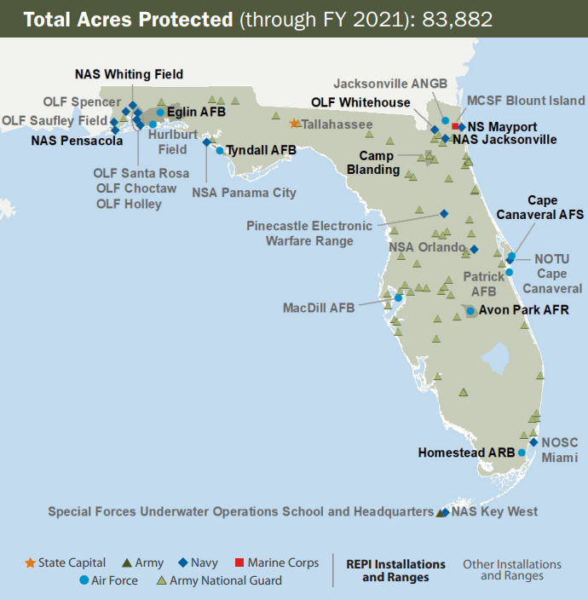
REPI in Florida
DoD and its partners have invested over $218 million at REPI projects at 10 installations in Florida
Notes:
Through FY 2021, DoD and its partners have invested over $218 million at REPI projects at 10 installations in Florida.
Partners, like the state and many of the organizations represented here today, have contributed over half of that total.

Slide 5
REPI Opportunities and Priorities
Military Installation Resilience Projects
The REPI program has the authority to address climate change hazards and increase military installation resilience under 10 U.S. Code § 2684a(a)(2)(B)(ii).
This authority allows the Military Services and partners to develop off-base natural infrastructure solutions designed to protect critical infrastructure, military personnel, and testing or training operations from climate change impacts.
Notes:
Both the Sentinel Landscapes Partnership and REPI program are prioritizing projects that help improve military installation resilience to climate change.
As several of you may be aware, climate change is a top priority for the Department of Defense and has tangible impacts on military readiness.
Given this pressing threat, the REPI office is continuing to advance resilience projects that use natural infrastructure solutions to protect critical testing and training operations.
There are several available solutions listed here on the slide that can help both installations and defense communities prevent, prepare for, and recover from climate change impacts that can create costly repairs and threaten public safety.
For example, REPI supports several coastal resilience projects that are developing living shorelines, establishing oyster beds, and restoring dunes and salt marshes to reduce risk from coastal climate hazards.
Communities can pursue funding for these types of projects through multiple avenues, including the annual REPI Challenge.
This past June, the REPI office announced the recipients for the 2022 REPI Challenge.
The nine REPI Challenge recipients received $31.6 million in REPI program funding coupled with $60.3 million in partner funding to support projects benefiting 13 DoD installations and their neighboring communities.
Up to $40 million in REPI funding is available for the 2023 REPI Challenge, which is already underway.
If this year’s deadline snuck up on you, it is never too early to start preparing for the 2024 REPI Challenge. The Request for Proposals will likely be released in June 2023.

Slide 6
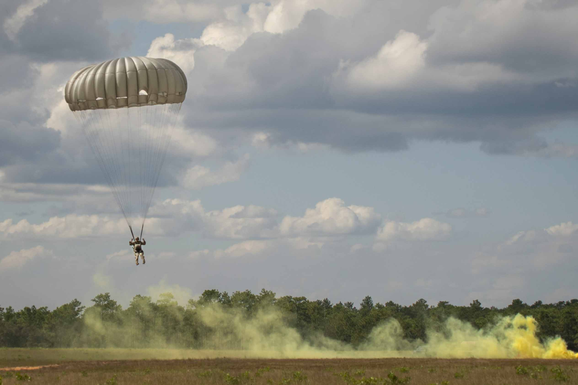
REPI and Sentinel Landscapes Opportunities and Priorities – Using REPI Tools to Achieve Multiple Objectives
“Funds as Match” authority (10 U.S.C. § 2679)
Leverage REPI funds to satisfy the cost sharing requirement of ANY resilience or conservation program of ANY federal agency.
Landscape Partnerships
Increase engagement with existing partnerships (e.g., the Southeast Regional Partnership for Planning and Sustainability, the South Atlantic Salt Marsh Initiative, and Sea Grant).
Foster new local, state, and federal partnerships across emerging sentinel landscapes.
Complementary Federal Resilience Funding
Develop large-scale resilience projects through multiple federal agencies (e.g., America the Beautiful Challenge).
Apply for REPI funding to serve as a non-federal match for federal resilience programs (e.g., the Federal Emergency Management Agency’s Building Resilient Infrastructure and Communities Program).
An Army Ranger instructor conducts airborne operations at Eglin Air Force Base, Fla., Oct. 7, 2020.
Notes:
Here are some of the REPI and Sentinel Landscapes opportunities I would recommend exploring moving forward.
“Funds as Match” authority
The first opportunity I want to emphasize is the 10 U.S. Code Section 2679 authority. For simplicity, we call this the DoD “Funds as Match” authority.
Under this authority, REPI funds can be used to satisfy the cost-sharing requirement of any resilience or conservation program of any federal agency.
In other words, REPI funds count as a non-federal match for other federal resilience programs.
One opportunity that specifically references this authority is the 2022 FEMA BRIC Notice of Funding Opportunity, which was just released this past month and includes $2.3 billion in funding for communities.
Landscape Partnerships
You already heard me cover the Sentinel Landscapes Partnership and the opportunity to leverage funding from DoD, USDA, and DOI, so I will use this time to touch on another partnership that Florida partners can take advantage of moving forward.
The South Atlantic Salt Marsh Initiative (SASMI) launched in May 2021 and is modeled off the existing America’s Longleaf Restoration Initiative. This new initiative aims to conserve one million acres of salt marsh along the South Atlantic coast.
Through this voluntary, collaborative, and non-regulatory approach, SASMI will bring together local, state, and federal interests to create mutually beneficial projects designed to protect salt marsh, coastal communities, and military missions.
A SASMI conservation plan will be released in early 2023, so stay tuned for more information on how that plan can help advance priorities in your community.
Complementary Federal Resilience Funding
Finally, I’ll close by sharing another resilience funding opportunity that partners in Florida could apply for to receive funding from DoD, U.S. Forest Service, U.S. Department of the Interior, and the U.S. Department of Agriculture’s Natural Resources Conservation Service.
Back in April, the White House Council on Environmental Quality announced a $1 billion America the Beautiful Challenge that will streamline the federal grant application process by offering states, Tribes, territories, and non-governmental organizations the opportunity to apply for multiple grant programs through a single application.
DoD is contributing $25 million to the America the Beautiful Challenge over five years through REPI, which will be leveraged with other federal and private funds to advance resilience projects and initiatives across sentinel landscapes.
For this year, the National Fish and Wildlife Foundation (NFWF) received 32 full proposals claiming benefits to DoD missions. These applicants are requesting over $34 million in funding out of the $1.1 billion in requests NFWF received.
The REPI office just finished reviewing proposals and looks forward to sharing the final funding recipients in November.

Slide 7
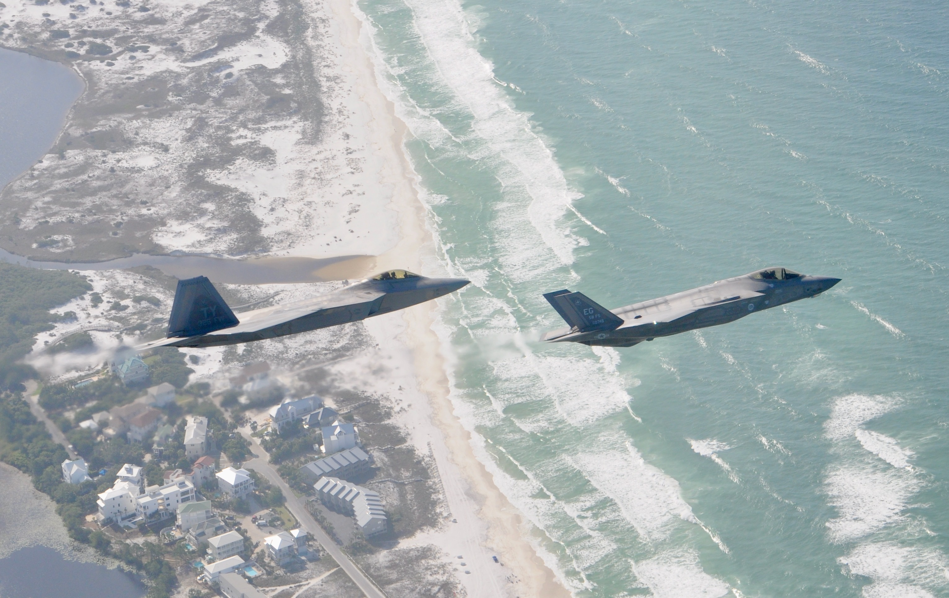
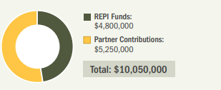
Tyndall Air Force Base REPI Challenge Project
Tyndall Air Force Base is currently home to several U.S. Air Force organizations and units, including the 325th Fighter Wing that trains F-22 Raptor pilots, intelligence officers, and maintainers.
The 2021 REPI Challenge project supports a multifaceted approach to improve the resilience of the base, including constructing up to 1,000 feet of living shorelines.
These nature-based coastal resilience solutions will also improve water quality and overall ecosystem health and provide new habitats for local endangered species such as the southeastern beach mouse.
A F-22 Raptor from the 325th Fighter Wing flies alongside a F-35 Lightning II from the 33rd Fighter Wing over the Emerald Coast.. (U.S. Air Force photo by 1st Lt Savanah Bray)
The nominating partner, The Nature Conservancy, received $4.8 million in REPI funds through the 2021 REPI Challenge.
Notes:
An example in Northwest Florida is Tyndall Air Force Base which has received funding through the 2021 REPI Challenge to support its recovery from Hurricane Michael.
This project received $4.8 million in REPI funding coupled with $5.2 million in partner contributions to construct 1,000 feet of living shorelines, 3,500 feet of submerged shoreline, and 1,500 feet of oyster reef habitat.
These solutions will protect critical base infrastructure, including Tyndall’s drone runway, preserve species habitat, and improve water quality.

Slide 8
Sentinel Landscapes Partnership
Established in 2013 by the U.S. Department of Defense, Department of Agriculture, and Department of the Interior, the partnership’s mission is to:
Strengthen military readiness
Conserve natural resources
Bolster agricultural and forestry economies
Increase climate change resilience
The Northwest Florida Sentinel Landscape and Avon Park Air Force Range Sentinel Landscape benefit ten military installations and the surrounding defense communities.
Notes:
The landscape partnerships you see here are a way for us to focus stakeholder engagements in specific regions or landscapes and target efforts with multiple partners.
A critical piece in the landscape partnerships is the Sentinel Landscapes Partnership.
Founded in 2013 by DoD, the Department of the Interior (DOI), and the U.S. Department of Agriculture (USDA), the Sentinel Landscapes Partnership coordinates actions in key landscapes anchored by one or more installations.
Sentinel Landscapes Partnership is a broad coalition of federal agencies, state and local governments, and non-governmental organizations that work with willing landowners to advance sustainable land management practices within landscapes anchored by military installations and ranges.
These partnerships allow the Department and installations to work more efficiently together for the mutual benefit of conservation, working lands, and national defense.
Stakeholder engagements are one of the most foundational components of the REPI program.
This engagement includes internal communication across DoD and external engagements working with federal, local, and academic partners.
These valuable interactions are truly the foundation for partnering to preserve and enhance the Department’s mission while protecting important landscapes, habitats, and species.
Defense communities also play a critical role in supporting the mission of the Sentinel Landscapes Partnership.
Through fiscal year 2020, projects across sentinel landscapes have attracted roughly $178 million in DoD funds, $250 million in USDA funds, $57 million in DOI funds, $230 million in state funds, $16 million in local funds, and $104 million in private funds.
These contributions have permanently protected over 515,000 acres of land and enrolled 2.7 million acres of land in technical assistance programs.
Florida is the only state with two sentinel landscapes, located in the Northwest Florida region and Avon Park Air Force Range.
We are meeting this morning in the newly designated Northwest Florida Sentinel Landscape, nine DoD installations and ranges are benefitting from the partnership’s access to funding assistance from federal, state, and local governments and private sector programs.
Please visit sentinellandscapes.org to learn more.

Slide 9
Notes:
I’m the Coordinator of the Northwest Florida Sentinel Landscape. The 16-county Northwest Florida Sentinel Landscape has hosted military bases since Spanish colonization. It is home to six of the nation’s most important installations and ranges spanning 165 miles along the northeastern Gulf of Mexico coast. These installations include:
Eglin and Tyndall Air Force Bases
Hurlburt Field
Naval Air Stations Pensacola and Whiting Field and
Naval Support Activity Panama City
These installations are vital to our national defense because of their training and weapons testing missions. As you can see most of the Northwest Florida is within a military mission footprint. These installations have direct access to the Eastern Gulf Testing and Training Range which is larger than all other ranges inside the continental US combined.

Slide 10
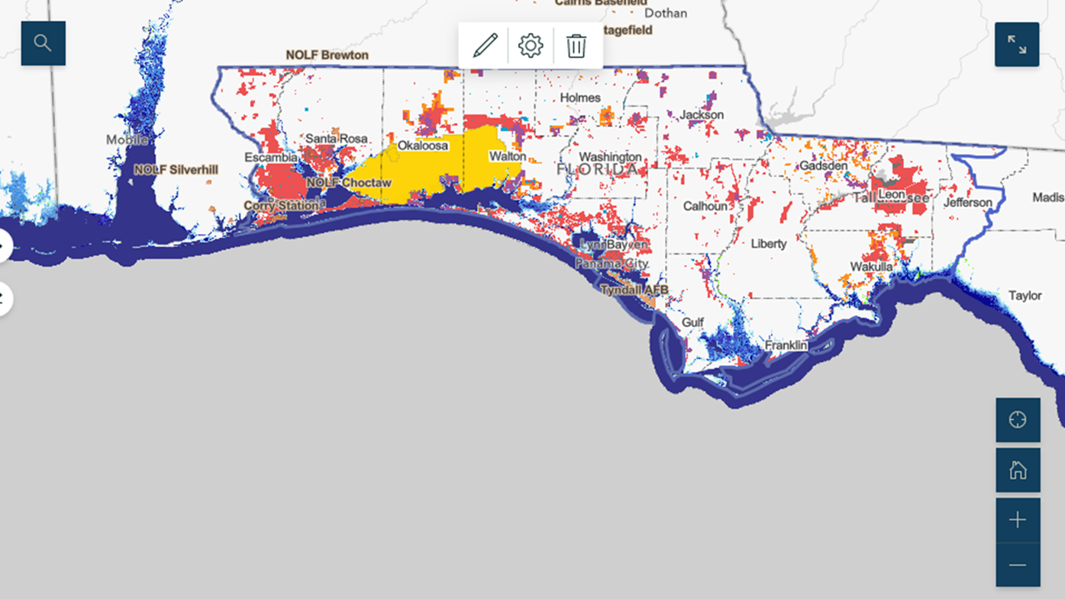
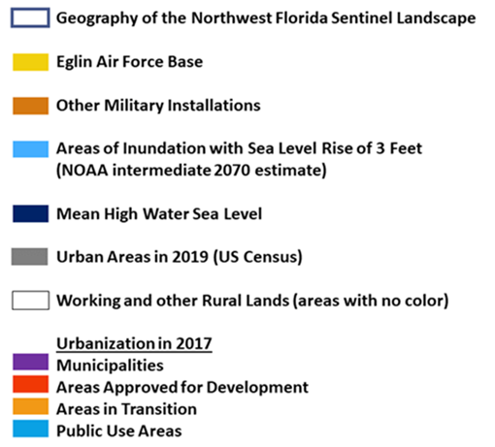
Notes:
Two primary challenges facing our installations and natural communities are impacts from population growth and climate change.
Between 2010 and 2018, the populations of the five counties home to the six principal military installations increased between 6 and 30 percent. Development can limit the use of prescribed fire, hinder wildlife movement, and negatively impact surface and ground waters, and threaten estuaries on the Gulf of Mexico. Finally, development in the wrong places may threaten military missions. In 2020, the military represented 28.6% of the total economy of Northwest Florida.
Increasing storm intensity and frequency heightens the urgency for regional collaboration to mitigate the effects of extreme weather, storm surge, sea level rise and coastal erosion on mission capabilities and natural systems.
Extreme weather events, such as Hurricane Michael’s destruction of Tyndall Air Force Base in 2018, directly impacted national security by degrading its mission capabilities. It also diverted significant national defense resources with approximately $4.5 billion being appropriated for Tyndall’s reconstruction.

Slide 11
Notes:
A key strategy for our sentinel landscape is to conserve a connected network of wildlife habitats. Landscape-level conservation is essential for listed species recovery and for working lands to persist despite the threats of climate change and land use conversion. This map shows our partners’ priority or focus areas including the Florida Wildlife Corridor shown in Florida.
Northwest Florida’s exceptional biological diversity benefits from innovative stewardship practices on the private and public lands surrounding and connecting our military installations. Thriving and recovering populations of listed species on non-military lands provides potential to reduce the regulatory burden associated with on-installation training and testing. For example, the successful stewardship Apalachicola National Forest and the Red Hills ensures that two of the largest remaining populations of the endangered red-cockaded woodpecker will continue to thrive outside of Eglin Air Force Base.
The NWFSL partners have formed three work groups as our conservation delivery networks. These work groups are focused on Private Lands Stewardship, Natural Systems resiliency and sustainability and Climate Resiliency to identify, implement and accelerate projects that mitigate coastal risks and increase the climate resiliency. Please reach out to me if you are interested in joining our partnership or a work group.
We will accomplish this conservation goal through our partners’ existing programs including the Florida Forever and Rural and Family Land Protection Programs, the USDA’s Forest Legacy Program and the Regional Conservation Partnership Program, and the Department of Defense’s Readiness and Environmental Protection Integration Program plus funding through the National Fish and Wildlife Foundation’s programs.
Complementing the description I provided about the REPI Challenge Funding project in Tyndall Air Force Base, Randy will describe how these various funding sources are being employed surrounding NAS Whiting Field, and Jennifer will describe how they are used in the Avon Park Air Force Range Sentinel Landscape.

Slide 12
Questions?
Contact the REPI office: osd.repi@mail.mil
www.repi.mil www.sentinellandscapes.org
Kent Wimmer, NWFSL Coordinator Defenders of Wildlife kwimmer@defenders.org / (850) 528-5261
Subscribe to the REPI listserv
Notes:
I also would encourage you to subscribe to the REPI listserv by scanning the QR code to stay up to date on the latest news, funding opportunities, and outreach events. Partnerships between communities working with your neighboring military installation and partner agencies and NGOs help ensure that we protect military missions, conserve habitat and maintain working forests and ranches.

