Slide 1

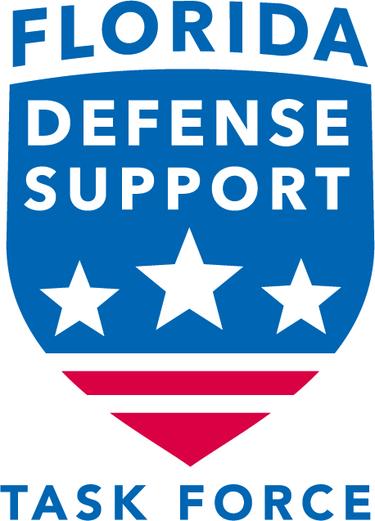
Florida Defense Community Resiliency, Sustainability and Mission Assurance Project Inventory
  Charlie Kuhl, PE

Slide 2
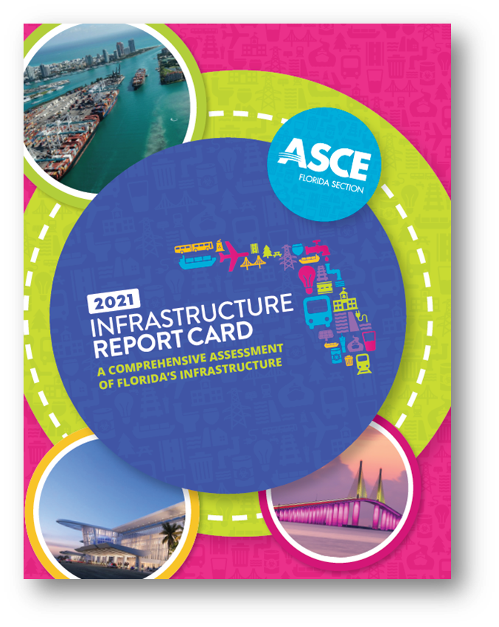
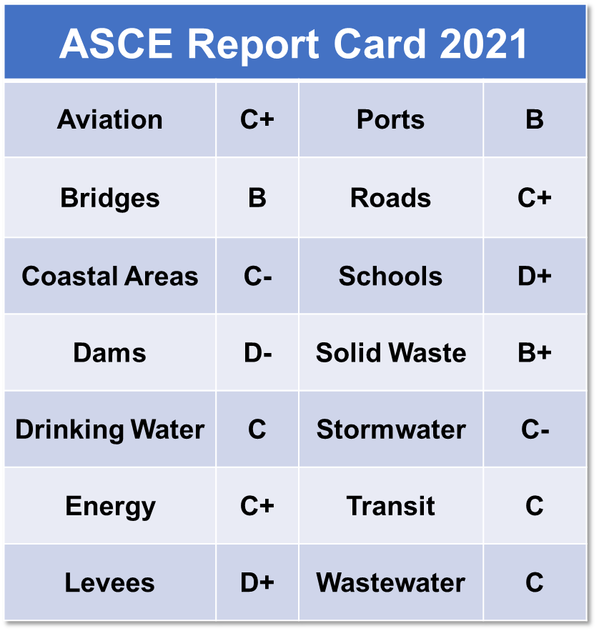
Agenda
Questions
Objective
Scope
Legislation and Policy
Defense Community Involvement
Project Inventory
Recommendations
Take Aways…

Slide 3
Questions to Ponder
  Is resilience project funding easy to get?
  How strong is communication between your Defense Community and Military Installations?
  Do you know the funding avenues?
  How can Florida optimize decentralized programs?
  How well are you poised for mission growth and force realignment?
Notes:
Funding competition is fierce
Communities need to know what projects have resiliency/sustainability links to the installation
Communication of vulnerabilities and requirements is key
Bolsters project justification
Prevents inadvertent degradation of military value
State of Florida has resources to assist
Up-to-date list of requirements needed to optimize funding
Florida needs to strategically align decentralized programs under the guidance of the Chief Resiliency Officer
Prepare for mission growth and force realignment
Resilience and Sustainability criteria

Slide 4
Objective
  From RFP…
    “Community resilience is the ability to focus human and infrastructure capital necessary to make for stronger military installations and associated defense communities that are better able to withstand, manage, and recover from disasters or national security events.”
  From the Client…
    “This is not a weather study”
  Problem Statement
    “Develop strategy and identify objectives for the State of Florida, along with Florida military installations partners, to improve installation and community resiliency”
Defense Community Projects
Resilience-Based Justification
Linked to Funding Opportunities

Slide 5
Scope
  Identify and consolidate projects
  Review policy, guidance, and funding opportunities
  Develop guidance recommendations
  Share best practices
  Develop a library of actionable projects
  Recommend funding avenues
Notes:
Identify and consolidate projects that enhance military value, resilience, and quality of life by addressing infrastructure deficiencies
Review DoD policy, guidance, and funding opportunities
Develop state-level guidance recommendations
Share best practices to spur additional ideas and projects
Develop a library of actionable projects
Recommend funding avenues and grant priorities

Slide 6
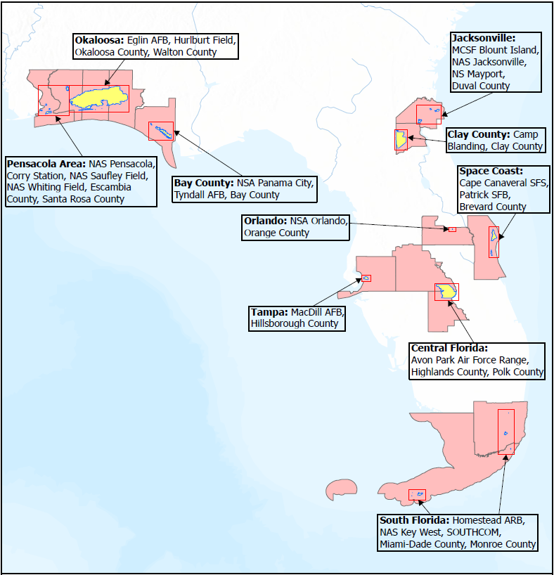
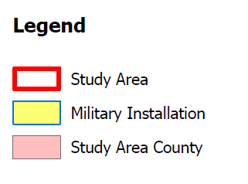
Defense Communities
  Bay County
    NSA Panama City
    Tyndall AFB
  Central FL
    Avon Park AF Range
  Clay County
    Camp Blanding JTC
  Jacksonville
    MCSF Blount Island
    NAS Jacksonville
    NS Mayport
  Okaloosa
    Eglin AFB
    Hurlburt Field
  Orlando
    NSA Orlando
  Pensacola
    NAS Pensacola
    Corry Station
    NAS Saufley Field
    NAS Whiting Field
  Space Coast
    Cape Canaveral SFS
    Patrick SFB
  South Florida
    Homestead ARB
    NAS Key West
    SOUTHCOM
  Tampa
    MacDill AFB
Notes:
10 Defense Communities and 20 military installations

Slide 7
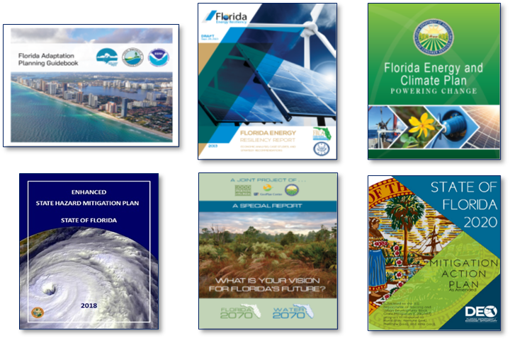
Florida Legislation and Policy
  Heavy focus on flooding and sea level rise
  Many quality plans, but siloed
  CS/HB 7053
    Chief Resilience Officer
    FDOT Resilience Action Plan
    FDEP Vulnerability Assessment
  FAC Local Mitigation Strategies
  Peril of Flood Statute
  Financing of Construction
  Resilient Coastlines
  Resiliency Energy Environment Florida (REEF)
Notes:
Florida is one of only 16 states with a Chief Resilience Officer
- FDOT June 2023
- DEP Flood and Sea Level rise dataset July 2023 and vulnerability assessment by July 2024
- FL Administrative Code LMS - This F.A.C. outlines the critical components of Local Mitigation Strategies (LMS) that are developed across Florida. A few key components of this statute are that an LMS should include a completed hazard assessment, a list of approved projects in order of priority (to included costs and funding sources), and GIS maps that depict hazard areas, project locations, critical facilities, and repetitive loss structures.
- Peril of Flood - requires inclusion of a development component in the Coastal Management Element of the Comprehensive Plan. It is intended to eliminate inappropriate and unsafe development when opportunities arise. The goal is to reduce losses due to flooding and claims made under flood insurance policies issued in Florida. 70% compliance reached.
- Public Financing of Construction Projects prohibits state-financed constructors from commencing construction of certain structures in coastal areas until completion of sea level impact projection study beginning July 1, 2022.
- Resilient Coastlines – DEP funding and technical assistance to prepare Florida’s coastal communities. Continuing to promote and ensure a coordinated approach to sea level rise planning among state, regional and local agencies.
- REEF - the public policy of the state to play a leading role in developing and instituting energy management programs that promote energy conservation, energy security, and the reduction of
greenhouse gases
Other states – North Carolina, South Carolina, Colorado, California, US Climate Alliance

Slide 8
Defense Community Assessment
  FEMA National Risk Index
  Florida Enhanced State Hazard Mitigation Plan
Notes:
FEMA 18 criteria
FL 17 criteria

Slide 9
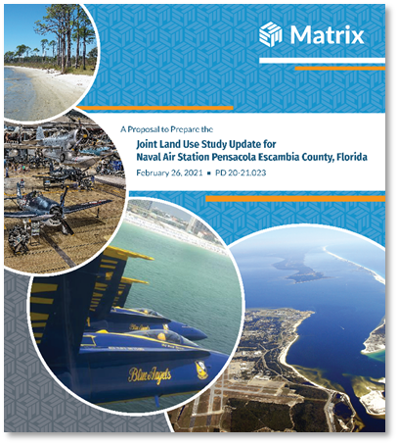
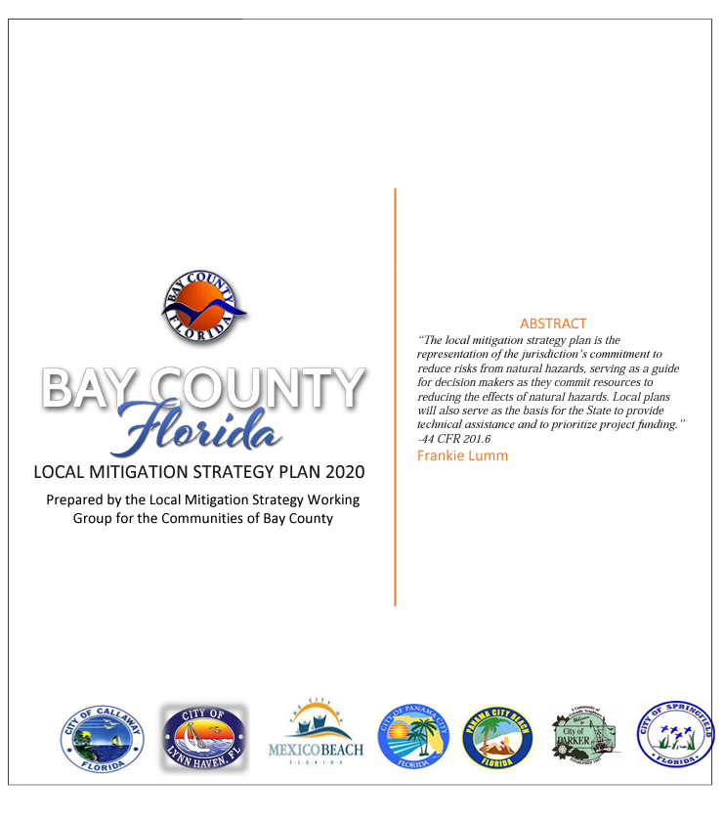
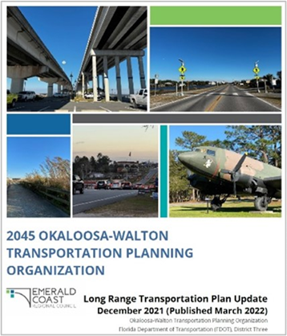
Defense Community Project Inventory
  Projects collected from
    2022 Florida Budget
    County Local Mitigation Strategies
    Joint Land Use & Compatibility Studies
    Emergency Operation Plans
    Capital Improvement Plans
    Infrastructure Restoration Plans
    Transportation Studies
    Future/Planned Projects
    Installation CPLO’s/reps
  Reviewed ~3,000 existing community requirements
    ~120 tied to military installation resiliency

Slide 10
Defense Community Project Inventory – cont.
  Inventory data elements include:
    Defense Community, description, source, type, hazard, cost, recommended funding sources, impact correlation,
Notes:
Lift stations, substations, hardening, water, wastewater, intersections, backup generation, Emergency Operations Centers , dredging, drainage, stormwater, runway repairs, storm surge, ferry shuttle, and many studies
High - The project is transformational in improving resilience, with direct impacts to the local military installation(s) and surrounding community through improving critical infrastructure, emergency response functions and/or base and community relationships
Medium - The project includes resilience-building components and reduces vulnerabilities of local military installation(s) and surrounding community through improving critical infrastructure, emergency response functions and/or base and community relationships
Low - The project has resilience components and increases the resiliency of the local community but may not directly impact the resilience of the military installation(s)

Slide 11
Recommendations
  Update existing plans
  Align Local Mitigation Strategies with Capital Improvement Plans
  Assign a Resilience POC/Liaison
  Commit resources to grant development
  Establish resilience metrics
  Build a centralized site for Florida Resilience
  Update Project Inventory annually

Slide 12
Take Aways…
  Funding competition is strong
    Communities need to know what projects have resiliency/sustainability links to the installation
    Develop strong justification
  Communication of vulnerabilities and requirements is key
    Bolsters project justification
    Prevents inadvertent degradation of military value
  State of Florida has resources to assist
    Up-to-date list of requirements needed to optimize funding
  Florida needs to strategically align decentralized programs under the guidance of the Chief Resiliency Officer
  Prepare for mission growth and force realignment
    Resilience and Sustainability criteria
Notes:
Is resilience project funding easy to get?
How strong is communication between your Defense Community and Military Installations?
Do you know the funding avenues?
How can Florida optimize decentralized programs?
How well are you poised for mission growth and force realignment?

Slide 13
Questions
Charlie.Kuhl@MatrixDesignGroup.com

Slide 14
Resilience Definitions
  10 USC 101
    Installation Resilience - the capability of a military installation to avoid, prepare for, minimize the effect of, adapt to, and recover from extreme weather events, or from anticipated or unanticipated changes in environmental conditions, that do, or have the potential to, adversely affect the military installation or essential transportation, logistical, or other necessary resources outside of the military installation that are necessary in order to maintain, improve, or rapidly reestablish installation mission assurance and mission-essential functions.
    Energy Resilience - the ability to avoid, prepare for, minimize, adapt to, and recover from anticipated and unanticipated energy disruptions in order to ensure energy availability and reliability sufficient to provide for mission assurance and readiness, including mission essential operations related to readiness, and to execute or rapidly reestablish mission essential requirements.

