Slide 1
Air National Guard Construction Growth Offset (CGO)
Briefer: Ross Gleason
NGB/A4AD
Date: 31 Oct 2022

Slide 2
Agenda
Reason Behind Policy
Policy & Guidance
ANG Implementation
Way Forward

Slide 3
Reason Behind CGO
HAF Infrastructure Investment Strategy (I2S): 29 Jan 2019
Calls out offsetting new construction growth as a means to align infrastructure requirements with the National Defense Strategy to create enduring plans for installations we need
SAF/IE Construction Growth Offset Policy: 20 May 22
References the I2S as justification for the new policy while providing implementing instructions and guidance for MILCON and UMMC projects
We have too much infrastructure and cannot afford to pay for it all
Money spent operating and maintaining excess real property could be better used improving readiness, recapitalizing weapons systems, or addressing quality of life
Since 1990, the Air Force has…
60% fewer Fighter Squadrons
40% Fewer Airmen
Only 15% fewer installations
To reduce footprint, we must first stop growing:
In FY21, ANG constructed 49,960sf more than we demolished
Notes:
This slide is taken almost verbatim from the AFCEC presentation.

Slide 4
CGO Guidance
All new construction growth must be offset with closed, demolished or transferred facilities
One for One offset required for all square foot growth
Applies to vertical construction (buildings) sustained by DAF (ANG)
CGO required beginning in FY25
Establishes a Growth Offset Bank (GOB)
NGB/A4 manages the bank for Air National Guard
GOB starting balance based on credits earned from ANG demolition or transfers through FY24
Waivers approved by SAF/IEE
Will require solid justification and insufficient capacity in the ANG bank
Also of Interest:
Tenants are responsible for growth offset for tenant requirements
AFCEC is requesting clarification from SAF/IEE regarding Joint Bases
Notes:
There is only one ANG growth offset bank. there are not individual sub-accounts for states or installations
As of 21 Oct 22: PDS has 335,000 SF of MILCON/UMMC requirements in planning & design for FY25 and beyond

Slide 5
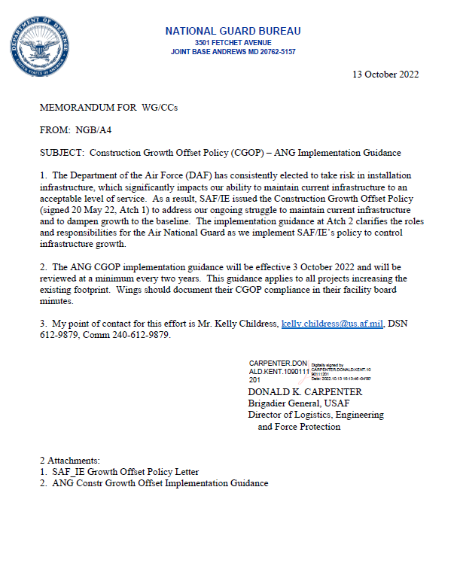
CGO ANG Implementation
NGB/A4 CGOP ANG Implementation Guidance released 14 Oct 2022
Offset Hierarchy:
First: Within the Wing
Second: Within the State
Last: NGB Growth Offset Bank
Growth Offset Bank Transactions
Loan: The installation will be required to plan, program, design, and execute a demo-consolidation project within 5 years of receiving the loan
Credit: The NGB bank is used to offset the new facility construction requirement.
Construction Growth Offset Plan being incorporated into Advanced Planning
AP1 & AP2 packages to include installation plan for offset
Credits from the Bank should be preserved to “pay” for major new mission requirements

Slide 6
Way Forward
FY23 and FY24 projects exempt from CGO requirements
NGB/A4A Developing GOB “Ledger” tool to include:
Tracking transactions by status (Pending, Approved, and Reconciled)
Linking loan and credit transactions to the associated construction project (debit)
Tracking GOB balance (current and future)
1 Oct 2025: Growth Offset Bank Starting Balance Established
Based on real property transferred or demolished through FY24

Slide 7
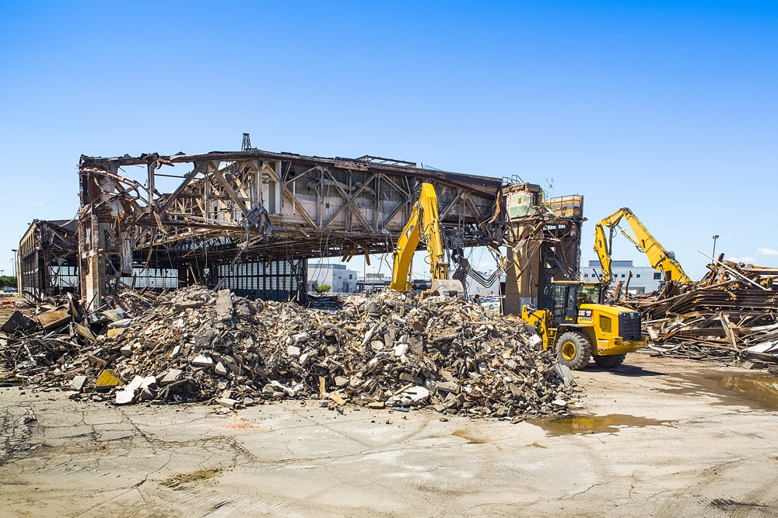
Is that all?
Prefer to include CGO demolition as part of construction project requiring offset (even when not in footprint of new facility)
Facility Divestment Plan and CGO will be included in future Installation Development Plans (IDPs)
Rumors of future change to CGO policy to include/capture horizontal facilities such as taxiways, aprons, roads, parking, etc.
For More Information:
ANG CGO POC: Kelly Childress
DSN 240-612-9879
kelly.childress@us.af.mil
NGB/A4AD Demolition SharePoint Page: https://intelshare.intelink.gov/sites/ngba4/SitePages/ProgramA4A.aspx?Program=250

Slide 8
Questions/Discussions

