Slide 1
PFAS Response: How Community Partnerships Play a Key Role
Ms. Elaine Magdinec, P.E.
Chief, Environmental Division, NGB/A4V
31 Oct 2022

Slide 2
PFAS Program Overview
Air National Guard aligns with Active, Reserve and BRAC using a three-prong approach to respond to PFAS at all installations
Identify:
Identify potential for PFAS releases and confirm suspected source locations
Sample for presence/absence of PFAS impacts
Respond:
Provide removal action when imminent or substantial endangerment to human health is identified such as alternate drinking water
Continue to follow the CERCLA process
Prevent: Implement/revise processes and procedures to reduce potential for additional impacts to soil or water
ANGRC centrally manages the environmental restoration program
18 Oct 22

Slide 3
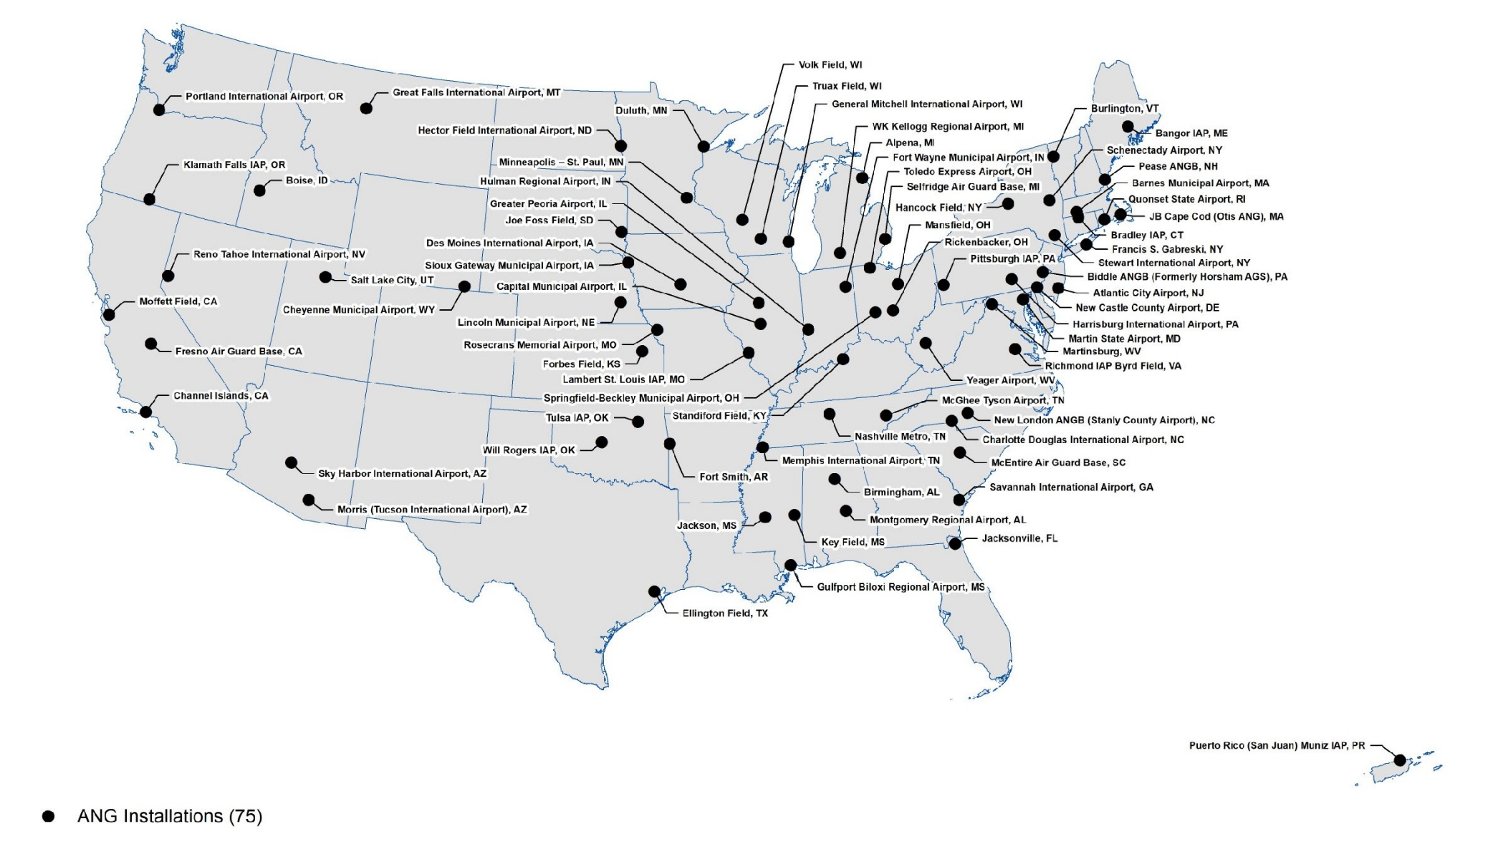
PFAS Investigation Locations
18 Oct 22

Slide 4
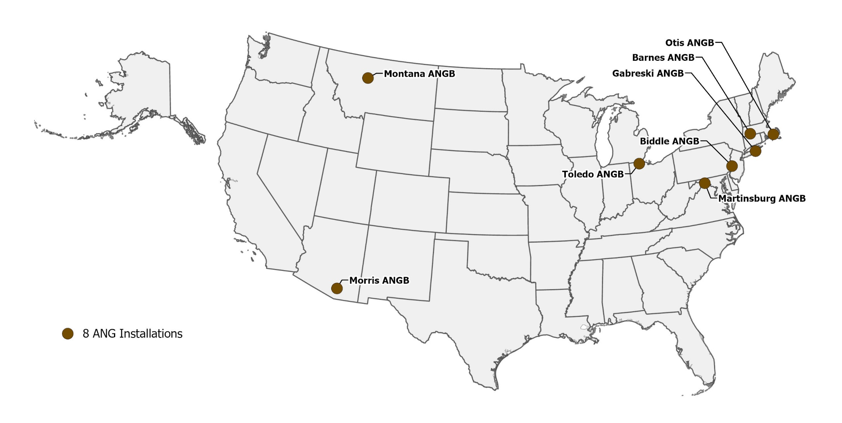
Drinking Water Response Actions
18 Oct 22

Slide 5
PFAS at 162nd, Morris ANGB
Identify: PFAS Preliminary Assessment - May 2016; Site Inspection - March 2019, Remedial Investigation underway
Respond (Initial): Off-base drinking water sampling results exceeded the 2016 EPA Health Advisory in 3 DW wells attributable to ANG operations
ADEQ responded initially and ANG took over with bottled water
Respond (Final Remedy): ANG and Tucson Water negotiated an Environmental Services Agreement to connect the households to municipal water where ANG funded the connections
Connections were completed in Sept 2022
Community partnerships ensure protection of human health
18 Oct 22

Slide 6
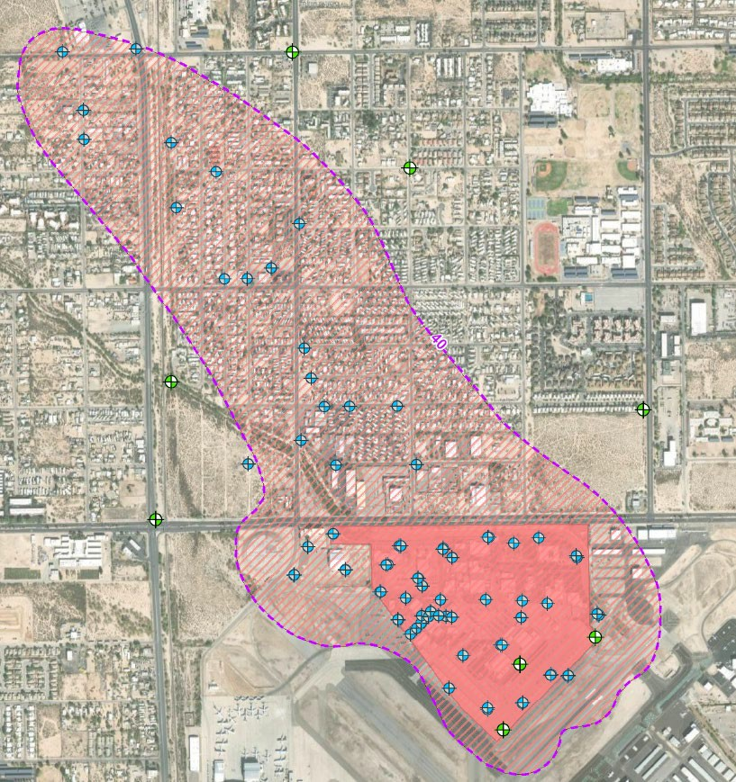
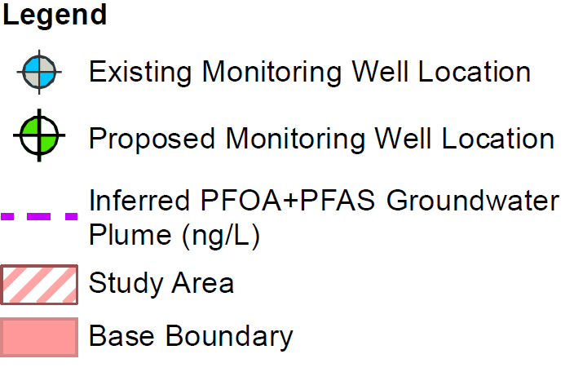
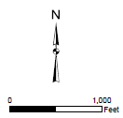
Morris ANGB PFAS Study Area
Existing Monitoring Well Location
Proposed Monitoring Well Location
Inferred PFOA+PFOS Groundwater Plume (ng/L, ppt)
Study Area Base Boundary
GW Flow Direction
18 Oct 22

Slide 7
Base Level Perspective: Col Greg Hoffman
Communication
Leverage the experts, consistency across DoD/AF/ANG matters
Less can be more - push information strategically
Can’t combat every false/inaccurate narrative
Partnerships
Local regulators/utility providers have established access/procedures to interface with community – use them (UCAB, private well owner identification process)
Role of Base Level Leadership
Local points of contact matter
T32 status – ADEQ/DEMA/Governor interface
Stress community dependence of ANG installation
18 Oct 22

