Slide 1
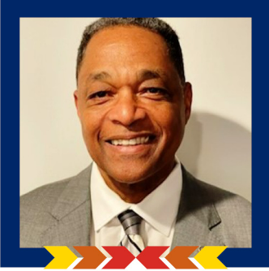
ARMY TOWN HALL
Moderated by Mr. Ivan G. Bolden, Chief of Army Partnerships DCS G-9, Chair of the Joint Services Partnerships Committee

Slide 2
2022 ADC IIF Army Town Hall Agenda
Opening Remarks Mr. Ivan G. Bolden, Chief of Army Partnerships DCS G-9
Honorable Rachel Jacobson, Assistant Secretary of the Army (Installations, Energy, and Environment)
Remarks and Q&A
LTG Kevin Vereen, Deputy Chief of Staff, G-9
Remarks and Q&A
LTG Omar Jones, Commanding General U.S Army Installation Management Command
Remarks and Q&A

Slide 3
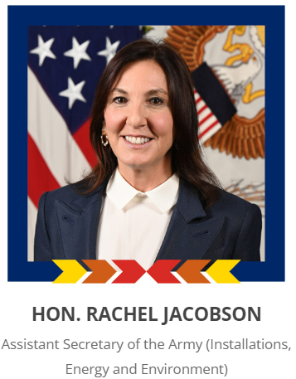

Slide 4
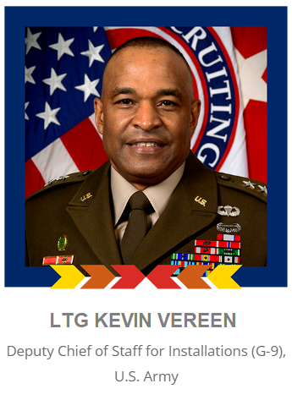

Slide 5
