Slide 1
An Innovative Approach to Partnerships
U.S. Navy, Port of San Diego & California’s Low Carbon Fuel Standard

Slide 2
Introducing the Panel
Panel Moderator: CDR Andy Cline, Assistant Region Engineer, Navy Region Southwest
CAPT Ted Carlson: Commanding Officer, Naval Base San Diego
Sandy Kline: Director Installation Resilience, Assistant Secretary of the Navy (Energy, Installations and Environment)
Jessica Ward: IGSA Program Manager, N5 Program Analyst, Navy Region Southwest
Jim Mugg: Deputy Public Works Officer, Naval Base San Diego

Slide 3
Agenda
Naval Base San Diego: Mission and Neighborhood
Program Benefits
The Program and Authorities
Business Case Analysis
Port Partnership and the Inter-Governmental Support Agreement (IGSA): How it Works
Naval Base San Diego: Limitation, Plans, and Considerations
What’s Next?

Slide 4
NBSD Mission
Our Mission
To PROTECT the Fleet, WarFighter and our Families
To SUPPORT the Fleet, WarFighter and our Families
To SERVE the Fleet, WarFighter and our Families
Our Vision
Naval Base San Diego is a world class, state of the art installation that provides outstanding service and support, around the clock, to tenants and visitors, in order to protect, serve and support the Fleet, the Warfighter and our Families.

Slide 5
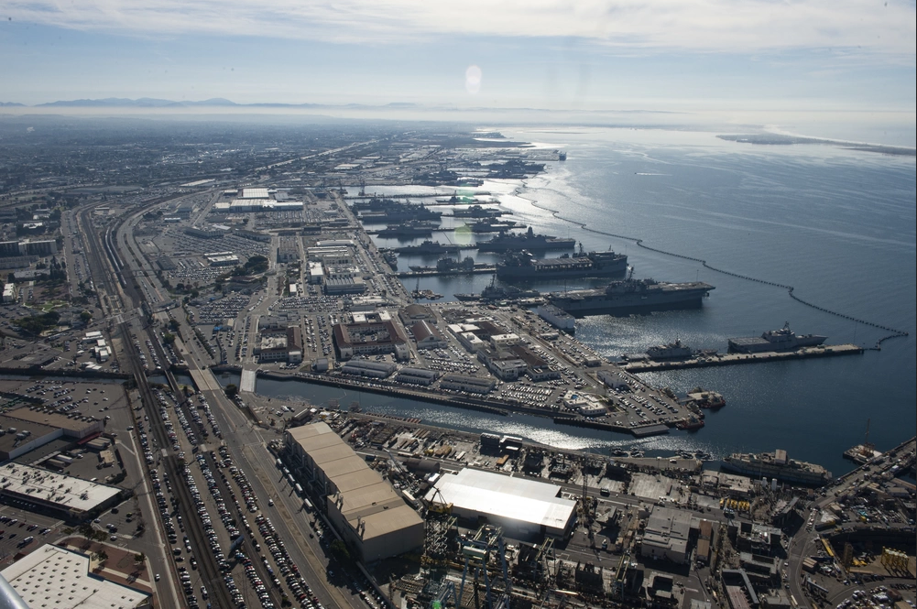
NBSD Mission
Naval Base San Diego (NBSD) is the Navy’s most populous west coast facility and the principal Homeport for the Pacific Fleet, with 60 ships, and over 200 tenant commands.
It occupies approximately 2,000 acres just south of downtown San Diego.
The installation has extensive specialized fleet support capabilities. NBSD’s berthing assets include 12 piers along waterfront property, two channels, and 12 quay walls.
The base expects to reach 62 SHIPS in the next few years and Homeporting 70 ships by 2035
More than 41,500 Military, Civilian, and Contractors work on NBSD plus an additional 5K-10K visiting the Navy Exchange and Commissary

Slide 6
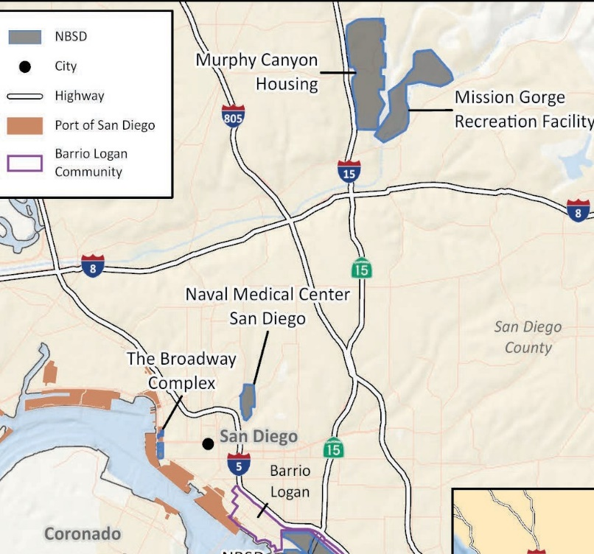
Neighbors
NBSD is surrounded by two communities of concern: Barrio Logan in San Diego and National City
The base is between two Port of SD terminals and shipyard
Our Areas of Operation includes the Main Base on Harbor Drive, NMCSD, Broadway Complex, Mission Gorge Recreation Facility, and 17 PPV family housing sites

Slide 7
Program Benefits
Sale of LCFS credits can be used to modernize, build out, and expand electrical infrastructure from our fence-line to the piers
Expand EV use to reduce emissions (e.g., electric vehicle chargers, electric autonomous transportation, heavy lift equipment, i.e., cranes)
Upgrade aging utility infrastructure to handle electrification needed for electrical loads of ships from planned ship number increase, as well additional shore power demands
Build resiliency through redundant power grids (multiple feeds, loops)
Reduced Air and Noise pollution in the local communities
Potentially $30M per year from credits that can be leveraged to electrify the base

Slide 8
Program and Authorities
The California Air Resources Board: CARB is charged with protecting the public from the harmful effects of air pollution and developing programs and actions to fight climate change. From requirements for clean cars and fuels to adopting innovative solutions to reduce greenhouse gas emissions, California has pioneered a range of effective approaches that have set the standard for effective air and climate programs for the nation, and the world.
Low Carbon Fuel Standard: The LCFS program is an incentive program established by CARB that allows ocean going vessels to earn LCFS program credits for using power from the electric grid (shore power) rather than electricity generated onboard-or portable diesel generators while in port. Data generated by fuel-supplying equipment (FSE) will be used to obtain credits, which can be sold on the open market to assist regulated entities such as fuel refiners to meet declining carbon intensity targets.
DoD Authority: 10 U.S. Code § 2913 - Energy savings contracts and activities (c) Acceptance of Financial Incentive, Goods, or Services.—The Secretary of Defense may authorize any military installation to accept any financial incentive, goods, or services generally available from a State or local government or gas or electric utility, to adopt technologies and practices that the Secretary determines are in the interests of the United States and consistent with the energy performance goals for the Department of Defense.
Naval Base SD
LCFS
Pentagon
Port of SD

Slide 9
Business Case Analysis
IGSA with Port of San Diego
Accrual begins in 2022, earlier than other potential avenues (potentially $35M greater revenue than alternatives)
Port organizational structure already in place to trade credits and manage construction
More able to address NBSD electrification requirements
IGSA also allows greater flexibility as we develop project execution processes

Slide 10
IGSA: How It Works for Our Case
Authorities: This IGSA is entered into by DON pursuant to 10 U.S.C. § 2679 and 10 U.S.C. § 2913(c), and by Port of San Diego pursuant to California Harbors & Navigation Code, Appendix 1 , i.e., §§ 30, 30.5, 35, 87.
Port of San Diego (PSD) is designated as a local government entity by State of California legislature.

Slide 11
Revenue to the Base
PSD’s Broker will sell credits generated from NRSW fuel-supplying equipment
To maximize revenue generated from sale of LCFS credits, Broker to purchase Renewable Energy Certificates (RECs)
Broker to reimburse itself for the purchase of RECs
Remaining revenue shall be considered “Net Revenue”
Portion of the net revenue is to compensate PSD for their services
Remaining net revenue, shall be held by PSD and used for the planning, design and construction of the NBSD installation utility infrastructure improvements

Slide 12
Agreement Summary Points
NRSW agrees to:
Designate PSD to be the credit generator of such credits for NBSD FSEs
NBSD agrees to provide the electricity data to the PSD for LCFS reporting
NRSW and NBSD agree to assist PSD in its efforts to provide installation infrastructure projects to NBSD, to include:
Determine priority of installation infrastructure projects
Develop conceptual scope requirements and Basis of Design for requested NBSD projects
Coordinate through all steps of project development and execution stages until acceptance of final installation infrastructure projects that satisfy requirements, approved designs, federal codes, regulations, and other requirements of the IGSA

Slide 13
Agreement Summary Points
PSD agrees to:
Accept all LCFS responsibilities as the fuel reporting entity, credit generator
Work with their third party contractor for:
Uploading records of FSE data, obtaining and selling LCFS credits while separately accounting for Navy-generated funds
Utilize LCFS credit revenue to provide installation infrastructure projects, with assistance from NRSW and NBSD, to include:
Use of procurement process for projects while utilizing PSDs competitive selection process,
Construction project management to meet applicable federal standards and criteria, including design in accordance with DoD Unified Facilities Criteria (UFC) 1-200-01 (DoD Building Code – General Building Requirements) and the latest versions of the technical criteria,
Construction inspection services to include quality assurance
Certify completion of projects with concurrence from NRSW and NBSD

Slide 14
Limitations on LCFS Funds
The Low Carbon Fuel Standard is designed to decrease carbon intensity of California’s transportation fuel pool and provide increasing range of low carbon and renewable alternatives, which reduce petroleum dependency and achieve air quality benefits.
Funds can only be used for:
Fossil Fuel electrification
Electrical grid updates and improvements
Electrical Vehicle charging infrastructure
Electrical Vehicles
Marketing, education and outreach to inform public on benefits of electrification

Slide 15
NBSD Project Plans/Considerations
NBSD plans to upgrade electrical infrastructure, increase electrical vehicle usage
Projects in the planning Stage for LCFS
Replace aged 12kV electrical feeders in support of electrification
Construct new 69kV Substation for Additional Electrical Capacity
Supports increased electrical vehicle charging in the future
Replace significantly degraded switching station and install POV charging hub
Install electric autonomous transportation
Replace switching station serving ship berths
Install new ship to shore power at quaywalls

Slide 16
What’s Next?
Expand to other Installations
Pursue options beyond ocean-going vessel shore power
Explore other incentive programs
Other IGSA opportunities

Slide 17
Thank you for your time and Happy Halloween!

