Slide 1


Moffett –
129th Rescue Wing
Problems to Opportunities
Mr. Ric Thomas, NGB/A4AM
Lt Col Juan Marulanda, 129RQW MSG/CD & BCE
31 October 2022

Slide 2
Overview
Problems to Opportunities Overview
Problem History
Opportunities History
Setting the Stage to:
  Consolidate
  Replace
  Exchange
Facility Exchange Process
Notes:
NARRATIVE:
Quick overview of our focus areas.

Slide 3
Problems to Opportunities Overview
Problems:
No Real Estate Instruments with the Air Force
Federal & State Share –
  No Real Estate Instruments from the Air Force to the CA-ANG
  No CA interest – challenge for State to budget against property they hold no interest in
  Jurisdiction issues for – Detain, Arrest, or use of deadly force
Opportunities
Real Estate Instruments allow for
  Focused Facility Investment (MILCON, SRM, etc.) (Both Federal and State)
  Jurisdiction - Lead and Follow in partnership of NASA Federal Forces
  State budgeting feasible because the State now holds long term interest in the property
Exchange Opportunities: Title 10 U.S.C. Section 18240
Time Value of Money (Business view) combines with Fair Market Value (Government View)
Notes:
NARRATIVE:
Quick overview of our focus areas.

Slide 4
129th RQW Problem History
1978: CA-ANG determined 129th RQW would move from Hayward Airport to NAS Moffett, CA
1984: 129th RQW completes move to Naval Air Station (NAS) Moffett,
  Navy permits Guard property directly to CA-ANG, By-Passing Air Force
1994: BRAC 1991 – Closes NAS Moffett
  Transfers all Real Property to NASA – Establishing Moffett Federal Airfield under the leadership of NASA Ames Research Center (ARC)
  Voided all Guard Real Estate/Property instruments
  Space Act Operations “Blue Book” verse Economy Act (annual to 5 year instruments)
  Challenges to CA State interest
2009: Property permitted from NASA allowing 129th RQW to establish their own compound of cantonment and several Temporary use Areas (TUAs)
Notes:
NARRATIVE:
Quick overview of our focus areas.

Slide 5
129th RQW Opportunities History
2009: Property permitted from NASA allowing 129th RQW to establish their own compound of cantonment and several Temporary use Areas (TUAs)
2010: 50-year Memorandum of Understanding (MOU) lease with NASA ARC
2014: NASA entered 96-year ground lease agreement with Google Planetary Ventures (PV),
2015: PV offered to relocate the 129th RQW functions from the TUAs onto the cantonment area through a Facility Exchange Agreement (FEA)
2015 To Present: PV and 129th work projects to consolidate to cantonment area – via Military Construction Cooperative Agreements (MCCA)
Notes:
NARRATIVE:
Quick overview of our focus areas.

Slide 6
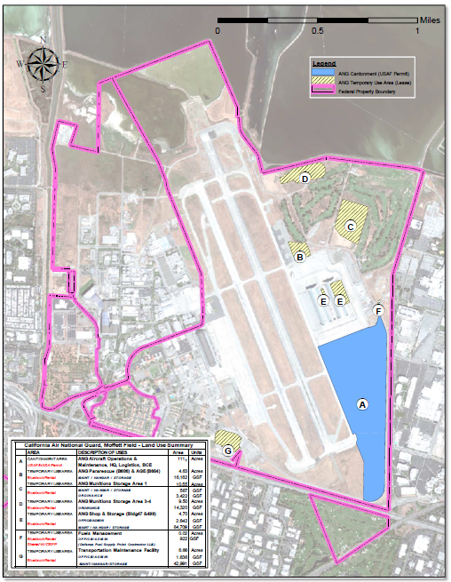
Setting the State: 2009 TUAs
A (Blue): Existing 111 acre 129th RQW Cantonment Area
B, C, D, E, F (Yellow) 25 acres of permitted property that PV wants to develop
TUA “G” first to close, Returned to NASA post MILCON
TUA “E” Returned to NASA and then transferred to PV post MILCON
TUA “B” part of the first exchange
Notes:
NARRATIVE:
Quick overview of our focus areas.

Slide 7
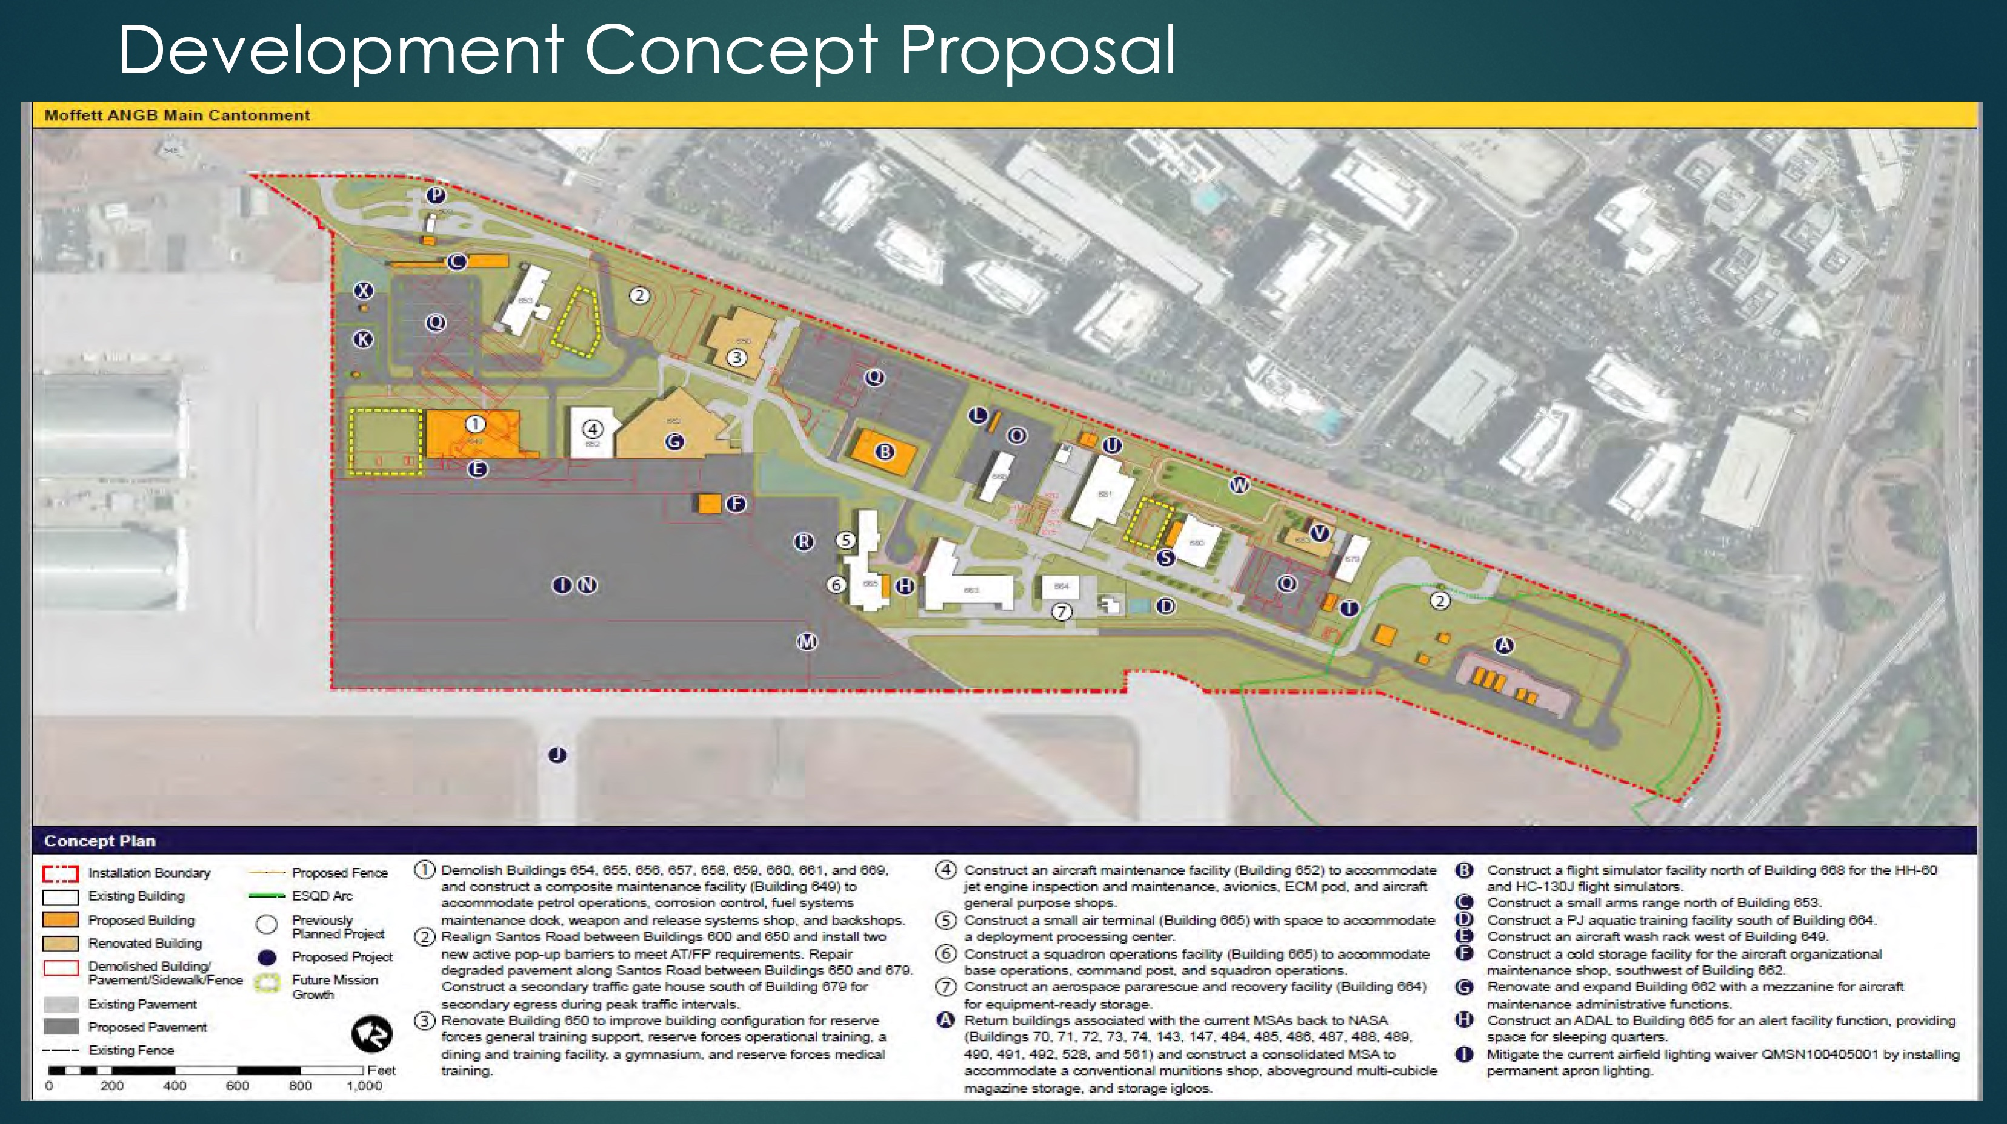
2009 TUAs
Notes:
NARRATIVE:
Quick overview of our focus areas.

Slide 8
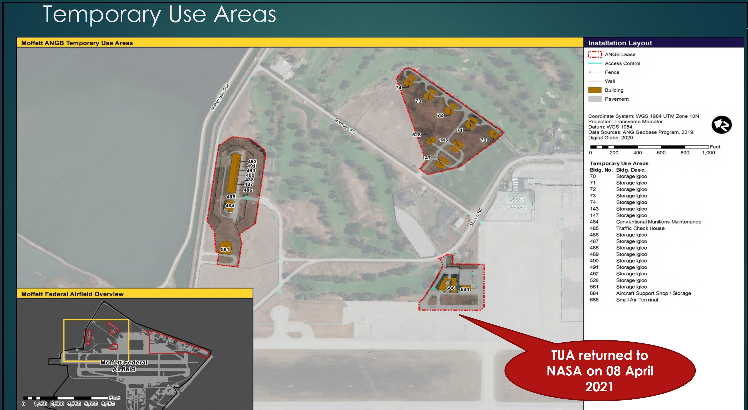
2009 TUAs
TUA “G” first to close
Notes:
NARRATIVE:
Quick overview of our focus areas.

Slide 9
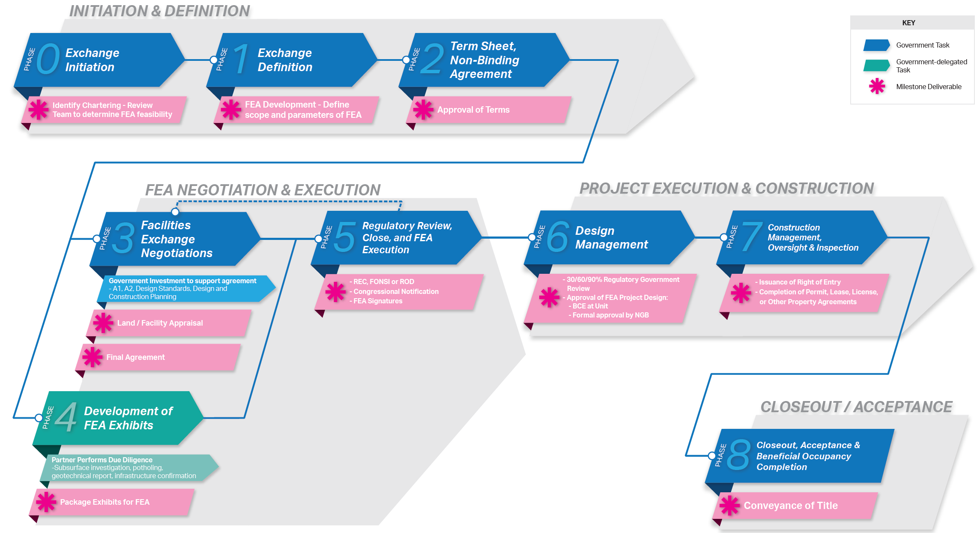
Facility Exchange Process
Notes:
NARRATIVE:
Quick overview of our focus areas.

Slide 10
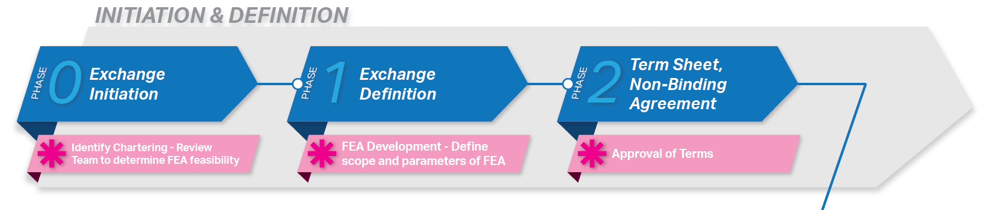
Initiation & Definition
Notes:
NARRATIVE:
Quick overview of our focus areas.

Slide 11
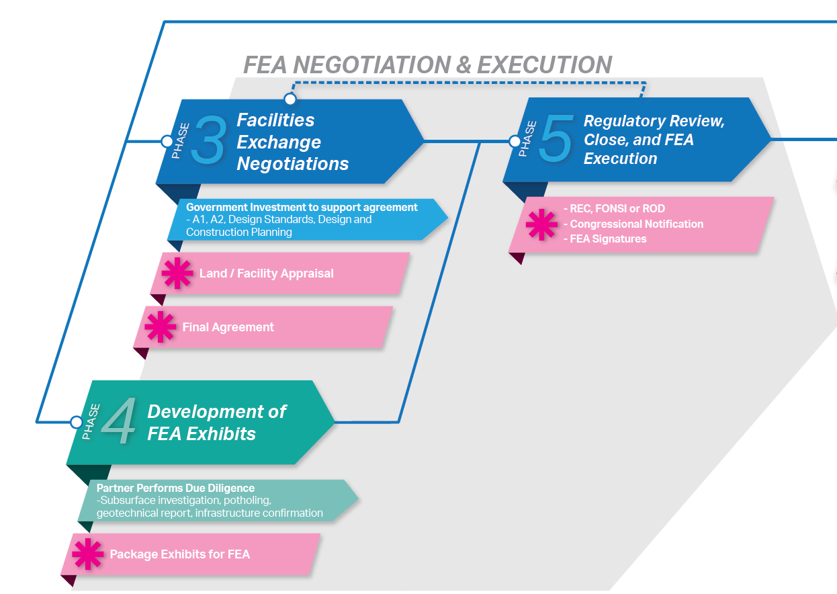
Negotiation & Execution
Notes:
NARRATIVE:
Quick overview of our focus areas.

Slide 12
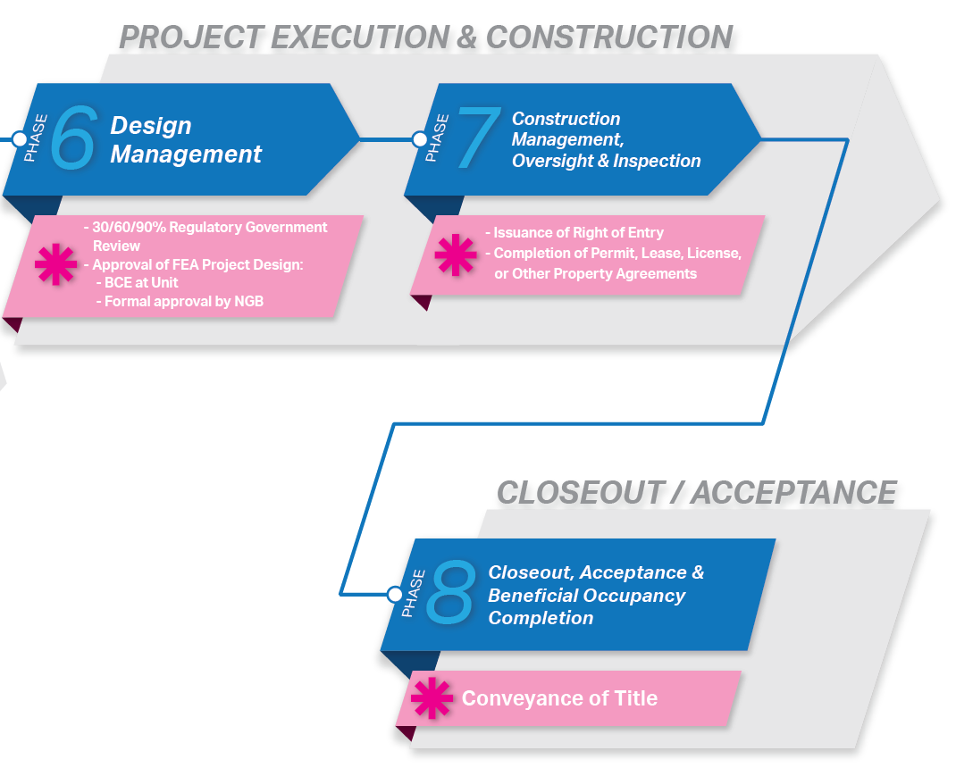
Execution
Notes:
NARRATIVE:
Quick overview of our focus areas.

Slide 13
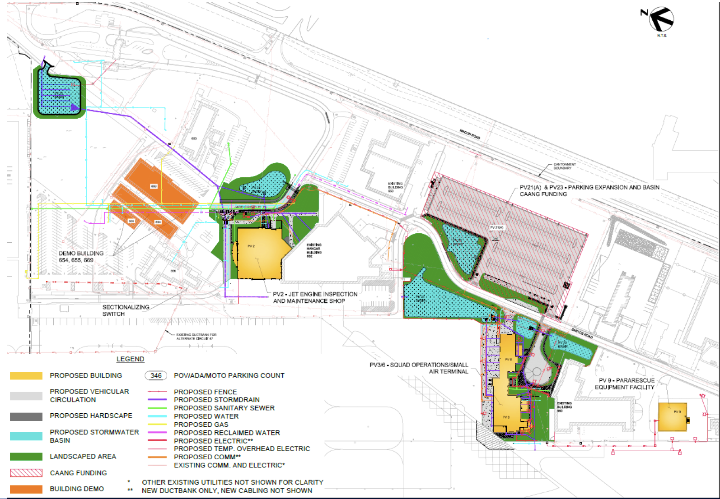
Execution
Notes:
NARRATIVE:
Quick overview of our focus areas.

Slide 14
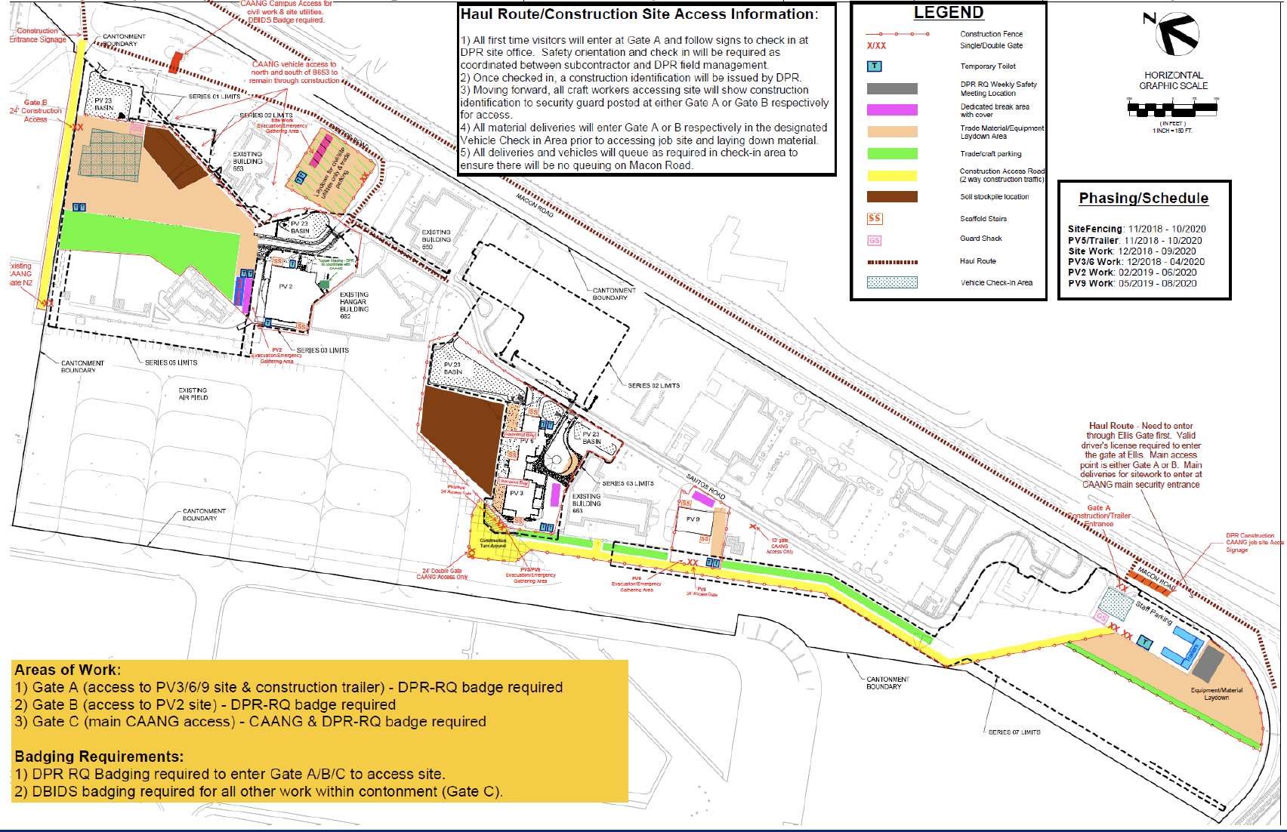
Execution
Notes:
NARRATIVE:
Quick overview of our focus areas.

Slide 15
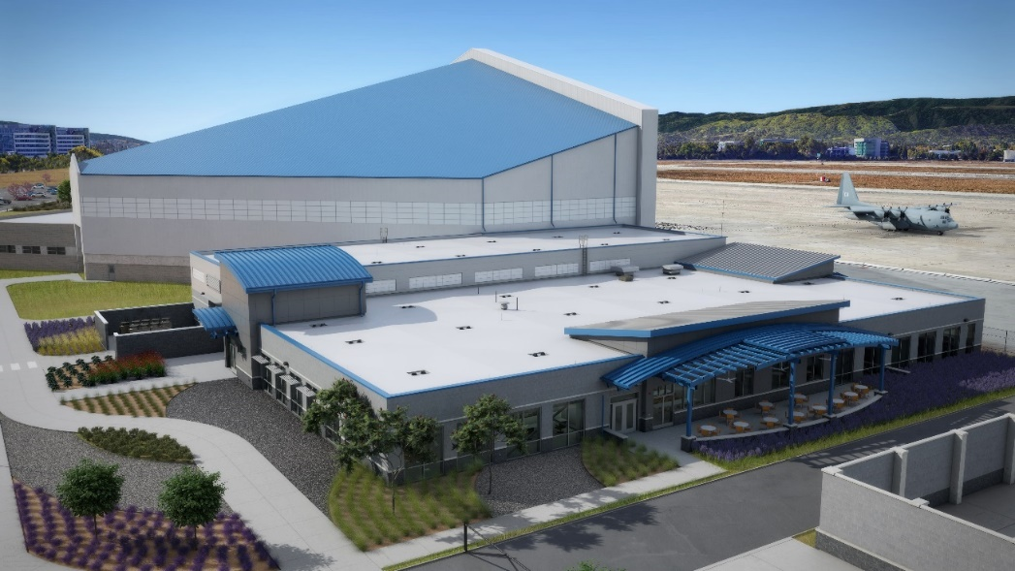
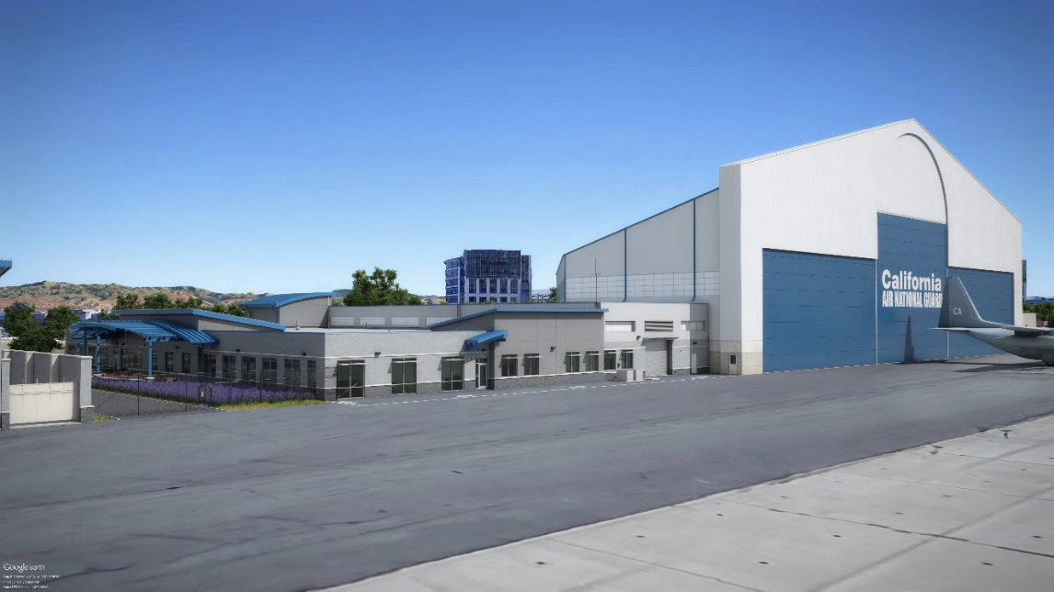
Execution
Notes:
NARRATIVE:
Quick overview of our focus areas.

Slide 16
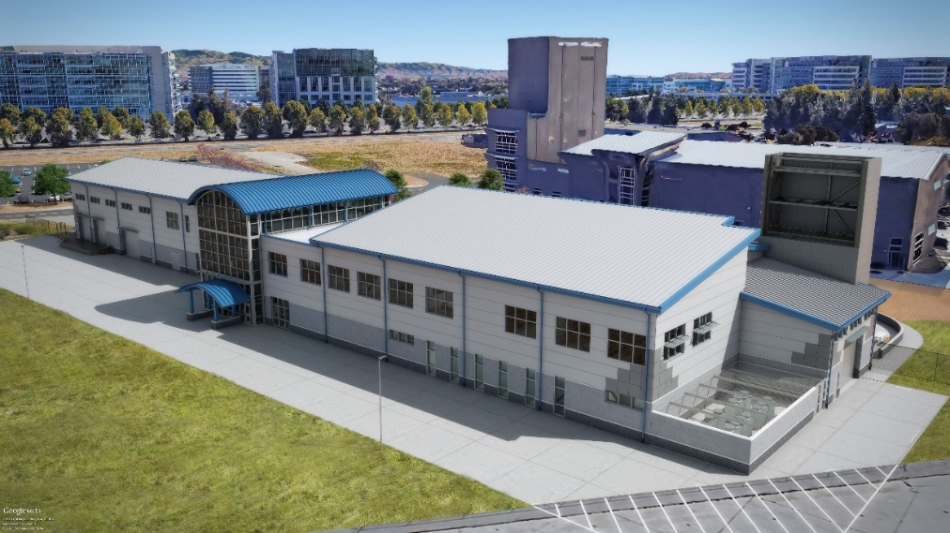
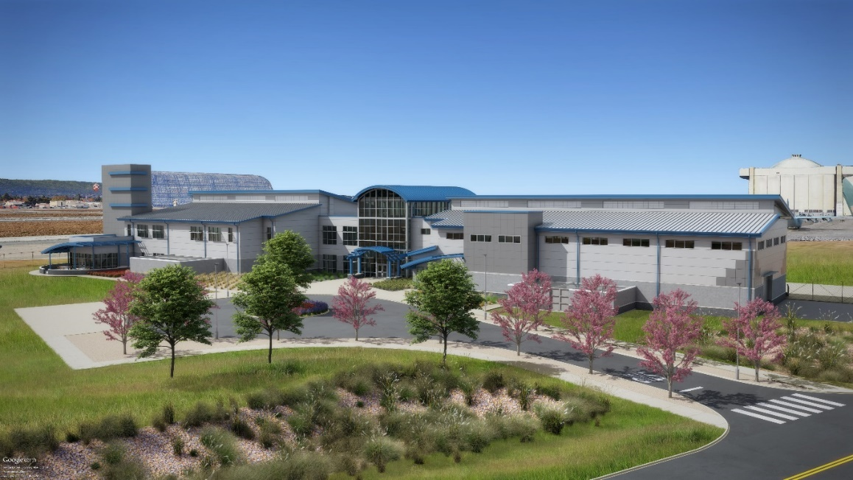
Execution
Notes:
NARRATIVE:
Quick overview of our focus areas.

Slide 17
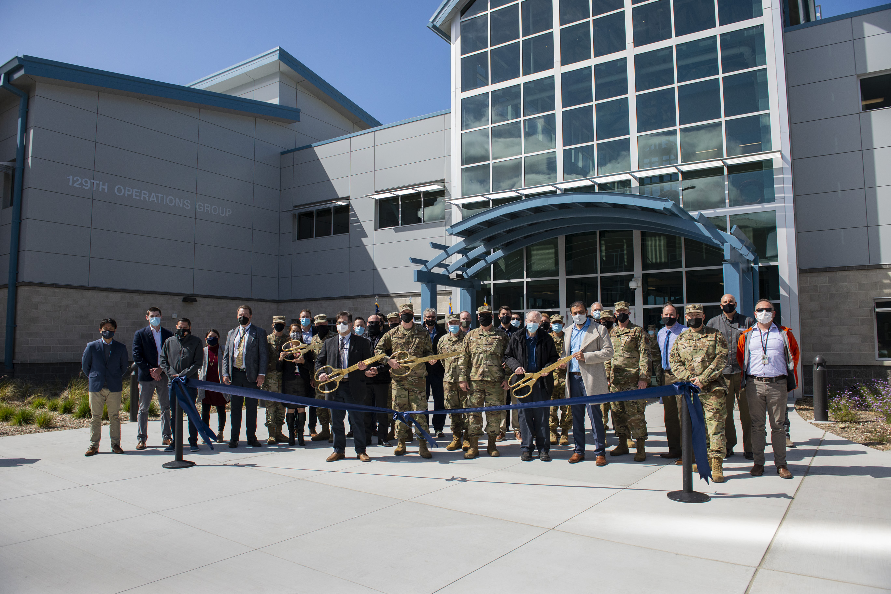

Execution
Notes:
NARRATIVE:
Quick overview of our focus areas.

Slide 18
Questions

Slide 19
Title 10 U.S.C. Section 18240
§ 18240. ACQUISITION OF FACILITIES BY EXCHANGE
(a) Exchange Authority.— In addition to the acquisition authority provided by section 18233 of this title, the Secretary of Defense may authorize the Secretary of a military department to acquire a facility, or addition to an existing facility, needed to satisfy military requirements for a reserve component by carrying out an exchange of an existing facility under the control of that Secretary through an agreement with an Executive agency (as defined in section 105 of title 5), the United States Postal Service, or a State, local government, local authority, or private entity. The acquisition of a facility or an addition to an existing facility under this section may include the acquisition of utilities, equipment, and furnishings for the facility.
(b) Facilities Eligible for Exchange.— Only a facility of a reserve component that is not excess property (as defined in section 102 (3) of title 40) may be exchanged using the authority provided by this section.
(c) Equal Value Exchange.— In any exchange carried out using the authority provided by this section, the value of the replacement facility, or addition to an existing facility, including any utilities, equipment, and furnishings, to be acquired by the United States shall be at least equal to the fair market value of the facility conveyed by the United States under the agreement. If the values are unequal, the values may not be equalized by any payment of cash consideration by either party to the agreement.
(d) Requirements for Replacement Facilities.— The Secretary of a military department may not accept a replacement facility, or addition to an existing facility, to be acquired by the United States in an exchange carried out using the authority provided by this section until that Secretary determines that the facility or addition—
(1) is complete and usable, fully functional, and ready for occupancy;
(2) satisfies all operational requirements; and
(3) meets all applicable Federal, State, and local requirements relating to health, safety, fire, and the environment.
Notes:
NARRATIVE:
Quick overview of our focus areas.

Slide 20
Title 10 U.S.C. Section 18240
§ 18240. ACQUISITION OF FACILITIES BY EXCHANGE (Continued)
(e) Consultation Requirements.— The Secretary of a military department authorized to enter into an agreement under subsection (a) to convey an existing facility under the control of that Secretary by exchange shall consult with representatives of other reserve components to evaluate—
(1) the value of using the facility to meet the military requirements of another reserve component, instead of conveying the facility under this section; and
(2) the feasibility of using the conveyance of the facility to acquire a facility, or an addition to an existing facility, that would be jointly used by more than one reserve component or unit.
(f) Advance Notice of Proposed Exchange.—
(1) When a decision is made to enter into an agreement under subsection (a) to exchange a facility using the authority provided by this section, the Secretary of the military department authorized to enter into the agreement shall submit to the congressional defense committees a report on the proposed agreement. The report shall include the following:
(A) A description of the agreement, including the terms and conditions of the agreement, the parties to be involved in the agreement, the origin of the proposal that lead to the agreement, the intended use of the facility to be conveyed by the United States under the agreement, and any costs to be incurred by the United States to make the exchange under the agreement.
(B) A description of the facility to be conveyed by the United States under the agreement, including the current condition and fair market value of the facility, and a description of the method by which the fair market value of the facility was determined.
(C) Information on the facility, or addition to an existing facility, to be acquired by the United States under the agreement and the intended use of the facility or addition, which shall meet requirements for information provided to Congress for military construction projects to obtain a similar facility or addition to an existing facility.
Notes:
NARRATIVE:
Quick overview of our focus areas.

Slide 21
Title 10 U.S.C. Section 18240
§ 18240. ACQUISITION OF FACILITIES BY EXCHANGE (Continued 2)
(D) A certification that the Secretary complied with the consultation requirements under subsection (e).
(E) A certification that the conveyance of the facility under the agreement is in the best interests of the United States and that the Secretary used competitive procedures to the maximum extent practicable to protect the interests of the United States.
(2) The agreement described in a report prepared under paragraph (1) may be entered into, and the exchange covered by the agreement made, only after the end of the 30-day period beginning on the date the report is received by the congressional defense committees or, if earlier, the end of the 21-day period beginning on the date on which a copy of the report is provided in an electronic medium pursuant to section 480 of this title.
(3) Section 2662 of this title shall not apply to an exchange carried out using the authority provided by this section.
(g) Relation to Other Military Construction Requirements.— The acquisition of a facility, or an addition to an existing facility, using the authority provided by this section shall not be treated as a military construction project for which an authorization is required by section 2802 of this title.
Notes:
NARRATIVE:
Quick overview of our focus areas.

