Slide 1
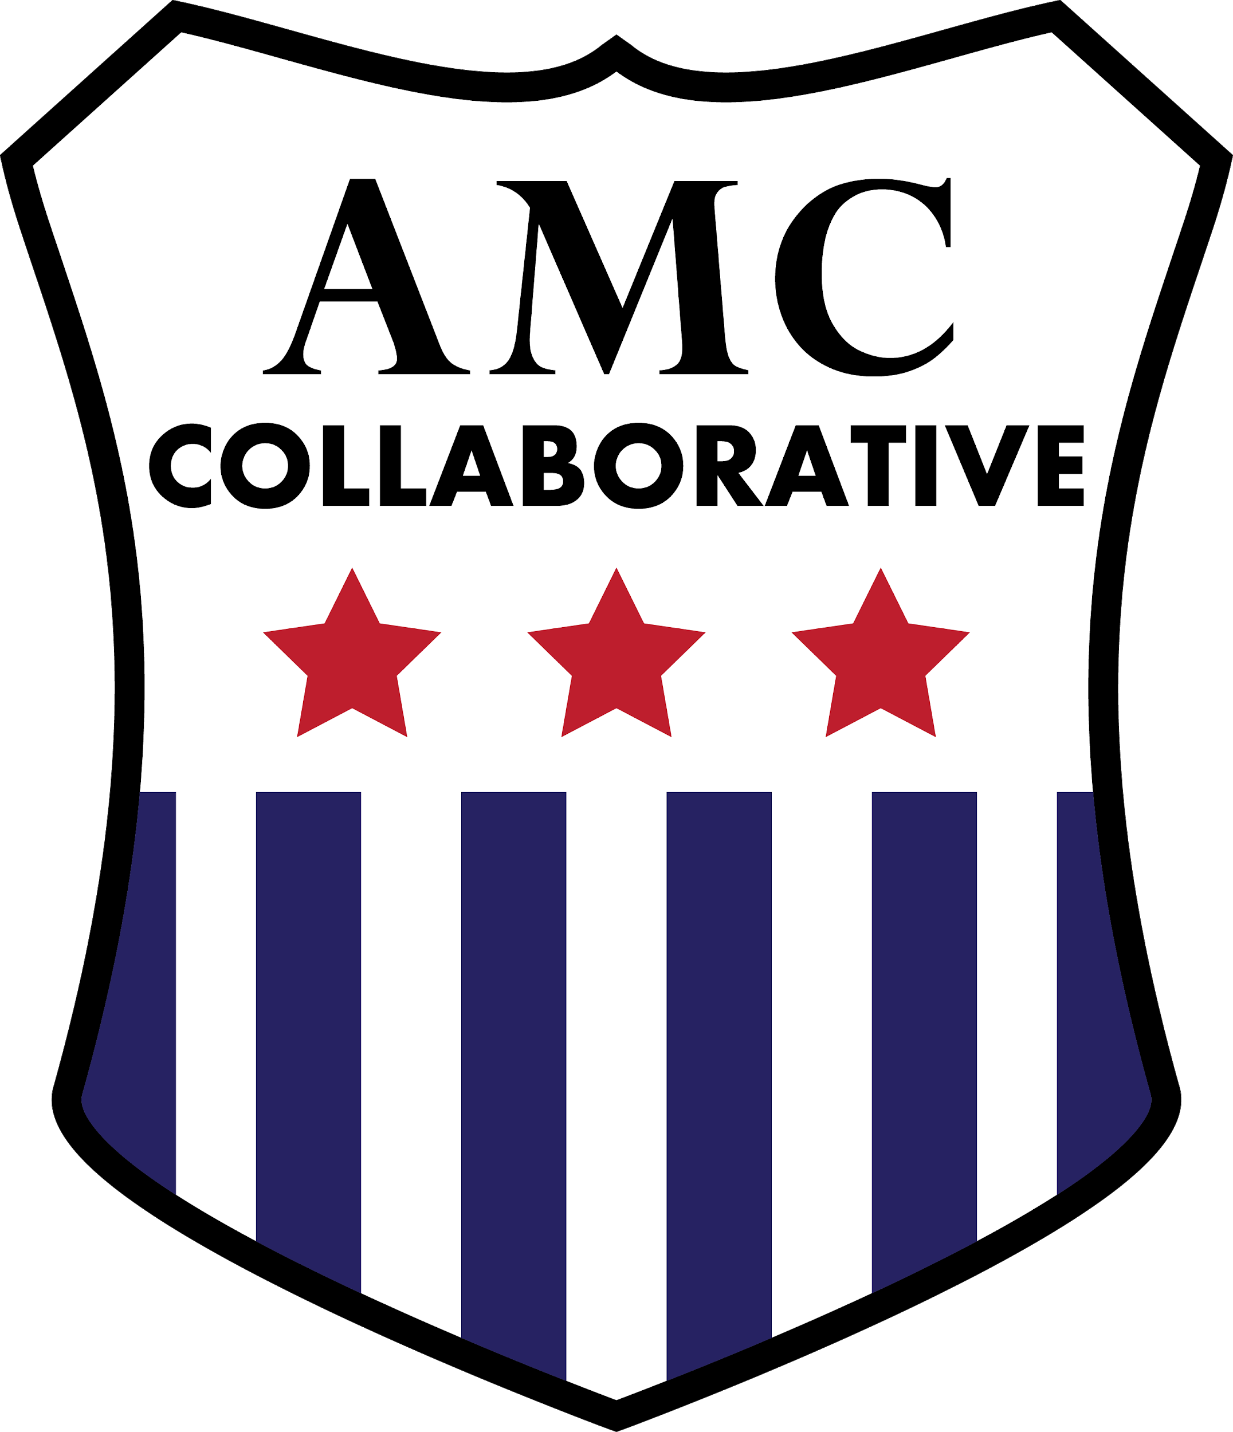
A New Federal Bottom-Up Policy Model: The Defense Manufacturing Community Support Program and Beyond
November 1, 10:00am to 10:45 am
Association of Defense Communities
2022 Conference, Phoenix, Arizona
American Manufacturing Communities Collaborative (AMCC)

Slide 2
Agenda
An Overview: Matt Bogoshian, AMCC Executive Director
A Regional Case Study: Debra Franklin, Associate Vice President Wichita State University
A Federal Program Perspective: Elizabeth Chimienti, Deputy Director for Community Adjustment, DOD Office of Local Defense Community Cooperation

Slide 3
The History:
Defense Manufacturing Critical to American Progress
Manufacturing Key to the Enlightenment
Manufacturing Key to the Founding Fathers
Manufacturing as the Arsenal of Democracy, WWII
Manufacturing as Dual Purpose, Endless Frontier Act Post WWII
Manufacturing into the 21st Century, Investing in Manufacturing Community Partnership (IMCP), the 2018 DOD Report
New 2019-2022 Legislation, Defense Manufacturing Community Support Program (DMCSP)

Slide 4
New Federal Interventions to Empower Regions
IMCP to AMCC to 2018 DOD Report to NDAA and DMCSP
Recognizing the need to strengthen manufacturing ecosystems
Each regional manufacturing ecosystem is different
Common features are the Big 6
2. 2021, 2022 Laws that support, emulate DMCSP

Slide 5
Along the Way AMCC Emerged
AMCC Monday national calls include informal discussions and short briefings, nearly all virtual, 2021 strategic plan
The Sustainable Development Briefing Series (4)
(Equity, Environmental Sustainability, Economic Competitiveness, Security)
3. The House Manufacturing Caucus Briefing Series (7)
(Overview and the Big 6)

Slide 6
AMCC Strategic Plan Goals
Goal 1 Grow: Grow the national community of manufacturing ecosystem partners with an intentional focus on enhancing competitiveness through innovation, equity, and environmental sustainability.
Goal 2 Integrate: Connect with and advocate for integrated national and state manufacturing policies with strong regional public and private partners.
Goal 3 Measure: Develop a standard set of metrics across communities that can be rolled up to demonstrate impact.
Goal 4 Sustain: Build and significantly expand organizational sustainability.
Link to the plan here.

Slide 7
Some Strategic Documents Informing & Reflecting
the Bottom-up Model

Slide 8
AMCC federally designated in 2022 as America’s national manufacturing Community of Practice by the Dept. of Commerce, Economic Development Administration

Slide 9
Matt Bogoshian
AMCC Executive Director
matt.bogoshian@amccmail.org
831-601-9509

