Slide 1
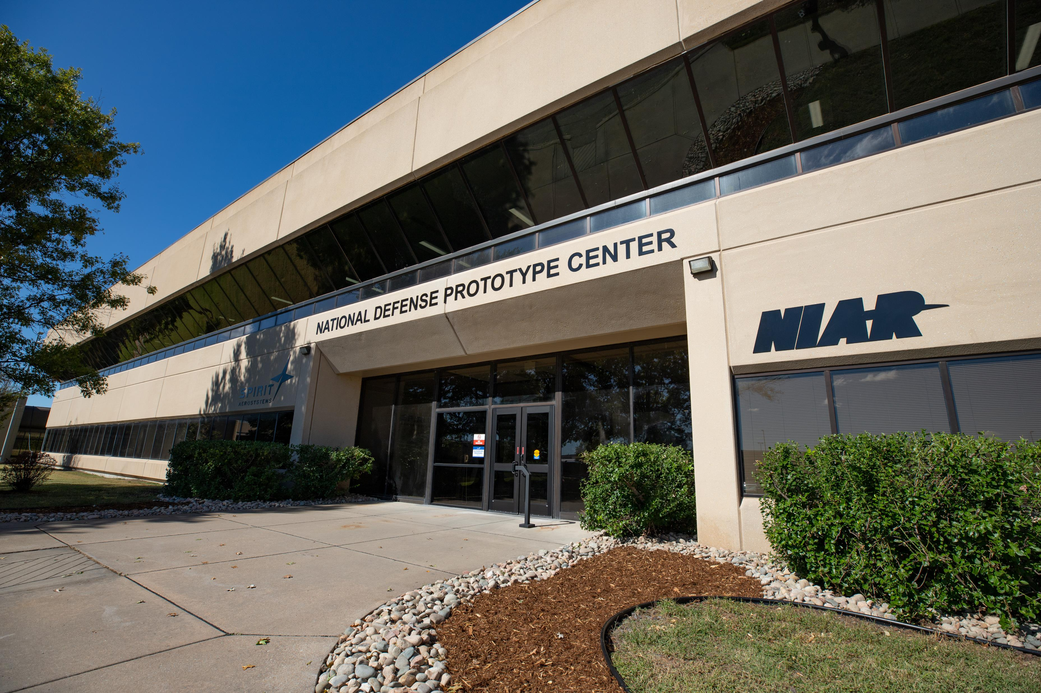
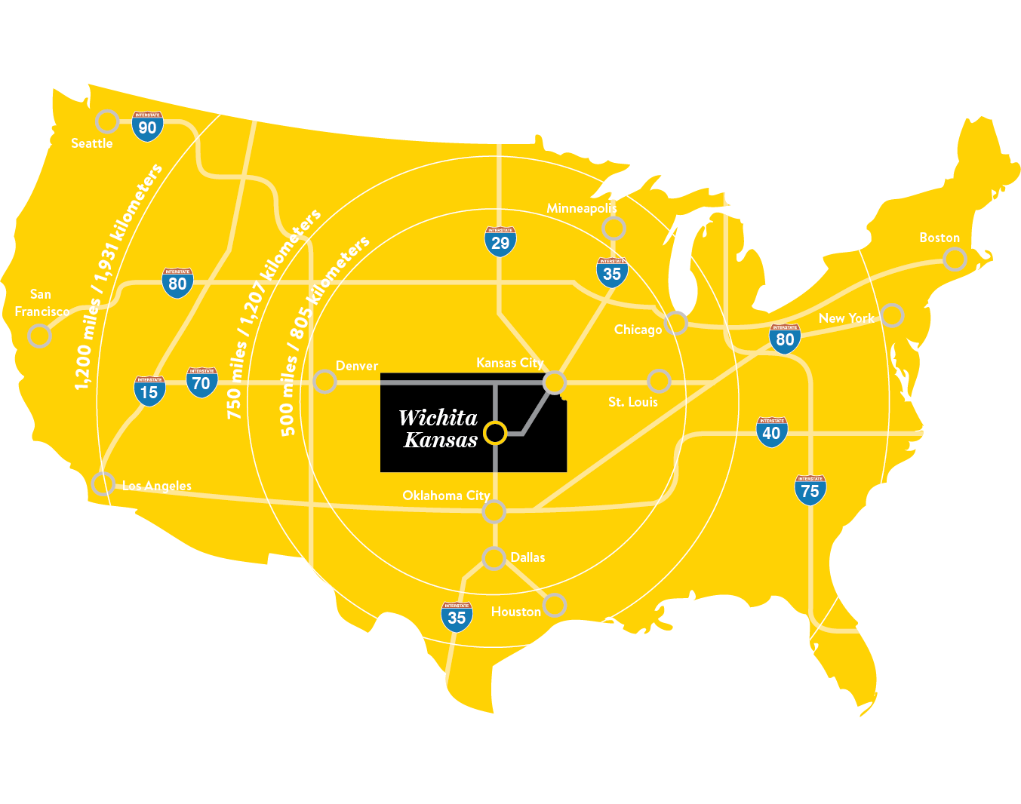
South Kansas Defense Manufacturing Community:
National Defense Prototype Center
The South Kansas region is a mixed manufacturing ecosystem anchored in aerospace products. Due to the nature of aerospace’s complex and regulated manufacturing environment, the region’s manufacturers have highly complex design, automation, advanced materials, machinery, and fabrication supply chain capabilities.

Slide 2
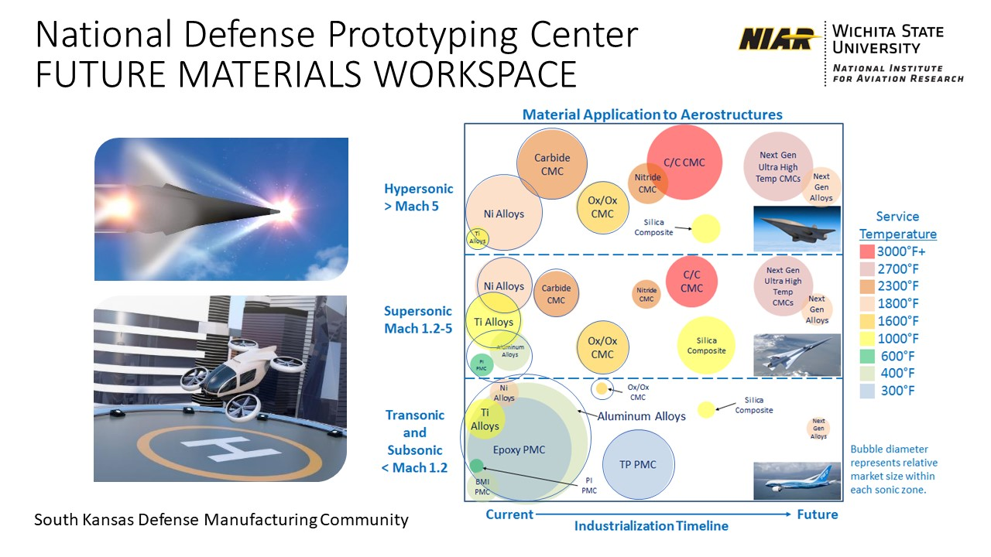

Slide 3
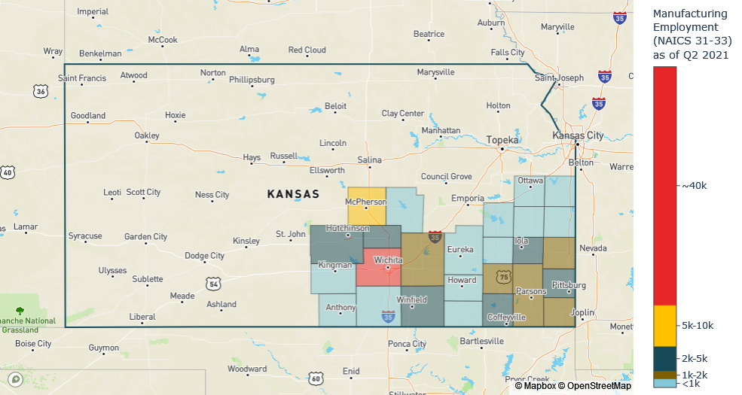
South Kansas Manufacturing Employment

Slide 4


Service Area: South Kansas (27 county region) with a defense manufacturing hub in the Wichita, Kansas Metropolitan Statistical Area (MSA). South Kansas includes the following counties: Allen, Anderson, Bourbon, Butler, Chautauqua, Cherokee, Coffey, Cowley, Crawford, Elk, Franklin, Greenwood, Harper, Harvey, Kingman, Labette, Linn, Marion, McPherson, Miami, Montgomery, Neosho, Reno, Sedgwick, Sumner, Wilson, and Woodson.
Defense Modernization Priorities: South Kansas will strengthen the national security innovation base by expanding ultra-high and high-temperature material characterizations, capabilities, process tools, sustainment planning, technical workforce, and engineering competencies for the purpose of enhancing the defense industrial base capabilities and accelerated weapon system prototype development.
WHO MANUFACTURERS
WHAT WE MAKE
WHERE PURCHASED
SUB AGENCY PRIME AWARDS, SOUTH KANSAS, 2015-2020 TOTAL DOLLARS OBLIGATED BY PRODUCT DESCRIPTION (Aircraft product descriptions shaded)
ALL DATA BY PRIME CONTRACTOR, PLACE OF PERFORMANCE, SELECTED ADVANCED MANUFACTURING NORTH AMERICAN INDUSTRY CLASSIFICATION SYSTEM (NAICS) CODES
DEFENSE LOGISTICS AGENCY (38.6% OF TOTAL S. KANSAS) | PERCENT |  | DEPARTMENT OF THE ARMY (31.6% OF TOTAL S. KANSAS) | PERCENT |  | DEPARTMENT OF THE AIR FORCE (17.9% OF TOTAL S. KANSAS) | PERCENT |  | DEPARTMENT OF THE NAVY (2.2% OF TOTAL S. KANSAS) | PERCENT
AIRCRAFT ENGINES AND SPARES | 27.0% |  | AMMUNITION | 18.5% |  | AIRFRAMES AND SPARES | 58.1% |  | AIRFRAMES AND SPARES | 41.8%
AIRFRAMES AND SPARES | 21.6% |  | AIRCRAFT ENGINES AND SPARES | 18.2% |  | OTHER AIRCRAFT EQUIPMENT | 14.8% |  | SERVICES | 22.0%
TEXTILES; CLOTHING AND EQUIPAGE | 20.7% |  | OTHER AIRCRAFT EQUIPMENT | 17.5% |  | SERVICES | 14.4% |  | OTHER AIRCRAFT EQUIPMENT | 12.9%
OTHER AIRCRAFT EQUIPMENT | 14.4% |  | AIRFRAMES AND SPARES | 10.2% |  | ALL OTHERS | 12.7% |  | ELECTRONICS AND COMMUNICATION EQUIPMENT | 4.9%
ALL OTHERS | 16.3% |  | ALL OTHERS | 35.6% |  |  |  |  | AIRCRAFT ENGINES AND SPARES | 1.9%
 |  |  |  |  |  |  |  |  | ALL OTHERS | 16.5%
Source: USASpending.gov; Department of Defense prime contract data by place of performance; selected NAICS codes include Manufacturing, Information, Professional, and R&D; data accessed on May 13, 2021.
Notes:
Slide 4 and 5: Service Area Identification and Regional Assessment: NOTE - The white paper should include more detail and shall include an integrated, evidence-based assessment of the local defense industrial ecosystem (i.e., the whole range of workforce and training, supplier network, research and innovation, infrastructure/site development, operational improvements and capital access components needed for manufacturing activities) as it exists today in the region defined by the applicant. The assessment should provide a Strengths, Weaknesses, Opportunities and Threats analysis as it pertains to supporting the manufacturing ecosystem of the region.
- What area are you serving? This could include cities, counties, regions, states, etc.
- What are the specific defense manufacturing technologies and or supply chains on which the consortium will focus?
- How are the identified technologies/supply chains considered top-ranked in the nation?
- How do they tie into Defense modernization priorities?
What are the key gaps and opportunities within the service area?
Advanced materials for advanced manufacturing/high-technology manufacturing including transportation equipment manufacturing (336), machinery manufacturing (333) and petroleum and coal products manufacturing (324). The employment location quotient for aerospace products and parts manufacturing (NAICS 3364) is 23.35 – employment concentration is over 23 times the national average concentration.

Slide 5



















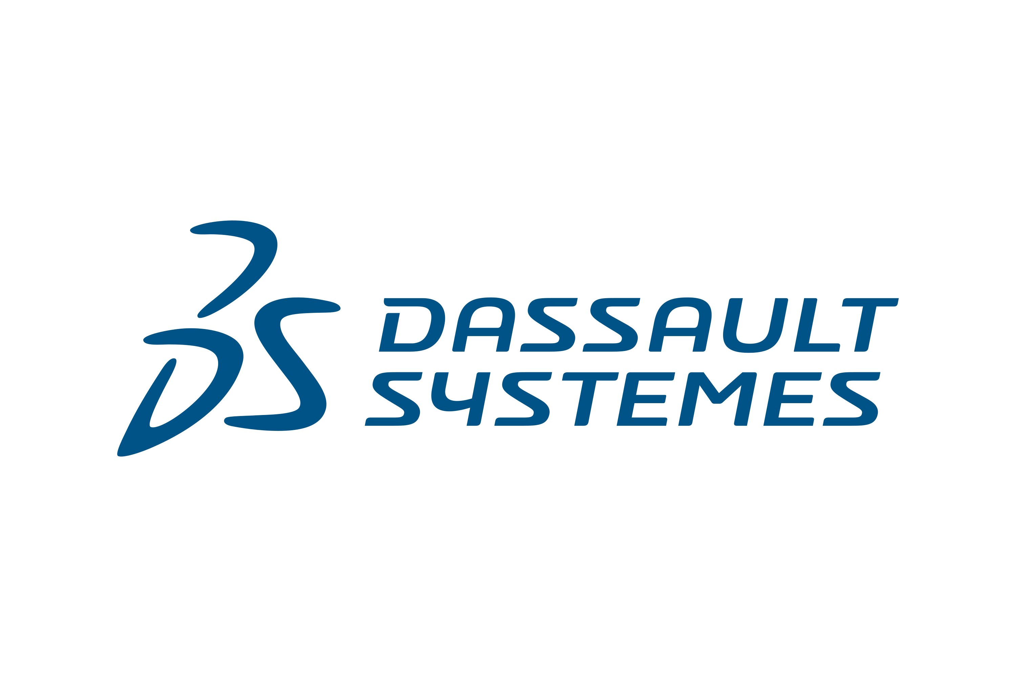











South Kansas Consortium Makeup and Leadership Structure
The South Kansas region is a mixed manufacturing ecosystem anchored in aerospace products. Due to the nature of aerospace’s complex and regulated manufacturing environment, the region’s manufacturers have highly complex design, automation, advanced materials, machinery, and fabrication supply chain capabilities.
Defense Manufacturing Community Lead Organization
Technical Advisory Panel
John Tomblin, Ph.D. Principal Investigator
Established in 2003
239 Manufacturing Members
23 Board Members
Defense Industry Base
DoD
Institutes
Defense
Research
Education & Workforce
Economic Development

Slide 6
Logic Model and Performance Metrics
Goal: To establish programs of record to build warfighting inventory utilizing high-temperature materials and production- and sustainment-enabling technologies.
Resources
Activities
Outputs
Outcomes: Short-Term and Long-Term
Wichita, Kansas
Heartland Location
Materials Expertise
FAA and EASA Acceptance of Composites Specification and Design Values
High-Precision Manufacturing
500+ Defense Prime Contractors in Region
NIAR
$130+ Million
2020 Aero R&D
1.3 Million
Square Feet – 6 Locations
1986
Established
900+
Employees, Over 10,000 Years Industry Experience
300+
Student Intern Employees
Research & Development
Titanium-6 Aluminum-4 Vanadium (Ti-6Al-4V)
Solvent-Based Ox/Ox Ceramic Matrix Composite Material
Critical Skills
Undergraduate, Graduate and/ or Technical Internships
Intern Security Clearances
Prototyping Facility
Secure Environment
Equipment Expansion: Autoclave and NDI
Small Business Support
RDDT&E Technical Assistance, Qualifications, and Certifications
Access to Secure Facility and Website Communications
R&D
Ti-6Al-4V Equivalency Reports: First round of data at 6 months, second round at 9 months, and third at 12 months
Solvent-Based Ox/Ox
Equivalency Report: Panels available at 4 months, data available at 7 months, and draft report at 9 months
Critical Skills
20+ interns experienced with test plan development, processing parameters, coupon design, testing parameters, and data analysis
20% interns get security clearances
Prototyping Facility
Establish and utilize capabilities in National Defense Prototyping Center
Bid, purchase, and install additional equipment in secure environment
Small Business Support
Perform increased number and value of contracts with defense industrial base
With specific need, use DD254 to sponsor small- and medium-sized firms
R&D High-Temp Materials Characterization
Ti-6Al-4V: Short-Term (ST) – Characterization will increase efficiency from an economic and manufacturing standpoint. Long-Term (LT) – Benefit reduced cost of military vehicles, both ground and aviation, space vehicles, commercial vehicles, and increasing the number of suppliers to those program types.
Ox/Ox: ST – Capable of operations at 1,650°F, this material is ideal for high-temperature areas of aircraft, thereby increasing fleet capabilities. LT – Increased performance of engine veins, blades, exhaust, and exterior components such as shielding and fins for low orbit aircraft will benefit from use of this material.
Critical Skills – Workforce
and 2) Experienced interns (some with security clearances): ST – Interns help NIAR and NDPC continue research at their facilities. LT – Advanced material skill sets in an advanced manufacturing method result in a stronger work force.
Prototyping Facility and Small Business
and 2) ST – This effort will actively pursue and win over five new defense program opportunities, some of which require a classified facility for the development of advanced materials and manufacturing technologies, as well as digital engineering and full-scale prototyping. LT – Defense platforms will mature from prototype to full production manufacturing with regional and national defense supply chain.
Performance Metrics:
R&D: Titanium-6Aluminum-4Vanadium (Ti-6Al-4V) and Solvent Based Ox/Ox Ceramic Matrix Composite Materials process control equivalency report published through NCAMP. Part 3: Supporting Documentation includes equivalency matrices that cover density, coefficient of thermal expansion, specific heat capacity, thermal diffusivity, and conductivity
Critical Skills: For student interns, skill metrics include number of student interns (15), number of hours worked on defense projects (23,400), number of student personnel security clearance applications submitted (5), and clearances awarded (4).
Prototyping Facility and Small Business: Actively pursue and win over five new defense program opportunities some of which require a classified facility for the development of high temperature advanced materials and manufacturing technologies, as well as digital engineering and full-scale prototyping. Number of jobs and amount of investment.
Notes:
Slides 8: Logic Model and Proposed Performance Metrics
- A concise presentation of the resources and activities envisioned in the proposal to produce specific outputs and outcomes (short and long-term)
- A description of 3-5 performance metrics that will be used measure the proposed outcomes.
ADD SPECIFIC TARGETS

Slide 7
National Defense Prototyping Center Impacts thru 9/30/22
METRICS
30 Students have submitted for security clearance for SECRET programs
17 Students have been granted security clearance
28 Students have been hired as interns and work an average of 22 – 24 hours per week
RESEARCH & DEVELOPMENT UPDATE
Characterization of Ti-6Al-4V powder bed fusion additively manufactured metal continues for virgin powder as part of pre-qualification trials. Once this step is complete, the full qualification using virgin powder will begin. The reused powder reclaimed from these builds will be blended with virgin powder for the various reuse scenarios.
Oxide /Oxide prepreg material was procured from the supplier (Axiom). During the reporting period, WSU fabricated trial panels and began trial tests prior to official equivalency panel fabrication and testing.
PROTOTYPING FACILITY & SMALL BUSINESS SUPPORT
The construction of the 26 feet by 13 feet diameter autoclave is underway onsite. Construction of footings and utility connections for the autoclave are also underway. Two sintering furnaces are installed and operational with personnel trained. Trial parts are being run in the sintering furnaces now.
The Multi-Method Non-Destructive Inspection equipment have been ordered and are currently being built by vendors, Innerspec and Kuka.
WSU NIAR Composites and ATLAS labs connect with small and medium-sized businesses to identify potential high temperature projects – one project is currently underway.

Slide 8
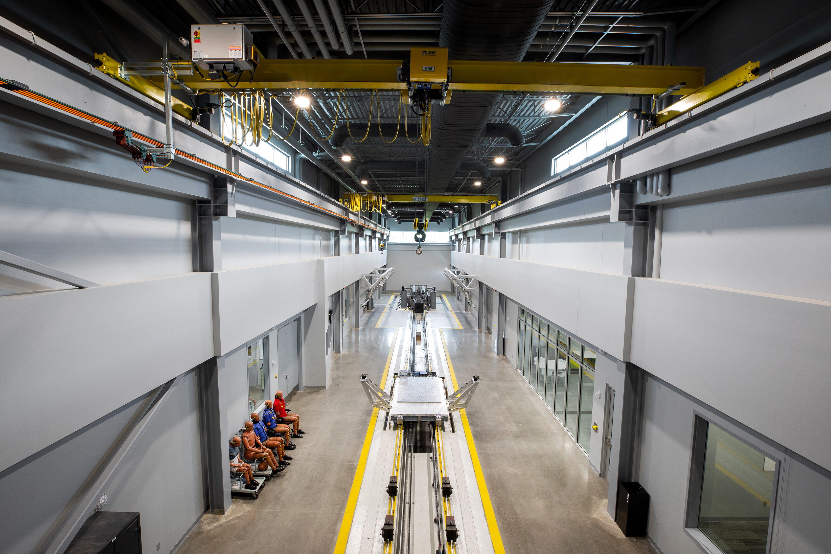
South Kansas
Defense Manufacturing Community:
National Defense Prototype Center
Lead Organization: Wichita State University, National Institute for Aviation Research
Headquarters: Wichita, Kansas Website: www.NIAR.wichita.edu
Leadership: John S. Tomblin, Ph.D., Senior Vice President for Industry and Defense
John.Tomblin@wichita.edu (316) 978-5234
Contact: Debra Franklin, Associate Vice President for Strategic Initiatives
Debra.Franklin@wichita.edu (316) 978-5209
Notes:
PART 1: Defense Manufacturing Community Designation Concept: No more than a ten (10) page PowerPoint presentation (including all relevant maps/drawings/diagrams), which outlines the following:
Slide 1: Consortium Information
- Name of Defense Manufacturing Consortium Community – National Defense Prototype Center
- Name of Lead Organization
- Headquarters' location (City, State)
- Website
- Contact Person (First Name, Last Name)
- Contact Email Address
- Contact Phone Number
- Additional contact, if applicable

