Slide 1
ADC Installation Innovation Forum: Joint Service Panel
1 November 2022 | 1000 – 1045
Army Energy Mailbox: usarmy.pentagon.hqda-asa-iee.mbx.energy-initiatives@army.mil

Slide 2
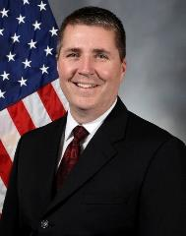
Mr. Robert “Bob” Hughes Executive Director U.S. Army Office of Energy Initiatives
28 October 2021 | Army Energy, Water & Sustainability CoP Webinar
2

Slide 3
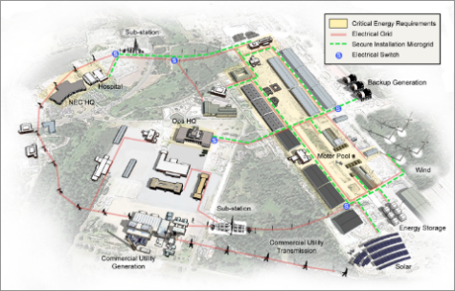
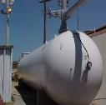
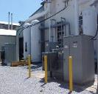
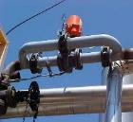
Funding Resilience
Private Equity
Power Purchase Agreements, 10 U.S.C. § 2922a
Real Estate Outgrants (e.g. lease easement), 10 U.S.C. § 2667, 10 U.S.C. § 2668
Utilities Privatization (UP), 10 U.S.C. § 2688
Third Party Financing
Energy Savings Performance Contracts (ESPCs), 42 U.S.C. § 8287 et seq.
Utility Energy Service Contracts (UESCs), 42 U.S.C. § 8256 (c), 10 U.S.C. § 2866, 10 U.S.C. § 2911, 10 U.S.C. § 2913
Appropriated Funding
Military Construction (MILCON)
Energy Resilience and Conservation Investment Program (ERCIP),
10 U.S.C. § 2914, 10 U.S.C. § 2802
Operations and Maintenance (O&M)
Availability and Use of Energy Cost Savings, 10 U.S.C. § 2912
Fort Campbell, KY: MILCON
Conceptual drawing a microgrid included in the FY2018 NDAA
Anniston Army Depot, AL: UESC
Replacement and Modernization of Depot-wide central heating and process high pressure steam plants, HVAC equipment and controls, interior and exterior lighting, compressed air equipment and distributions, and potable water fixtures.
1 Nov 2022

Slide 4
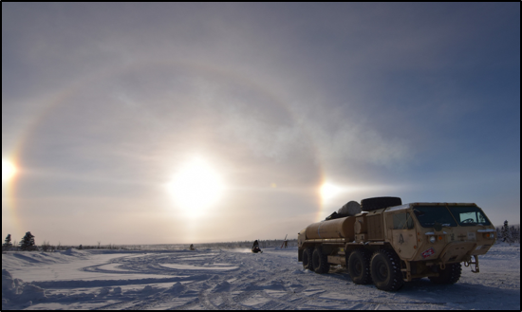
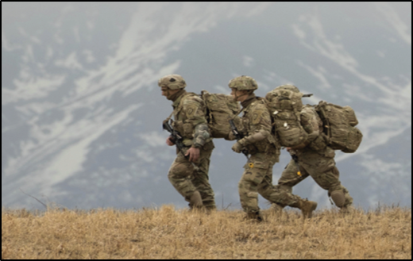
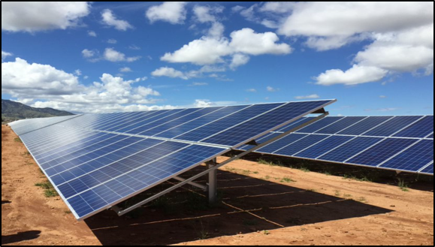
Army Climate Strategy
END STATE
The Army will be a resilient and sustainable land force able to operate in all domains with effective mitigation and adaptation measures against the key effects of climate change, consistent with Army modernization efforts.
INSTALLATIONS
ACQUISTIONS
& LOGISTICS
TRAINING
Enhance resilience and sustainability by adapting infrastructure and natural environments to climate change risks,
securing access to training and testing lands into the future, and mitigating GHG emissions
Increase operational capability while reducing sustainment demand and strengthening climate resilience
Prepare a force that is ready to operate in a climate-altered world
Ft. Irwin, CA
Water Treatment Plant
Ft. Carson, CO
Battery Energy Storage System
The Army Climate Strategy will strengthen our ability to accomplish the mission by strengthening climate preparedness and increasing the resilience of installations and the capabilities of the force
1 Nov 2022

Slide 5
Army Climate Strategy
Installation Energy Objectives
1 Nov 2022

Slide 6
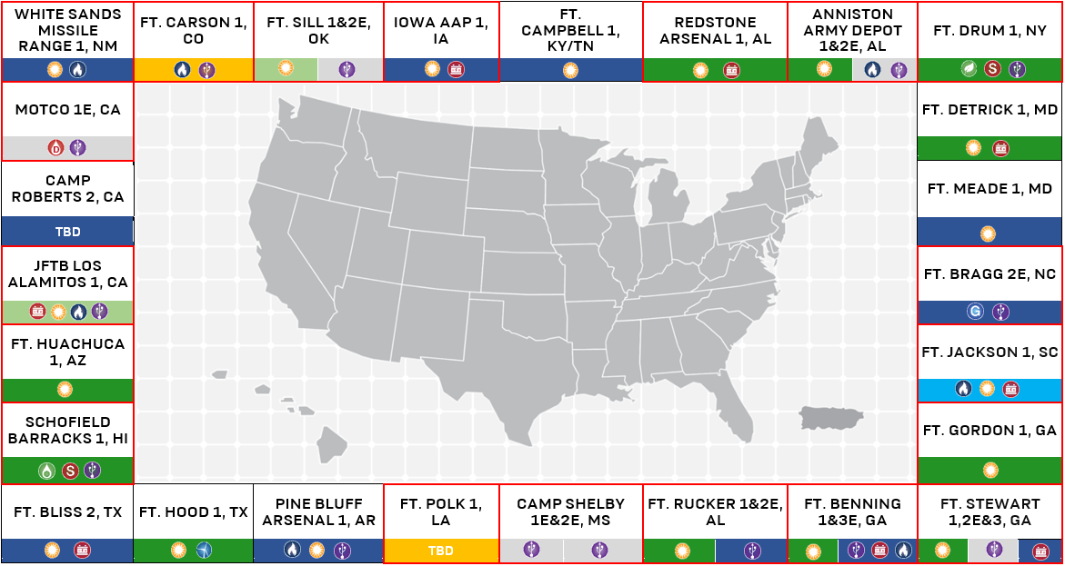
Current Energy Projects Portfolio
Updated 30 September 2022
ERCIP: Energy Resilience and Conservation Investment
Program

Slide 7
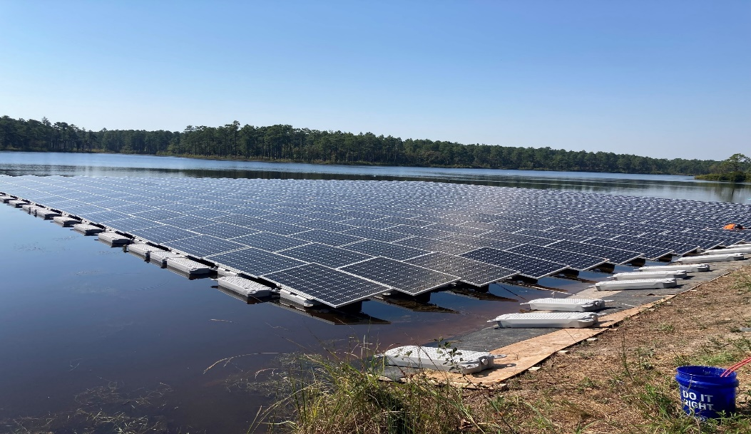
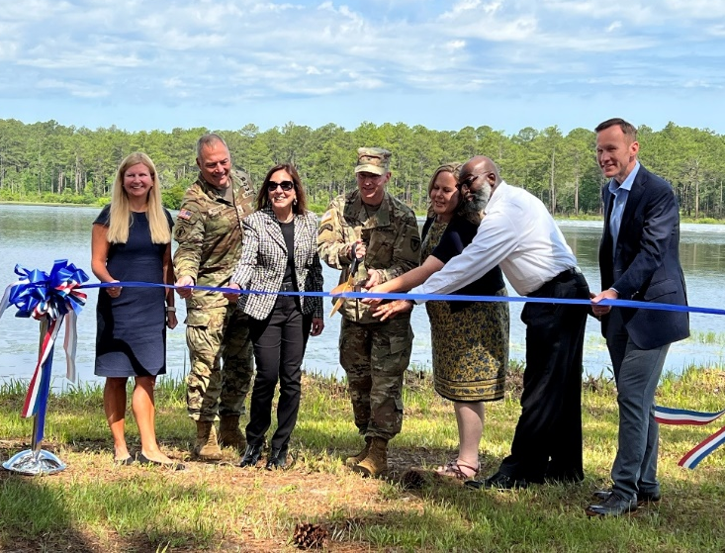
Army, Utility & Industry:
Fort Bragg, NC – UESC
Fort Bragg UESC Floating Solar Project Ribbon-Cutting Event
Renewable energy and on-site energy generation, including 1.1 MW floating solar PV system
2 MW / 2 MWh battery energy storage system
This system will supplement power from the local grid and provide backup power during electric service outages
Fort Bragg, NC
Fort Bragg, in collaboration with Duke Energy and Ameresco, through a Utility Energy Service Contract (UESC), developed the first of its kind in the Department of Defense and the largest floating system in the Southeast United States. The 1.1 megawatt (MW) floating solar system located on the Big Muddy Lake at Camp Mackall on Fort Bragg also includes a 2 MW/2 MWh battery energy storage system. The project provides carbon free on-site generation, supplements power to the local grid, and provides backup power for Camp Mackall during electricity outages.
1 Nov 2022

Slide 8
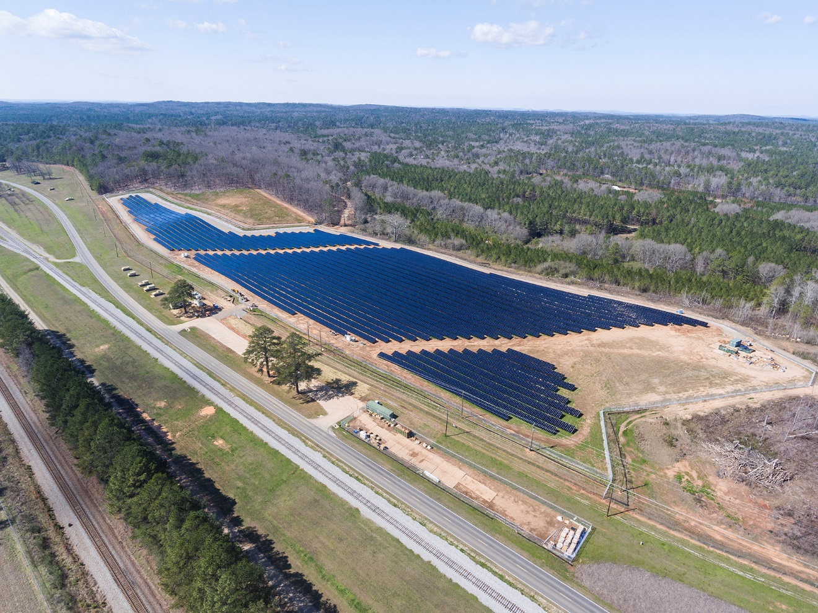
Anniston Army Depot, AL
ERCIP Components:
(FY20) ERCIP funding will be used to execute a 7.5 MWAC microgrid and contingency generation project
Microgrid system will combine 2.6 MWAC of the existing grid-facing solar PV system with three 2.5 MWAC reciprocating internal combustion engine generators
Anniston Army Depot, AL
Anniston Army Depot (ANAD) is a grid-facing 7 megawatt (MW) alternating current (AC) solar energy project in Alabama. The project is fully operational, providing onsite generation, supply diversity and microgrid compatibility. The ANAD project is an example of energy security improvements and resilience of the power grid at installations.
1 Nov 2022

Slide 9
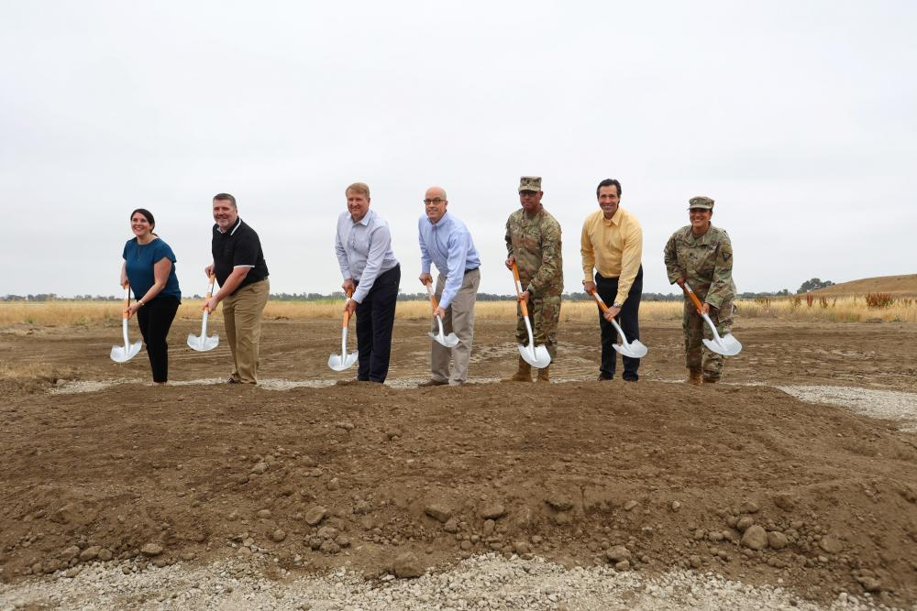
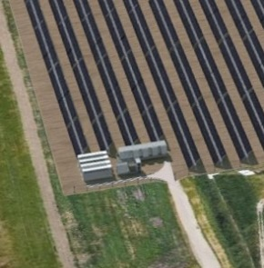
Joint Forces Training Base Los Alamitos, CA
Energy Resilience Project Groundbreaking Event
On 19 May 2022, the Army broke ground energy resilience project at JFTB
Include 26MW of solar, a 20MW/40 MWh battery, 3MW of backup generators, and a microgrid control system
Enhance installation energy resilience by providing power for critical JFTB missions for a minimum of 14 days during electrical grid outages
Joint Forces Training Base (JFTB) – Los Alamitos, CA
Bright Canyon Energy (BCE) will construct, own and operate the energy resilience project on 100 acres for the 30-year lease term. During normal operations, BCE will sell carbon-free energy to San Diego Gas & Electric via the Southern California Edison transmission system. The project supports the Army Climate Strategy goal to build a microgrid on every installation by 2035.
15
1 Nov 2022

Slide 10
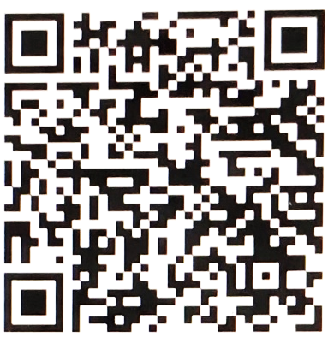
Contact Us
Mr. Robert Hughes
Executive Director
robert.b.hughes48.civ@army.mil
Mr. Dave Irwin, P.E.
Program Director, Project Development
david.j.irwin22.civ@army.mil
OEI Mailbox
usarmy.pentagon.hqda-asa-iee.mbx.energy-initiatives@army.mil

