Slide 1
ADC Installation Innovation Summit
Kirk Phillips
Director
Air Force Office of Energy Assurance
Notes:
This will be here fore we know it. Do we have a good idea what I should
present. I am thinking we need to cover what directions we are going (on
base green energy for resilience, geothermal, nuclear, PVor wind combined
with H2), provide summaries of what we need at our installations (IE
summarize the RSRs we have completed or are completing now), provide the
information on how we will communicate future needs and give them the
information to sign up to our communications.

Slide 2
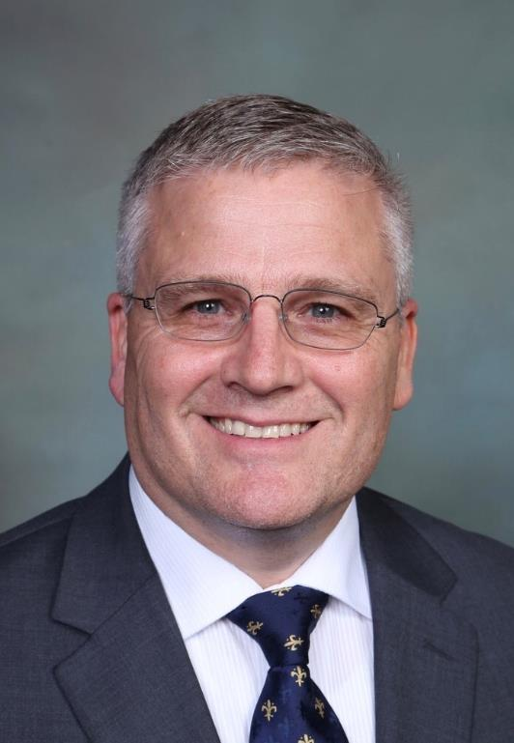
Kirk A. Phillips
Director, Air Force Office of Energy Assurance

Slide 3
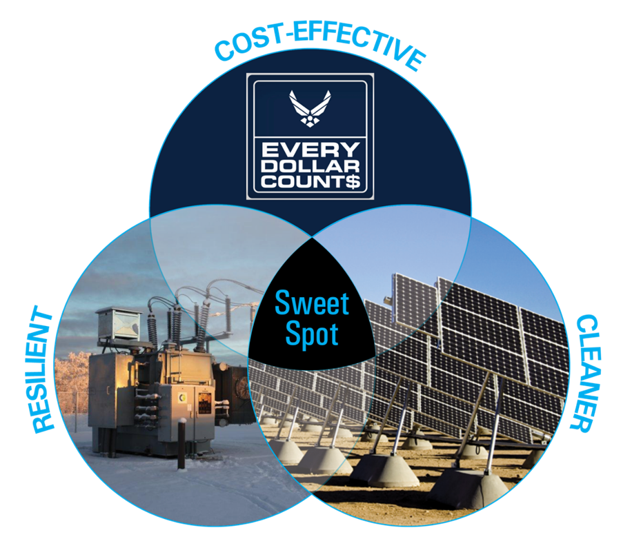
Air Force Energy: The Big Picture
Look first-and-foremost at energy projects designed to improve mission resiliency
Examine energy and water vulnerabilities
Coordinate activities across multiple organizations to enhance mission assurance through energy assurance
Integrate reliable, resilient, cost-effective energy initiatives to ensure power is available when and where the warfighters need it
Notes:
This is a big, intertwined task which touches the entire enterprise. AFCEC/CN work within the larger Air Force Energy construct to apply best practices, track lessons learned, and provide data-driven analysis to develop installation energy and water project solutions that are cost effective, reliable and resilient.
Energy continues to be one of the focus areas in the Air Force, and appropriately so as we learned from the recent natural disasters at Tyndall and Offutt. Both taught us the value of “resilient infrastructure” and energy resilience.
AFCEC/CN acts as the Air Force’s "resiliency advocates" by ensuring projects align with installation resilience needs and with the three strategic goals of the Air Force Energy Flight Plan - improve resiliency, optimize demand, and assure supply.

Slide 4
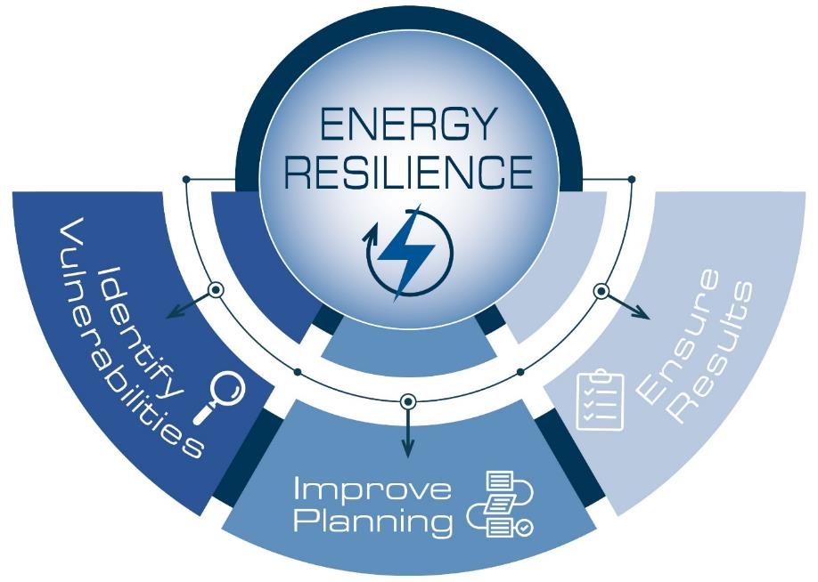
Executing Energy Assurance
With energy resilience at the core, the DAF is aligning every installation energy effort with mission needs
4
Notes:
Goal One: Identify Enabling System Vulnerabilities. Taking a holistic approach to determine both where these mission vulnerabilities exist and the scope of their impact on a mission is essential for any future resilience actions.
In an effort to assess installation energy resilience through real-world testing, the Office of the Assistant Secretary of Defense has led power outage exercises known as Energy Resilience Readiness Exercises (ERRE) across the Services. The DAF will complete a total of five ERREs by the end of FY21, documenting lessons learned and best practices resulting from the process to refine its execution of ERREs. This effort will enable the DAF to begin to meet the legislative requirement included in the FY21 National Defense Authorization Act of five ERREs a year.
Goal Two: Improve Resilience Planning. Developing a plan that accounts for enabling system vulnerabilities and connecting it the identified vulnerabilities directly to potential mission impacts.
Installation Energy Plans (IEP) are at the center of DAF efforts to improve energy and water resilience throughout the Enterprise. IEPs provide an important decision-making structure to define energy mission requirements, incorporate long-term plans for energy resilience capabilities, and ensure reliable and available utilities for key missions. Developing initial IEPs for our priority installations and our large energy consumers will establish a common planning baseline to not only mitigate installation enabling system vulnerabilities, but also recognize how those vulnerabilities can cascade throughout the mission.
Goal Three: Ensure Resilience Results. Making the important link between resilience planning, project implementation, and monitoring and verification, completes the process of considering mission resilience from vulnerability identification through to solution execution.
The DAF will encourage installations to first identify any mission resilience gaps based on quantitative analysis outputs, and then demonstrate how project funding requests fill those gaps. These analyses can come from the processes resulting from Goals 1 and 2, and tools like CJA, ICS, and the installation water dashboard

Slide 5
Installation Energy Plans Process
Air Force mission-driven IEP process integrates applicable installation- and higher-level strategic guidance, plans, and policies into a holistic roadmap to help an installation meet energy assurance goals
Based on 5Rs of Resilience (Robustness, Redundancy, Resourcefulness, Response, Recovery)
GOAL: Meet current and future demands to achieve mission assurance through energy assurance while integrating cybersecurity requirements into planning strategies
Where am I now? (Establish a baseline)
Integration with the Installation Development Plan
What do I need to protect? (Requirements)
Planning alternate scenarios (current vs. requirement or future state)
How am I protecting
the mission? (Gaps/ Delta-Strategies)

Slide 6
Resilient Project Concept Development
Installation Energy Plans
Resilience Solution Report
Program Lead: OEA (formerly SAF/IEE)
Report Lead: IEP Contractor
Support: Host Base Missions and Tenant Unit Missions
Focus: Identifying energy & water resilience requirements/gaps and strategies that mitigate issues
Key steps:
Mission Owner Interviews (IEP CTR)
COA Workshop (IEP CTR)
Report Development (IEP CTR)
Ongoing IEP Maintenance (CE Squadron)
Program Lead: OEA
Report Lead: OEA
Support: Base CE, AFCEC, IMSC
Focus: Executable projects (ERCIP, ESPC, UESC, lease, etc.) to implement IEP strategies
Key steps:
RSR (OEA, CE Squadron)
Project Review and Approval (SAF/IE, AFCEC, IMSC, SAF/GCN, MAJCOM)
Project Execution (AFCEC, Base CE)
IEP Kickoff
IEP Final Draft
IEP Site Visit
IEP Draft
RSR complete
Approval/ Transition to AFCEC for Execution
Execution
Concept review with FEP
Entire cycle ~15-18 Months
Execution ~30 Months
IEP
RSR
Execution
6

Slide 7
Air Force Installation Energy: Vision
INNOVATION: PRINCIPLES
Resilience and Mission Focused
Creatively Leverage All Acquisition Tools (e.g., Other Transaction Authorities)
Leverage and Combine All Appropriate Funding for Comprehensive Solutions (DAF, Vendor, Federal Agencies, State, Financiers)
Move at Commercial Speed
Long-Term Planning Horizons with Concrete Near- and Medium-Term Milestones (e.g., geothermal pilots)
Teaming for Success - Air Force, DoD, Federal Gov’t, States, Utilities, Vendors
INNOVATION: PRIORITY PROJECTS
Closed-Loop Geo (prototypes, ERCIP at FE Warren)
Small Modular Reactors
Long-Duration Energy Storage
Green Hydrogen
Electric Vehicle Support Equipment (EVSE)

Slide 8
Procuring Innovative Solutions
Leverage the Proper Acquisition Tools (e.g., Other Transaction Authorities)
Move at Commercial Speed
Use Long-Term Planning Horizons
Unity of Effort
March Toward Resilience:
Distributed on-site generation
Protectable
Not tied to supply chain
Notes:
Proper Acquisition Tools. We need to have the proper acquisition tools that allow us to quickly fail and succeed in the pursuit of innovative, cutting-edge solutions. What do the following all have in common – the Apollo Moon Shot, unmanned aerial vehicles (UAV), and COVID vaccines? These game-changing technologies leveraged an acquisition tool known as Other Transaction Authorities to allow innovators to prototype solutions rapidly, gather data, iterate, and de-risk the solution prior to entering into long-term contracts. At OEA, we are exploring how to leverage OTAs to build the world’s first-ever, utility-scale prototypes for cutting-edge geothermal technologies. Such technology holds the promise of being able to provide long-term, base-load electricity by mining heat from underground rock – anywhere in the United States. Using OTAs, the Air Force will first prototype these geothermal technologies before negotiating a PPA.
Commercial Speed. In the commercial world, across many industries, market dynamics evolve quickly. Companies maintain their competitive edge by implementing innovative strategies using data-driven insights to move quickly and adapt. Tackling emerging climate and cybersecurity threats will also require the military to innovate through agile prototyping and industry collaboration. Energy offices, such as mine, however, often rely on acquisition tools that ensure fair competition without rapid agility. It often takes years, multiple solicitations, numerous contract modifications, and multiple government teams and appropriation cycles for a promising technology to go from the demonstration phase to procurement. This is why OEA is leveraging OTAs to drive innovation. Unlike standard FAR-based vehicles, iterative and collaborative problem-solving can occur after down selection and continuously during the prototype phase. And unlike typical R&D approaches, if the prototype is successfully completed, the vendor can obtain a sole-source follow-on contract from the same contract team.
Long-Term Time Horizons. The Air Force is doing a great job of developing Installation Energy Plans with specific energy resilience solutions to address identified vulnerabilities. While the IEPs incorporate analysis about long-term impacts from climate change, our technological solutions often rely on yesterday’s answers. Is a solar + storage solution that is sized to meet a facility’s critical load the best solution in a long-term climate change context? Some modeling scenarios suggest that extreme drought may deplete the Colorado River Basin to the point that hydropower facilities at Lake Mead and Lake Powell will be unable to produce electricity for tens of millions of people and businesses, including DoD installations? In such a scenario, we would need an innovative solution for the entire base and the region, not just critical loads. Innovation, however, takes time. This is why my office is taking a lead role as the co-chair of the Air Force’s Innovation Working Group to develop pilot projects in the near-term that begin to de-risk tomorrow’s promising solutions today.
Unity of Effort. Innovation is a team effort. It involves integration and collaboration among different teams that build upon each other’s work from within the Air Force, across the federal family, and between the government and private sector. Through the Innovation Working Group, OEA is working closer with the Air Force labs and other partners to identify near-commercial technologies that are suitable for pilots and prototypes. They in turn are working closer with us to create an end-to-end strategy to expedite technology transition from prototypes to procurement.
Summary: Agile and collaborative prototyping of promising technologies is a prerequisite before we can procure and scale innovative energy resilience solutions through PPAs.

Slide 9
Air Force Energy Toolbox
 | Resilience | Physical IKC | Monetary Payments | Reduced Energy Bill | Reduced Energy Load | Assured Access to Power | Preservation of MILCON
PPA
ESPC
UESC
ERCIP
EAL
EUL
UP
Partnerships
MILCON
REQUIRED
Notes:
OEA strives to find the right set of tools for each aspect of a project – each acquisition vehicle should target a specific purpose and be complementary to other actions that address mission requirements and deliver resilience.
OEA considers three categories of acquisition tools:
Funding for energy resilience requirements will primarily be through third-party financing. With third-party agreements, there is opportunity to leverage a third-party’s ability to provide the initial capital and pay for the agreement over a long-term contract through must-pay utilities bills (i.e., PPAs or ESPCs).
Programmed funding is the traditional military model, where Defense dollars are used to fund a project (i.e., ERCIP, MILCON, FSRM).
Partnerships provide funding leveraged from entities that are mutually interested in an installation’s success (typically local communities, state and local governments and other federal agencies).

Slide 10
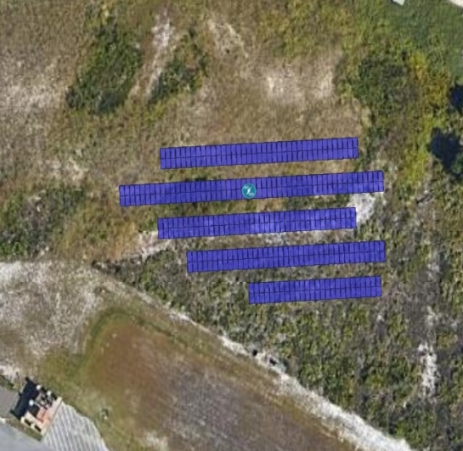
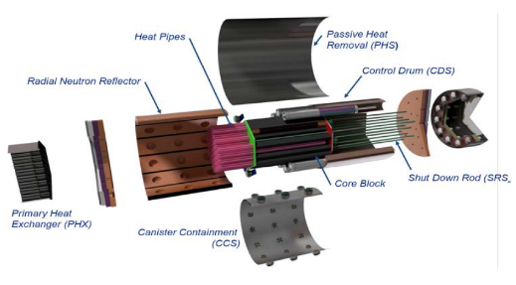
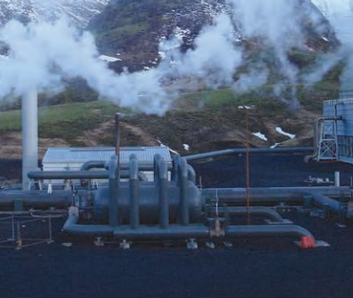
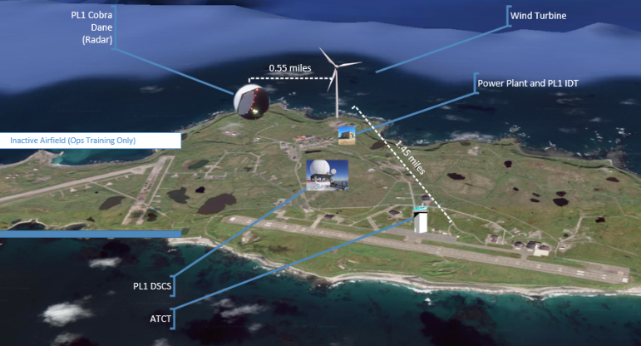
Key Project Highlights
Microgrid & Community Solar
Tyndall AFB is first microgrid produced via Energy Assurance Lease
Supports operations of AFNORTH buildings
Explores large-scale community solar project
Small Modular Reactor (SMR)
DAF selected Eielson as the site for a pilot program
Nuclear reactor in operation by 2027
First SMR in the DoD, serving as a platform to replicate at others
Geothermal Energy
FE Warren to create the first DoD carbon-free microgrid
JBSA and Mountain Home investigating utility-scale geothermal energy projects that will support critical mission loads
Wind & Battery Storage
Capitalizes on Eareckson AS’s rich wind source
Meets installation redundancy requirements
OEA engaged as a potential FY26 ERCIP submission
Notes:
Microgrid & Community Solar:
Installed the first microgrid produced via Energy Assurance Lease (EAL), paid for by the utility. Microgrid uses solar and battery storage to support operations of AFNORTH buildings.
OEA initiating an effort with the utility and base to explore large-scale community solar project (40MW+) plus innovative storage such as H2 Fuel Cell, that will support installation critical missions and community partners.
Small Modular Reactor (SMR):
DAF selected Eielson as the site for a pilot program demonstrating a SMR (in response to NDAA requirement)
Project aims to have a nuclear reactor in operation by 2027; 24 hr/day 365 days/yr power and heat for a decade or more!
Pilot will be the first SMR in the DoD, serving as a platform to replicate at other installations (including using larger modules)
DAF working to create new processes that address challenges, such as commercially availability of fuel, environmental risks, and the potential for community pushback regarding introducing a new power source to the region
Geothermal Energy Pilots:
FE Warren seeking to install small-scale geothermal plant coupled with existing wind turbines and new battery storage to create the first DoD carbon-free microgrid that supports all critical and essential mission loads on-base. Project submitted to ODASD(E) as FY24 ERCIP concept. DAF priority due to ODASD(E) interest to help meet a FY21 requirement (Section 2825(b)(2)(C)).
JBSA and Mountain Home investigating utility-scale geothermal energy projects that will support critical mission loads. OEA is working with Defense Innovation Unit (DIU) on an Other Transaction Authority (OTA) solicitation for a prototype geothermal project in early FY23.
Wind & Battery Storage:
Existing power plant lacks required redundancy and operates solely on jet fuel
Proposed BESS fills identified IEP gaps and balances the load profile of critical missions protecting electronic equipment.
Proposed wind turbine capitalizes on the region’s rich wind source; meets installation redundancy requirements while reducing emissions and provide savings on jet fuel
OEA engaged with PACAF and critical mission owners on potential FY26 ERCIP submission
One More not shown: Cape Cod SFS – Microgrid w/ Existing Wind:
Existing diesel generators need replacement (IEP gap), currently run up to 1,000 hours per (operated when anticipating a storm)
New microgrid takes existing 3.4MW wind turbines power 1st (vs. sell to grid) with battery storage and bi-fuel generators
Result will be uninterrupted power from multiple sources, reduced emissions, and extend diesel supply
Currently completing planning charrette for FY25 ERCIP submission

Slide 11
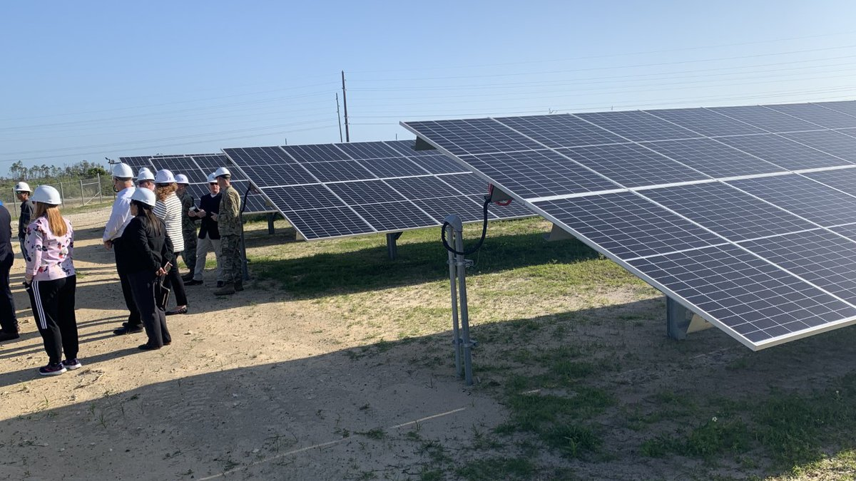
Technologies of Interest and Potential Sites
Technology | Potential Sites
Microgrids | Cape Cod SFS, Eglin AFB, Offut AFB
Microreactors | Eielson AFB
Small Modular Reactors
Geothermal | Mountain Home AFB, JB San Antonio
Solar | Arnold AFB, Eglin AFB, JB McGuire-Dix-Lakehurst, Offut AFB, Tyndall AFB
Long-Duration Energy Storage | JB McGuire-Dix-Lakehurst, Eareckson AS, Offut AFB, Tyndall AFB
Electric Vehicle Support Equipment / Fleet Electrification | Dover AFB, Hanscom AFB, JB Andrews, JB Anacostia-Bolling, JB McGuire-Dix-Lakehurst
Natural Gas On-Site Generation | Eglin AFB, Tinker AFB
Energy, Charging, or Fleet as a Service | Hanscom AFB
Notes:
Fuel Cells
Linear Generators
Wireless Power Transfer
DC Transmission and Distribution
Tidal Generation

Slide 12
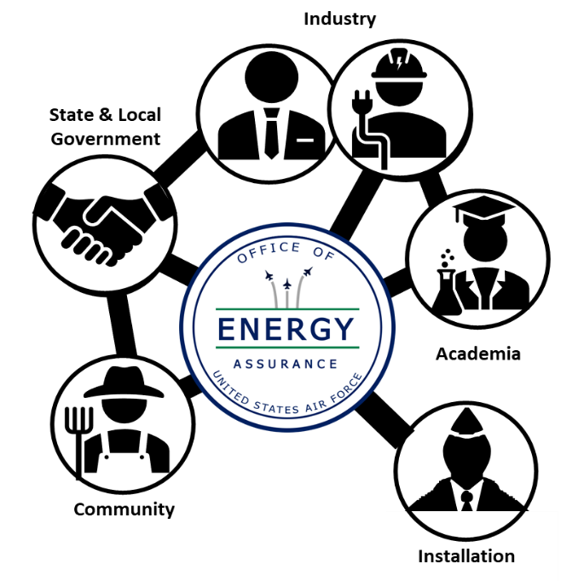
Partner with the Air Force
The Air Force is looking for innovative, executable solutions which increase resilience while addressing climate concerns
Identification
OEA works with industry to bring your installation new technology
Exploration
OEA examines new technologies
Integration
OEA teams with external partners to deploy solutions using creative acquisition pathways
Notes:
How do we develop impactful energy resilience solutions?
Sometimes resilience gaps can be resolved using known technologies
But in the energy landscape, innovative solutions are popping up everyday. And to put it simply: we do not know, what we do not know
So we need partners with cutting edge, and possibly game-changing, technologies to IDENTIFY solutions and SHARE them with OEA
Once we have them, our team of experts work together to EXAMINE, model and analyze how the technology could align to with a resilience gap
OEA builds economic models with county specific inputs to accurately determine technology feasibility
We utilize analytical tools to identify and configure appropriate technologies
Finally, we find a way to INTEGRATE these technologies. This can be a challenge in this fiscally-restrained environment
We have learned to look for Creative acquisition pathways
First, we analyze traditional authorities…hopefully that works!
But if we encounter a roadblock, We turn to non-traditional methods
Many times we team with external partners to identify new acquisition applications
Working together we can facilitate technology transition and inform the development of modern, flexible approaches to meet requirements
And the best part? By collecting ideas, best practices, and lessons learned from industry leaders; OEA shapes future acquisition strategies and modeling needs
Next slide, please

Slide 13
Have Project Ideas?
Industry and bases without Installation Energy Plans can submit their ideas directly to OEA staff for consideration
OEA will review submissions and, if selected, projects will move through the same governance process as any other project would
To be invited to Industry Days or to submit your project ideas , please email us at
AF.Energy.Assurance@us.af.mil
Notes:
If you are a base that does not have an IEP, you can contact OEA directly. OEA will review project submissions and, if the project is valid, we will run it through the same governance process that any other project would go through, however, a RSR will not be undertaken.
OEA also has an open RFI that gives more in-depth information about what OEA is looking for in these projects. If you have a project idea, please contact Ms. Lucy Notestine

Slide 14
Contact The Air Force Office of Energy Assurance
Mr. Kirk A. Phillips
Director
kirk.phillips.3@us.af.mil
Ms. Miranda Brannon
Project Development Division Chief
miranda.brannon@us.af.mil
Ms. Lucy Notestine
Special Projects Division Chief
lucinda.notestine@us.af.mil
Email Inquiries: AF.Energy.Assurance@us.af.mil

