Slide 1
Resilient Florida: Lessons Learned from Hurricane Recovery at Tyndall for Resilience Building in South Florida
ASSOCIATION OF DEFENSE COMMUNITES
INNOVATION FORUM
Oct. 31 – Nov 2, 2022 | Phoenix, AZ

Slide 2
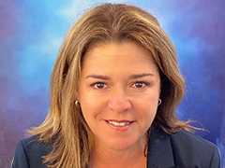
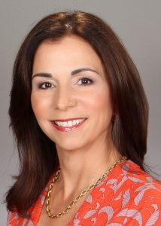
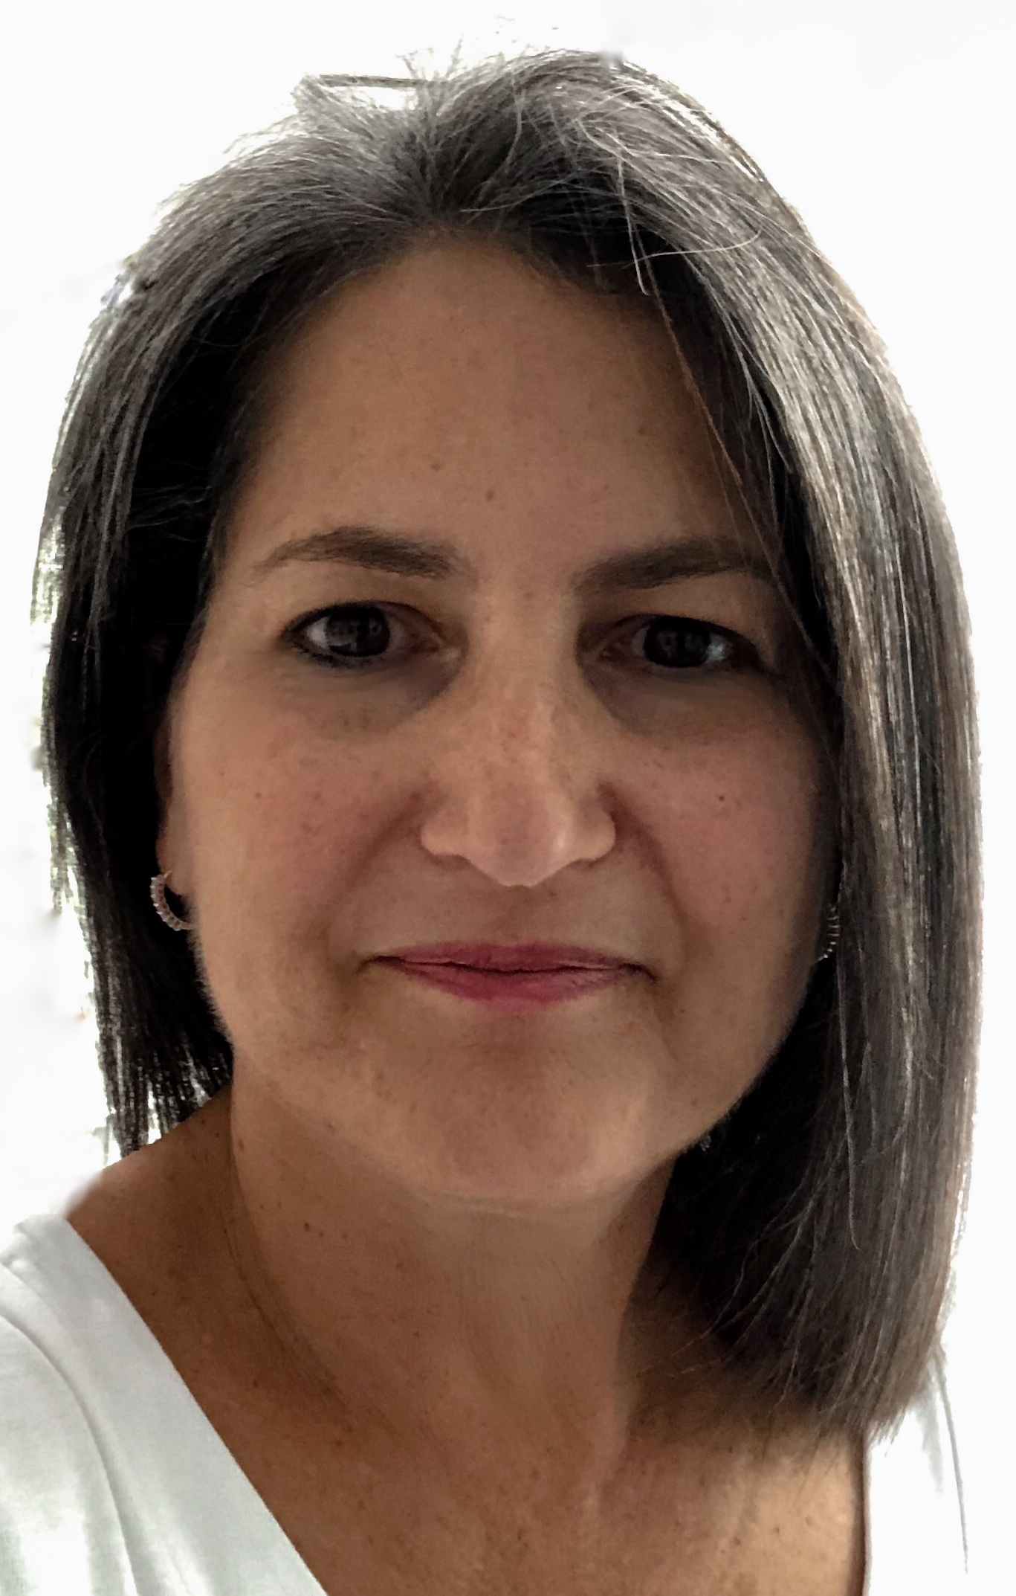
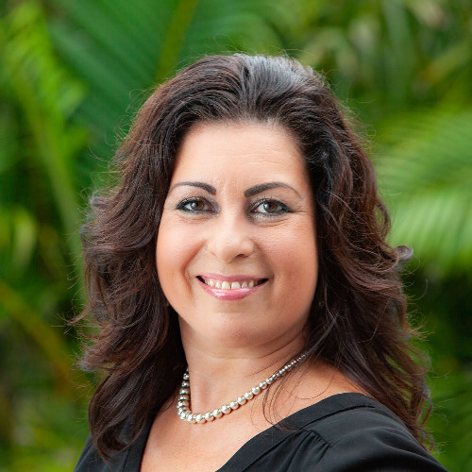
South Florida Military Installation Resilience Review Team
Susy Torriente,
Susy.Torriente@jacobs.com Global Lead –City Resilience
Isabel Cosio Carballo
Executive Director
isabelc@sfrpc.com
Pamela Berkowsky
Deputy Project Manager
Pberkowsky@bluesapphirestrategies.com
Hollie Schmidt
Hollie.Schmidt@jacobs.com
Director, Resilience & Sustainability

Slide 3
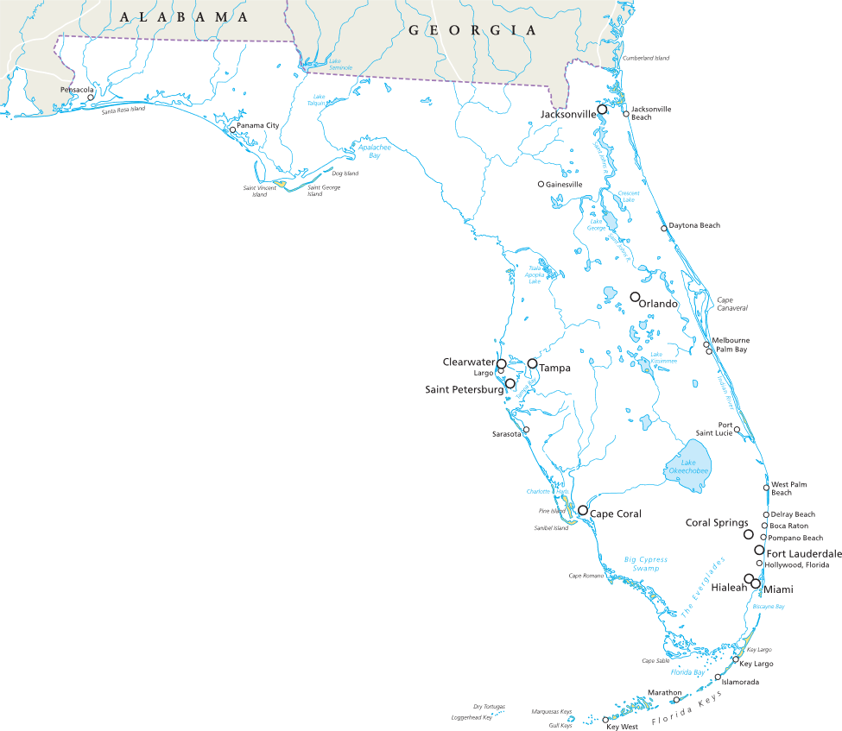
Tyndall AFB

Slide 4
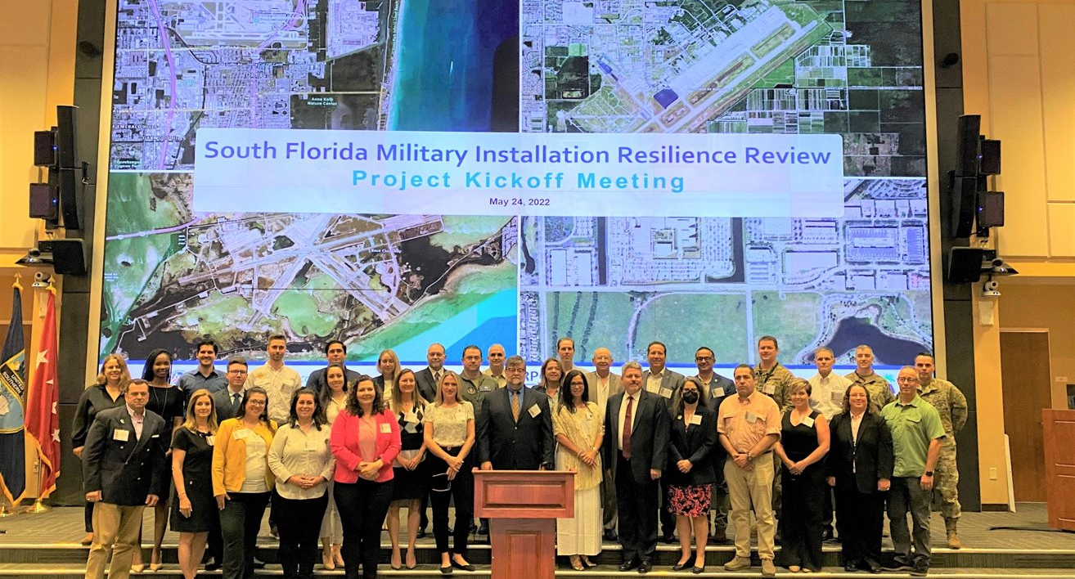

Slide 5
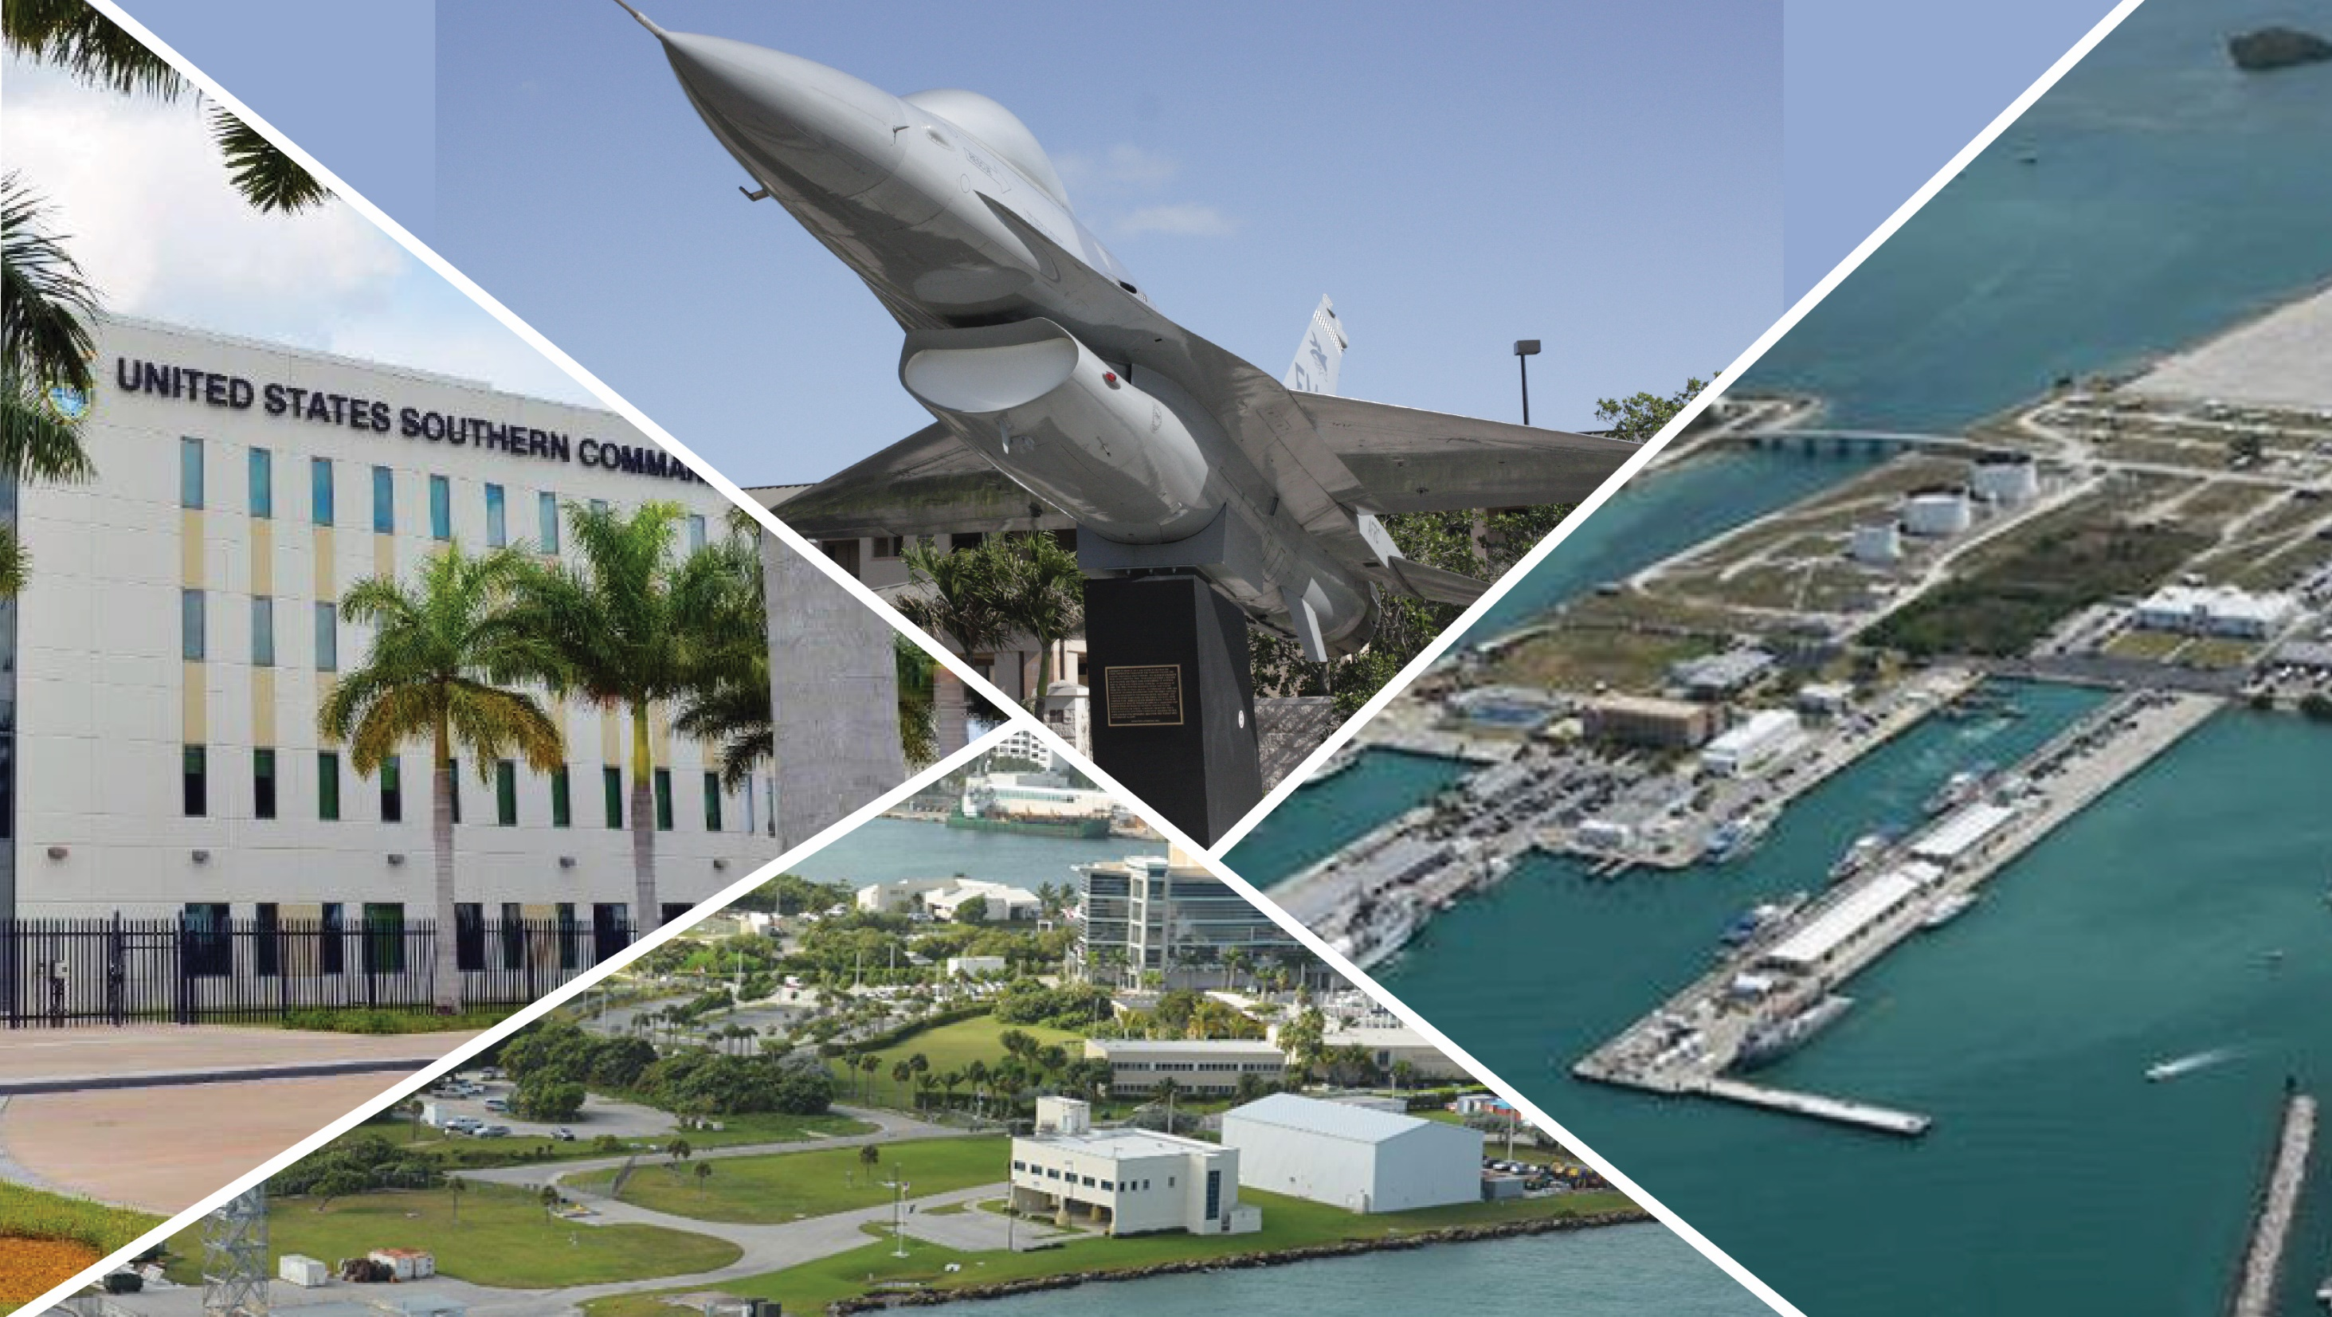
^{Thank you}
Notes:
Homestead Air Reserve Base
US Army Garrison Miami
South Florida Ocean Measurement Facility (Dania Beach Florida)
Naval Air Station Key West

